Slide 1
Computer Science Resumes & Interview Tips
Raven Ortolan * RavenOrtolan@Creighton.edu
John P. Fahey Career Center

Slide 2

Resume Resources
Career Center Resume & Cover Letter Resource Manual
Job Hero
Raw Resume

Slide 3
A Resume…
Initiates conversation with employer.
Is a simple, clear, and concise.
Shows that you have the basic education, skills and experience to qualify you for a specific job.
Doe NOT fit all. Every field is different. Every applicant is different. A generic resume does not help you. Your resume can only reflect you and your experience.
Must be technically perfect. No errors.
Should easily guide the reader through your education and experience and address the position’s needs.

Slide 4
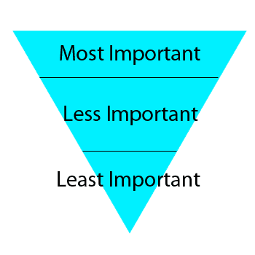
Resume Structure
Header
Education
Technical Skills
Coursework
Experience
Additional Experience
Additional Training
Service
Activities
Honors/Awards
Certifications
Interests
Notes:
Employer may look at resume for less than 8 seconds. Most important info at the top.

Slide 5
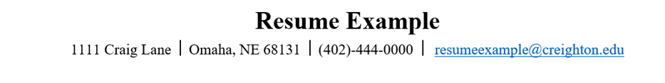
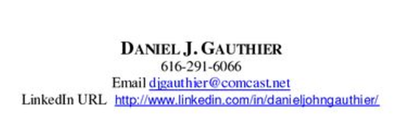
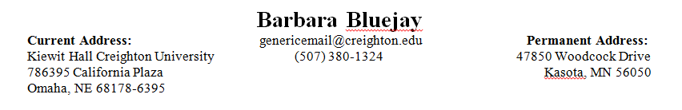
Header

Slide 6
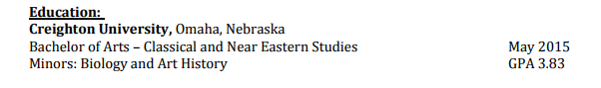
Education
Bachelor of Science - Biology May 2016
Creighton University, Omaha, NE GPA: 3.5
Minor: Chemistry
University of Queensland, Brisbane, Queensland, Australia Fall 2013
Marian High School, Omaha, Nebraska
Diploma May 2012

Slide 7

Skills
Database
SQL Server 2008, MySql
Tools
Eclipse, NetBeans, MS Visual Studio, SVN, Emacs, Jbuilder, JUnit Testing, Spring, JPA, Hibernate
Languages
Java, C++, C#,HTML, PHP
Web/App
ServerRestful, SOAP
Operating Systems
Windows XP, Vista, 7, Linux, Mac OS

Slide 8
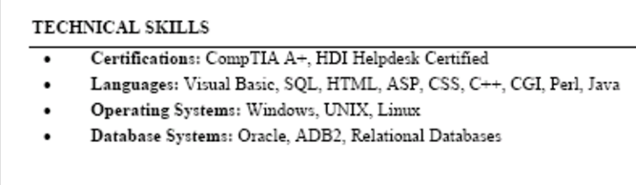
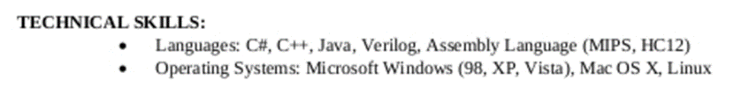
Skills Examples

Slide 9
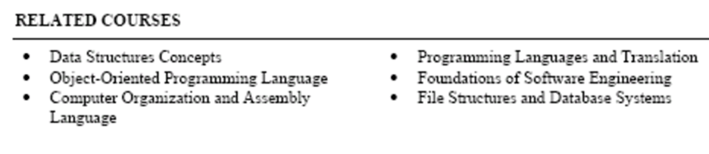
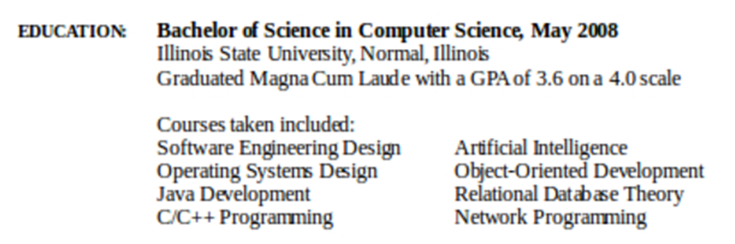
Coursework
Notes:
List your related computer science coursework
○ “Courses Completed and in Progress” ▪ This allows you to list past courses and current courses
○ Use the name of the course but not course numbers
○ People in the industry understand the sequence and level of courses

Slide 10
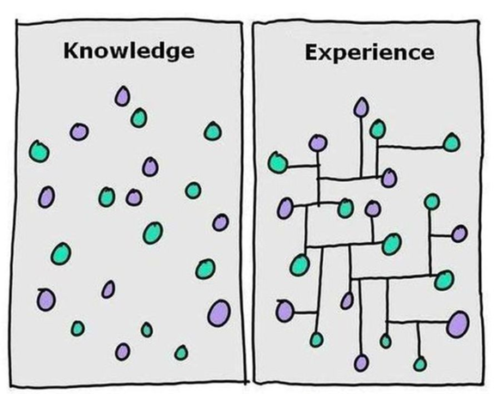
Experience
Format
Reverse chronological order
Most recently obtained at the top
Where you worked, city & state
Title
Dates
Descriptions
Notes:
Create a section where all technology skills and experiences are pulled together for the reader
○ Everything you have done (paid, unpaid, community service, fraternity or sorority, research, coursework, etc) are all together on the resume
○ Be clear about your level of competence, years of experience, etc. with each skill

Slide 11
Experience
Computing Experience is the preferred term because it is broader and includes software experience, general information technology experience and hardware experience.
Computer Experience is a narrower term because refers primarily to hardware.
Computer Science Experience is also narrower than "Computing Experience" because it refers primarily to software development and associated theory.
Academic projects can be included!
Notes:
Create a section where all technology skills and experiences are pulled together for the reader
○ Everything you have done (paid, unpaid, community service, fraternity or sorority, research, coursework, etc) are all together on the resume
○ Be clear about your level of competence, years of experience, etc. with each skill

Slide 12

Descriptions
Use bullets or dashes
Start each sentence with an action verb
Administer, Delegate, Perform, Establish
No periods
Utilize a variety of action verbs to describe experiences
Use terms related to your field
List responsibilities from most important to least important
Past tense vs. present tense
No gerunds (ie, no “ings”)
Use professional language
Managed, supervised and evaluated 18 employees. No “I”s!
Notes:
There are many ways to use your technology skills…
○ Technical
○ Training
○ Consulting
○ Managing

Slide 13
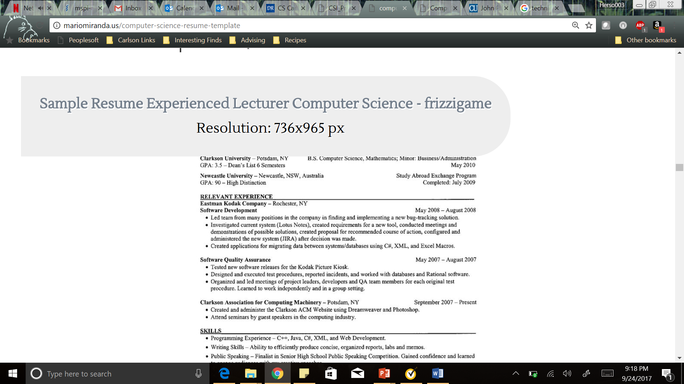
Experience Examples

Slide 14
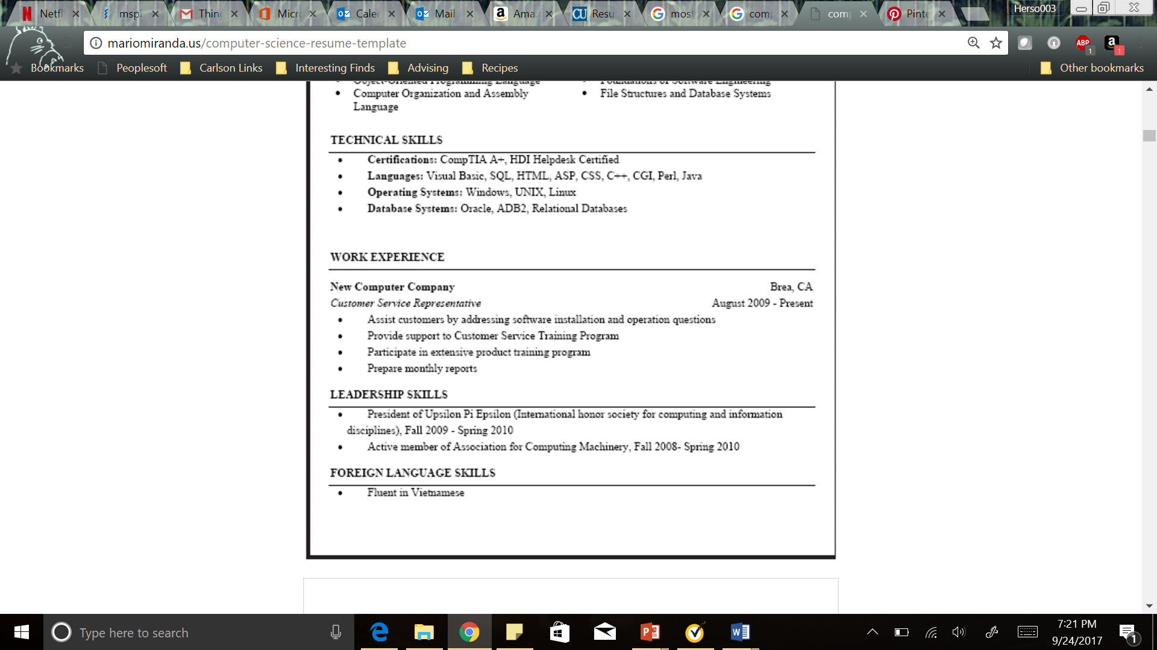
Experience Examples

Slide 15
Additional Experience
Old Navy, Omaha, Nebraska March 2013 – Present
Sales Associate
Assisted customers with purchases and provide quality customer service
Or
Up Stream Brewery, Hostess, Omaha, NE May 2013 – July 2014
Private Residence, Nanny, Madison, WI May 2012-August 2012

Slide 16
General Guidelines
Consistency!
Be flawless. No mistakes. Ask for help proofreading.
Never use personal pronouns. It is obvious the document is about you.
Be consistent with verb tense, abbreviations and construction throughout the document
Be honest describing your experience.
Use Microsoft Word. Not a preset program.
Use Calibri or other font that does not cast shadows on a computer screen.
10-12 pt font

Slide 17
General Guidelines
Use ¾ to 1” margins all around-use white space generously. Make it easy to read.
Use boldface, italics and limited underlining.
1-2 pgs
Use simple structure to make it easy for the reader to follow. Remember, we read from left to right and top to bottom. Keep readers focused on helpful content. And the reading time is less that six seconds!
If sending a hard copy, print professionally on a laser printer using white 25% cotton bond paper.
If sending electronically convert word documents into a PDF and name document appropriately

Slide 18

Prepare for the Interview…
An interview is a conversation about what you can do for them.
Research the company and tailor your responses towards substantiating how your talents and personality match the position.
Rehearse interview questions out loud with a friend, family member, or your Career Counselor.
Arrive at least 15 minutes early, but enter the premises 8-10 minutes early.
Bring copies of your resume and reference sheet with you to offer.
Use professional language and avoid slang words such as “uh,” “um,” “you know,” and “like.”

Slide 19

Prepare for the Interview…
Body language should be professional: good posture, not slouched, good eye contact but not staring.
Watch the nervous habits of twirling hair, tapping a foot, or drumming fingers.
Smile. It’ll help you ---and them--- relax!
Be prepared to offer evidence through detailed examples of times and ways and situations you used certain technical applications, characteristics, or skills.
Collect their business cards so you can follow up with a thank you card or e-mail.
After the interview, take notes on everything you can remember and use the experience to further develop your interview techniques.

Slide 20


Interview Tips

Slide 21
Interview Resources
Career Center Interview Manual
http://typo3.creighton.edu/fileadmin/user/CareerCenter/docs/2015/Resource_Manual_Interviewing.pdf
Technical Interviews
http://www.cs.columbia.edu/career/student-resources/resume-interview/
Coding Interviews
https://medium.com/@nickciubotariu/ace-the-coding-interview-every-time-d169ce1fd3fc
Computer Science Interview Questions
https://sites.google.com/site/sumedhshende/computerscience
Elevator Pitch
https://www.uml.edu/student-services/Career-Services/How-to-Articles/Job-Search-Preperation/Elevator-Pitch.aspx

Slide 22
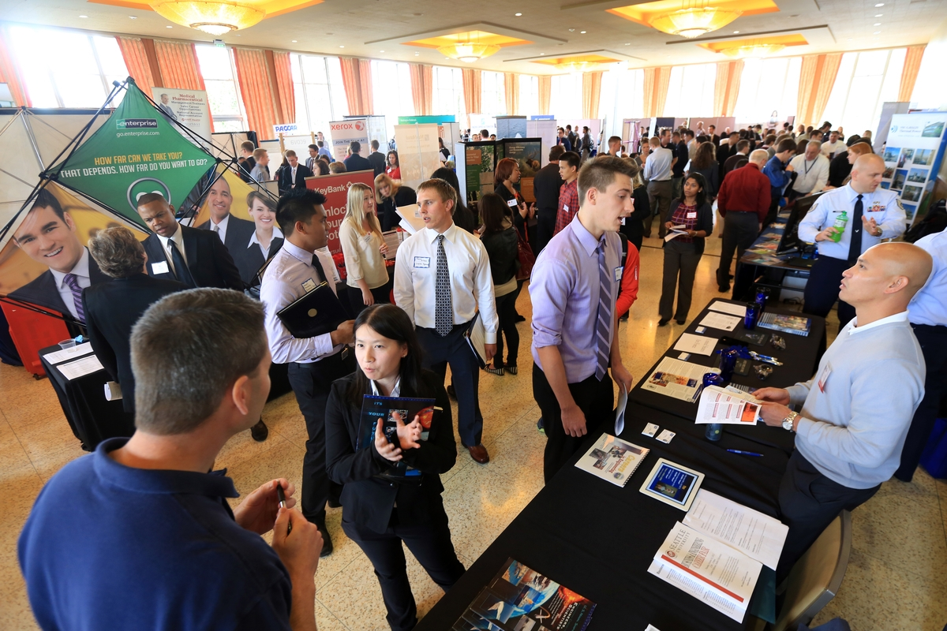
Career Fairs
STEM Fair
October 3, 3-5:30
Skutt Student Center
Career Fair
October 6, 12-3pm
Harper Ballroom

Slide 23
Walk-in appointments
Monday – Friday 1:30 – 4:30 pm
402.280.2722
Thank you!

