Slide 1
RED DOT
By Dan Gotlund & Eric Acierto

Slide 2
OVERVIEW
An app for students with Apple mobile devices
Contact the Public Safety Office by pressing a button
Public Safety receives an alert with GPS coordinates of the device through their website
Public Safety can send help to that location

Slide 3
Situation
Students may be in need of assistance around campus
Emergency “Blue Light” phones are one option
But may be out of reach / service
Calling Public Safety’s Emergency Number
This is better, but not all students will remember the number or program it into their phones

Slide 4
Solution
RED DOT App
Gives students an alternative way to contact help from Public Safety
Students would be reminded to install the app throughout the school year

Slide 5
The App
Developed with Apple’s Xcode + the Swift Programming Language
Model-View-Controller Paradigm
Model – the classes that hold the app’s data
View – controls & other elements the user sees and interacts with
Controller– the code that binds the model and view
together

Slide 6
The GUI
User Interface
Simple, quick & easy to use
A large red button
Instructions: hold the button down for 5 seconds to request assistance from Public Safety

Slide 7
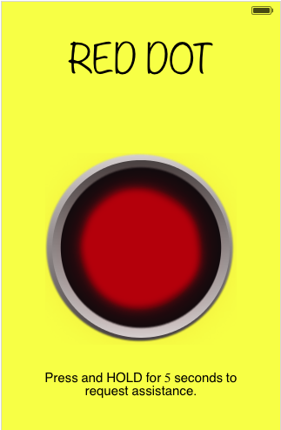

Slide 8


HAL 9000 from the film 2001: A Space Odyssey
RED DOT BUTTON

Slide 9
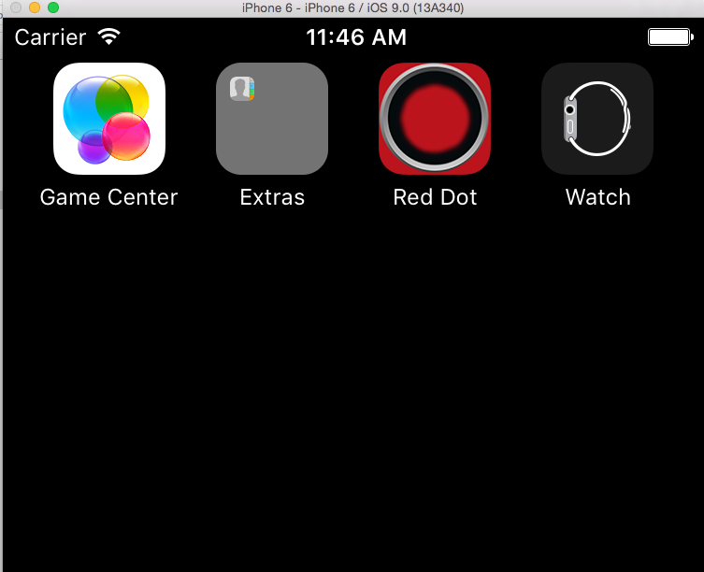
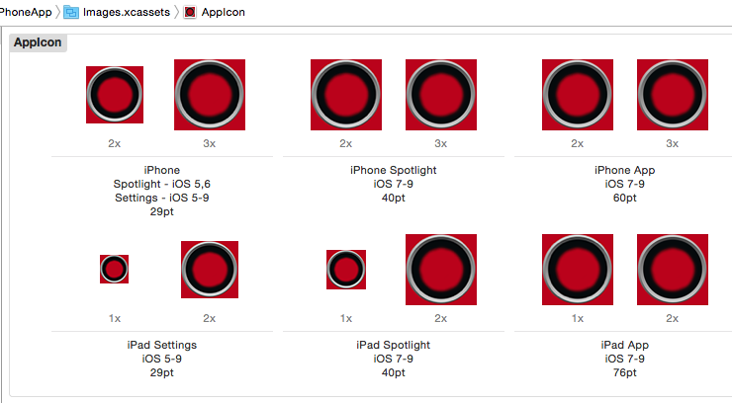
The App Icon

Slide 10
The App
CoreLocation Framework imported
GPS
Latitude and Longitude of device are each converted to a String & stored in variables
HTTP Post Request
Sends variables to a PHP script located on a server
PHP script stores coordinates in a MySQL Database

Slide 11
The Button
Outlet & Action created
Binds the button on the View to the ViewController code
UILongPressGestureRecognizer object
Added to the button
minimumPressDuration property set to 5 seconds

Slide 12
Button Pressed
The button’s Action method is triggered
NSMutableURLRequest created
HTTP Method established as “POST”
POST String created
"x=\(latitudeLabel.text)&y=\(longitudeLabel.text)";
POST String encoded with NSUTF8StringEncododing
String set to the URL Request’s HTTPBody Property

Slide 13
Button Pressed
NSURLSession created with the Request
Stored in a variable called “task”
If no errors were encountered:
task.resume() command
POST Request is sent to the server
UIAlert is displayed on the GUI

Slide 14
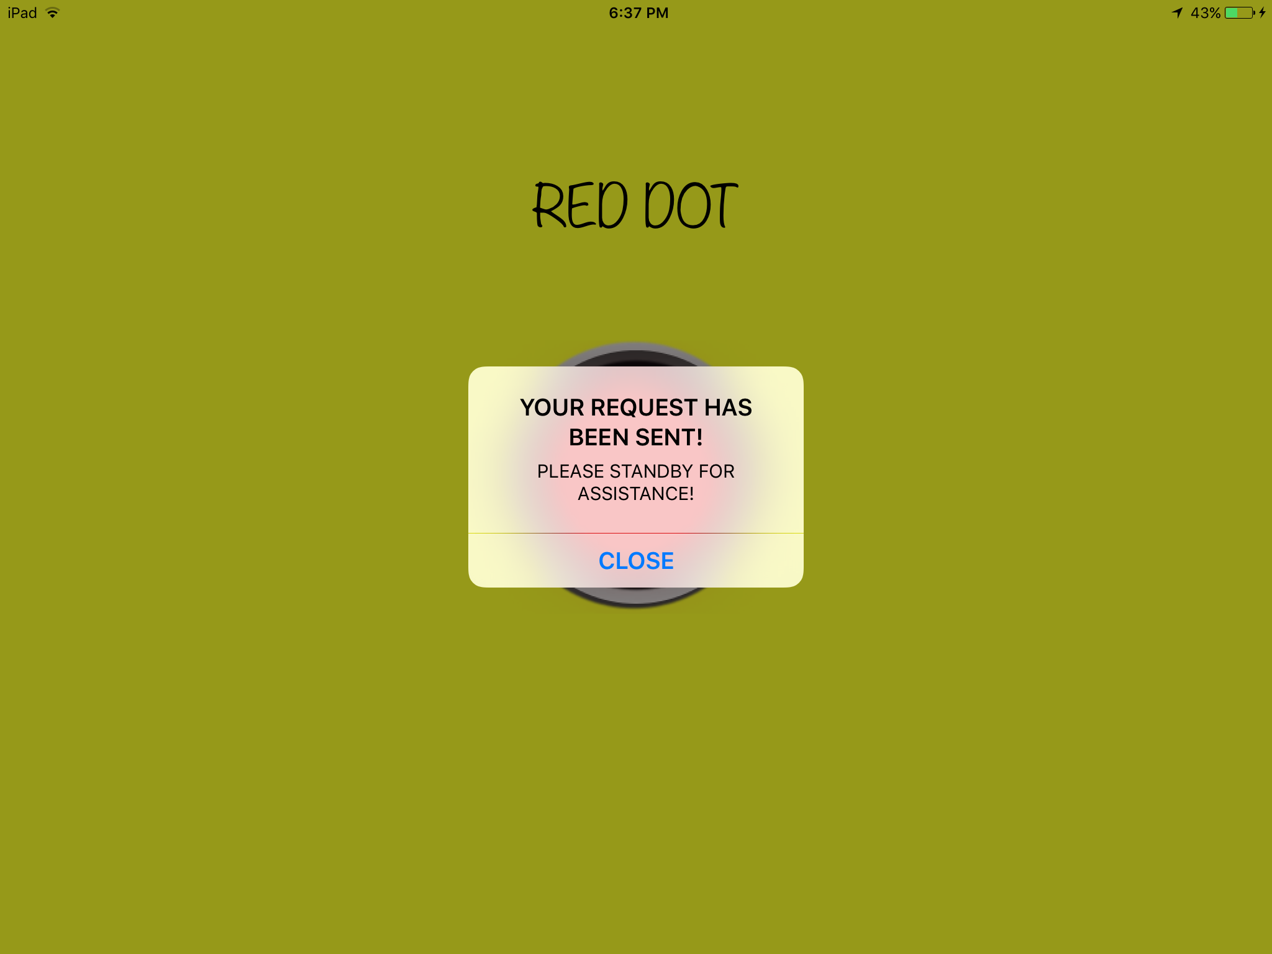

Slide 15
PHP Script
Handles the POST Request
Retrieves the Latitude and Longitude from the Superglobal $_REQUEST array
Each is stored in a variable
Creates a TimeStamp of the request
Stores the Latitude and Longitude in the Database

Slide 16
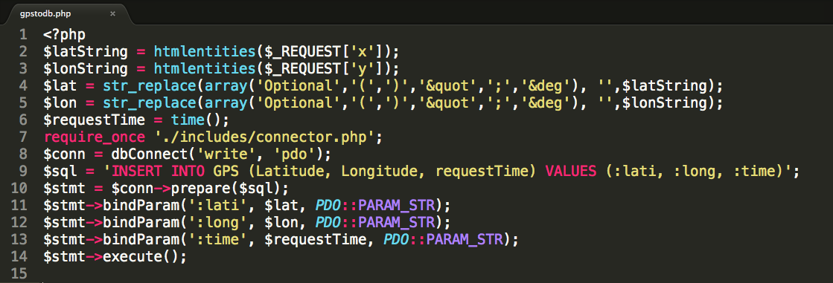

Slide 17
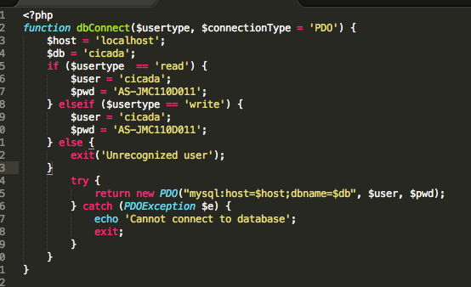

Slide 18
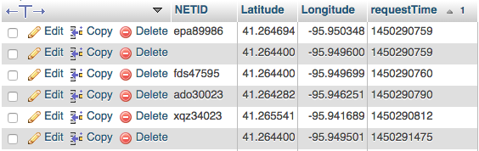
GPS TABLE

Slide 19
The Website
Hosted “cicada” server in Hitchcock Comm. Building
Website Files edited with Sublime Text Editor
FileZilla

Slide 20
Login Page
The main page will only be accessible with login
Public Safety Officers will use ID and Password to log in
A session is started when the page loads
If the login button is pressed:
PHP script checks if the ID and password match using the password_verify function
Redirects to the main page

Slide 21
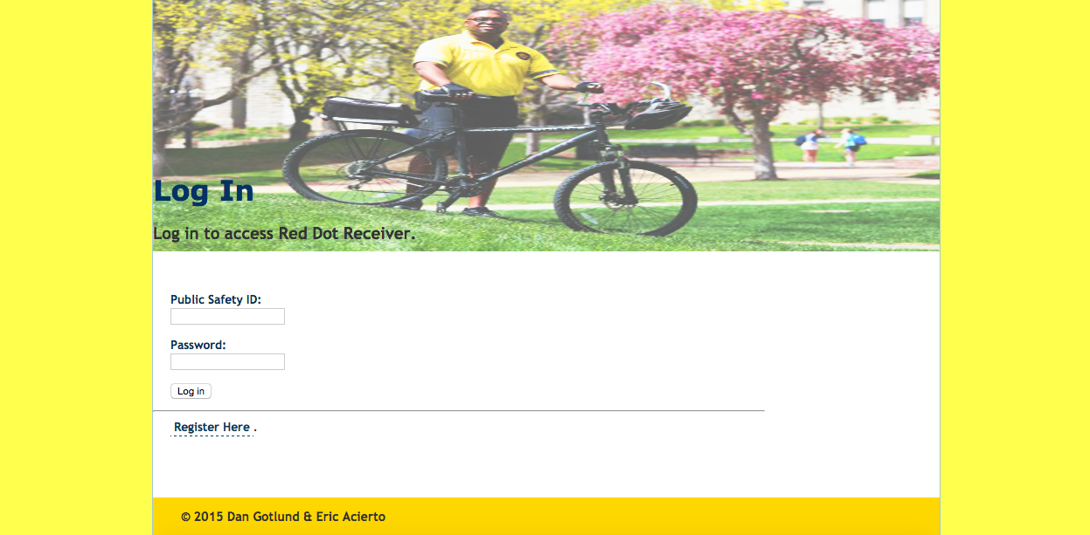

Slide 22
Register Page
HTML POST Form
First name, middle initial & last name text fields
Create a password field
Confirm password field
PHP script checks if it’s valid
Password hash with password_hash function
Stored in Database with SQL

Slide 23
Register Page
When the register button is pressed
A script analyzes the form
The first letter from the first name, Mid. Initial, & first letter of last name are concatenated
A random 5 digit number is added to the end
Public Safety ID is created
The passwords are tested to see if they match and that they have the correct requirements

Slide 24
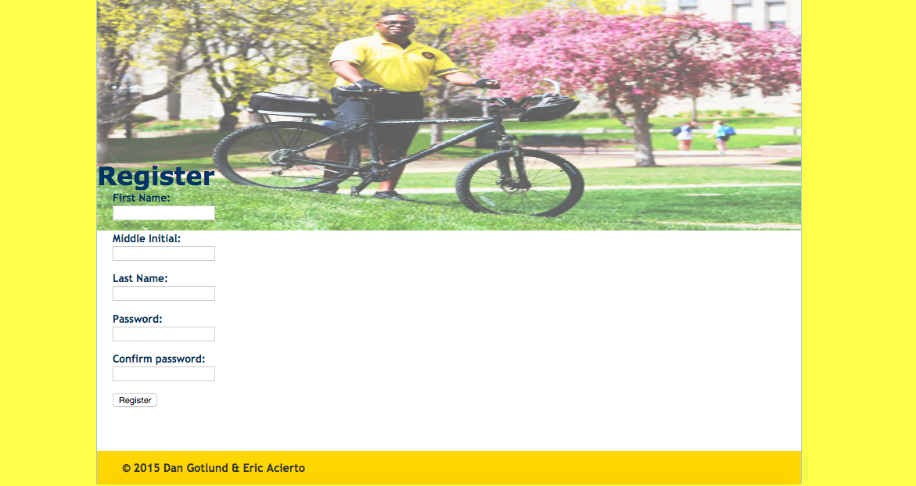

Slide 25
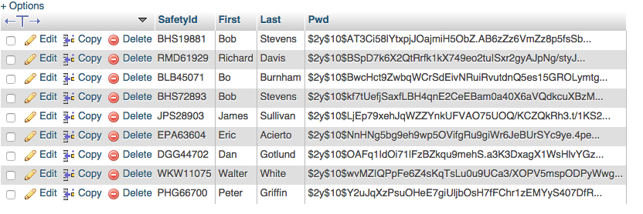
ID & Password Table

Slide 26
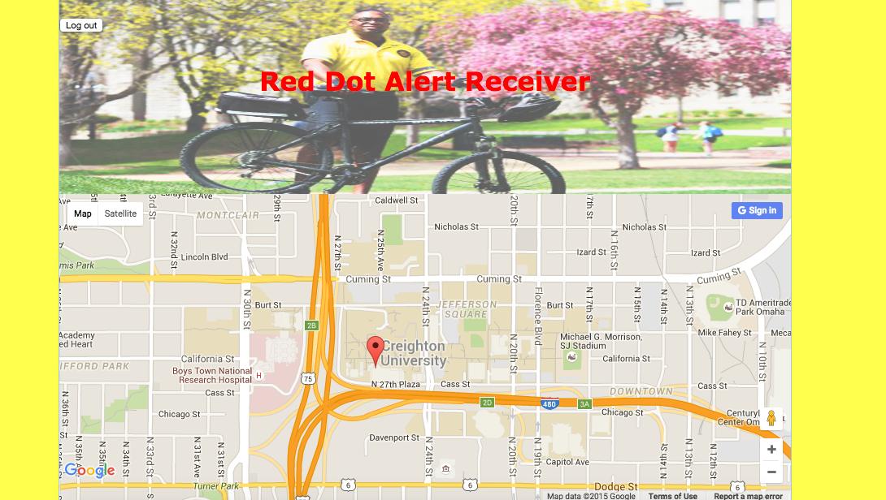
Main Page

Slide 27
Logout Button
‘Includes’ file
if (isset($_POST['logout'])) – checks if the logout button is pressed
Destroys the session (session_destroy function)
Returns to the login page

Slide 28
Improvement Plans for the Future
More features in the app’s interface
NetID registration
Public Safety can Identify who sent the request
Eliminate possibility of ‘false’ alarms
Non-Emergency request form
User can type in what problem needs to be fixed etc.
Android Version
For students without apple devices

Slide 29
Improvement Plans for the Future
Features to add to the website
When an alert is received:
Send an email/call/text to the Officers
An alarm or flashing icon on the website
The Person that sent the request
Phone number displayed with the map marker

