Slide 1
Creighton Directory
Ayana Edmonds
Justin Peck
Adam Schmidt

Slide 2
Agenda
Overview
Background and Motivation
Functionality
Issues
Future Work
Demo

Slide 3
Overview
Creighton Directory
Search
Chat
Create/edit profile

Slide 4
Background and Motivation
AMI
Creighton Directory
Search by:
Student Name
Returns:
Creighton ID Image
Full name
College
Year Graduating
Search by:
First and Last Name
Dorm Number
Group
Net ID
Major
Email
Returns:
First and Last Name
Dorm Number
Group
Net ID
Major
Email
Notes:
The issue that we saw as prevalent is the existing technology, AMI, which only allows for searching

Slide 5
Background and Motivation
Facebook
Creighton Directory
Available to public
Not many truly utilize account
Exclusive to only Creighton students
Provides live chat

Slide 6
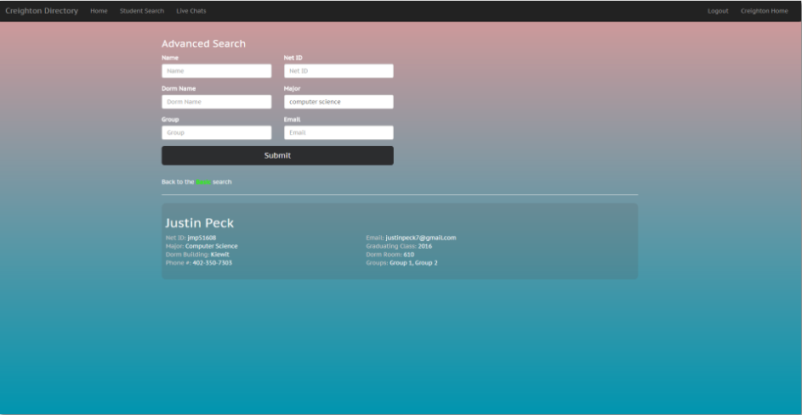
Functionality
Advanced Search
Easy navigation with text inputs
Simple Search
Click on searched student’s name

Slide 7
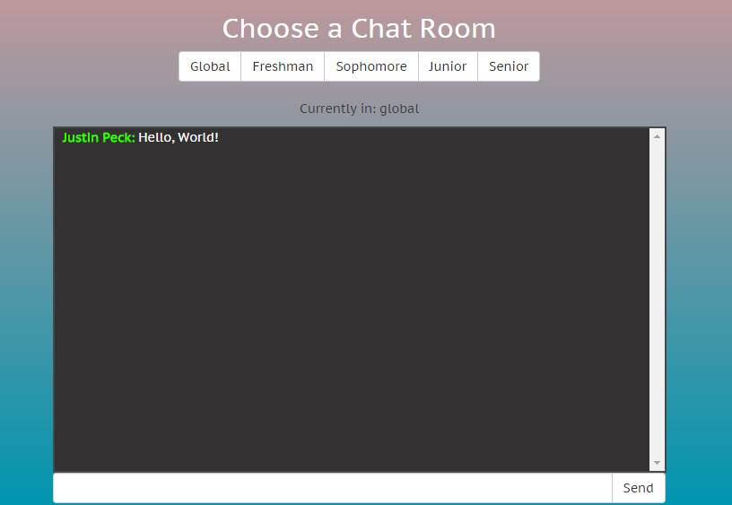
Functionality
Chat Feature
5 chat rooms
Differentiate current user names vs other user names

Slide 8
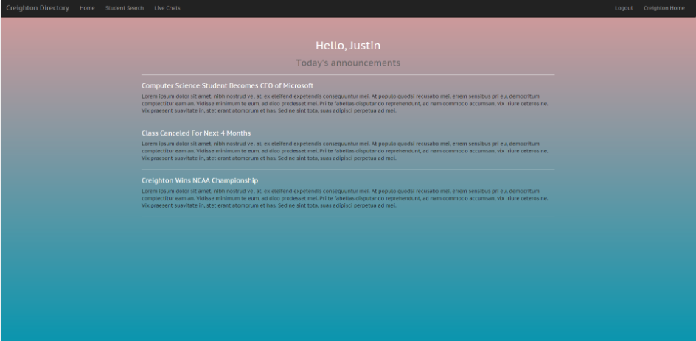
Functionality
Announcements
New Announcement option

Slide 9
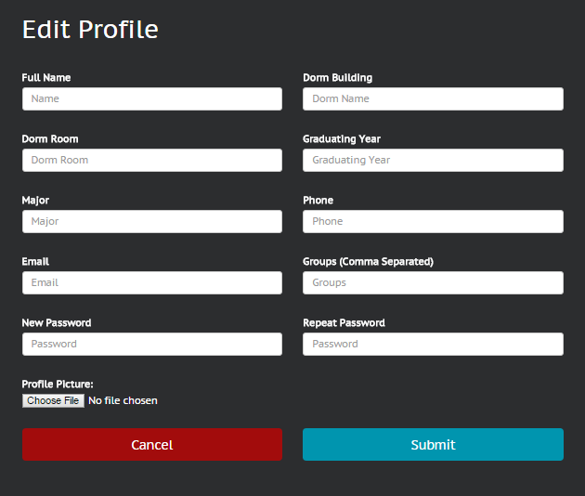
Functionality
Profile
Edit
Upload Picture

Slide 10
Issues
Profile
Node/Express don’t support file upload
Saving profile picture locally vs in database

Slide 11
Future Work
Filtering Chats:
User groups
Notifications:
Notification alert through email/Creighton account
GUI Enhancements:
Mirror the official Creighton website design and feel
Handling Local Files:
Remove unused images
Resize images
Allow to back up the data already stored on the server just in case it crashes.
Improve speed & provide security

Slide 12
Demo
http://174.74.91.215:3000/#/
Notes:
Easy to Navigate GUI
Bootstrap- Bootstrap- These classes are useful for getting a general layout and style of various components
Scalability
Collapsible menu
User Responsiveness
MongoDB
JSON
Postgres
No SQL
Node.js
Real time - chat
Socket.io library

Slide 13
References
http://mongoosejs.com/docs/guide.html
http://blog.modulus.io/top-10-reasons-to-use-node
http://getbootstrap.com/components/
https://docs.angularjs.org/api
http://socket.io/docs/
https://www.terlici.com/2015/05/16/uploading-files-locally.html
http://www.infoworld.com/article/2975233/javascript/why-node-js-beats-java-net-for-web-mobile-iot-apps.html

