Slide 1
CSC 581: Mobile App Development
Spring 2019
Unit 4: navigation & data persistence
navigation design
tab bar view, design guidelines
viewDidLoad and other event-based methods
reading text from a file
String.split, String.components
reading/writing data
Info.plist, UserDefaults
other (potentially useful) features
picker view, scroll view, table view
protocols, reading/writing objects

Slide 2
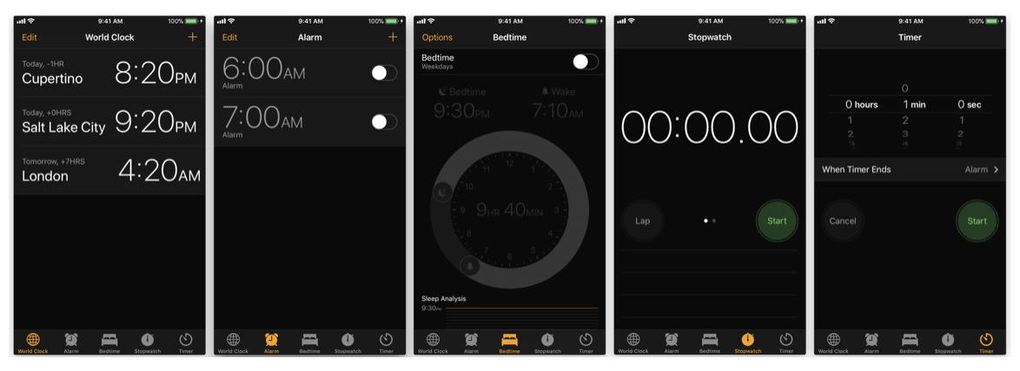
Tab bar view
a tab bar allows you to arrange your app into distinct sections
e.g., Apple Clock app: World Clock, Alarm, Bedtime, Stopwatch, Timer
a tab bar is defined using a Tab Bar View
shows tabs (icons) across the bottom of the screen
each tab has its own navigation hierarchy
the tab bar controller coordinates the navigation

Slide 3
Adding a tab bar
first, create the main View for your project
select that View, then choose Editor > Embed in > Tab Bar Controller
this adds a Tab Bar Controller to the canvas as well as adding a UITabBarItem to the bottom of the View
to add another tab bar item
drag a View Controller from the Object Library to the canvas
connect it by control-dragging from the Tab Bar Controller to the new View Controller, and choosing "view controllers" under Relationship Segue
this adds a second tab bar item to the Tab Bar Controller
if desired, create a ViewController class to define the behavior of the new view
customize the tab bar item
select the desired tab bar item in a View
in the Attributes Inspector, select the desired icon under System Item
e.g., Favorites, Features, Search, Downloads, …
you can change the title under Bar Item > Title
you can select a custom icon image under Bar Item > Image

Slide 4
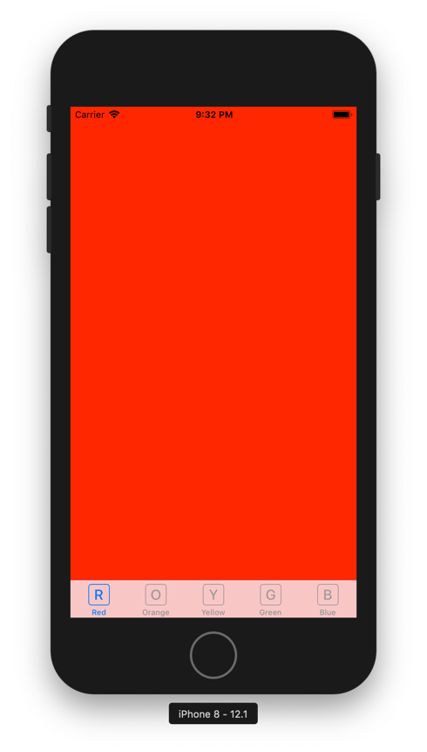
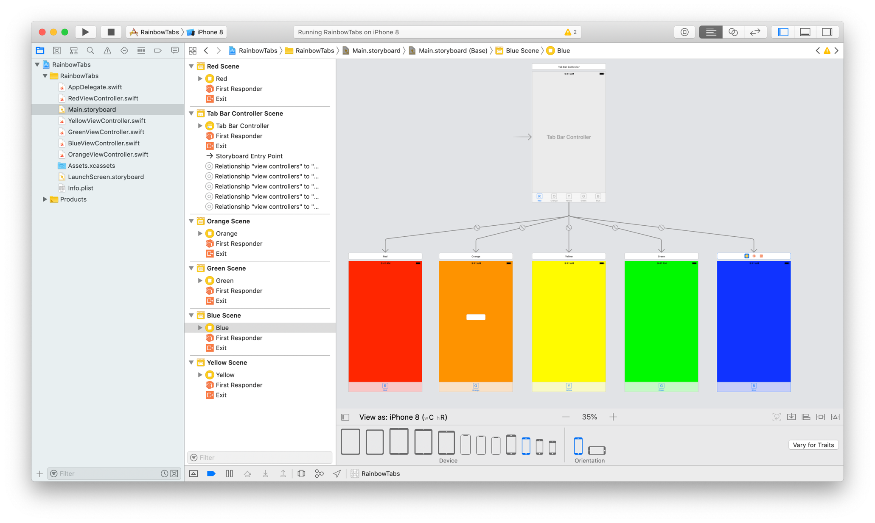
Tab bar view example

Slide 5
Navigation design guidelines
Design an information structure that makes it fast and easy to get to content.
Organize your information in a way that requires a minimum number of taps, swipes, and screens.
Use standard navigation components.
Whenever possible, use standard navigation controls, such as tab bars, segmented controls, table views, collection views, and split views. Users are already familiar with these controls and will intuitively know how to get around in your app.
Use a navigation bar to traverse a hierarchy of data.
The navigation bar's title can display the user's current position in the hierarchy, and the Back button makes it easy to return to the previous position.
Use a tab bar to present peer categories of content or functionality.
A tab bar lets people quickly and easily switch between categories or modes of operation, regardless of their current location.

Slide 6
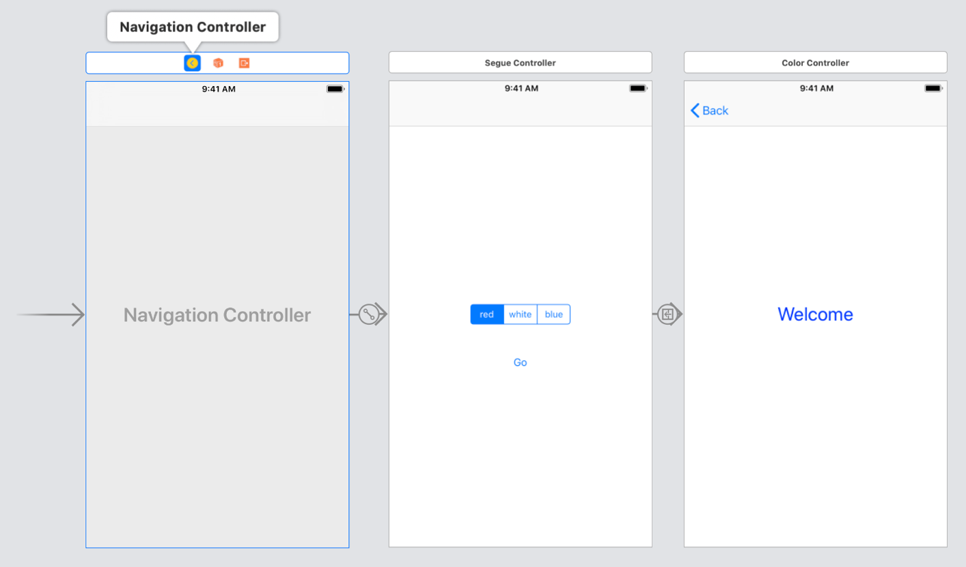
View event management
recall that a ViewController has a default viewDidLoad
this method is automatically called after the view loads
useful if you need to set properties of the view, especially after a segue
e.g., suppose we wanted to select a color theme on the welcome screen
then segue to a new screen that utilizes the selected color theme

Slide 7
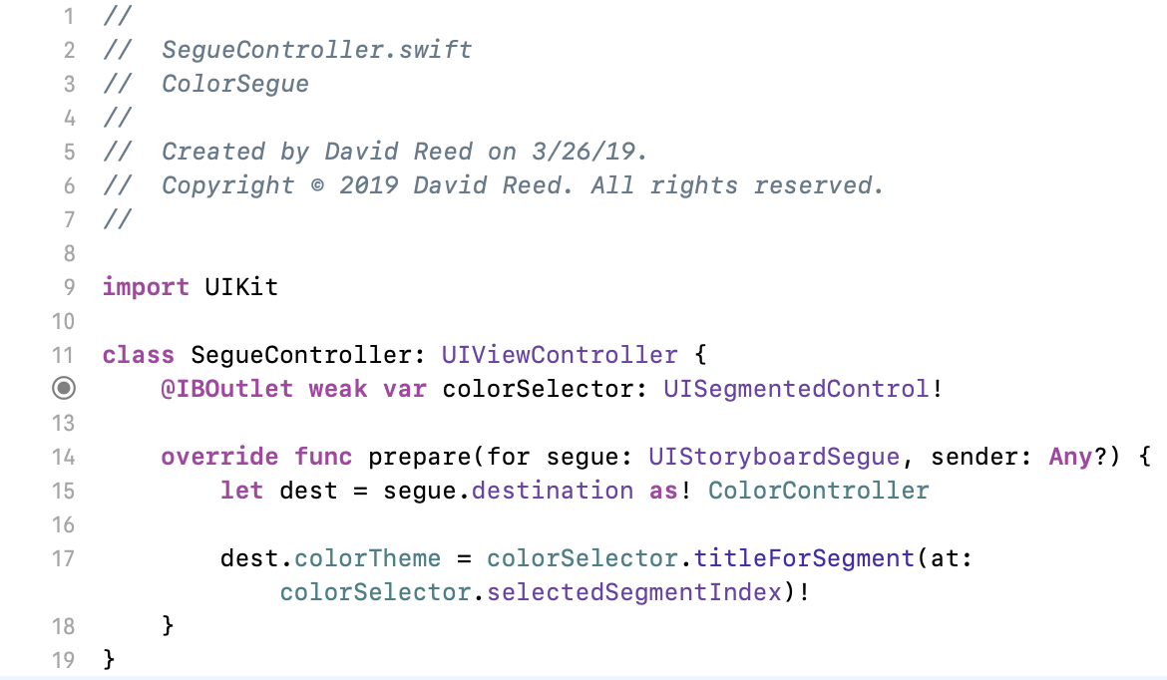
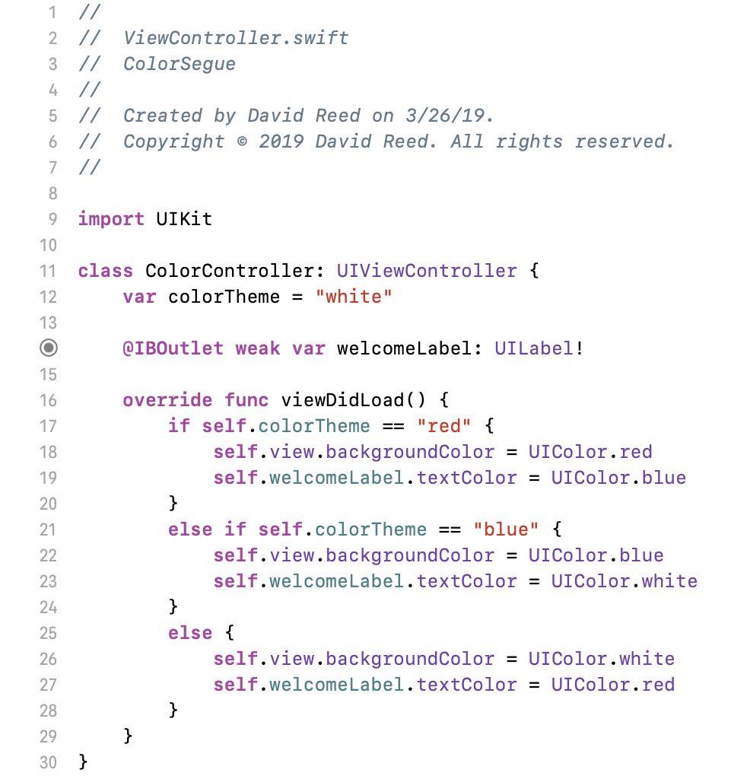
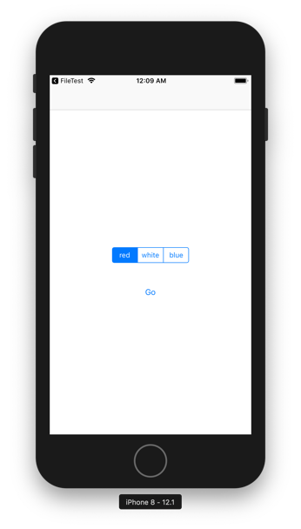
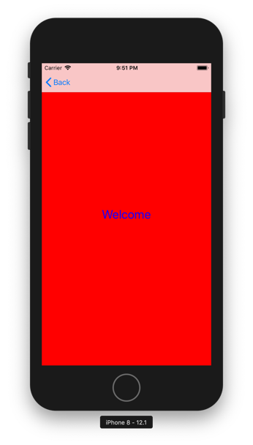
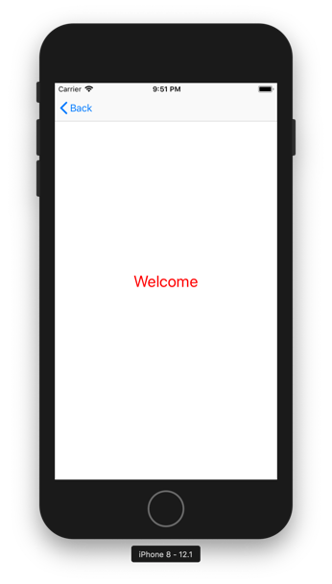
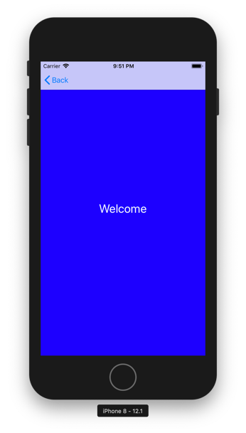
Color theme segue

Slide 8
Other view event methods
in addition to viewDidLoad, there are other event-based methods
viewWillAppear()
performs tasks that need to be done each time the view is to appear on the screen
e.g, refreshing views, adjusting to new orientation, accessing location
viewDidAppear()
waits until the view is fully loaded – better for complex or slow tasks
e.g., starting an animation, fetching data
viewWillDisappear()
performs tasks that need to be done when the user navigates away from the screen
e.g, refreshing views, adjusting to new orientation, accessing location
viewDidDisappear()
waits until the user has navigated to a new view
e.g., stop services related to the old view (such as background audio)

Slide 9
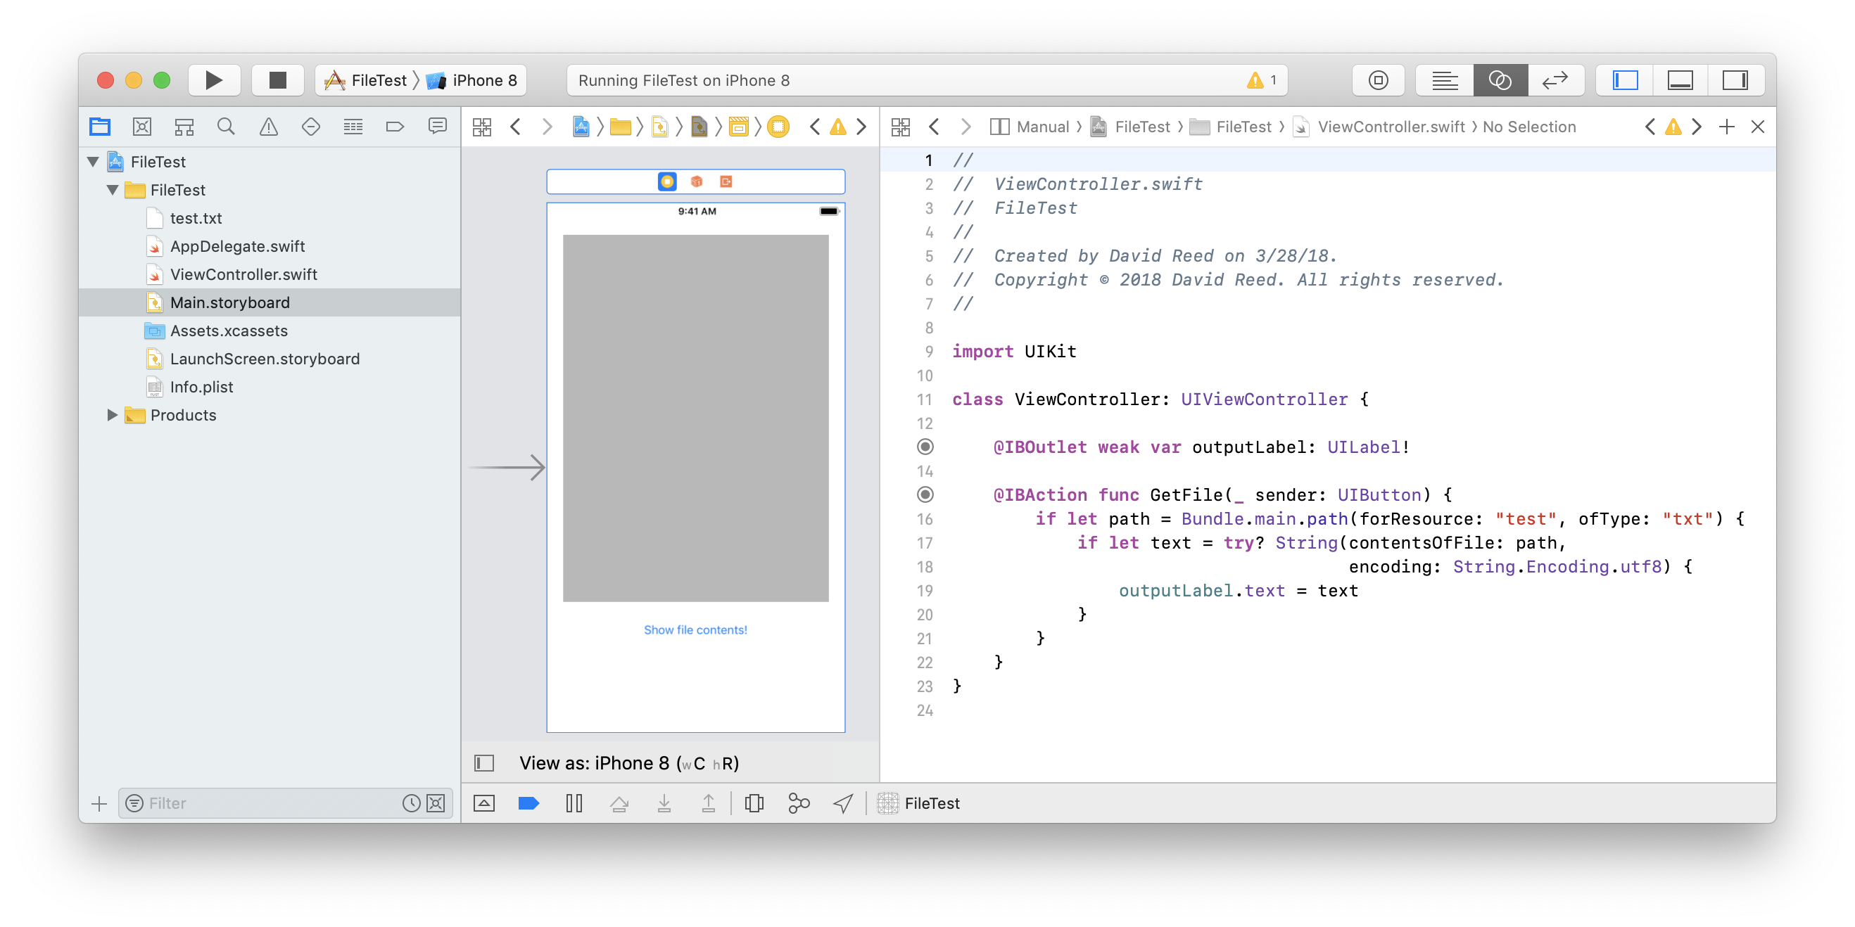
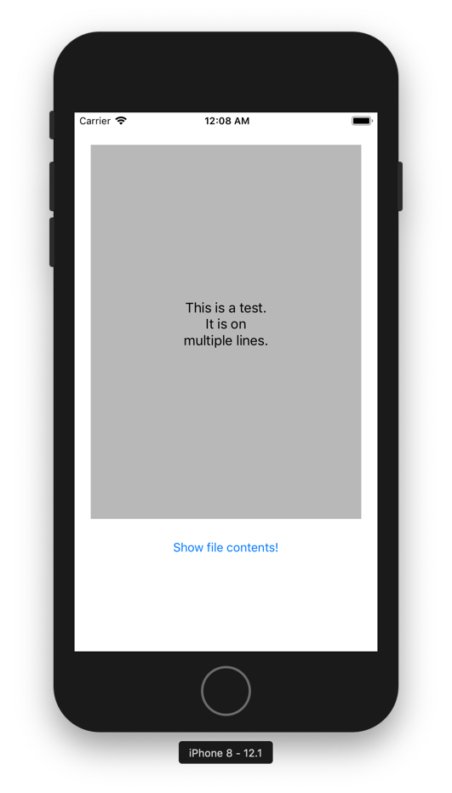
Reading text from a file
it is fairly straightforward to add a data file to a Project & read from it
add the file to the project Bundle by dragging into the Project Navigator
utilize Bundle.main.path to specify the file name (here, test.txt)
call String method to get the file contents (note use of try? since may not find it)

Slide 10
Extracting content from text
to split a String into components based on a separator
String.split(separator: Character)
or
String.components(separatedBy: CharacterSet)
let text = "apple banana casaba"
text.split(separator: " ")
→ ["apple", "banana", "casaba"]
text.components(separatedBy: " ")
→ ["apple", "banana", "casaba"]
text.components(separatedBy: .whitespaces)
→ ["apple", "banana", "casaba"]

Slide 11
Extracting content from text (cont.)
what if there are an arbitrary number of spaces between?
split handles it automatically; components does not
let spaced = "apple banana casaba"
spaced.split(separator: " ")
→ ["apple", "banana", "casaba"]
spaced.components(separatedBy: " ")
→ ["apple", "", "banana", "", "", "casaba"]
spaced.components(separatedBy: .whitespaces)
→ ["apple", "", "banana", "", "", "casaba"]

Slide 12
Extracting content from text (cont.)
but, can filter out empty Strings from the components array
let spaced = "apple banana casaba"
spaced.split(separator: " ")
→ ["apple", "banana", "casaba"]
spaced.components(separatedBy: " ").filter { $0 != "" }
→ ["apple", "banana", "casaba"]
spaced.components(separatedBy: .whitespaces).filter { $0 != "" }
→ ["apple", "banana", "casaba"]

Slide 13
Extracting content from text (cont.)
components also allows you to split based on newlines
let multi = """"
apple banana
casaba
"""
multi.components(separatedBy: .newlines)
→ ["apple banana", "casaba"]
multi.components(separatedBy: .whitespacesAndNewlines)
→ ["apple", "", "banana", "casaba"]
multi.components(separatedBy: .whitespacesAndNewlines).filter
{ $0 != "" }
→ ["apple", "banana", "casaba"]

Slide 14
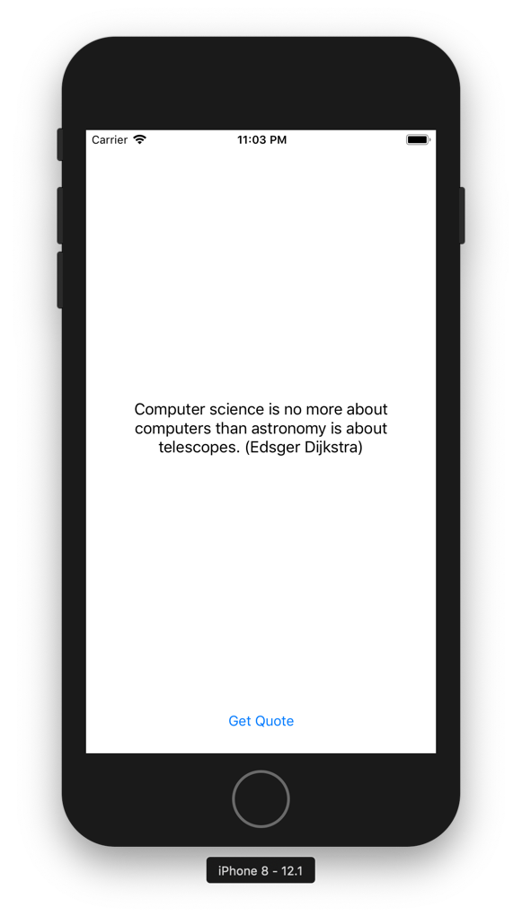
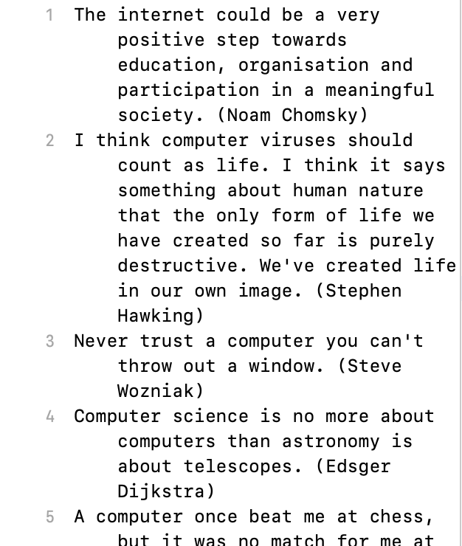
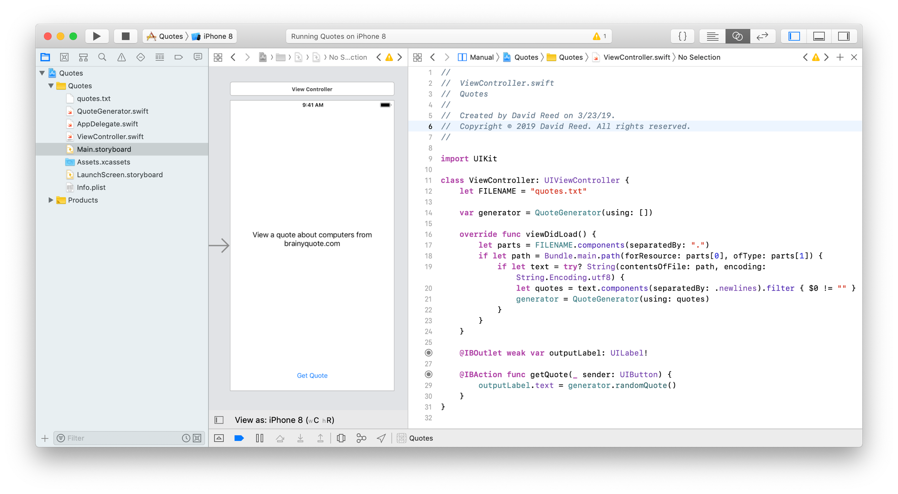
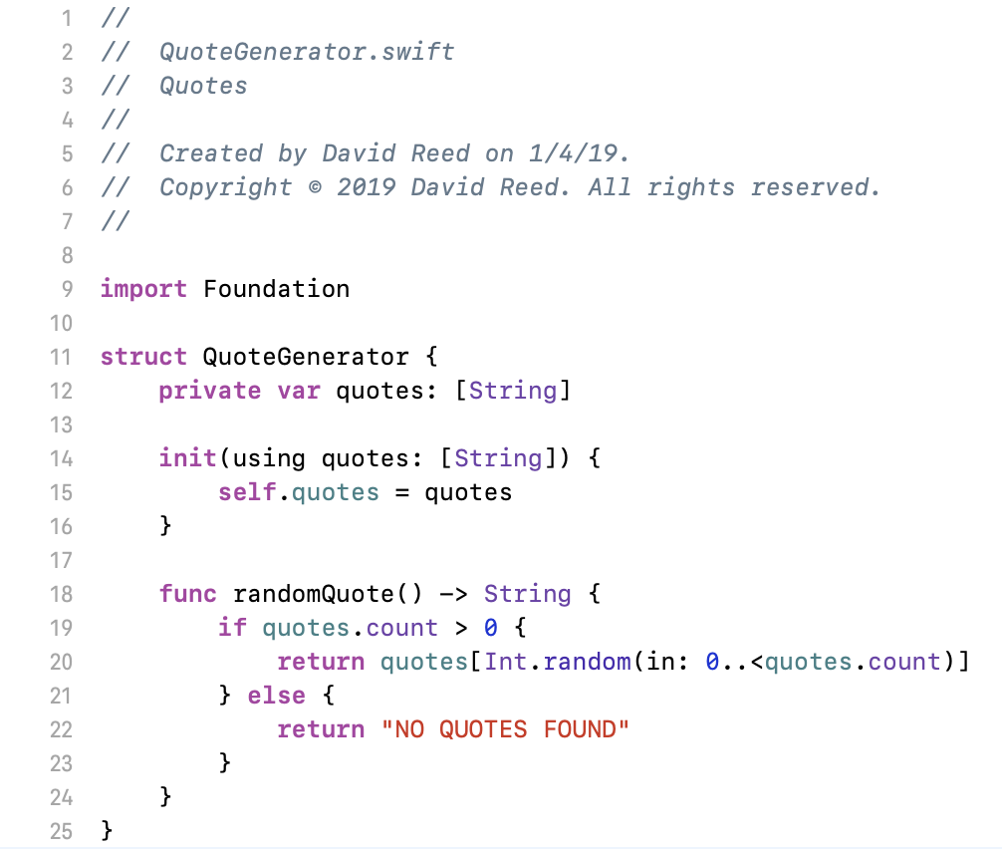
App example
suppose you have a text file that contains quotes, one per line
can create an app that picks a quote at random and displays it

Slide 15
Storing/accessing data
Bundle.main.path enables you to read from existing files
unfortunately, it does not allow you to write to files
Swift provides a different mechanism for storing and subsequently retrieving data values
every app has an associated Info.plist (property list) file associated with it, which stores information about the project
it also provides storage where the app can write data & access it
you can create and initialize multiple data storage areas if desired, but UserDefaults.standard is provided as a default storage area
UserDefaults.standard.set("foo", forKey: "word")
stores "foo" under the access key "word"
UserDefaults.standard.string(forKey: "word")
retrieves "foo" using the access key

Slide 16
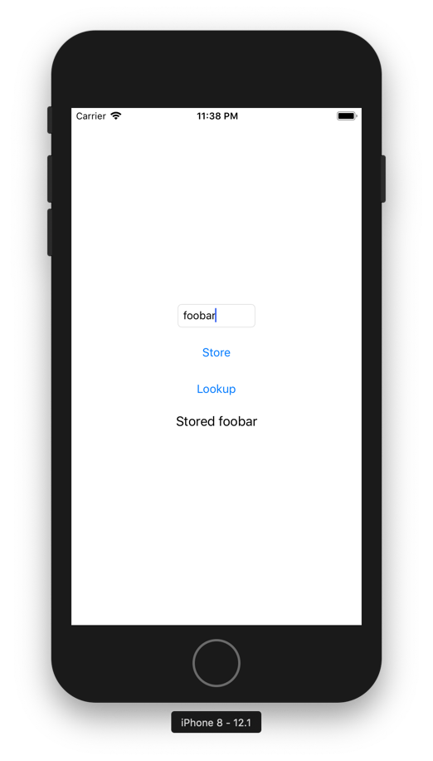
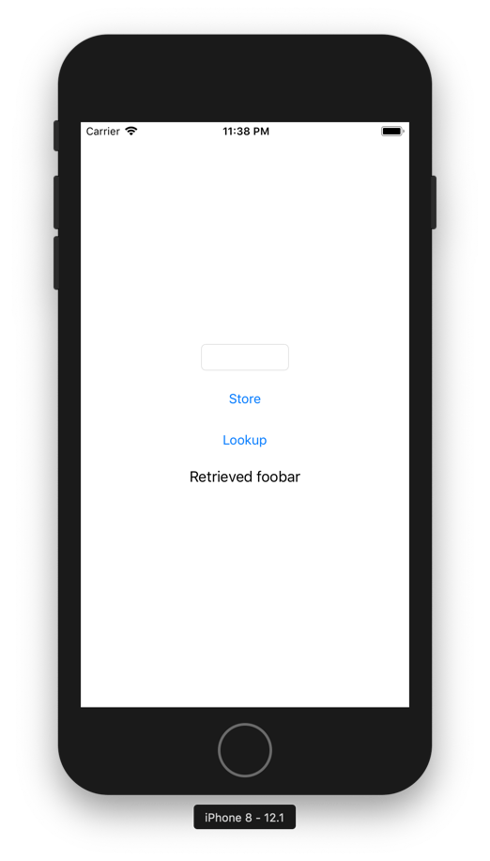
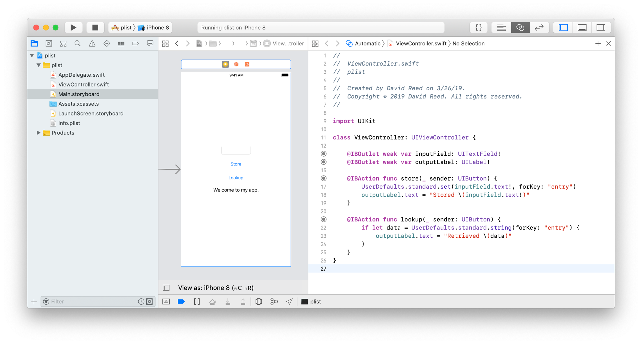
Example app
here, the user can enter a word in a field
click the Store button to store it
click the Retrieve button to retrieve it

Slide 17
Storing/accessing data
can store data of any built-in type, including arrays
UserDefaults.standard.set("Chris", forKey: "name")
UserDefaults.standard.set(21, forKey: "age")
UserDefaults.standard.set(["Pat", "Alex"], forKey: "friends")
.
.
.
var who = UserDefaults.standard.string(forKey: "name")
var howOld = UserDefaults.standard.integer(forKey: "age")
var peeps = UserDefaults.standard.array(forKey: "friends") as! [String]?

Slide 18
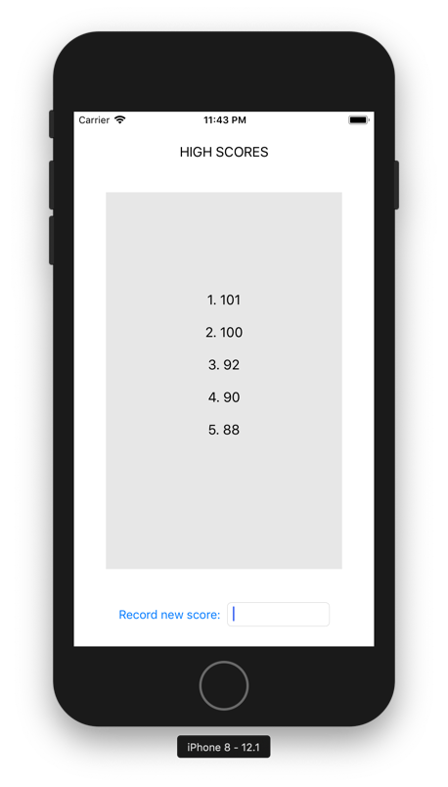
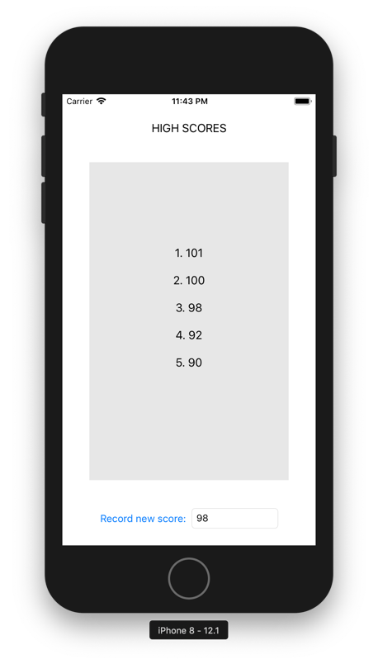
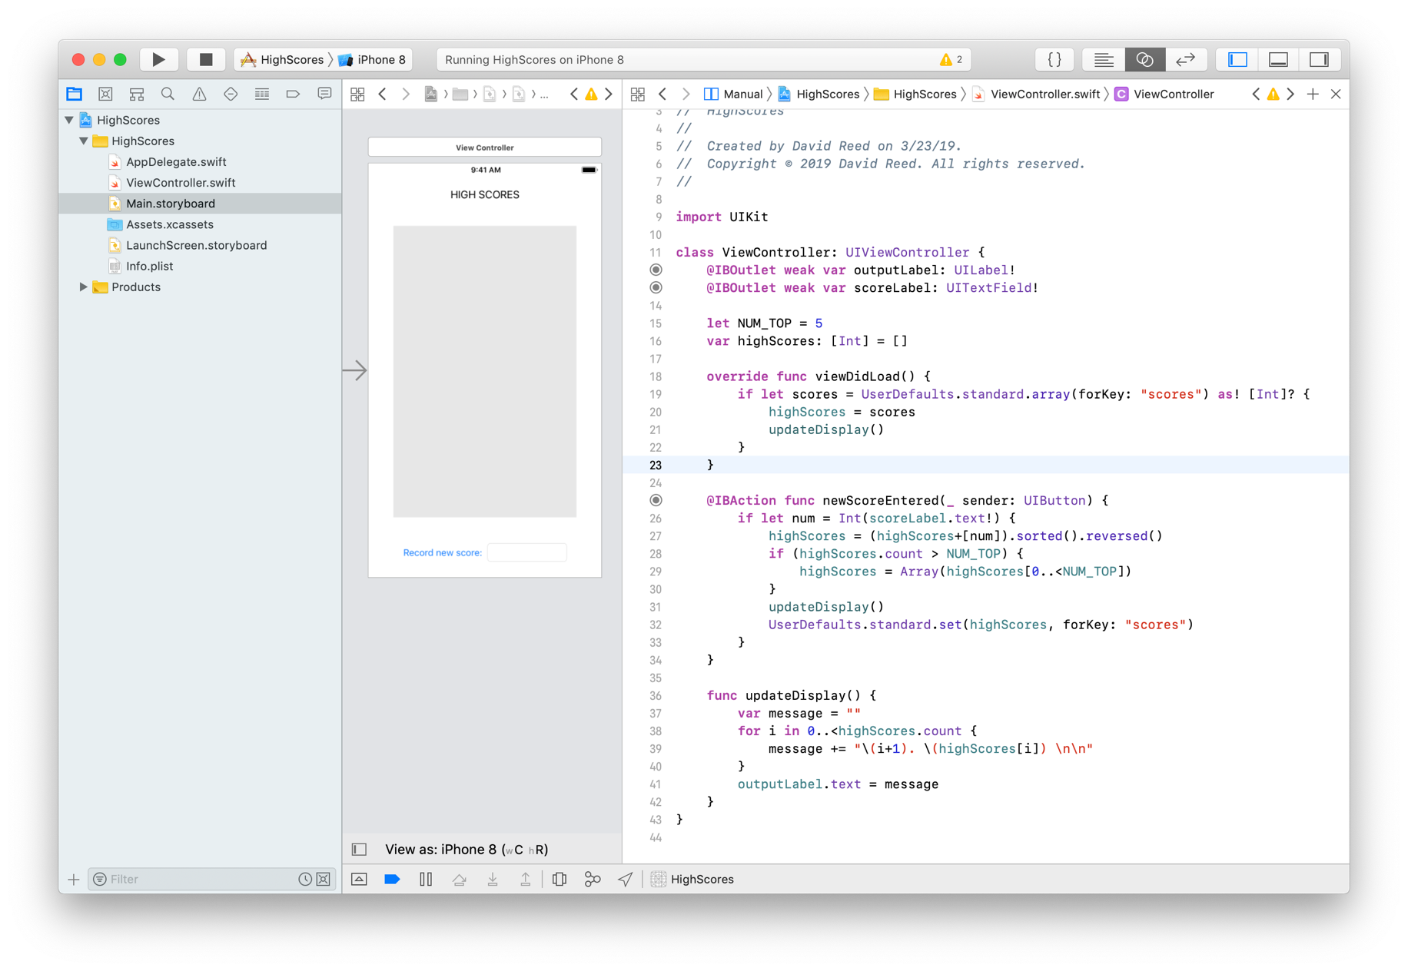
High score example
consider a game in which you want to store high scores
this simple app shows how an array of Ints can be stored, accessed & updated

Slide 19
OTHER FEATURES
YOU MAY (OR MAY NOT)
FIND USEFUL

Slide 20
PickerView
note that PickerView is a view element, not a control element (like UIButton)
more complex to integrate into the screen
add a PickerView to the scene
drag a PickerView from the Object Library into Interface Builder
position and size as desired
connect the PickerView to the ViewController
control-click from the PickerView to the View Controller icon and select Outlet: dataSource
repeat the process and select delegate
add UIPickerViewDataSource, UIPickerViewDelegate
add the protocol names to the ViewController class
class ViewController: UIViewController,
UIPickerViewDataSource,
UIPickerViewDelegate {

Slide 21
PickerView (cont.)
finally, add methods to complete the protocol implementation
func numberOfComponents(in pickerView: UIPickerView) -> Int {
// returns # of columns (usually 1)
}
func pickerView(_ pickerView: UIPickerView,
numberOfRowsInComponent component: Int) -> Int {
// returns the number of options to select from
}
func pickerView(_ pickerView: UIPickerView, titleForRow row: Int,
forComponent component: Int) -> String? {
// returns String representation of entry at the selected row
}
func pickerView(_ pickerView: UIPickerView, didSelectRow row: Int,
inComponent component: Int) {
// specifies action to be taken when user selects a row
}

Slide 22
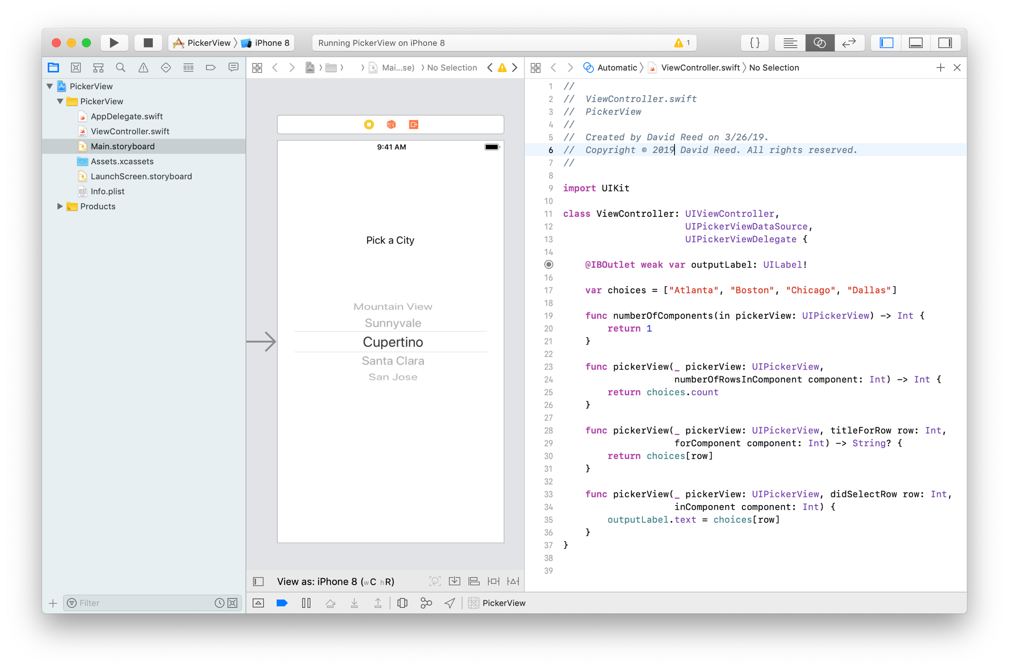
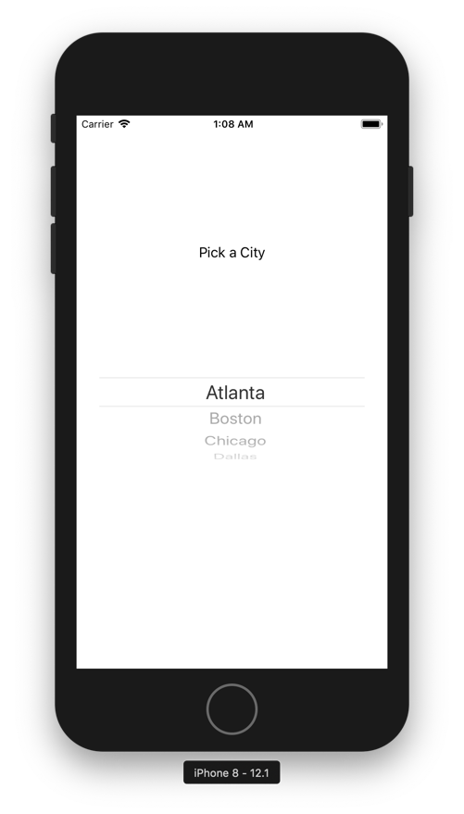
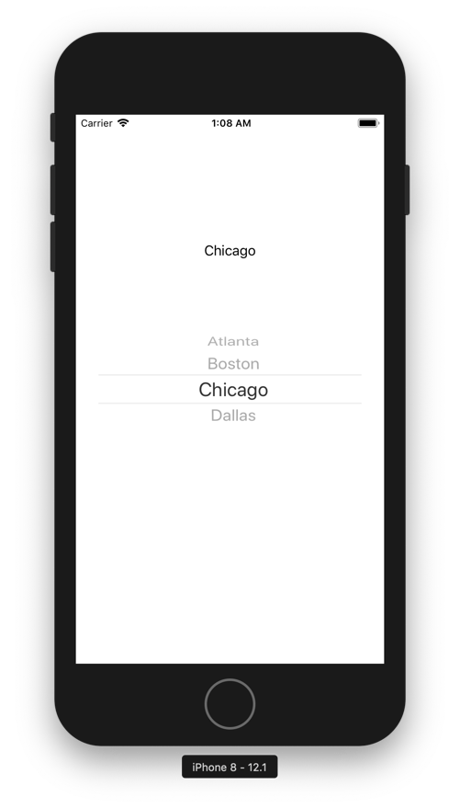
Example: picking cities

Slide 23
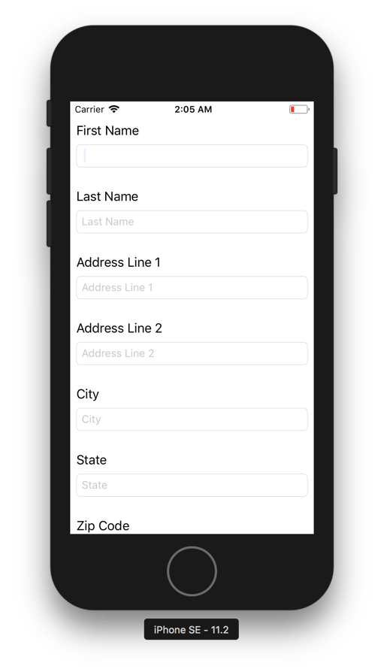
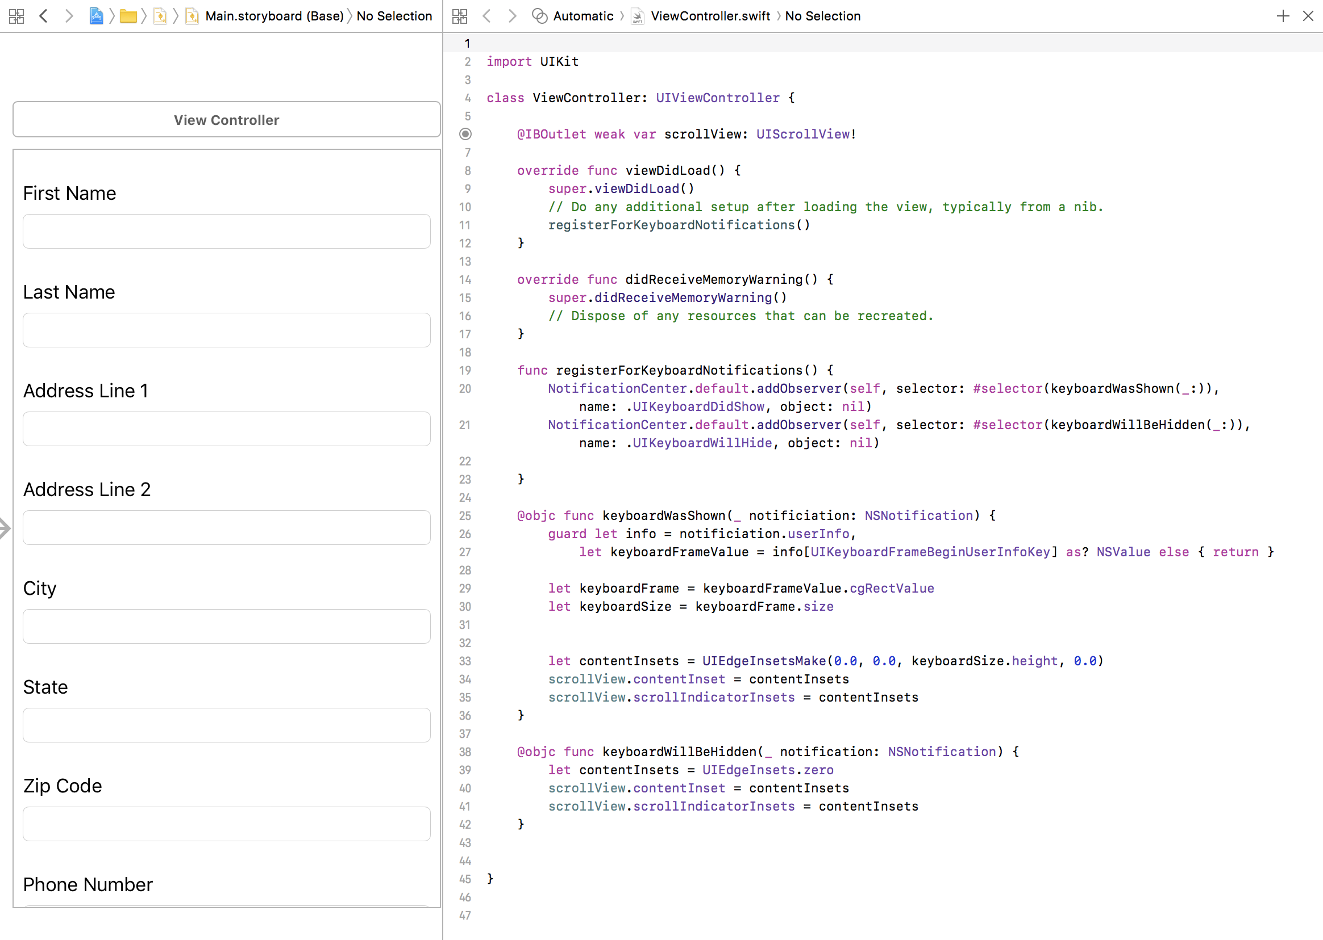
Scroll Views

Slide 24
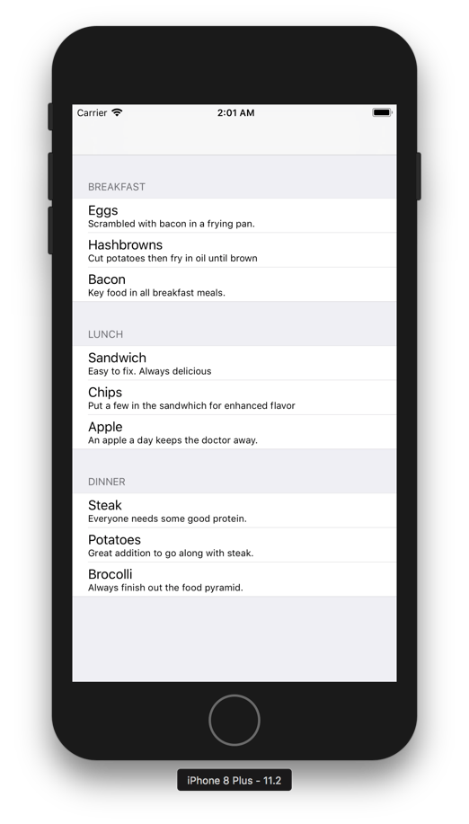
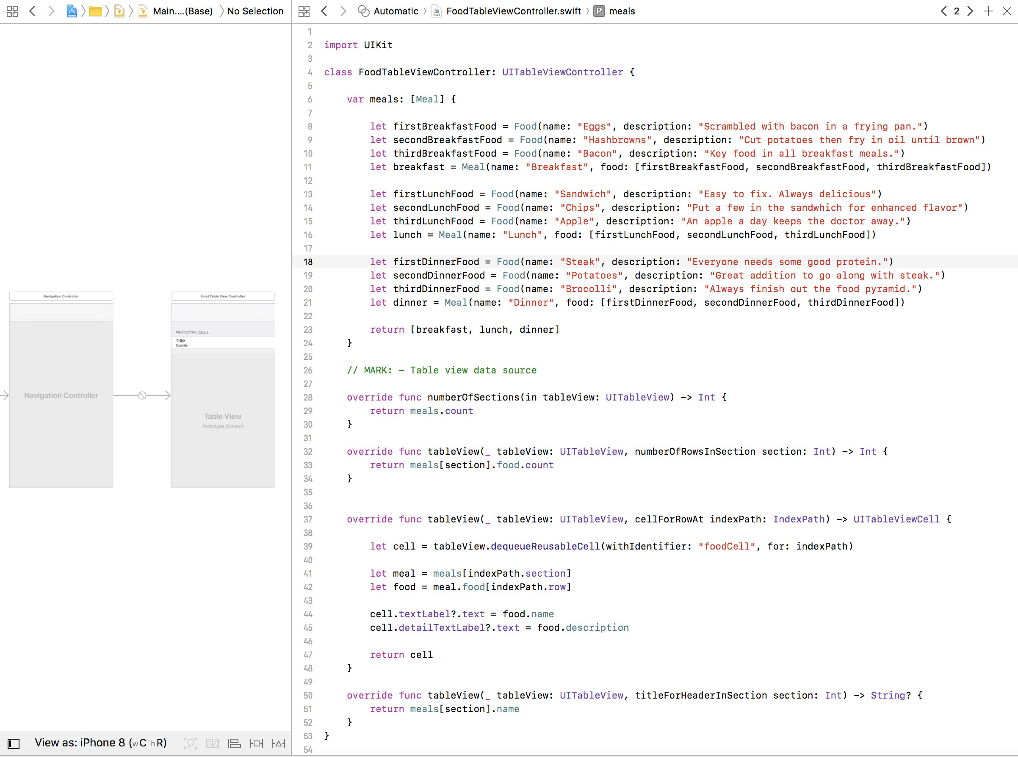
Table views

Slide 25
Protocols
a protocol defines the properties or methods that an object must have in order to complete a task
corresponds to a Java interface; used to define the behavior of a family of classes
e.g., CustomStringConvertible
built-in protocol, specifies a computed property/field named description
protocol CustomStringConvertible {
var description: String { get }
}
if a class/struct implements the CustomStringConvertible protocol
can use the computed property/field to convert to a string
will automatically be called when you print an object
(similar to toString in Java)

Slide 26
CustomStringConvertible
e.g., a Name struct that can be printed
struct Name: CustomStringConvertible {
var first: String
var middle: Character
var last: String
var description: String {
return "\(self.first) \(self.middle). \(self.last)"
}
}
let me = Name(first: "Dave", middle: "W", last: "Reed")
me.description → "Dave W. Reed"
print(me)

Slide 27
Object equality
by default, user-defined objects cannot be tested for equality
var me = Name(first: "Dave", middle: "W", last: "Reed")
var notMe = Name(first: "Dale", middle: "F", last: "Reed")
if me == notMe { ➔ ERROR
. . .
}
the Equatable protocol specifies a static == operator for comparisons
operators are implemented as static methods
defined like a method, but called like an operator: me == notMe
protocol Equatable {
static func ==(lhs: TYPE, rhs: TYPE) -> Bool
}
note: when you define ==, Swift will automatically infer !=

Slide 28
Equatable
e.g., Names with == and !=
class Name: CustomStringConvertible, Equatable {
. . .
static func ==(lhs: Name, rhs: Name) -> Bool {
return lhs.first == rhs.first &&
lhs.middle == rhs.middle &&
lhs.last == rhs.last
}
}
var me = Name(first: "Dave", middle: "W", last: "Reed")
var notMe = Name(first: "Dale", middle: "F", last: "Reed")
if me == notMe {
print("\(me) is the same as \(notMe)")
}
if me != notMe {
print("\(me) is different from \(notMe)")
}

Slide 29
Object comparisons
by default, user-defined objects cannot be compared
var me = Name(first: "Dave", middle: "W", last: "Reed")
var notMe = Name(first: "Dale", middle: "F", last: "Reed")
if me < you { ➔ ERROR
. . .
}
the Comparable protocol specifies a static < operator for comparisons
as with ==, the < operator is implemented as a static method
protocol Comparable {
static func <(lhs: TYPE, rhs: TYPE) -> Bool
}
a class/struct that implements Comparable MUST also implement Equatable
note: from < and ==, Swift will automatically infer >, <= and >=

Slide 30
Comparable
e.g., Names with <, >, <=, >=
class Name: CustomStringConvertible, Equatable {
. . .
static func <(lhs: Name, rhs: Name) -> Bool {
return lhs.last < rhs.last ||
(lhs.last == rhs.last && lhs.first < rhs.first) ||
(lhs.last == rhs.last && lhs.first == rhs.first
&& lhs.middle < rhs.middle)
}
}
var me = Name(first: "Dave", middle: "W", last: "Reed")
var notMe = Name(first: "Dale", middle: "F", last: "Reed")
if me < notMe {
print("\(me) comes before \(notMe)")
}
if me > notMe {
print("\(me) comes after \(notMe)")
}

Slide 31
User-defined protocols
user-defined protocols can contain
functions/methods (so really more like Java abstract classes)
computed properties/fields, which must be identified as get and/or set
protocol Shape {
var coord: [Int] { get }
mutating func shift(byX: Int, byY: Int)
}
struct Square: Shape {
var x: Int
var y: Int
var coord: [Int] { return [self.x, self.y] }
mutating func shift(byX: Int, byY: Int) {
self.x += byX
self.y += byY
}
}

Slide 32
Storing/accessing objects
UserDefaults.standard can be used to read/write primitive values & arrays/dictionaries of primitive values
however, it can't be used to read/write complex objects
it is possible to encode an object so that it can be stored, then retrieve and extract the object
the object must implement the Codable protocol, which includes a method on how to encode the object
then utilize a PropertyListEncoder to encode the object and store it
subsequently, can retrieve the encode object and utilize a PropertyListDecoder
SEE UNIT 4 IF YOU WANT TO TAKE ADVANTAGE OF THIS FEATURE

