Slide 1
CSC 581: Mobile App Development
Spring 2018
Unit 3: Optionals & segues
Swift Optionals
other Swift features:
guards, variable scope, enumerations
multiscreen apps with segues
passing data, Navigation Controllers
popover windows
Example app: Concentration

Slide 2
Optionals
recall: Swift uses Optionals when a value may or may not be present
var ages = ["Pat": 18, "Chris": 20, "Kelly": 19]
print(ages["Chris"]) → Optional(20)
outputLabel.text = "Hello world"
print(outputLabel.text) → Optional("Hello world")
you can unwrap an optional using ! or (more elegantly) if-let
print(ages["Chris"]!) → 20
if let msg = outputLabel.text {
print(msg) → Hello world
}
every type in Swift has a corresponding optional type (with ? at end)
var age: Integer? = ages["Chris"]
var msg: String? = outputLabel.text

Slide 3
Intentional Optionals
structs/classes can have optional fields; functions can return Optionals
struct GradeList {
private var grades: [Int] = []
var lowest: Int? {
return self.grades.min() // note: min returns nil if empty
}
mutating func recordGrade(of grade: Int) {
self.grades.append(grade)
}
func average() -> Double {
if grades.count == 0 {
return 0.0
}
else {
var sum = 0
for g in self.grades {
sum += g
}
if self.grades.count > 2 {
return Double(sum-self.lowest!)/Double(self.grades.count-1)
}
else {
return Double(sum)/Double(self.grades.count)
}
}
}
}

Slide 4
Guards
when defining functions, will often have an initial validity test or tests
a guard is a cleaner notation for handling validity tests
guard condition else { }
func average() -> Double {
guard grades.count > 0 else { return 0.0 }
var sum = 0
for g in self.grades {
sum += g
}
if self.grades.count > 2 {
return Double(sum-self.lowest!)/Double(self.grades.count-1)
}
else {
return Double(sum)/Double(self.grades.count)
}
}

Slide 5
Variable scope
as in most languages, a block (code enclosed in { } ) defines a new scope for variables
note: a function defines a new scope as well as control statements
var x = 100
if true {
var y = 3
print("\(x) \(y)") → 100 3
}
print(x) → 100
print(y) → ERROR: Use of unresolved identifier 'y'
variable shadowing
unlike Java, you can override an existing variable inside a new scope
var x = 100
if true {
var x = 3
print(x) → 3
}
print(x) → 100

Slide 6
Enumerations
as in Java, you can define a new type by enumerating all of the possible values of that type
useful when you want a limited range of values to be assignable
enum Answer {
case yes, no, maybe
}
enum DayOfWeek {
case Monday, Tuesday, Wednesday, Thursday,
Friday, Saturday, Sunday
}
let response = Answer.yes
if (response == .yes || response == .no) { // Swift infers the
print("That's a decisive answer") // enum type
}
let today: DayOfWeek = .Tuesday
print(today)

Slide 7
Multiscreen apps
a Single View app automatically has one screen on the storyboard
can add a screen by dragging a View Controller from the Object Library
can then specify segues (transitions) between the screens
segues are defined in Interface Builder by connecting an action to a screen
e.g., place a button in a screen, control-drag to the other screen
alternatively, could use a tap or swipe gesture to initiate a segue
can select the presentation method for the transition
e.g., Show performs a sliding transition between screens
e.g., Present Modally allows you to customize (dissolve, curl, …)
the initial screen (a.k.a. entry point) is identified with an arrow
can drag it from one screen to another to select the entry point

Slide 8
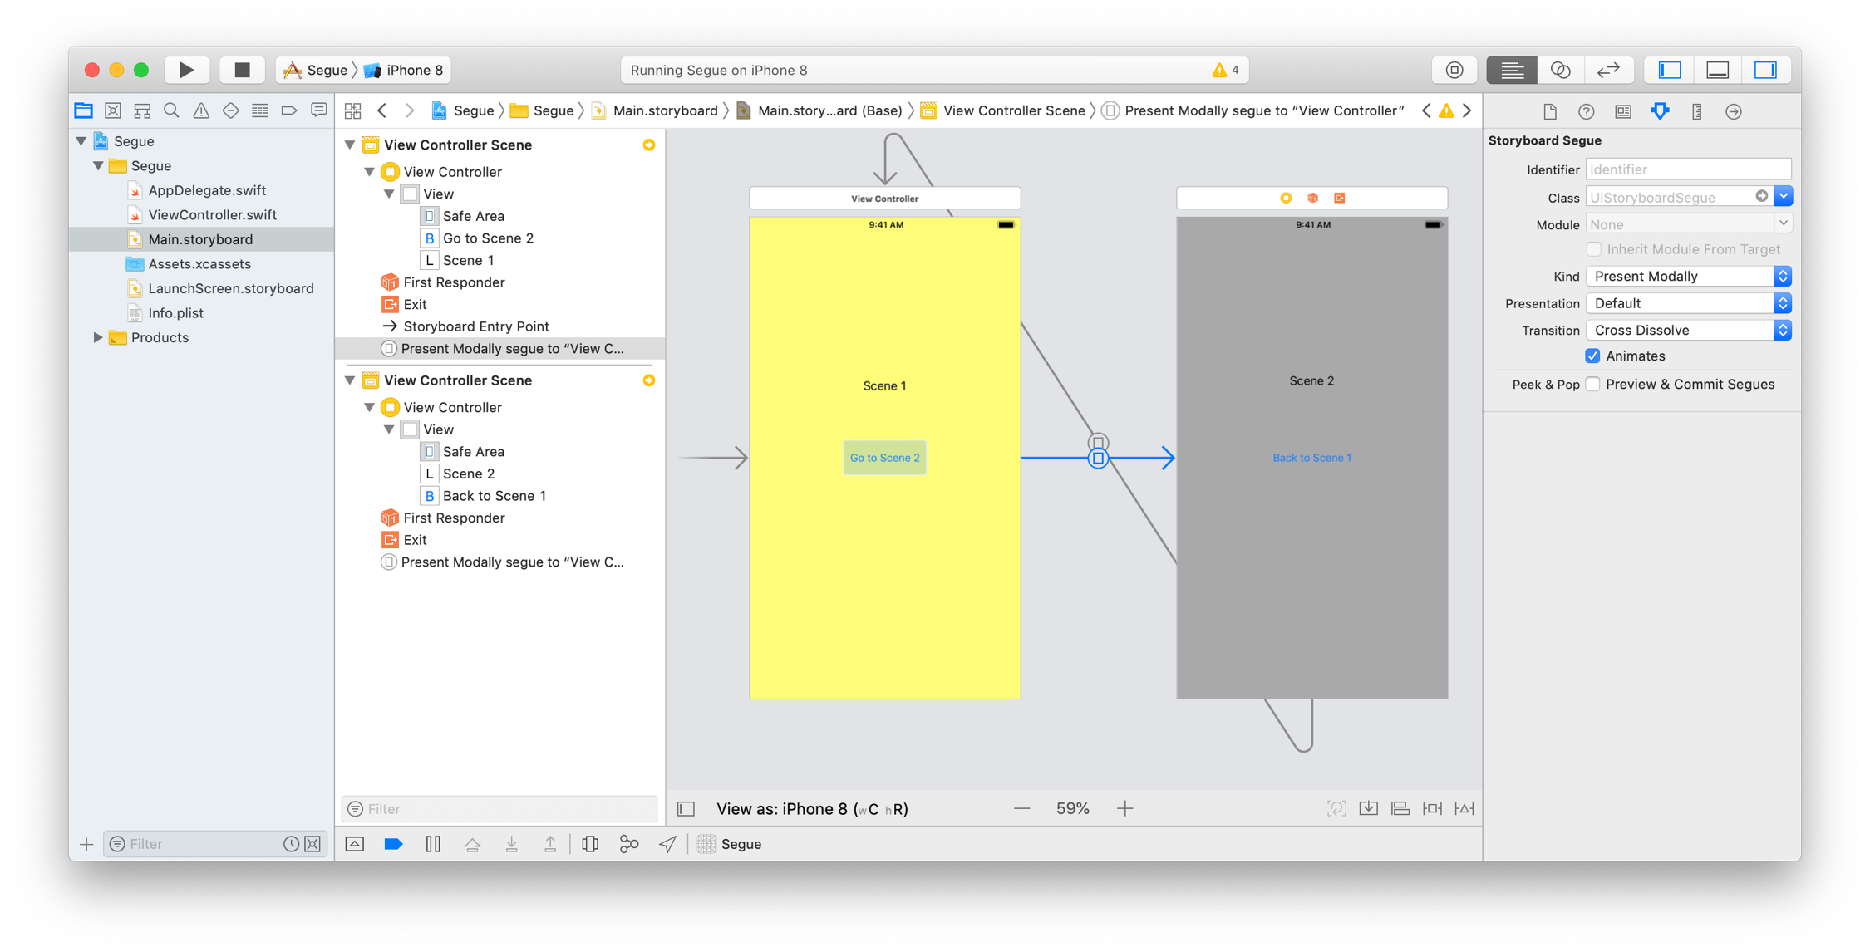
Simple segue
2 screens (view controllers), each with a button that segues to the other screen
arrows in the storyboard show the segues between the screens
can select an arrow and inspect or change its properties (e.g., transition type)
here, scene 1 is the entry point

Slide 9
Controlling each screen
technically, each screen is a View Controller element
each can have its own UIViewController class to specify its behavior
Single View app automatically creates one UIViewController class that can be associated with a screen (default name ViewController.swift)
if each screen has its own behavior, then each needs its own UIViewController
to add a new UIViewController to the project
under the File menu, select New → File → Cocoa Touch Class
enter the desired class name (e.g., Scene1Controller) and specify that it is a subclass of UIViewController
associate that new class with the appropriate screen by clicking on the bar at the top of the screen and selecting the class name in the Identity Inspector
the default name was fine when there was only one UIViewController
if you are going to have multiple controllers, give them reasonable names
you can always rename a variable/class by highlighting its name, right-clicking, and selecting Refactor

Slide 10
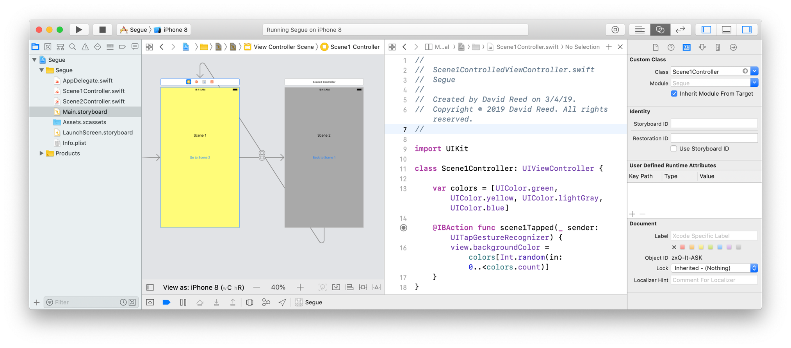
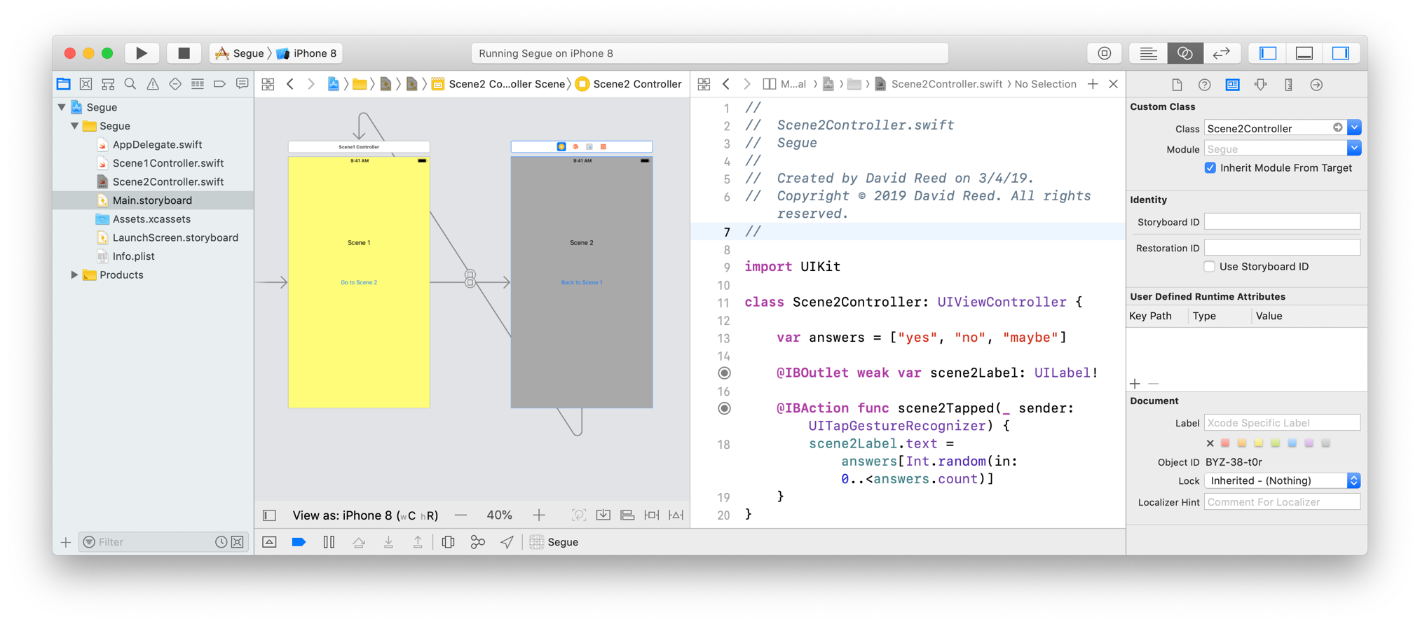
Multiple controllers
supposed we wanted each scene to have its own behavior
when you tap on scene 1, the background color changes at random
when you tap on screen 2, the label displays a random word

Slide 11
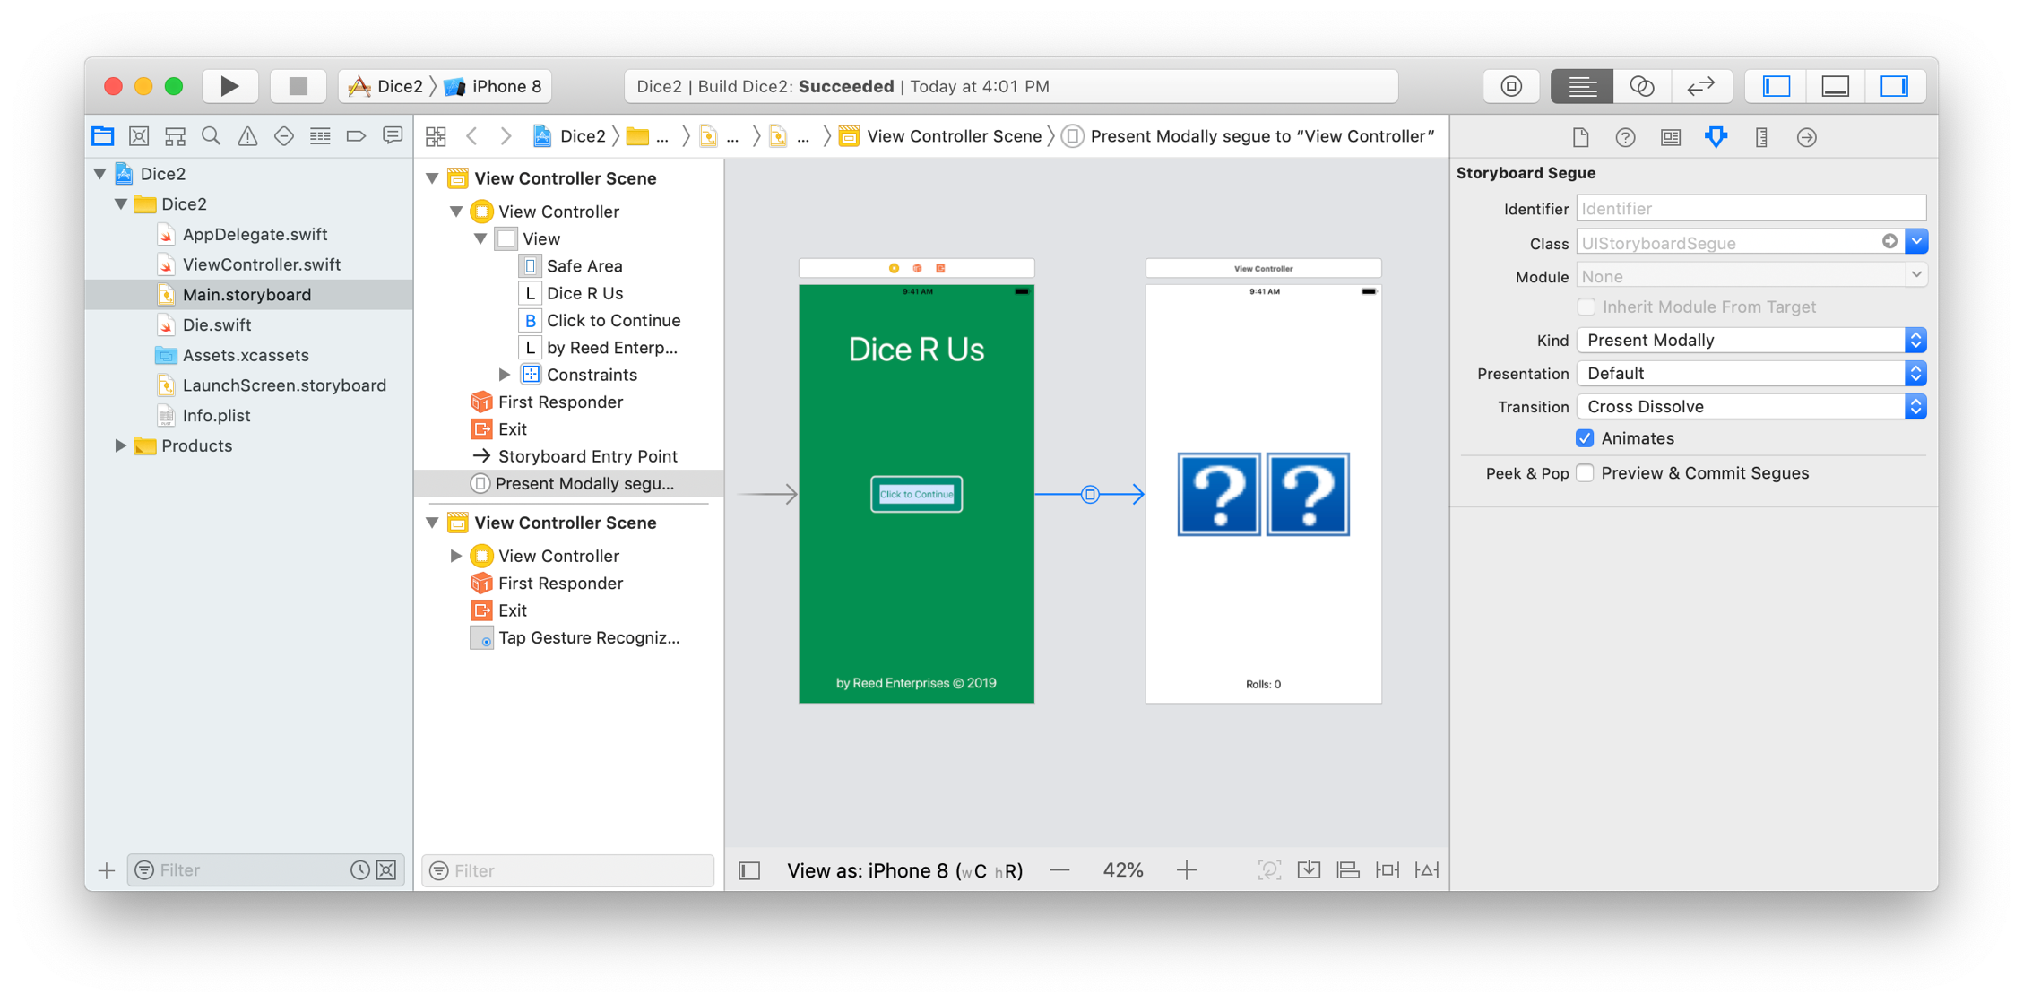
Welcome screen
a common feature in an app is to have a welcome screen
may contain developer info, instructions, initial settings, …
if the welcome screen does nothing other than present info and segue to the main screen, it does not require its own UIViewController class

Slide 12
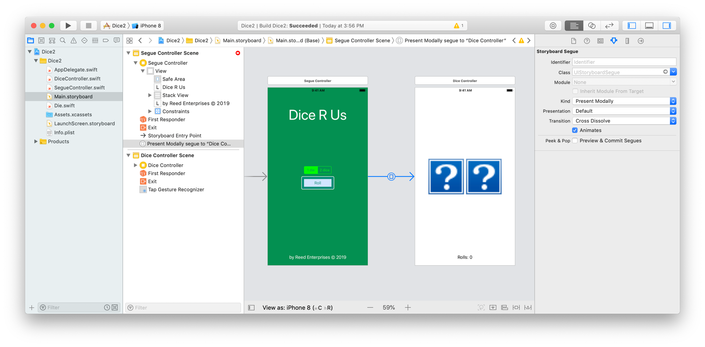
Passing data between screens
suppose we wanted to be able to select settings in the welcome screen
e.g., select whether rolls one or two dice
could have a UIControl to specify the desired number of dice, then must somehow pass that data to the other screen as part of the segue

Slide 13
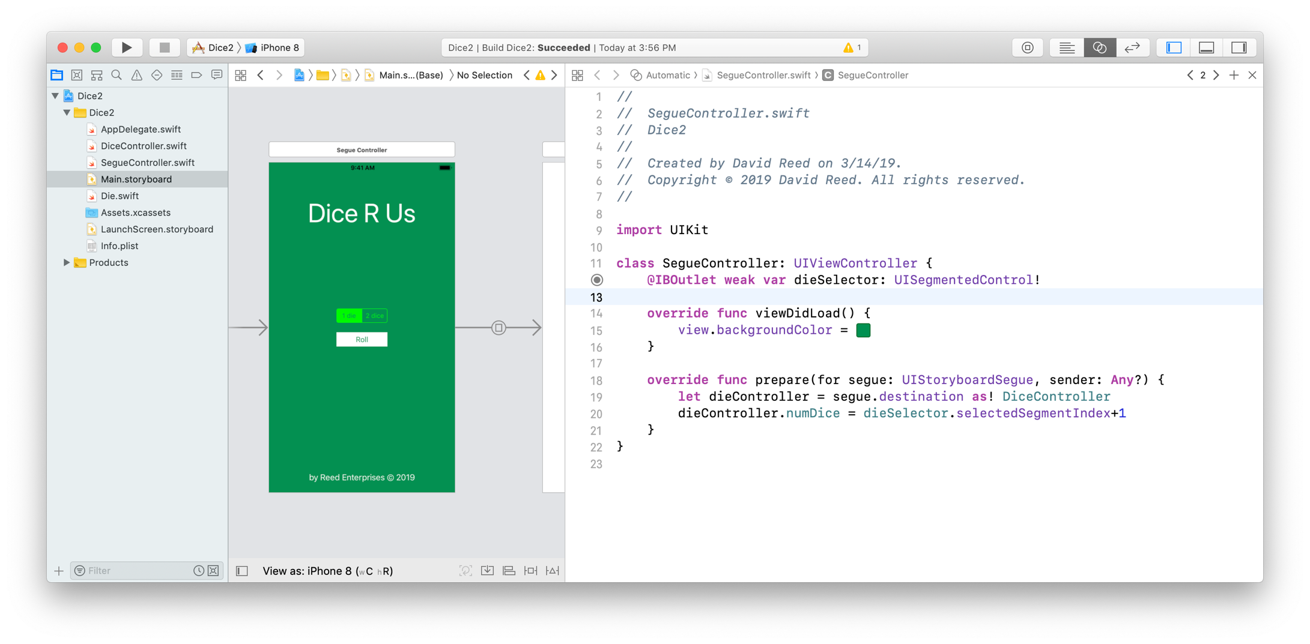
SegueController
need a UIViewController for the welcome screen
it has an outlet for the segmented control
plus a method that prepares for the segue by accessing the destination controller and passing the number of dice to its numDice field

Slide 14
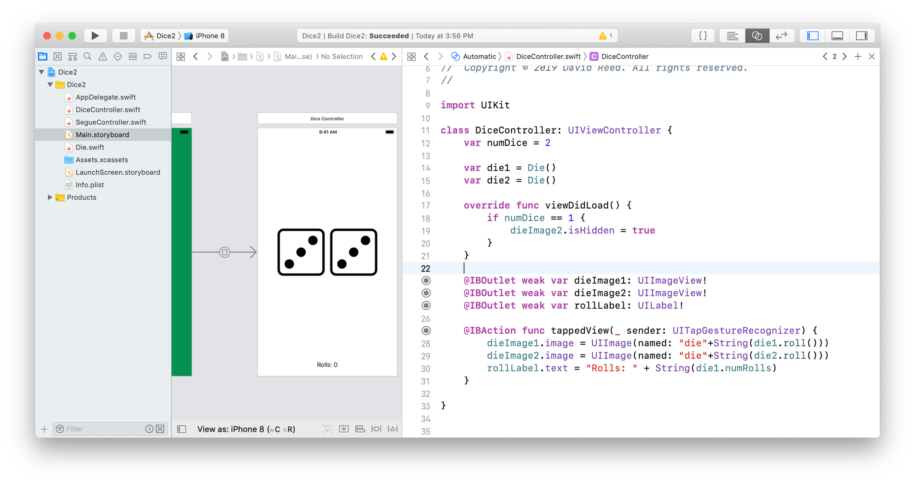
DiceController
since now more than one UIViewController, rename the main one
have a field that stores the number of dice (default is 2)
recall, viewDidLoad (if defined) is automatically called after the view loads
here, check to see if this field was changed via the segue, if so hide the 2nd die

Slide 15
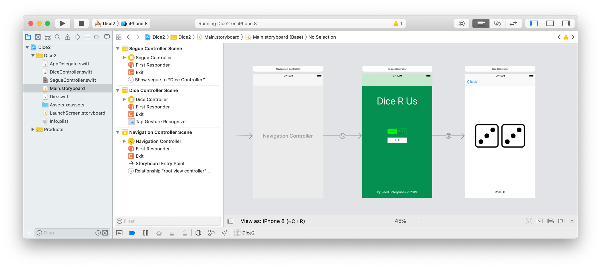
Navigation Controller
would like to be able to go back a screen
e.g., after clicking one die, go back top the settings screen and switch to two dice
select the controller of the entry-point screen (here, SegueController)
go to Editor → Embed In → Navigation Controller
this adds a navigation controller to the storyboard
note: need to make sure that the segue is a Show (e.g., Push)

Slide 16
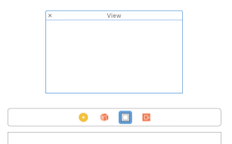
Popovers
sometimes, a separate screen is overkill
a popover window is a less weighty alternative (e.g., for showing help info)
a popover is a View embedded in an existing View Controller
in particular, it does not have its own UIViewController class
to open a popover (at the click of a button)
add a popover View to the storyboard
drag a View from the Object Library onto the bar at the top of the ViewController
this will add a View icon to the bar and also display the View in the storyboard

Slide 17
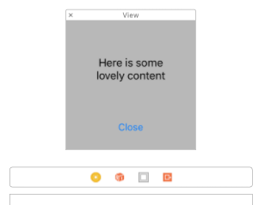
Popovers (cont.)
specify the background & size for the popover
select the View, go to the Attributes Inspector and set background color
select the View, go to the Size Inspector and set X & Y
add content to the popover View
e.g., a label for displaying text and a button for closing
connect the popover View to the existing ViewController
i.e., control-drag from the View to create an outlet in the ViewController code (be careful to connect the UIView, not the contained elements)
@IBOutlet var popoverView: UIView!

Slide 18
Popovers (cont.)
create an Action for the button in the ViewController (to open the popover)
add Swift statements that open & position the popover
@IBAction func openPopover(_ sender: UIButton) {
self.view.addSubview(popoverView)
popoverView.center = self.view.center
}
create an Action for the button in the popover View (to close the popover)
add a Swift statement to close the popover
@IBAction func closePopover(_ sender: UIButton) {
self.popoverView.removeFromSuperview()
}
if desired, you can round the edges of the popover
select the View and go to the Identify Inspector
create a new User Defined Runtime Attribute (by clicking on +)
Key Path = layer.cornerRadius, Type = Number, Value = 10

Slide 19
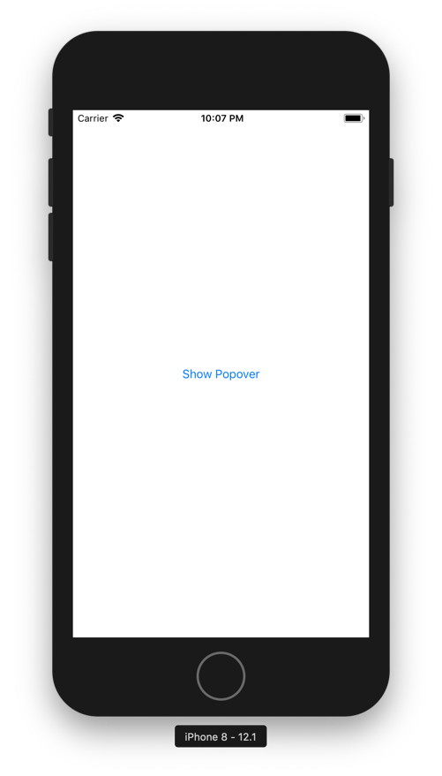
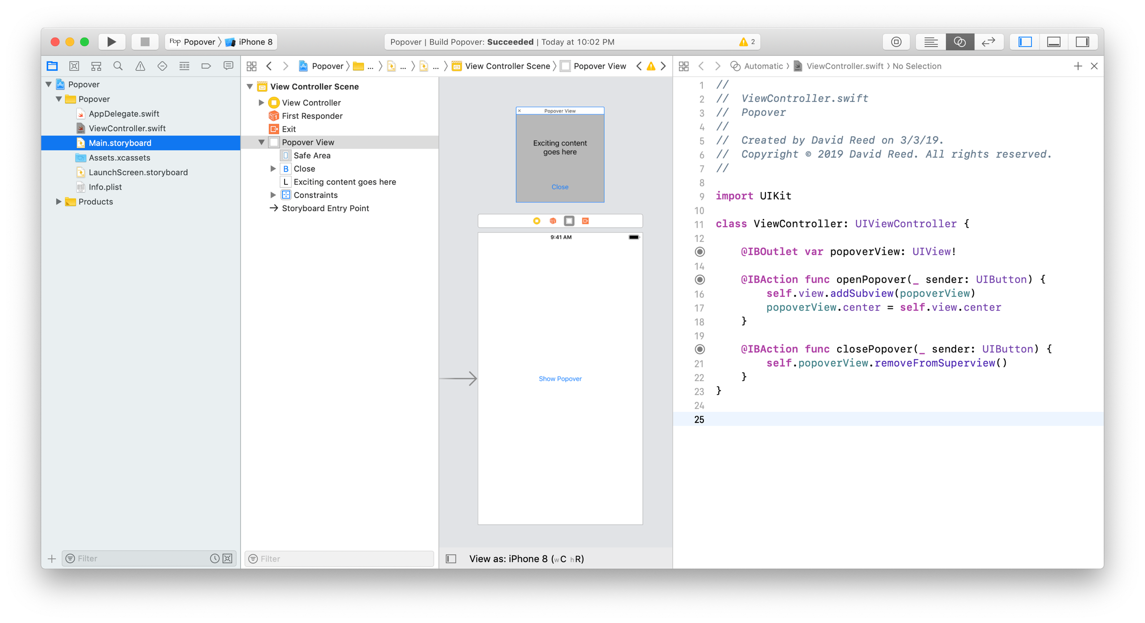
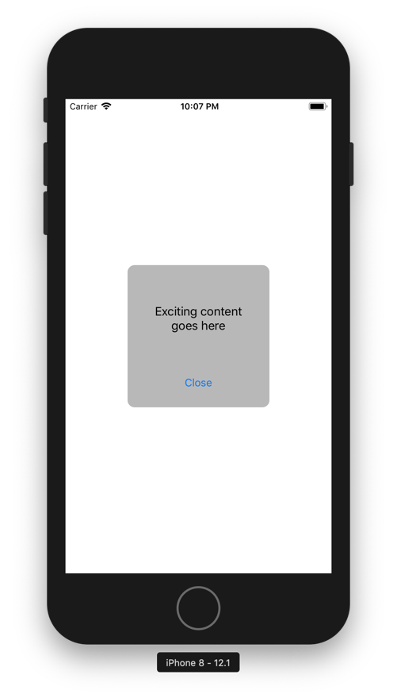
Popover example

Slide 20
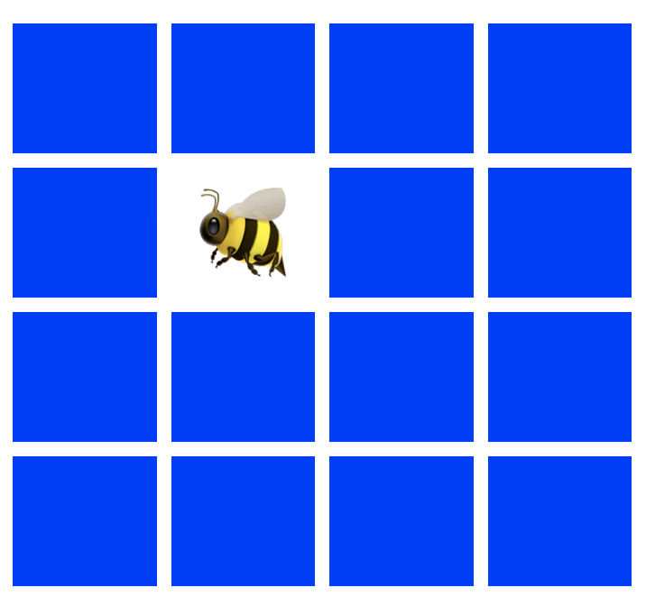
Complete example
suppose we wanted to create a Concentration game app
Concentration is played with rows of cards, dealt face down
a player picks two cards & flips them
if they match, the cards are removed; otherwise, they are flipped back over
the goal is to find all the matching pairs in the fewest number of flips

Slide 21
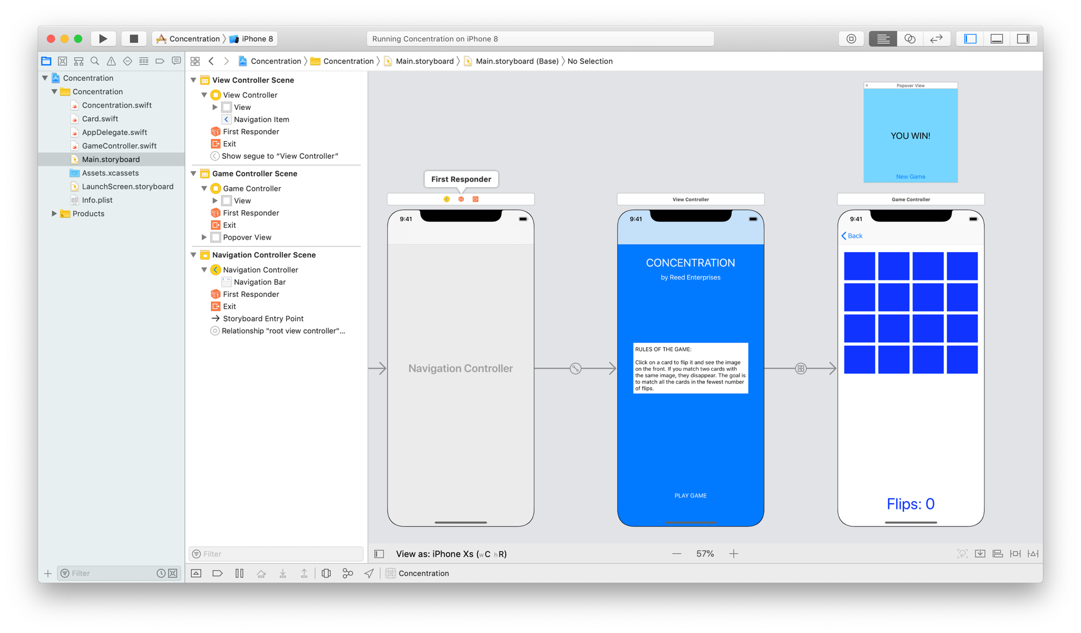
Concentration View
the project will contain
a welcome screen with instructions
a game screen with the grid of cards & a popover when the player wins
a navigation controller to allow the user to go back to the welcome screen

Slide 22
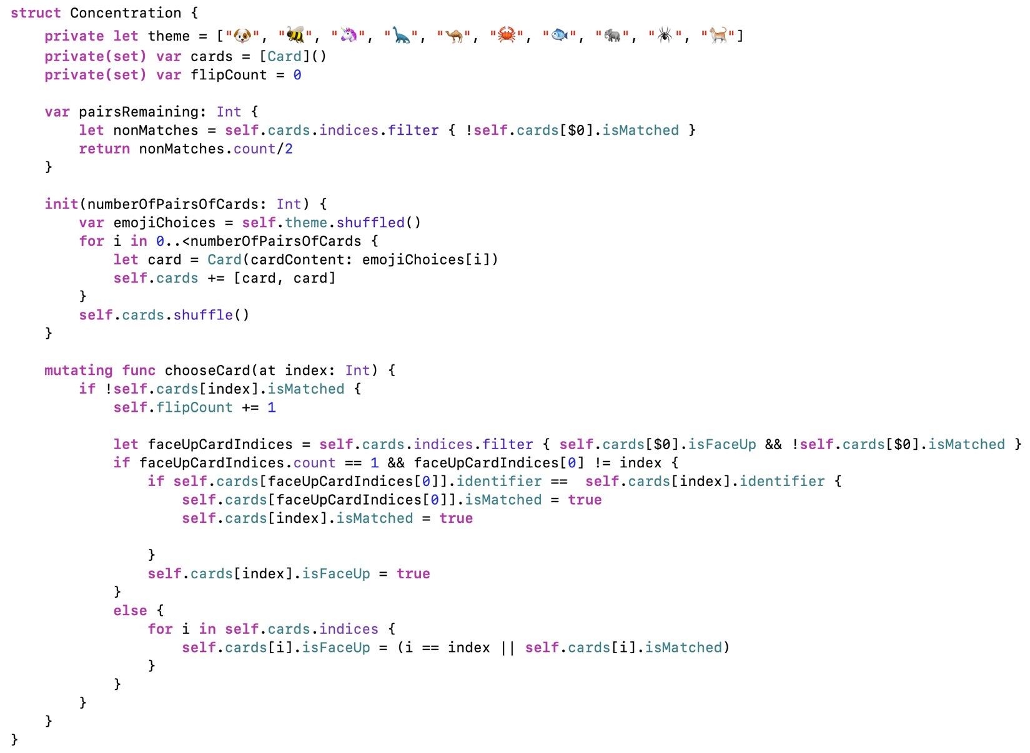
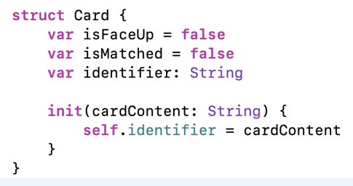
Concentration model
2 structs:
Card represents a card
Concentration contains the game logic
new feature: filter

Slide 23
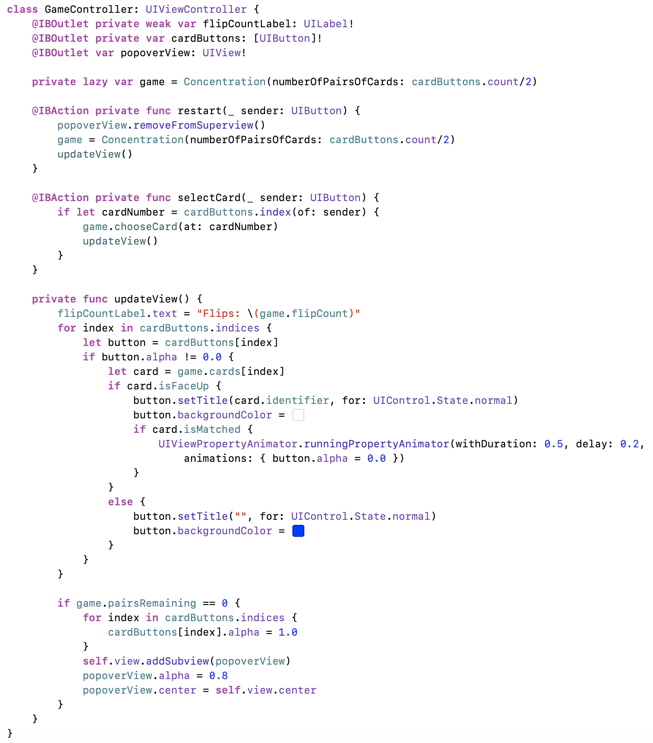
Concentration controller
uses several new features:
OutletCollection
lazy field
alpha property
animation

