Slide 1
CSC 581: Mobile App Development
Spring 2019
    Unit 2: More Swift & UIKit
computed properties/fields
classes & inheritance
collections:
  arrays, dictionaries
UIKit
  UIView subclasses: UILabel, UIImageView, …
  UIControl subclasses: UIButton, UISwitch, …
Appicon

Slide 2
RouletteWheel struct
struct RouletteWheel {
private var die = Die(withSides: 36)
private(set) var numSpins = 0
mutating func spin() -> String {
let dieRoll = self.die.roll()
self.numSpins += 1
if dieRoll == 36 {
return "00"
}
else if dieRoll == 35 {
return "0"
}
else {
return String(dieRoll)
}
}
}
var wheel = RouletteWheel()
for _ in 1...10 {
print(wheel.spin())
}
print(wheel.numSpins)
  consider a struct for simulating a roulette wheel
  American roulette wheels contain 00,0,1…34
  to differentiate between 0 and 00, spin method will return a String
  numSpins field seems redundant – the private die field already keeps track of the # of rolls

Slide 3
Avoiding redundant counters
struct RouletteWheel {
private var die = Die(withSides: 36)
mutating func spin() -> String {
let dieRoll = self.die.roll()
if dieRoll == 36 {
return "00"
}
else if dieRoll == 35 {
return "0"
}
else {
return String(dieRoll)
}
}
func numSpins() -> Int {
return die.numRolls
}
}
var wheel = RouletteWheel()
for _ in 1...10 {
print(wheel.spin())
}
print(wheel.numSpins())
  we could get rid of the numSpins field
  instead have a method for determining the number of spins
  this avoids the redundant counter, but many feel that a field is more natural

Slide 4
Computed properties/fields
struct RouletteWheel {
private var die = Die(withSides: 36)
var numSpins: Int {
return die.numRolls
}
mutating func spin() -> String {
let dieRoll = self.die.roll()
if dieRoll == 36 {
return "00"
}
else if dieRoll == 35 {
return "0"
}
else {
return String(dieRoll)
}
}
}
var wheel = RouletteWheel()
for _ in 1...10 {
print(wheel.spin())
}
print(wheel.numSpins)
it is possible to make the method look like a field
a computed property/field is declared and accessed like a field, but its value is computed whenever it is accessed
  after the field declaration, specify code in { } that computes & returns the value
  don't specify protection, but implicitly private(set)
  essentially, it acts like an accessor method but looks like a private(set)field

Slide 5
Classes
class Die {
private var numRolls: Int
private var numSides: Int
init(withSides sides: Int = 6) {
self.numSides = sides
self.numRolls = 0
}
func roll() -> Int {
self.numRolls += 1
return Int.random(in: 1...self.numSides)
}
func numberOfRolls() -> Int {
return self.numRolls
}
func numberOfSides() -> Int {
return self.numSides
}
}
var d = Die()
for _ in 1...10 {
print(d.roll())
}
print(d.numberOfRolls())
in addition to structs, Swift supports classes for defining new types
  can define just like in Java
  private fields
  init (constructor)
  accessor & mutator methods
note: unlike structs, you do not declare methods mutating
classes are typically more work & less natural than structs
  used in Swift mainly when you want to utilize inheritance

Slide 6
Inheritance
class ColoredDie: Die {
private var color: String
init(withColor color: String,
withSides sides: Int = 6) {
self.color = color
super.init(withSides: sides)
}
override func roll() -> Int {
if self.color == "red" {
return 1
}
else {
return super.roll()
}
}
func dieColor() -> String {
return self.color
}
}
var d = ColoredDie(withColor: "white")
print(d.roll())
print(d.dieColor())
var poly: Die = ColoredDie(withColor: "red")
print(poly.roll())
to inherit from an existing class:
  specify the parent class in the header
  all fields & methods of the parent class are inherited
  call super.init AT THE END of the init
  if overriding a method, must declare as override
  as in Java, private fields from parent class are not accessible (can allow access by declaring as internal)

Slide 7
Values vs. references
structs are value types (as in Python)
  when you assign a struct object to a variable or pass it as a parameter, a copy of that object is assigned
    var me = Name(first: "David", middle: "W", last: "Reed")
    var copy = me
    me.first = "Dave"
    me.first → "Dave"
    copy.first → "David"
classes are reference types (as in Java)
  when you assign a class object to a variable or pass it as a parameter, a reference to that object is assigned
    var die1 = ColoredDie(withColor: "green")
    var die2 = die1
    die1.roll()
    die1.numberOfRolls() → 1
    die2.numberOfRolls() → 1

Slide 8
Collections
Swift provides three different collection structs for storing values
  array: an indexed list
  dictionary: a list of key-value pairs
  set: a non-index list of unique items (we will ignore for now)
  note: all three are homogeneous (items must all be of the same type)
arrays
  var example: Array<String> // declares an array of Strings
  var example: [String] // same thing, but cleaner
  var empty: Array<String>() // declares & inits to be empty
  var empty: [String]() // same thing
  var empty: [String] = [] // same thing
  var words = ["foo", "bar"] // declares & initializes

Slide 9
Array properties & methods
    var words = ["foo", "bar"]
    words.count → 2
    words.append("biz")
    words → ["foo", "bar", "biz"]
    words += ["baz", "boo"]
    words → ["foo", "bar", "biz", "baz", "boo"]
    words[0] → "foo"
    words[words.count-1] → "boo"
    for str in words { // displays all five words
    print(str)
    }
    for i in 0..<words.count { // also displays all five words
    print(words[i])
    }
    words.remove(at: 2)
    words → ["foo", "bar", "baz", "boo"]
    words.insert("zoo", at: 1)
    words → ["foo", "zoo", "bar", "baz", "boo"]

Slide 10
Decision Maker
for HW2, you separated the Model & Controller in your Decision Maker app
  could have taken the HW1 code as is and placed it in a struct with no fields
this is not ideal
  hardcoded to those three answers
  adding more answers is tedious
  impossible to have different Deciders with different options
better solution:
  when a Decider is created, pass in a list of the options
  store that list as a private field
  can then randomly choose an option from the list
struct Decider {
func getAnswer() -> String {
let randomNum = Int.random(in: 1...3)
if randomNum == 1 {
return "YES"
}
else if randomNum == 2 {
return "NO"
}
else {
return "MAYBE"
}
}
}
var chooser = Decider()
print(chooser.getAnswer())

Slide 11
Better Decider
struct Decider {
private let options: [String]
init(between options: [String]) {
self.options = options
}
func getAnswer() -> String {
return self.options[Int.random(in: 0..<options.count)]
}
}
var chooser = Decider(between: ["yes", "no", "maybe"])
print(chooser.getAnswer())
var dinnerOptions = ["Pizza", "Sushi", "Burger",
"Tacos", "Pancakes", "Salad"]
var foodPicker = Decider(between: dinnerOptions)
print(foodPicker.getAnswer())

Slide 12
Dictionaries (a.k.a. Maps)
suppose you wanted to store people and their ages
  e.g., Pat is 18, Chris is 20, …
  once stored, could look up a person to get their age
a dictionary is a collection of key:value pairs
  var ages = ["Pat": 18, "Chris": 20, "Kelly": 19]
  can add pairs simply by assigning a value to a key
  ages["Jan"] = 21 // adds "Jan": 21 to the dictionary
  can access the value by indexing with the key
  note: indexing returns an Optional (nil if key is not stored in the dictionary)
  ages["Chris"] → Optional(20)
  if let age = ages["Chris"] {
  print(age)
  }

Slide 13
Dictionary properties & methods
    var example = Dictionary<String, Int> // declares Dictionary of
    var example = [String: Int] // String:Int pairs
    var example: Dictionary<String: Int>() // declares and initializes as
    var example: [String: Int]() // empty
    var example: [String: Int] = [:] //
    var ages = ["Pat": 18, "Chris": 20, "Kelly": 19]
for (name, age) in ages {
print("\(name) is \(age) years old.")
}
    ages["Pat"] = 19 // updates "Pat"'s value
    ages["Sean"] = 22 // adds "Sean":22 to end
    for name in ages.keys { // adds 1 to each age
    if let age = ages[name] {
    ages[name] = age+1
    }
    }
    print(ages.values.max()!) // prints 22

Slide 14
Copy care
arrays and dictionaries, like other built-in Swift types, are structs
  that means that assigning an array/dictionary or passing it as a parameter to a function makes a copy
  var nums = [3, 6, 1, 7]
  var copy = nums
  nums += [10, 20, 30]
  nums.count → 7
  copy.count → 4
  func zeroOut(numList: [Int]) {
  for index in 0..<numList.count {
  numList[index] = 0
  }
  }
  zeroOut(numList: nums)
  nums → [3, 6, 1, 7, 10, 20, 30]

Slide 15
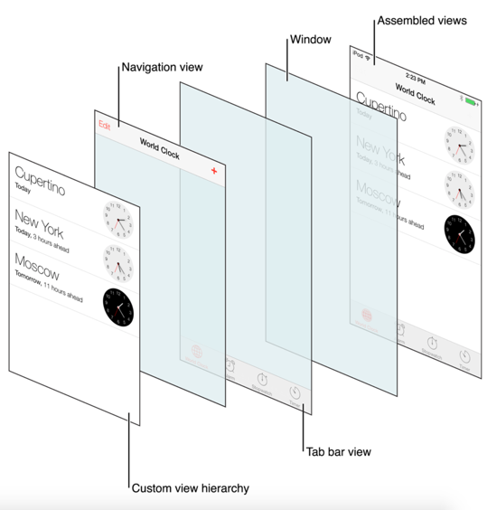
UIKit
the UIKit is a code framework for building mobile apps
  the foundational class for all visual elements in the UIKit is the UIView (or just view)
  a view is a clear rectangular shape that is customized to display things on the screen
  UIView subclasses:
    UILabel – for displaying text
    UIImageView – for displaying images
    UIScrollView – for scrollable content
  most app screens consist of many views

Slide 16


UIView subclasses (so far)
UILabel
  for displaying text
  access/change label: labelOutlet.text
  access/change text color: labelOutlet.textColor
  access/change background color: labelOutlet.backgroundColor
UIImageView
  for displaying images
  access/change image: imgOutlet.image

Slide 17


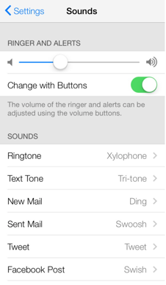



Other UIView subclasses
UITextView
  for entering and displaying multiline text
UIScrollView
  for scrollable content
UITableView
  for displaying data in a scrollable column of rows and sections
UIToolbar
  for displaying a toolbar of buttons
  usually at the bottom of the screen
UINavigationBar
  for displaying main navigational controls
  usually at the top of the screen
UITabBar
  for displaying options for actions

Slide 18


UIControl subclasses (so far)
UIButton
  can be clicked
  change label text: buttonOutlet.setTitle("???", for: .normal)
  change label color: buttonOutlet.setTitleColor(???, for: .normal)
  change background color: buttonOutlet.backgroundColor
  change image: buttonOutput.setImage(named: ???, for: .normal)
UISwitch
  can turn on or off
  determine its position: switchOutlet.isOn

Slide 19



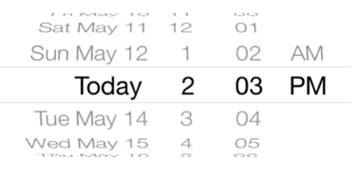

Other UIControl subclasses
UISegmentedControl
  can select from visible options
UITextField
  can enter text
UISlider
  can select from a range
UIDatePicker
  can select a date
UIStepper
  can increment/decrement a counter

Slide 20
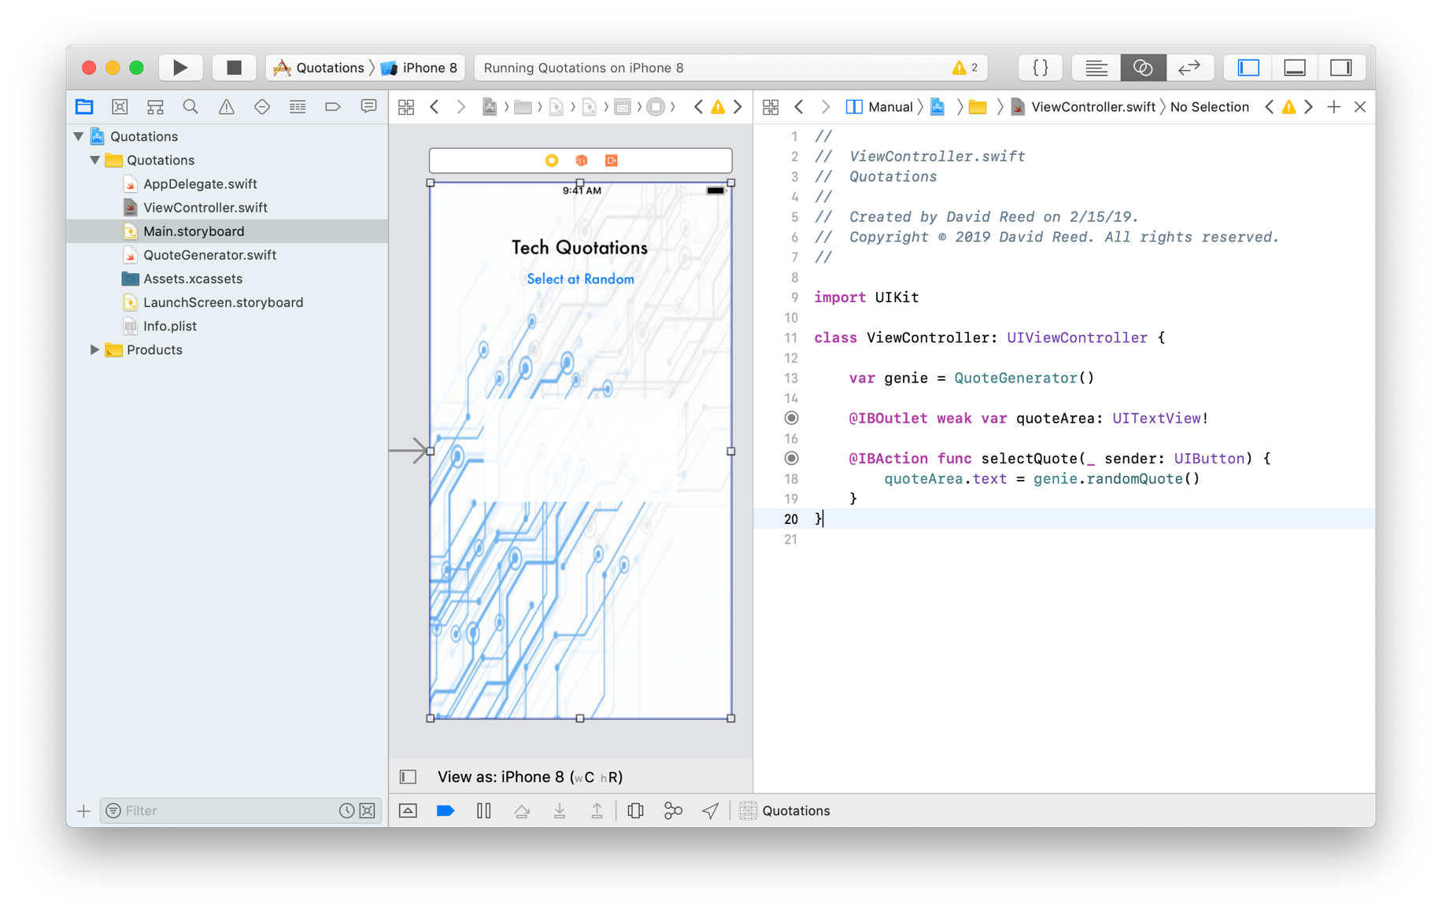
Example: text view
UITextView can display multiline text in an editable, scrollable rectangle
  here, a random quotation is selected and displayed in the text view
  a UIImageView provides the background
  setting the UITextView's alpha to 0.9 make it semi-transparent

Slide 21
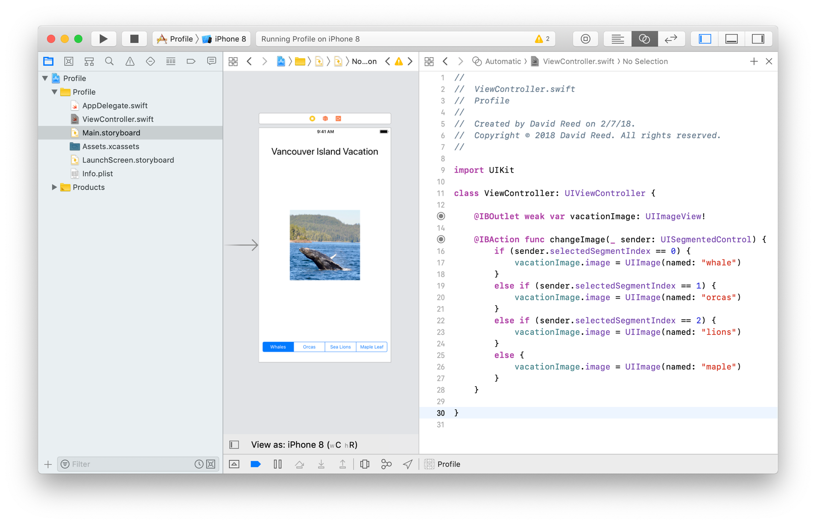
Example: segmented control
UISegmentedControl provides a series of clickable segments
  here, a different image is displayed when a segment is selected

Slide 22
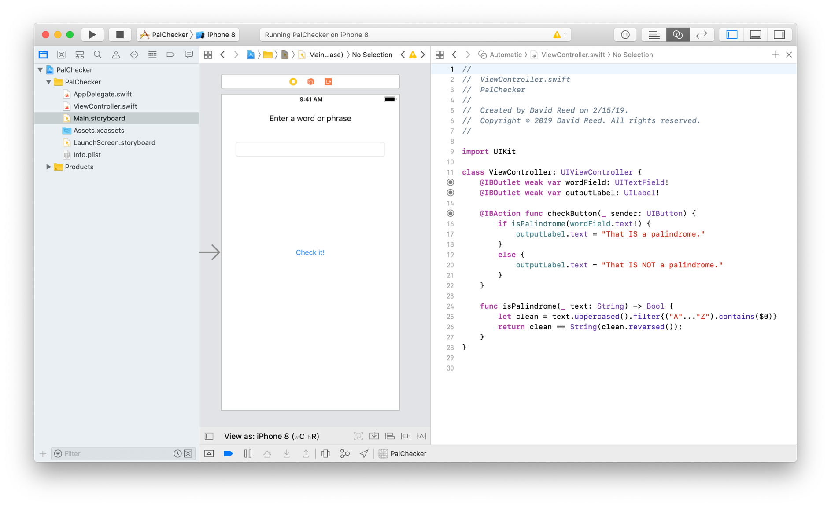
Example: text field
UITextField allows the user to enter text, which can be accessed
  here, the user enters a word or phrase in the text field
  a message identifying whether it is a palindrome or not is displayed in a label

Slide 23
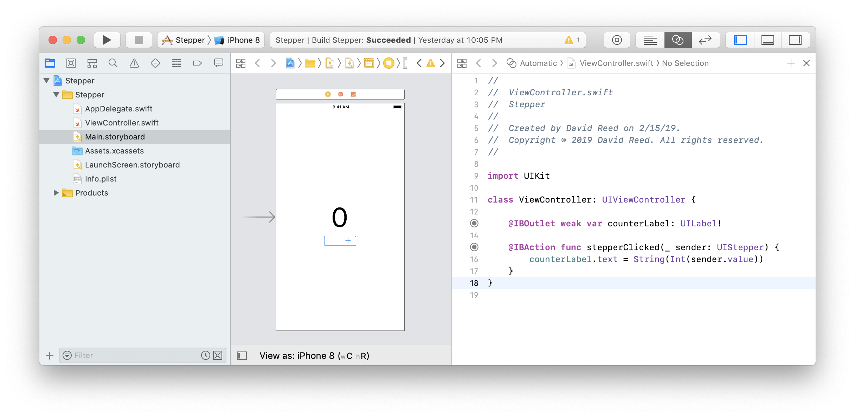
Example: stepper
UIStepper allows simple increment/decrement of a counter
  here, the user clicks +/– to increment/decrement

Slide 24
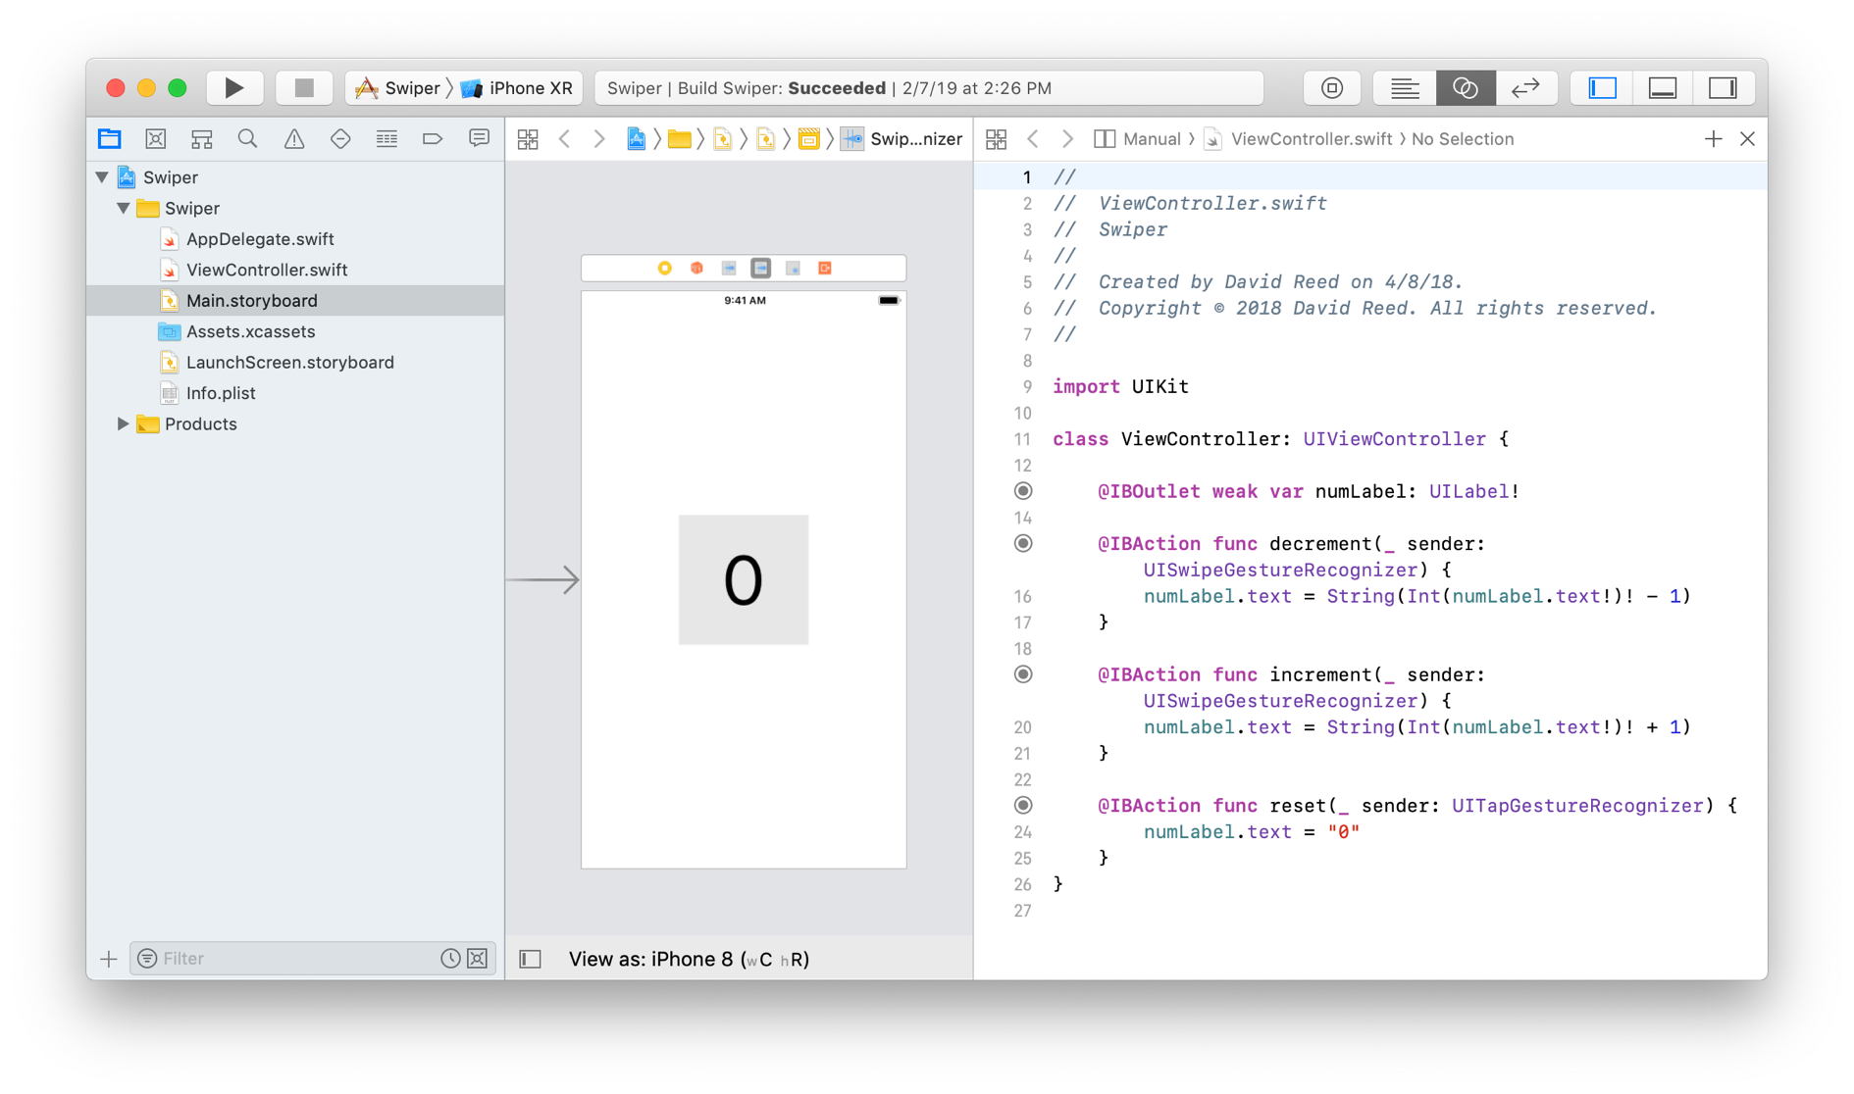
Example: swipe gesture recognizers
similar to the earlier Tap Gesture Recognizer example, we can add Swipe Gesture Recognizers to the main View
  here, swipe right increments, swipe left decrements, tap resets

Slide 25
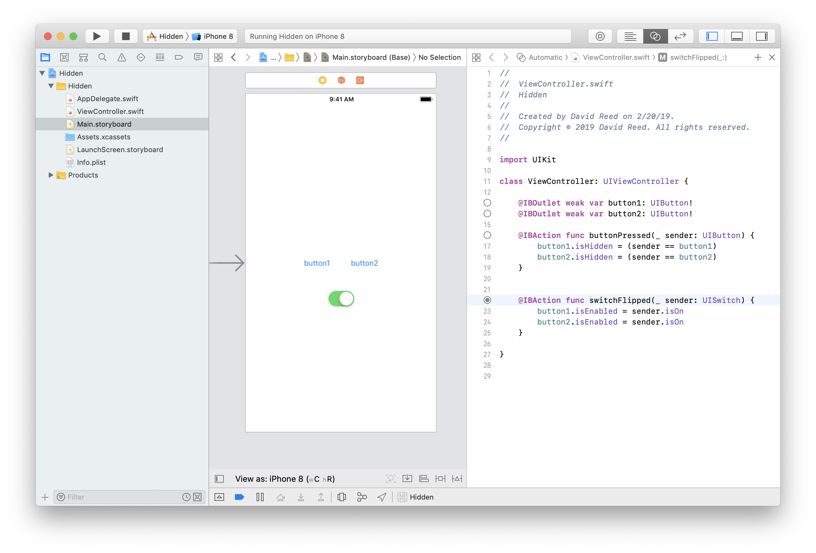
Example: isHidden & isEnabled
can hide views or even disable controls
  every UIView element has an isHidden field
  every UIControl (which inherits from UIView) also has an isEnabled field
  here, one button is visible, clicking on it hides it and makes the other visible
  if the switch is turned off, all the buttons are disabled

Slide 26
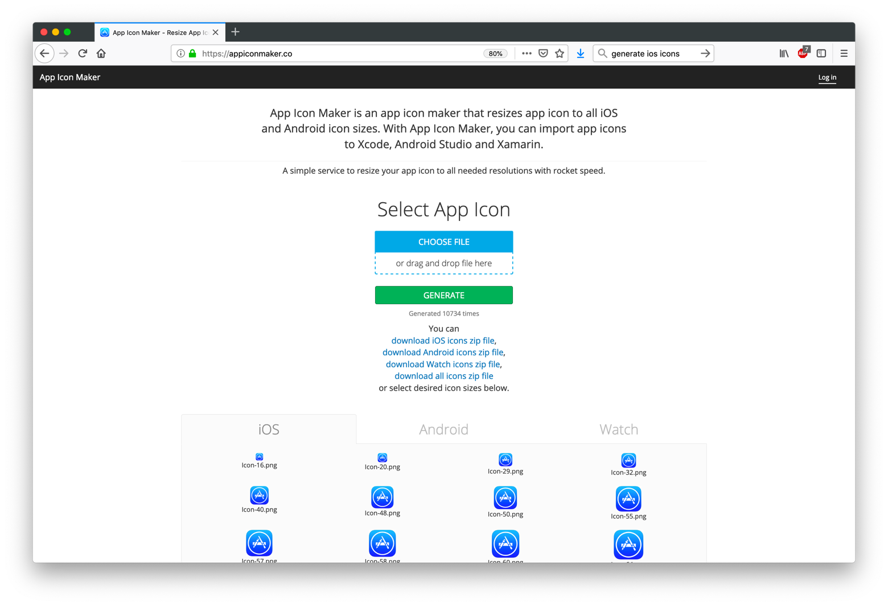
Adding an app icon
adding an icon to your app is simple but tedious
  download or create an icon image (it should be square)
  go to a site (many free ones exist) that will generate all of the required resolutions
  drag your image there, then download a zip file of images

Slide 27
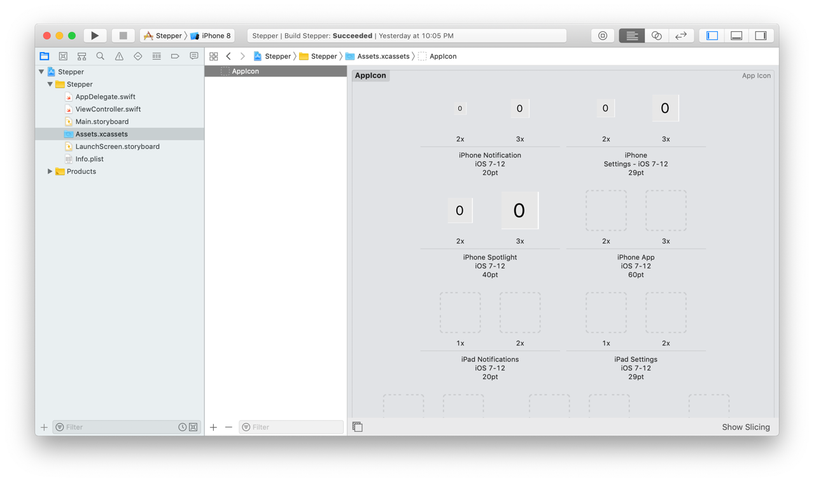
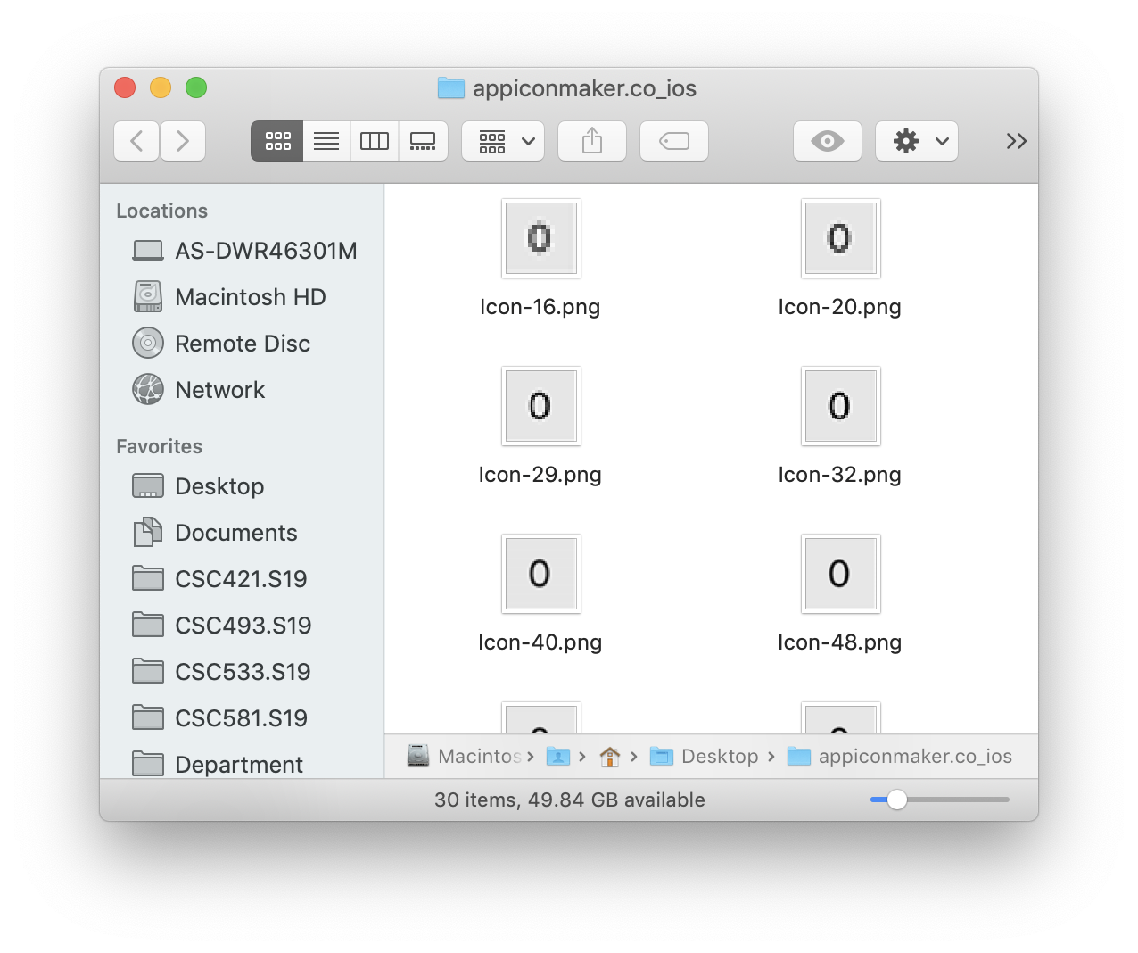
Adding an app icon
  open the Assets folder in your project and select Appicon
  drag the corresponding icon image to each slot
      2x specifies twice the resolution; 3x specifies three times
      e.g., 20 pt 2x → drag in Icon-40.png
Xcode will complain if you don't specify all the icon resolutions!

