Slide 1
CSC 581: Mobile App Development
Spring 2019
Unit 2: Structs & layout
Strings
functions
external & internal parameter names, return types
structs
public vs. private vs. private(set) fields, init, methods
layout with Stack Views
Model-View-Controller pattern
Optionals
UI toolbox (so far):
UILabel, UIImageView
UISwitch, UIButton, Tap Gesture Recognizer

Slide 2
Strings
Swift Strings have many similarities to Python/Java strings
var str1 = "foobar"
var str2 = "State \"your name.\""
var cute = "👍😃🌈" // can contain Unicode symbols
str2 = str1 + str1
str2 += str1
var single = """
line 1 \
line2
"""
var multi= """
line 1
line2
"""
a single character is inferred to be a String, but can be declared to be a char
var ch1 = "q" // type(of: ch1) → String.Type
var ch2: Character = "q" // type(of: ch2) → Character.Type

Slide 3
String interpolations & comparisons
String interpolations make it easy to embed values in Strings
var a = 7
var b = 2
print("The sum of \(a) and \(b) is \(a+b)")
comparison operators can be applied to Strings
if str1 == str2 {
print("same")
}
if str1 != "foobar" {
print("not foobar")
if str1 < "bar" {
print("before bar")
}
else if str1 >= "foo" {
print("foo or after")
}
else {
print("between bar and foo")
}
}

Slide 4
String properties & methods
var str = "Creighton"
str.count → 9
str.lowercased() → "creighton"
str.uppercased() → "CREIGHTON"
str.contains("igh") → true
str.hasPrefix("Cr") → true
str.hasSuffix("ton") → true
for ch in str { // iterates over the characters
print(ch)
}
for index in str.indices { // iterates over indices, then
print(str[index]) // prints each character
}

Slide 5
Functions
general form of a Swift function
func functionName(param1: Type1, param2: Type2, …) -> ReturnType {
// BODY OF THE FUNCTION
}
e.g.
func increment(num: Int) -> Int {
return num+1
}
func greet(name: String) -> String {
return "Hello, " + name + "!"
}
func compare(num1: Int, num2: Int) {
if (num1 == num2) {
print("same")
}
else {
print("different")
}
}

Slide 6
External vs. internal names
low and high are reasonable names within the function, but not so much in the call
better:
var value = sum(from: 1, to: 10)
but then the function looks strange
func sum(from: Int, to: Int) -> Int {
var total = 0;
for i in from...to {
total += i
}
return total
}
solution: specify two names – an external one for the call, an internal one for the function
func sum(from low: Int, to high : Int) -> Int {
var total = 0;
for i in low...high {
total += i
}
return total
}

Slide 7
Swift parameter style
if different external & internal names read better, specify both
display(message: String, in: UILabel)
func display(message msg: String, in label: UILabel) {
...
}
if same name works externally and internally, specify a single name (internal & external)
func display(message: String, in label: UILabel) { ... }
if you really don't want to specify an external name, can use an underscore (but not considered good style)
func increment(_ num: Int) -> Int {
return num+1
}
x = increment(x)

Slide 8
Default parameters
you can specify default values for parameters
func rollDie(sides: Int = 6) -> Int {
return Int.random(in: 1...sides)
}
print(rollDie()) // rolls a 6-sided die,
// same as print(rollDie(sides: 6))
print(rollDie(sides: 8)) // rolls an 8-sided die
if a function has multiple parameters, default parameters must be at the end
func drawSquare(size side: Int, at x: Int = 0, and y: Int = 0) {
// draws a square side pixels big, centered at (x, y)
}
drawSquare(side: 50) // draws a square with 50-pixel sides at (0,0)
// same as drawSquare(side: 50, at: 0, and: 0)
drawSquare(side: 50, at: 30) // draws 50-pixel square at (30, 0)
// same as drawSquare(side: 50, at: 30, and: 0)
drawSquare(side: 50, at: 30, and: 40)
// draws a 50-pixel square at (30, 40)

Slide 9
In-class exercise
Create a playground, enter the rollDie function, and verify that it works
func rollDie(sides: Int = 6) -> Int {
return Int.random(in: 1...sides)
}
define a function named rollDice that rolls a specified number of dice
rollDice(thisMany: 2, withSides: 6) // returns the sum of 2 6-sided dice
rollDice(thisMany: 4, withSides: 8) // returns the sum of 4 8-sided dice
rollDice() // specify defaults for dice (2) and sides (6)
define a function named rollPercentage that repeatedly rolls a pair of 6-sided dice and returns the percentage of a specified total
rollPercentage(of: 7, outOf: 10_000) // returns the percentage of 7's
// out of 10,000 rolls
rollPercentage(of: 7) // specify a default for the number // of rolls (10,000)

Slide 10
Defining types
so far, we have manipulated primitive data values
struct and class are two ways to define a new type
both can:
encapsulate fields/properties and methods/functions
hide fields/methods by making them private
fields/methods can be class-wide by declaring them static
utilize init to initialize fields (i.e., a constructor)
significant differences:
structs are copied whenever you assign or pass as parameters; class objects are shared references (like in Java)
classes can utilize inheritance; structs cannot
common practice:
structs are used most often in Swift, especially for simpler objects
classes are used for more complex, reusable data types
classes are the only option if inheritance/polymorphism is desired
MORE ON CLASSES LATER

Slide 11
Name struct
a struct groups related data values into a single object
specify the field values when creating a struct object
by default: no information hiding or protection
e.g., can access and change the fields directly
we can change this (LATER)
struct Name {
var first: String
var middle: Character
var last: String
}
var me = Name(first: "David", middle: "W", last: "Reed")
print("\(me.last), \(me.first) \(me.last)")
→ "Reed, David Reed"
me.first = "Dave"
print("\(me.last), \(me.first) \(me.last)")
→ "Reed, Dave Reed"

Slide 12
Struct methods
struct Name {
var first: String
var middle: Character
var last: String
func compare(with other: Name) -> Int {
if self.last == other.last &&
self.first == other.first &&
self.middle == other.middle {
return 0
} else if self.last < other.last ||
(self.last == other.last &&
self.first < other.first) ||
(self.last == other.last &&
self.first == other.first &&
self.middle < other.middle) {
return -1
}
else {
return 1
}
}
}
var me = Name(first: "David", middle: "W", last: "Reed")
var him = Name(first: "Mark", middle: "V", last: "Reedy")
me.compare(with: him) → -1
me.compare(with: me) → 0
him.compare(with: me) → 1
structs can have methods
e.g., add a comparison method for names (similar to Java compareTo)
returns -1 if <
returns 0 if ==
returns 1 if >
note: use of external and internal parameter names
also: the optional self. prefix for fields is similar to similar to this. in Java

Slide 13
Private fields
in Java, we always avoided public fields
they violate the spirit of classes, since they allow accessing/modifying fields without calling methods
we can similarly declare Swift fields to be private
need to provide an init method (similar to Java constructor)
might need to define accessor methods
struct Name {
private var first: String
private var middle: Character
private var last: String
init(first: String, middle: Character, last: String) {
self.first = first
self.middle = middle
self.lat = last
}
func compare(with other: Name) -> Int {
// SAME AS PREVIOUS SLIDE
}
}
var me = Name(first: "David", middle: "W", last: "Reed")
var him= Name(first: "Mark", middle: "V", last: "Reedy")
me.compare(with: him) → -1
me.first → NOT ALLOWED

Slide 14
Private(set) fields
a simpler alternative is available
can declare a field private(set)
this allows you to set the field when you create the struct
subsequently, can view the field, but not change it
no longer need the init
also don't need accessor methods
struct Name {
private(set) var first: String
private(set) var middle: Character
private(set) var last: String
func compare(with other: Name) -> Int {
// SAME AS PREVIOUS SLIDE
}
}
var me = Name(first: "David", middle: "W", last: "Reed")
var him= Name(first: "Mark", middle: "V", last: "Reedy")
me.compare(with: him) → -1
me.first → “David”
me.first = “Dave” → NOT ALLOWED

Slide 15
Mutating methods
if a method is going to change any fields, must declare it as mutating
methods are allowed to change private(set) fields
note use of external and internal names for parameter
struct Name {
private(set) var first: String
private(set) var middle: Character
private(set) var last: String
func compare(with other: Name) -> Int {
// SAME AS PREVIOUS SLIDE
}
mutating func changeLastName(to newName: String) {
self.last = newName
}
}
var me = Name(first: "David", middle: "W", last: "Reed")
me.last → “Reed”
me.changeLastName(to: “Pseudonym”)
me.last → “Pseudonym”
me.last = “Reed” → NOT ALLOWED

Slide 16
Die struct
to simulate a 6-sided die
private(set) fields for # of sides & rolls
mutating method for returning a random roll (+ update # rolls)
note: random is a static method of the Int class
takes a range as input, selects random number from that range
struct Die {
private(set) var numSides: Int
private(set) var numRolls: Int
mutating func roll() -> Int {
self.numRolls += 1
return Int.random(in: 1...numSides)
}
}
var d1 = Die(numSides: 6, numRolls: 0)
for i in 1...10 {
print(d1.roll()) → DISPLAYS 10 ROLLS
}
d1.numRolls → 10
d1.numSides → 6
d1.numSides = 8 → NOT ALLOWED

Slide 17
Default fields
can provide default values for fields
e.g., 6-sided die with 0 rolls
can override the defaults by specifying all field values
would really like to have numSides changeable, but numRolls always start at 0
unfortunately, default fields are all or nothing
struct Die {
private(set) var numSides = 6
private(set) var numRolls = 0
mutating func roll() -> Int {
self.numRolls += 1
return Int.random(in: 1...numSides)
}
}
var d1 = Die()
for i in 1...10 {
print(d1.roll()) → DISPLAYS 10 ROLLS
}
var d2 = Die(numSides: 8, numRolls: 0)
d2.numSides → 8

Slide 18
Defaults via init
can have partial defaults using init
have init with one parameter, with default value
numRolls is automatically 0
can create a Die using the default # of sides or specify the desired #
struct Die {
private(set) var numSides: Int
private(set) var numRolls: Int
init(withSides sides: Int = 6) {
self.numSides = sides
self.numRolls = 0
}
mutating func roll() -> Int {
self.numRolls += 1
return Int.random(in: 1...numSides)
}
}
var d1 = Die()
var d2 = Die(withSides: 8)

Slide 19
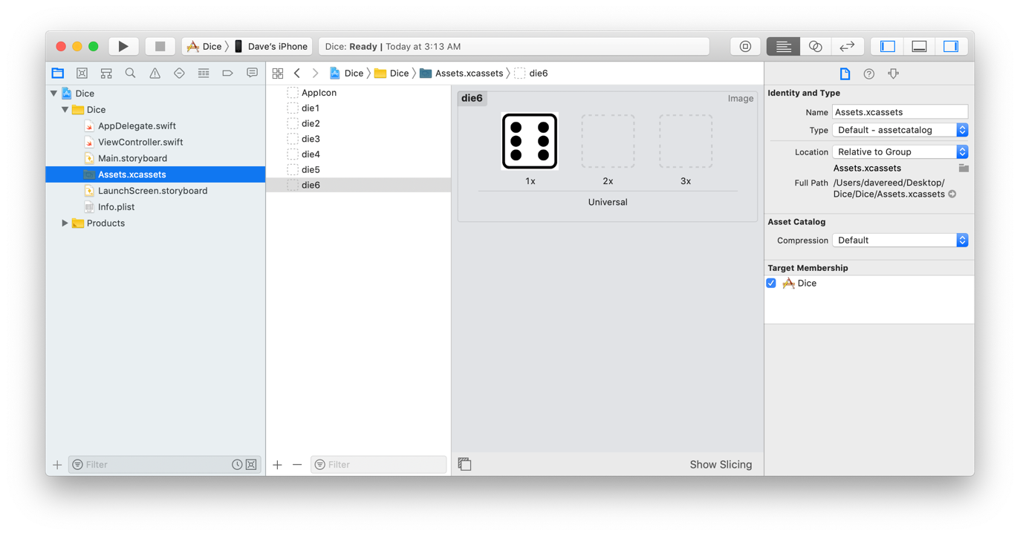
Dice app
suppose we want to create an app that simulates rolling dice
images of dice, change at random when clicked
in order to utilize images in an app,
open Assets.xcassets in the Edit Area
drag the desired images into the window

Slide 20
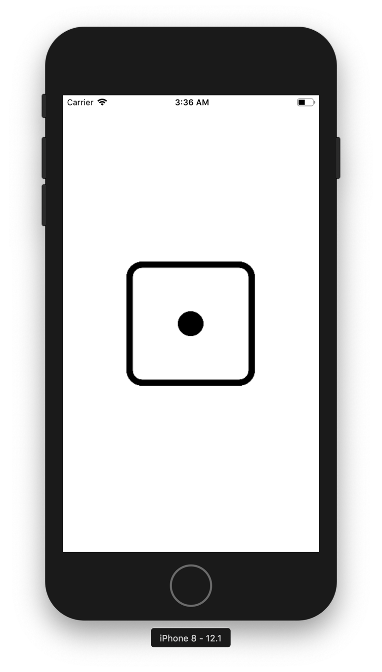
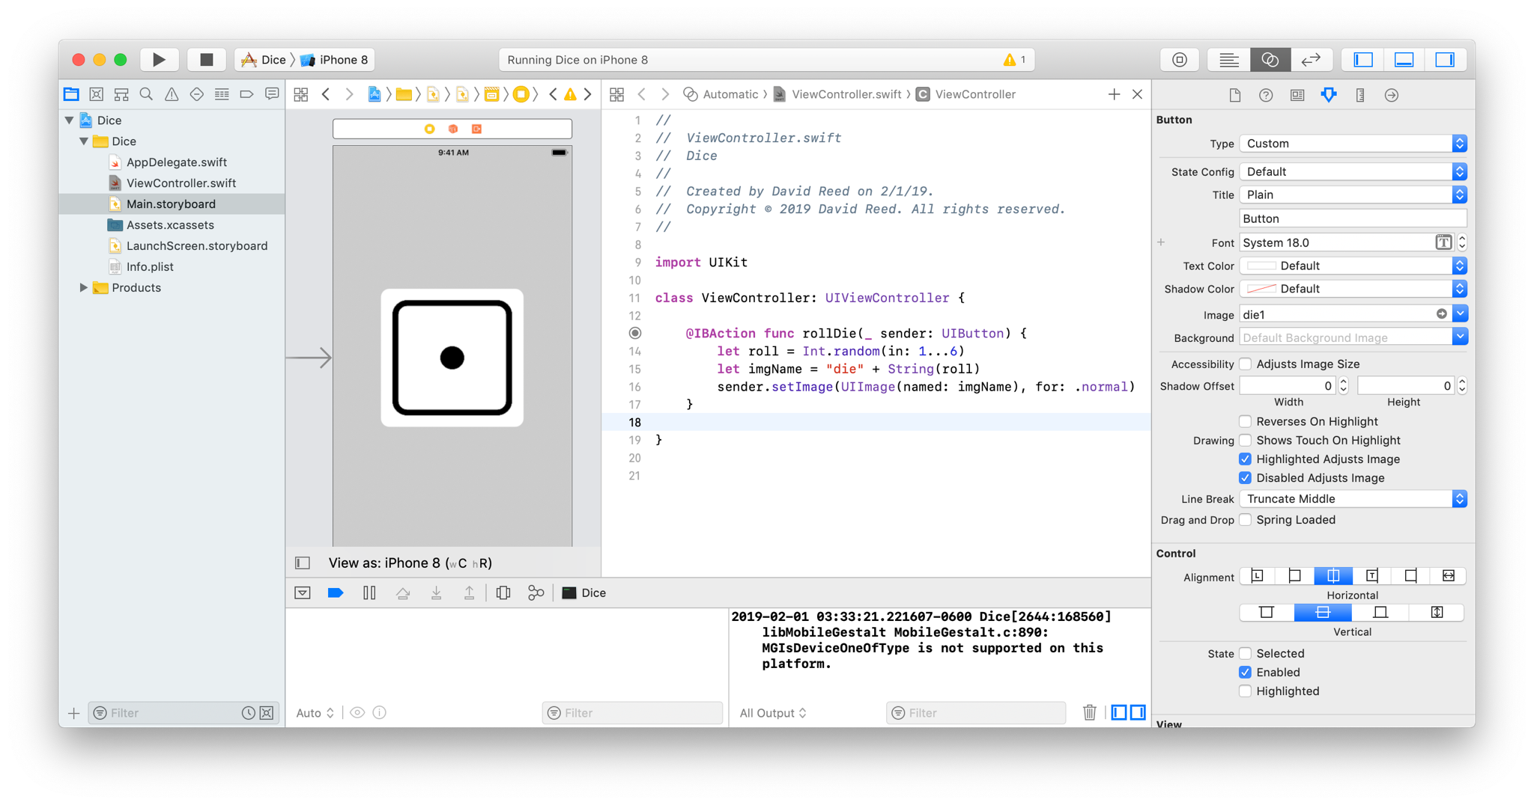
Single die
place a UIButton on the storyboard
under the Attributes Inspector, select its Image (will have die1, …, die6 as options)
create an action associated with the button that sets the image when clicked

Slide 21
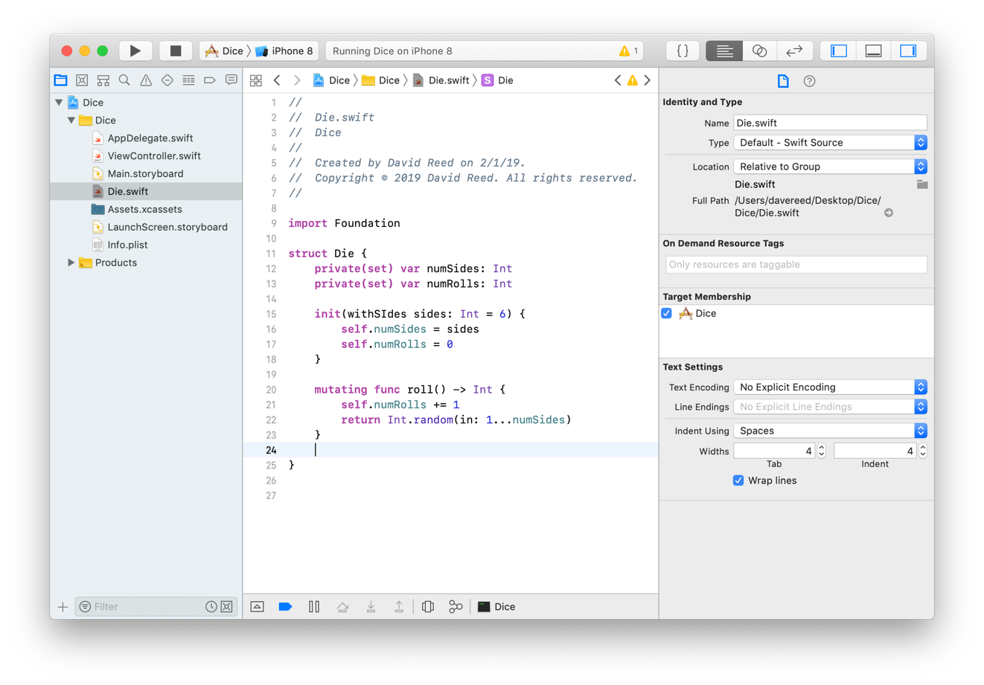
Adding a model
if things got more complicated (e.g., another die image, label with # rolls),
the Controller would start getting messy
better approach: place the logic for a die in a separate file (i.e., the Model)
select File → New → File
select Swift from from the options, specify name (e.g., Die.swift)
enter the definition of the Die struct in this file

Slide 22
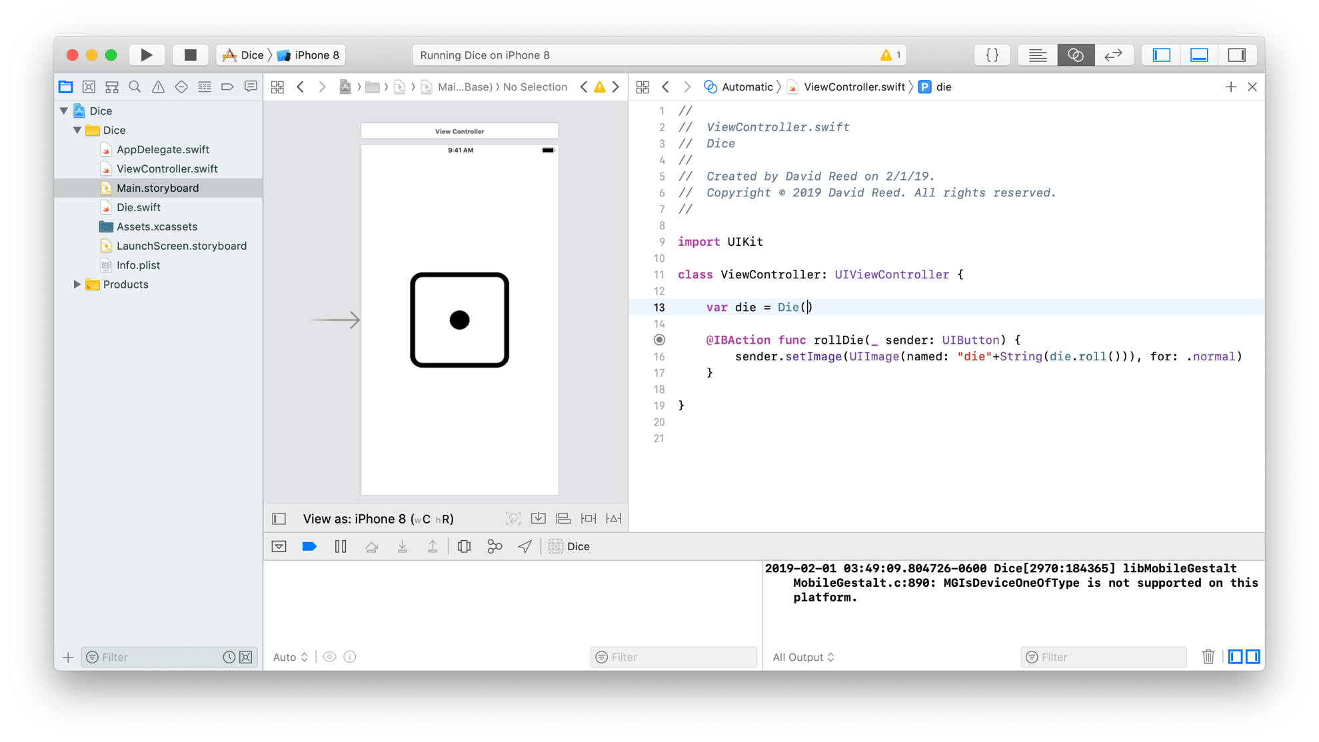
Using the model
can now have a field of type Die in the ViewController
within the roll method can call methods of the Die field
add a constraint so that the aspect ratio of the die is square

Slide 23
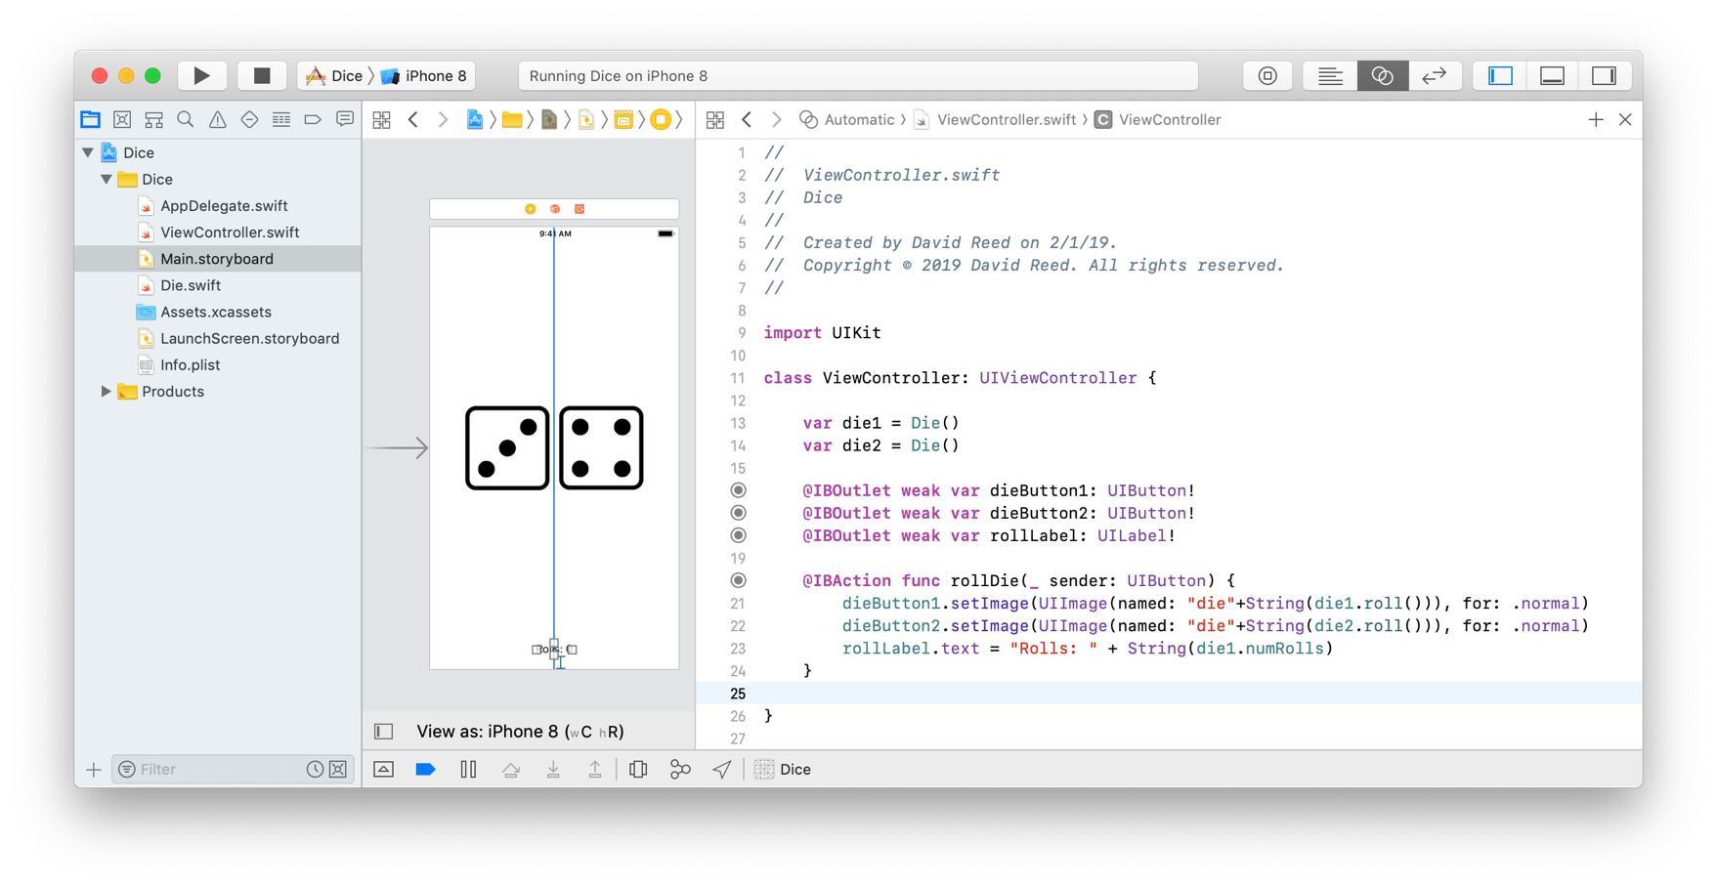
Two dice
can copy-paste the die button and arrange the two dice side-by-side
want to make it so clicking either die rolls them both
create outlets for each die button so that they can be referenced in the code
update the rollDie method so that it changes both dice
note: both buttons can be tied to the same action
also create a label to display the # of rolls

Slide 24
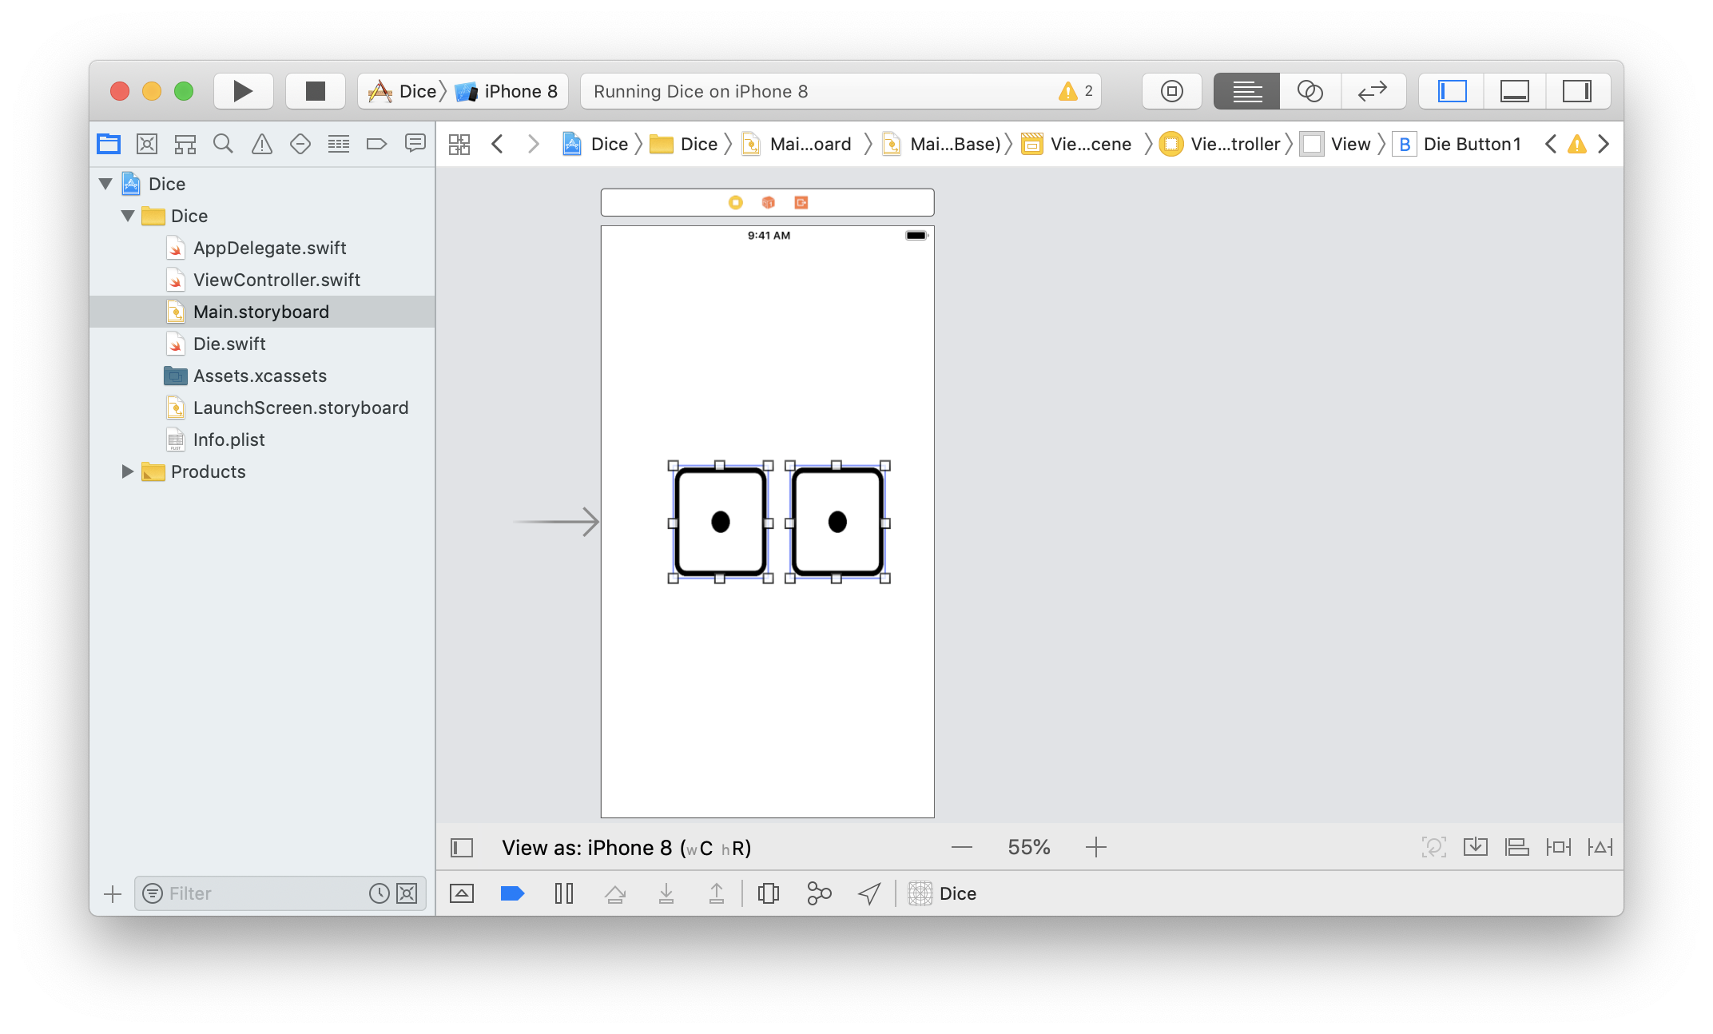
Dice layout
would like to ensure that the pair of dice are always centered
could try to do it with alignment and layout constraints – TRICKY
better solution, group the two dice together, then center the grouping
select the two dice buttons
click on the Embed In icon
select Stack View – this embeds them in a grouping (in this case, horizontal)
note: this may resize badly

Slide 25
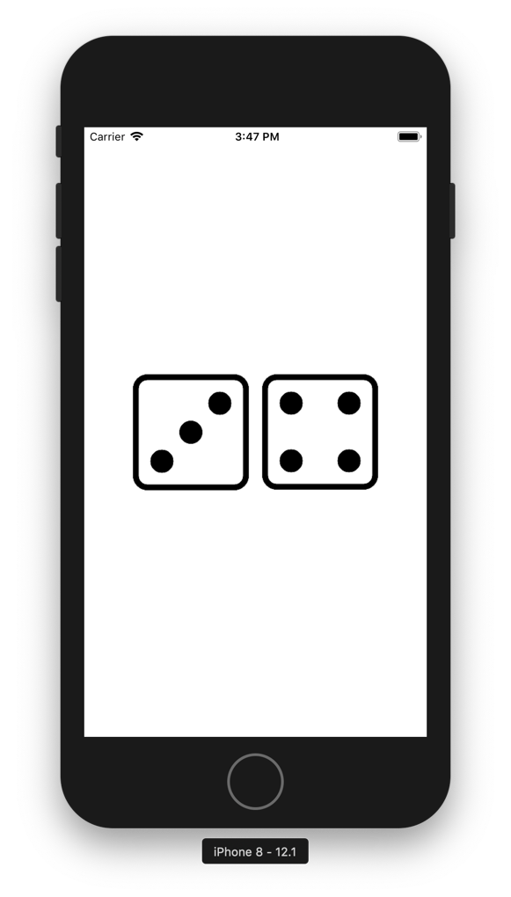
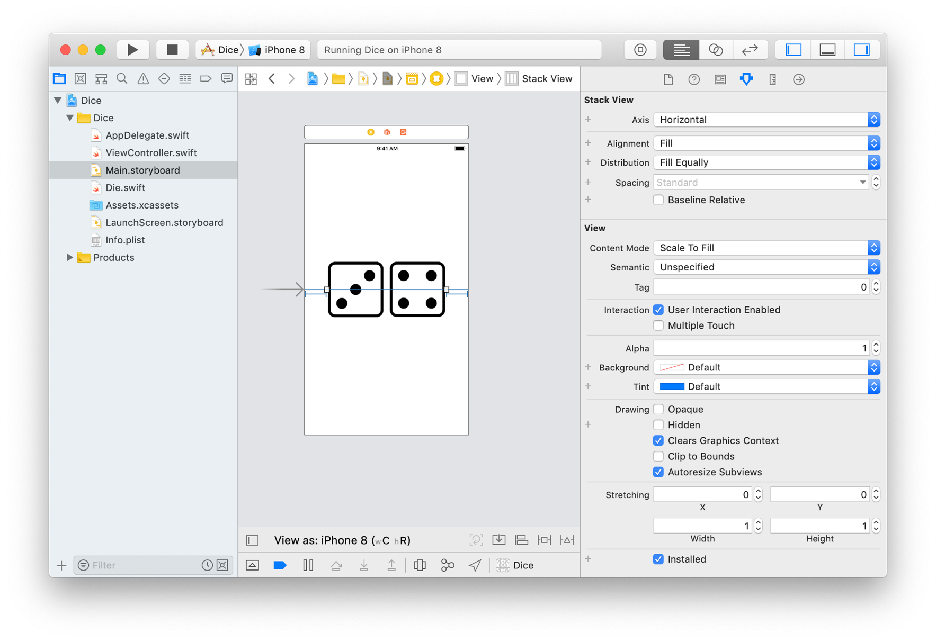
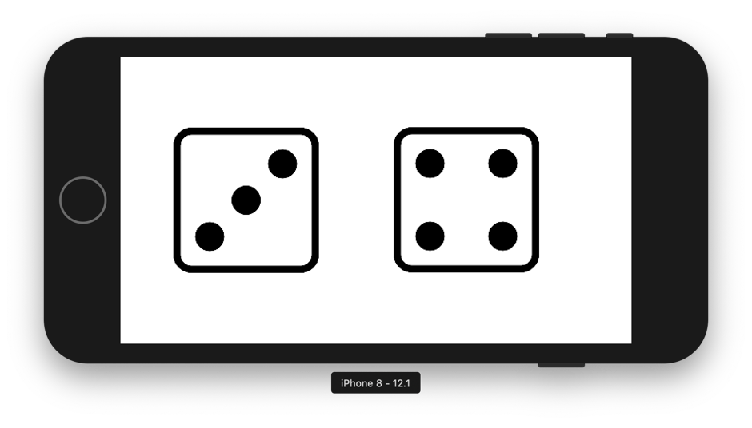
Stack View
to adjust the sizes & layout of the dice images
select the Stack View & set its constraints
e.g., Leading & Trailing at 50 from Safe Area; Vertically centered
if desired, in Attributes Inspector set Spacing = Standard, Distribution = Fill Equally

Slide 26
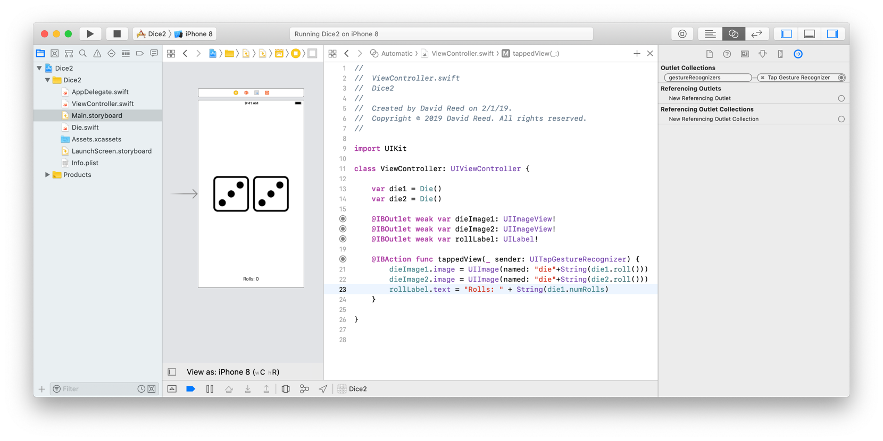
Alternative design
since the dice are buttons, you have to tap on one of the die images to roll
what if we wanted to be able to tap anywhere on the screen?
could instead use a UIImageView for each die image
add a Tap Gesture Recognizer to the view
drag Tap Gesture Recognizer from the Library to the main View
this adds an icon above the storyboard
control-drag from that icon to the ViewController to create an Action

Slide 27
Model-View-Controller pattern
in both versions of the dice app,
the logic of the app is defined in the Die struct MODEL
the user interface is defined in the storyboard VIEW
the ViewController connects interface with the logic CONTROLLER
we want to strive for this division of labor
encourages modular design, supports code reuse, keeps the controller simple
general rule of thumb -- the VewiController class can have:
fields that are (1) structs/objects defined in separate files or (2) IBOutlets
methods that are IBActions and primarily perform intermediary steps
access attributes of the IBOutlets (e.g., label text or background color)
call methods of struct/class objects
display the results of method calls in IBOutlets

Slide 28
HW 2.1
reimplement your Executive Decision Maker app using a struct for the model
behavior should be the same, but the logic is defined in a separate struct
should significantly simplify the ViewController
struct Decider {
private let options: [String]
init(between options: [String]) {
self.options = options
}
func getAnswer() -> String {
return self.options[Int.random(in: 0..<options.count)]
}
}
var decisionMaker = Decider(between: ["YES", "NO", "MAYBE"])
decisionMaker.getAnswer() → either "YES", "NO", or "MAYBE"
var dinnerPicker = Decider(between: ["pizza", "chinese", "tacos", "salad"])
dinnerPicker.getAnswer() → one of the dinner options

Slide 29
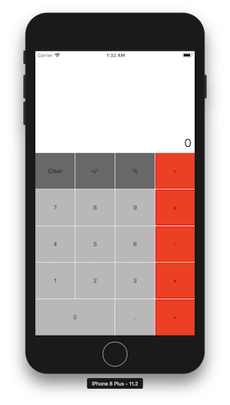
HW 2.2
follow the tutorial in Unit 2 to create a calculator interface
define the CalculatorModel struct to serve as the model
update the ViewController to connect the View & the Model
struct CalculatorModel {
private(set) var currentValue = 0.0
private var lastOp = "+"
mutating func apply(op: String, with number: Double) {
if self.lastOp == "=" {
self.currentValue = number
}
else if self.lastOp == "+" {
self.currentValue += number
}
else if self.lastOp == "-" {
self.currentValue -= number
}
else if self.lastOp == "*" || self.lastOp == "x" {
self.currentValue *= number
}
else if self.lastOp == "/" || self.lastOp == "÷" {
self.currentValue /= number
}
self.lastOp = op
}
mutating func clear() {
self.currentValue = 0.0;
self.lastOp = "="
}
}

Slide 30
Optionals
for HW 2.,2, you will need to know about Optionals
Swift is extremely picky about types
recall that you can create an Int value out of a String
var x = Int("23")
but what happens if the String is not just digits?
var y = Int("foo")
for values that could be undefined, Swift uses an Optional Type
Optional is a wrapper (think Integer in Java), either wraps the value or nil
var x = Int("23") → Optional(23)
var y = Int("foo") → nil

Slide 31
Unwrapping Optionals with !
the simplest way to unwrap an Optional is using !
var x = Int("23") → Optional(23)
var y = Int("23")! → 23
this is dangerous in general
unwrapping a nil value causes an error
only over do it if you are sure you have a wrapped value
or, can check before unwrapping
let str = ???
var value = Int(str)
if value != nil {
print(value!)
}

Slide 32
! vs. if-let
Swift provides a control statement to do this more cleanly: if-let
if the assigned value is not nil, it is unwrapped and the test succeeds
if let value = Int(str) {
print(value)
}
or
if let value = Int(str) {
print(value)
}
else {
print("\(str) does not represent an integer")
}
Optionals are common in Swift, whenever an undefined value is possible
in particular, many UI elements have fields/methods that use Optionals

Slide 33
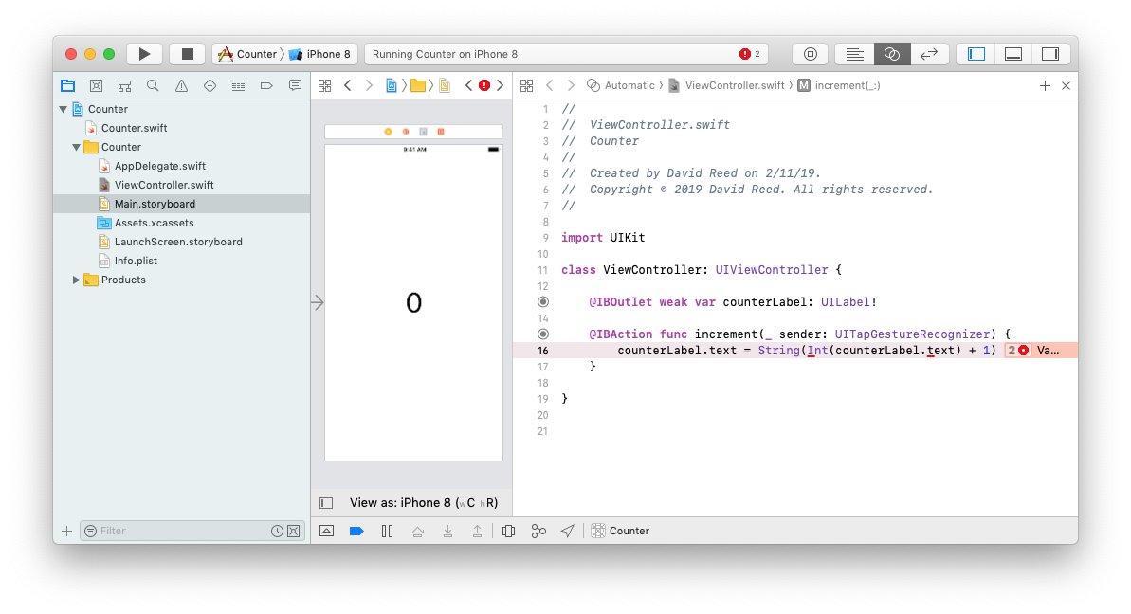
Optionals in UIKit
consider a simple counter app
have a counter (initially 0) centered in a label
use a Tap Gesture Recognizer to increment the counter when tapped
can access label.text to get the text displayed in the label
can then convert that to an Int, add 1, and display the incremented value

Slide 34
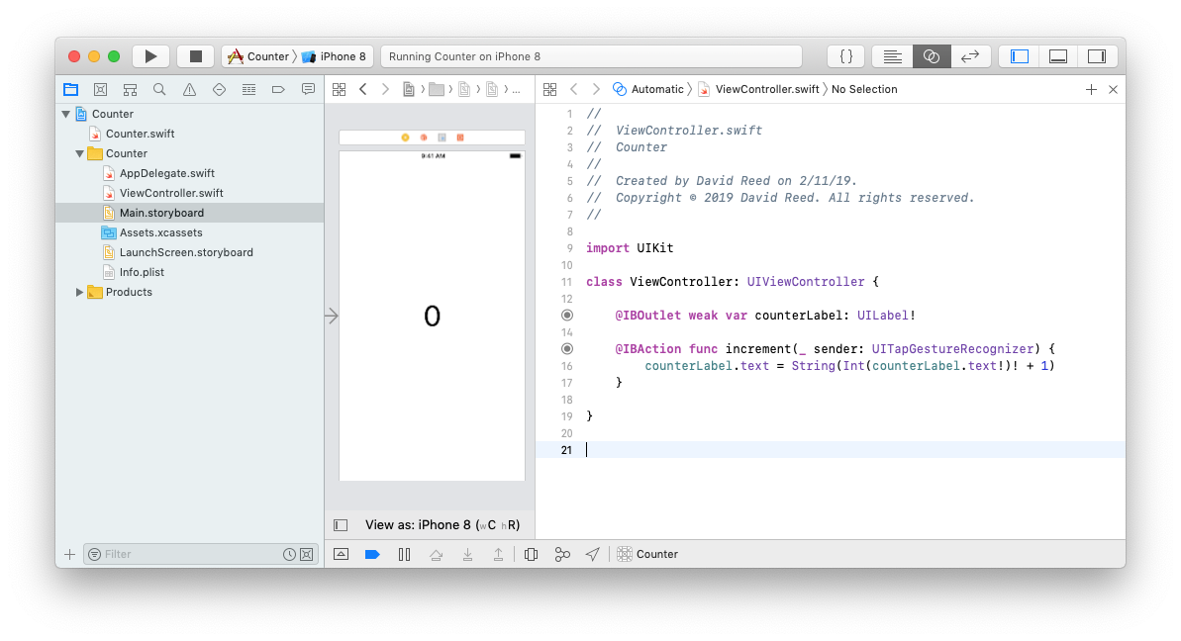
Unwrapping the Optionals
there are two problems:
counterLabel.text returns an Optional (since the text may not be defined)
Int also returns an Optional (as previously discussed)
since we are confident that the label will always contain a number, using ! is OK
it must be applied twice, one for counterLabel.text and one for Int

Slide 35
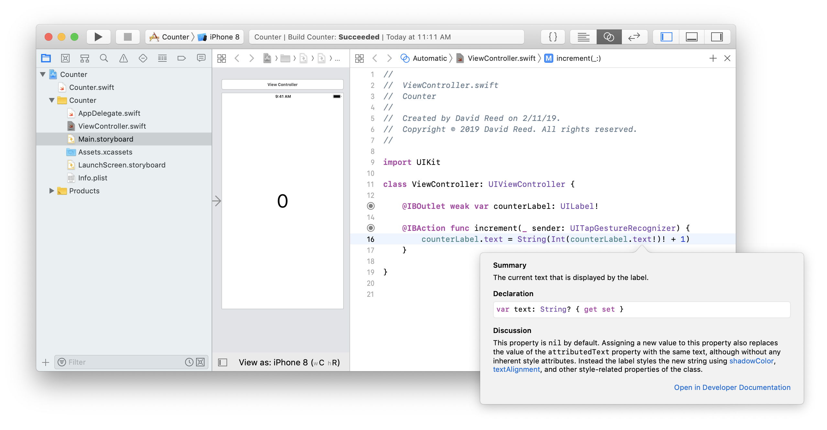
Inspecting variable info
recall: can get info on a variable in Xcode by Option-clicking
Option-clicking on counterLabel.text shows that its type is String?
the ? at the end denotes Optional (e.g., Int returns a value of type Int?)

Slide 36
Unwrapping Outlets?
in case you are curious:
the ! at the end of Outlet types is related but different
it warns that the app will crash if the Outlet is not connected to a UI element

