Slide 1
CSC 581: Mobile App Development
Spring 2019
Unit 1: Getting Started with App Development
Xcode
installing XCode, creating a project, MVC pattern
interface builder, storyboards, object library
outlets vs. actions, attributes inspector
UIView, UILabel, UISwitch, UIButton, …
auto layout, constraints, alignment
Swift
language history, playgrounds vs. projects
let vs. var, types, type inference
operators, if-else, while, for

Slide 2
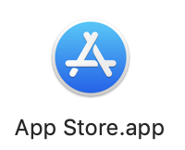
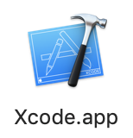
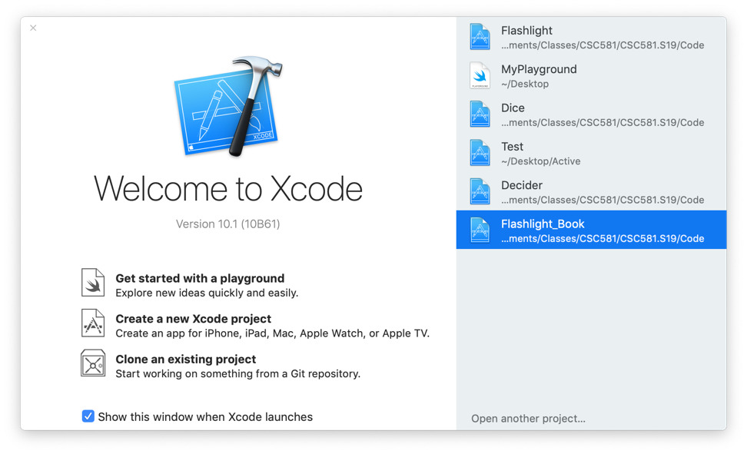
Installing Xcode
the latest version is Xcode 10 (specifically, 10.1), with Swift 4.2
requires macOS 10.13.4 (High Sierra) or above
to download and install:
launch the App Store from Applications
search for and select Xcode
click on the download icon
once downloaded, launch from Applications

Slide 3
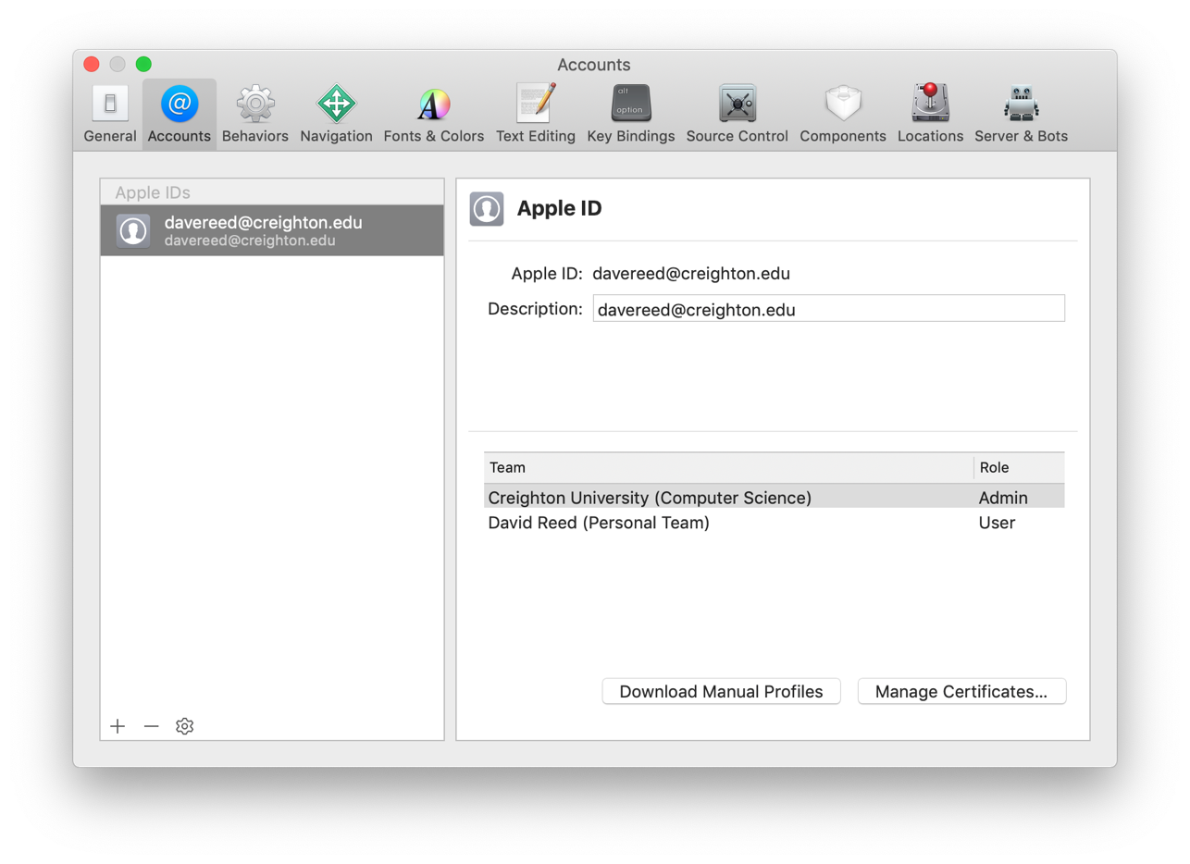
Customizing Xcode
add your Apple ID to Xcode Preferences
this step is necessary if you want to download apps to your own device
go to the Xcode menu
select Preferences
select Accounts
click on the + at the bottom left and enter your Apple ID

Slide 4
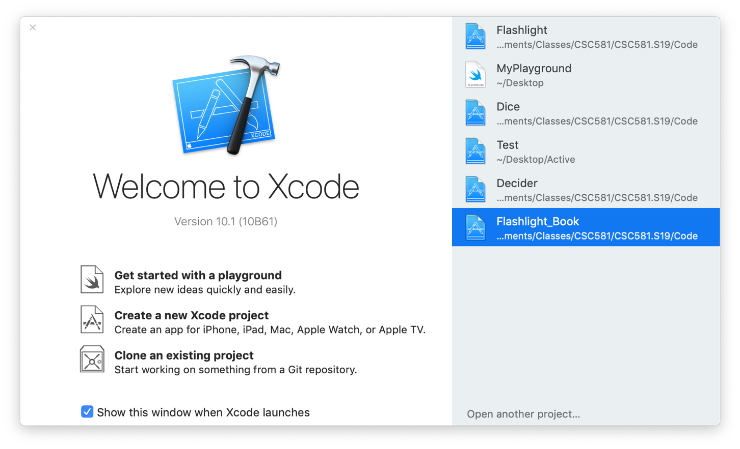
Xcode
XCode can be used to create/open a playground or a project
a Playground is an interactive environment for testing Swift code
similar to the IDLE interpreter for Python
very useful tool, but not always stable (e.g., locks up in my installation)
a Project is an app, which can be run in a simulator or an actual device

Slide 5
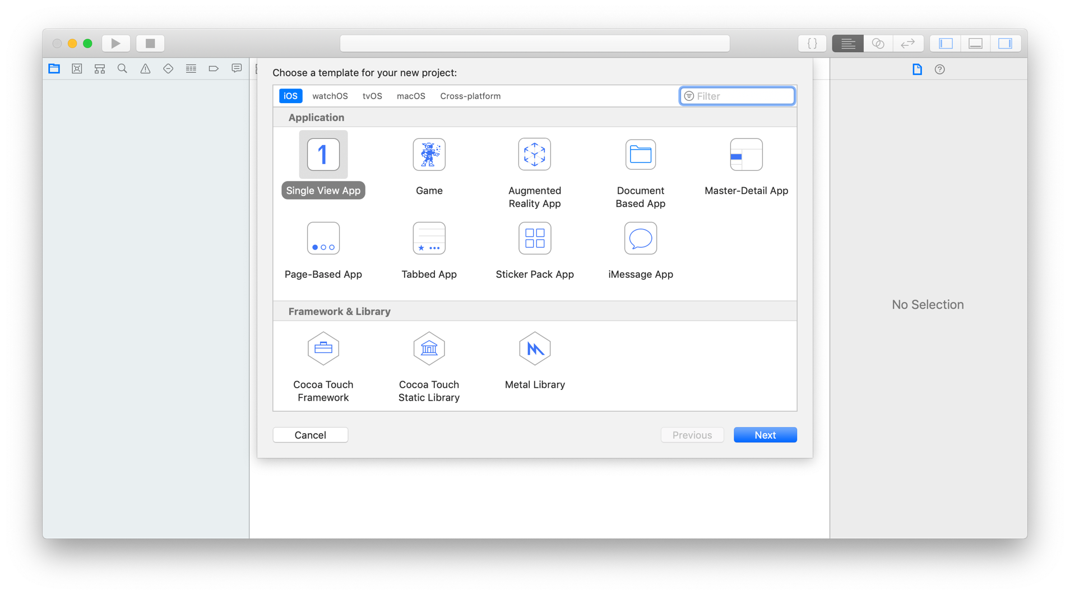
Creating a project in Xcode
select Create a new Xcode project from the opening window
you are then shown a collection of templates to choose from
we will use the generic Single View App

Slide 6
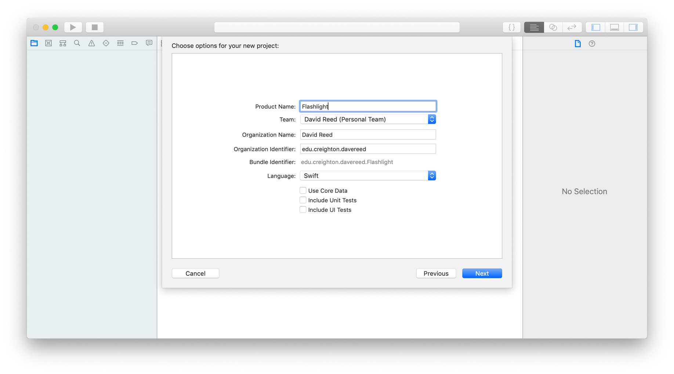
Creating a project in Xcode (cont.)
enter the name of the project
also personal information
the organization identifier should be unique, use edu.creighon.NETID
you will also be prompted for the location where the project will be stored

Slide 7
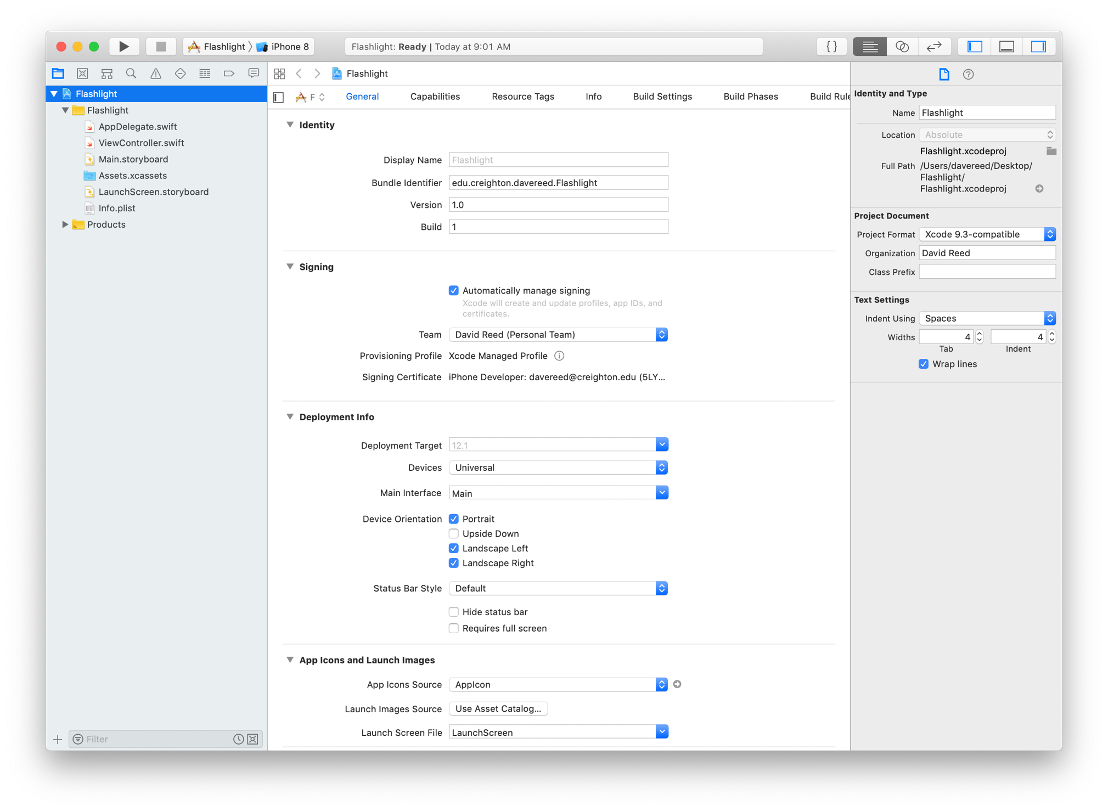
Xcode IDE
Hide/View Controls
Toolbar Area
Navigator
Area
Editor
Area
Utility
Area

Slide 8
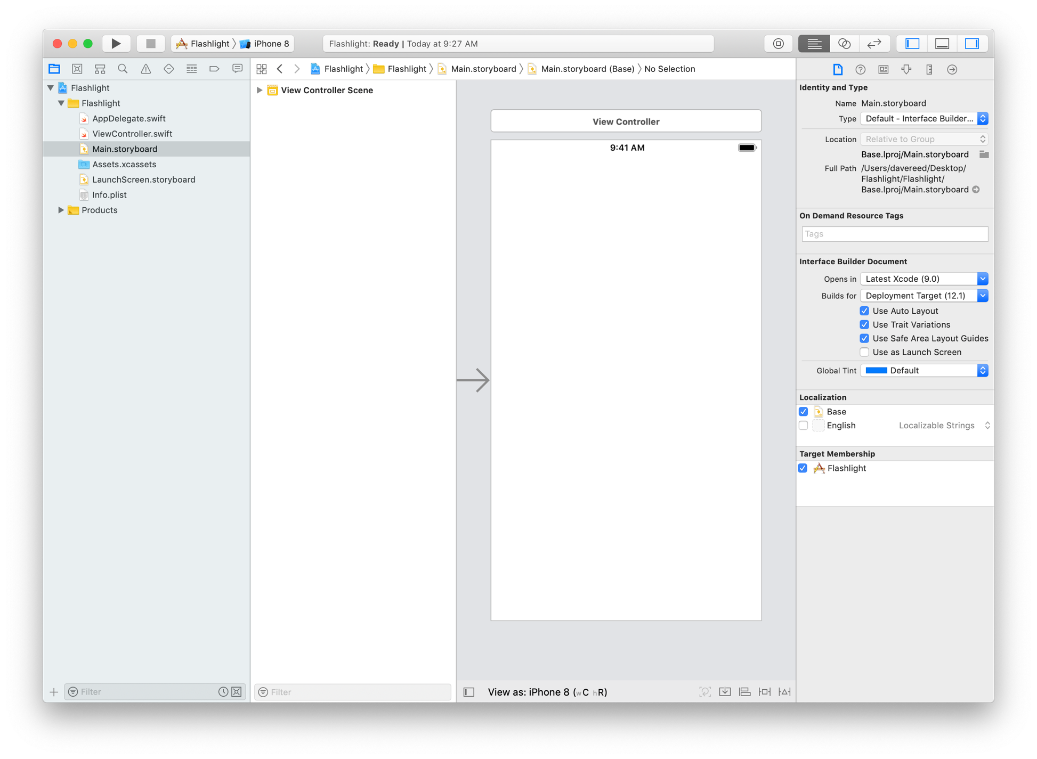
Storyboard
can click on Main.storyboard in the Navigator to see the default project View
by default, the storyboard is split, can click on icon at the bottom to hide the left panel
the Single View App template automatically creates project components

Slide 9
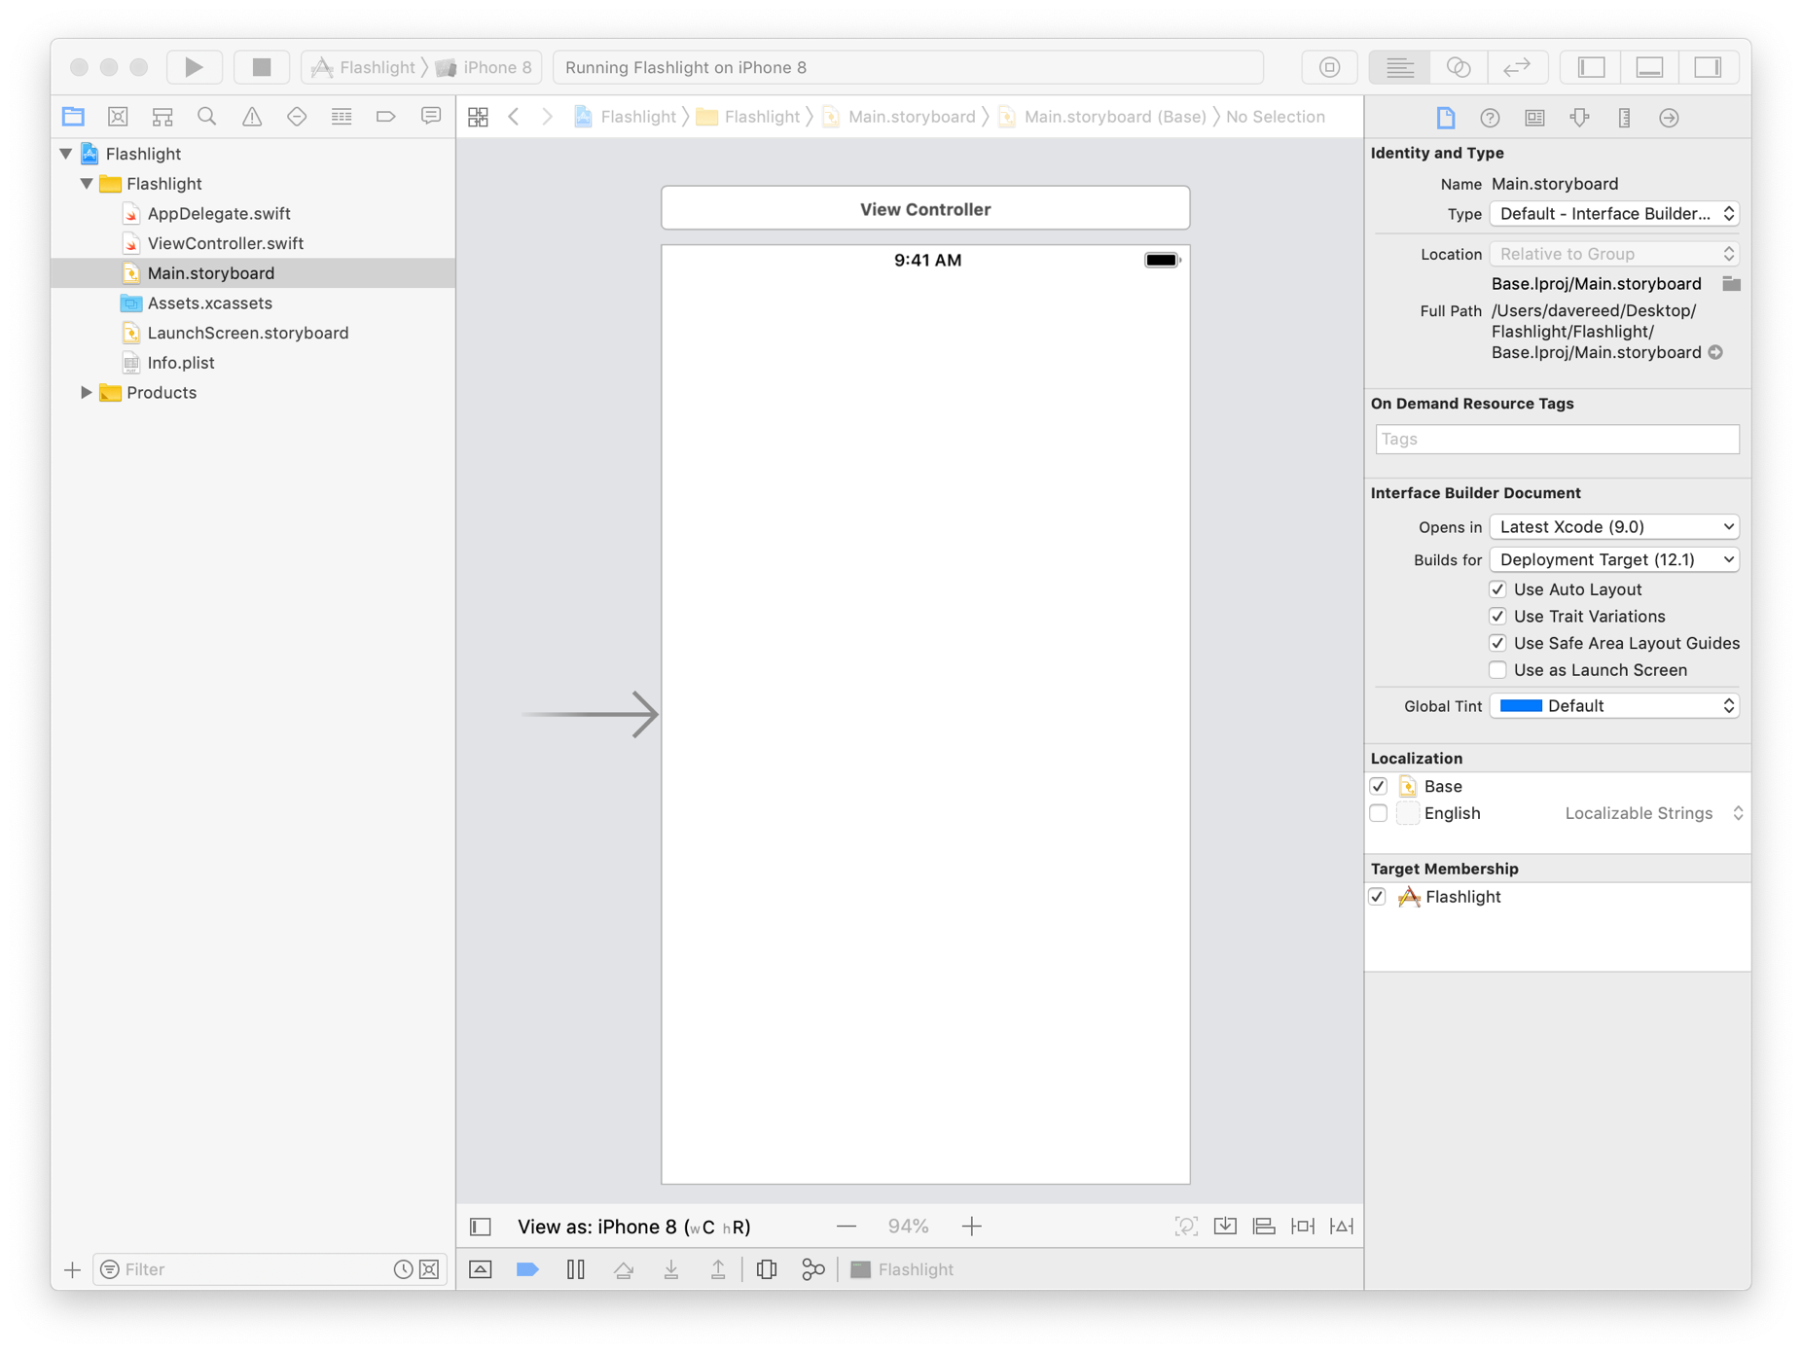
Execution
the default projects is complete– can click on the arrow to execute
you can select how to execute – either a simulator or an actual device
the default app is just a blank screen

Slide 10
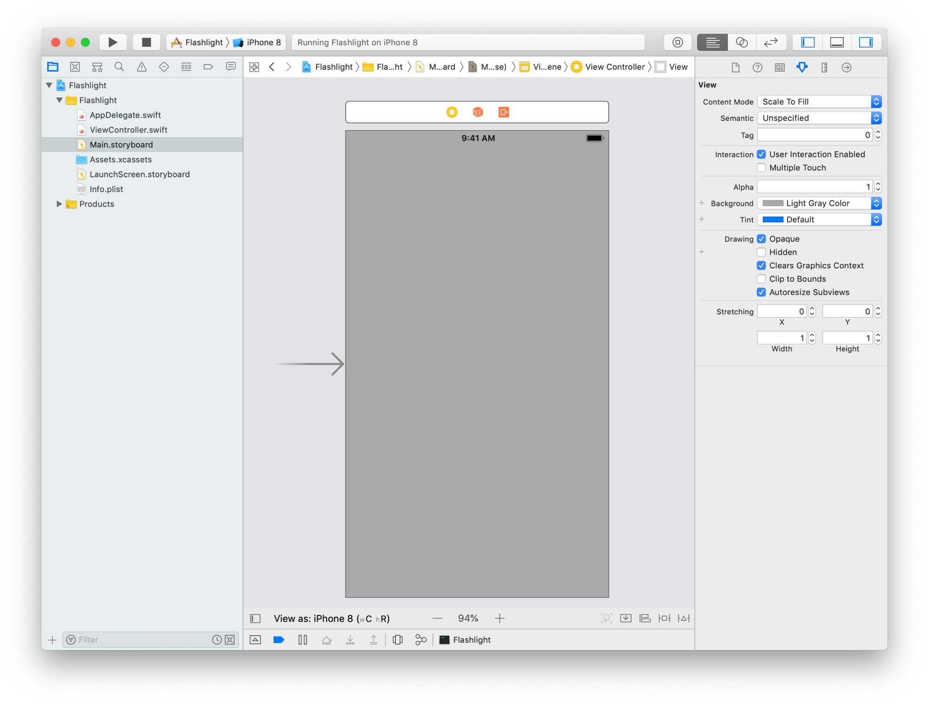
Changing view attributes
the default storyboard contains a single element, a View
click on the storyboard
go to the utility area and click on the Attributes Inspector (4th icon)
can change the background color

Slide 11
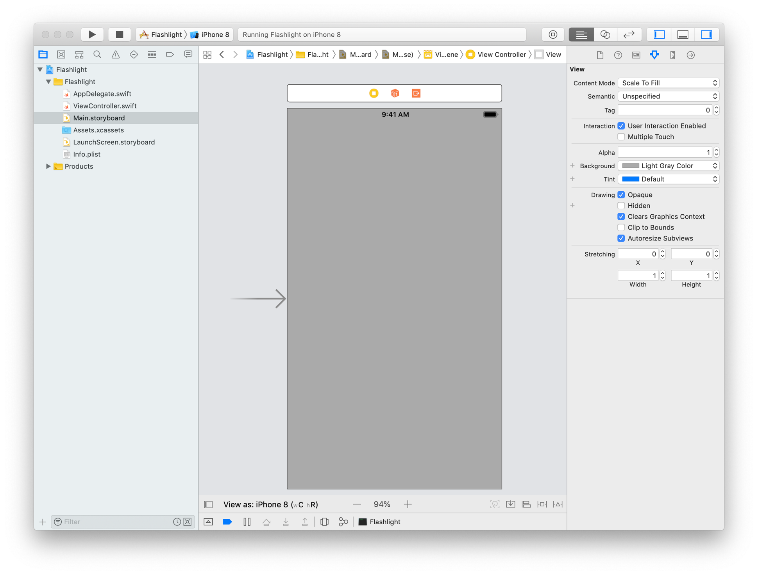
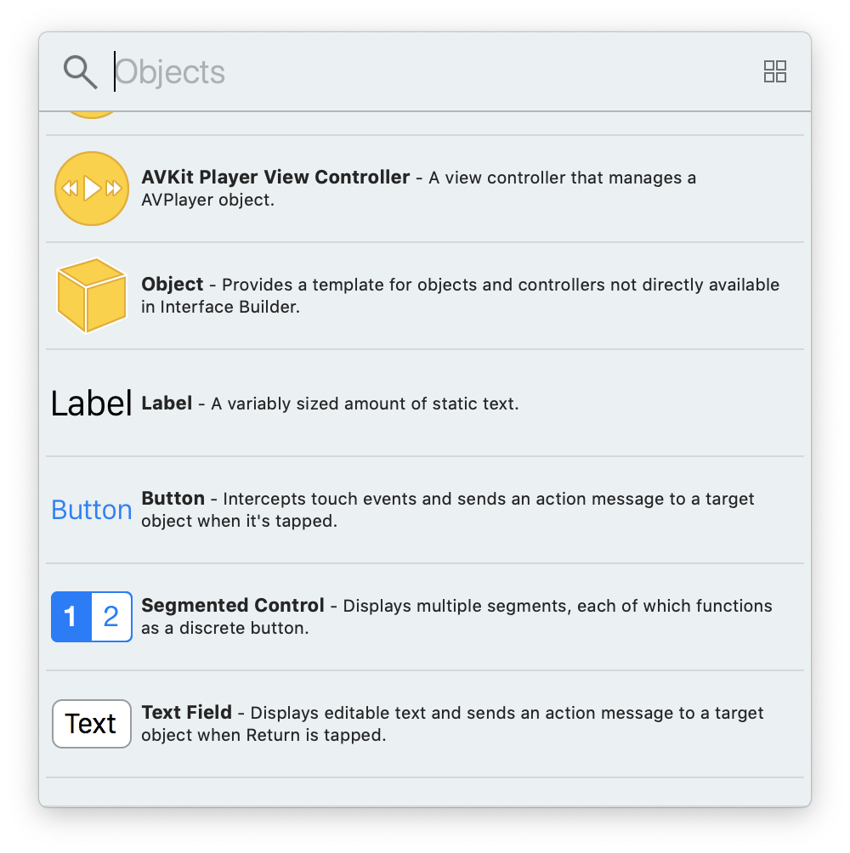
UI Library
to add other user interface (UI) elements to the storyboard, select the storyboard
click on the Library icon in the toolbar
this opens a window with UI elements
can drag and drop onto the storyboard

Slide 12
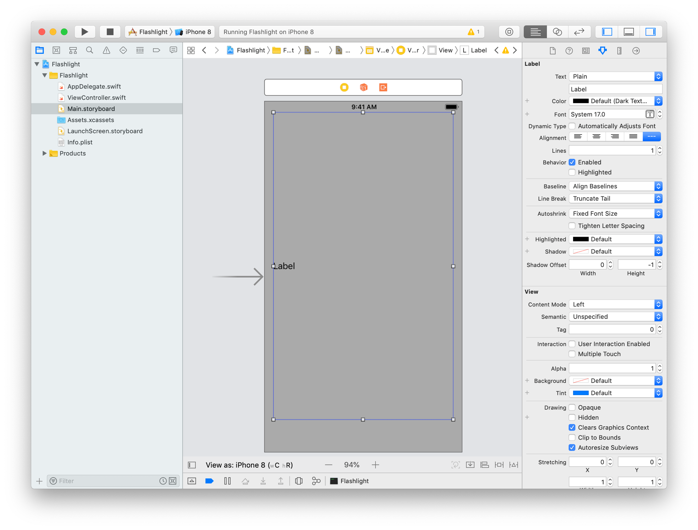
Adding UI elements to the storyboard
for example, drag a label onto the storyboard
once there, can move around the screen
can drag edges or corners to resize
here, resized to fill most of storyboard

Slide 13
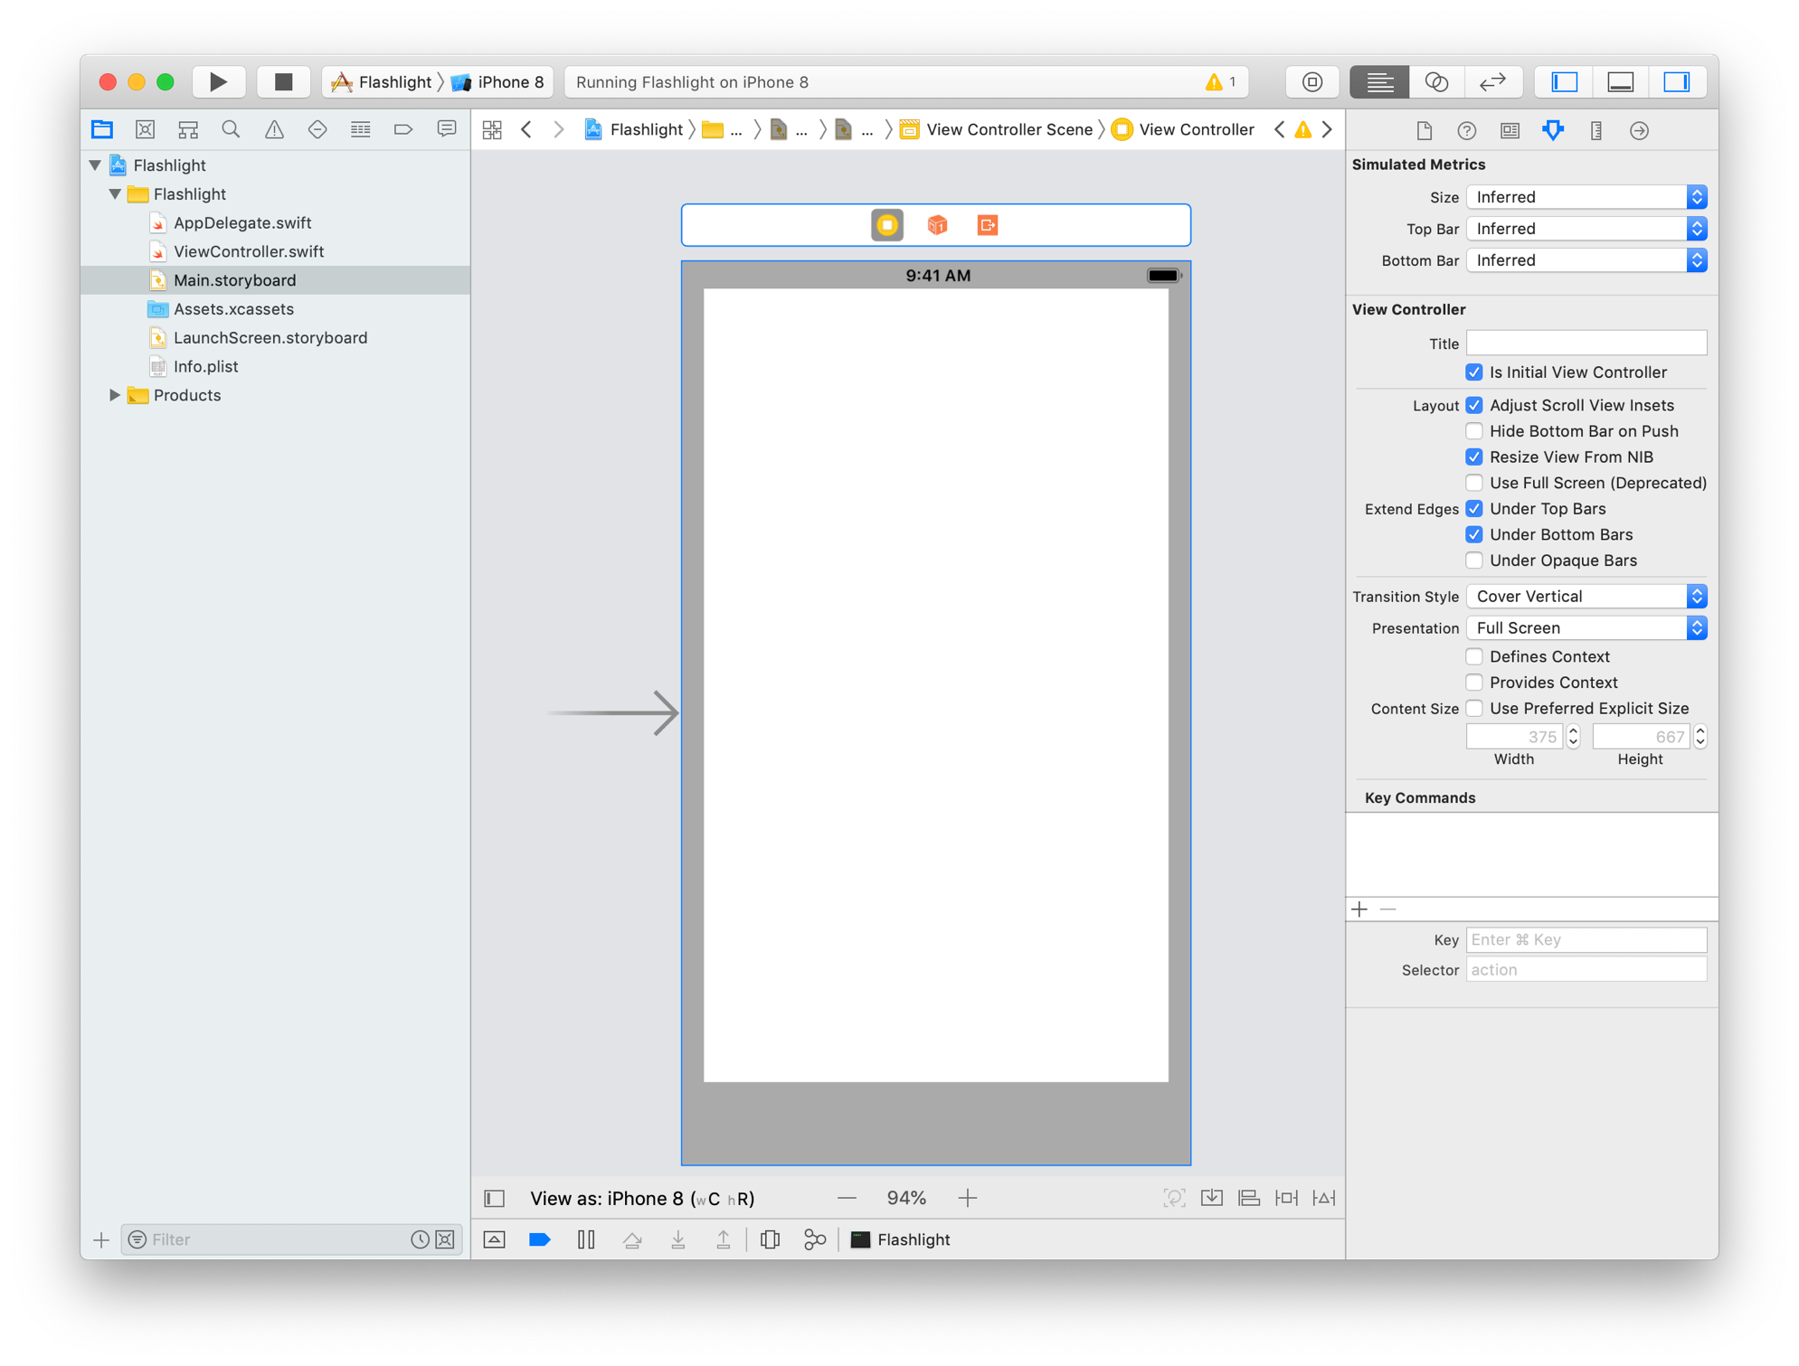
Changing UI elements attributes
can select a UI element then go to the Attributes Inspector to modify
click on the label
select the Attributes Inspector in the Utility Area
change the label text to be empty
change the background to be white

Slide 14
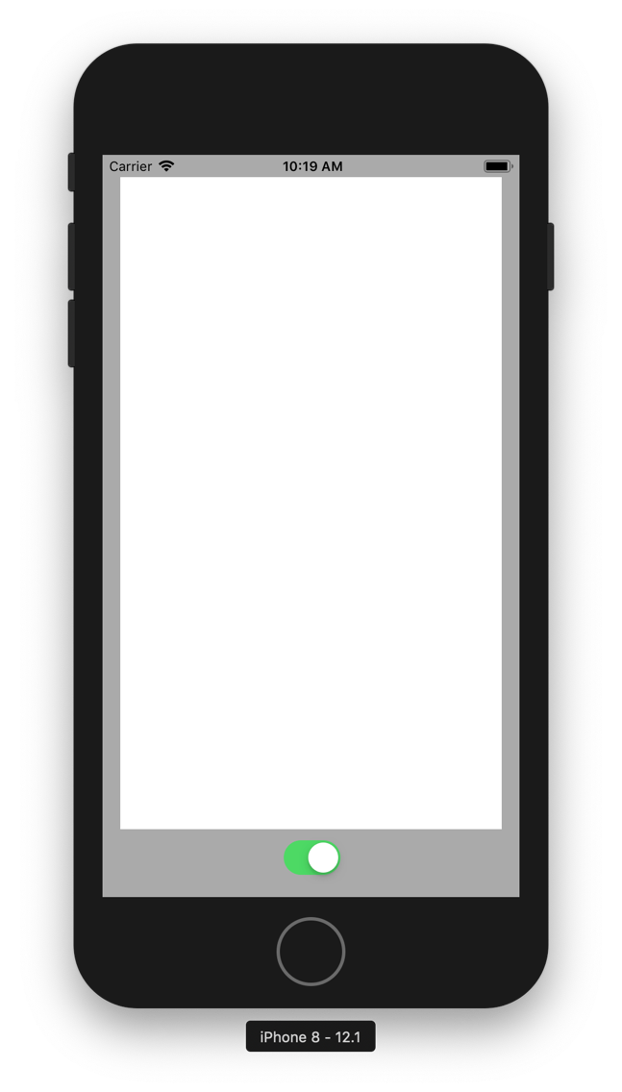
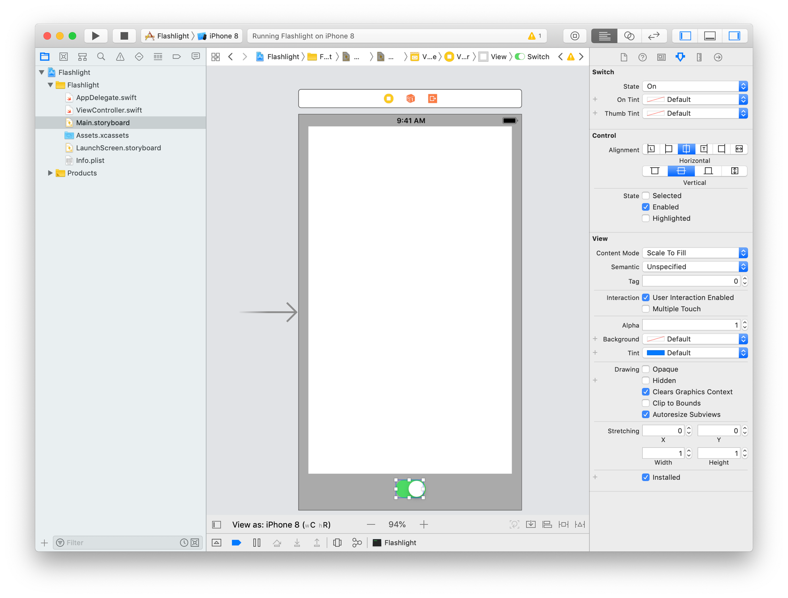
Adding another UI element
similarly, can drag a Switch element to the storyboard
place at the bottom
can use the blue guidelines to center horizontally
the switch moves, but doesn't do anything yet

Slide 15
Model-View-Controller
well designed apps utilize the Model-View-Controller software pattern:
the Model defines the logic underlying the app
e.g., if you are building a poker app, you would define classes to represent and model cards, decks of cards, poker hands, …
the View defines the look of the app
e.g., images of the cards on a tabletop, buttons or other controls for selecting or displaying cards, …
the Controller defines actions of the app - it connects the user interface (View) with the app logic (Model)
e.g., when the user clicks on a button to deal a card, it calls the appropriate method on a deck of cards object, then displays the resulting image

Slide 16
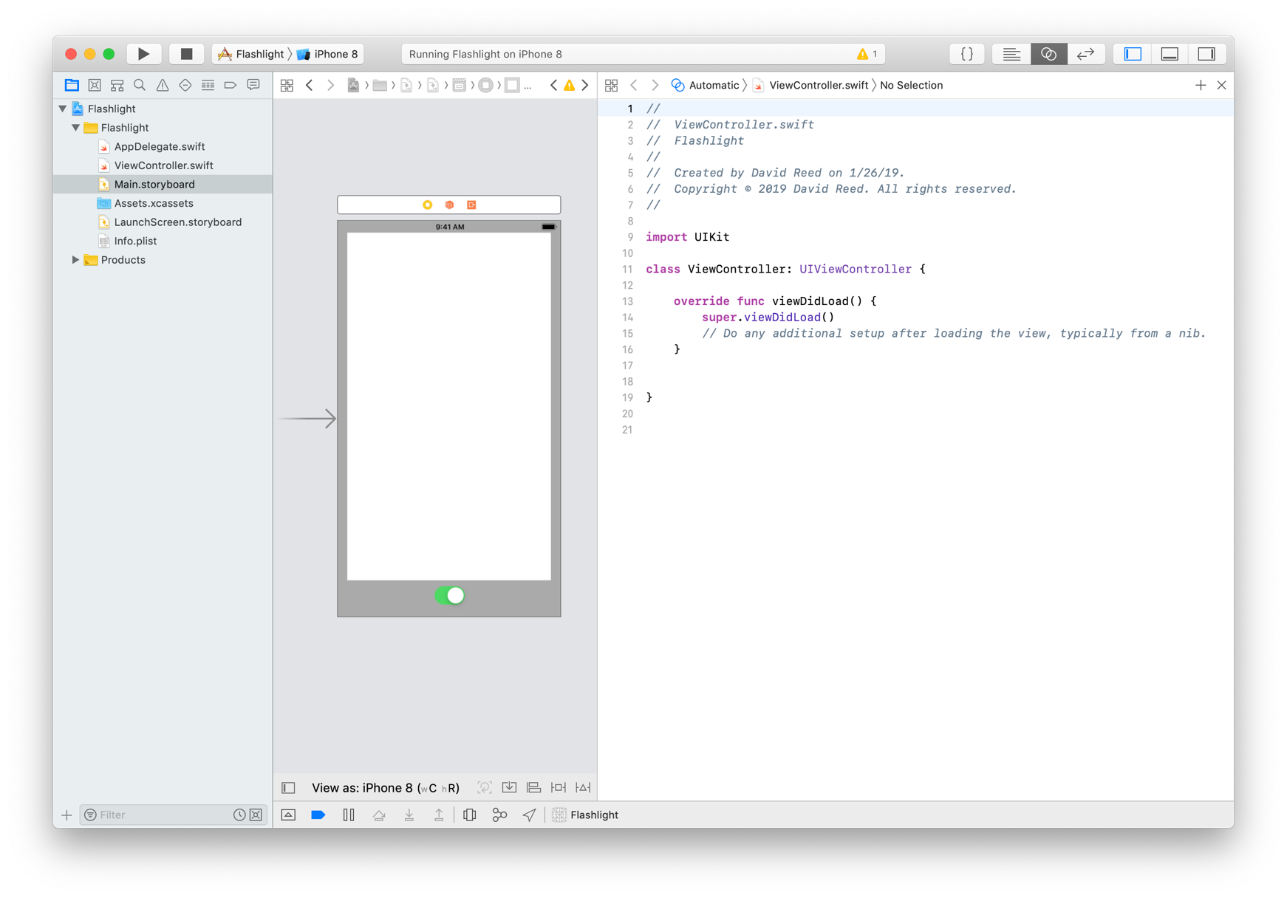
Flashlight MVC
Model: since the Flashlight app is so simple, its model will be implicit
View: the storyboard defines the look of the app (i.e., its View)
Controller: by default, each storyboard view has predefined controller (instance of the UIViewController class)
click on linked circles icon in toolbar to open side-by-side Assistant editor
we won't often need the default viewDidLoad method – can delete it

Slide 17
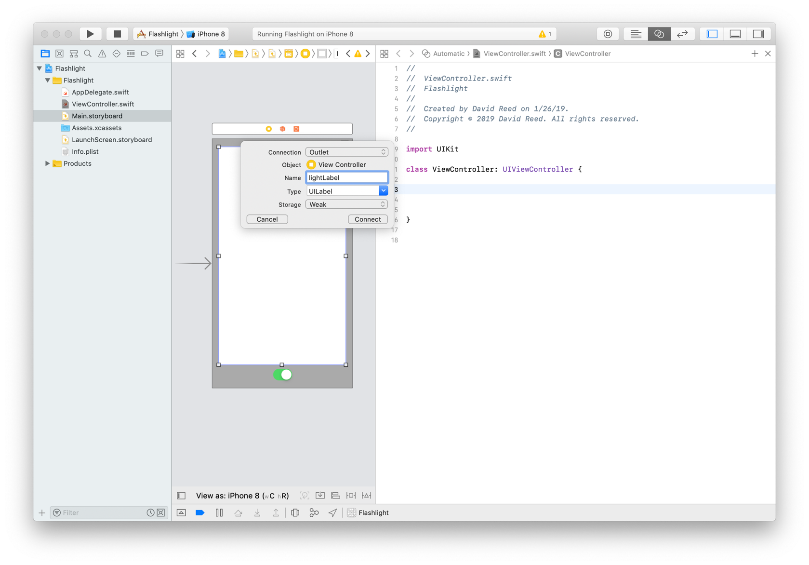
Connecting the View & Controller
to connect View & Controller,
Control-drag (or right-click-drag) from elements in the View to code in the Controller
e.g., control-drag from the flashlight label to inside the class definition
a line will show the connection
once released, a window will appear with choices
select Outlet, enter a name, then hit Connect

Slide 18
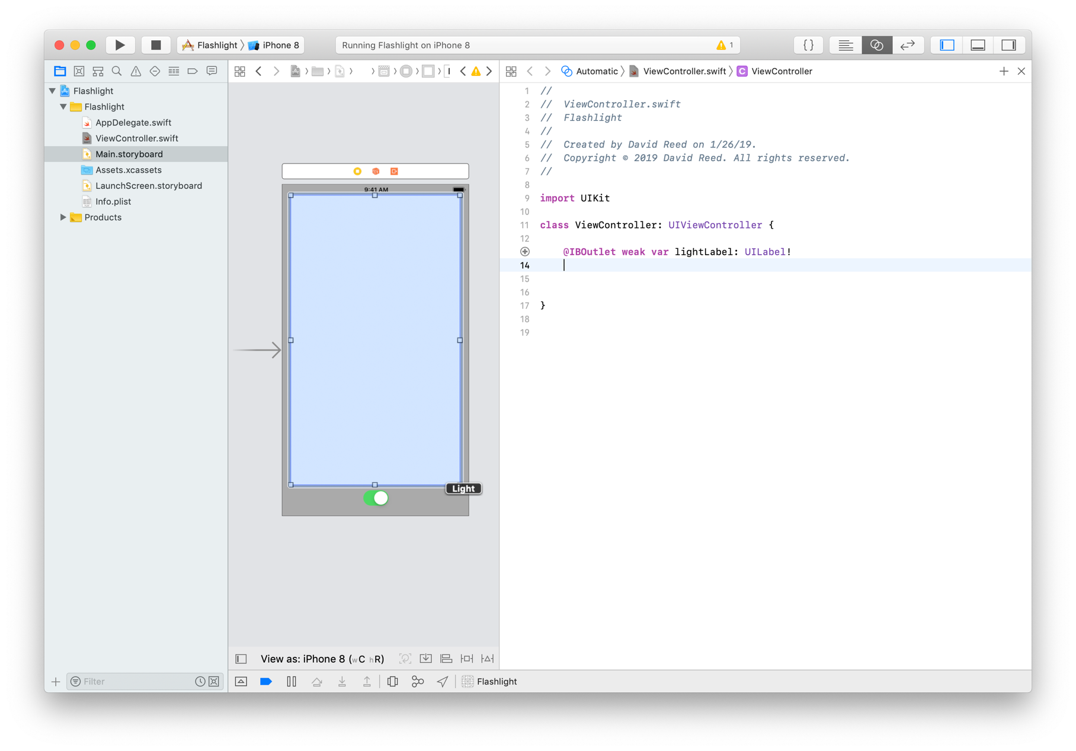
Outlets/Fields
as a result, a field is added to the ViewController class with the specified name
essentially, that UI element is now accessible to the controller code
note: if you move the mouse of the circle to the left of the field, the corresponding UI element in the storyboard is highlighted

Slide 19
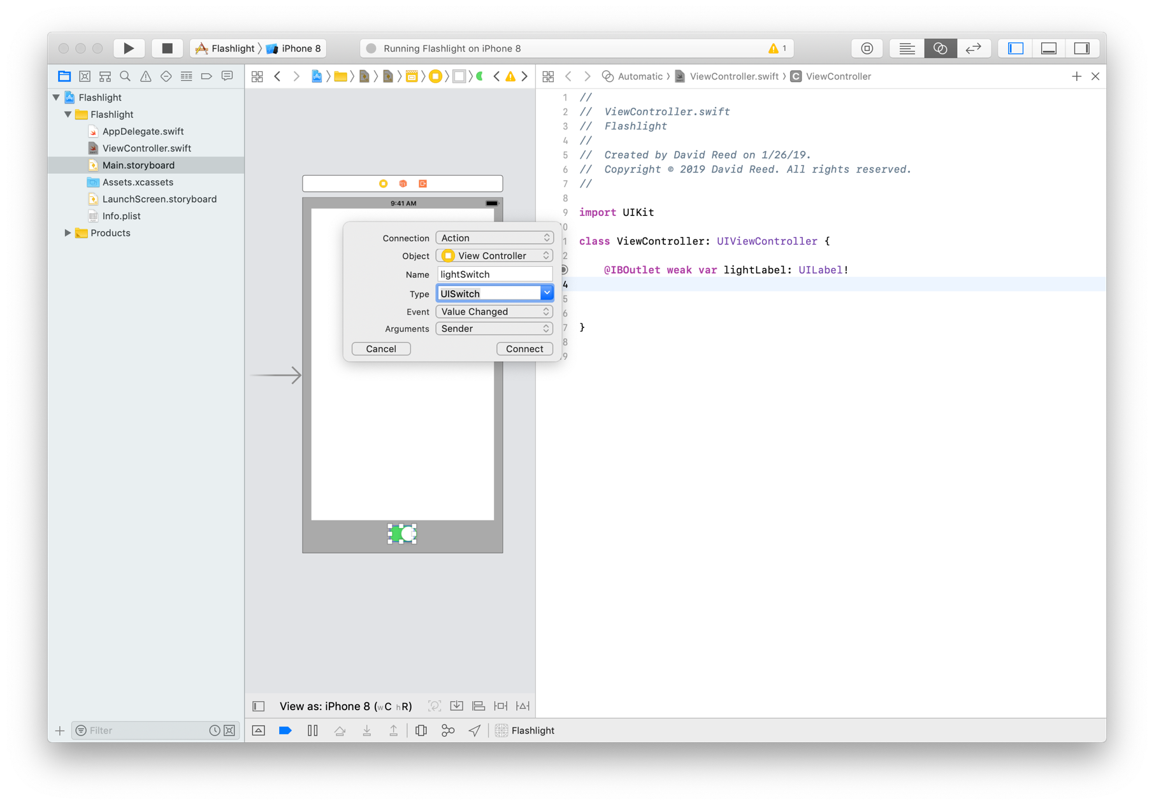
Defining actions via control elements
a switch is a control element, so it can define an action
similarly, control-drag from the switch to the ViewController definition
select Action, enter a name, and select UISwitch for the Type (IMPORTANT)
then, hit Connect

Slide 20
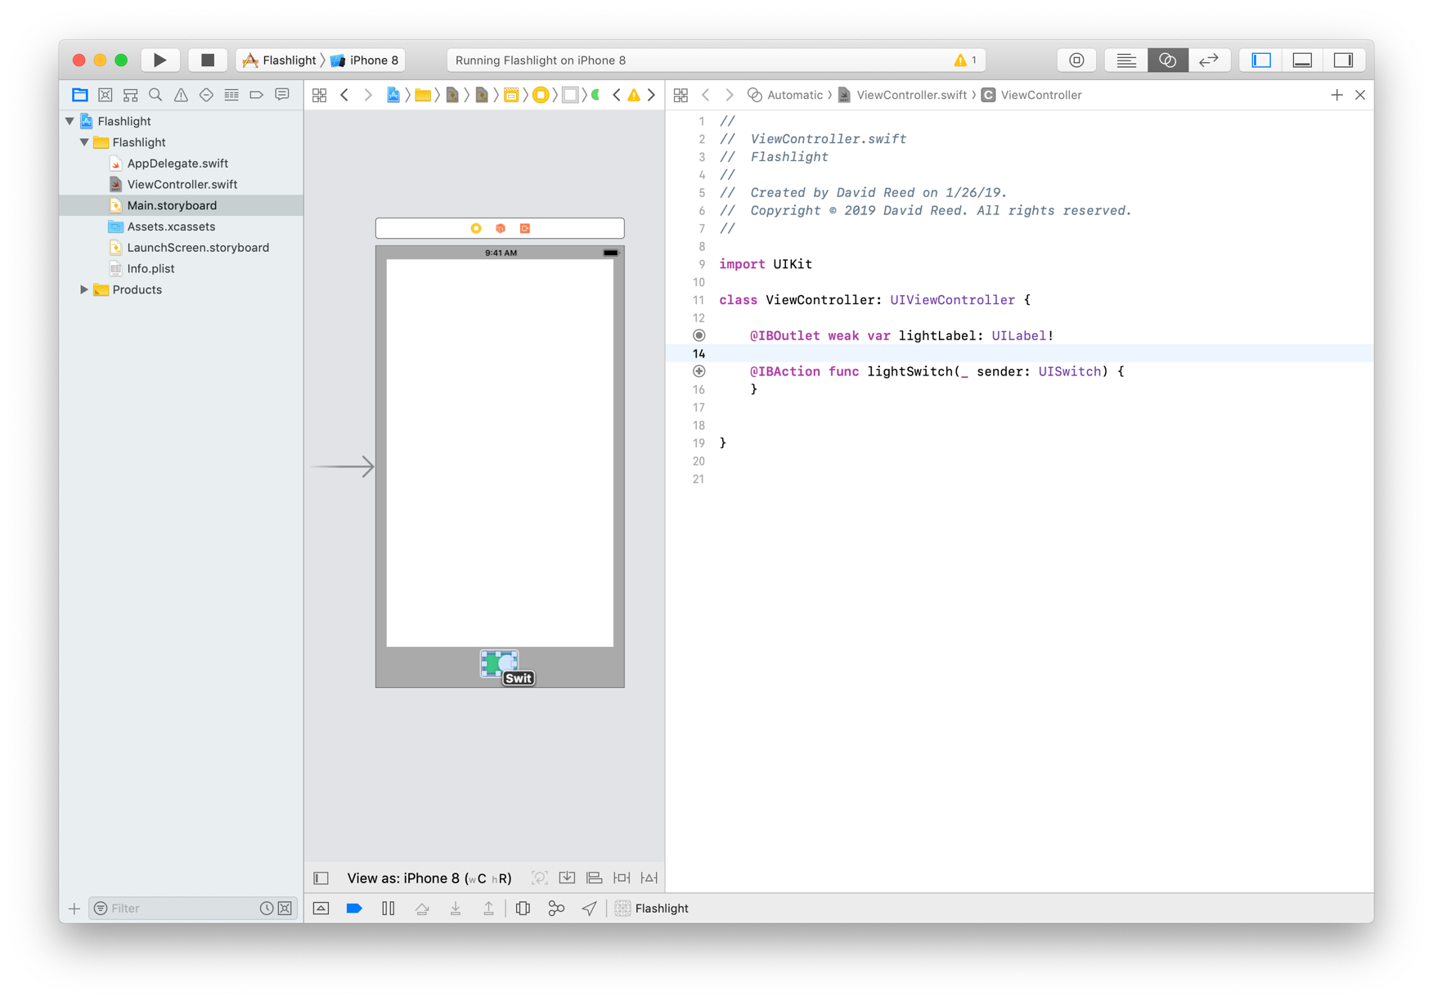
Actions/methods
this creates a method associated with that control element
each time the switch is changed, this method will be called
as before, if you move the mouse over the circle, the switch is highlighted

Slide 21
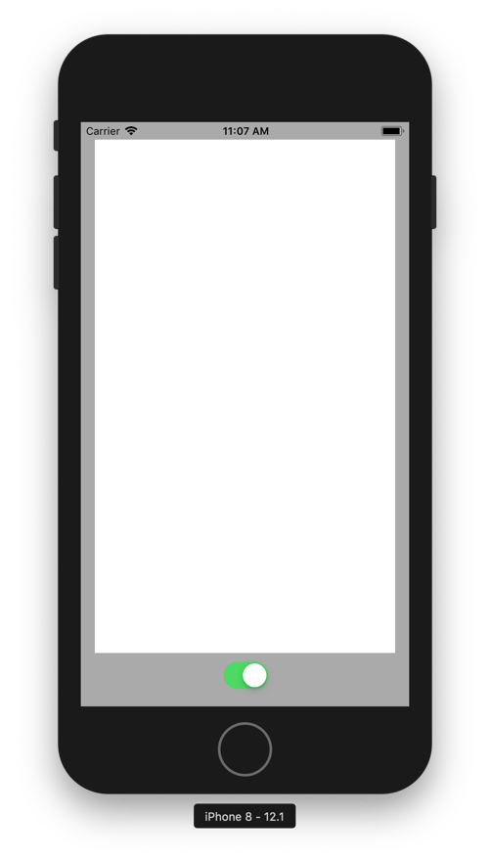
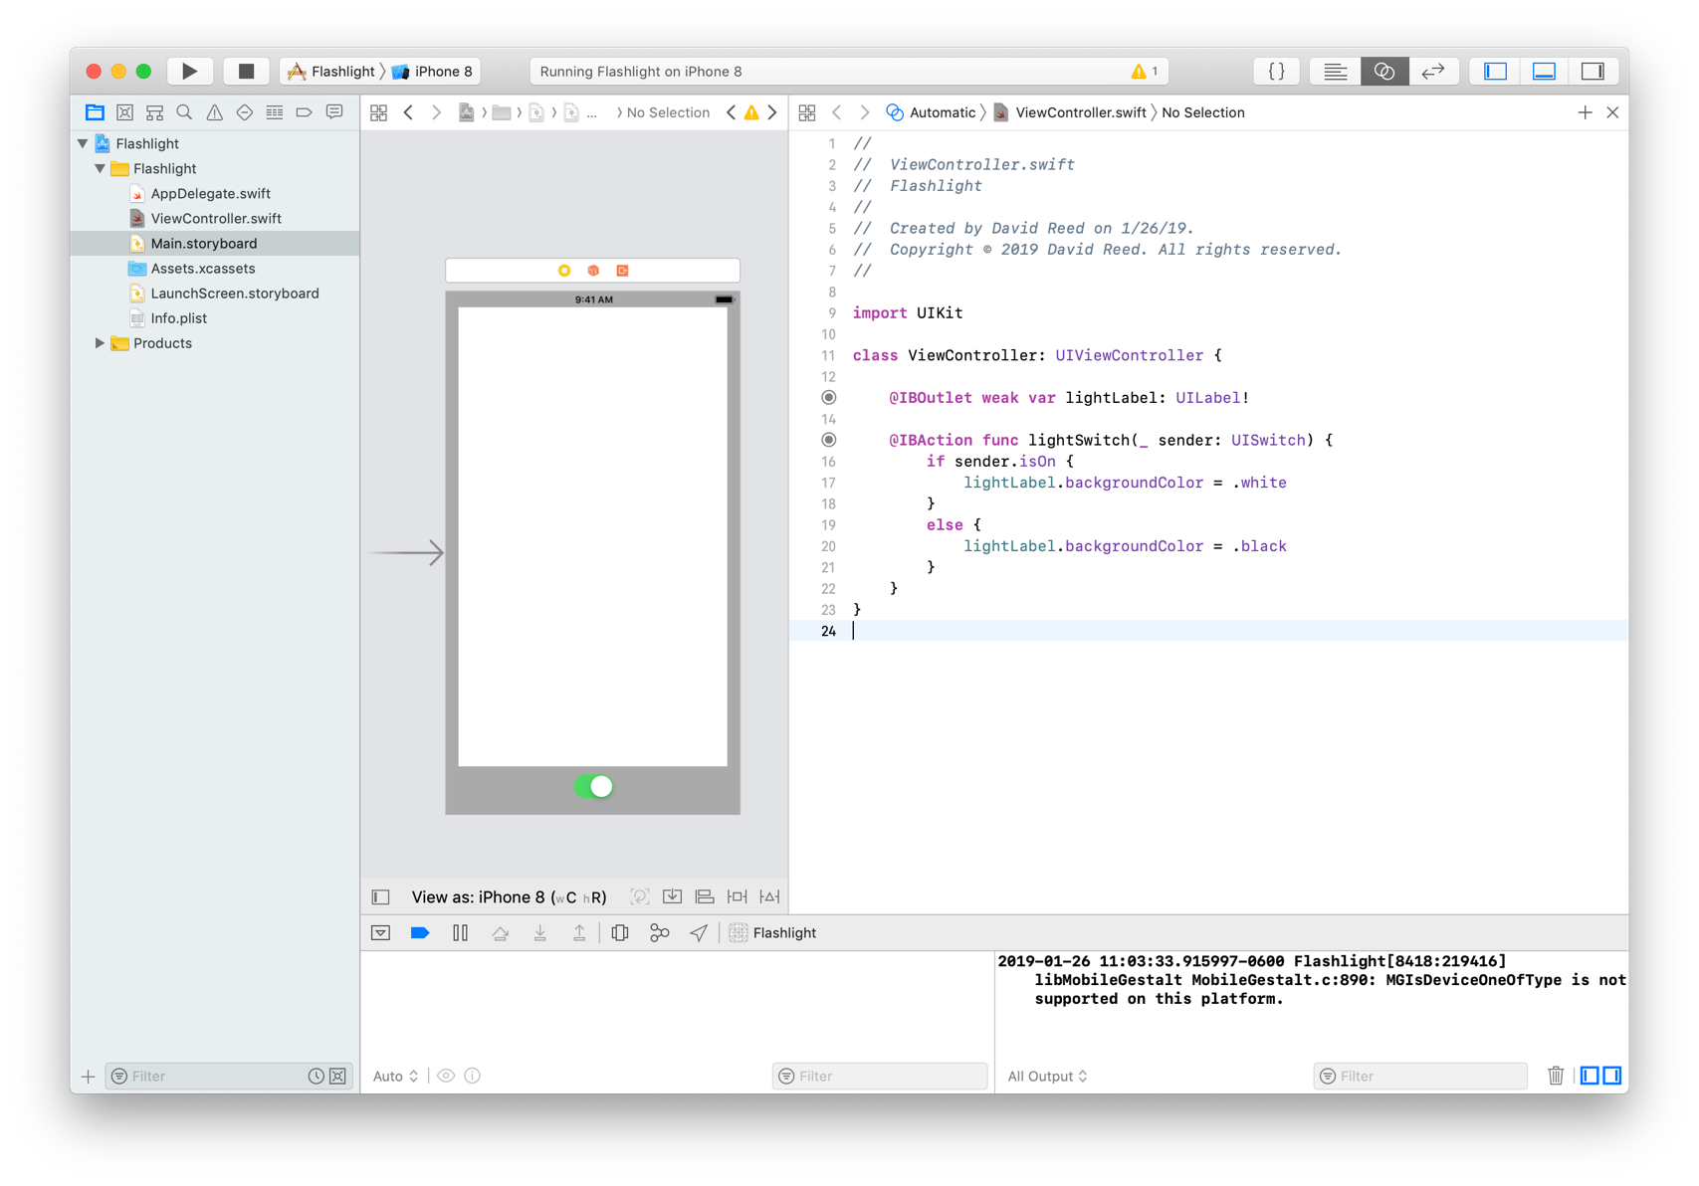
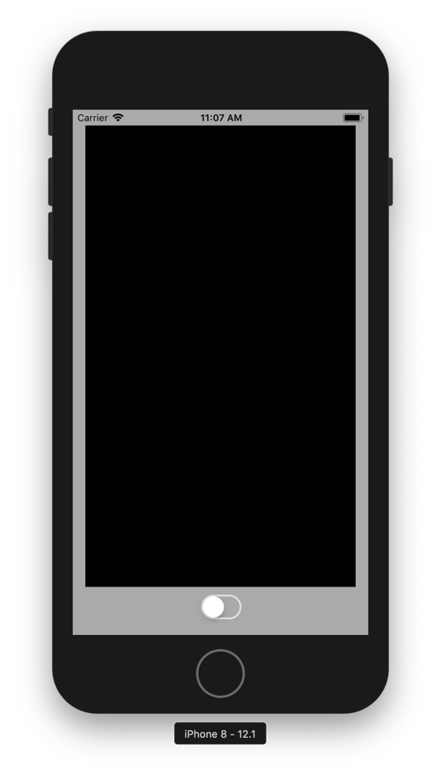
Actions/methods
for more complex apps, we would now create a separate Model
e.g., define classes, have fields that are objects of those classes, call methods to implement actions
here, the logic is so basic, the Model can be implicit in the Controller
simply change the label color based on the switch position

Slide 22
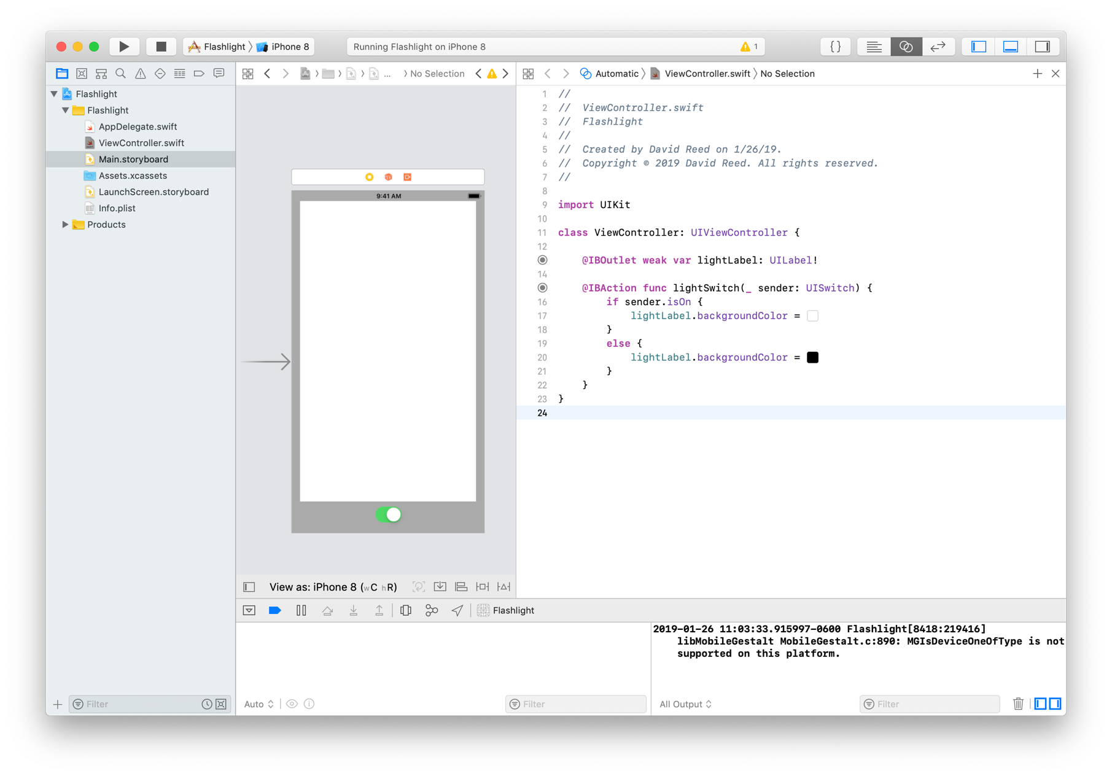
Color literals
Xcode has numerous features that incorporate non-text
instead of .black and .white, can insert a Color Literal and see the actual color in the code
code completion helps in selecting non-text values

Slide 23
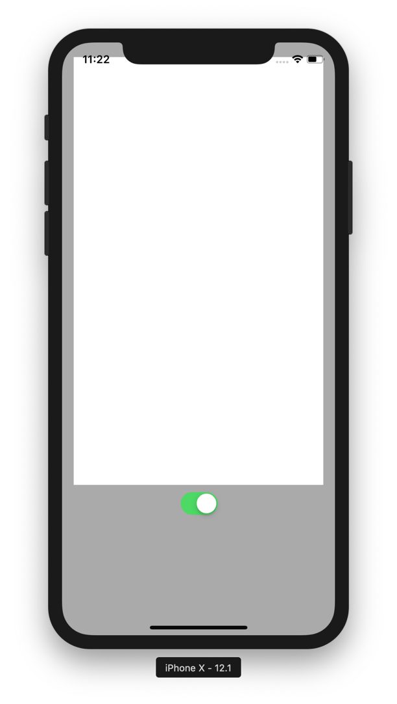
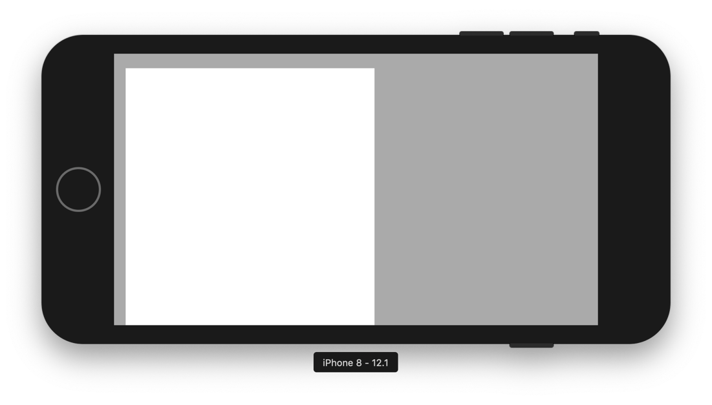
Different devices?
this app now works fine and looks good in the iPhone 8 simulator:
what happens if we run it under a different simulator (e.g., iPhone X)?
what happens if we rotate the phone (⌘→ or ⌘←)?

Slide 24
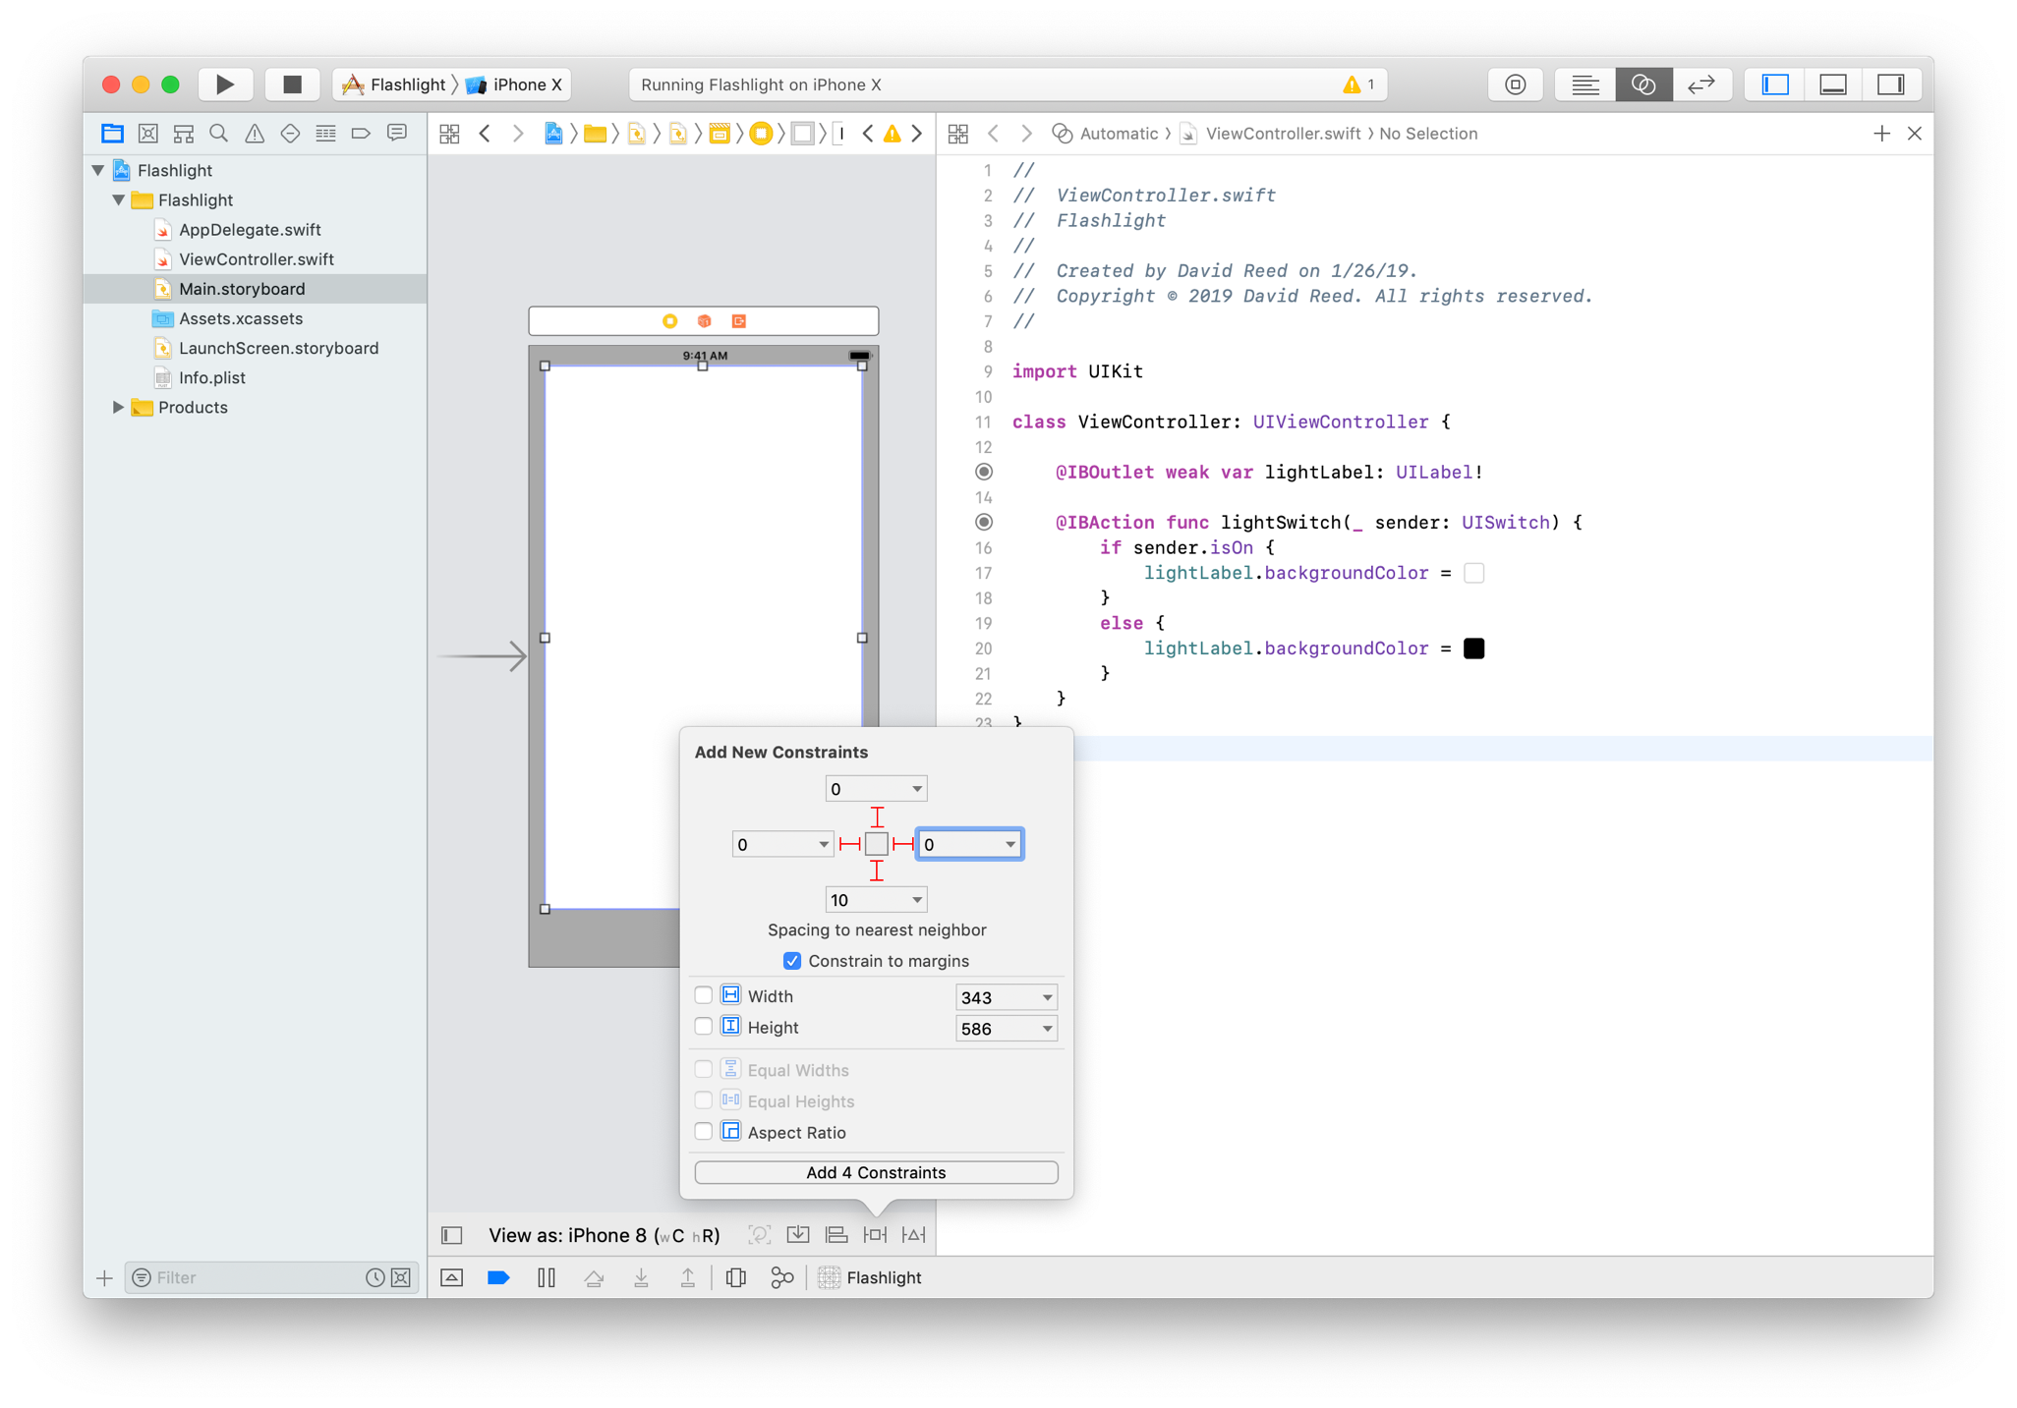
Auto layout
can use auto layout so that the layout of elements adjusts as the view size & orientation changes
select the label
click on the Constraints icon at the bottom
enter margin number for each of the four directions (0 margin will etend to the edge)
similarly, add a bottom constraint for the switch

Slide 25
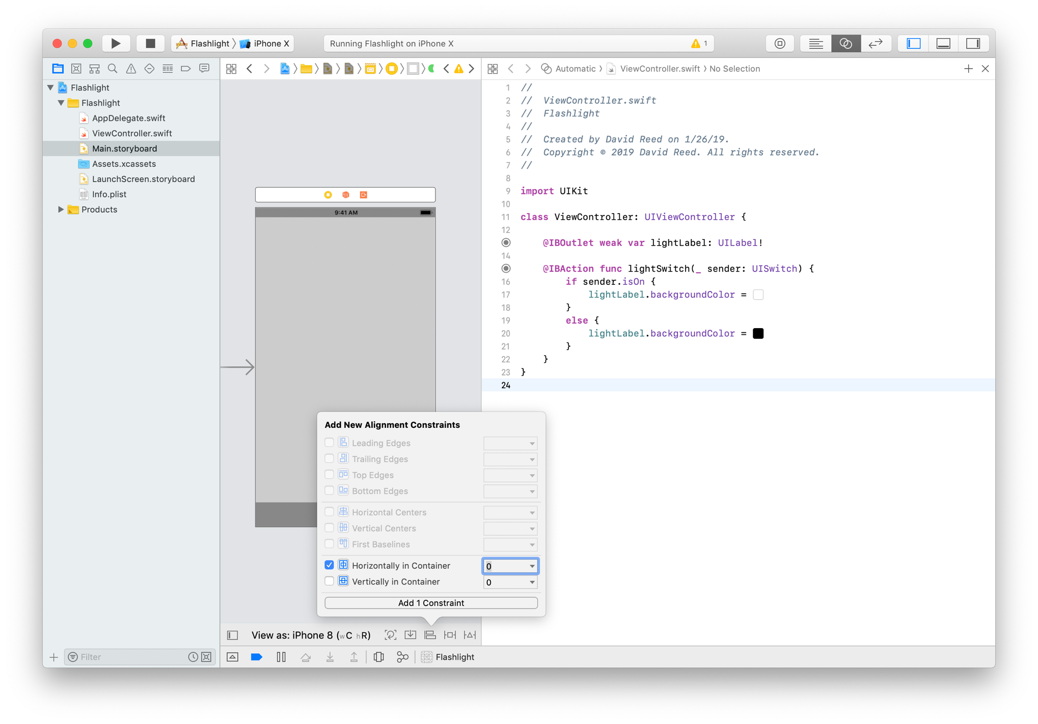
Auto layout
similarly, can center elements horizontally and/or vertically
select the switch
click on the Align icon at the bottom
select Horizontally in Container

Slide 26
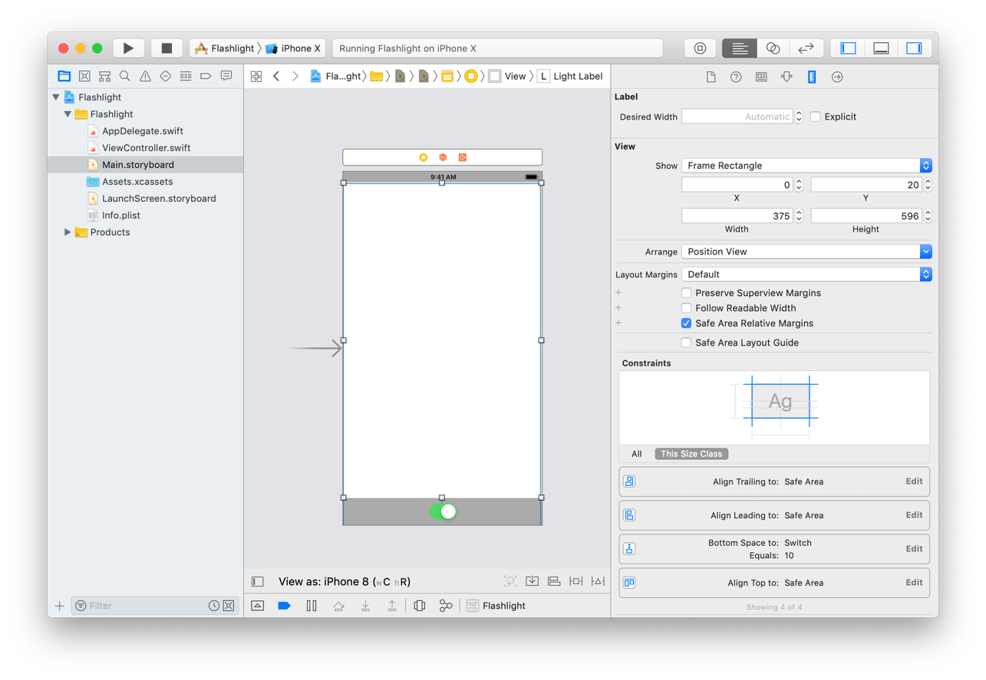
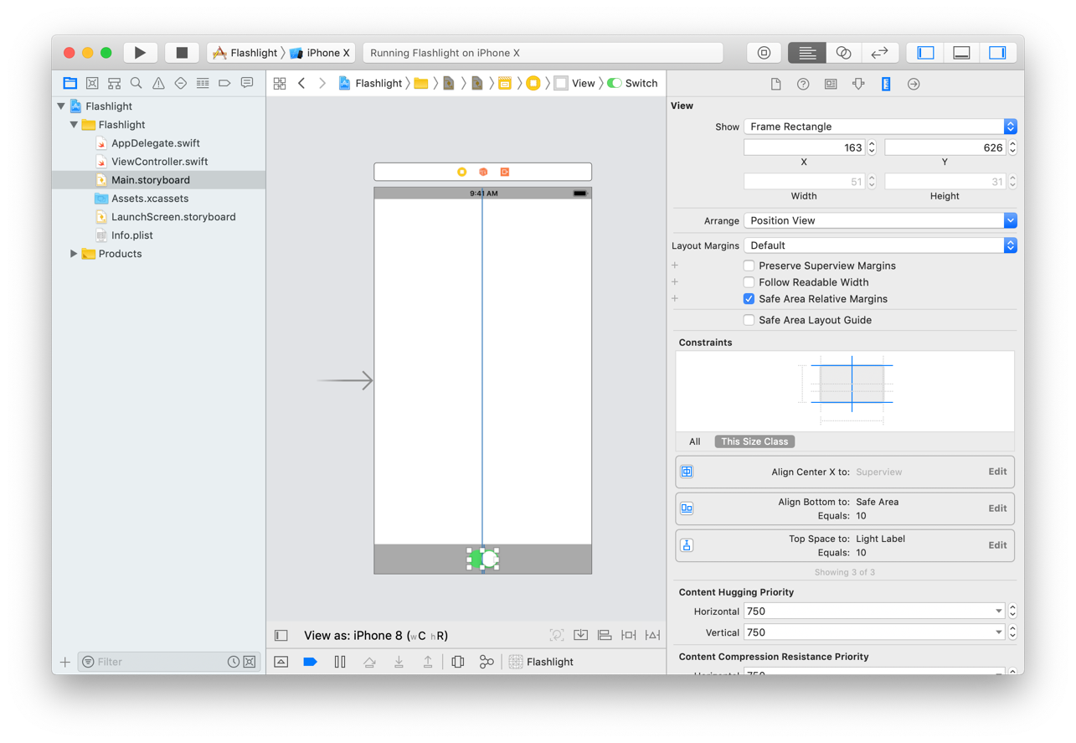
Viewing/editing constraints
if you select a UI element and go to the Size Inspector (top right)
can view the auto layout constraints assigned to that element
you can edit and/or delete as well

Slide 27
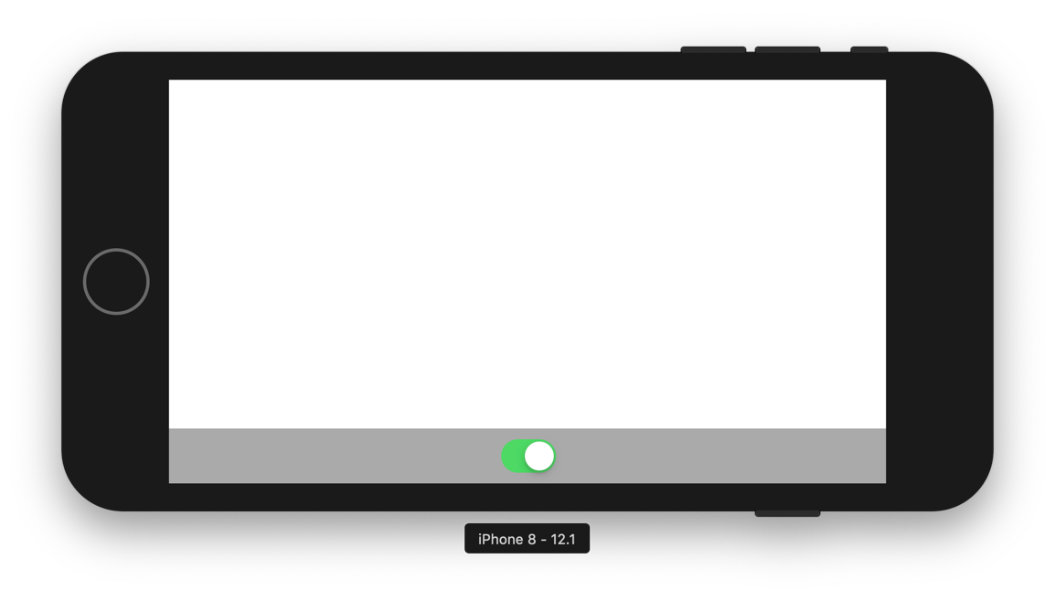
Different devices?
with auto layout constraints, the app now looks good on different devices and different orientations

Slide 28
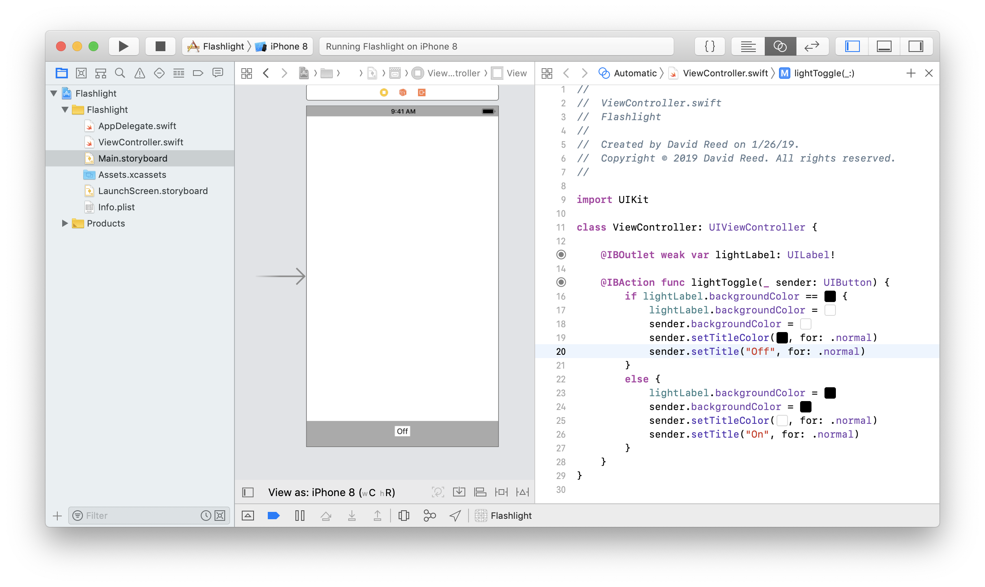
UIButton
alternatively, we could have used a button instead of a switch
add a button labeled Off, with black text on a white background
add an Action for handling button click
when clicked, change the backgroundColor of the label, as well as the button text and background colors

Slide 29
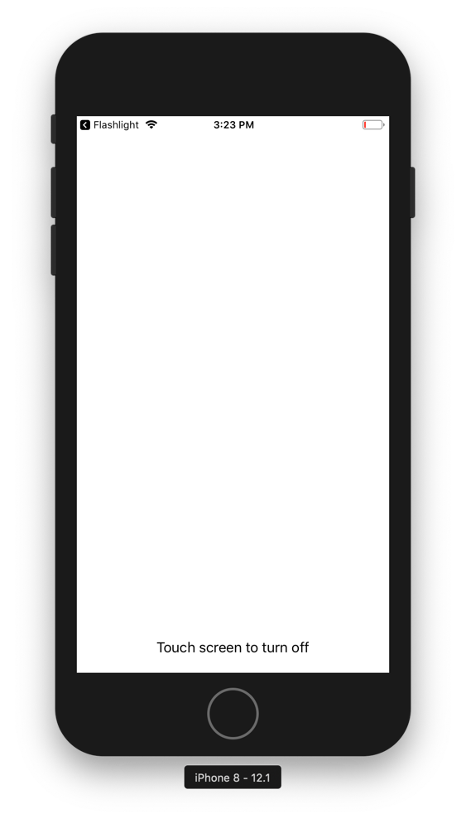
HW 1.1
the Lab at the end of Unit 1 leads you through a different Flashlight design
end result is a single button that fills the screen
when clicked, it switches between white and black backgrounds
complete this tutorial, then add a label at the bottom of the screen with instructions

Slide 30
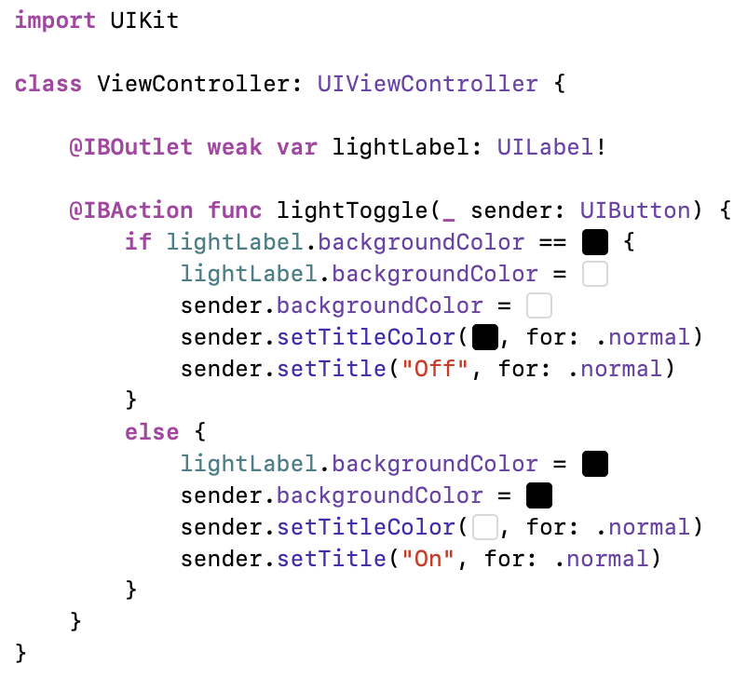
Swift
Apple released Swift in 2014, for iOS and macOS development
easier to use & understand alternative to Objective-C
now also used for watchOS and tvOS development
Swift has been open-source since 2015, with a large community of supporters
Swift is fully object-oriented, but has the look of cleaner scripting languages
ViewController is a Swift class
with a field (lightLabel) and method (lightToggle)
note: Swift statements do NOT end with ;

Slide 31
Swift variables
Swift variables must be declared (using var) before use
var num = 5
var word = "foobar"
var flag = true
Swift is type-safe, the type of every value must be known by the compiler
you can declare the type along with a variable
var age: Int (primitives are Int, Double, String, Bool)
but this is rarely done, as Swift performs type inferencing on assignments
naming conventions for variables are more liberal than Java
no spaces or math operators, can't start with a digit
all legal: maxValue salary$ mañana π 🎲

Slide 32
Swift constants
Swift distinguishes between variables and constants
constants, whose values don't change, are declared using let
let maxNum = 10 // constant
var sum = 0 // variable
for i in 1...maxNum {
sum += i
}
if you declare a variable with var but never reassign it, the compiler will warn you
Swift provides the same math operators as Java
+, -, *, /, %, +=, -=, *=, /=, %= (note: no ++ or --)
unlike Java, operators must be applied to values of same type
var sum1 = 2 + 3.5 // illegal
var sum2 = Double(2) + 3.5 // but can cast values

Slide 33
Swift control statements
Swift if-else and while are similar to Java, but tests don't require parentheses
Boolean operators are the same: ==, !=, <, >, <=, >=, &&, ||, !
var letter: String var num = 1024
let x = 92 var count = 0
if x >= 70 { while num > 1 {
letter = "P" num /= 2
} count += 1
else { }
letter = "F"
}
for loops can step through a range
x..<y is exclusive on the upper end; x...y is inclusive
var sum1to9 = 0 var sum1to10 = 0
for i in 1..<10 { for i in 1...10 {
sum1to9 += i sum1to10 += i
} }

Slide 34
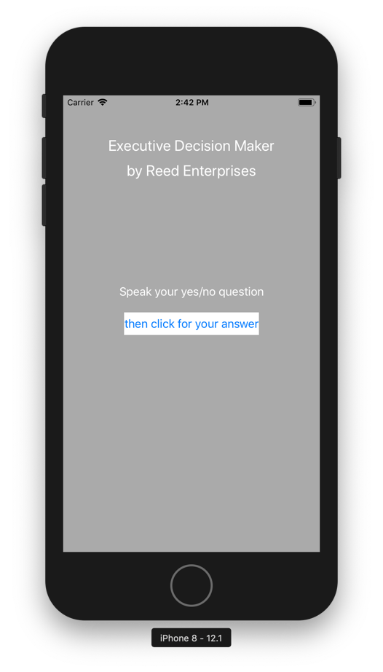
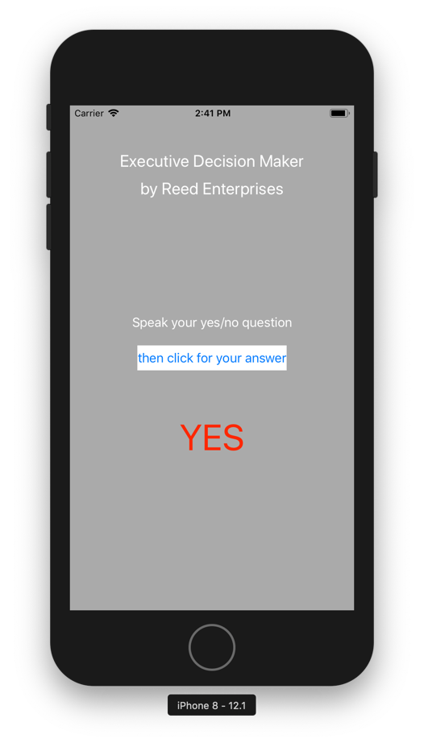
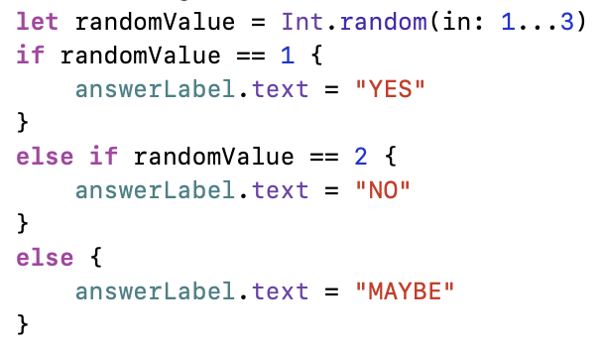
HW 1.2
create an Executive Decision Maker app
gray background & title with your name, centered at the top
instructions and a button at the center
an empty label centered, below the button
when the button is clicked, display either YES, NO, or MAYBE in the label

