Slide 1
CSC 581: Mobile App Development
Spring 2019
    Mobile platforms
Web vs. Native vs. Hybrid apps
App stats
  number of apps, app categories, retention
iOS vs. Android
  feature comparisons, typical users, tradeoffs

Slide 2
Web apps
Web app is a Web page you access through your mobile browser
  generally optimized to fit on smaller screen and utilize touch interface
Progressive Web Apps (WPAs) are a recent variant
  utilize browser support to provide some native-like features
    (e.g., push notifications, access to device controls & sensors)
Advantages | Disadvantages
easy to build | needs a browser to run
easy to maintain | much slower than native apps
an inexpensive option | less interactive and intuitive
build one app for all platforms | no icon on mobile desktop
 | cannot leverage device utilities

Slide 3
Native apps
native apps are built for a specific platform
  using platform-specific languages (Swift/Objective-C for iOS, Java/Kotlin for Android)
  using platform-specific IDEs (Xcode for iOS, Android Studio et al. for Android)
  platforms exist that allow you to code in a single language/IDE, then export as native code (e.g., Xamarin in C#, React Native in JavaScript & React)
Advantages | Disadvantages
very fast and responsive | difficult languages to learn
distributed in app stores | more expensive (at least initially)
more interactive and intuitive | overkill on very simple apps
can access all device features | user must download updates
Internet connection not required
overall better user experience

Slide 4
Hybrid apps
hybrid app is a combination of native & Web app
  users download and install it like a native app, but it runs like a Web app
  back-end written in JavaScript, CSS & HTML
  front-end is a native shell that loads the back-end code using a webview
  popular frameworks: Phone Gap, Ionic, Mobile Angular, …
Advantages | Disadvantages
built on Web technology | slower than native
cheaper than native | more expensive/complex than Web app
one app for all platforms | less interactive than native
no browser needed | customization leads away from single-build
access to device API & features
fast to develop multi-platform

Slide 5
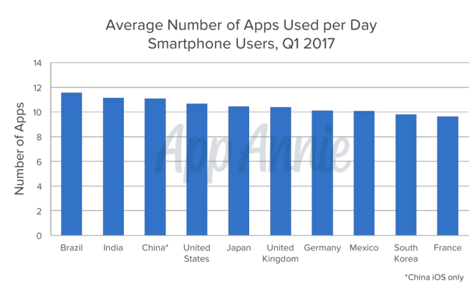
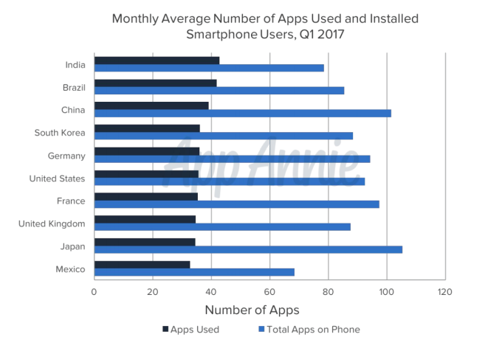
App use
in a 2017 survey by App Annie, smart phone users accessed
  9+ apps per day
  30+ apps per month
in 2018, mobile was responsible for 52.2% of all Internet traffic (source: comScore)
  71% in the U.S.
  75% in Mexico

Slide 6
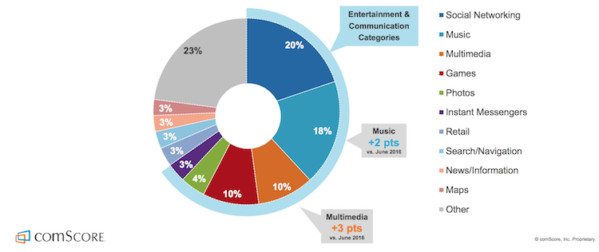
App use by category

Slide 7
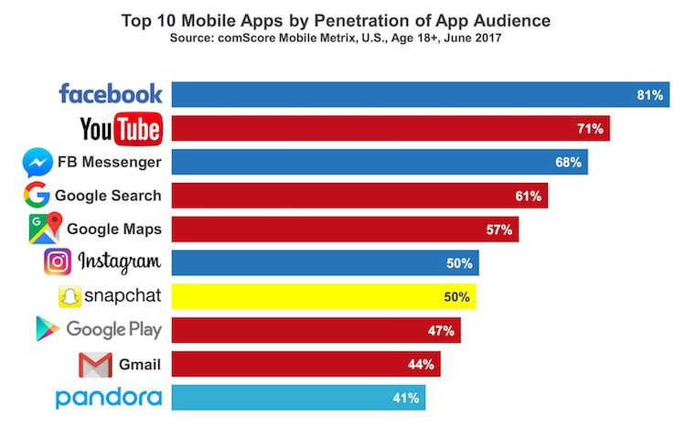
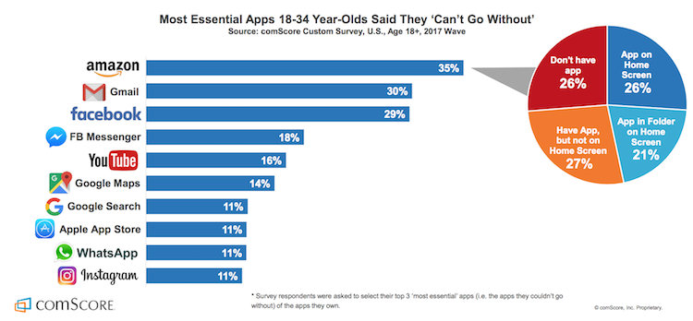
Most popular apps

Slide 8
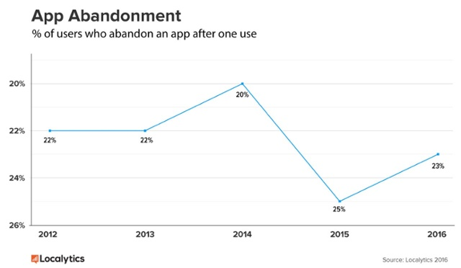
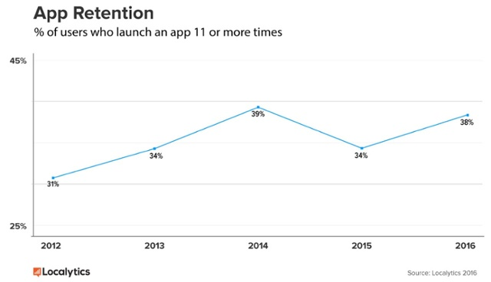
App retention
nearly ¼ of users abandon an app after one use
common standard: app is successful if 11+ uses

Slide 9
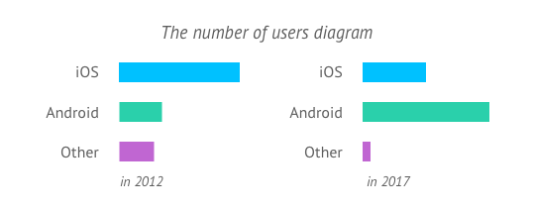
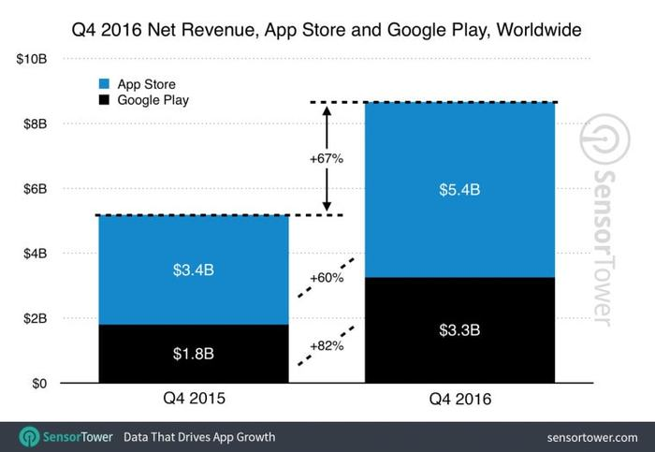
iOS vs. Android
recall: Android has a much larger (64%) market share than iOS (32%)
but, iOS has higher revenue
  Android apps tend to be more ad driven

Slide 10


iOS vs. Android comparison (from Bondarenko)
 | iOS | Android
Market share & number of users |  | X
Average revenue | X
Number of downloads |  | X
Development complexity | X
Development time | X
Development costs | X | X
Publishing |  | X

Slide 11
Typical users (from Bondarenko)
iOS | Android
mostly live in North America and Western Europe | mainly live in South American, Asia, Central & Eastern Europe
prefer creative and entrepreneurial professions | prefer technical professions
tend to spend more money on the Internet & mobile apps | highly appreciate price-quality ratio
pay more attention to apps from business, education, & lifestyle categories | pay more attention to apps from tools, entertainment, & communication categories
more inclined to make in-app purchases | more loyal to in-app ads

Slide 12
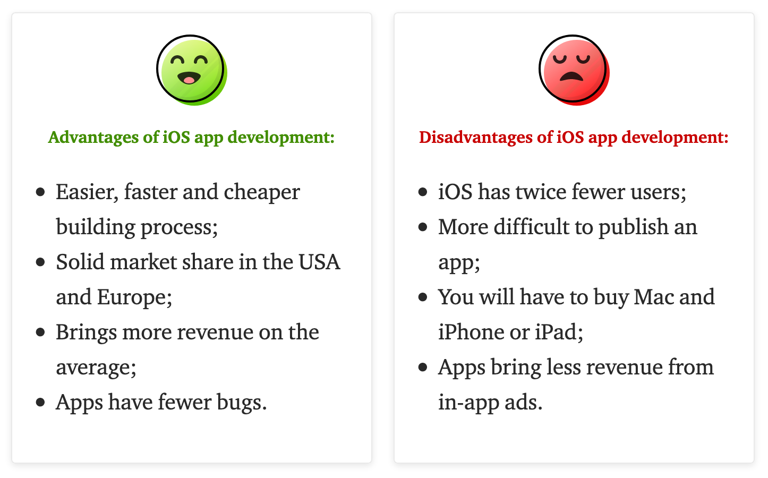
Tradeoffs (from Bondarenko)

Slide 13
Questions
The first article describes the different development options for mobile: native apps, Web apps, and Hybrid apps. What do you see as the greatest advantages that native apps have over Web apps? What is the difference between a Web app and a Progressive Web app?
Describe what is meant by the term "hybrid app." Identify and describe one major advantage of developing a native app versus taking a hybrid development approach? Identify and describe one major disadvantage.
Are there any games or services that you regularly access on your mobile device through the browser? Is there an app alternative? If so, why do you continue to access the content/service through your mobile browser? If there is not an app alternative, why do you think it has not been developed as an app?
The second article compares the iOS and Android platforms, rating each on numerous characteristics (e.g., market share, development complexity). Which category and argument did you find most compelling in favor of Android? Which category and argument did you find most compelling in favor of iOS? As part of your answer, identify which type of phone you own (if you do own a smartphone) and your main reason for selecting that phone.
One of the obvious distinction between iOS and Android is that iOS runs on a single family of devices designed by a single company (Apple), while Android runs on a wide variety of devices from different manufacturers. From a developer’s perspective, describe the trade-offs between these two scenarios. If you had an idea for a new game app that you wanted to market, which platform would you focus on?

