Slide 1
CSC 581: Mobile App Development
Spring 2019
    The iOS landscape
iPhone/iOS market share
iOS history
iOS architecture
  Cocoa Touch, media layer, core services, core OS
iOS development
  XCode & Swift

Slide 2
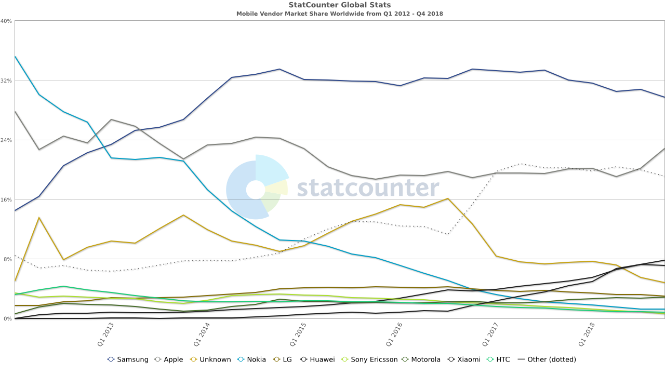
Vendor market share: worldwide
Samsung has 30% of the worldwide mobile market, Apple 22%
http://gs.statcounter.com/vendor-market-share/mobile

Slide 3
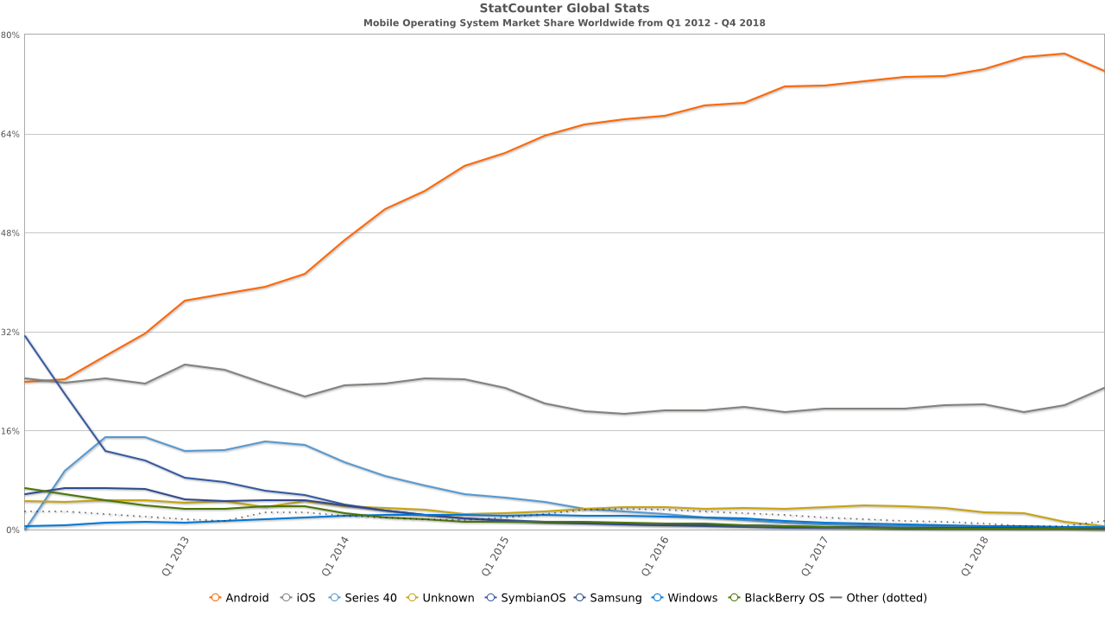
iOS market share: worldwide
important to note that the Android OS is supported by many vendors
  Android has 75% of the worldwide mobile market, iOS 22%

Slide 4
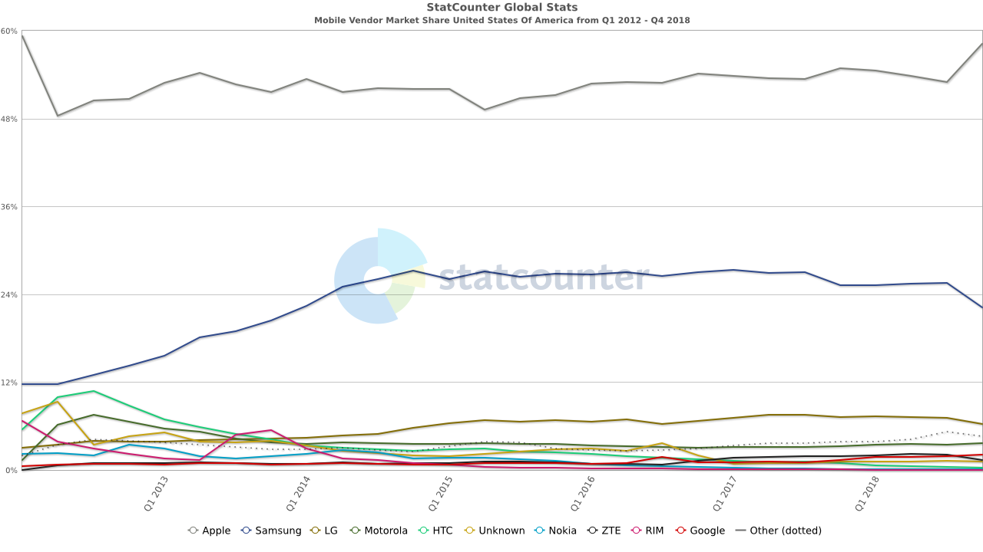
Vendor market share: U.S.
in the US, however, Apple leads the market with 58%, Samsung 22%

Slide 5
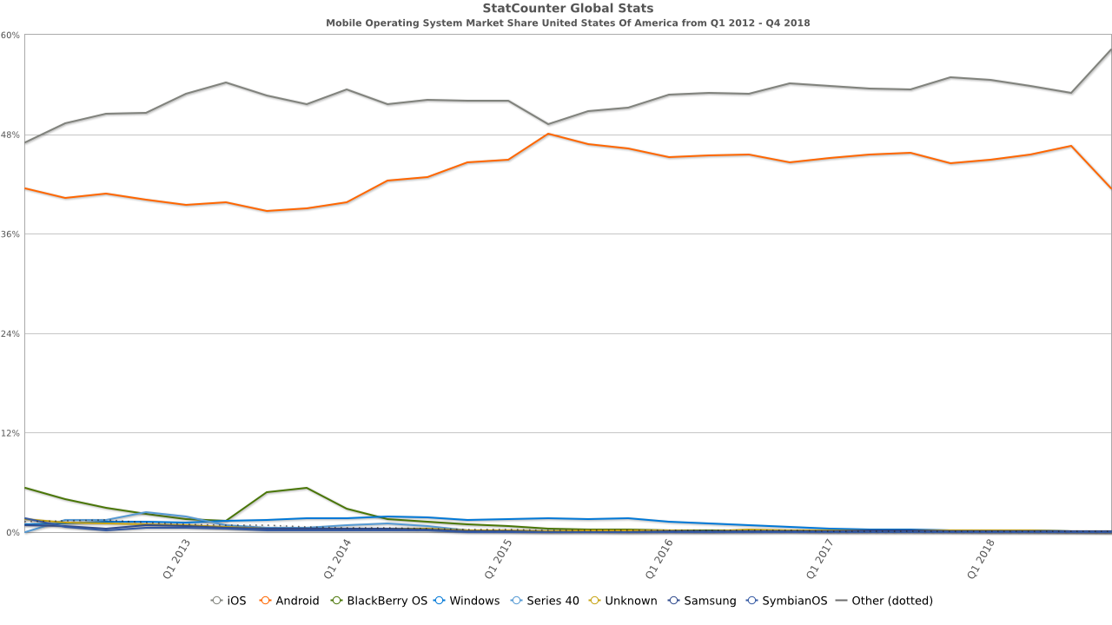
iOS market share: U.S.
in the US, iOS leads the market with 58%, Android 41%

Slide 6
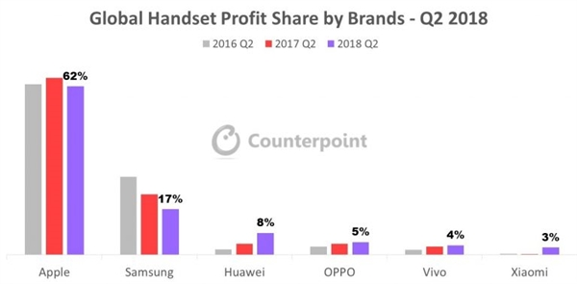
Profits vs. volume
unit volume can be a misleading measure
  Samsung and other manufacturers sell many low-end models
  Apple sells only high-end phones, with high profit margins
  as a result, Apple brings in 62% of all mobile phone profits

Slide 7
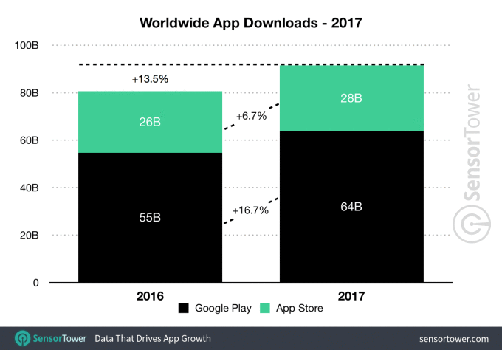
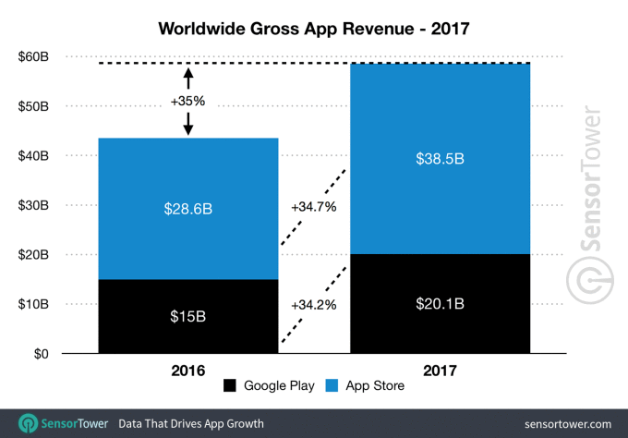
Downloads vs. profits
from a developer perspective,
  more apps are downloaded from the Google Play Store
  but revenue is much higher at the Apple App Store

Slide 8
iOS history
the iOS mobile operating system was released with the iPhone in 2007
  based on the MacOS, written in C, C++ and Objective-C
  extended to support iPod Touch (2007) and iPad (2010)
  major versions are released annually – iOS 12 (Sept 2018)
  initially, 3rd party app development was not supported
    Steve Jobs wanted new apps to utilize the Web interface
  in 2008, the iPhone SDK was released for developing native apps
    the XCode IDE was extended for iOS development (in addition to MacOS)
the iOS App Store opened in July 2008
  initially, 500 apps available
  by July 2017, 3+ million apps & games available
  by July 2017, cumulative number of downloads exceeded 180 billion

Slide 9
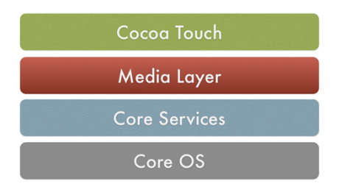
iOS architecture
iOS is a layered architecture
  apps interact with the hardware through well-defined system interfaces
basic application support
multitasking, touch input, UIKit, …
graphics & A/V technology
images, animation, media player
higher-level features
contacts, iCloud, location, motion, …
low-level features
external accessories, Bluetooth, …

Slide 10


iOS development
Apple utilizes a single IDE, XCode, for development on all its platforms
  released in 2003, based on the Project Builder IDE developed at NeXT
    could support many languages, but primarily used with Objective-C
  3.x series (2008) added support for iOS development
  4.x series (2010) consolidated editing tools and Interface Builder into one IDE
  6.x series (2014) introduced the Swift programming language
  Swift is a much simpler language than Objective-C (but utilizes the Objective-C runtime library, and can coexist in a project)
    fully object-oriented, but borrows heavily from scripting languages
    e.g., type inferencing, simple list/dictionary data structures, streamlined syntax
vs.

Slide 11
Questions
Do you own a smartphone? If so, what brand? What were the driving forces that led you to select that particular brand? If you don’t own a smartphone, what is the primary reason you do not.
If you have a smartphone, how many apps do you have installed? What apps do you use most often? If you don't have a smartphone, what apps do you miss having the most?
Researchers have recently coined the term nomophobia (short for no-mobile-phone-phobia) to describe the anxiety that many people have when separated from their mobile phones. Do you feel that you suffer from some degree of nomophobia? If not you, perhaps someone you know? Describe your (or their) feelings/behaviors. Do you feel that people's dependence on mobile devices is becoming unhealthy?
The History of iOS article outlines each release of iOS (originally iPhone OS) and describes the major new features in each. Which release (after the first, of course), do you feel was most significant? That is, which new release introduced new features that had the greatest impact on the mobile phone sector. Justify your selection.

