Slide 1
CSC 581: Mobile App Development
Spring 2019
Future of mobile
Hacker Noon: The Future of App Development
DCI: Future of App Development 2018
Value Coders: Mobile App Development Trends
Fingent: Top Technologies Used to Develop Mobile Apps

Slide 2
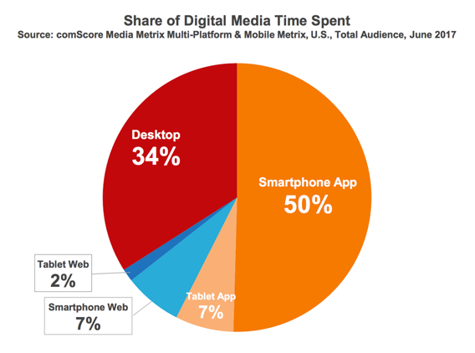
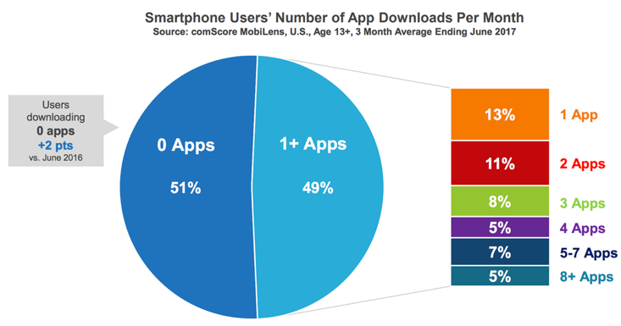
app usage continues to grow and revenue mounts
in 2017, 2.8+ million Android apps; 2.2+ million iOS apps
app revenues to exceed $189 million by 2020
however, a majority of users download 0 apps/month
“The mobile app boom kicked off in July 2008, when Apple introduced the App Store. Now it is over.”
-- Peter Kafka, recode.net, 2016
IS THE APP BOOM REALLY OVER?

Slide 3
Hacker Noon
claim: people want to use apps, but they're sick of downloading them
in the future, apps will need to speak to each other, the same way IoT works
the cloud and its ability to connect things via APIs is essential
low-code approach: rapid design & development, minimal coding via 3rd party APIs
can led to lower cost, fewer bugs & greater accessibility
e.g., Uber app
Box for storage, Google for maps, Braintree for payments,
Twilio for messaging, SendGrid for email
conclusion: app developers should hone their skills in data science, cloud operations & security technologies

Slide 4
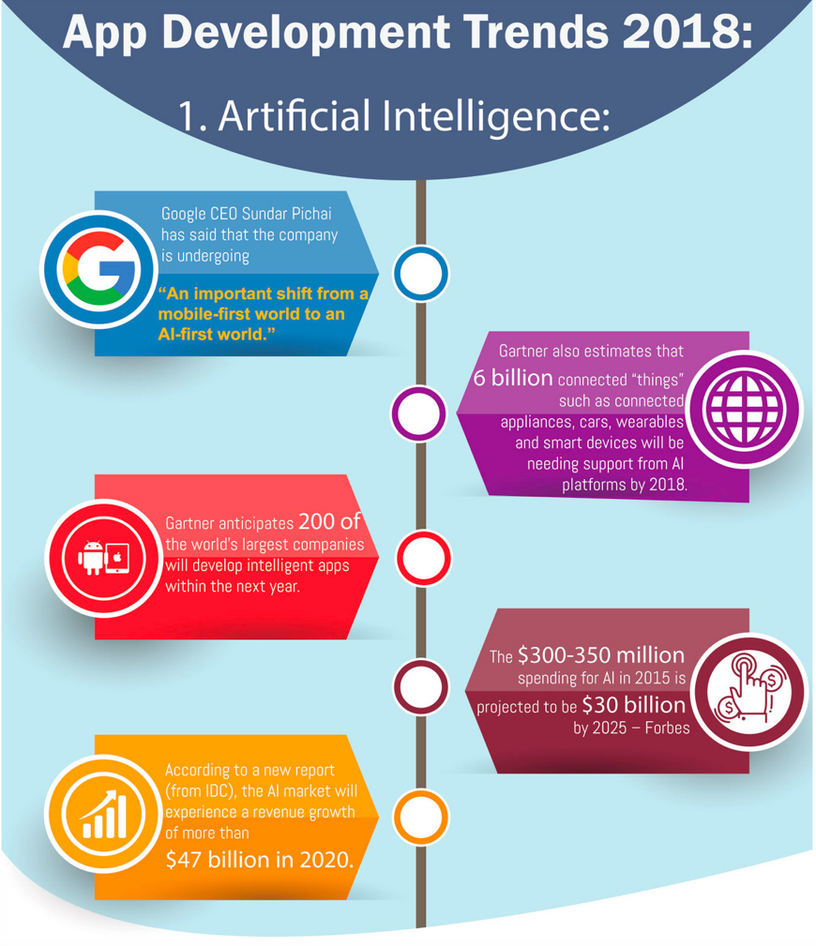
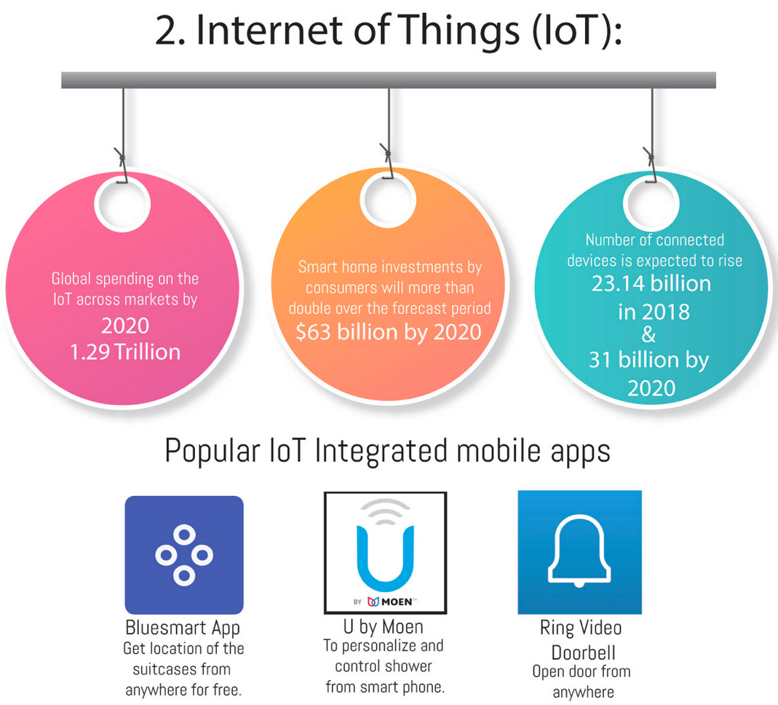

Slide 5
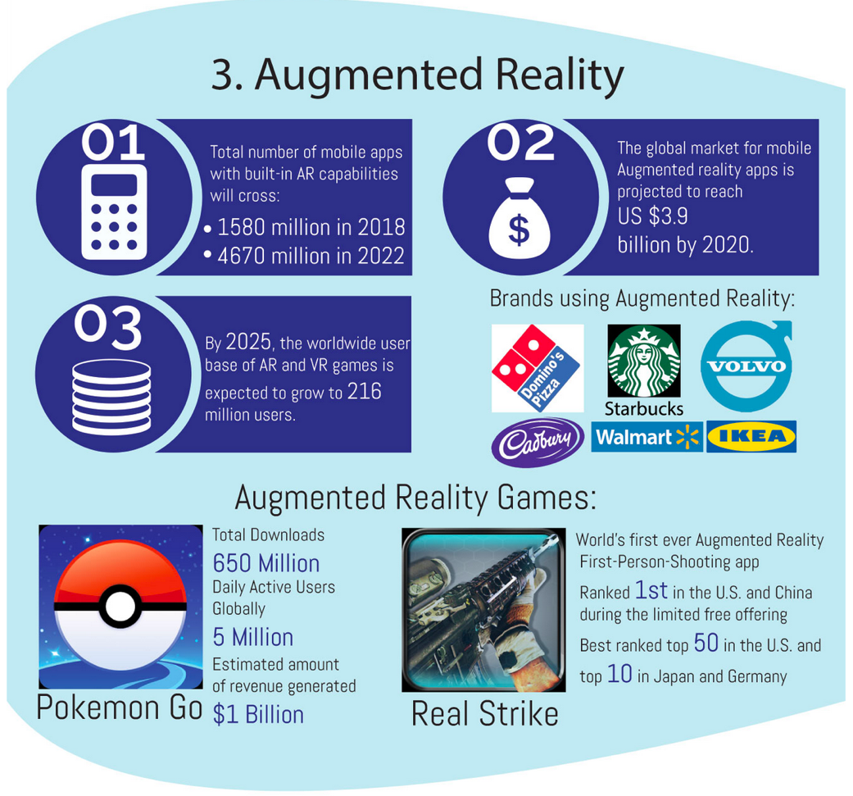
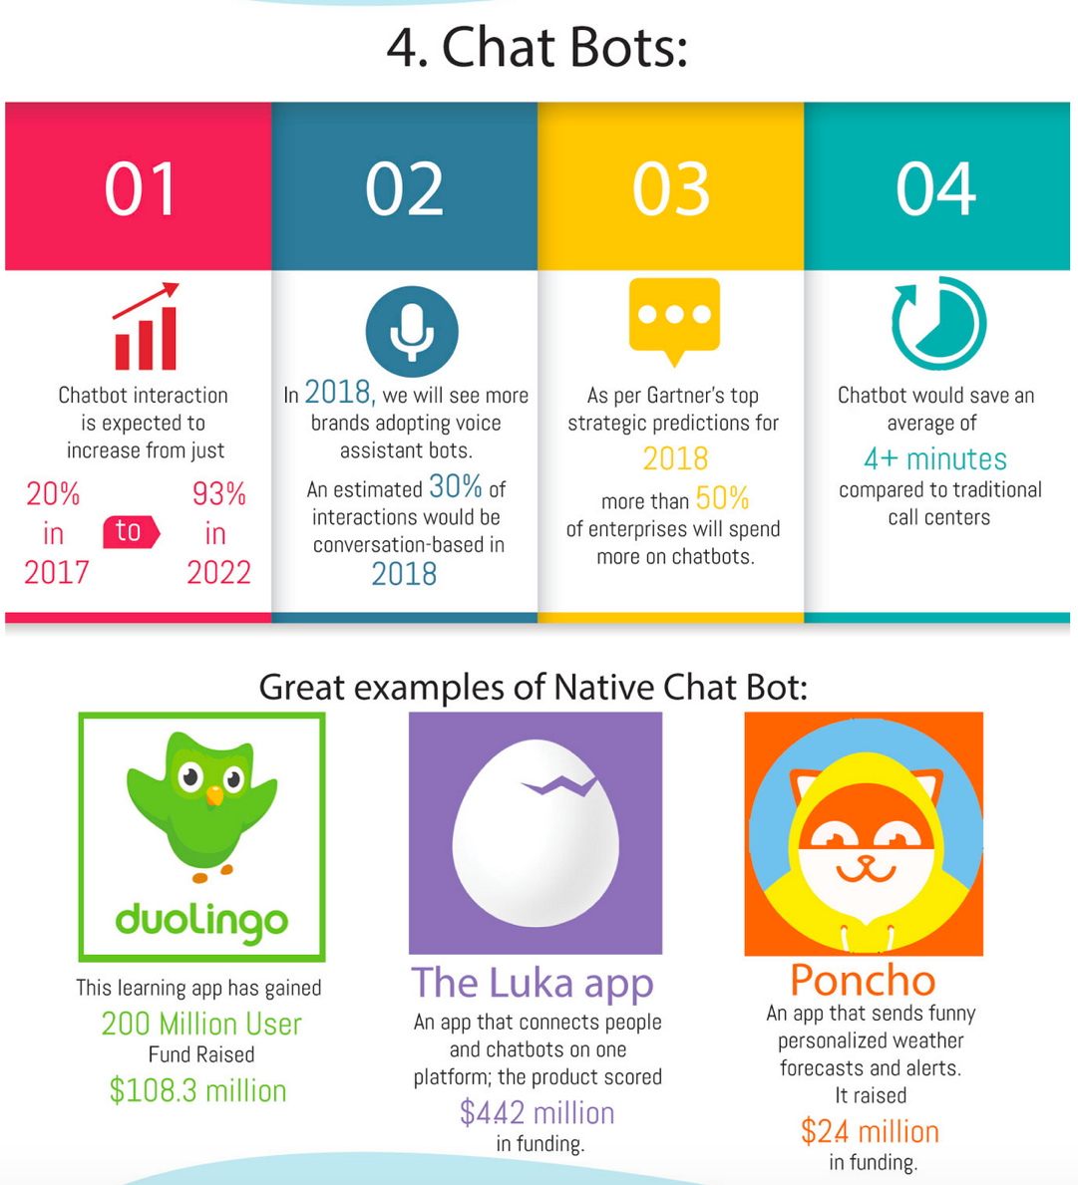
Dot Com Infoway

Slide 6
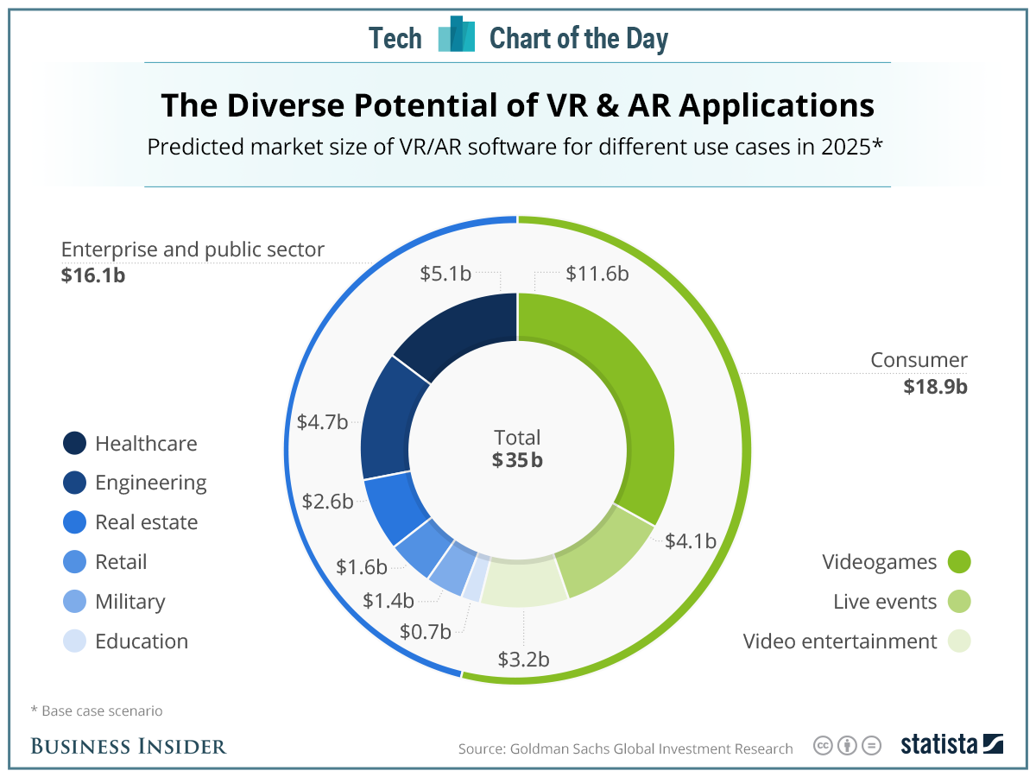
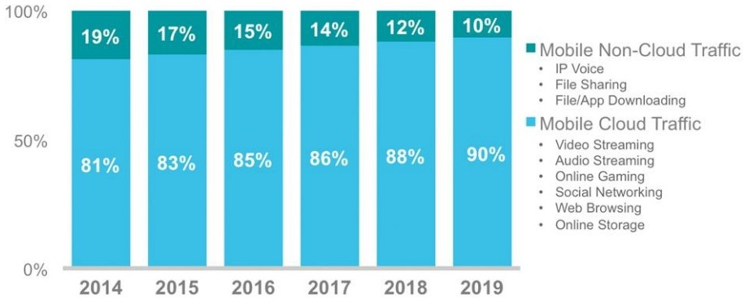
Accelerated Mobile Pages (AMP) are changing the Web app landscape
AR & VR will show some magic
Artificial Intelligence is real now
Cloud driven mobile apps are on the rise
Enterprise apps & micro-apps will advance further

Slide 7
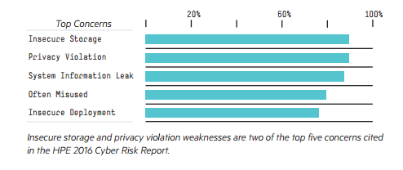
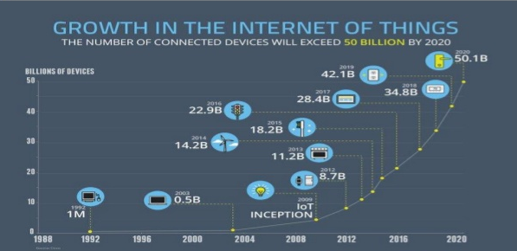
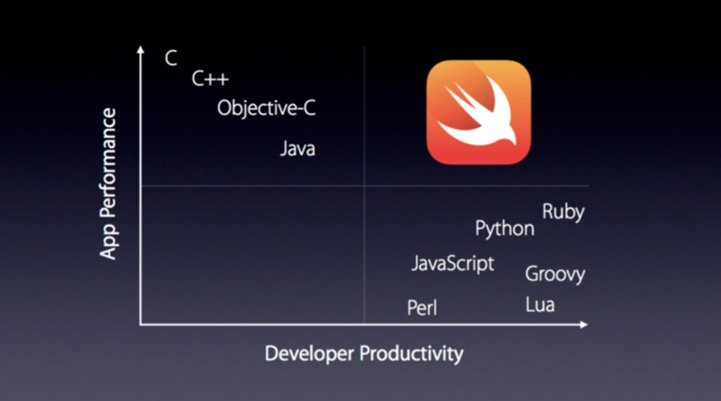
Value Coders
More focus on security in apps
Wearable devices are getting attention
M-commerce is becoming a new standard
Internet of Things will be much bigger
Beacons & location based servers are on the rise
Swift is much swifter now

Slide 8
Top development languages
Swift
C++
Java
HTML5
PHP
Top development tools
PhoneGap
Appcelerator
RhoMobile
WidgetPad
MoSync
Trending development frameworks
Flutter
React Native
Ionic
Xamarin

Slide 9
Questions
The first three articles are different views of the future of mobile development. Describe three (3) things you found interesting and useful from these articles.
Which of the three articles did you find most compelling? Explain why?
The fourth article, from Fingent, lists different technologies that can be used to develop apps. It lists five tools that are commonly used: PhoneGap, Appcellerator, RhoMobile, WidgetPad, and MoSync. Scan the Web site for one of these tools and describe one fact that you learned about the tool from that site.

