Slide 1
CSC 581: Mobile App Development
Spring 2019
    App design & development
MVC pattern
development process
  View → Model → Controller
HW5: tic-tac-toe

Slide 2
Model-View-Controller pattern
recall: designed apps utilize the Model-View-Controller software pattern:
  Model defines the logic underlying the app
    e.g., for a poker app, model cards, decks of cards, poker hands, …
  View defines the look of the app
    e.g., images of cards, button for dealing cards, …
  Controller defines actions of the app - it connects the View with the Model
    e.g., when the user clicks on a button to deal a card, it calls the appropriate method on a deck of cards object, then displays the resulting image
utilizing the MVC pattern leads to code that is
  easier to develop (especially when working in teams)
  easier to read & debug
  easier to reuse

Slide 3
App development process
Step 0: come up with an idea
  what problem are you trying to solve?
  who is your target audience?
  what makes it different from other apps?
Step 1: identify its features
  what functionality will it provide?
  what features are essential to its usability? → focus on these first
  what features would make it stand out? → design with these in mind
Step 2: create a storyboard (View)
  how many different views? what type of navigation?
  what are the visual elements? what are the controls?
  for common tasks, what is the user experience like?
  can use Interface Builder in Xcode to draw the storyboard

Slide 4
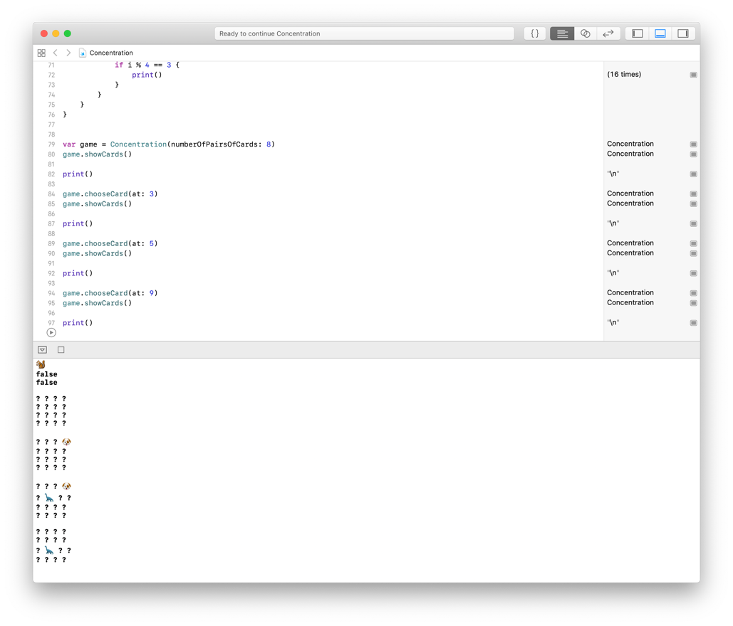
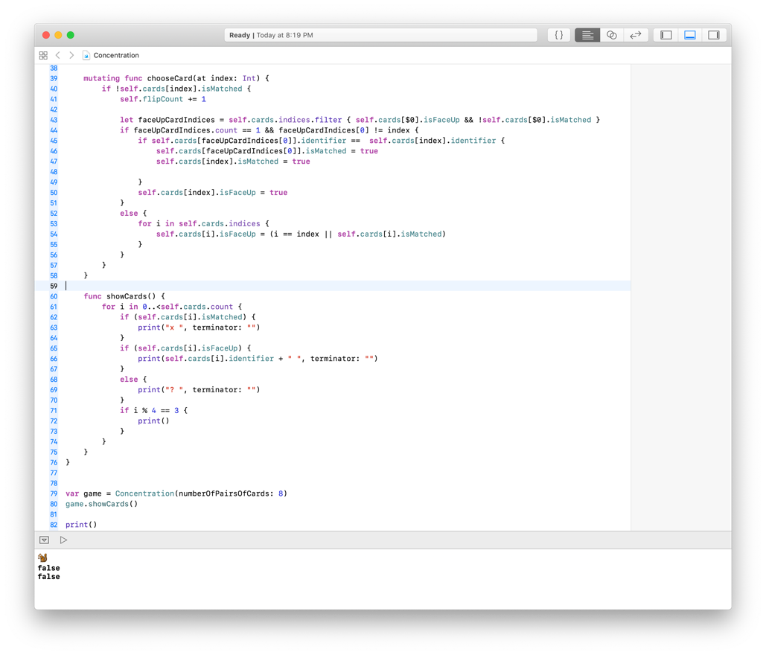
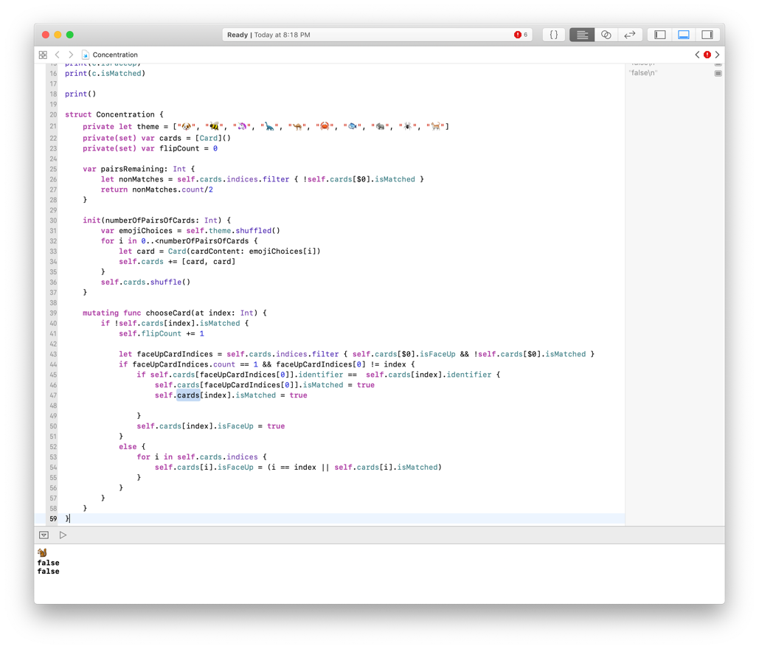
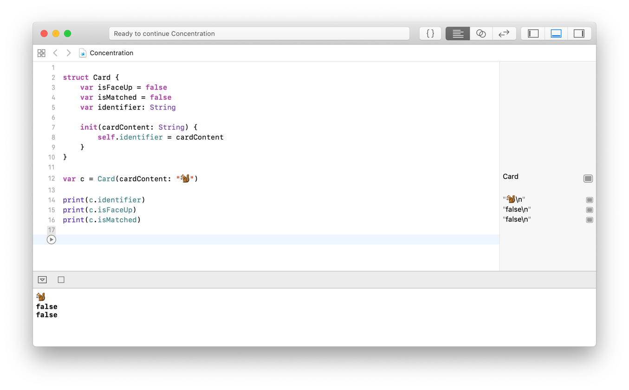
App development advice
Step 3: design & develop the underlying logic (Model)
  identify the objects that need to be modeled with structs/classes
    for each struct/class, identify the state that must be maintained + operations
  develop the Swift structs/classes in a playground
    use print statements to debug the code
  e.g., Concentration app

Slide 5
App development advice
Step 4: create the basic app (Controller)
  add the model classes to the project (can leave the print functions for now)
  create controller(s) to connect the view(s) with the model
  implement and test one feature at a time
  get the basic app working first (with the essential features)
Step 5: revise and add features as time allows
  as you test/debug your app…
    you may find that the user experience needs to change – change the flow
    you may find that some features are unnecessary – cut them
    you may find that some missing features are needed – add them
  before revising or adding a feature, save the current app so you can restore
  when done revising, clean up (remove prints, make sure names make sense, …)

Slide 6
HW5: tic-tac-toe
for your final HW, you will complete the development of a tic-tac-toe app
  STEP 0: a simple tic-tac-toe game, the user plays against the app
    i.e., user clicks on a board spot to place an X, the app selects a spot for O
    target audience: young children (or really bored adults)
  STEP 1: features
    displays the board (initially blank)
    user can click on a spot to make an X appear (O follows automatically)
    ideally, the app uses a smart strategy for O (but not too smart)
    winner (or draw) is displayed when game is over

Slide 7
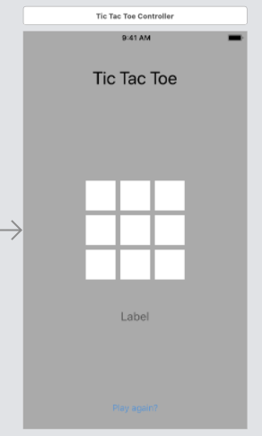
HW5: tic-tac-toe (cont.)
  STEP 2: create a storyboard (View)
    ideally, would have a welcome screen with author info & rules of the game
    for now, you are given a single view with the game board
label for the app title
a 3x3 grid of buttons for the board spots
clicking on a button changes the button text to X
label to display winner or draw (initially hidden)
button to play new game (initially hidden)
when the game is over, the label (with appropriate message) and button appear
once a new game starts, they disappear

Slide 8
HW5: tic-tac-toe (cont.)
  STEP 3: design & develop the underlying logic (Model)
    the basic design has been done for you: you must implement a struct named TicTacToeGame that has the following:
    a private(set) field named board that represents the tic-tac-toe board
      e.g., print( game.board[0][1] ) should display piece at row 0, col 1
  a method named place that places a piece at a specific row/column
  e.g., game.place(piece: "X", inRow: 0, andColumn: 1)
  a method named place that places a piece in a random empty spot
  for 80% credit, can pick any empty spot at random
  for full credit, should prioritize wins & non-losses
  e.g., game.place(piece: "O")
  a method named status that returns the status of the game
  can return "X wins!", "O wins!", "It's a draw.", or "Play on…"
  e.g., print( game.status() )

Slide 9
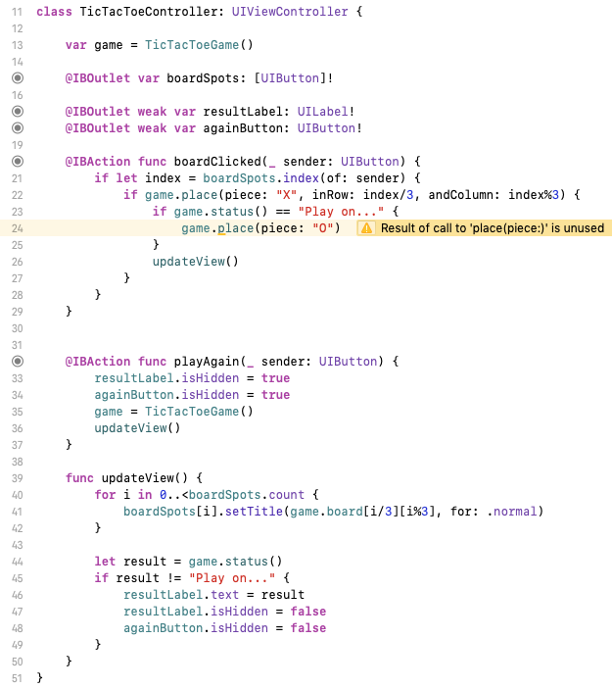
HW5: tic-tac-toe (cont.)
  STEP 4: create the basic app (Controller)
    this has been done for you
    note: your Model must match the names used here exactly
  STEP 5: revise & add features
    you are to add at least one significant feature
    e.g., a welcome screen with rules, a help popover, persistent stats (games won & lost), …

