Slide 1
CSC 581: Mobile App Development
Spring 2019
Design Guidelines
iOS Human Interface Guidelines (Apple)
themes: clarity, deference, depth
principles: aesthetic integrity, consistency, direct manipulation, feedback, metaphors, user control
The Guide to Mobile App Design: Best Practices for 2018 and Beyond (UXPin)
UX fundamentals: minimize cognitive load, optimized user flow, reduce clutter, self-evident navigation…

Slide 2
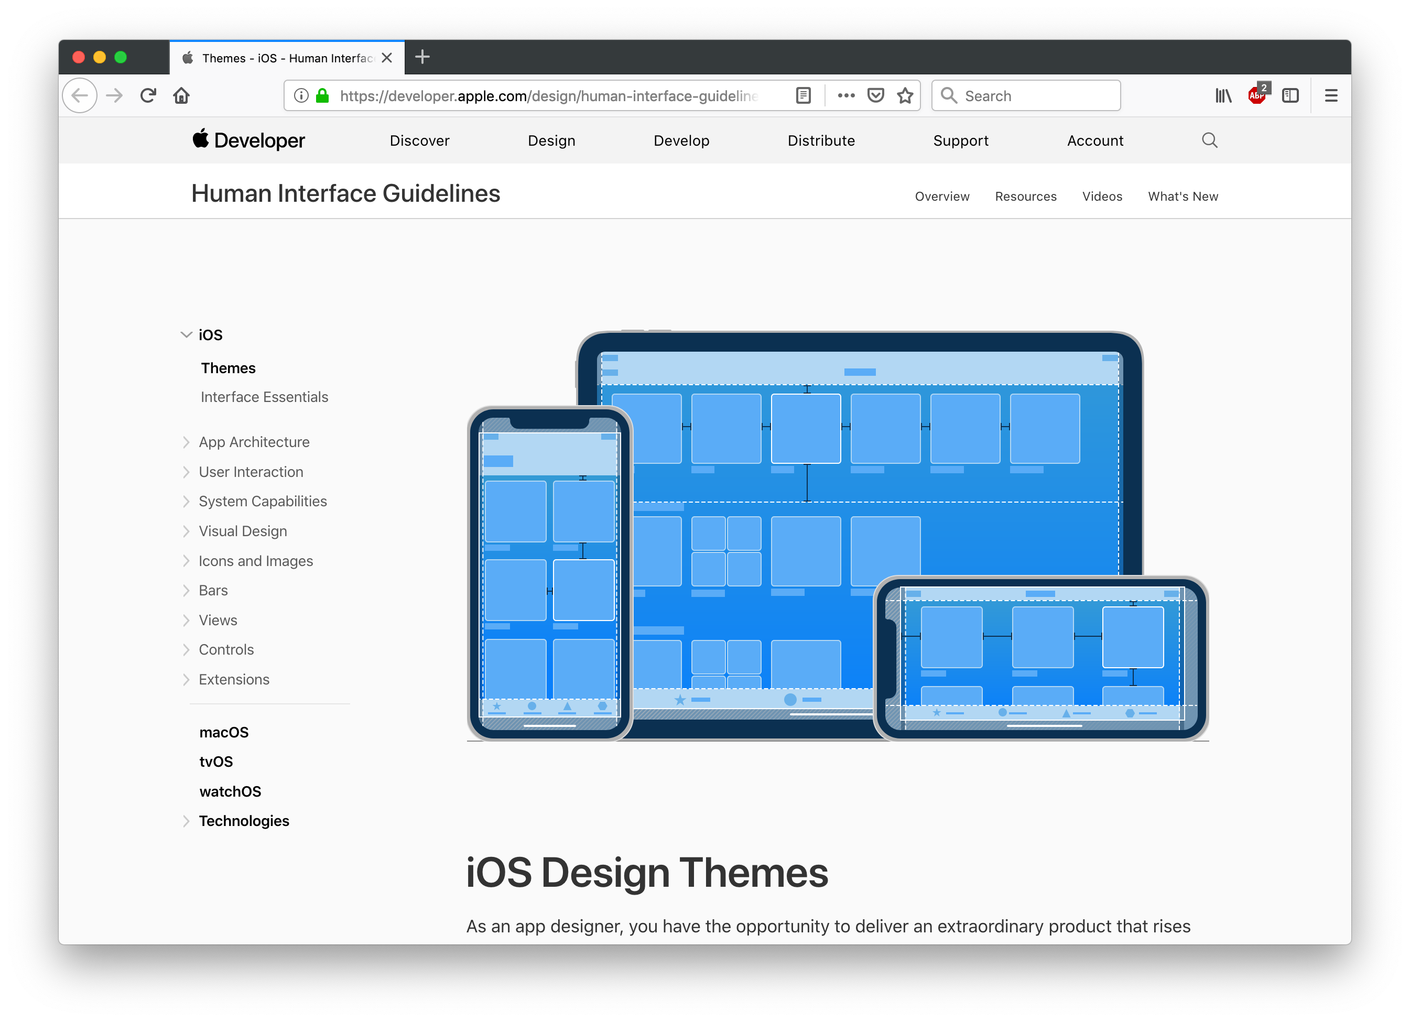

Slide 3
iOS design themes (from Apple Developer)
Clarity
text is legible at every size
icons are precise and lucid
adornments are subtle & appropriate
a sharpened focus on functionality motivates the design
Deference
fluid motion & a crisp interface help people understand & interact with content
content typically fills the entire screen, while translucency/blurring hint at more
minimal use of bezels, gradients & drop shadows keep the interface light & ensure that content is paramount
Depth
distinct visual layers & realistic motion convey hierarchy & facilitate understanding
touch & discoverability heighten delight and enable access to functionality
transitions provide a sense of depth as you navigate through content

Slide 4
iOS design principles
Aesthetic Integrity - an app's appearance and behavior should integrate with its functionality
Consistency - should implement familiar standards and paradigms by using system-provided UI elements, well-known icons, standard text styles, and uniform terminology
Direct Manipulation - the direct manipulation of onscreen content engages people and facilitates understanding
Feedback - acknowledges actions and shows results to keep people informed
Metaphors - people learn more quickly when an app’s virtual objects and actions are metaphors for familiar experiences
User Control – people are in control; the app can suggest or warn, but actions and decision making are in the hands of the user

Slide 5
iOS design guidelines
interface essentials
bars tell people where they are, provide navigation
views contain the primary content people see
controls initiate actions and convey information
accessibility
provide alternative text labels for images, icons, and interface elements
test your app with accessibility features
loading
show content as soon as possible and make it clear when loading is occurring
modality
preventing people from doing other things until the current mode is complete is sometimes necessary, but should be avoided whenever possible

Slide 6
iOS design guidelines
navigation
navigation can be hierarchical, flat, or content-driven
always provide a clear path (including backwards)
launching
design a launch experience that is fast, fun, and educational
restore the previous state when your app restarts
requesting permission
request personal data only when your app clearly needs it and it cannot be accessed automatically (e.g., from location)
data entry
when possible, provide choices or reasonable default values
dynamically validate fields and only advance if valid entries obtained
gestures
use standard gestures for standard actions (tap, drag, flick, swipe, pinch, …)
notifications
use sparingly – can be banner (disappears shortly) or alert (manually dismissed)

Slide 7
iOS design guidelines
adaptivity & layout
extend visual elements to fill the screen; support diff screen sizes & orientations
provide ample touch targets for interactive elements
use visual weight and balance to convey importance
branding
incorporate refined, unobtrusive branding; defer to content over branding
color
use color judiciously for communication, choose a key color to indicate interactivity
choose a limited color palette that complements your logo/branding
be aware of colorblindness, cultural attitudes to colors
fonts
if possible, use a single typeface (iOS uses San Francisco)
image size & resolution
supply high-res images of all artwork (@2x and @3x)
notifications
use whenever possible, since they will be familiar to users

Slide 8
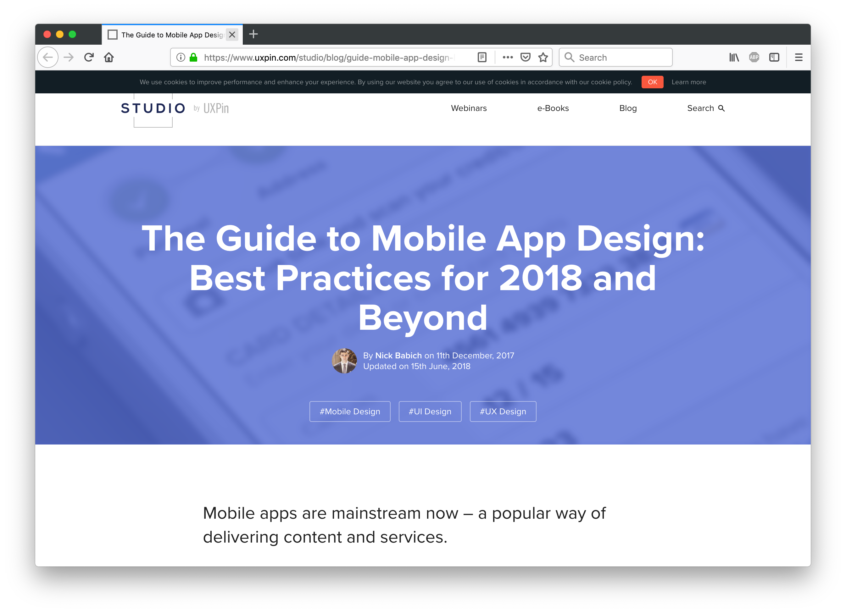

Slide 9
UXPin best practices
minimize cognitive load
minimize confusion, things the user has to remember
optimize user flow
understand how users interact with the app, streamline as much as possible
e.g., chunking for big tasks, always provide a natural next step
cut out the clutter
deliver relevant info (signal) while avoiding irrelevant info (noise)
make navigation self-evident
e.g., communicate the current location, don't hide nav. controls, be consistent
design elements should look like they behave, utilize intuitive gestures
provide visual feedback to make interaction comfortable
design for interruption
make it easy to re-engage with the app if interrupted or distracted
focus on first time experience
make the app appear fast with skeleton screens
annoying notifications are the #1 reason people uninstall apps

Slide 10
Questions
On the first page of the Apple site, there is a list of 6 high-level design principles: aesthetic integrity, consistency, direct manipulation, feedback, metaphors, and user control. Select an app that you use regularly, and give it a grade in each of these areas. Briefly describe why you assigned each grade.
Review the Apple site, which is produced by Apple for its developers. Identify and describe three guidelines or design tips that you found especially informative and potentially useful.
Review the Best Practices article, which is produced by UXPin (a third-party community of designers and marketers). Identify and describe three guidelines or design tips that you found especially informative and potentially useful.
Did you find that the design guidelines produced by UXPin largely agreed with those from Apple? Can you identify any instances where the advice from the two sites was at odds?
Did you learn any design principles from these sites that have caused you to rethink your project design? If so, what aspects of the design are you considering changing? If not, describe briefly how your initial design is supported by the design principles from the sites.

