Slide 1
CSC 581: Mobile App Development
Spring 2019
Progressive Web Apps
saving Web pages to iOS home screen
Progressive Web Apps
icon
manifest file
service worker
PWA vs. native tradeoffs

Slide 2
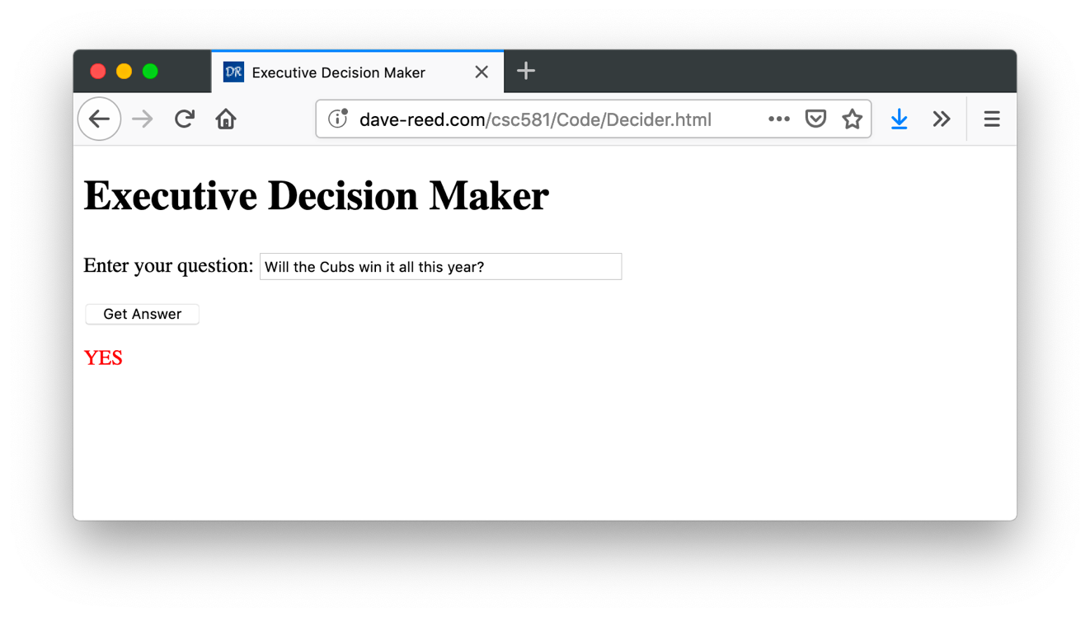
Web vs. App development
developing a Web page is generally much simpler than a native app
does not require development tools – can create using a simple text editor
HTML/CSS/JavaScript are easy to pick up (and lots of online support)
PWAs can run on all platforms (so no need for separate iOS & Android apps)
the user does not have to download an app, no app store required
<!doctype html>
<html>
<head>
<title>Executive Decision Maker</title>
<script>
function showAnswer() {
var responses = ["YES", "NO", "MAYBE"];
var index = Math.floor(Math.random()*responses.length);
document.getElementById("outputDiv").innerHTML = responses[index];
}
</script>
</head>
<body>
<h1>Executive Decision Maker</h1>
<p>Enter your question: <input type="text" size=40></p>
<p><input type=button value="Get Answer" onclick="showAnswer()"></p>
<div id="outputDiv" style="color:red"></div>
</body>
</html>
simple Web page for an executive decision maker

Slide 3
Pseudo-apps
however, a Web page in a browser is not as convenient as an app
e.g., an app has an icon on the home screen, so easier to find and access
iOS does allow you to save a Web page on the home screen
essentially, creates a pseudo-app that looks like other apps (but is actually the Web page in a browser window)
load the page in Safari (or Chrome)
click on the Share icon and select "Add to Home Screen"
this puts a pseudo-app on the screen
its icon is a screen shot of the Web page
when you click on the icon, it opens the page in a browser window
since pseudo-apps are just Web pages viewed in the browser
they can't access any of the native phone features (sensors, GPS, photos, …)
they can't work when offline or save their state if closed or interrupted

Slide 4
Progressive Web App
a PWA is a Web page with supporting files that allows it to
specify its icon image
provide information as to how the page is to be displayed (manifest file)
provide code so that it works offline and can save app data (service worker)
can also access device sensors, native features, push notices, …
recall: PWAs were the 3rd-party dev. model initially envisioned by Apple
3rd-party native apps & the App Store were added with Phone OS 2
as of 2018, all major mobile Web browsers support PWAs
PWAs are not enthusiastically supported by Apple
Apple wants to control app quality/security through the App Store approval process
PWAs do not need to be downloaded through the App Store – can link directly to a Web site and download the PWA without Apple intervention
many PWA developers will still post them to the App Store for visibility

Slide 5
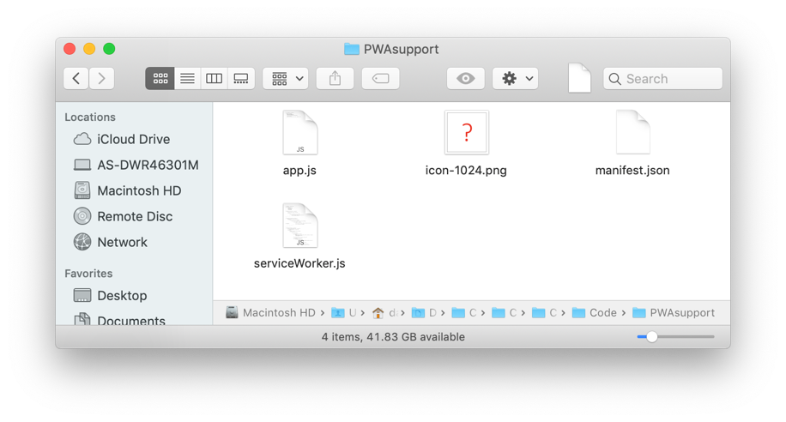
Executive Decision Maker PWA
we can transform our simple Web page to a PWA by adding resources (here, organized in a PWAsupport folder)
<!doctype html>
<html>
<head>
<title>Executive Decision Maker</title>
<link rel="apple-touch-icon" sizes="1024x1024" href="PWAsupport/icon-1024.png">
<link rel="manifest" href="PWAsupport/manifest.json">
<script src="PWAsupport/app.js"></script>
<script>
function showAnswer() {
var responses = ["YES", "NO", "MAYBE"];
var index = Math.floor(Math.random()*responses.length);
document.getElementById("outputDiv").innerHTML = responses[index];
}
</script>
</head>
<body>
<h1>Executive Decision Maker</h1>
<p>Enter your question: <input type="text" size=40></p>
<p><input type=button value="Get Answer" onclick="showAnswer()"></p>
<div id="outputDiv" style="color:red"></div>
</body>
</html>

Slide 6
Manifest file
the manifest file (usually a .json file), contains info about the app
may include PWA name, title, author, default style settings, icons, …
used by the browser to make the PWA look like an actual app
for this example, manifest.json:
{
"name": "Executive Decision Maker",
"short_name": "Decider",
"start_url": "../DeciderPWA.html",
"display": "standalone",
"orientation": "portrait",
"lang": "en-US"
}

Slide 7
Service worker
a service worker acts a proxy for the Web server if it is unavailable
e.g., if the phone is offline, the service worker can restore the PWA to its last saved state and run from that
can also allow access to push notifications and some native APIs
// serviceWorker.js
//////////////////////////////////////////////////////////////////////////////////////////
var cacheName ='version: 1.0.0';
var cacheFiles = [ '../DeciderPWA.html', './app.js',
'./serviceWorker.js', './manifest.json', './icon-1024.png' ]
self.addEventListener('install', function(e) {
console.log('[Service Worker] Installed');
e.waitUntil(
caches.open(cacheName).then(function(cache) {
console.log('[Service Worker] Caching cacheFiles');
return cache.addAll(cacheFiles);
}) ); });
self.addEventListener('activate', function(e) {
console.log('[Service Worker] Activated');
e.waitUntil(caches.keys().then(function(cacheNames){
return Promise.all(cacheNames.map(function(thisCacheName){
if(thisCacheName != cacheName){
console.log('[Service Worker] Removing Cached Files from Cache- ', thisCacheName);
return caches.delete(thisCacheName);
} })) }) ); })
self.addEventListener('fetch', function(e) {
console.log('[ServiceWorker] Fetch', e.request.url);
e.respondWith(
. . .

Slide 8
Registering a service worker
a service worker must be registered with the browser
this is done the first time the PWA is loaded, again every 24 hours to keep current
for our PWA, the app.js script is run by the page to register serviceWorker.js
// app.js
////////////////////////////////////////////////////////////
if ('serviceWorker' in navigator) {
navigator.serviceWorker
.register('serviceWorker.js')
.then(function(registration) {
console.log("[Service Worker] Registered");
})
.catch(function(err) {
console.log("[Service Worker] Failed to Register", err);
})
}

Slide 9
Downloading a PWA
the PWA page and supporting resources must be stored together
when you load the page into your mobile browser and Add to Home Screen, it downloads the supporting resources along with the page
will use the specified image for the PWA icon
will display the page using the style settings in manifest.json
will register the service worker via the app.js script
will provide the proxy and API services of serviceWorker.js
since PWAs are running through the browser, they are platform independent
the same PWA can run on an Android device or an iOS device
HUGE ADVANTAGE OVER NATIVE DEVELOPMENT!
tradeoff: PWAs do not have the full range of native features
may not have same look & feel, or be as responsive as native apps

Slide 10
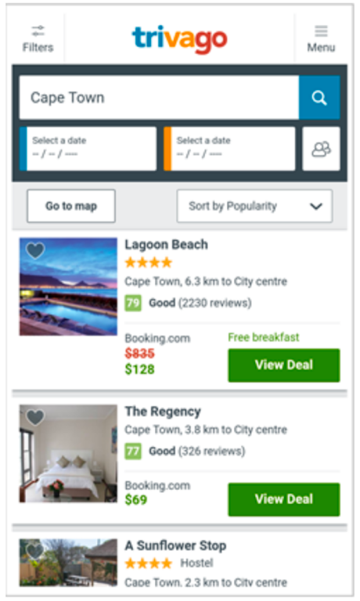
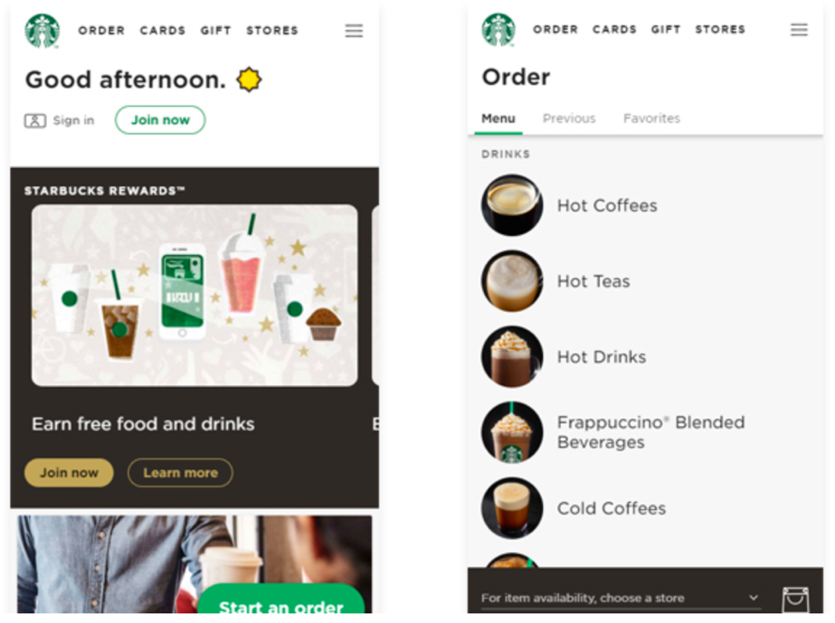
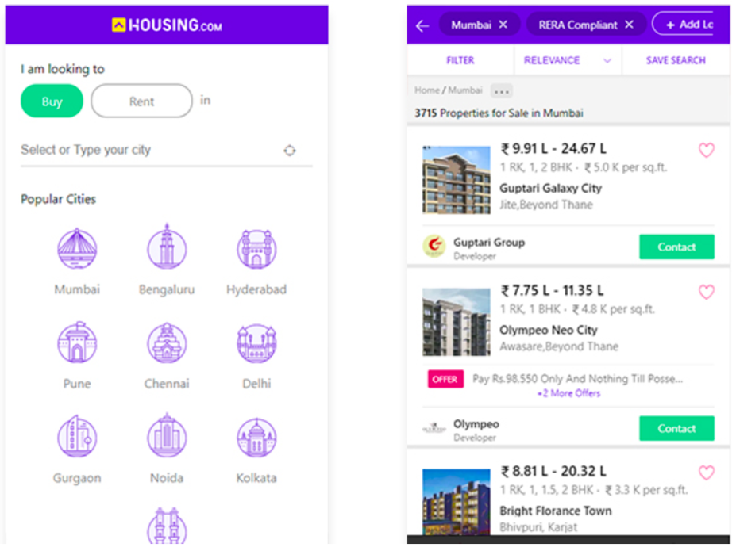
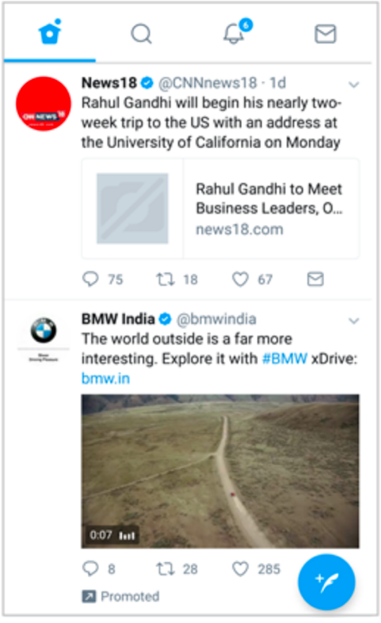
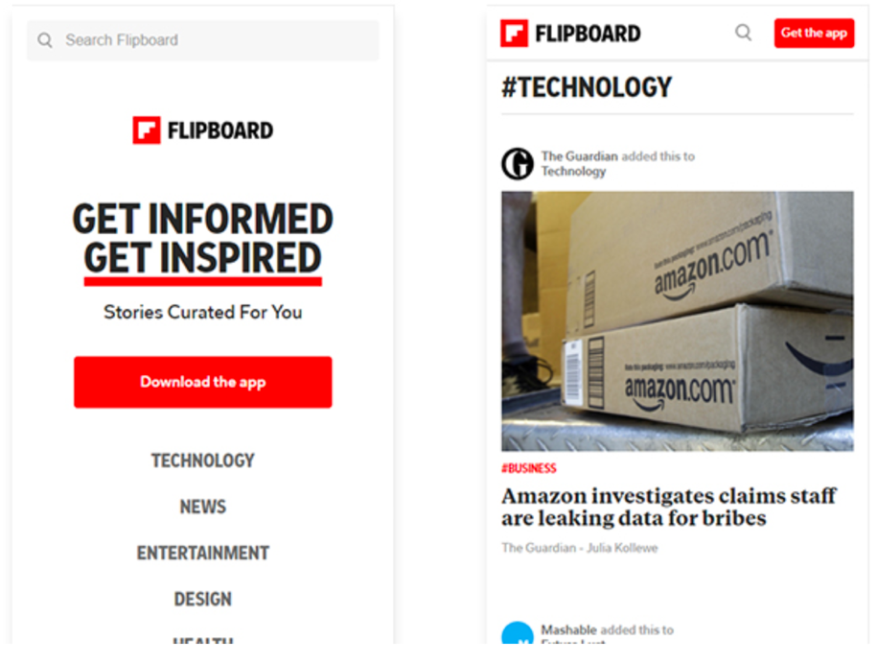
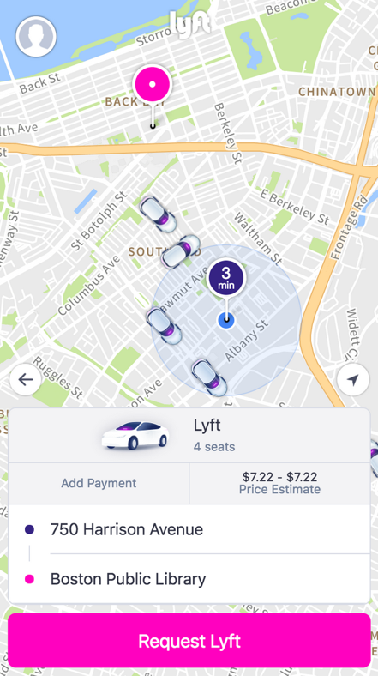
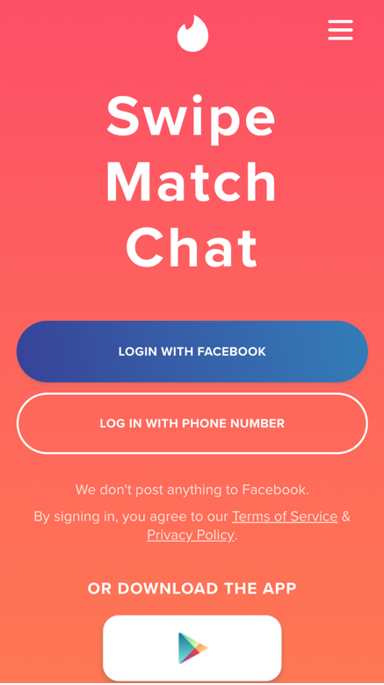
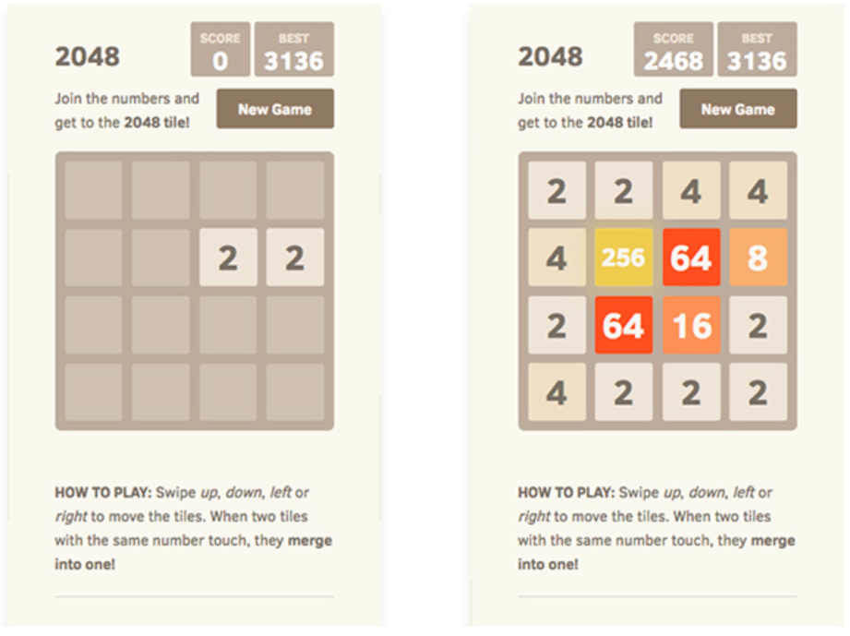
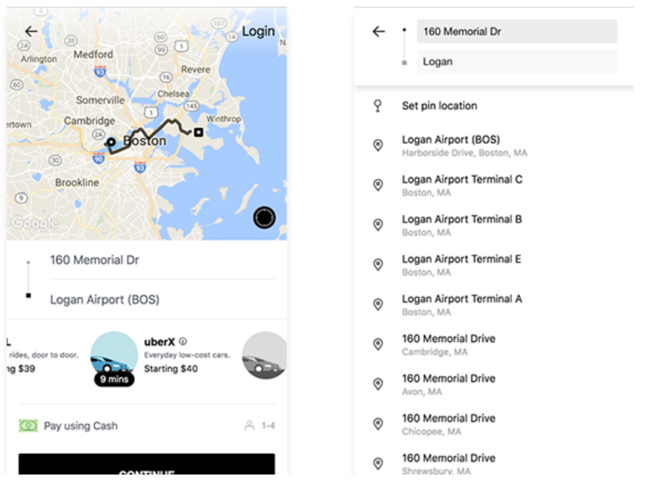
Popular PWAs

Slide 11
Questions
Describe in what ways a Progressive Web App is similar to a Web page. Describe how it is different.
Describe in what ways a Progressive Web App is similar to a mobile app. Describe how it is different.
What role does the manifest file play in a Progressive Web App? What role does the service worker play?
After reading about PWAs and their advantages and disadvantages, do you believe that PWAs will grow in popularity, replacing native apps for many tasks? Explain your answer.

