Slide 1
CSC 533: Programming Languages
Spring 2024
Functional programming
  functional vs. imperative
    functional programming principles
    functional features in Java
  LISP
    history and basic design
  Clojure
    modern updates

Slide 2
Functional programming
imperative languages are modeled on the von Neumann architecture
  a program is a sequence of statements that alter its state
  key features: variable assignments, conditionals, loops, functions
  OOP is a specialization that emphasizes modularity & reusability
    each object maintains its own state (fields) and modifies via methods
    can utilize inheritance and polymorphism to ease development
functional programming represents a very different approach
  a program is a collection of functions with no internal state
  computation occurs not by executing a sequence of statements, but by composing functions to transform data into its desired form
  Procedural approach Functional approach
  get list of grades
  sort in increasing order (get-last (sort (get-grades)))
  get last entry in list

Slide 3
Basic principles
there are several principles that define functional programming
  pure functions
    functions should return a value based solely on the inputs, with no side-effects
  first-class functions
    functions are allowed to support all operations available to other entities
      e.g., assigning to variables, passing as inputs to functions, returning as outputs of functions
  immutability
    an entity cannot be modified after it is instantiated
      e.g., variables can't be reassigned, data structures can't be changed
  referential transparency
    replacing an expression with its corresponding value should have no impact on the program's behavior

Slide 4
Functional programming in imperative languages
it is possible (but not necessarily easy) to program in a functional style using imperative languages
  public class Funky {
  public static void main(String[] args) {
  double[] numbers = { 1, 3, 10, 8 };
  System.out.println(square(sum(numbers)));
  }
  public static double square(double x) {
  return x * x;
  }
  public static double sum(double[] nums) {
  double sum = 0.0;
  for (double n : nums) {
  sum += n
  }
  return sum;
  }
  }
functions not first class
variables not immutable (nor are most objects)
definitely not referential transparency

Slide 5
Functional programming in Java
Java 8 (2014) introduced many functional programming constructs
    lambda expressions (unnamed functions)
    first-class functions
    streams with filter, map, reduce, …
  to really understand the function approach, you need to learn a functional language
int sumAbove = 0;
for (int n : nums) {
if (n > 50) {
sumAbove += n;
}
}
-------------------------------------------------------------------------
int sumAbove = nums.stream().filter(n -> n > 50).reduce(0, Integer::sum);

Slide 6
LISP
the 2nd high-level language developed was LISP (List Processing Language)
  while FORTRAN was well-suited to scientific computing, not so much for AI
  Artificial Intelligence was driving a number of initiatives in 50's, and required a language closer to human reasoning symbolic
    (dynamic) list-oriented vs. array-oriented
    transparent memory management vs. programmer-controlled
    functional vs. imperative
LISP was developed by John McCarthy at MIT in 1958
  instantly popular as the language for AI
  functional approach produced a separation from the underlying architecture that made it less efficient (and usually interpreted)
  over the years, many variants have been developed
    e.g., Scheme (1975), Common Lisp (1984), Racket (1994), Clojure (2005)

Slide 7
LISP design
LISP is very simple and orthogonal
  only 2 kinds of data objects
    atoms (symbols, strings, numbers, booleans, …)
      red above "foo" 12 1.5 #t #f
    lists (of atoms and sublists)
      unlike arrays, lists do not have to store items of same type/size
      do not have to be stored contiguously
      do not have to provide random access
      ()
      (1 2 3)
      ("foo" 100 #t)
      (block1 (color red) (above block2))

Slide 8
LISP design
  all computation is performed by applying functions to arguments
  function calls appear as lists: (FUNC ARG1 ARG2 … ARGn)
      no variables, no assignments, no iteration
  (+ 3 2)
  5
  (+ 3 (* 2 5))
  13
  (list 'a 'b 'c)
  (a b c)
  (car '(foo bar biz baz))
  foo
  (cdr '(foo bar biz baz))
  (bar biz baz)

Slide 9
LISP design
  functions and function calls are also represented as lists
      no distinction between program and data
  (define FUNC
  (lambda (ARG1 ARG2 . . . ARGn)
  RETURN_EXPRESSION))
  (define square (define last
  (lambda (x) (lambda (arblist)
  (* x x)) (car (reverse arblist)))
  (square 3) ➢ (last '(a b c))
  9 c
  (square 1.5) ➢ (last '(foo))
  2.25 foo

Slide 10
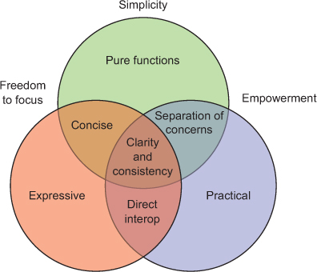
Clojure
Clojure is a modern variant of LISP
  developed by Rich Hickey in 2005
  very LISP-like, with some updates to relate to more modern expectations
  concepts underlying the Clojure philosophy, from The Joy of Clojure (2nd ed.)

Slide 11
Clojure details
  dynamic typing (like LISP)
  dynamic memory management (like LISP)
  static scoping (unlike LISP)
  whereas LISP was interpreted (and slow), Clojure uses a hybrid approach
    code is compiled into Java Byte Code, then interpreted
  takes advantage of wide popularity & availability of Java
  utilizes Java's garbage collection, support for concurrency, data types, …
  this approach also makes it easy to integrate Clojure and Java code
    can import Java classes, create objects and call methods
  added modern features
    additional built-in data structures: arrays, sets, maps (based on Java)
    support for exception handling, concurrency

Slide 12
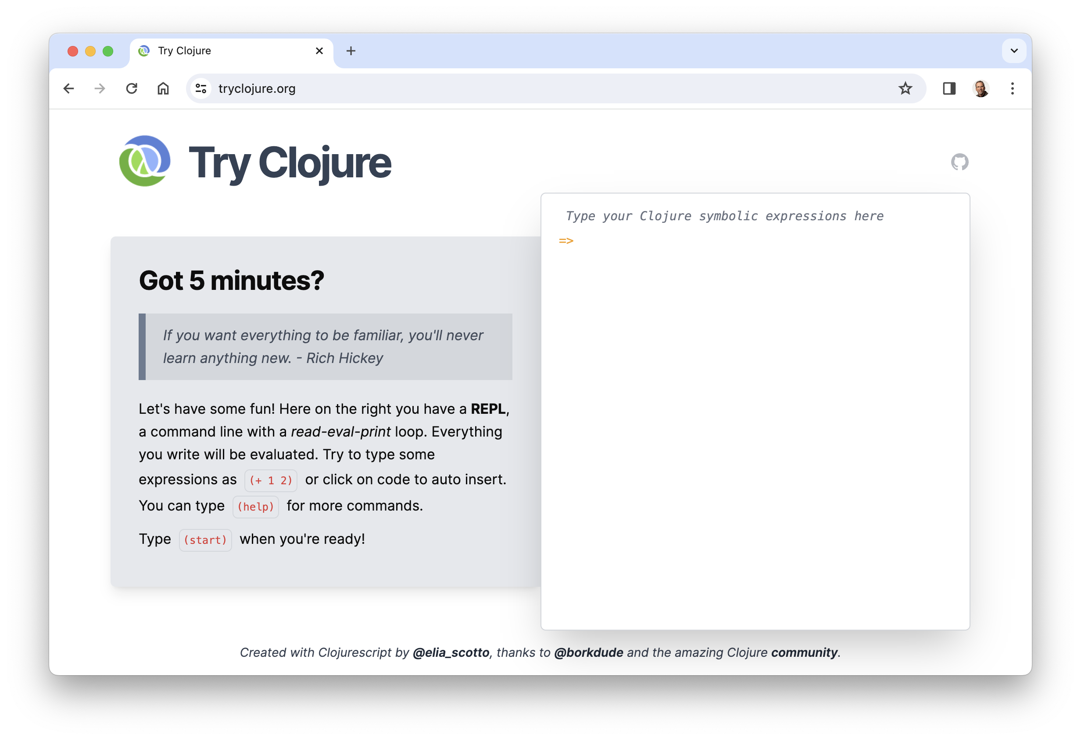
Online Clojure tutorial

