Slide 1
CSC 533: Programming Languages
Spring 2024
Data types
  primitive types (integer, float, boolean, char, pointer)
  heap management
  reference counts vs. garbage collection
  partition & copy vs. mark & sweep
We will focus on C, C++, and Java as example languages

Slide 2
Primitive types: integer
languages often provide several sizes/ranges
  in C/C++/Java short (2 bytes in Java)
  int (4 bytes in Java)
  long (8 bytes in Java)
  absolute sizes are implementation dependent in C/C++ TRADEOFFS?
  Java has a byte type (1 byte)
  in C/C++, char is considered an integer type
  most languages use 2’s complement notation for negatives
    1 = 00…000001 -1 = 11…111111
    2 = 00…000010 -2 = 11…111110
    3 = 00…000011 -3 = 11…111101

Slide 3
Primitive types: floating-point
again, languages often provide several sizes/ranges
  in C/C++/Java float (4 bytes in Java)
  double (8 bytes in Java)
  C/C++ also have a long double type
  historically, floating-points have been stored in a variety of formats
    same basic components: sign, fraction, exponent
  in 1985, IEEE floating-point formats were standardized
(sign)fraction x 2^{exponent}
special bit patterns represent:
  infinity
  NaN
other number types: decimal, fixed-point, rational, …

Slide 4
Primitive types: Boolean
introduced in ALGOL 60
  C does not have a boolean type, conditionals use zero (false) and nonzero (true)
  C++ has bool type
    really just syntactic sugar, automatic conversion between int and bool
  Java has boolean type
    no conversions between int and boolean
implementing Booleans
  could use a single bit, but not usually accessible
  use smallest easily-addressable unit (e.g., byte)

Slide 5
Primitive types: character
stored as numeric codes, e.g., ASCII (C/C++) or UNICODE (Java)
  in C/C++, char is an integer type
    can apply integer operations, mix with integer values
    char ch = ’A’; char ch = ’8’;
    ch = ch + 1; int d = ch – ’0’;
    cout << ch << endl cout << d << endl;
  in Java, char to int conversion is automatic
    but must explicitly cast int to char
    char next = (char)(ch + 1);

Slide 6
Primitive types: pointer
a pointer is nothing more than an address (i.e., an integer)
  useful for:
  dynamic memory management (allocate, dereference, deallocate)
  indirect addressing (point to an address, dereference)
  PL/I was the first language to provide pointers
    pointers were not typed, could point to any object
      ➔ no static type checking for pointers
  ALGOL 68 refined pointers to a specific type
  in many languages, pointers are limited to dynamic memory management
  e.g., Pascal, Ada, Java, …

Slide 7
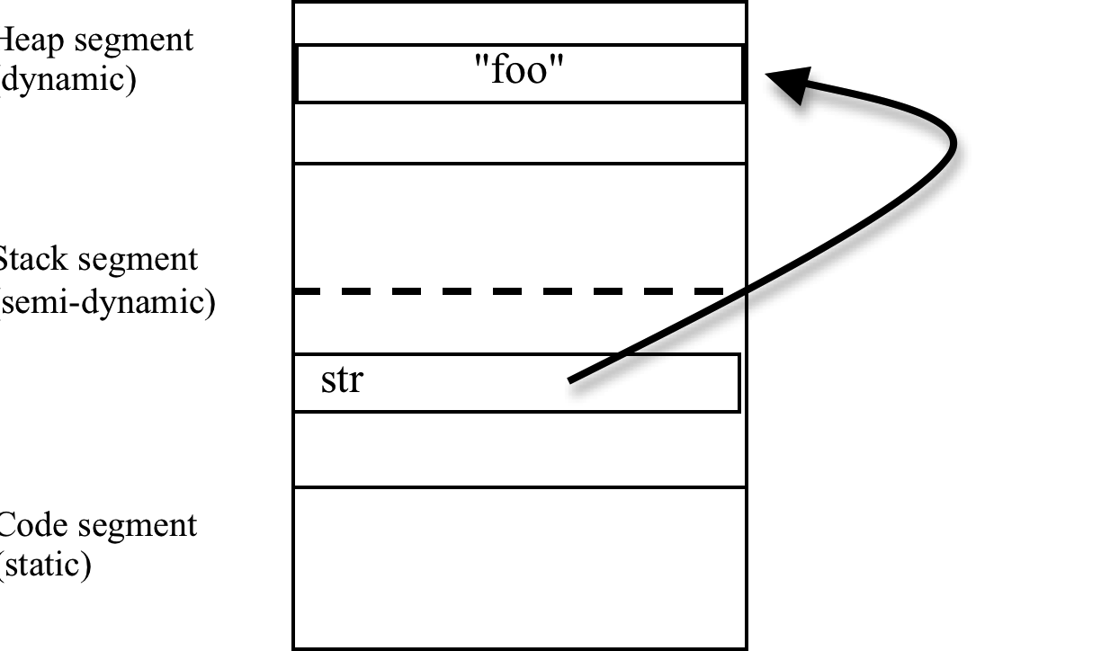
Primitive types: pointer (cont.)
C/C++ allows for low-level memory access using pointers
  * dereferencing operator & address-of operator
  int x = 6;
  int* ptr1 = &x;
  int* ptr2 = ptr1;
  *ptr2 = 3;
  in C/C++, the 0 (NULL) address is reserved, attempted access → ERROR
Java does not provide explicit pointers,
but every object is really a pointer
  String str = “foo”;

Slide 8
Heap management
pointers access memory locations from the heap
(a dynamically allocated storage area)
the heap is divided into equal-size cells, each with a pointer
  the pointer fields are used initially to organize the heap as a linked list
keep pointer to head of free list
to allocate space, take from front of free list
to deallocate, put back at front

Slide 9
Heap example
stack
heap
HEAD OF FREE
"foo"
"bar"
str2
str1
.
.
.
stack
heap
HEAD OF FREE
"foo"
"bar"
String str1 = "foo";
String str2 = "bar";
/* CHECKPOINT 1 */
str1 = str2;
/* CHECKPOINT 2 */
String str3 = str1+"n";
/* CHECKPOINT 3 */
str2
str1
.
.
.
stack
heap
HEAD OF FREE
"barn"
str3
"bar"
str2
str1
.
.
.

Slide 10
Pointer problems
returning memory to the free list is easy, but when do you do it?
dangling reference: memory is deallocated, but still have a pointer to it
  int* Foo() { a problem in C/C++, since the & operator allows access to stack
  int x = 5; memory that has already been reclaimed
  return &x;
  } not a problem in Java since no equivalent to the & operator
garbage reference: pointer is destroyed, but memory has not been deallocated
  void Bar() { a problem in both C/C++ and Java
  Date today = new Date(); when today's lifetime ends, its dynamic memory is inaccessible
  … (in C/C++, must explicitly deallocate dynamic memory w/ delete)
  }
would like to automatically and safely reclaim heap memory
2 common techniques: reference counts, garbage collection

Slide 11
Reference counts
along with each heap element, store a reference count
  indicates the number of pointers to the heap element
  when space is allocated, its reference count is set to 1
  each time a new pointer is set to it, increment the reference count
  each time a pointer is lost, decrement the reference count
provides a simple method for avoiding garbage & dangling references
  if result of an operation leaves reference count at 0, reclaim memory
  can even double check explicit deallocations

Slide 12
Reference counts example
String str1 = "foo";
String str2 = "bar";
/* CHECKPOINT 1 */
str1 = str2;
/* CHECKPOINT 2 */
if (str1.equals(str2)) {
String temp = "biz";
str2= temp;
/* CHECKPOINT 3 */
}
String str3 = "baz";
/* CHECKPOINT 4 */
HEAD OF FREE
stack
ptr
????
????
STACK
HEAP

Slide 13
Reference counts (cont.)
unfortunately, reference counts are very costly
  must update & check reference counts for each assignment, end of lifetime
  String str1;
  String str2;
  …
  str1 = str2; ➔ 1) dereference str1, decrement count
  2) if count = 0, deallocate
  3) copy str1 reference to str2
  4) dereference str1, increment count
reference counts are popular in parallel programming
  work is spread evenly

Slide 14
Garbage collection
approach: allow garbage to accumulate, only collect if out of space
  as program executes, no reclamation of memory (thus, no cost)
  when out of memory, take the time to collect garbage (costly but rare)
  e.g., toothpaste tube analogy
2 common approaches to garbage collection
  Partition & Copy
  Mark & Sweep

Slide 15
Partition & Copy approach
  divide the memory space into 2 partitions: current + backup
  when the current partition is full,
    sweep through all active objects (from the stack)
    copy each active object to the backup partition (contiguously)
    when done, make that the current partition
CURRENT
PARTITION
BACKUP
PARTITION
when current partition is full
STACK
BACKUP
PARTITION
STACK
CURRENT
PARTITION
copy to backup & make it current
HEAP
HEAP

Slide 16
Partition & Copy example
String str1= "foo";
String str2= "bar";
/* CHECKPOINT 1 */
str1 = str2;
/* CHECKPOINT 2 */
if (str1.equals(str2)) {
String temp = "biz";
str2 = temp;
/* CHECKPOINT 3 */
}
String str3 = "baz";
/* CHECKPOINT 4 */
HEAD OF FREE
stack
ptr
????
????
STACK
HEAP

Slide 17
Mark & Sweep approach
  mark all active objects
    sweep through all active objects (from the stack)
    mark each memory cell associated with an active object
  sweep through the heap and reclaim unmarked cells
    traverse the heap sequentially
    add each unmarked cell to the FREE list
FREE HEAD
FREE HEAD
FREE HEAD
traverse the stack
ACTIVE
traverse the heap
ACTIVE
ACTIVE
ACTIVE
STACK
and mark active objects
STACK
and reclaim unmarked cells
STACK
ACTIVE
ACTIVE
HEAP
HEAP
HEAP

Slide 18
Mark & Sweep example
String str1= "foo";
String str2= "bar";
/* CHECKPOINT 1 */
str1 = str2;
/* CHECKPOINT 2 */
if (str1.equals(str2)) {
String temp = "biz";
str2 = temp;
/* CHECKPOINT 3 */
}
String str3 = "baz";
/* CHECKPOINT 4 */
HEAD OF FREE
stack
ptr
????
????
STACK
HEAP

Slide 19
Mark & Sweep & Compactify
note: not all memory allocations are the same size
  C/C++/Java: double bigger than float, array elements must be contiguous, …
heap
HEAD OF
as memory is allocated & deallocated, fragmentation occurs
e.g., suppose wish to allocate a 3 element array
previous allocations/deallocations have left 3 free cells, but not contiguously
→ must garbage collect (even though free space exists)
FREE
ACTIVE
ACTIVE
ACTIVE
using Partition & Copy, not a big problem
  simply copy active objects to other partition – this automatically coalesces gaps
using Mark & Sweep, must add another pass to defragment the space
  once active objects have been identified, must shift them in memory to remove gaps
  COSTLY!

Slide 20
Partition & Copy vs. Mark & Sweep & Compactify
Partition & Copy
  wastes memory by maintaining the backup partition
  but quick (especially if few active objects) and avoids fragmentation
Mark & Sweep & Compactify
  able to use the entire memory space for active objects
  but slow (2 complete passes through heap to reclaim and compactify)
Java takes a hybrid approach to provide automatic garbage collection
  memory is divided into two types: new objects and old objects
  the new objects partition is optimized for objects with short lifetimes
    garbage collection happens relatively frequently
    uses Partition & Copy, since it is expected that few active objects will remain
  eventually, persistent new objects are moved to the old objects partition
    garbage collections happens relatively infrequently
    uses Mark & Sweep & Compactify, since many active objects will persist

