Slide 1
CSC 533: Programming Languages
Spring 2024
Concurrency
  levels of concurrency
  synchronization
    competition vs. cooperation, race conditions
  synchronization mechanisms
    semaphores, monitors, message passing
  concurrency in Java
    threads, Thread/Runnable, synchronize

Slide 2
Concurrency
many modern computers utilize multiple processors or multicores
  can speed up processing by executing statements/programs concurrently
  e.g., a Web server may have multiple processors to handle requests
  e.g., a Web browser might download/request/render concurrently
concurrency can occur at four levels
  machine instruction level – handled at hardware level
  high-level language statement level
  unit (subprogram) level
  program level – handled at OS level
concurrency can be
  physical - multiple independent processors (multiple threads of control)
  logical – even with one processor, can time-share to (e.g., browser tasks)

Slide 3
Subprogram-level concurrency
a task or process or thread is a program unit that can be in concurrent execution with other program units
tasks differ from ordinary subprograms in that:
  a task may be implicitly started
  when a program unit starts the execution of a task, it is not necessarily suspended
  when a task’s execution is completed, control may not return to the caller
tasks can be:
  heavyweight – each executes in its own address space
  lightweight – all tasks execute in the same address space (more efficient)
  since tasks are rarely disjoint, there must be mechanisms for coordinating or synchronizing tasks

Slide 4
Competition synchronization
sometimes tasks compete for resources
  tasks A and B both require access to a non-shareable resource – must prevent simultaneous access to preserve integrity
  e.g., suppose tasks A & B access a shared variable TOTAL
    A executes TOTAL += 1; B executes TOTAL *= 2;
    at the machine-language level, each assignment involves 3 steps:
      fetch the value of TOTAL
      perform the operation
      store the result in TOTAL

Slide 5
Race condition
if the shared variable can be accessed "simultaneously," the interleaving of steps can produce different results
B fetches TOTAL (3)
A fetches TOTAL (3)
B performs operation (6)
A performs operation (4)
B stores TOTAL (6)
A stores TOTAL (4)
B fetches TOTAL (3)
B performs operation (6)
B stores TOTAL (6)
A fetches TOTAL (6)
A performs operation (7)
A stores TOTAL (7)
are other results possible?
A fetches TOTAL (3)
B fetches TOTAL (3)
A performs operation (4)
B performs operation (6)
A stores TOTAL (4)
B stores TOTAL (6)
A fetches TOTAL (3)
A performs operation (4)
A stores TOTAL (4)
B fetches TOTAL (4)
B performs operation (8)
B stores TOTAL (8)

Slide 6
Cooperation synchronization
sometimes, tasks must cooperate
  task A must wait for task B to complete some activity before it can begin or continue its execution
  e.g., producer/consumer relationship
    task A constantly monitors the keyboard, reading each new input and storing in a buffer
      can't store if the buffer is full
    task B constantly monitors the buffer, accesses each new input and removes from the buffer
      can't access if the buffer is empty

Slide 7
Synchronization mechanisms
3 methods for providing mutually exclusive access to a resource
  semaphores
      early, simple approach (Dijkstra, 1965)
  monitors
      incorporates data abstraction (Brinch Hansen, 1973)
  message passing
      utilizes rendezvous messages (Brinch Hansen and Hoare, 1978)
      (see text for examples - will not discuss here)

Slide 8
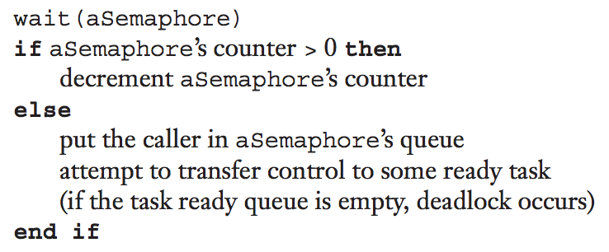
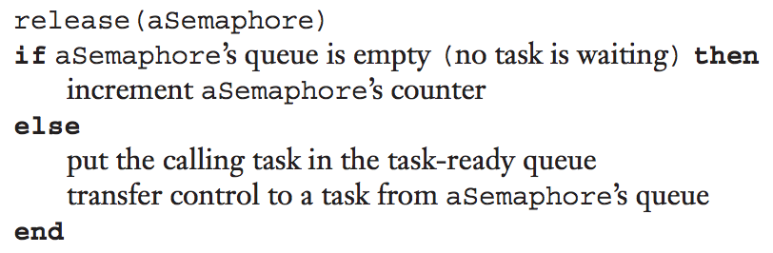
Semaphores
a semaphore is a data structure consisting of a counter and a queue for storing task descriptors
  counter represents a number of available resources (initially some N)
  queue represents tasks waiting for resources (initially empty)
  wait operation: allocate resource if available, else enqueue the task
  release: deallocate the resource, reassign to a task if waiting
  can be used for both competition and cooperation synchronization

Slide 9
Semaphores for competition synchronization
semaphore access;
access.count = 1;
task A;
…
wait(access); {wait for access}
TOTAL += 1;
release(access); {relinquish access}
…
end A;
task B;
…
wait(access); {wait for access}
TOTAL *= 2;
release(access); {relinquish access}
…
end B;
wait & release must be implemented as single machine instructions
WHY?

Slide 10
Semaphores for cooperation synchronization
semaphore fullspots, emptyspots;
fullspots.count = 0;
emptyspots.count = BUFLEN;
task producer;
loop
-- produce VALUE –-
wait (emptyspots); {wait for space}
DEPOSIT(VALUE);
release(fullspots); {increase filled}
end loop;
end producer;
task consumer;
loop
wait (fullspots);{wait till not empty}}
FETCH(VALUE);
release(emptyspots); {increase empty}
-- consume VALUE –-
end loop;
end consumer;
java.util.concurrent.Semaphore defines a Semaphore class with acquire & release methods

Slide 11
Evaluation of semaphores
assuming they are indivisible, wait & release can be used to provide competition and cooperation synchronization
however, the programmer must use them correctly
  forgetting to wait can lead to mutual access
  forgetting to release can lead to deadlock (infinite waiting)
  for producer/consumer, can lead to buffer overflow or underflow
"The semaphore is an elegant synchronization tool for an ideal programmer who never makes mistakes." (Brinch Hansen, 1978)

Slide 12
Monitors
a monitor is an abstract data type that encapsulate the shared data and its operations
  originally implemented in Concurrent Pascal (1975)
  supported by Java, Ada, C#, …
since the shared data is resident in the monitor (rather than in the client code), monitor operations can control access
  monitor implementation guarantees synchronized access by allowing only one access at a time
  calls to monitor procedures are implicitly queued if the monitor is busy at the time of the call

Slide 13
Java synchronization
Java automatically associates a monitor with each object
  can force mutual exclusion by declaring methods to be synchronized
  when a synchronized method is executing, all other methods are blocked
public class Counter {
private int c = 0;
public synchronized void increment() {
c++;
}
public synchronized void decrement() {
c--;
}
public synchronized int value() {
return c;
}
}

Slide 14
Example: producer/consumer in Java
public class Buffer {
private int [] buffer;
private int numStored, putIndex, getIndex;
public Buffer(int size) {
this.buffer = new int[size];
}
public synchronized void put(int task) {
while(this.numStored == this.buffer.length) {
try { wait(); }
catch (InterruptedException e) { }
}
this.buffer[this.putIndex] = task;
this.putIndex =
(this.putIndex + 1) % this.buffer.length;
this.numStored++;
notify();
}
public synchronized int get() {
while (this.numStored == 0) {
try { wait(); }
catch (InterruptedException e) { }
}
int task = this.buffer[this.getIndex];
this.getIndex =
(this.getIndex + 1) % this.buffer.length;
this.numStored--;
notify();
return task;
}
consider a shared buffer (array of ints)
  will treat as a circular queue
  putIndex will keep track of next place to put a value (wraps around)
  getIndex will keep track of next place to get a value (wraps around)
  numStored keeps track of number currently stored
  wait() suspends the current thread (and releases the monitor)
  notify() wakes up a thread waiting for the monitor

Slide 15
Java threads
Java supports concurrency via threads (lightweight processes)
  public static void main automatically spawns a thread
  users can create additional threads by extending the Thread class
  a Thread class must override run(), which specifies the action of that thread
class Producer extends Thread {
private Buffer buffer;
Producer(Buffer b) {
this.buffer = b;
}
public void run() {
for (int t = 1; t <= 10; t++) {
System.out.println("Produced task " + t);
this.buffer.put(t);
}
}
}
class Consumer extends Thread {
private Buffer buffer;
Consumer(Buffer b) {
this.buffer = b;
}
public void run() {
for (int i = 1; i <= 10; i++) {
int t = this.buffer.get();
System.out.println("Consuming task " + t);
}
}
}

Slide 16
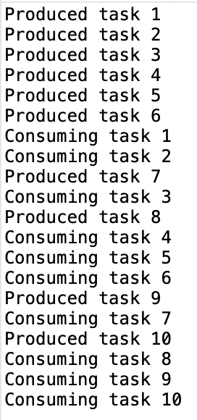
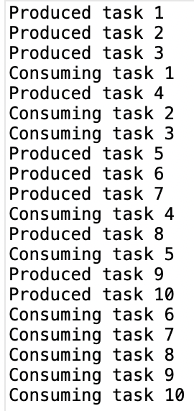
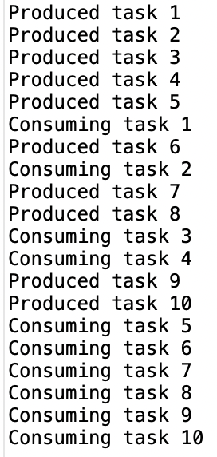
public class BufferDriver {
public static void main(String [] args) {
Buffer b = new Buffer(4);
Producer p = new Producer(b);
Consumer c = new Consumer(b);
p.start();
c.start();
}
}
since the producer & consumer are executing independently (?), can produce different results every time

Slide 17
Example: summing an array
consider the task of summing all of the numbers in an array
  public static int sum(int[] nums) {
  int total = 0;
  for (int i = 0; i < nums.length; i++) {
  total += nums[i];
  }
  return total;
  }
  brute force algorithm is O(N), so doubling the size doubles the time
 | 0 | 1 | 2 | 3 | 4 | 5 | 6 | 7 | 8 | 9 | 10 | 11 | 12 | 13 | 14 | 15
nums | 22 | 18 | 12 | -4 | 27 | 30 | 36 | 50 | 7 | 68 | 91 | 56 | 2 | 85 | 42 | 98

Slide 18
Example: summing an array
if we had 2 CPUs/cores, could sum each half separately, then combine
 | 0 | 1 | 2 | 3 | 4 | 5 | 6 | 7 | 8 | 9 | 10 | 11 | 12 | 13 | 14 | 15
nums | 22 | 18 | 12 | -4 | 27 | 30 | 36 | 50 | 7 | 68 | 91 | 56 | 2 | 85 | 42 | 98
sum1 = 22+18+12+-4+27+30+36+50 = 191
sum2 = 7+68+91+56+2+85+42+98 = 449
sum = sum1 + sum2 = 640
  note: still O(N), but reduces the constant BY HOW MUCH?

Slide 19
Example: summing an array
public class SumThread extends Thread {
private int[] nums;
private int minIndex;
private int maxIndex;
private int computedSum;
public SumThread(int[] nums, int minIndex, int maxIndex) {
this.nums = nums;
this.minIndex = minIndex;
this.maxIndex = maxIndex;
this.computedSum = 0;
}
public int getSum() {
return this.computedSum;
}
public void run() {
this.computedSum = 0;
for (int i = this.minIndex; i < this.maxIndex; i++) {
this.computedSum += this.nums[i];
}
}
}
note: the run method does not have any parameters
  must store needed values in fields when construct the thread
  similarly, must store the run result in a field and access later

Slide 20
Example: summing an array
public class ArraySum {
public static int sumConcurrently(int[] a, int threadCount) {
int len = (int) Math.ceil(1.0 * a.length / threadCount);
Thread[] threads = new Thread[threadCount];
for (int i = 0; i < threadCount; i++) {
threads[i] = new SumThread(a, i*len, Math.min((i+1)*len, a.length));
threads[i].start();
}
try {
for (Thread t : threads) {
t.join();
}
} catch (InterruptedException ie) {}
int total = 0;
for (Thread summer : threads) {
total += ((SumThread)summer).getSum();
}
return total;
}
. . .
}
here, the array is divided into threadCount segments
  each spawns a SumThread to process
the join method coordinates by forcing the program to wait for each thread to finish

Slide 21
Example: summing an array
public static void main(String[] args) {
System.out.print(Enter number of threads: ");
Scanner input = new Scanner(System.in);
int numThreads = input.nextInt();
input.close();
Random randy = new Random();
int size = 1000;
while (true) {
int[] nums = new int[size];
for (int j = 0; j < size; j++) {
nums[j] = randy.nextInt();
}
long start = System.currentTimeMillis();
int total = 0;
for (int j = 1; j <= 1000; j++) {
total = sumConcurrently(nums, numThreads);
}
long end = System.currentTimeMillis();
double timePerSum = (endTime-startTime)/1000.0;
System.out.printf("%10d elements => %8.4f millisec\n", size, timePerSum);
size *= 2;
}
}
driver program prompts for the number of threads, runs & produces a rough timing
note: timing is clock time, so includes overhead & poss. other threads sharing the core
since summing is so fast, it actually performs 1000 sums, then divides total time by 1000

Slide 22
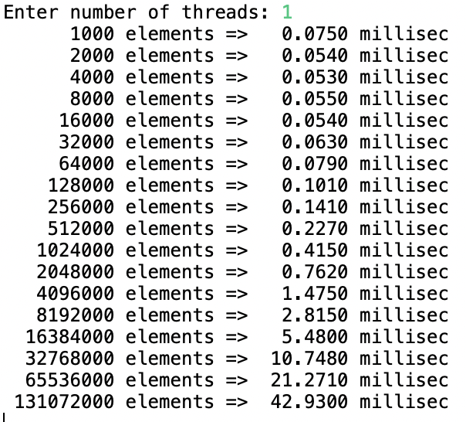
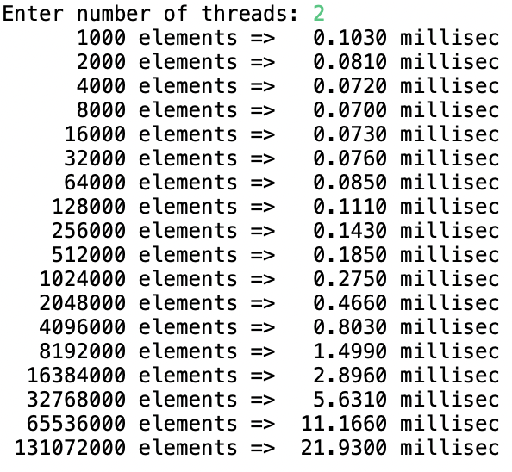
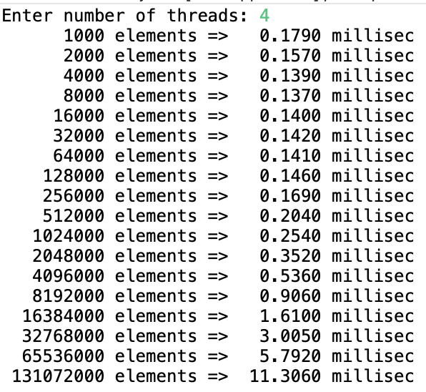
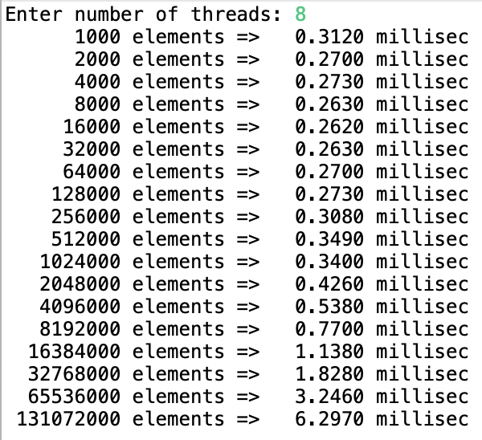

Slide 23
How many threads?
you can find out how many CPUs/cores your machine has
  int cores = Runtime.getRuntime().availableProcessors();
    timings on previous slide were on a computer with 10 cores
    note that a user program may not have access to all cores
      for array sum example, 16 threads decreases performance
    in addition, there is overhead associated with creating and managing threads
      1 thread was faster than 2 threads up to 500K numbers
      2 threads was faster than 4 threads up to 1M numbers
      4 threads was faster than 8 threads up to 16M numbers

Slide 24
Example: parallel mergeSort
suppose we want to take advantage of multicores when sorting
  have separate threads sort the left and right halves, then merge
  each of the threads can spawn new threads, up to some limit
 | 0 | 1 | 2 | 3 | 4 | 5 | 6 | 7
nums | 22 | 18 | 12 | -4 | 58 | 7 | 31 | 42
split
22 | 18 | 12 | -4
58 | 7 | 31 | 42
sort
sort
-4 | 12 | 18 | 22
7 | 31 | 42 | 58
merge
-4 | 7 | 12 | 18 | 22 | 31 | 42 | 58

Slide 25
Example: parallel mergeSort
public class SortThread extends Thread {
private int[] nums;
private int minIndex;
private int maxIndex;
private int threadCount;
public SortThread(int[] nums, int minIndex, int maxIndex, int threadCount) {
this.nums = nums;
this.minIndex = minIndex;
this.maxIndex = maxIndex;
this.threadCount = threadCount;
}
public void run() {
MergeSort.mergeSortConcurrently(this.nums, this.minIndex,
this.maxIndex, this.threadCount);
}
}

Slide 26
Example: parallel mergeSort
public class MergeSort {
public static void mergeSortConcurrently(int[] a, int threadCount) {
MergeSort.mergeSortConcurrently(a, 0, a.length-1, threadCount);
}
public static void mergeSortConcurrently(int[] a, int minIndex, int maxIndex,
int threadCount) {
if (minIndex < maxIndex) {
int mid = (minIndex+maxIndex)/2;
if (threadCount > 1) {
Thread leftThread = new SortThread(a, minIndex, mid, threadCount/2);
Thread rightThread = new SortThread(a, mid+1, maxIndex, threadCount/2);
leftThread.start();
rightThread.start();
try {
leftThread.join();
rightThread.join();
} catch (InterruptedException ie) {}
}
else {
MergeSort.mergeSortConcurrently(a, minIndex, mid, threadCount/2);
MergeSort.mergeSortConcurrently(a, mid+1, maxIndex, threadCount/2);
}
MergeSort.merge(a, minIndex, maxIndex);
}
}

Slide 27
Example: parallel mergeSort
public static void main(String[] args) {
Random randy = new Random();
int size = 1000;
System.out.println("Enter the thread limit: ");
Scanner input = new Scanner(System.in);
int numThreads = input.nextInt();
input.close();
while (true) {
int[] nums = new int[size];
for (int j = 0; j < size; j++) {
nums[j] = randy.nextInt();
}
long start = System.currentTimeMillis();
MergeSort.mergeSortConcurrently(nums, numThreads);
long end = System.currentTimeMillis();
System.out.printf("%10d elements => %6d ms \n", size, end-start);
size *= 2;
}
}

Slide 28
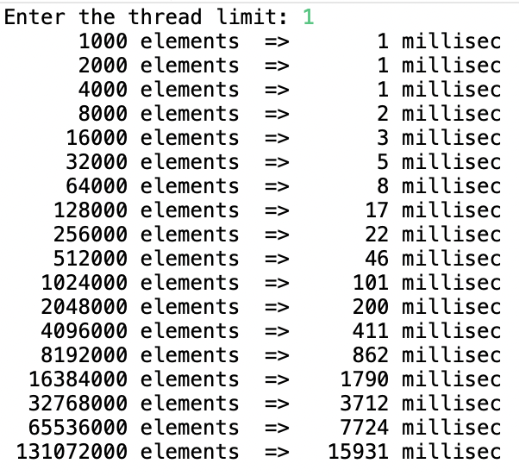
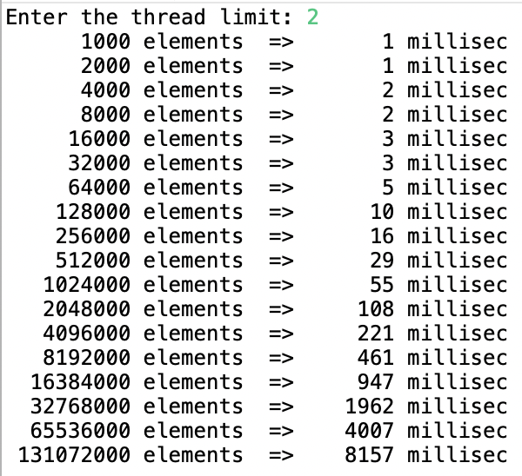
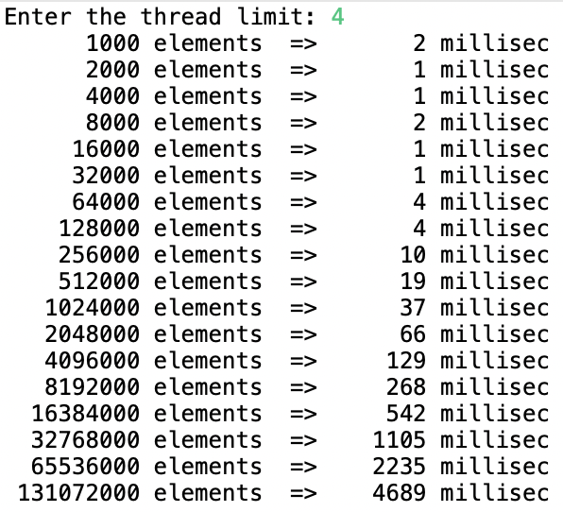
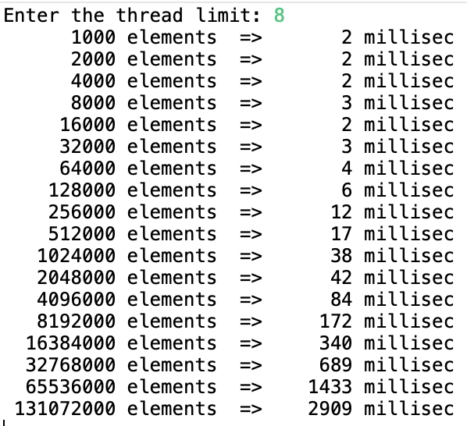

Slide 29
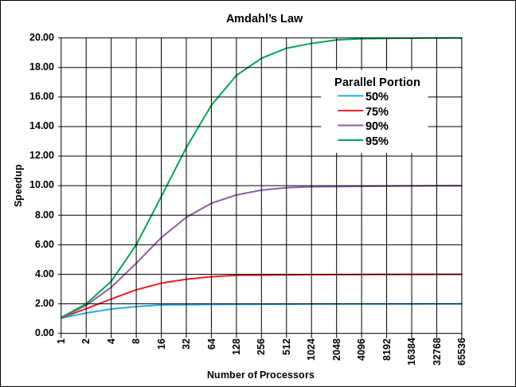
Amdahl's Law
the speedup that can be achieved by parallelizing a program is limited by the sequential fraction of the program
  if P is the proportion that is parallelizable and N is the # of processors,
    max speedup = 1/((1-P)+(P/N))
if 50% parellelizable:
max speedup with 2 processors =
1/((1-.5)+(.5/2)) = 1/(.5+.25) = 1/.75 = 1.3x
max speedup with 4 processors =
1/((1-.5)+(.5/4)) = 1/(.5+.125) = 1.6x
max speedup with 8 processors =
1/((1-.5)+(.5/8)) = 1/(.5+.0625) = 1.8x
max speedup with 100 processors =
1/((1-.5)+(.5/100)) = 1/(.5+.005) = 1.9x
max speedup with ♾ processors =
1/((1-.5)+(.5/ ♾)) = 1/(.5+0) = 1/.5 = 2x

Slide 30
Amdahl's Law (cont.)
if 75% parallelizable:
max speedup with 2 processors =
1/((1-.75)+(.75/2)) = 1/(.25+.375) = 1/.625 = 1.6x
max speedup with 4 processors =
1/((1-.75)+(.75/4)) = 1/(.25+.1875) = 2.29x
max speedup with 8 processors =
1/((1-.75)+(.75/8)) = 1/(.25+.09375) = 2.90x
max speedup with 100 processors =
1/((1-.75)+(.75/100)) = 1/(.25+.0075) = 3.88x
max speedup with ♾ processors =
1/((1-.75)+(.75/ ♾)) = 1/(.25+0) = 1/.25 = 4x
if 90% parallelizable:
max speedup with ♾ processors =
1/((1-.90)+(.90/ ♾)) = 1/(.1+0) = 1/.1 = 10x
if 95% parallelizable:
max speedup with ♾ processors =
1/((1-.95)+(.95/ ♾)) = 1/(.05+0) = 1/.05 = 20x
if 99% parallelizable:
max speedup with ♾ processors =
1/((1-.99)+(.99/ ♾)) = 1/(.01+0) = 1/.01 = 100x

Slide 31
How parallel?
for array sum example, 131M numbers:
  1 core → 42.9 ms
  2 cores → 21.9 ms (1.9x)
  4 cores → 11.3 ms (3.8x)
  8 cores → 6.2 ms (6.9x)
for merge sort example, 131M numbers:
  1 core → 15,931 ms
  2 cores → 8,157 ms (1.9x)
  4 cores → 4,689 ms (3.4x)
  8 cores → 2,909 ms (5.4x)

