Slide 1
CSC 533: Programming Languages
Spring 2024
Clojure structures
  lists
    LISP-style lists, memory management
  vectors, sets & maps
  structured data, non-linear structures
  let expressions
  non-functional features: print, println, do

Slide 2
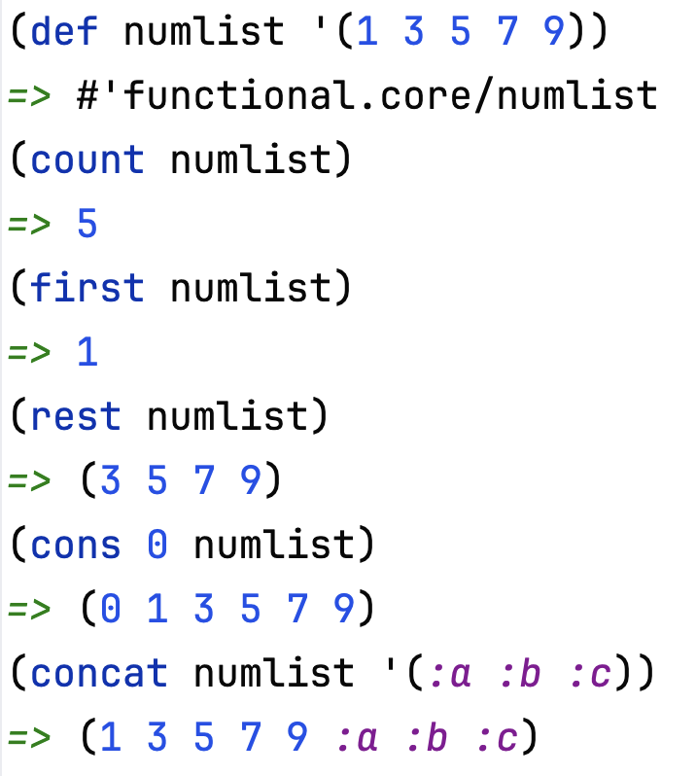
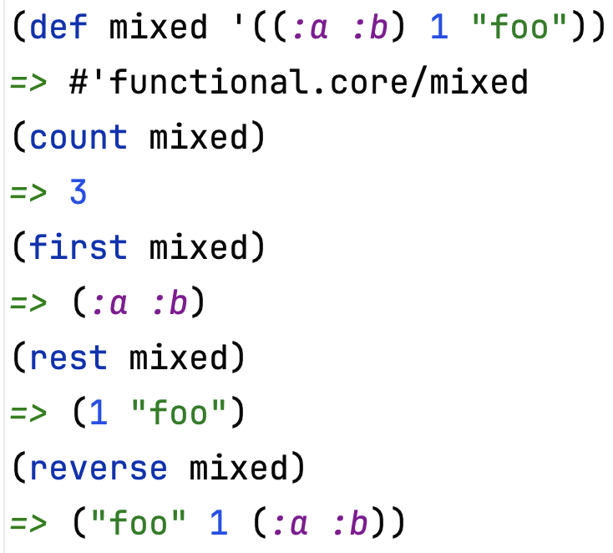
Clojure lists
the list data structure is simple and flexible
  list was the only data structure in LISP – it's all you need!
  why are first, rest, cons the basic functions on lists?

Slide 3
Memory management in Clojure
lists are stored as linked structures
  (def lst '(:a :b :c))
:a
:b
:c
  front returns the first field in the initial node
  rest returns the second field in the initial node
  cons adds a new node with the two fields set
  (cons :d lst)
:d

Slide 4
Structure sharing
since lists are immutable, Clojure makes extensive use of structure-sharing
  (defn my-count [lst]
  (if (empty? lst)
  0
  (inc (my-count (rest lst)))))
  (my-count '(:a :b :c))
  => 3
  each recursive call shares a part of the list
  other code that uses a, b, c can share as well
lst
lst
lst
lst
run-time stack
:a
:b
:c

Slide 5
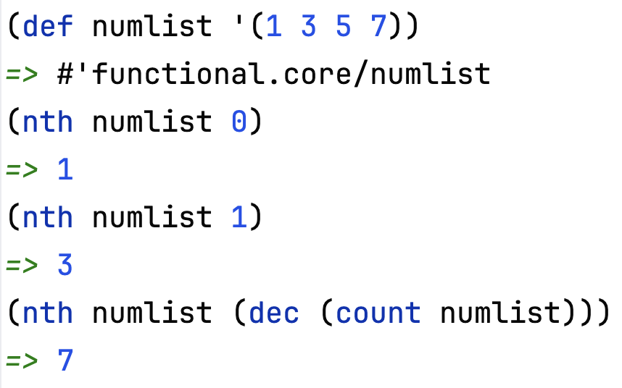
List efficiency
the flexibility of lists also means they are inefficient to traverse
  the nth function accesses a list at a specified index (starting at 0)
  must traverse the linked structure starting at the beginning
  (defn my-nth [arblist index]
  (cond (empty? arblist) nil
  (zero? index) (first arblist)
  :else (recur (rest arblist) (dec index))))

Slide 6
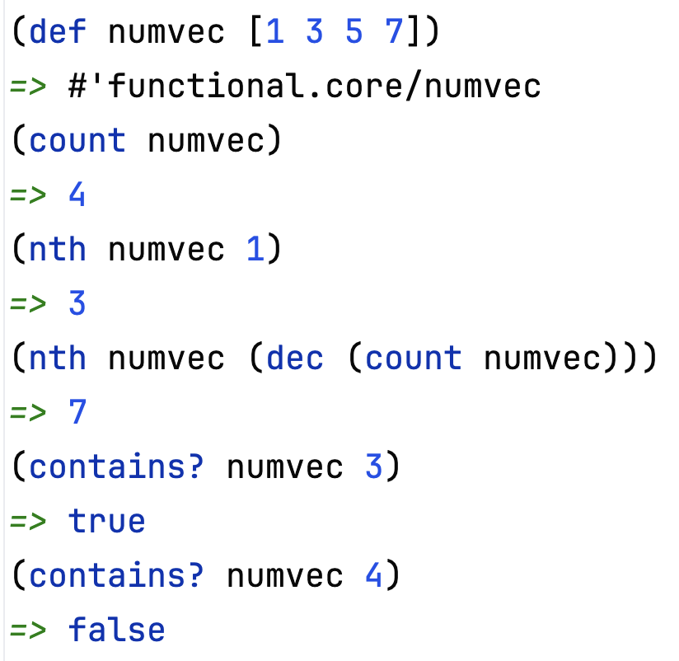
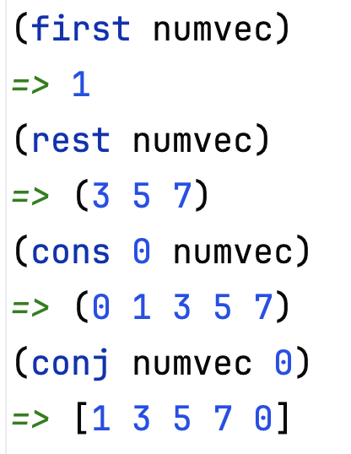
Vectors
Clojure introduced vectors for direct access via indexing
  specify using [ ] instead of ( )
  items are stored contiguously in memory, so constant time indexing
  less flexible – can only add to the end (similar to Java ArrayLists)
note: rest & cons work on vectors, but return lists
conj can add to the end of a vector

Slide 7
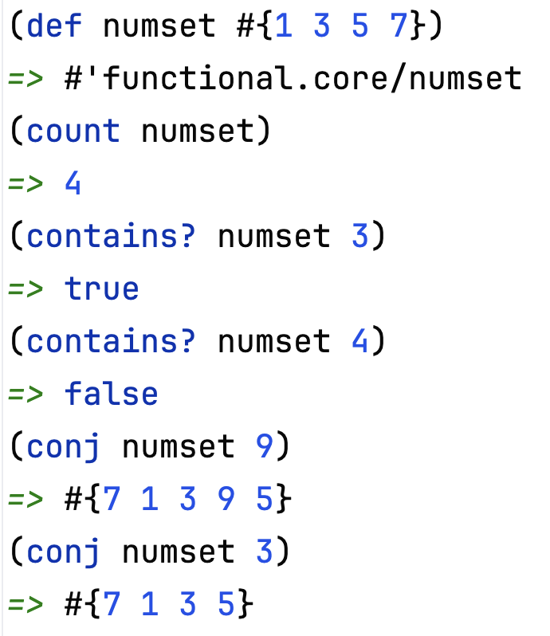
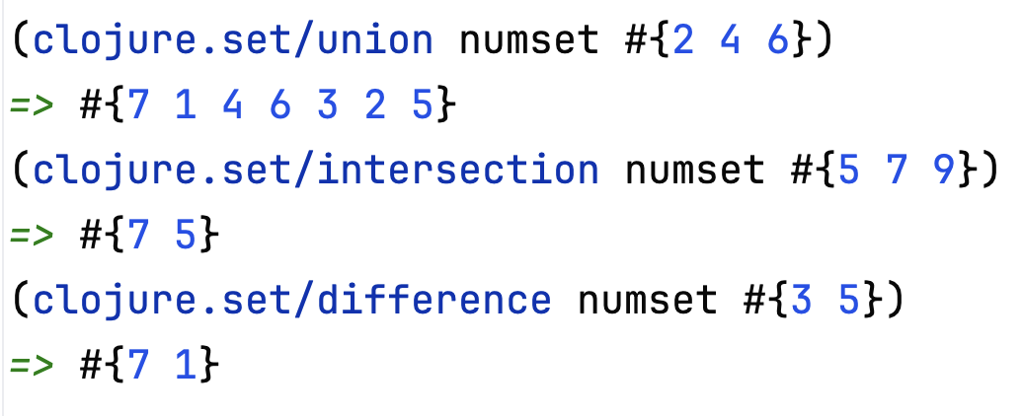
Sets
Clojure also provides a set data structure
  specify using #{ }
  sets are unordered (by default), cannot contain duplicates
  the clojure.set library has functions for standard set manipulations

Slide 8
Structuring data
since nests can be listed, can define a list of "records"
    (def NAMES '((:Smith :Pat :Q)
    (:Jones :Chris :J)
    (:Walker :Kelly :T)
    (:Thompson :Shelly :P)))
  can easily access the record (sublist) for a particular entry
(defn my-get [records key]
(cond (empty? records) nil
(= (first (first records)) key) (first records)
:else (recur (rest records) key)))
(my-get NAMES :Jones)
=> (:Jones :Chris :J)
(second (my-get NAMES :Walker))
=> :Kelly

Slide 9
Record lists
for another example, consider a restaurant menu
    (define MENU '((:bean-burger 2.99)
    (:tofu-dog 2.49)
    (:fries 0.99)
    (:medium-soda 0.79)
    (:large-soda 0.99)))
    (second (my-get MENU :tofu-dog))
    => 2.49
    (second (my-get MENU :fries))
    => 0.99
    (defn price [item]
    (second (my-get MENU item)))
    (price :fries)
    => 0.99

Slide 10
Menu example
consider a more general problem: determine price for an entire meal
  represent the meal order as a list of items,
    e.g., (:tofu-dog :fries :large-soda)
  use recursion to traverse the meal list, add up price of each item
(defn meal-price [meal]
(if (empty? meal)
0.0
(+ (price (first meal)) (meal-price (rest meal)))))
  alternatively, could use map & apply
(defn meal-price [meal]
(apply + (map price meal)))

Slide 11
Maps
a list of records, searchable via the first record item, is really a map
  Clojure provides a map type to make this simpler
  specify using { key1 val1 key2 val2 … }
    (define MENU {:bean-burger 2.99
    :tofu-dog 2.49
    :fries 0.99
    :medium-soda 0.79
    :large-soda 0.99})
  access values using (get MAP KEY)
  (get MENU :tofu-dog)
  => 2.49
  (defn price [item]
  (get MENU item))

Slide 12
Example: circle of friends
suppose we want to represent friendships between people
  can have a map, where key is a person and value is a set of friends
  (def FRIENDS {:amy #{:bob :dan :elle}
  :bob #{:amy :dan}
  :chaz #{:dan :elle}
  :dan #{:chaz}
  :elle #{:amy :bob :chaz :dan}
  :fred #{:dan}})
  (defn get-friends [person]
  (get FRIENDS person))
  (get-friends :bob)
  => #{:amy :dan}

Slide 13
Circle of friends (cont.)
BASE CASE: level 1 → direct friends
RECURSION: level N → level N-1 circle ∪ friends of level N-1 circle
(defn get-circle [person N]
(if (= N 1)
(get-friends person)
(clojure.set/union (get-circle person (dec N))
(apply clojure.set/union (map get-friends
(get-circle person (dec N)))))))
  note: need to calculate the level N-1 circle twice – wasteful & complex
  imperative solution: calculate once and assign to a variable
  actually, this would not violate our functional principles
  okay to define names for values, refer to those names
  just need to treat names as immutable once defined

Slide 14
Let expression
a let expression defines a new scope with variables
  then specifies the expression to be evaluated within that scope
  (let [VAR1 VALUE1
  VAR2 VALUE2
  . . .
  VARn VALUEn]
  EXPRESSION)
  (defn get-circle [person N]
  (if (= N 1)
  (get-friends person)
  (let [circle (get-circle person (dec N))]
  (clojure.set/union circle
  (apply clojure.set/union (map get-friends circle))))))

Slide 15
Slight problem
  (defn get-circle [person N]
  (if (= N 1)
  (get-friends person)
  (let [circle (get-circle person (dec N))]
  (clojure.set/union circle
  (apply clojure.set/union (map get-friends circle))))))
  (get-circle :bob 1)
  => #{:dan :amy}
  (get-circle :bob 2)
  => #{:bob :dan :amy :chaz :elle}
a person should not
be their own friend
(defn get-circle [person N]
(if (= N 1)
(get-friends person)
(let [circle (get-circle person (dec N))]
(clojure.set/difference
(clojure.set/union circle
(apply clojure.set/union (map get-friends circle)))
#{person}))))

Slide 16
Non-linear data structures
note: can represent non-linear structures using lists
e.g. trees
(:dog
(:bird (:aardvark () ()) (:cat () ()))
(:possum (:frog () ()) (:wolf () ())))
  empty tree stored as empty list: ()
  non-empty tree stored as a list: (ROOT LEFT-SUBTREE RIGHT-SUBTREE)
  can access the the tree efficiently
  (nth TREE 0) ➔ ROOT
    (nth TREE 1) ➔ LEFT-SUBTREE
    (nth TREE 2) ➔ RIGHT-SUBTREE

Slide 17
Tree routines
(def ANIMALS '(:dog
(:bird (:aardvark () ()) (:cat () ()))
(:possum (:frog () ()) (:wolf () ()))))
(defn root [tree]
(nth tree 0))
(defn left-subtree [tree]
(nth tree 1))
(defn right-subtree [tree]
(nth tree 2))

Slide 18
Tree size
BASE CASE: empty tree → 0
RECURSION: 1 + size(left-subtree) + size(right-subtree)
(defn size [tree]
(if (empty? tree)
0
(+ 1 (size (left-subtree tree))
(size (right-subtree tree)))))

Slide 19
Tree height
BASE CASE: empty tree → 0
RECURSION: 1 + max(height(left-subtree), height(right-subtree))
(defn height [tree]
(if (empty? tree)
0
(inc (max (height (left-subtree tree))
(height (right-subtree tree))))))

Slide 20
Tree searching
if the items in the tree are unordered, then must search exhaustively
BASE CASE: empty tree → false
BASE CASE: item stored at root → true
RECURSION: item is in left subtree or item is in right subtree
(defn tree-contains? [tree item]
(cond (empty? tree) false
(= (root tree) item) true
:else (or (tree-contains? (left-subtree tree) item)
(tree-contains? (right-subtree tree) item))))

Slide 21
Binary search trees
note: can access root & either subtree in constant time
→ can implement binary search trees with O(log N) access
  note: > and < only work for numbers
  compare function works like Java compareTo method
  (compare val1 val2) → neg # if val1 comes before val2
  → 0 if val1 = val2
  → pos # if val1 comes after val2
(defn bst-contains? [tree item]
(cond (empty? tree) false
(= (root tree) item) true
(pos? (compare (root tree) item))
(bst-contains? (left-subtree tree) item)
:else (bst-contains? (right-subtree tree) item)))

Slide 22
In class exercises
(defn sum-values [numtree]
??? )
(defn inc-all [numtree]
??? )

Slide 23
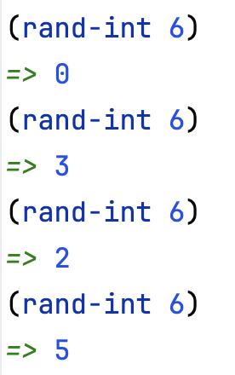
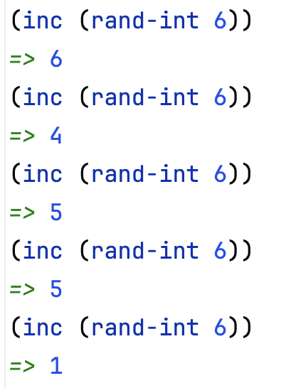
Example: dice simulations
suppose we want to run simulations involving dice
  rand-int returns a random int in range 0..(input-1)
  if add 1, obtain random in in range 1..input
(defn roll-die [num-sides]
(inc (rand-int num-sides)))
(defn roll-dice [num-sides]
(+ (roll-die num-sides) (roll-die num-sides)))

Slide 24
Example: craps simulation
consider a game of craps:
  if first roll is 7, then WINNER
  if first roll is 2 or 12, then LOSER
  if neither, then first roll is "point"
    – keep rolling until get 7 (LOSER) or point (WINNER)
(defn craps []
(defn roll-until [point]
(let [next-roll (roll-dice 6)]
(cond (== next-roll 7) :LOSER
(== next-roll point) :WINNER
:else (recur point))))
(let [roll (roll-dice 6)]
(cond (or (== roll 2) (== roll 12)) :LOSER
(== roll 7) :WINNER
:else (roll-until roll))))

Slide 25
Example: craps with history list
as is, all you see from craps is WINNER or LOSER
  would like to see the actual rolls to confirm proper behavior
the "functional way" is to construct a list of the rolls & return it
(defn craps []
(defn roll-until [point history]
(let [next-roll (roll-dice 6)]
(cond (== next-roll 7)
(reverse (cons :LOSER (cons next-roll history)))
(== next-roll point)
(reverse (cons :WINNER (cons next-roll history)))
:else (recur point (cons next-roll history)))))
(let [roll (roll-dice 6)]
(cond (or (== roll 2) (== roll 12)) (list roll :LOSER)
(== roll 7) (list roll :WINNER)
:else (roll-until roll (list roll)))))

Slide 26
Example: craps with I/O
alternatively, can bite the bullet and use non-functional features
  print displays a value
  println displays a value with a line break
  do provides sequencing (for side effects) – returns value of last item
(defn craps []
(defn roll-until [point]
(let [next-roll (roll-dice 6)]
(do (print "Roll: ") (println next-roll)
(cond (== next-roll 7) :LOSER
(== next-roll point) :WINNER
:else (recur point)))))
(let [roll (roll-dice 6)]
(do (print "Point: ") (println roll)
(cond (or (== roll 2) (== roll 12)) :LOSER
(== roll 7) :WINNER
:else (roll-until roll)))))

