Slide 1
CSC 533: Programming Languages
Spring 2024
Clojure basics
  installing IntelliJ & Cursive
  scalars
    numbers, symbols, keywords, strings, characters, booleans
    def, var != variable
  collections
    lists, vectors, sets, maps
  function calls & definitions
    fn, def, defn
    built-in functions

Slide 2

Installing IntelliJ
download and install IntelliJ IDEA Community (free) edition
  scroll down from top of page (or else you get the commercial edition)

Slide 3
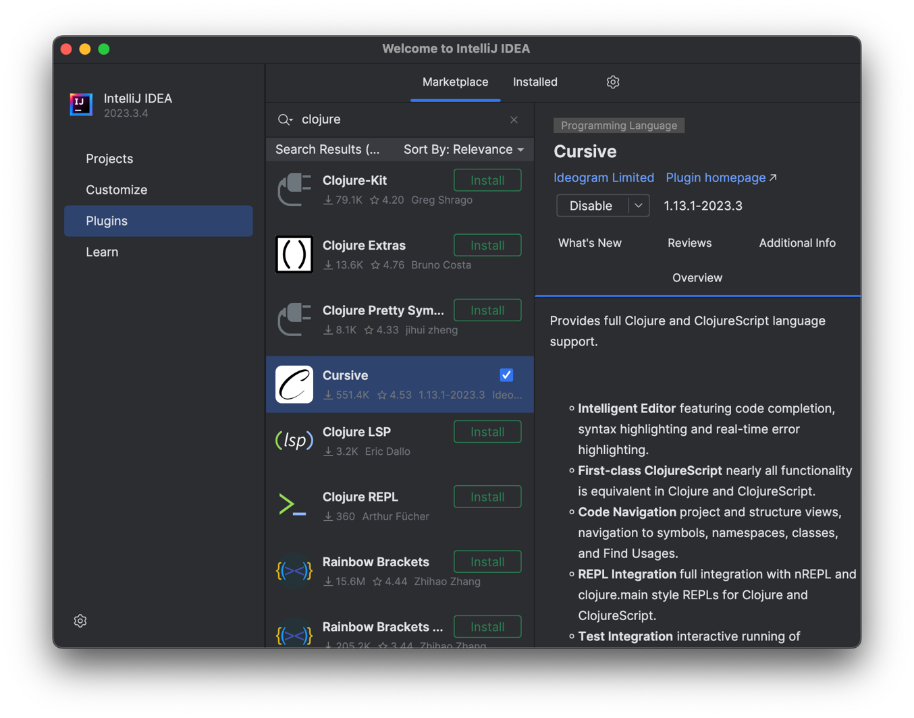
Installing the Cursive plugin
start up IntelliJ IDEA
  select Plugins from the left, and type clojure in the search box
  click on and install Cursive, the Clojure editor and REPL
  restart the IDE when done installing

Slide 4
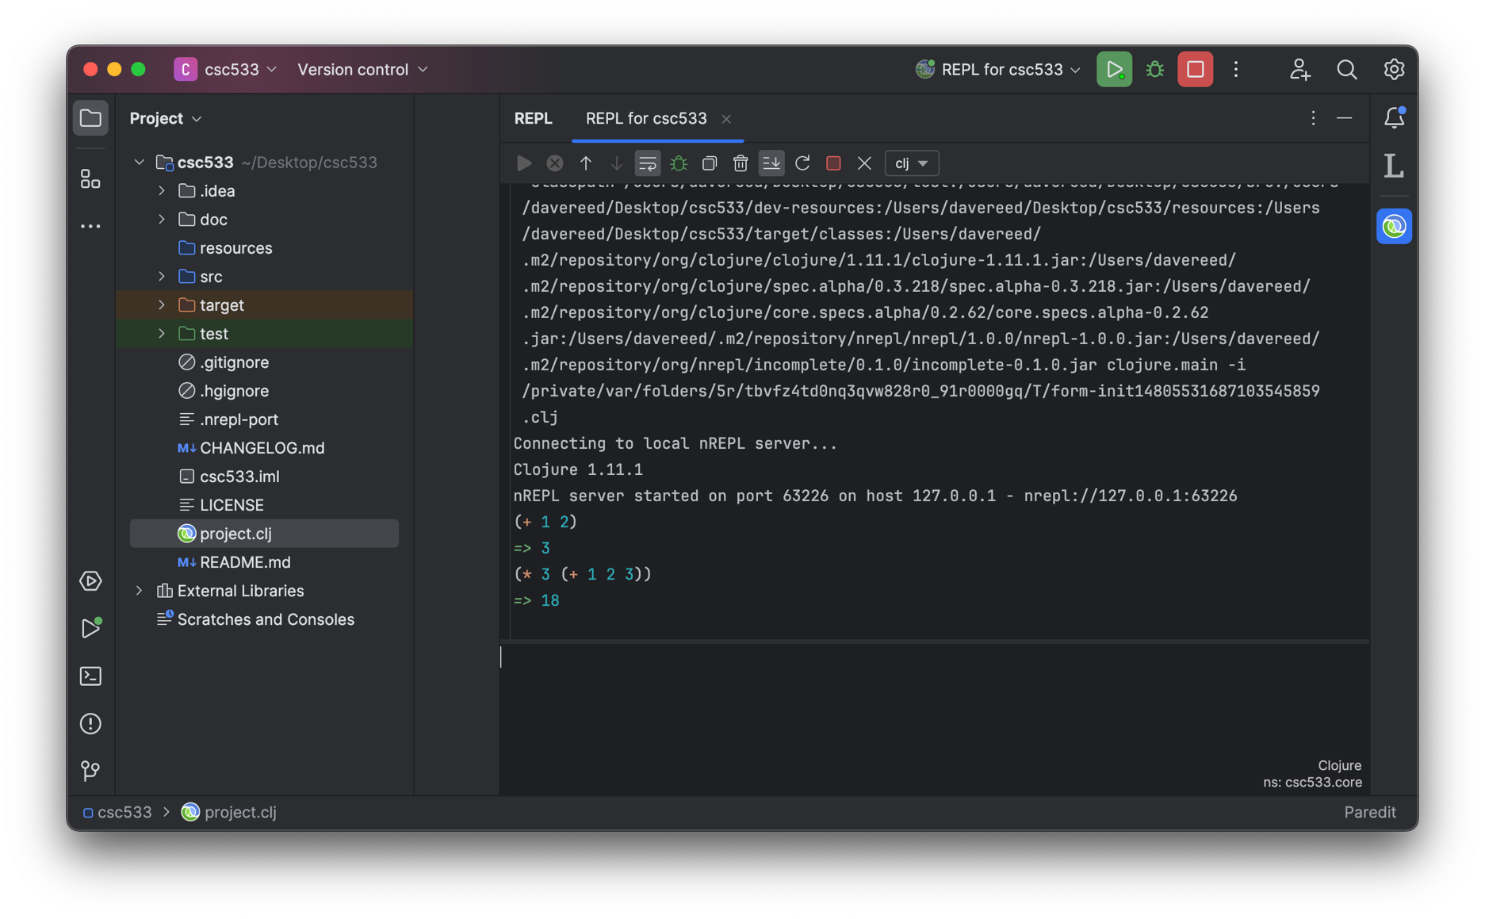
Creating a Clojure project
select New Project → Clojure → Leiningen
  specify the project name (e.g., csc533) and folder – no capital letters
  right click on project.clj and select Run 'REPL for csc533'
  creates a REPL pane on the right, enter expressions to evaluate at bottom

Slide 5
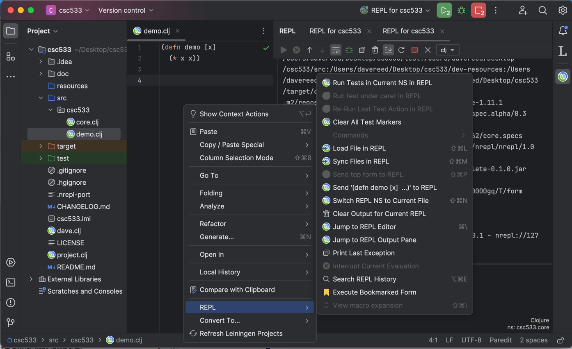
Adding a file
select the src folder on the left
  right-click and select New → File
  save the file with a .clj extension
  enter function definitions in the editor window
  to load, right-click in the window and select REPL → Load File in REPL

Slide 6
Scalars
the primitive data types in Clojure are called scalars
  scalars include numbers, symbols, keywords, strings, characters, booleans
numbers
    in theory, numbers can have unlimited size in Clojure
    integers are implemented using Java long type or BigInt class (if too big)
    4 -8 +104 987654321987654321987654321
    can also be represented in hex, octal or binary
    0x4B 0113 2r1001011
    reals are implemented using Java double type or BigDecimal class (if too big)
    1.0 +2. -12.345678 2e7 1.445e-3
    rationals are implemented as a numerator/denominator pair
    3/4 -7/8 123456789/987654321
note: when the interpreter uses a BigInt, it will add N to the end when displaying the value

Slide 7
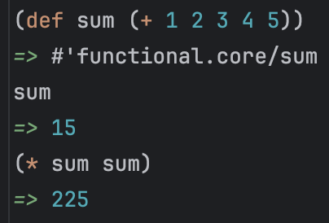
Scalars (cont.)
symbols
    symbols are names (identifiers) used to represent another value
    sum num1 firstName first-name help? ft->m
    can assign a symbol to a value using def
    note: symbols are NOT variables
    more like constants (not reassignable)
keywords
    keywords are symbols (starting with colon) that always evaluate to themselves
    essentially, new literals in the language
    :a :b :red :Dave :root :left :right

Slide 8
Scalars (cont.)
strings
    strings are implemented using Java Strings, but can include line breaks
    "" "foo" "foo bar" "Howdy "Howdy\ndo"
    do"
characters
    characters are specified using a backslash, implemented using Java chars
    \a \B \4 \\ \u0042
booleans
    true false

Slide 9
Collections
lists
  a list is a sequence of items enclosed in parentheses
    () is a list
    (L1 L2 . . . Ln) is a list, where each Li is either a scalar or a list
  for example:
    () (1)
    (:a :b :c :d) ((:a :b) 1.7 (5 10))
    (((((0)))))
  note the recursive definition of a list – GET USED TO IT!
  also, get used to parentheses (LISP = Lots of Inane, Silly Parentheses)
  lists are very dynamic
    implemented as linked structures, so flexible but do not provide direct access

Slide 10
Collections (cont.)
lists were the only collection type in LISP
  lists are all you need, but not the most efficient for certain operations
Clojure provides other collections, based on Java data structures
  vector: based on Java array, stored contiguously and provides direct access
  [1 2 3 :a :b :c]
  set: based on Java Set, items are unique
  #{:red :blue :green}
  map: based on Java Map, sequence of key & value pairs
  {:first "Chris" :last "Jones" :age 20}
  MORE ON THESE LATER

Slide 11
Function calls
computation in a functional language is via function calls
  function call is represented as a list, with the function first followed by inputs
    (FUNC ARG1 ARG2 . . . ARGn)
    (first [:a :b :c]) (+ 3 (* 4 2))
  prefix notation takes some getting used to
    allows for a function to have an arbitrary number of inputs (< 1 3 6 8 12)
    also removes need for precedence rules
  since function calls can be nested, evaluation is recursive
    e.g., to evaluate (+ 3 (* 4 2))
    evaluate each item (in any order)
    + is a scalar, evaluates to a built-in function (i.e., code)
      3 is a scalar, evaluates to an integer literal
      (* 4 2) is a function call, recursively evaluates to 8
  apply the function code to the input values
    (+ code) applied to 3 and 8 → 11

Slide 12
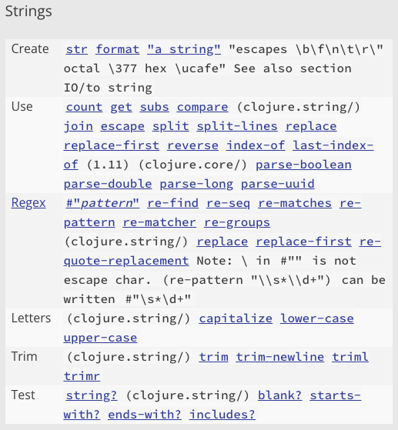
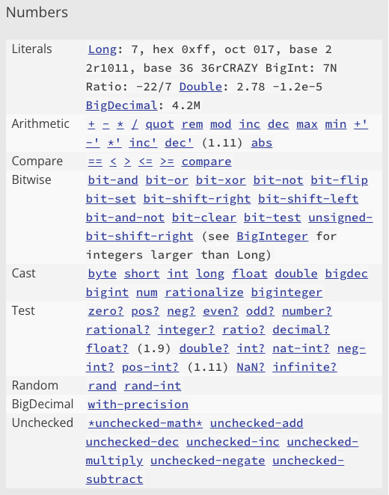
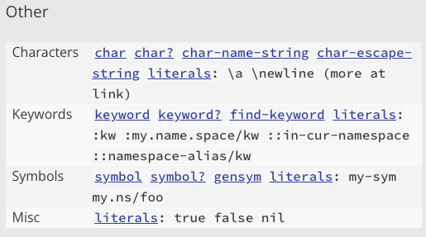
Built-in functions
from the Clojure Cheatsheet
EXPLORE!

Slide 13
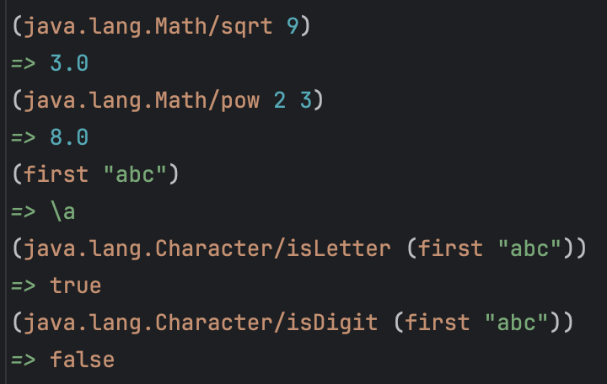
Java libraries
because Clojure is built on the Java Virtual Machine
  can easily access static methods in Java libraries
  specify the library path / method name

Slide 14
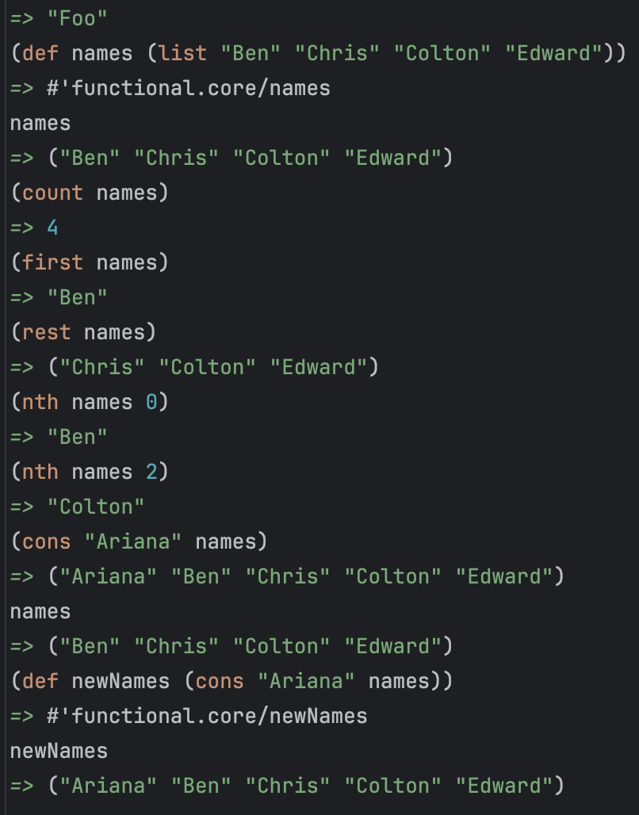
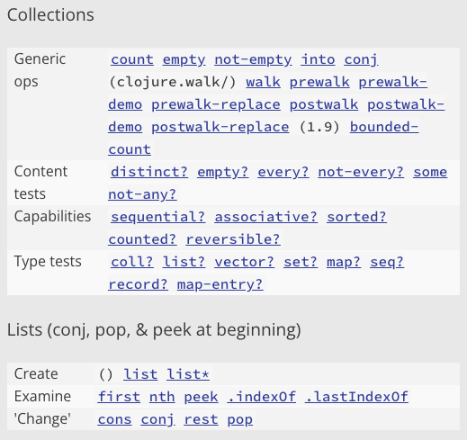
Built-in functions
from the Clojure Cheatsheet
EXPLORE!

Slide 15
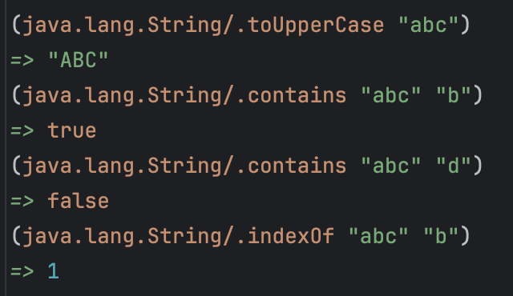
Java libraries
can call Java String methods on Clojure strings
  note: non-static methods must have . prefix
note: calling String methods does not violate our functional principles, since Strings are immutable in Java

Slide 16
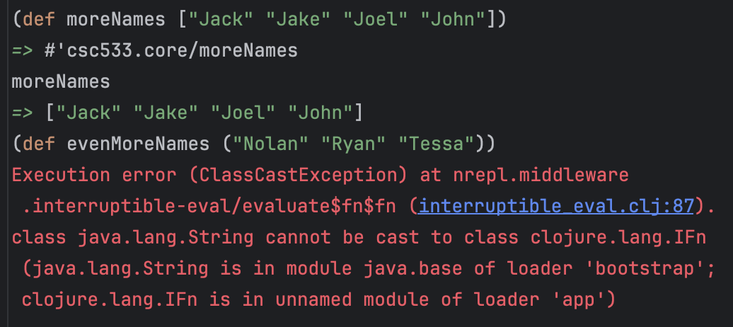
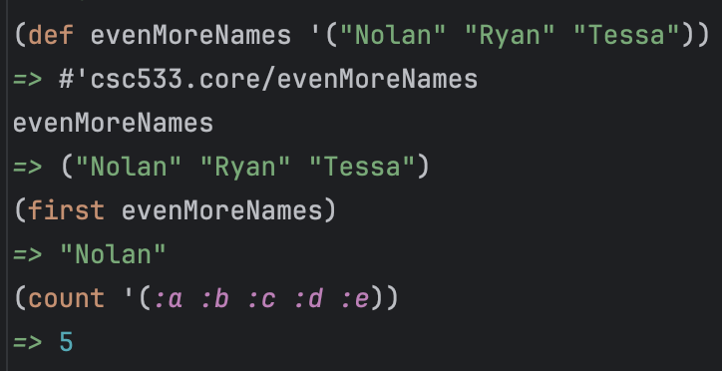
Interesting inconsistency
consider the following definitions
  defining a name for a vector works
  defining a name for a list fails
  WHY?
parentheses serve double-duty in Clojure
  used to represent a list, e.g., ("Nolan" "Ryan" "Tessa")
  used to represent a function call, e.g., (+ 2 3)
how does the interpreter know which is which?
it can't – it assumes parentheses denote a function call
  if you want to specify a list as data, preface it with a quote
when the interpreter evaluates an expression starting with ', it treats it as data

Slide 17
Defining functions
can define a new function using def and fn
  fn maps a vector of inputs to a single output expression
  def then assigns that function to a name
  (def FUNC_NAME
  (fn [input1 input2 … inputN]
  (OUTPUT_EXPRESSION_INVOLVING_INPUTS)))
  (def square (def next-to-last
  (fn [x] (fn [arblist]
  (* x x))) (nth (reverse arblist) 1)))
better yet, can combine def and fn into defn
  (defn FUNC_NAME [input1 input2 … inputN]
  (OUTPUT_EXPRESSION_INVOLVING_INPUTS))
  (defn square [x] (defn next-to-last [arblist]
  (* x x)) (nth (reverse arblist) 1))

Slide 18
Function examples
(defn ft->m [ft]
(* ft 0.3048))
(defn m->ft [m] (defn m->ft [m]
(/ m 0.3048)) (/ m (ft->m 1)))
(defn sum-of-squares [x y] (defn square-of-sum [x y]
(+ (* x x) (* y y))) (* (+ x y) (+ x y)))
(defn round [num]
(int (+ num 0.5)))
(defn palindrome [word]
(= (seq word) (reverse word)))

Slide 19
In-class exercises
define a function that converts from Fahrenheit to Celsius
  note: celsius = 5/9 * (fahr – 32)
  (defn fahr->celsius [temp]
  ( ??? )
similarly, define a function that converts from Celsius to Fahrenheit
  (defn celsius->fahr [temp]
  ( ??? )
define a function that calculates a baseball player's batting average
  (defn BA [hits at-bats]
  ( ??? )

Slide 20
More complex exercise
define a function that calculates the wind-chill index
wind-chill = 35.74 + 0.6215☓temp + (0.4275☓temp – 35.75)☓wind^{0.16}
  (defn wind-chill [temp wind]
  ( ??? ))

Slide 21
Conditional evaluation
can select alternative expressions to evaluate
  (if TEST TRUE_EXPRESSION FALSE_EXPRESSION)
  (defn my-abs [num] (defn singleton? [arblist]
  (if (neg? num) (if (= (count arblist) 1)
  (- 0 num) true
  num)) false))
  (defn singleton-list? [arblist]
  (if (and (list? arblist) (= (count arblist) 1))
  true
  false))
and, or, not are standard Boolean connectives
        evaluated from left-to-right, short-circuit evaluation

Slide 22
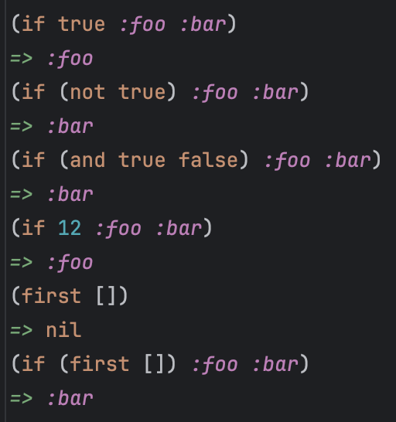
Conditional evaluation (cont.)
note: an if-expression is a special form
  doesn't follow standard evaluation rules
  (if (list? x)
  (first x)
  x)
  anything but false or nil
  (equivalent to Java null value) is "true"
test expression is evaluated first
  if value is "true", first expression is evaluated & returned
  else, second expression is evaluated & returned

Slide 23
Multi-way conditional
when there are more than two alternatives, can
  nest if-expressions (i.e., cascading ifs)
  use the cond special form (i.e., a switch)
  (cond TEST1 EXPRESSION1
  TEST2 EXPRESSION2
  . . .
  :else EXPRESSIONn)
(defn compare [num1 num2]
(cond (= num1 num2) :equal
(> num1 num2) :greater
:else :less))
(defn grade [avg]
(cond (>= avg 90) :A
(>= avg 80) :B
(>= avg 70) :C
(>= avg 60) :D
:else :F))
evaluate tests in order
  when reach one that evaluates to "true", evaluate corresponding expression & return

Slide 24
Leap year example
a leap year is divisible by 4 but not 100 except if divisible by 400
  yes: 2000, 2020, 2024, 2028, 2400 no: 2025, 2026, 2027, 2100, 2200, 2300
  (defn leap-year? [year
  (cond (zero? (remainder year 400)) true
  (zero? (remainder year 100)) false
  :else (zero? (remainder year 4))))
(defn leap-year? [year]
(and (zero? (remainder year 4))
(or (zero? (remainder year 400))
(not (zero? (remainder year 100))))))
write a function that determines the number of days in a year
  (defn days-in-year [year]
  ( ??? ))

Slide 25
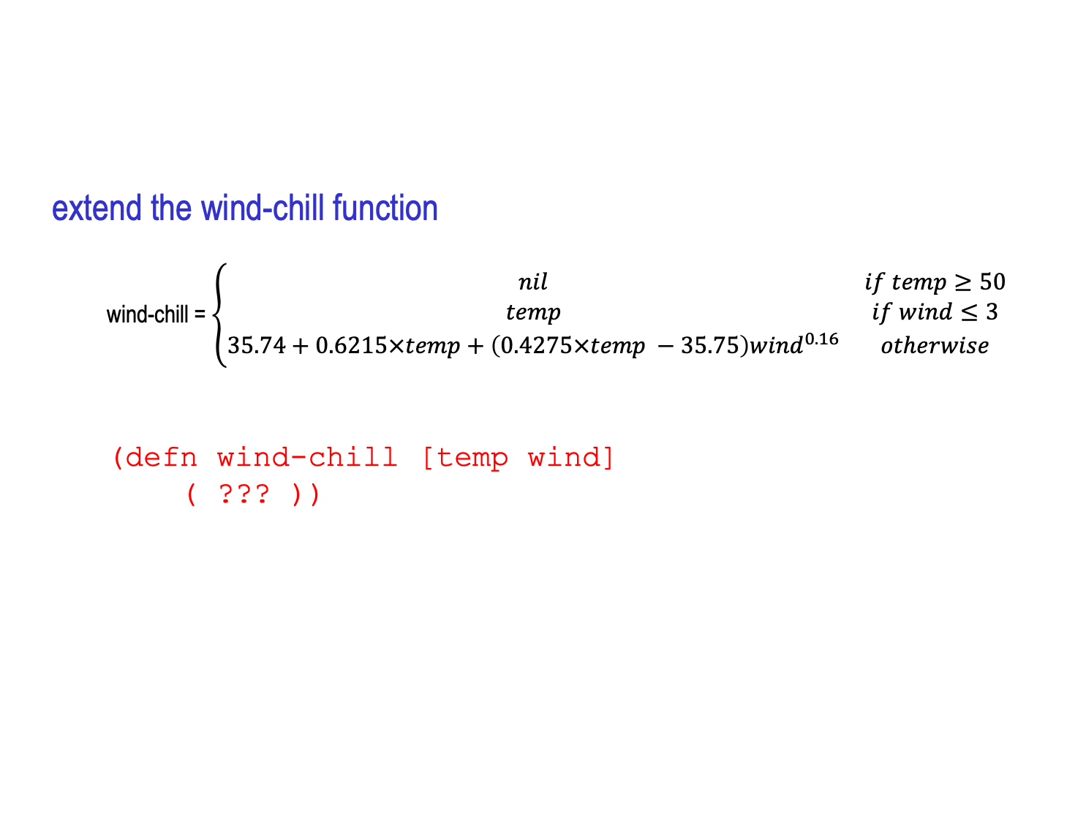
In-class exercise
extend the wind-chill function
  wind-chill = $\left\{\begin{matrix}nil & if temp≥50 & \\ temp & if wind≤3 & \\ 35.74+0.6215×temp+\left(0.4275×temp −35.75\right){wind}^{0.16} & otherwise & \end{matrix}\right.$
  (defn wind-chill [temp wind]
  ( ??? ))

Slide 26
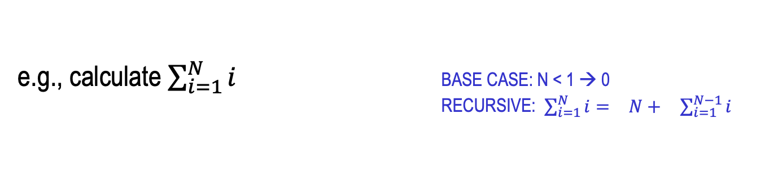
Repetition via recursion
pure functional languages do not have loops
  repetition is performed via recursive functions
recall (from CSC 222): to solve a problem recursively
  must have a base case – a case so simple that it can be solved directly
  each recursive call must be working on an instance that is closer to the base case
e.g., calculate $\sum_{i=1}^{N}{i}$ BASE CASE: N < 1 → 0
RECURSIVE: $\begin{matrix}\sum_{i=1}^{N}{i}= & N+ & \sum_{i=1}^{N−1}{i}\end{matrix}$
e.g., calculate length of a list BASE CASE: 0 if list is empty
RECURSIVE: otherwise, remove first item and add 1 to length of resulting list
e.g., list membership? BASE CASE1: no if list is empty
BASE CASE 2: yes if it is first item in list
RECURSIVE: otherwise, remove first item and
determine if member of resulting list

Slide 27
Repetition via recursion
common pattern with numbers:
BASE CASE: handle extreme num (low or high)
RECURSIVE: recursively apply to num+1 or num-1, then combine somehow with num
  (defn sum-up-to [N]
  (if (< N 1)
  0
  (+ N (sum-up-to (- N 1)))))
  (defn my-length [lst]
  (if (empty? lst)
  0
  (+ 1 (my-length (rest lst)))))
  (defn my-contains? [lst item]
  (cond (empty? lst) false
  (= item (first lst)) true
  :else (my-contains? (rest lst) item)))
common pattern with lists:
BASE CASE: handle the null list
RECURSIVE: recursively apply to rest of the list, then combine somehow with front of the list

Slide 28
In-class exercise
define function to count the number of days in a range of years
  (defn days-in-range [start-year end-year]
  ( ??? ))
  (days-in-range 2015 2016) → 731
  (days-in-range 2015 2020) → 2192
what is the base case?
  i.e., when is it trivial to count the number of days in a range?
what is the recursion?
  i.e., how can counting the number of days in a slightly smaller range help solve this problem?

Slide 29
Tail-recursion vs. full-recursion
a tail-recursive function is one in which the recursive call occurs last
  (defn my-contains? [lst item]
  (cond (empty? lst) false
  (= item (first lst)) true
  :else (my-contains? (rest lst) item)))
a full-recursive function is one in which further evaluation is required
  (defn sum-up-to [N]
  (if (< N 1)
  0
  (+ N (sum-up-to (- N 1)))))
any full-recursive solution can be rewritten using tail-recursion
  full recursive solutions are usually simpler, more intuitive
  why do we care? MEMORY UTILIZATION

Slide 30
Implementing full-recursion
for a full-recursive function, work is done after the recursive call
  (defn factorial [N]
  (if (zero? N)
  1
  (* N (factorial (- N 1)))))
(factorial 0)
0 is zero
1
(factorial 1)
1 not zero
evaluate (* 1 (factorial 0))
1
  each recursive call pushes a new activation record on the run-time stack
  e.g., when (factorial 3) tries to evaluate (* 3 (factorial 2)), it must first evaluate (factorial 2) before it can multiply
  in effect, no multiplications can occur until the base case is reached, then occur as records are popped off the stack
(factorial 2)
2 not zero
evaluate (* 2 (factorial 1))
2
(factorial 3)
3 not zero
evaluate (* 3 (factorial 2))
6

Slide 31
Optimizing tail-recursion
if a function is tail-recursive, can replace the recursive call with recur
  (defn my-contains? [lst item]
  (cond (empty? lst) false
  (= item (first lst)) true
  :else (my-contains? (rest lst) item)))
  (defn my-contains? [lst item]
  (cond (empty? lst) false
  (= item (first lst)) true
  :else (recur (rest lst) item)))
  since the call to my-contains? returns the same value as its recursive call (i.e., recur), no need to keep the old activation record
  if you specify tail-recursion using recur, the interpreter will use the same space, so no limit on recursion depth
(my-contains? '(1 2 4 6) 4)
'(1 2 4 6) is not empty
4 ≠ 1
call (recur '(2 4 6) 4)
(my-contains? '(2 4 6) 4)
'(2 4 6) is not empty
4 ≠ 2
call (recur '(4 6) 4)
(my-contains? '(4 6) 4)
'(4 6) is not empty
4 = 4
true

Slide 32
Full → tail
can convert any full-recursive function into tail recursion
  need a helper method with an extra input, the work done so far
  do the operation on that value before making the recursive call
  (defn factorial [num]
  (if (zero? num)
  1
  (* num (factorial (= num 1)))))
  ---------------------------------------------
  (defn factorial [N]
  (factorial-help N 1))
  (defn factorial-help [num val-so-far]
  (if (zero? num)
  val-so-far
  (recur (- num 1) (* num val-so-far)))))
(factorial-help 1 6)
1 not zero
then call (recur 0 (* 1 6))
(factorial-help 3 1)
3 not zero
then call (recur 2 (* 3 1))
(factorial-help 2 3)
2 not zero
then call (recur 1 (* 2 3))
(factorial-help 0 6)
0 is zero
6
(factorial 3)
call (factorial-help 3 1)
6

Slide 33
Scoping in Clojure
unlike the original LISP, Clojure is statically scoped
  can nest functions and hide details
  (defn factorial [N]
  (defn factorial-help [num val-so-far]
  (if (zero? num)
  val-so-far
  (recur (- num 1) (* num val-so-far))))
  (factorial-help N 1))
  since factorial-help is defined inside of factorial, hidden from the outside
  since statically scoped, arguments in enclosing function are visible to enclosed functions (i.e., non-local variables)

Slide 34
When tail-recursion?
  (defn sum-up-to [N]
  (if (< N 1)
  0
  (+ N (sum-up-to (- N 1)))))
  (defn sum-up-to [N]
  (defn sum-help [num sum-so-far]
  (if (< num 1)
  sum-so-far
  (recur (- num 1) (+ num sum-so-far))))
  (sum-help N 0))
  for a small number of repetitions, full-recursion is sufficient (and simpler)
  for a potentially large number of repetitions, tail-recursion may be needed

Slide 35
Hailstone example
hailstone sequence: start with any number N
  if even, next number in sequence is N/2
  if odd, next number in sequence is 3N+1
  e.g., 3 → 10 → 5 → 16 → 8 → 4 → 2 → 1 → 4 → 2 → 1 → …
open question: does every starting N result in the 4-2-1 cycle?
  (defn hailstone [N]
  (cond (= N 1) 1
  (even? N) (+ 1 (hailstone (/ N 2)))
  :else (+ 1 (hailstone (+ (* 3 N) 1)))))
is tail-recursion needed? if so, rewrite the function using tail recursion:
  (defn hailstone-tail [N]
  ( ??? ))

Slide 36
Hailstone (cont.)
what if we want to see the actual sequence?
  we will eventually see how to do non-functional things (e.g., output)
  but, functional approach is to build a list of the sequence
(defn hailstone-list [N]
(defn hailstone-help [so-far]
(cond (= (first so-far) 1) (reverse so-far)
(even? (first so-far))
(recur (cons (/ (first so-far) 2) so-far))
:else
(recur (cons (+ (* 3 (first so-far)) 1) so-far))))
(hailstone-help (list N)))
purpose of the reverse call?

Slide 37
Full → tail pattern (w/ numbers)
converting from full-recursion to tail-recursion is fairly mechanical
  recursion on a number (where the BASE-NUM and COMBINE-NUMS vary)
(defn full-recursive-num [N]
(if (zero? N)
BASE-NUM
(COMBINE-NUMS N (full-recursive-num (- N 1)))))
(defn tail-recursive-num [num]
(defn tail-help [num so-far]
(if (zero? N)
so-far
(recur (- N 1) (COMBINE-NUMS N so-far))))
(tail-help num BASE-NUM))
  (def BASE-NUM 0) (def COMBINE-NUMS +) → ???
  (def BASE-NUM 1) (def COMBINE-NUMS *) → ???

Slide 38
Full → tail pattern (w/ lists)
  recursion on a list (where the BASE-LIST and COMBINE-LISTS vary)
(defn full-recursive-list [lst]
(if (empty? lst)
BASE-LIST
(COMBINE-LISTS (first lst) (full-recursive-list (rest lst)))))
(defn tail-recursive-list [arblist]
(defn tail-help [lst so-far]
(if (empty? lst)
so-far
(recur (rest lst) (COMBINE-LISTS (first lst) so-far))))
(tail-help arblist BASE-LIST))
  (def BASE-LIST '()) (def COMBINE-LISTS cons) → ???

Slide 39
More hailstone
suppose you wanted to find the longest hailstone sequence from a range
  (longest 1 100) → 119 (longest 101 1000) → 179
  (defn longest [low high]
  (if (> low high)
  0
  (max (hailstone-tail low) (longest (inc low) high))))
  -------------------------------------------------------------
  (defn longest-tail [low high]
  (defn longest-help [num longest-so-far]
  (if (> num high)
  longest-so-far
  (recur (inc num)
  (max (hailstone-tail num) longest-so-far))))
  (longest-help low 0))

Slide 40
In-class exercises
define a function to calculate the sum of a list of numbers
  (sum-nums '(1 2 3 4 5)) → 15
define a function to calculate the product of a list of numbers
  (prod-nums '(2 3 4)) → 24
define a function to count the number of zeros in a number list
  (num-zeros '(0 2 0 4 0)) → 3

Slide 41
In-class exercises
define a function to remove all zeros from a number list
  (remove-zeros '(2 0 1 0)) → (2 1)
define a function to remove all non-zeros from a number list
  (remove-nonzeros '(2 0 1 0)) → (0 0)
define a function to increment every number in a number list
  (inc-all '(1 2 4 8)) → (2 3 5 9)

Slide 42
In-class exercises
define a function to simulate a random coin flip (with no inputs)
  (coin-flip) → :HEADS
  (coin-flip) → :TAILS
define a function to simulate a sequence of coin flips & count heads
  (count-heads 100) → 47
  (count-heads 10000) → 5010
define a tail-recursive version
  (count-heads-tail 1000000) → 500042

Slide 43
Higher-order functions
(apply FUNCTION LIST) applies the function with the list elements as inputs
  (apply + '(1 2 3)) ≡
  (+ 1 2 3) → 6
  (apply min '(5 2 8 6)) ≡
  (min 5 2 8 6) → 2
(map FUNCTION LIST) applies the function to each list element
  (map sqrt '(9 25 81)) ≡
  (list (sqrt 9) (sqrt 25) (sqrt 81)) → (3 5 9)
  (map first '((:a :b) (:c :d))) ≡
  (list (first '(:a :b)) (first '(:c :d))) → (:a :c)

Slide 44
Hailstone again
much simpler to find the longest Hailstone sequence using apply & map
  (defn longest [low high]
  (apply max (map hailstone-tail (range low (+ high 1)))))
can any of your in-class functions be simplified using apply & map?

Slide 45
Higher-order functions
(filter FUNCTION LIST) filters out elements for which the function is true
  (filter neg? '(3 -2 9 -5 0)) → (-2 -5)
  (filter list? '(:a (:b :c) :d (:e))) → ((:b :c) (:e))
(comp F1 F2 F3) returns a composition of the functions
  (def mult-plus-one (comp inc *))
  (mult-plus-one 8 4) ≡ (inc (* 8 4)) → 33
  (filter (comp not list?) '(:a (:b :c) :d (:e))) → (:a :d)

Slide 46
Back to exercises
can simplify other functions using filter & comp
(defn count-zeros [numlist]
(count (filter zero? numlist)))
(defn remove-zeros [numlist]
(filter (comp not zero?) numlist))

