Slide 1
CSC 533: Programming Languages
Spring 2023
See online syllabus at:
  http://dave-reed.com/csc533
Course goals:
  understand issues in designing, implementing, and evaluating programming languages
  appreciate strengths and tradeoffs of different programming paradigms
  working knowledge of Java, Scheme, & a modern scripting language

Slide 2
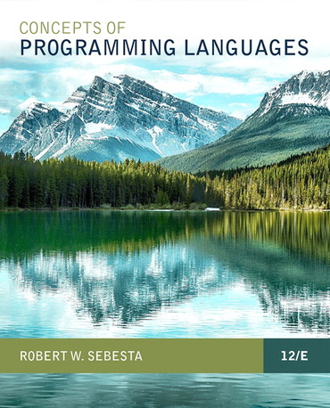
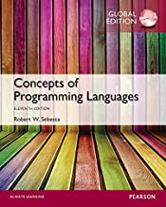
Course text
the official text is the 12th edition of Sebesta (2018)
  if you are interested in programming languages (and can afford it), buy it
alternatively, the 11th edition (global edition, 2016) can be accessed for free online
  you may use this older edition

Slide 3
Why are there different programming languages?
in theory, all programming languages are equivalent
  compiled/interpreted into basic machine operations
  Church-Turing thesis applies
Why are there different natural languages?
in practice, different languages provide distinct voices
  different cultures (application domains)
  different primitive concepts (operations)
  different ways of thinking about the world (perspectives)

Slide 4
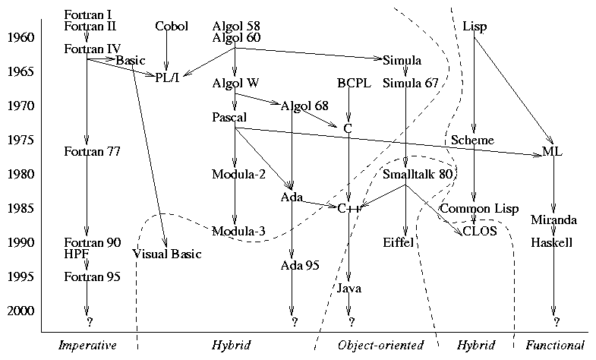
Family tree of (some) early high-level languages

Slide 5
Programming paradigms
similarly, different problem-solving approaches (paradigms) exist and are better suited to different types of tasks
imperative approaches: programs specify sequences of state changes
    procedure-oriented: subroutines & nested scopes (Pascal, C)
    object-based: interacting objects (Ada, Modula)
    object-oriented: objects + inheritance (C++, Java, Smalltalk)
functional approach: programs transform data by applying functions
    e.g., LISP/Scheme, ML, Haskell
logic approach: programs are statements in logic that describe a solution
    e.g., Prolog, Oz
scripting? visual? concurrent?

Slide 6
Example: Circle of Friends
consider a group of friends
  note: friends are not necessarily bidirectional (?)
    Amy is friends with Bob, Dan, and Elle
    Bob is friends with Amy and Dan
    Chris is friends with Dan and Elle
    Dan is friends with Chris
    Elle is friends with Amy, Bob, Chris and Dan
  we can define a circle of friends:
    circle (level 1) of Dan = direct friends of Dan = {Chris}
    circle (level 2) of Dan = direct friends of Dan + their direct friends – Dan
    = {Chris} + {Dan, Elle} – Dan
    = {Chris, Elle}
    circle (level N) of Dan = circle (level N-1) of Dan + their direct friends – Dan
suppose we want to enter a collection of friends and determine friend circles
  solution in Java? input format? data structures? algorithm?

Slide 7
Example: Circle of Friends in LISP/Scheme
this problem is ideal for Scheme
  Scheme is a functional programming language
  it is symbolic, can represent words and text as easily as numbers
  it has primitives for manipulating lists and structures
  recursion is natural and efficient
(define FRIENDS
'((amy (bob dan elle))
(bob (amy dan))
(chaz (dan elle))
(dan (chaz))
(elle (amy bob chaz dan))))
(define (getFriends person)
(cadr (assoc person FRIENDS)))
(define (getCircle person distance)
(if (= distance 1)
(getFriends person)
(let ((circle (getCircle person (- distance 1))))
(remove person
(remove-duplicates (append circle
(apply append (map getFriends circle))))))))
can compactly represent the friends as nested lists
can write the basic code in 7-9 lines

Slide 8
Why study programming languages?
increased capacity to express ideas
  broader perspective on programming and problem solving, new paradigms
improved background for choosing appropriate languages
  know tradeoffs between different languages
  simplify programming task by choosing best-suited language
increased ability to learn new languages
  as with natural languages, 2nd language is hardest to learn
  languages come and go, must be able to adapt/adjust
better understanding of the significance of implementation
  can use language more intelligently if understand implementation
  also aids in identifying bugs
increased ability to design/implement new languages

Slide 9
How do we judge a programming language?
readability
  in software engineering, maintenance cost/time far exceeds development cost/time
    want code to be easy to understand, modify, and maintain
  simplicity: language should be as small as possible, avoid redundant features
    Java is pretty complex, e.g., x++; ++x; x +=1; x = x + 1;
    Scheme is very simple
  orthogonality: small set of primitive constructs, can be combined independently and uniformly (i.e., very few special cases)
    Java is OK but some exceptions,.e.g., no primitives in ArrayList
    Scheme is highly orthogonal
  natural control and data structures: provide useful, high-level abstractions
    Java is good but does include some tricky ones, e.g., :? switch continue
    Scheme is limited (e.g., recursion for looping)
  simple and unambiguous syntax: intended form of code is clear to reader
    Java not so good, e.g., overall complexity, dangling else, optional { }
    Scheme syntax is simple and clear

Slide 10
How do we judge a programming language (cont.)?
writability
  want to make programming as simple as possible for the programmer
  simplicity + orthogonality + natural control & data structures + simple & unambiguous syntax
  support for abstraction: need to be able to define and utilize abstractions
    Java is good, e.g., support for functions, libraries, classes
    Scheme is OK, but more tedious
  expressivity: language provides convenient ways of specifying computations
    Java is good, e.g., if & switch, while & do-while & for, bitwise operators, …
    Scheme is not very expressive (few control structures)
note: readability & writability are often at odds
  e.g., more control structures can simplify programmer's task, but make code harder to read and maintain (more to know, more redundancy)
  Common LISP vs. Scheme

Slide 11
How do we judge a programming language (cont.)?
reliability
  want to ensure that a program performs to its specifications under all conditions
    want to build in strong error checking and recovery capabilities
    also want to help the programmer to avoid errors
  readability + writability
  type checking: identify errors either at compile-time or during execution
    Java is good, e.g., most types checked at compile time
    Scheme is dynamic, must do checking during execution
  exception handling: ability to intercept and recover from errors in code
    Java is good, e.g., try/catch, libraries require exception handling
    Scheme is more awkward
  memory management: control memory accessing, allocation/deallocation, aliasing
    Java is good, e.g., garbage collection, must explicitly allocate dynamic
    Scheme handles all transparently

