Slide 1
CSC 533: Programming Languages
Spring 2023
Scheme structures
  memory management: structure sharing, garbage collection
  structuring data: association list
  let expressions
  non-functional features: set!, read, display, begin
  non-linear lists: trees

Slide 2
Memory management in Scheme
all data is dynamically allocated (heap-based)
  variables (from function definitions, let-expressions) may be stored on stack
underlying lists is the dotted-pair structure
  (a b c) ≡ (a . (b . (c . ())))
this structure demonstrates
  non-contiguous nature of lists (non-linear linked-lists)
  behavior of primitive operations (car, cdr, cons)
  (car '(a b c)) ≡ (car '(a . (b . (c . ())))) → a
  (cdr '(a b c)) ≡ (cdr '(a . (b . (c . ())))) → (b . (c . ())) ≡ (b c)
  (cons 'x '(a b c)) ≡ (cons 'x '(a . (b . (c . ()))))
  → (x . (a . (b . (c . ())))) ≡ (x a b c)
a
b
c

Slide 3
Structure sharing
since destructive assignments are rare, Scheme makes extensive use of structure-sharing
  (define (my-length lst)
  (if (null? lst)
  0
  (+ 1 (my-length (cdr lst)))))
  (my-length '(a b c))
  3
  each recursive call shares a part of the list
  other code that uses a, b, c or () can share as well
problems caused by destructive assignments? solutions?
lst
lst
lst
lst
run-time stack
a
b
c

Slide 4
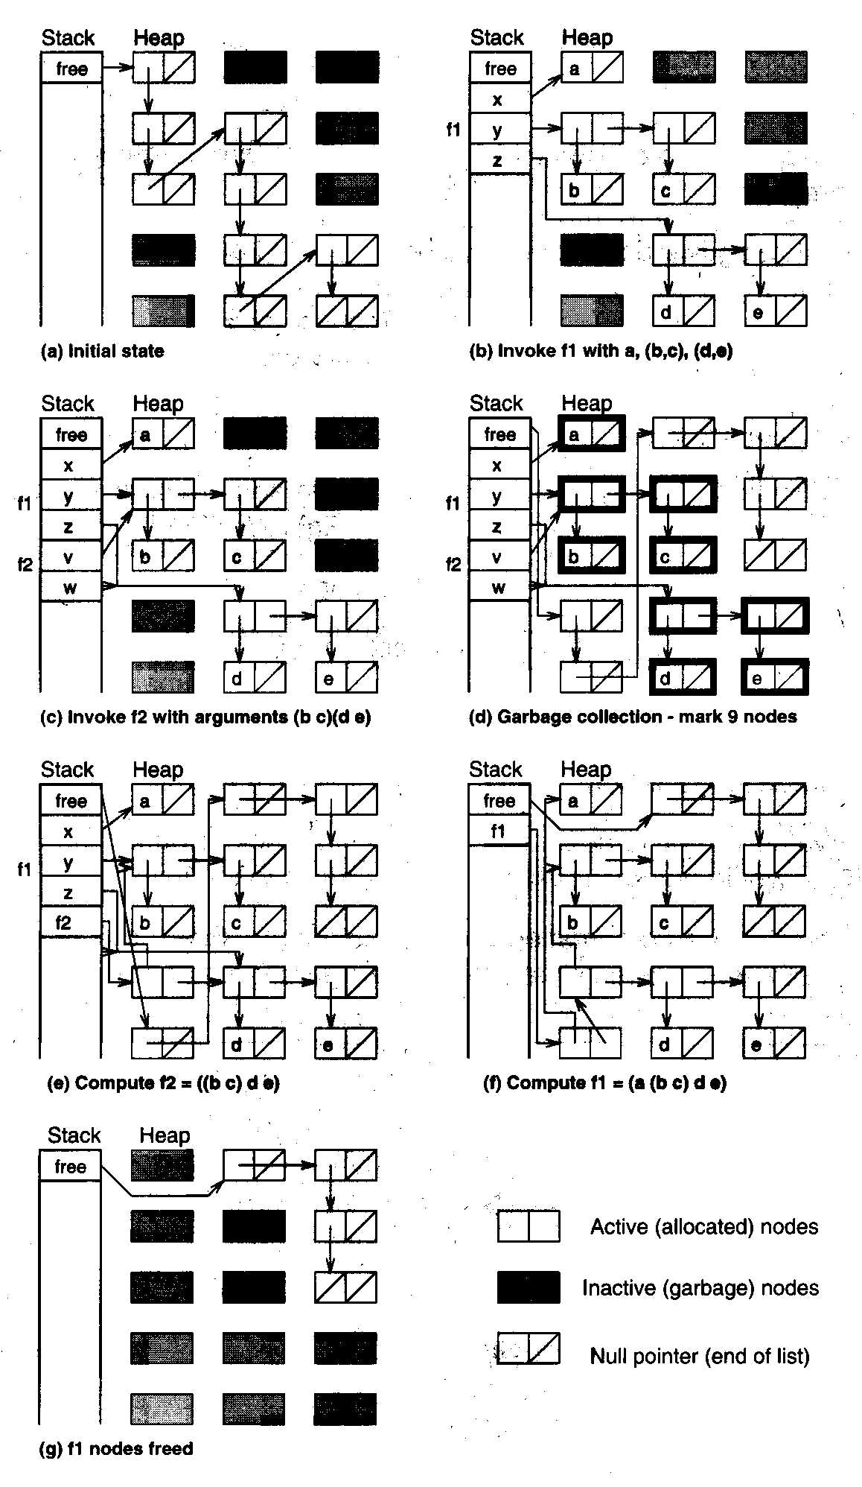
Garbage collection
garbage collection is used to reclaim heap memory
  (define (f1 x y z)
  (cons x (f2 y z)))
  (define (f2 v w)
  (cons v w))
  (f1 'a '(b c) '(d e))
  (a (b c) d e)

Slide 5
Structuring data
an association list is a list of "records"
  each record is a list of related information, keyed by the first field
  i.e., a Map
    (define NAMES '((Smith Pat Q)
    (Jones Chris J)
    (Walker Kelly T)
    (Thompson Shelly P)))
note: can use define to
create "global constants"
(for convenience)
  can access the record (sublist) for a particular entry using assoc
    ➢ (assoc 'Smith NAMES) ➢ (assoc 'Walker NAMES)
    (Smith Pat Q) (Walker Kelly T)
  assoc traverses the association list, checks the car of each sublist
    (define (my-assoc key assoc-list)
    (cond ((null? assoc-list) #f)
    ((equal? key (caar assoc-list)) (car assoc-list))
    (else (my-assoc key (cdr assoc-list)))))

Slide 6
Association lists
to access structured data,
  store in an association list with search key first
  access via the search key (using assoc)
  use car/cdr to select the desired information from the returned record
    (define MENU '((bean-burger 2.99)
    (tofu-dog 2.49)
    (fries 0.99)
    (medium-soda 0.79)
    (large-soda 0.99)))
    ➢ (cadr (assoc 'fries MENU))
    0.99
    ➢ (cadr (assoc 'tofu-dog MENU))
    2.49
    (define (price item)
    (cadr (assoc item MENU)))

Slide 7
assoc example
consider a more general problem: determine price for an entire meal
  represent the meal order as a list of items,
    e.g., (tofu-dog fries large-soda)
  use recursion to traverse the meal list, add up price of each item
    (define (meal-price meal)
    (if (null? meal)
    0.0
    (+ (price (car meal)) (meal-price (cdr meal)))))
  alternatively, could use map & apply
    (define (meal-price meal)
    (apply + (map price meal)))

Slide 8
In-class exercise
given a menu structure:
    (define MENU '((bean-burger 2.99)
    (tofu-dog 2.49)
    (fries 0.99)
    (medium-soda 0.79)
    (large-soda 0.99)))
define a function to count how many items are below a certain price
    (define (num-priced-below cutoff menu)
    ??? )
    (num-priced-below 1.00 MENU) → 3
    (num-priced-below 0.99 MENU) → 1

Slide 9
Finally, variables!
Scheme does provide for variables and destructive assignments
  ➢ (define x 4) define creates and initializes a variable
  ➢
  ➢ x
  4
  (set! x (+ x 1)) set! updates a variable
  ➢
  x
  5
since Scheme is statically scoped, can have global variables
  YUCK: destroys functional model, messes up structure sharing

Slide 10
Let expression
fortunately, Scheme provides a "clean" mechanism for creating variables to store (immutable) values
  (let ((VAR1 VALUE1)
  (VAR2 VALUE2)
  . . .
  (VARn VALUEn))
  EXPRESSION)
let expression introduces a new environment with variables (i.e., a block)
good for naming a value (don't need set!)
a let expression has the same effect as creating a help function & passing value
as long as destructive assignments are not used, the functional model is preserved
  in particular, structure sharing is safe
  (let ((x 5) (y 10))
  (let (z (+ x y))
  )
  )
environment
where z = 15
environment
where x = 5 and
y = 10

Slide 11
Example: circle of friends
suppose we want to compute a person's circle of friends
  level 1: direct friends
  level 2: direct friends + friends of direct friends
  …
  level n : level (n-1) friends + friends of level (n-1) friends
(define FRIENDS
'((amy (bob dan elle)) (bob (amy dan)) (chaz (dan elle))
(dan (chaz)) (elle (amy bob chaz dan)) (fred (dan))))
(define (get-friends person)
(cadr (assoc person FRIENDS)))
(define (get-circle person distance)
(if (= distance 1)
(get-friends person)
(let ((circle (get-circle person (- distance 1))))
(append circle (apply append (map get-friends circle))))))

Slide 12
Example: circle of friends (cont.)
consider Amy's circle of friends
  level 1: (bob dan elle)
  level 2: (bob dan elle) + (amy dan) + (chaz) + (amy bob chaz dan) →
    (bob dan elle amy dan chaz amy bob chaz dan)
(require scheme/list)
(define FRIENDS
'((amy (bob dan elle)) (bob (amy dan)) (chaz (dan elle))
(dan (chaz)) (elle (amy bob chaz dan)) (fred (dan))))
(define (get-friends person)
(cadr (assoc person FRIENDS)))
(define (get-circle person distance)
(if (= distance 1)
(get-friends person)
(let ((circle (get-circle person (- distance 1))))
(remove person
(remove-duplicates (append circle
(apply append
(map get-friends circle))))))))
don't list self in circle of friends
don't list duplicates in circle of friends

Slide 13
Example: craps simulation
consider a game of craps:
  if first roll is 7, then WINNER
  if first roll is 2 or 12, then LOSER
  if neither, then first roll is "point"
    – keep rolling until get 7 (LOSER) or point (WINNER)
(define (craps)
(define (roll-until point)
(let ((next-roll (+ (random 6) (random 6) 2)))
(cond ((= next-roll 7) 'LOSER)
((= next-roll point) 'WINNER)
(else (roll-until point)))))
(let ((roll (+ (random 6) (random 6) 2)))
(cond ((or (= roll 2) (= roll 12)) 'LOSER)
((= roll 7) 'WINNER)
(else (roll-until roll)))))

Slide 14
Example: craps with history list
as is, all you see from craps is WINNER or LOSER
  would like to see the actual rolls to confirm proper behavior
the "functional way" is to construct a list of the rolls & return it
(define (craps)
(define (roll-until point)
(let ((next-roll (+ (random 6) (random 6) 2)))
(cond ((= next-roll 7) (list next-roll 'LOSER))
((= next-roll point) (list next-roll 'WINNER))
(else (cons next-roll (roll-until point))))))
(let ((roll (+ (random 6) (random 6) 2)))
(cond ((or (= roll 2) (= roll 12)) (list roll 'LOSER))
((= roll 7) (list roll 'WINNER))
(else (cons roll (roll-until roll)))))

Slide 15
Example: craps with I/O
alternatively, can bite the bullet and use non-functional features
  display displays S-expr (newline yields carriage return)
  read reads S-expr from input
  begin provides sequencing (for side effects)
(define (craps)
(define (roll-until point)
(let ((next-roll (+ (random 6) (random 6) 2)))
(begin (display "Roll: ")(display next-roll) (newline)
(cond ((= next-roll 7) 'LOSER)
((= next-roll point) 'WINNER)
(else (roll-until point))))))
(let ((roll (+ (random 6) (random 6) 2)))
(begin (display "Point: ") (display roll) (newline)
(cond ((or (= roll 2) (= roll 12)) 'LOSER)
((= roll 7) 'WINNER)
(else (roll-until roll))))))

Slide 16
Non-linear data structures
note: can represent non-linear structures using lists
e.g. trees
(dog
(bird (aardvark () ()) (cat () ()))
(possum (frog () ()) (wolf () ())))
  empty tree is represented by the empty list: ()
  non-empty tree is represented as a list: (ROOT LEFT-SUBTREE RIGHT-SUBTREE)
  can access the the tree efficiently
  (car TREE) ➔ ROOT
    (cadr TREE) ➔ LEFT-SUBTREE
    (caddr TREE) ➔ RIGHT-SUBTREE

Slide 17
Tree routines
(define TREE1
' (dog
(bird (aardvark () ()) (cat () ()))
(possum (frog () ()) (wolf () ()))))
(define (empty-tree? tree)
(null? tree))
(define (root tree)
(if (empty-tree? tree)
'ERROR
(car tree)))
(define (left-subtree tree) (define (right-subtree tree)
(if (empty-tree? tree) (if (empty-tree? tree)
'ERROR 'ERROR
(cadr tree))) (caddr tree)))

Slide 18
Tree searching
note: can access root & either subtree in constant time
→ can implement binary search trees with O(log N) access
  binary search tree: for each node, all values in left subtree are <= value at node
all values in right subtree are > value at node
(define (bst-contains? bstree num)
(cond ((empty-tree? bstree) #f)
((= (root bstree) num) #t)
((> (root bstree) num) (bst-contains? (left-subtree bstree) num))
(else (bst-contains? (right-subtree bstree) num))))
note: recursive nature of trees makes them ideal for recursive traversals

Slide 19
Tree traversal
(define (pre-order tree)
(if (empty-tree? tree)
'()
(append (list (root tree))
(pre-order (left-subtree tree))
(pre-order (right-subtree tree)))))
(define (in-order tree)
(if (empty-tree? tree)
'()
(append (in-order (left-subtree tree))
(list (root tree))
(in-order (right-subtree tree)))))
(define (post-order tree)
(if (empty-tree? tree)
'()
(append (post-order (left-subtree tree))
(post-order (right-subtree tree))
(list (root tree)))))

Slide 20
In class exercises
(define (num-nodes tree)
??? )
(define (sum-values numtree)
??? )
(define (max-value numtree)
??? )

