Slide 1
CSC 421: Algorithm Design & Analysis
Spring 2019
Greedy algorithms
  greedy algorithms
    examples: optimal change, job scheduling
  Prim's algorithm (minimal spanning tree)
  Dijkstra's algorithm (shortest path)
  Huffman codes (data compression)
  applicability

Slide 2
Greedy algorithms
the greedy approach to problem solving involves making a sequence of choices/actions, each of which simply looks best at the moment
  local view: choose the locally optimal option
  hopefully, a sequence of locally optimal solutions leads to a globally optimal solution
example: optimal change
  given a monetary amount, make change using the fewest coins possible
  amount = 16¢ coins?
  amount = 96¢ coins?

Slide 3
Example: greedy change
while the amount remaining is not 0:
  select the largest coin that is ≤ the amount remaining
  add a coin of that type to the change
  subtract the value of that coin from the amount remaining
    e.g., 96¢ = 50¢ + 25¢ + 10¢ + 10¢ + 1¢
will this greedy algorithm always yield the optimal solution?
for U.S. currency, the answer is YES
for arbitrary coin sets, the answer is NO
  suppose the U.S. Treasury added a 12¢ coin
    GREEDY: 16¢ = 12¢ + 1¢ + 1¢ + 1¢ + 1¢ (5 coins)
    OPTIMAL: 16¢ = 10¢ + 5¢ + 1¢ (3 coins)

Slide 4
Example: job scheduling
suppose you have a collection of jobs to execute and know their lengths
  want to schedule the jobs so as to minimize waiting time
    Job 1: 5 minutes Schedule 1-2-3: 0 + 5 + 15 = 20 minutes waiting
    Job 2: 10 minutes Schedule 3-2-1: 0 + 4 + 14 = 18 minutes waiting
    Job 3: 4 minutes Schedule 3-1-2: 0 + 4 + 9 = 13 minutes waiting
  GREEDY ALGORITHM: do the shortest job first
    i.e., while there are still jobs to execute, schedule the shortest remaining job
does the greedy approach guarantee the optimal schedule? efficiency?

Slide 5
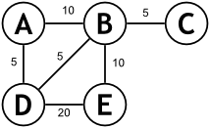
Application: minimal spanning tree
consider the problem of finding a minimal spanning tree of a graph
  a spanning tree of a graph G is a tree (no cycles) made up of all the vertices and a subset of the edges of G
  a minimal spanning tree for a weighted graph G is a spanning tree with minimal total weight
  minimal spanning trees arise in many real-world applications
    e.g., wiring a network of computers; connecting rural houses with roads
spanning tree?
minimal spanning tree?
example from http://compprog.wordpress.com/

Slide 6
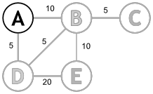
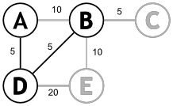
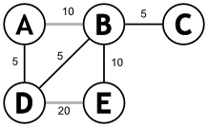
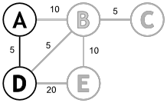
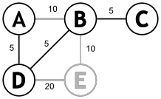
Prim's algorithm
to find a minimal spanning tree (MST):
  select any vertex as the root of the tree
  repeatedly, until all vertices have been added:
    find the lowest weight edge with exactly one vertex in the tree
    select that edge and vertex and add to the tree

Slide 7
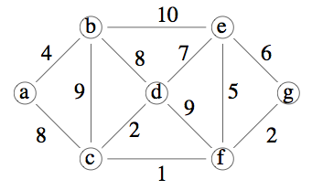
Prim's algorithm
to find a minimal spanning tree (MST):
  select any vertex as the root of the tree
  repeatedly, until all vertices have been added:
    find the lowest weight edge with exactly one vertex in the tree
    select that edge and vertex and add to the tree
minimal spanning tree?
is it unique?

Slide 8
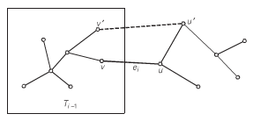
Correctness of Prim's algorithm
Proof (by induction): Each subtree T₁, T₁, …, T_{|V|} in Prim's algorithm is contained in a MST. [Thus, T_{|V|} is a MST.]
  BASE CASE: T₁ contains a single vertex, so is contained in a MST.
  ASSUME: T₁, …, T_{i-1} are contained in a MST.
  STEP: Must show Ti is contained in a MST.
    Assume the opposite, that Ti is not contained in a MST.
    Let e_{i} be the new edge (i.e., minimum weight edge with exactly one vertex in T_{i-1}).
    Since we assumed T_{i} is not part of any MST, adding e_{i} to a MST will yield a cycle.
    That cycle must contain another edge with exactly one vertex in T_{i-1} .
    Replacing that edge with e_{i} yields a spanning tree, and since e_{i} had the minimal weight of any edge with exactly one vertex in T_{i-1}, it is a MST.
    Thus, T_{i} is contained in a MST → CONTRADICTION!

Slide 9
Efficiency of Prim's algorithm
brute force (i.e., adjacency matrix):
  simple (conservative) analysis
    for each vertex, must select the least weight edge → O(|V| * |E|)
  more careful analysis:
    note that the number of eligible edges is shrinking as the tree grows
      Σ (|V| * deg(v_{i})) = O(|V|² + |E|) = O(|V|²)
smarter implementation:
  use a priority queue (min-heap) to store vertices, along with minimal weight edge
  to select each vertex & remove from PQ → |V| * O(log |V|) = O(|V| log |V|)
  to update each adjacent vertex after removal (at most once per edge)
    |E| * O(log |V|) = O(|E| log |V|)
  overall efficiency is O( (|E|+|V|) log |V| )

Slide 10
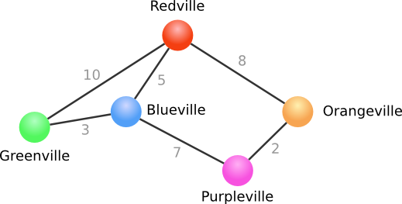
Application: shortest path
consider the general problem of finding the shortest path between two nodes in a graph
  flight planning and word ladder are examples of this problem
    - in these cases, edges have uniform cost (shortest path = fewest edges)
  if we allow non-uniform edges, want to find lowest cost/shortest distance path
Redville → Purpleville ?
example from http://www.algolist.com/Dijkstra's_algorithm

Slide 11
Modified BFS solution
we could modify the BFS approach to take cost into account
  instead of adding each newly expanded path to the end (i.e., queue), add in order of path cost (i.e., priority queue)
  [ [Redville]:0 ]
  [ [Redville, Blueville]:5,
  [Redville, Orangeville]:8,
  [Redville, Greenville]:10 ]
  [ [Redville, Orangeville]:8,
  [Redville, Blueville, Greenville]:8,
  [Redville, Greenville]:10,
  [Redville, Blueville, Purpleville]:12 ]
  [ [Redville, Blueville, Greenville]:8,
  [Redville, Greenville]:10,
  [Redville, Orangeville, Purpleville]:10,
  [Redville, Blueville, Purpleville]:12 ]
  [ [Redville, Greenville]:10,
  [Redville, Orangeville, Purpleville]:10,
  [Redville, Blueville, Purpleville]:12 ]
  [ [Redville, Orangeville, Purpleville]:10,
  [Redville, Blueville, Purpleville]:12,
  [Redville, Greenville, Blueville]:13 ]
note: as before, requires lots of memory to store all the paths
HOW MANY?

Slide 12
Dijkstra's algorithm
alternatively, there is a straightforward greedy algorithm for shortest path
Dijkstra's algorithm
  Begin with the start node. Set its value to 0 and the value of all other nodes to infinity. Mark all nodes as unvisited.
  For each unvisited node that is adjacent to the current node:
    If (value of current node + value of edge) < (value of adjacent node), change the value of the adjacent node to this value.
    Otherwise leave the value as is.
  Set the current node to visited.
  If unvisited nodes remain, select the one with smallest value and go to step 2.
  If there are no unvisited nodes, then DONE.
this algorithm is O(N²), requires only O(N) additional storage

Slide 13
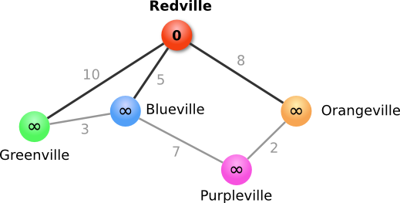
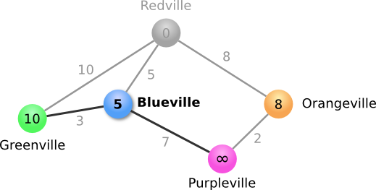
Dijkstra's algorithm: example
suppose want to find shortest path from Redville to Purpleville
  Begin with the start node. Set its value to 0 and the value of all other nodes to infinity. Mark all nodes as unvisited
For each unvisited node that is adjacent to the current node:
  If (value of current node + value of edge) < (value of adjacent node), change the value of the adjacent node to this value.
  Otherwise leave the value as is.
Set the current node to visited.

Slide 14
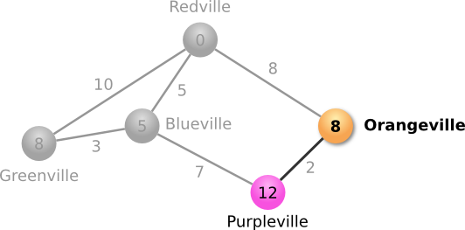
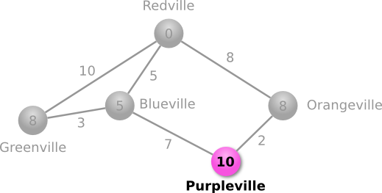
Dijkstra's algorithm: example cont.
  If unvisited nodes remain, select the one with smallest value and go to step 2.
  Blueville: set Greenville to 8 and Purpleville to 12; mark as visited.
  Greenville: no unvisited neighbors; mark as visited.
  If unvisited nodes remain, select the one with smallest value and go to step 2.
  Orangeville: set Purpleville to 10; mark as visited.
  Purpleville: no unvisited neighbors; mark as visited.
  If there are no unvisited nodes, then DONE.
With all nodes labeled, can easily construct the shortest path – HOW?

Slide 15
Correctness & efficiency of Dijkstra's algorithm
analysis of Dijkstra's algorithm is similar to Prim's algorithm
  can show that each greedy selection is safe, leads to shortest path
  brute force (i.e., adjacency matrix) approach
    for each vertex, need to select shortest edge → O(|V| * |E|)
    or, more carefully, Σ (|V| * deg(v_{i})) = O(|V|² + |E|) = O(|V|²)
  smarter implementation
    use a priority queue (min-heap) to store vertices, along with minimal weight edge
    to select each vertex & remove from PQ → |V| * O(log |V|) = O(|V| log |V|)
    to update each adjacent vertex after removal → |E| * O(log |V|) = O(|E| log |V|)
    overall efficiency is O( (|E|+|V|) log |V| )

Slide 16
Another application: data compression
in a multimedia world, document sizes continue to increase
  a 6 megapixel digital picture is 2-4 MB
  an MP3 song is ~3-6 MB
  a full-length MPEG movie is ~800 MB
storing multimedia files can take up a lot of disk space
  perhaps more importantly, downloading multimedia requires significant bandwidth
it could be a lot worse!
  image/sound/video formats rely heavily on data compression to limit file size e.g., if no compression, 6 megapixels * 3 bytes/pixel = ~18 MB
  the JPEG format provides 10:1 to 20:1 compression without visible loss

Slide 17
Audio, video, & text compression
audio & video compression algorithms rely on domain-specific tricks
  lossless image formats (GIF, PNG) recognize repeating patterns (e.g. a sequence of white pixels) and store as a group
  lossy image formats (JPG, XPM) round pixel values and combine close values
  video formats (MPEG, AVI) take advantage of the fact that little changes from one frame to next, so store initial frame and changes in subsequent frames
  audio formats (MP3, WAV) remove sound out of hearing range, overlapping noises
what about text files?
  in the absence of domain-specific knowledge, can't do better than a fixed-width code
    e.g., ASCII code uses 8-bits for each character
    '0': 00110000 'A': 01000001 'a': 01100001
    '1': 00110001 'B': 01000010 'b': 01100010
    '2': 00110010 'C': 01000011 'c': 01100011
    . . .
    . . .
    . . .

Slide 18
Fixed- vs. variable-width codes
suppose we had a document that contained only the letters a-f
  with a fixed-width code, would need 3 bits for each character
    a 000 d 011
    b 001 e 100
    c 010 f 101
  if the document contained 100 characters, 100 * 3 = 300 bits required
however, suppose we knew the distribution of letters in the document
  a:45, b:13, c:12, d:16, e:9, f:5
  can customize a variable-width code, optimized for that specific file
    a 0 d 111
    b 101 e 1101
    c 100 f 1100
  requires only 45*1 + 13*3 + 12*3 + 16*3 + 9*4 + 5*4 = 224 bits

Slide 19
Huffman codes
Huffman compression is a technique for constructing an optimal* variable-length code for text
  *optimal in that it represents a specific file using the fewest bits
  (among all symbol-for-symbol codes)
Huffman codes are also known as prefix codes
  no individual code is a prefix of any other code
    a 0 d 111
    b 101 e 1101
    c 100 f 1100
  this makes decompression unambiguous: 1010111110001001101
  note: since the code is specific to a particular file, it must be stored along with the compressed file in order to allow for eventual decompression

Slide 20


Huffman trees
to construct a Huffman code for a specific file, utilize a greedy algorithm to construct a Huffman tree:
  process the file and count the frequency for each letter in the file
  create a single-node tree for each letter, labeled with its frequency
  repeatedly,
    pick the two trees with smallest root values
    combine these two trees into a single tree whose root is labeled with the sum of the two subtree frequencies
  when only one tree remains, can extract the codes from the Huffman tree by following edges from root to each leaf (left edge = 0, right edge = 1)

Slide 21
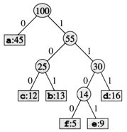
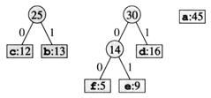
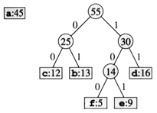
Huffman tree construction (cont.)
the code corresponding to each letter can be read by following the edges from the root: left edge = 0, right edge = 1
a: 0 d: 111
b: 101 e: 1101
c: 100 f: 1100

Slide 22
Huffman code compression
note that at each step, need to pick the two trees with smallest root values
  perfect application for a priority queue (min-heap)
  store each single-node tree in a priority queue (PQ) O(N log N)
  repeatedly, O(N) times
    remove the two min-value trees from the PQ O(log N)
    combine into a new tree with sum at root and insert back into PQ O(log N)
    ======================
    total efficiency = O(N log N)
while designed for compressing text, it is interesting to note that Huffman codes are used in a variety of applications
  the last step in the JPEG algorithm, after image-specific techniques are applied, is to compress the resulting file using a Huffman code
  similarly, Huffman codes are used to compress frames in MPEG (MP4)

Slide 23
Greed is good?
IMPORTANT: the greedy approach is not applicable to all problems
  but when applicable, it is very effective (no planning or coordination necessary)
GREEDY approach for N-Queens: start with first row, find a valid position in current row, place a queen in that position then move on to the next row
since queen placements are not independent, local choices do not necessarily lead to a global solution
GREEDY does not work – need a more holistic approach

