Slide 1
CSC 421: Algorithm Design & Analysis
Spring 2019
Dynamic programming
top-down vs. bottom-up
divide & conquer vs. dynamic programming
examples: Fibonacci sequence, binomial coefficient
examples: World Series puzzle, Floyd's algorithm
top-down with caching
example: making change
problem-solving approaches summary

Slide 2
Divide and conquer
divide/decrease & conquer are top-down approaches to problem solving
start with the problem to be solved (i.e., the top)
break that problem down into smaller piece(s) and solve
continue breaking down until reach base/trivial case (i.e., the bottom)
they work well when the pieces can be solved independently
e.g., merge sort – sorting each half can be done independently, no overlap
what about Fibonacci numbers? 1, 1, 2, 3, 5, 8, 13, 21, …
public static int fib(int n) {
if (n <= 1) {
return 1;
}
else {
return fib(n-1) + fib(n-2);
}
}

Slide 3
Top-down vs. bottom-up
divide and conquer is a horrible way of finding Fibonacci numbers
the recursive calls are NOT independent; redundencies build up
public static int fib(int n) {
if (n <= 1) {
return 1;
}
else {
return fib(n-1) + fib(n-2);
}
}
fib(5)
fib(4) + fib(3)
fib(3) + fib(2) fib(2) + fib(1)
. . . .
. . . .
. . . .
in this case, a bottom-up solution makes more sense
start at the base cases (the bottom) and work up to the desired number
requires remembering the previous two numbers in the sequence
public static int fib(int n) {
int prev = 1, current = 1;
for (int i = 1; i < n; i++) {
int next = prev + current;
prev = current;
current = next;
}
return current;
}

Slide 4
Dynamic programming
dynamic programming is a bottom-up approach to solving problems
start with smaller problems and build up to the goal, storing intermediate solutions as needed
applicable to same types of problems as divide/decrease & conquer, but bottom-up
usually more effective than top-down if the parts are not completely independent (thus leading to redundancy)
example: binomial coefficient C(n, k) is relevant to many problems
the number of ways can you select k lottery balls out of n
the number of birth orders possible in a family of n children where k are sons
the number of acyclic paths connecting 2 corners of an k(n-k) grid
the coefficient of the x^{k}y^{n-k} term in the polynomial expansion of (x + y)^{n}

Slide 5
Example: binary coefficient
while easy to define, a binomial coefficient is difficult to compute
e.g, 6 number lottery with 49 balls → 49!/(6!43!)
49! = 608,281,864,034,267,560,872,252,163,321,295,376,887,552,831,379,210,240,000,000,000
could try to get fancy by canceling terms from numerator & denominator
can still can end up with individual terms that exceed integer limits
a computationally easier approach makes use of the following recursive relationship
e.g., to select 6 lottery balls out of 49, partition into:
selections that include 1
(must select 5 out of remaining 48)
+
selections that don't include 1
(must select 6 out of remaining 48)

Slide 6
Example: binomial coefficient
could use straight divide & conquer to compute based on this relation
/**
* Calculates n choose k (using divide-and-conquer)
* @param n the total number to choose from (n > 0)
* @param k the number to choose (0 <= k <= n)
* @return n choose k (the binomial coefficient)
*/
public static int binomial(int n, int k) {
if (k == 0 || n == k) {
return 1;
}
else {
return binomial(n-1, k-1) + binomial(n-1, k);
}
}
however, this will take a long time or exceed memory due to redundant work

Slide 7
Dynamic programming solution
 | 0 | 1 | 2 | 3 | … | k
0 | 1
1 | 1 | 1
2 | 1 |  | 1
3 | 1 |  |  | 1
… | … |  |  |  | …
n | 1 |  |  |  |  | 1
could instead work bottom-up, filling a table starting with the base cases (when k = 0 and n = k)
/**
* Calculates n choose k (using dynamic programming)
* @param n the total number to choose from (n > 0)
* @param k the number to choose (0 <= k <= n)
* @return n choose k (the binomial coefficient)
*/
public static int binomial(int n, int k) {
if (n < 2) {
return 1;
}
else {
int bin[][] = new int[n+1][n+1]; // CONSTRUCT A TABLE TO STORE
for (int r = 0; r <= n; r++) { // COMPUTED VALUES
for (int c = 0; c <= r && c <= k; c++) {
if (c == 0 || c == r) {
bin[r][c] = 1; // ENTER 1 IF BASE CASE
}
else { // OTHERWISE, USE FORMULA
bin[r][c] = bin[r-1][c-1] + bin[r-1][c];
}
}
}
return bin[n][k]; // ANSWER IS AT bin[n][k]
}
}

Slide 8
World Series puzzle
Consider the following puzzle:
At the start of the world series (best-of-7), you must pick the team you want to win and then bet on games so that
if your team wins the series, you win exactly $1,000
if your team loses the series, you lose exactly $1,000
You may bet different amounts on different games, and can even bet $0 if you wish.
QUESTION: how much should you bet on the first game?
DIVIDE & CONQUER SOLUTION? DYNAMIC PROGRAMMING?

Slide 9
Divide and conquer approach
BASE CASES: winnings(4, ?) → $1,000
winnings(?, 4) → -$1,000
RECURSION: winnings(W, L) = (winnings(W+1,L)+winnings(W,L+1))/2
winnings(0,0)
winnings(0,1)
winnings(1,0)
winnings(0,2)
winnings(1,1)
winnings(1,1)
winnings(2,0)
.
.
.
.
.
.
.
.
.
.
.
.

Slide 10
Dynamic approach
fill in a table, where each entry is winnings(row, column)
base cases are row 4 (win $1000) and column 4 (lose $1000)
for other cells, average cell below and to right
L W | 0 | 1 | 2 | 3 | 4
0 |  |  |  |  | -1000
1 |  |  |  |  | -1000
2 |  |  |  |  | -1000
3 |  |  |  |  | -1000
4 | 1000 | 1000 | 1000 | 1000

Slide 11
World Series puzzle code
private static double winningsTopDown(int numWins, int numLosses) {
if (numWins == GAMES_TO_WIN) {
return FINAL_WORTH;
}
else if (numLosses == GAMES_TO_WIN) {
return -FINAL_WORTH;
}
else {
return (winningsTopDown(numWins+1, numLosses) +
winningsTopDown(numWins, numLosses+1))/2;
}
}
divide & conquer solution
private static double winningsBottomUp(int numWins, int numLosses) {
double winGrid[][] = new double[GAMES_TO_WIN+1][GAMES_TO_WIN+1];
for (int w = GAMES_TO_WIN; w >= numWins; w--) {
for (int l = GAMES_TO_WIN; l >= numLosses; l--) {
if (w == GAMES_TO_WIN) {
winGrid[w][l] = FINAL_WORTH;
}
else if (l == GAMES_TO_WIN) {
winGrid[w][l] = -FINAL_WORTH;
}
else {
winGrid[w][l] = (winGrid[w+1][l]+winGrid[w][l+1])/2;
}
}
}
return winGrid[numWins][numLosses];
}
dynamic programming solution

Slide 12
All-pairs shortest path
recall Dijkstra's algorithm for finding the shortest path between two vertices in a graph
simple implementation is O(|V|²)
trickier implementaion is O((|E| + |V|) log |V|)
suppose we wanted to find the shortest paths between all pairs of vertices
e.g., oracleofbacon.org, baseball-reference.com/oracle/
brute force solution: run Dijkstra's algorithm for every pair
O(|V|²) pairs x O(|V|²) → O(|V|⁴)
O(|V|²) pairs x O((|E| + |V|) log |V|) → O((|E||V|² + |V|³) log |V|)
we can do much better

Slide 13
Floyd's algorithm
Floyd's algorithm uses a dynamic programming approach to find all shortest path is O(|V|³)
computes a series of distance matrices D⁽⁰⁾, D⁽¹⁾, …, D^{(|V|)}
D⁽⁰⁾ is is the weight matrix for the graph (D⁽⁰⁾[i][j] is weight of edge from v_{i} to v_{j})
represents the minimum distances if no intermediate vertices are allowed
D⁽¹⁾ allows paths with v₁ as intermediate vertex
D⁽²⁾ allows paths with v_{1,} v₂ as intermediate vertices
…
D^{(|V|)} allows paths with v_{1,} v₂, …, v_{|V|} as intermediate vertices (i.e., all paths)
when calculating the entries in D^{(k)}
shortest path connecting v_{i} and v_{j} either uses v_{k} or it doesn't
D^{(k)}[i][j] = min(D^{(k-1)}[i][j], D^{(k-1)}[i][k] + D^{(k-1)}[k][j] )

Slide 14
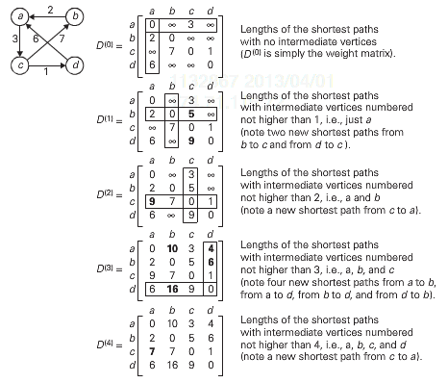
Floyd's example
D⁽⁰⁾[i][j] = w_{ij}
D^{(k)}[i][j] = min(D^{(k-1)}[i][j], D^{(k-1)}[i][k] + D^{(k-1)}[k][j] )

Slide 15
Floyd's algorithm
bottom-up algorithm statement:
D = weight matrix
for k from 1 to |V|:
for i from 1 to |V|:
for j from 1 to |V|:
D[i][j] = min( D[i][j], D[i][k] + D[k][j] );
clearly, this is O(|V|³)
could be formulated top-down (requires 3 dimensions)
solve(0, i, j) ← weight[i][j]
solve(k, i, j) ← min( solve(k-1, i, j), solve(k-1, i, k) + solve(k-1, k, j) )

Slide 16
Dynamic programming & caching
 | 0 | 1 | 2 | 3 | … | k
0 | 1
1 | 1 | 1
2 | 1 |  | 1
3 | 1 |  |  | 1
… | … |  |  |  | …
n | 1 |  |  |  |  | 1
when calculating C(n,k), the entire table must be filled in (up to the nth row and kth column)
→ working bottom-up from the base cases does not waste any work
for many problems, this is not the case
solving a problem may require only a subset of smaller problems to be solved
constructing a table and exhaustively working up from the base cases could do lots of wasted work
can dynamic programming still be applied?

Slide 17
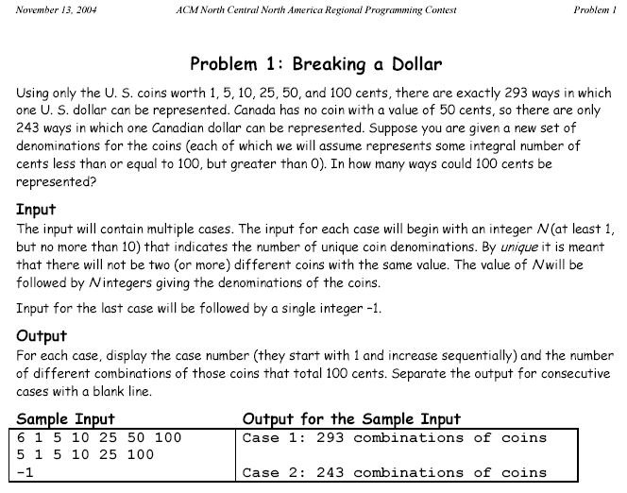
Example: programming contest problem

Slide 18
Divide & conquer approach
let getChange(amount, coinList) represent the number of ways to get an amount using the specified list of coins
getChange(amount, coinList) =
getChange(amount-biggestCoinValue, coinList) // # of ways that use at least
+ // one of the biggest coin
getChange(amount, coinList-biggestCoin) // # of ways that don't
// involve the biggest coin
e.g., suppose want to get 10¢ using only pennies and nickels
getChange(10, [1¢, 5¢])
getChange(5, [1¢, 5¢]) + getChange(10, [1¢])
getChange(0, [1¢, 5¢]) + getChange(5, [1¢]) 1
1 1

Slide 19
Divide & conquer solution
could implement as a ChangeMaker class
when constructing, specify a sorted list of available coins (why sorted?)
recursive helper method works with a possibly restricted coin list
public class ChangeMaker1 {
private List<Integer> coins;
public ChangeMaker1(List<Integer> coins) {
this.coins = coins;
}
public int getChange(int amount) {
return this.getChange(amount, this.coins.size()-1);
}
private int getChange(int amount, int maxCoinIndex) {
if (amount < 0 || maxCoinIndex < 0) {
return 0;
}
else if (amount == 0) {
return 1;
}
else {
return this.getChange(amount-this.coins.get(maxCoinIndex), maxCoinIndex) +
this.getChange(amount, maxCoinIndex-1);
}
}
}
base case: if amount or max coin index becomes negative, then can't be done
base case: if amount is zero, then have made exact change
recursive case: count how many ways using a largest coin + how many ways not using a largest coin

Slide 20
Will this solution work?
certainly, it will produce the correct answer -- but, how quickly?
at most 10 coins
worst case: 1 2 3 4 5 6 7 8 9 10
6,292,069 combinations → depending on your CPU, this can take a while
# of combinations will explode if more than 10 coins allowed
the problem is duplication of effort
getChange(100, 9)
getChange(90, 9) + getChange(100, 8)
getChange(80, 9) + getChange(90, 8) getChange(91, 8) + getChange(100, 7)
. . . . . . . . . . . .
. . . . . . . . . . . .
. . . . . . . . . . . .
. . . .
. . . .
getChange(80, 6) getChange(80, 6) getChange(80, 6) getChange(80, 6)

Slide 21
Caching
we could use dynamic programming and solve the problem bottom up
however, consider getChange(100, [1¢, 5¢, 10¢, 25¢])
would we ever need to know getChange(99, [1¢, 5¢, 10¢, 25¢]) ?
getChange(98, [1¢, 5¢, 10¢, 25¢]) ?
getChange(73, [1¢, 5¢]) ?
when exhaustive bottom-up would yield too many wasted cases, dynamic programming can instead utilize top-down with caching
create a table (as in the exhaustive bottom-up approach)
however, fill the table in using a top-down approach
that is, execute a top-down decrease and conquer solution, but store the solutions to subproblems in the table as they are computed
before recursively solving a new subproblem, first check to see if its solution has already been cached
avoids the duplication of pure top-down
avoids the waste of exhaustive bottom-up (only solves relevant subproblems)

Slide 22
ChangeMaker with caching
as each subproblem is solved, its solution is stored in a table
each call to getChange checks the table first before recursing
public class ChangeMaker2 {
private List<Integer> coins;
private static final int MAX_AMOUNT = 100;
private static final int MAX_COINS = 10;
private int[][] remember;
public ChangeMaker2(List<Integer> coins) {
this.coins = coins;
this.remember = new int[ChangeMaker.MAX_AMOUNT+1][ChangeMaker.MAX_COINS];
for (int r = 0; r < ChangeMaker.MAX_AMOUNT+1; r++) {
for (int c = 0; c < ChangeMaker.MAX_COINS; c++) {
this.remember[r][c] = -1;
}
}
}
public int getChange(int amount) {
return this.getChange(amount, this.coins.size()-1);
}
private int getChange(int amount, int maxCoinIndex) {
if (maxCoinIndex < 0 || amount < 0) {
return 0;
}
else if (this.remember[amount][maxCoinIndex] == -1) {
if (amount == 0) {
this.remember[amount][maxCoinIndex] = 1;
}
else {
this.remember[amount][maxCoinIndex] =
this.getChange(amount-this.coins.get(maxCoinIndex), maxCoinIndex) +
this.getChange(amount, maxCoinIndex-1);
}
}
return this.remember[amount][maxCoinIndex];
}
}
with caching, even the worst case is fast:
6,292,069 combinations

Slide 23
Algorithmic approaches summary
brute force: sometimes the straightforward approach suffices
transform & conquer: sometimes the solution to a simpler variant suffices
divide/decrease & conquer: tackles a complex problem by breaking it into smaller piece(s), solving each piece (often w/ recursion), and combining into an overall solution
applicable for any application that can be divided into independent parts
dynamic: bottom-up implementation of divide/decrease & conquer – start with the base cases and build up to the desired solution, storing results to avoid redundancy
usually more effective than top-down recursion if the parts are not completely independent
can implement by adding caching to top-down recursion
greedy: makes a sequence of choices/actions, choose whichever looks best at the moment
applicable when a solution is a sequence of moves & perfect knowledge is available
backtracking: makes a sequence of choices/actions (similar to greedy), but stores alternatives so that they can be attempted if the current choices lead to failure
more costly in terms of time and memory than greedy, but general-purpose
branch & bound variant cuts off search at some level and backtracks

