Slide 1
CSC 421: Algorithm Design & Analysis
Spring 2019
Complexity & Computability
  classifying problem complexity
  tractability, decidability
  P vs. NP, Turing machines
  NP-complete, reductions
  approximation algorithms, genetic algorithms

Slide 2
Classifying problem complexity
throughout this class, we have considered problems, designed algorithms, and classified their efficiency
  e.g., sorting a list – could use O(N²) selection sort or O(N log N) quick sort
  big-Oh provides for direct comparison between two algorithms
when is a problem too difficult?
  EXTREMELY LOW BAR: we say that a problem is intractable if there does not exist a polynomial time O( p(n) ) algorithm that solves it
  θ(2^{N}) is definitely intractable note: N = 20 → millions of steps
  2⁶⁰ > # of seconds since Big Bang
  2²⁷³ > # of atoms in the universe
    but θ(N¹⁰⁰) is tractable?!? in reality, anything worse than N³ is not practical

Slide 3
Beyond intractable
Turing showed there are UNSOLVABLE problems (regardless of efficiency)
THE HALTING PROBLEM: Given a computer program and an input to it, determine whether the program will halt on the input.
  Proof by contradiction:
    Assume that there is a program that solves the Halting Problem.
  def haltsOn(sourceFile, dataFile):
  """Returns true if the program in sourceFile halts when
  executed on the data in dataFile; else false."""
  return ???
    We need to show that the existence of this program leads to a logical contradiction.
      If the steps leading to a contradiction are valid, must conclude that the original assumption was wrong (and that there cannot be such a program).

Slide 4
Halting problem proof (cont.)
  def haltsOn(sourceFile, dataFile):
  """Returns true if the program in sourceFile halts when
  executed on the data in dataFile; else false."""
  return ???
    Note: a program is stored in a text file, so can be input to another program (stored in file hp.py):
  def haltsOnlyIfSelfieDoesnt(sourceFile):
  """Returns true if the program in sourceFile does not halt
  when run with itself as input; else loops forever."""
  if haltsOn(sourceFile, sourceFile):
  while true:
  print("infinite loop")
  else:
  return true
    Question: does the following call halt?
  haltsOnlyIfSelfieDoesnt("hp.py");
if haltsOnlyIfSelfieDoesnt("hp.py") halts
then, according to the code, this means that
haltsOn("hp.py", "hp.py") returns false
which, by assumption, means that
the program in hp.py does not halt on input file hp.py
but the program in hp.py is haltsOnlyIfSelfieDoesnt, so same as
haltsOnlyIfSelfieDoesnt("hp.py") does not halt
CONTRADICTION!

Slide 5
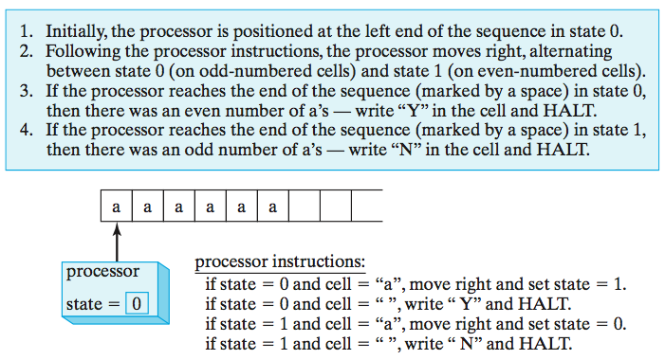
Impact of Turing's proof
Turing's proof of the Halting Problem in 1936 had profound impact
  it proved that there are problems that are unsolvable
  not only that, but easily understood (and potentially useful) unsolvable problems
  for his proof, Turing introduced a simple, theoretical model of computation
  a Turing Machine (TM) consists of:
    a potentially infinite tape on which characters can be written
    a processing unit that can read and write on the tape, move in either direction, and distinguish between a finite number of states

Slide 6
Example execution (even)
if in state 0 & read "a", then
write "a", move R, goto state 1
if in state 0 and read " ", then
write "Y", move right, goto HALT
if in state 1 & read "a", then
write "a", move R, goto state 0
if in state 1 and read " ", then
write "N", move right, goto HALT
a | a | a | a | _ | …
state 0
a | a | a | a | _ | …
state 1
a | a | a | a | _ | …
state 0
a | a | a | a | _ | …
state 1
a | a | a | a | _ | …
state 0
a | a | a | a | Y | …
HALT

Slide 7
Example execution (odd)
if in state 0 & read "a", then
write "a", move R, goto state 1
if in state 0 and read " ", then
write "Y", move right, goto HALT
if in state 1 & read "a", then
write "a", move R, goto state 0
if in state 1 and read " ", then
write "N", move right, goto HALT
a | a | a | _ | _ | …
state 0
a | a | a | _ | _ | …
state 1
a | a | a | _ | _ | …
state 0
a | a | a | _ | _ | …
state 1
a | a | a | N | _ | …
HALT

Slide 8
Another example
consider the task of recognizing a power of 2
  want to be able to represent a number on a tape
  accept that number if it is of the form 2^{n} for some n > 0; otherwise reject
  similar to odd/even example, can represent the number in unary
    e.g., the number 4 would be represented as a sequence of 4 0's on the tape
0 | 0 | 0 | 0 | _ | …
algorithm (in general terms):
  traverse left to right, crossing off every other 0
  if the result contains a single 0, then accept
  if the result contains an odd number of 0's (> 1), then reject
  otherwise, return to the left edge of the tape & repeat

Slide 9
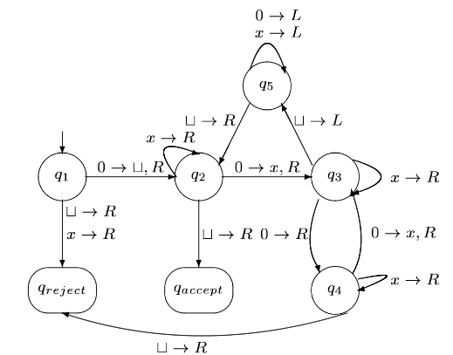
Turing Machine program
we can define the TM using a finite state machine, or as a program
if in q1 & read 0, then
write _, move R, goto q2
if in q1 & read x, then
write x, move R, goto reject
if in q1 & read _, then
write _, move R, goto reject
if in q2 & read 0, then
write x, move R, goto q3
if in q2 & read x, then
write x, move R, goto q2
if in q2 & read _, then
write _, move R, goto accept
if in q3 & read 0, then
write 0, move R, goto q4
if in q3 & read x, then
write x, move R, goto q3
if in q3 & read _, then
write _, move L, goto q5
if in q4 & read 0, then
write x, move R, goto q3
if in q4 & read x, then
write x, move R, goto q4
if in q4 & read _, then
write _, move R, goto reject
if in q5 & read 0, then
write 0, move L, goto q5
if in q5 & read x, then
write x, move L, goto q5
if in q5 & read _, then
write _, move R, goto q2

Slide 10
Example execution (accept)
if in q1 & read 0, then
write _, move R, goto q2
if in q1 & read x, then
write x, move R, goto reject
if in q1 & read _, then
write _, move R, goto reject
if in q2 & read 0, then
write x, move R, goto q3
if in q2 & read x, then
write x, move R, goto q2
if in q2 & read _, then
write _, move R, goto accept
if in q3 & read 0, then
write 0, move R, goto q4
if in q3 & read x, then
write x, move R, goto q3
if in q3 & read _, then
write _, move L, goto q5
if in q4 & read 0, then
write x, move R, goto q3
if in q4 & read x, then
write x, move R, goto q4
if in q4 & read _, then
write _, move R, goto reject
if in q5 & read 0, then
write 0, move L, goto q5
if in q5 & read x, then
write x, move L, goto q5
if in q5 & read _, then
write _, move R, goto q2
0 | 0 | 0 | 0 | _ | …
q1
_ | 0 | 0 | 0 | _ | …
q2
_ | x | 0 | 0 | _ | …
q3
_ | x | 0 | 0 | _ | …
q4
_ | x | 0 | x | _ | …
q3
_ | x | 0 | x | _ | …
q5

Slide 11
Example execution (cont.)
if in q1 & read 0, then
write _, move R, goto q2
if in q1 & read x, then
write x, move R, goto reject
if in q1 & read _, then
write _, move R, goto reject
if in q2 & read 0, then
write x, move R, goto q3
if in q2 & read x, then
write x, move R, goto q2
if in q2 & read _, then
write _, move R, goto accept
if in q3 & read 0, then
write 0, move R, goto q4
if in q3 & read x, then
write x, move R, goto q3
if in q3 & read _, then
write _, move L, goto q5
if in q4 & read 0, then
write x, move R, goto q3
if in q4 & read x, then
write x, move R, goto q4
if in q4 & read _, then
write _, move R, goto reject
if in q5 & read 0, then
write 0, move L, goto q5
if in q5 & read x, then
write x, move L, goto q5
if in q5 & read _, then
write _, move R, goto q2
0 | x | 0 | x | _ | …
q5
_ | x | 0 | x | _ | …
q5
_ | x | 0 | x | _ | …
q5
_ | x | 0 | x | _ | …
q5
_ | x | 0 | x | _ | …
q2
_ | x | 0 | x | _ | …
q2

Slide 12
Example execution (cont.)
if in q1 & read 0, then
write _, move R, goto q2
if in q1 & read x, then
write x, move R, goto reject
if in q1 & read _, then
write _, move R, goto reject
if in q2 & read 0, then
write x, move R, goto q3
if in q2 & read x, then
write x, move R, goto q2
if in q2 & read _, then
write _, move R, goto accept
if in q3 & read 0, then
write 0, move R, goto q4
if in q3 & read x, then
write x, move R, goto q3
if in q3 & read _, then
write _, move L, goto q5
if in q4 & read 0, then
write x, move R, goto q3
if in q4 & read x, then
write x, move R, goto q4
if in q4 & read _, then
write _, move R, goto reject
if in q5 & read 0, then
write 0, move L, goto q5
if in q5 & read x, then
write x, move L, goto q5
if in q5 & read _, then
write _, move R, goto q2
0 | x | 0 | x | _ | …
q2
_ | x | x | x | _ | …
q3
_ | x | x | x | _ | …
q3
_ | x | x | x | _ | …
q5
_ | x | x | x | _ | …
q5
_ | x | x | x | _ | …
q5

Slide 13
Example execution (cont.)
if in q1 & read 0, then
write _, move R, goto q2
if in q1 & read x, then
write x, move R, goto reject
if in q1 & read _, then
write _, move R, goto reject
if in q2 & read 0, then
write x, move R, goto q3
if in q2 & read x, then
write x, move R, goto q2
if in q2 & read _, then
write _, move R, goto accept
if in q3 & read 0, then
write 0, move R, goto q4
if in q3 & read x, then
write x, move R, goto q3
if in q3 & read _, then
write _, move L, goto q5
if in q4 & read 0, then
write x, move R, goto q3
if in q4 & read x, then
write x, move R, goto q4
if in q4 & read _, then
write _, move R, goto reject
if in q5 & read 0, then
write 0, move L, goto q5
if in q5 & read x, then
write x, move L, goto q5
if in q5 & read _, then
write _, move R, goto q2
0 | x | x | x | _ | …
q5
_ | x | x | x | _ | …
q5
_ | x | x | x | _ | …
q2
_ | x | x | x | _ | …
q2
_ | x | x | x | _ | …
q2
_ | x | x | x | _ | …
q2

Slide 14
Example execution (cont.)
if in q1 & read 0, then
write _, move R, goto q2
if in q1 & read x, then
write x, move R, goto reject
if in q1 & read _, then
write _, move R, goto reject
if in q2 & read 0, then
write x, move R, goto q3
if in q2 & read x, then
write x, move R, goto q2
if in q2 & read _, then
write _, move R, goto accept
if in q3 & read 0, then
write 0, move R, goto q4
if in q3 & read x, then
write x, move R, goto q3
if in q3 & read _, then
write _, move L, goto q5
if in q4 & read 0, then
write x, move R, goto q3
if in q4 & read x, then
write x, move R, goto q4
if in q4 & read _, then
write _, move R, goto reject
if in q5 & read 0, then
write 0, move L, goto q5
if in q5 & read x, then
write x, move L, goto q5
if in q5 & read _, then
write _, move R, goto q2
0 | x | x | x | _ | …
q2
_ | x | x | x | _ | …
accept
note that the algorithm defined by this Turing Machine is slow and cumbersome
in general, the simper the model, the more steps it requires to perform a task
  e.g., a machine-language program will require more instructions to complete the same task as a high-level language program

Slide 15
Example execution (reject)
if in q1 & read 0, then
write _, move R, goto q2
if in q1 & read x, then
write x, move R, goto reject
if in q1 & read _, then
write _, move R, goto reject
if in q2 & read 0, then
write x, move R, goto q3
if in q2 & read x, then
write x, move R, goto q2
if in q2 & read _, then
write _, move R, goto accept
if in q3 & read 0, then
write 0, move R, goto q4
if in q3 & read x, then
write x, move R, goto q3
if in q3 & read _, then
write _, move L, goto q5
if in q4 & read 0, then
write x, move R, goto q3
if in q4 & read x, then
write x, move R, goto q4
if in q4 & read _, then
write _, move R, goto reject
if in q5 & read 0, then
write 0, move L, goto q5
if in q5 & read x, then
write x, move L, goto q5
if in q5 & read _, then
write _, move R, goto q2
0 | 0 | 0 | _ | _ | …
q1
_ | 0 | 0 | _ | _ | …
q2
_ | x | 0 | _ | _ | …
q3
_ | x | 0 | _ | _ | …
q4
_ | x | 0 | _ | _ | …
reject

Slide 16
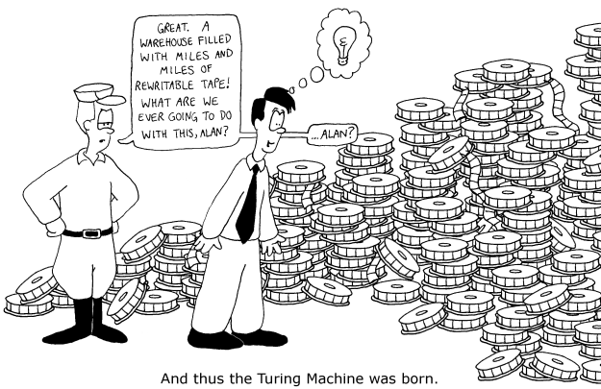

Slide 17
Church/Turing Thesis
Turing Machines provide a simple model of computation that is easier to reason with than code
  Turing's proof of the undecidability of the Halting Problem used TMs
  recall that the proof relied on self reference: a program that can take another program (including itself) as input
  similarly, a TM can take the program of any other TM as input and emulate that machine
Church/Turing Thesis: a TM is comparable to any other model of computation
→ proofs about the limitations of TMs apply to computation in general

Slide 18
Problem types: decision & optimization
the Halting Problem is an example of a decision problem
  solving the problem requires answering a yes/no question
another common type of problems is an optimization problem
  solving the problem requires finding the best/largest/shortest answer
  e.g., shortest path, minimal spanning tree
many problems have decision and optimization versions
  find the shortest path between vertices v₁ and v₂ in a graph
  is there a path between v₁ and v₂ whose length is ≤ d
decision problems are more convenient for formal investigation of their complexity

Slide 19
Class P
P: the class of decision problems that are solvable in polynomial time O(p(n))
  i.e., the class of tractable decision problems
  O(log N) binary search
  add/remove/search a BST/AVL/red-black tree
  add/remove/min a heap
  O(N) sequential search
  preorder/inorder/postorder of a binary tree
  quick select (find kth largest value)
  Boyer-Moore algorithm (search for pattern in string of N chars)
  O(N log N) merge sort, quick sort, heap sort
  Huffman coding (text compression)
  closest pair on a plane
  O(N²) insertion sort, selection sort
  Prim’s algorithm (minimal spanning tree)
  Dijkstra’s algorithm (shortest path)
  O(N³) Floyd’s algorithm (all-pairs shortest path)

Slide 20
P or not?
interestingly, there are many important problems for which no polynomial-time algorithm has been devised
  Hamiltonian Circuit Problem: determine whether a graph has a path that starts and ends at the same vertex and passes through every other vertex once
  Traveling Salesman Problem: find the shortest Hamiltonian circuit in a complete graph)
  Graph Coloring Problem: Determine the smallest number of colors needed so that adjacent vertices are different colors
  Partition Problem: Given N positive integers, determine whether it is possible to partition them into two disjoint subsets with the same sum.
  Knapsack Problem: Given a set of N items with integer weights and values, determine the most valuable subset that fits in a knapsack with limited capacity.
  Bin-packing Problem: Given N items with varying sizes, determine the smallest number of uniform-capacity bins required to contain them.

Slide 21
Class NP
however, many of these problems fit into a (potentially) broader class
a nondeterministic polynomial algorithm is a two-stage procedure that:
  generates a random string purported to solve the problem (guessing stage)
  checks whether this solution is correct in polynomial time (verification stage)
NP: class of decision problems that can be solved by a nondeterministic polynomial algorithm
  i.e., whose proposed solutions can be verified in polynomial time
example: Hamiltonian Circuit Problem is in NP
  given a path of length N, can verify that it is a Hamiltonian circuit in O(N)
example: Partition Problem is in NP
  given two partitions of size N, can verify that their sums are equal in O(N)

Slide 22
P vs. NP
decision versions of Traveling Salesman, Knapsack, Graph Coloring, and many other optimization problems are also in NP
note that problems in P can also be solved using the 2-stage procedure
  the guessing stage is unnecessary
  the verification stage generates and verifies in polynomial time
  so, P ⊆ NP
big question: does P = NP ?
  considerable effort has gone into trying to find polynomial-time solutions to NP problems (without success)
  most researchers believe they are not equal (i.e., P is a proper subset), but we don't know for sure

Slide 23
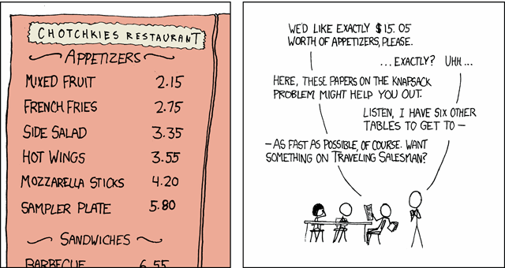

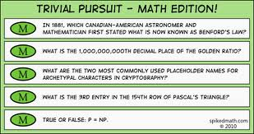
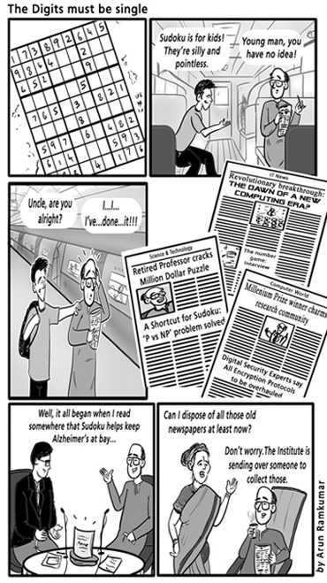
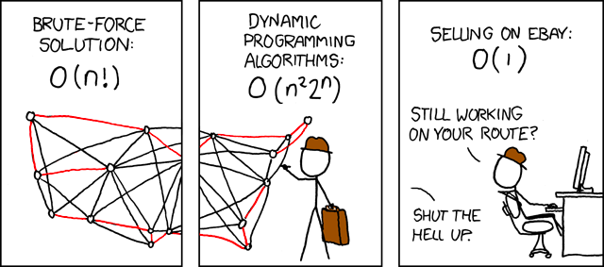
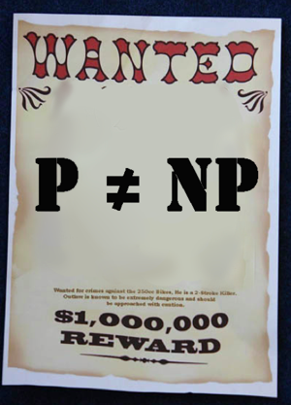
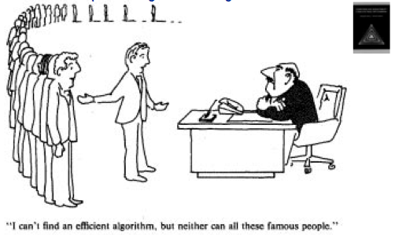


Slide 24
P, NP & Turing Machines
P and NP can alternatively be formulated in terms of Turing Machines
  P is the class of decision problems that can be solved in polynomial time by a Turing Machine (TM)
  NP is the class of decision problems that can be solved in polynomial time by a Non-deterministic Turing Machine (NTM)
    a NTM allows for having multiple rules that can be applied in a state
    e.g., if state = 4 and cell = ‘a’, can 1) move right and set state = 5 OR
    2) move left and set state = 6
    a NTM answers ‘yes’ if ANY sequence of transitions leads to the answer ‘yes’
    in other words, it is greedy - can always guess the right one (equivalently, can think of it as trying all choices in parallel)
a → a, R
accept
if in s0 and read a, then
EITHER write a, move R, goto s0
OR write a, move R, goto accept
if in s0 and read anything else, then
write _, move R, goto reject
s0
a → a, R
? → _, R
reject

Slide 25
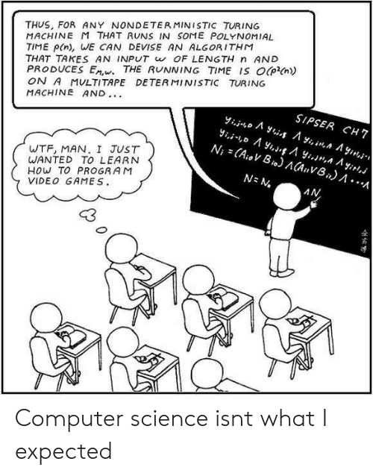
P, NP & Turing Machines
it has been shown that NTM’s and TM’s are equivalent in power
  any problem that can be solved by a NTM can be solved by a TM
  does this mean that P = NP?
    NO!
    not if the reduction can’t be done in polynomial time

Slide 26
NP-complete
while we don't know whether P = NP, we can identify extremes within NP
given decision problems D₁ and D₂, we say that D₁ is polynomial-time reducible to D₂ if there exists transformation t such that:
  t maps all yes-instances of D₁ to yes-instances of D₂
  maps all no-instances of D₁ to no-instances of D₂
  t is computable by a polynomial time algorithm
we say that decision problem D is NP-complete if:
  D belongs to NP
  every problem in NP is polynomial-time reducible to D
in short, an NP-complete problem is
as hard as any problem in NP

Slide 27
NP-complete example
the first problem proven to be NP-complete was Boolean Satisfiability (SAT)
  given a Boolean expression, determine if it is satisfiable
    e.g., (A ∨ B) ∧ (~B ∨ C) is true if A & C are true
  SAT is clearly in NP
    given true/false assignments to the propositions, can evaluate the truth of the expression in polynomial time
  to be NP-complete, every other NP problem must be reducible to it
    proof idea (Cook, 1971):
      if a problem is in NP, can construct a non-deterministic (Turing) machine to solve it
      for each input to that machine, can construct a Boolean expression that evaluates to true if the machine halts and answers "yes" on input
      thus, original problem is reduced to determining whether the corresponding Boolean expression is satisfiable

Slide 28
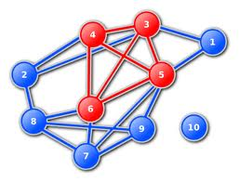
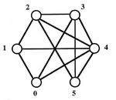
NP-complete reductions
if we can reduce SAT to another NP problem, then it is also NP-complete
CLIQUE: given a graph with N vertices, is there a fully connected subgraph of C vertices?

Slide 29
SAT → CLIQUE
can reduce the SAT problem to CLIQUE
  given an instance of SAT, e.g., (A ∨ B) ∧ (~B ∨ C) ∧ (B ∨ C)
    note: any Boolean expression can be transformed into conjunctive normal form
    here, there are 3 OR-groups, joined together with AND
  construct a graph with vertices grouped by each OR-group
    there is an edge between two vertices if
      the vertices are in different OR-groups, and
      they are not negations of each other
    note: edge implies endpoints can be simultaneously true
  the expression is satisfiable if can have vertex from
  each OR-group simultaneously true
    in other words, is a clique of size C (where C is the number of OR-groups)
    since example expression has 3 OR-groups, need a clique of size 3
so, CLIQUE is also NP-complete
A
~B
B
C
B
C

Slide 30
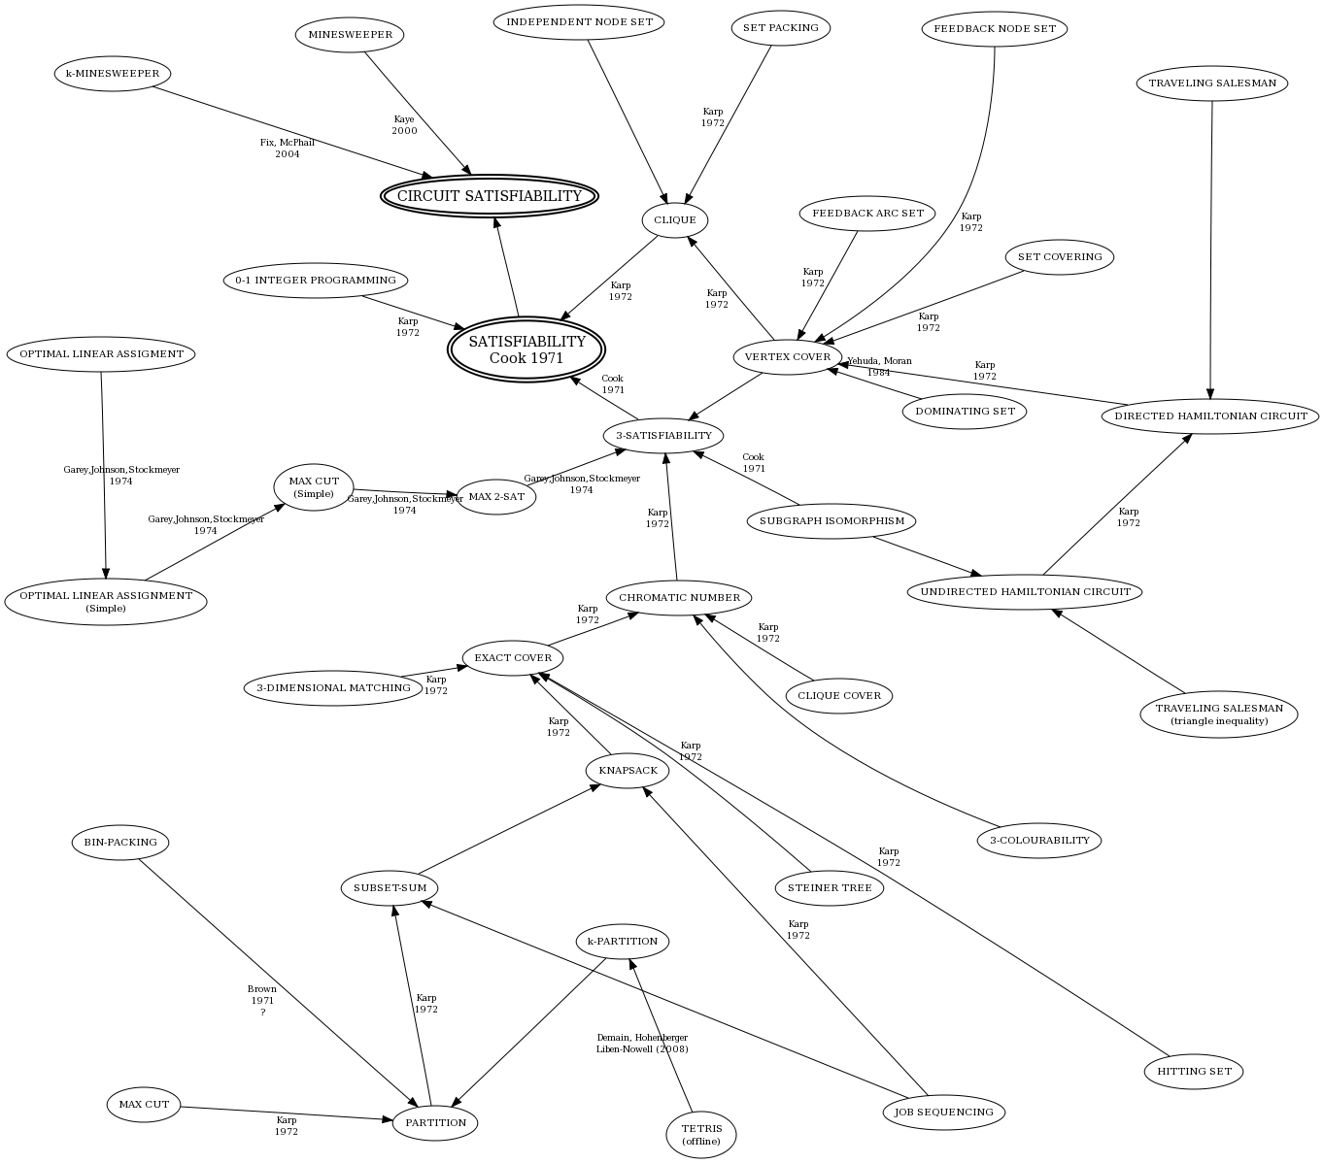

Slide 31
Implications of NP-completeness
an NP-complete problem is as hard as any problem in NP
  i.e., all problems in NP reduce to it
  discovering a polynomial solution to any NP-complete problem
    would imply a polynomial solution to all problems in NP
    would show P = NP
if P = NP, many problems currently thought to be intractable would be tractable
  e.g., PRIME FACTORIZATION PROBLEM: factor a number into its prime factors
  the RSA encryption algorithm relies on the fact that factoring large numbers is intractable
  if an efficient factorization algorithm were discovered, modern encryption could break
  QUESTION: would it necessarily break?

Slide 32
Approximation algorithms
what if you need to solve a problem that is intractable?
  in the case of optimization problems, approximation algorithms can bus used
  i.e., will find a solution, but it may not be optimal
Knapsack Problem (KP):
  given N items (each with a value and weight) and a knapsack with weight capacity
  want to find the subset of items that has optimal value without exceeding the knapsack weight capacity
example: given the following items and a knapsack with capacity 50 lbs.
      tiara $5000 3 lbs
      coin collection $2200 5 lbs
      HDTV $2100 40 lbs
      laptop $2000 8 lbs
      silverware $1200 10 lbs
      stereo $800 25 lbs
      PDA $600 1 lb
      clock $300 4 lbs

Slide 33
Greedy approximations
tiara $5000 3 lbs
coin collection $2200 5 lbs
HDTV $2100 40 lbs
laptop $2000 8 lbs
silverware $1200 10 lbs
stereo $800 25 lbs
PDA $600 1 lb
clock $300 4 lbs
1666
440
52.5
250
120
32
600
75
simple greedy approach:
  repeatedly take the highest value item that fits, until capacity is reached
    tiara + coin collection + HDTV + PDA = $8,900 & 49 lbs.
smarter greedy approach:
  calculate the value/weight ratio, make greedy choices based on that
    tiara + PDA + coin collection + laptop + silverware + clock = $11,300 & 31 lbs.
  this happens to be the optimal choice, but this approach won’t always work
    suppose there was also a printer worth $1400 and weighing 20 lbs.
    it value/weight ratio is 70, which is less than the clock, but
    tiara + PDA + coin collection + laptop + silverware + printer= $12,400 & 47 lbs.
it can be proven that the max from these two approaches > optimal/2

Slide 34
Genetic algorithms
many NP-hard problems have approximation algorithms
  requires problem-specific techniques & analysis
generate & test is not tractable due to the size of the solution space
  a genetic algorithm (GA) uses an evolutionary metaphor to perform a massive number of greedy searches in parallel
  GA were invented by psychologist/computer scientist John Holland in 1975
  many real-world resource scheduling problems turn out to be NP-hard
    e.g., Smart Airport Operations Center by Ascent Technology
      uses GA for logistics: assign gates, direct baggage, direct service crews, …
      considers diverse factors such as maintenance schedules, crew qualifications, shift changes, …
      too many variables to juggle using a traditional algorithm (NP-hard)
      GA is able to evolve sub-optimal schedules, improve performance
      Ascent claims 30% increase in productivity (including SFO, Logan, Heathrow, …)

Slide 35
Genetic Algorithm (GA)
for a given problem, must define:
  chromosome: bit string that represents a potential solution
  fitness function: a measure of how good/fit a particular chromosome is
  reproduction scheme: combining two parent chromosomes to yield offspring
  mutation rate: likelihood of a random mutation in the chromosome
  replacement scheme: replacing old (unfit) members with new offspring
  termination condition: when is a solution good enough?
in general, the genetic algorithm:
  start with an initial (usually random) population of chromosomes while the termination condition is not met
    evaluate the fitness of each member of the population
    select members of the population that are most fit
    produce the offspring of these members via reproduction & mutation
    replace the least fit member of the population with these offspring

Slide 36
GA example (cont.)
tiara $5000 3 lbs
coin collection $2200 5 lbs
HDTV $2100 40 lbs
laptop $2000 8 lbs
silverware $1200 10 lbs
stereo $800 25 lbs
PDA $600 1 lb
clock $300 4 lbs
chromosome: a string of 8 bits with each bit corresponding to an item
  1 implies that the corresponding item is included; 0 implies not included
    e.g., 11100000 represents (tiara + coins + HDTV)
    01101000 represents (coins + HDTV + silverware)
fitness function: favor collections with higher values
  fit(chromosome) = sum of dollar amounts of items, or 0 if weight > 50
    e.g., fit(11100000) = 9300
    fit(01101000) = 0
reproduction scheme: utilize crossover (a common technique in GA's)
  pick a random index, and swap left & right sides from parents
    e.g., parents 11100000 and 01101000, pick index 4
    1110|0000 and 0110|1000 yield offspring 11101000 and 01100000

Slide 37
GA example (cont.)
      tiara $5000 3 lbs
      coin collection $2200 5 lbs
      HDTV $2100 40 lbs
      laptop $2000 8 lbs
      silverware $1200 10 lbs
      stereo $800 25 lbs
      PDA $600 1 lb
      clock $300 4 lbs
Generation 0 (randomly selected):
  11100000 (fit = 9300) 01101000 (fit = 0) 11001011 (fit = 9300)
  11010000 (fit = 9200) 00010100 (fit = 2800) 01001011 (fit = 4300)
  11110111 (fit = 0) 10011000 (fit = 8200)
  choose fittest 4, perform crossover with possibility of mutation
  111000|00 + 110010|11 → 11100011 11001001
  110|10000 + 100|11000 → 11011000 10010000
Generation 1 (replacing least fit from Generation 0):
  11100000 (fit = 9300) 11100011 (fit = 0) 11001011 (fit = 9300)
  11010000 (fit = 9200) 11001001 (fit = 8700) 11011000 (fit = 10400)
  10010000 (fit = 7000) 10011000 (fit = 8200)
  choose fittest 4, perform crossover with possibility of mutation
  1101|1000 + 1100|1011 → 11011011 11001000
  1110000|0 + 1101000|0 → 11100000 11010000
Generation 2 (replacing least fit from Generation 1):
  11100000 (fit = 9300) 11001000 (fit = 8400) 11001011 (fit = 9300)
  11010000 (fit = 9200) 11100000 (fit = 9300) 11011000 (fit = 10400)
  11011011 (fit = 11300) 11010000 (fit = 9200)

Slide 38
In the news…
A New Approach to Multiplication Opens the Door to Better Quantum Computers
Kevin Hartnett, Quanta Magazine, April 24, 2019

