Slide 1
CSC 421: Algorithm Design & Analysis
Spring 2019
Algorithm case studies
Facebook code completion
Google search rankings
National Resident Matching Program

Slide 2
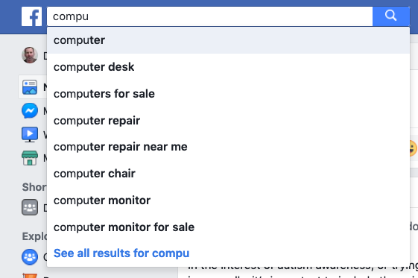
Facebook keyboard predictions
like many applications, Facebook utilizes keyboard predictions to suggest search terms as the user types

Slide 3
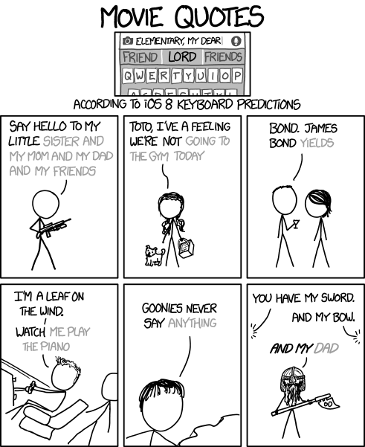
xkcd

Slide 4
Facebook keyboard predictions
how does Facebook do this quickly and at scale?
BINARY SEARCH!
Facebook maintains a sorted list of keywords/phrases (let's call it POSSIBLES)
when you type in the first letter, e.g., 'c',
it performs a binary search to find the first item that starts with that letter
it similarly performs a binary search to find the last item
it reduces POSSIBLES to the sublist between these two words
when you type each subsequent letter, it does the same thing
perform binary search to find first item that starts with that sequence
perform binary search to find the last item that starts with that sequence
further reduce POSSIBLES
source: a Facebook engineer at the Facebook Faculty Summit in 2010

Slide 5
Facebook example
for example, suppose
POSSIBLES = [about, bell, cave, coat, compost, computer, cult, dog, elder, …]
when the user types 'c':
binary searches to find "cave" and "cult"
reduces POSSIBLES to [cave, coat, compost, computer, cult]
when the user types 'co':
binary searches to find "coat" and "computer"
reduces POSSIBLES to [coat, compost, computer]
when the user types 'com':
binary searches to find "compost" and "computer"
reduces POSSIBLES to [compost, computer]
. . .

Slide 6
Efficiency?
if the initial size of the POSSIBLES list is N,
each of the initial binary searches take O(log N)
reducing the size of the POSSIBLES list can be done in constant time,
simply by keeping low and high indices of the sublist
cost of the initial 1-letter prediction is O(log N)
even if POSSIBLES contains a million keywords/phrases,
only requires <100 comparisons to determine & narrow the range
note that with each letter typed, the POSSIBLE list shrinks
if the words/phrases are evenly distributed (is that a reasonable assumption?), each step would reduce the size of the list by a factor of 26
if started with 1 million keywords/phrases,
1,000,000 → 38,462 → 1,480 → 57 → 3

Slide 7
Google PageRank
one of the keys to Google's rise to domination of the search engine market was the superior quality of its searches
Larry Page & Sergey Brin developed the underlying technology (including the PageRank algorithm) as part of their dissertation work at Stanford
their main goals were to improve search quality & support data-science research
the PageRank algorithm measures the importance of a Web site and is used when ranking search results
works by counting the number and quality of links to a page
basic idea: the more sites that find a page useful, especially "important" sites, the more important the page is
the PageRank algorithm outputs a probability distribution that models the likelihood that a person randomly clicking on links will arrive at the page
(clearly, having lots of other sites link to a page increases its likelihood, as does having the page linked to by popular sites)

Slide 8
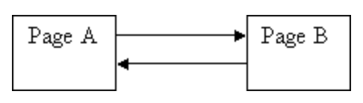
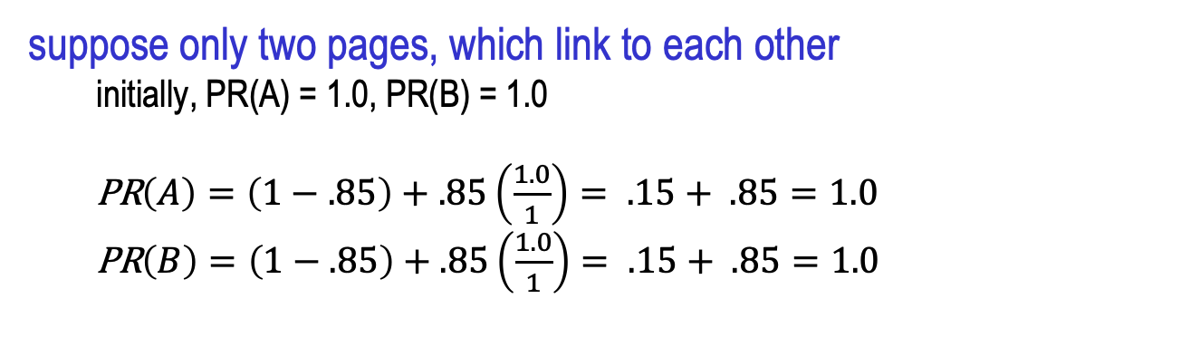
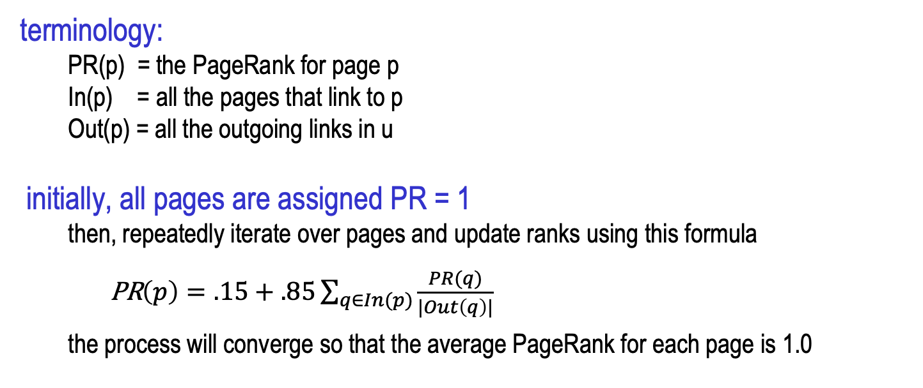
Simplified PageRank algorithm
terminology:
PR(p) = the PageRank for page p
In(p) = all the pages that link to p
Out(p) = all the outgoing links in u
initially, all pages are assigned PR = 1
then, repeatedly iterate over pages and update ranks using this formula
PR$\left(p\right)=.15+.85\sum_{q∈In(p)}{\frac{PR(q)}{|Out\left(q\right)|}}$
the process will converge so that the average PageRank for each page is 1.0
suppose only two pages, which link to each other
initially, PR(A) = 1.0, PR(B) = 1.0
PR$\left(A\right)=\left(1−.85\right)+.85\left(\frac{1.0}{1}\right)= .15+ .85=1.0$
PR$\left(B\right)=\left(1−.85\right)+.85\left(\frac{1.0}{1}\right)= .15+ .85=1.0$

Slide 9
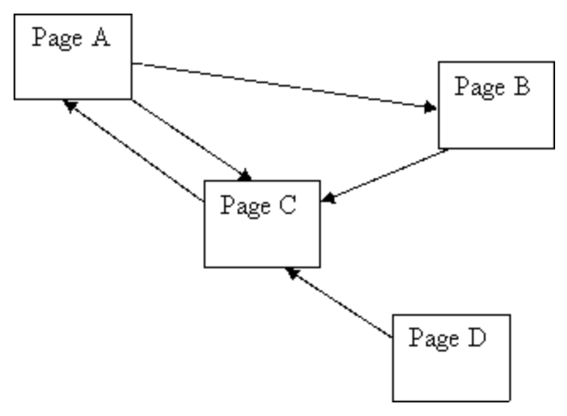
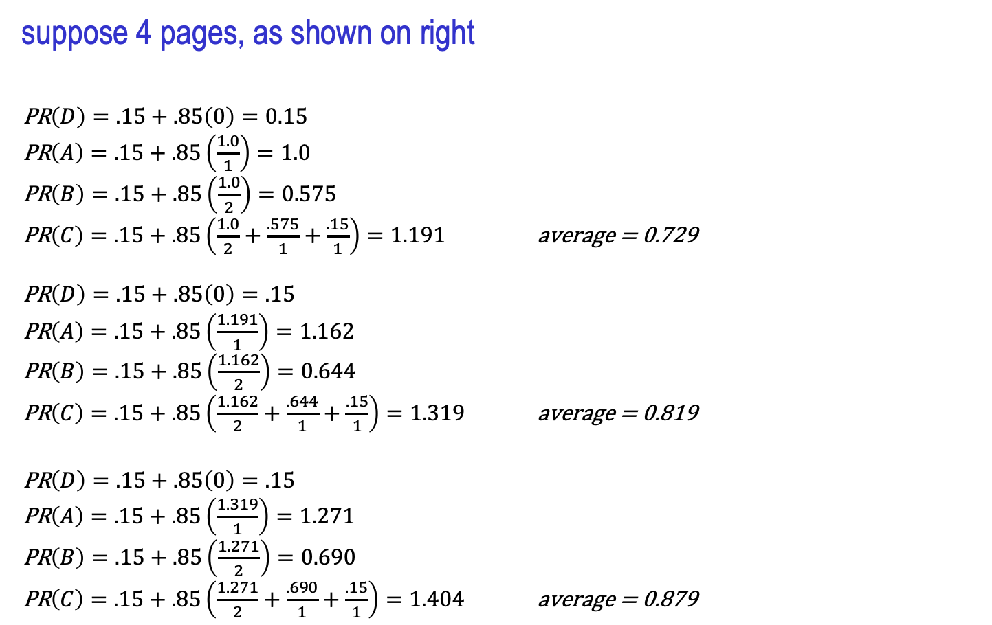
Another example
suppose 4 pages, as shown on right
PR$\left(D\right)=.15+.85\left(0\right)=0.15$
PR$\left(A\right)=.15+.85\left(\frac{1.0}{1}\right)=1.0$
PR$\left(B\right)=.15+.85\left(\frac{1.0}{2}\right)=0.575$
PR$\left(C\right)=.15+.85\left(\frac{1.0}{2}+\frac{.575}{1}+\frac{.15}{1}\right)=1.191$ average = 0.729
PR$\left(D\right)=.15+.85\left(0\right)=.15$
PR$\left(A\right)=.15+.85\left(\frac{1.191}{1}\right)=1.162$
PR$\left(B\right)=.15+.85\left(\frac{1.162}{2}\right)=0.644$
PR$\left(C\right)=.15+.85\left(\frac{1.162}{2}+\frac{.644}{1}+\frac{.15}{1}\right)=1.319$ average = 0.819
PR$\left(D\right)=.15+.85\left(0\right)=.15$
PR$\left(A\right)=.15+.85\left(\frac{1.319}{1}\right)=1.271$
PR$\left(B\right)=.15+.85\left(\frac{1.271}{2}\right)=0.690$
PR$\left(C\right)=.15+.85\left(\frac{1.271}{2}+\frac{.690}{1}+\frac{.15}{1}\right)=1.404$ average = 0.879

Slide 10
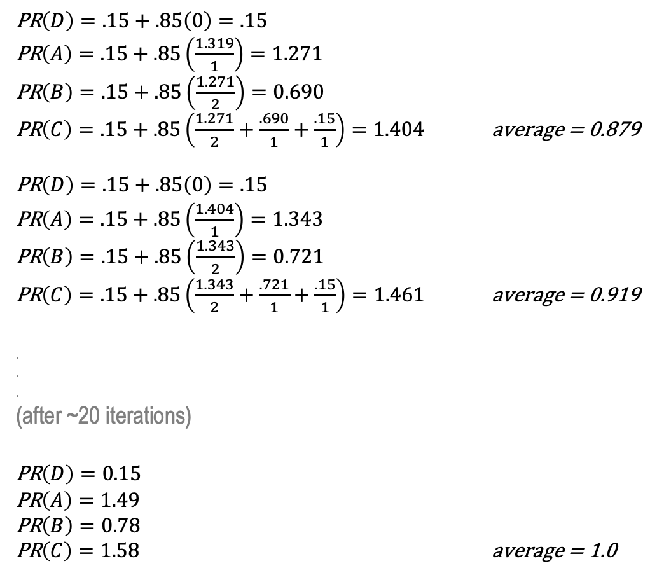
Another example
PR$\left(D\right)=.15+.85\left(0\right)=.15$
PR$\left(A\right)=.15+.85\left(\frac{1.319}{1}\right)=1.271$
PR$\left(B\right)=.15+.85\left(\frac{1.271}{2}\right)=0.690$
PR$\left(C\right)=.15+.85\left(\frac{1.271}{2}+\frac{.690}{1}+\frac{.15}{1}\right)=1.404$ average = 0.879
PR$\left(D\right)=.15+.85\left(0\right)=.15$
PR$\left(A\right)=.15+.85\left(\frac{1.404}{1}\right)=1.343$
PR$\left(B\right)=.15+.85\left(\frac{1.343}{2}\right)=0.721$
PR$\left(C\right)=.15+.85\left(\frac{1.343}{2}+\frac{.721}{1}+\frac{.15}{1}\right)=1.461$ average = 0.919
.
.
.
(after ~20 iterations)
PR$\left(D\right)=0.15$
PR$\left(A\right)=1.49$
PR$\left(B\right)=0.78$
PR$\left(C\right)=1.58$ average = 1.0
NOTE:
C has the highest PR, since it is linked from 3 pages
PR(A) > PR(B), since A is linked from the highest ranked page & B only gets half the credit from A
PR(D) remains at 0.15 since it is not linked at all

Slide 11
Google search results
obviously, more than just PageRank goes into determining the content & order of search results, e.g.,
frequency and proximity of search terms in the page
occurrence of search terms in links to the page
timeliness of the page
other factors that are kept proprietary
still, the heart of Google's search remains the PageRank algorithm
Brin & Page patented the PageRank algorithm
they generously assigned the patent to Stanford University, then gave Stanford 1.8 million shares of Google stock in exchange for exclusive use
Stanford sold the shares when Google went public in 2004 & 2005 for a total of $336 million
if they had kept the stock, it would be worth $2.18 billion today!

Slide 12
National Resident Matching Program
each year, the National Resident Matching Program matches 40,000+ med school graduates with residency programs
each graduate ranks programs by order of preference
each program ranks students by order of preference
pairing graduates & programs in a way that makes everyone (reasonably) happy is an extremely complex task
want to ensure that the pairings are stable, i.e., no grad and program would prefer each other over their assigned matches
e.g., suppose G₁ listed P₁ > P₂; and P₁ listed G₁ > G₂
the match {G₁ → P₂,G₂ → P₁} is unstable, since both G₁ and P₁ would prefer G₁ → P₁
since 1952, the NRMP has utilized an algorithm for processing all residency requests and assigning stable matches to graduates
(this general problem is known as the stable matching or stable marriage problem)

Slide 13
Stable matching example
can specify preferences by two tables of rankings
grad's preferences program's preferences
1st 2nd 3rd 1st 2nd 3rd
G₁: P₂ P₁ P₃ P₁: G₂ G₃ G₁
G₂: P₂ P₃ P₁ P₂: G₃ G₁ G₂
G₃: P₃ P₂ P₁ P₃: G₂ G₃ G₁
1st 2nd 3rd 1st 2nd 3rd
G₁: P₂ P₁ P₃ P₁: G₂ G₃ G₁
G₂: P₂ P₃ P₁ P₂: G₃ G₁ G₂
G₃: P₃ P₂ P₁ P₃: G₂ G₃ G₁
G₁→P₁, G₂→P₂, G₃→P₃ is unstable
G₁ would prefer P₂ over P₁
P₂ would prefer G₁ over G₂
1st 2nd 3rd 1st 2nd 3rd
G₁: P₂ P₁ P₃ P₁: G₂ G₃ G₁
G₂: P₂ P₃ P₁ P₂: G₃ G₁ G₂
G₃: P₃ P₂ P₁ P₃: G₂ G₃ G₁
G₁→P₁, G₂→P₃, G₃→P₂ is stable

Slide 14
Stable match algorithm (Gale-Shapley)
start with all the grads and programs being unassigned
while there are unassigned grads, select an unassigned grad (G_{u}):
have G_{u} choose the next program on their preference list (P_{n})
if P_{n} is unassigned, it (tentatively) accepts G_{u}
otherwise, it compares G_{u} with its current match (G_{m})
if P_{n} prefers G_{u} to G_{m}, it switches its assignment to G_{u} (releasing G_{m})
1st 2nd 3rd 1st 2nd 3rd
G₁: P₂ P₁ P₃ P₁: G₂ G₃ G₁
G₂: P₂ P₃ P₁ P₂: G₃ G₁ G₂
G₃: P₃ P₂ P₁ P₃: G₂ G₃ G₁
suppose we select G₁
G1 chooses P₂
P₂ is unassigned, so it accepts G₁
1st 2nd 3rd 1st 2nd 3rd
G₁: P₂ P₁ P₃ P₁: G₂ G₃ G₁
G₂: P₂ P₃ P₁ P₂: G₃ G₁ G₂
G₃: P₃ P₂ P₁ P₃: G₂ G₃ G₁
suppose we next select G₂
G₂ chooses P₂
P₂ is already assigned G₁ and prefers G₁
1st 2nd 3rd 1st 2nd 3rd
G₁: P₂ P₁ P₃ P₁: G₂ G₃ G₁
G₂: P₂ P₃ P₁ P₂: G₃ G₁ G₂
G₃: P₃ P₂ P₁ P₃: G₂ G₃ G₁
G₁ → P₂ assignment remains
G₂ is still unassigned

Slide 15
Stable match algorithm (Gale-Shapley)
1st 2nd 3rd 1st 2nd 3rd
G₁: P₂ P₁ P₃ P₁: G₂ G₃ G₁
G₂: P₂ P₃ P₁ P₂: G₃ G₁ G₂
G₃: P₃ P₂ P₁ P₃: G₂ G₃ G₁
suppose we select G₂ again
G₂ next chooses P₃
P₃ is unassigned, so it accepts G₂
1st 2nd 3rd 1st 2nd 3rd
G₁: P₂ P₁ P₃ P₁: G₂ G₃ G₁
G₂: P₂ P₃ P₁ P₂: G₃ G₁ G₂
G₃: P₃ P₂ P₁ P₃: G₂ G₃ G₁
we now select G₃
G₃ chooses P₃
P₃ is already assigned G₂ and prefers G₂
1st 2nd 3rd 1st 2nd 3rd
G₁: P₂ P₁ P₃ P₁: G₂ G₃ G₁
G₂: P₂ P₃ P₁ P₂: G₃ G₁ G₂
G₃: P₃ P₂ P₁ P₃: G₂ G₃ G₁
G₂ → P₃ assignment remains
G₃ is still unassigned
1st 2nd 3rd 1st 2nd 3rd
G₁: P₂ P₁ P₃ P₁: G₂ G₃ G₁
G₂: P₂ P₃ P₁ P₂: G₃ G₁ G₂
G₃: P₃ P₂ P₁ P₃: G₂ G₃ G₁
we again select G₃
G₃ next chooses P₂
P₂ is already assigned G₁ but prefers G₃
1st 2nd 3rd 1st 2nd 3rd
G₁: P₂ P₁ P₃ P₁: G₂ G₃ G₁
G₂: P₂ P₃ P₁ P₂: G₃ G₁ G₂
G₃: P₃ P₂ P₁ P₃: G₂ G₃ G₁
switch to G₃ → P₂
G₁ is now unassigned

Slide 16
Stable match algorithm (Gale-Shapley)
1st 2nd 3rd 1st 2nd 3rd
G₁: P₂ P₁ P₃ P₁: G₂ G₃ G₁
G₂: P₂ P₃ P₁ P₂: G₃ G₁ G₂
G₃: P₃ P₂ P₁ P₃: G₂ G₃ G₁
we now select G₁
G₁ chooses P₂
P₂ is already assigned G₃ and prefers G₃
1st 2nd 3rd 1st 2nd 3rd
G₁: P₂ P₁ P₃ P₁: G₂ G₃ G₁
G₂: P₂ P₃ P₁ P₂: G₃ G₁ G₂
G₃: P₃ P₂ P₁ P₃: G₂ G₃ G₁
G₂ → P₃ assignment remains
G₁ is still unassigned
1st 2nd 3rd 1st 2nd 3rd
G₁: P₂ P₁ P₃ P₁: G₂ G₃ G₁
G₂: P₂ P₃ P₁ P₂: G₃ G₁ G₂
G₃: P₃ P₂ P₁ P₃: G₂ G₃ G₁
we again select G₁
G₁ now chooses P₁
P₁ is unassigned, so it accepts G₁
now have stable match:
{G₁ → P₁, G₂ → P₃, G₃ → P₂}

Slide 17
Analysis of the Gale-Shapley Algorithm
the algorithm produces a stable matching in no more than N² iterations
the stable matching produced is always graduate-optimal, meaning each grad gets the highest rank program on his/her list under any stable matching
the grad-optimal matching is unique for a given set of grad/program preferences
originally, the NRMP used a variant of this algorithm with the roles reversed, producing a program-optimal matching
1st 2nd 3rd 1st 2nd 3rd
G₁: P₂ P₁ P₃ P₁: G₂ G₃ G₁
G₂: P₂ P₃ P₁ P₂: G₃ G₁ G₂
G₃: P₃ P₂ P₁ P₃: G₂ G₃ G₁
1st 2nd 3rd 1st 2nd 3rd
G₁: P₂ P₁ P₃ P₁: G₂ G₃ G₁
G₂: P₂ P₃ P₁ P₂: G₃ G₁ G₂
G₃: P₃ P₂ P₁ P₃: G₂ G₃ G₁
1st 2nd 3rd 1st 2nd 3rd
G₁: P₂ P₁ P₃ P₁: G₂ G₃ G₁
G₂: P₂ P₃ P₁ P₂: G₃ G₁ G₂
G₃: P₃ P₂ P₁ P₃: G₂ G₃ G₁
1st 2nd 3rd 1st 2nd 3rd
G₁: P₂ P₁ P₃ P₁: G₂ G₃ G₁
G₂: P₂ P₃ P₁ P₂: G₃ G₁ G₂
G₃: P₃ P₂ P₁ P₃: G₂ G₃ G₁
1st 2nd 3rd 1st 2nd 3rd
G₁: P₂ P₁ P₃ P₁: G₂ G₃ G₁
G₂: P₂ P₃ P₁ P₂: G₃ G₁ G₂
G₃: P₃ P₂ P₁ P₃: G₂ G₃ G₁
for this scenario, the stable matching is unique, so program-optimal = grad-optimal
1st 2nd 3rd 1st 2nd 3rd
G₁: P₂ P₁ P₃ P₁: G₂ G₃ G₁
G₂: P₂ P₃ P₁ P₂: G₃ G₁ G₂
G₃: P₃ P₂ P₁ P₃: G₂ G₃ G₁
1st 2nd 3rd 1st 2nd 3rd
G₁: P₂ P₁ P₃ P₁: G₂ G₃ G₁
G₂: P₂ P₃ P₁ P₂: G₃ G₁ G₂
G₃: P₃ P₂ P₁ P₃: G₂ G₃ G₁

Slide 18
Non-unique example
suppose we changed the preferences of G₁ and P₁
grad's preferences program's preferences
1st 2nd 3rd 1st 2nd 3rd
G₁: P₁ P₂ P₃ P₁: G₁ G₃ G₂
G₂: P₂ P₃ P₁ P₂: G₃ G₁ G₂
G₃: P₃ P₂ P₁ P₃: G₂ G₃ G₁
this scenario has multiple stable matchings
the grad-optimal matching assigns each graduate their first choice
the program-optimal matching assigns each program its first choice
graduate-optimal program-optimal
1st 2nd 3rd 1st 2nd 3rd
G₁: P₁ P₂ P₃ P₁: G₁ G₂ G₃
G₂: P₂ P₃ P₁ P₂: G₃ G₁ G₂
G₃: P₃ P₂ P₁ P₃: G₂ G₃ G₁
1st 2nd 3rd 1st 2nd 3rd
G₁: P₁ P₂ P₃ P₁: G₁ G₂ G₃
G₂: P₂ P₃ P₁ P₂: G₃ G₁ G₂
G₃: P₃ P₂ P₁ P₃: G₂ G₃ G₁

Slide 19
NRMP & Gale-Shapley
from 1952-1997, the NRMP used the program-optimal variant
after complaints and lawsuits from grads, the algorithm was inverted in 1998 to produce the graduate-optimal matching
the NRMP algorithm now allows for couples to apply together
with paired couples, a stable matching is NOT guaranteed
as a result, the algorithm may produce a partial matching, with some left unassigned grads going through additional rounds of selection to the unfilled programs
in fact, this more complex problem turns out to be nP-complete (LATER)
Lloyd Shapley, along with Alvin Roth, was awarded the 2012 Nobel Prize in Economics for his work and analysis of matching algorithms

