Slide 1
CSC 421: Algorithm Design & Analysis
Spring 2019
Backtracking
  greedy vs. generate & test vs. backtracking (DFS)
  examples:
    N-queens, 2-D gels, Boggle, Sudoku
  problem characteristics
  branch & bound
  game trees

Slide 2
Greed is good?
IMPORTANT: the greedy approach is not applicable to all problems
  but when applicable, it is very effective (no planning or coordination necessary)
GREEDY approach for N-Queens: start with first row, find a valid position in current row, place a queen in that position then move on to the next row
since queen placements are not independent, local choices do not necessarily lead to a global solution
GREEDY does not work – need a more holistic approach

Slide 3

Generate & test?
recall the generate & test solution to N-queens
  systematically generate every possible arrangement
  test each one to see if it is a valid solution
= 1,820 arrangements
fortunately, we can do better if we recognize that choices can constrain future choices
  e.g., any board arrangement with a queen at (1,1) and (2,1) is invalid
  no point in looking at the other queens, so can eliminate 16 boards from consideration
  similarly, queen at (1,1) and (2,2) is invalid, so eliminate another 16 boards

Slide 4
Backtracking
backtracking is a smart way of doing generate & test
  view a solution as a sequence of choices/actions (similar to GREEDY)
  when presented with a choice, pick one (similar to GREEDY)
  however, reserve the right to change your mind and backtrack to a previous choice (unlike GREEDY)
  you must remember alternatives:
    if a choice does not lead to a solution, back up and try an alternative
  eventually, backtracking will find a solution or exhaust all alternatives
backtracking is essentially depth first search
  add ability to prune a path as soon as we know it can't succeed
  when that happens, back up and try another path

Slide 5
N-Queens psuedocode
/**
* Fills the board with queens starting at specified row
* (Queens have already been placed in rows 0 to row-1)
*/
private boolean placeQueens(int row) {
if (ROW EXTENDS BEYOND BOARD) {
return true;
}
else {
for (EACH COL IN ROW) {
if ([ROW][COL] IS NOT IN JEOPARDY FROM EXISTING QUEENS) {
ADD QUEEN AT [ROW][COL]
if (this.placeQueens(row+1)) {
return true;
}
REMOVE QUEEN FROM [ROW][COL]
}
}
return false;
}
}
if row > board size, then all queens have been placed already – return true
place a queen in available column
if can recursively place the remaining queens, then done
if not, remove the queen just placed and continue looping to try other columns
return false if cannot place remaining queens

Slide 6
Chessboard class
we could define a class hierarchy for chess pieces
  ChessPiece is an abstract class that specifies the common behaviors of pieces
  Queen, Knight, Pawn, … are derived from ChessPiece and implement specific behaviors
ChessPiece
King
Queen
Bishop
Knight
Rook
Pawn
public class ChessBoard {
private ChessPiece[][] board; // 2-D array of chess pieces
private int pieceCount; // number of pieces on the board
public ChessBoard(int size) {…} // constructs size-by-size board
public ChessPiece get(int row, int col) {…} // returns piece at (row,col)
public void remove(int row, int col) {…} // removes piece at (row,col)
public void add(int row, int col, ChessPiece p) {…} // places a piece, e.g., a queen,
// at (row,col)
public boolean inJeopardy(int row, int col) {..} // returns true if (row,col) is
// under attack by any piece
public int numPieces() {…} // returns number of pieces on board
public int size() {…} // returns the board size
public String toString() {…} // converts board to String
}

Slide 7
Backtracking N-queens
in an NQueens class, will have a ChessBoard field and a method for placing the queens
  placeQueens calls a helper method with a row # parameter
public class NQueens {
private ChessBoard board;
. . .
/**
* Fills the board with queens.
*/
public boolean placeQueens() {
return this.placeQueens(0);
}
/**
* Fills the board with queens starting at specified row
* (Queens have already been placed in rows 0 to row-1)
*/
private boolean placeQueens(int row) {
if (row >= this.board.size()) {
return true;
}
else {
for (int col = 0; col < this.board.size(); col++) {
if (!this.board.inJeopardy(row, col)) {
this.board.add(row, col, new Queen());
if (this.placeQueens(row+1)) {
return true;
}
this.board.remove(row, col);
}
}
return false;
}
}
}
BASE CASE: if all queens have been placed, then done.
OTHERWISE: try placing queen in the row and recurse to place the rest
note: if recursion fails, must remove the queen in order to backtrack

Slide 8
Why does backtracking work?
backtracking burns no bridges – all choices are reversible
backtracking provides a systematic way of trying all paths (sequences of choices) until a solution is found
  assuming the search tree is finite, will eventually find a solution or exhaust the entire search space
backtracking is different from generate & test in that choices are made sequentially
  earlier choices constrain later ones
  can avoid searching entire branches




 | 

 |  | 
X
X

 |  | 


 |  | 
 | 

 |  | 
 |  | 

 |  | 
 |  |  | 
X
X
X
X

Slide 9
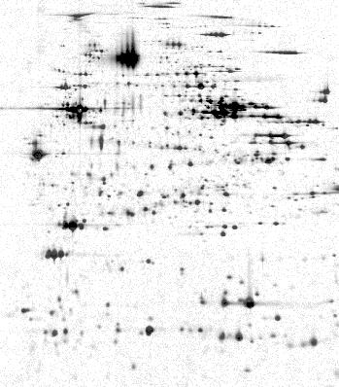
Another example: blob count
application: 2-D gel electrophoresis
  biologists use electrophoresis to produce a gel image of cellular material
  each "blob" (contiguous collection of dark pixels) represents a protein
  identify proteins by matching the blobs up with another known gel image
we would like to identify each blob, its location and size
  location is highest & leftmost pixel in the blob
  size is the number of contiguous pixels in the blob
  in this small image: Blob at [0][1]: size 5
    Blob at [2][7]: size 1
    Blob at [6][0]: size 4
    Blob at [6][6]: size 4
  can use backtracking to locate & measure blobs

Slide 10
Blob count (cont.)
can use recursive backtracking to get a blob's size
  when find a spot:
    1 (for the spot) +
    size of all connected subblobs (adjacent to spot)
note: we must not double count any spots
  when a spot has been counted, must "erase" it
  keep it erased until all blobs have been counted
private int blobSize(int row, int col) {
if (OFF THE GRID || NOT A SPOT) {
return 0;
}
else {
ERASE SPOT;
return 1 + this.blobSize(row-1, col-1)
+ this.blobSize(row-1, col)
+ this.blobSize(row-1, col+1)
+ this.blobSize( row, col-1)
+ this.blobSize( row, col+1)
+ this.blobSize(row+1, col-1)
+ this.blobSize(row+1, col)
+ this.blobSize(row+1, col+1);
}
}
pseudocode:

Slide 11
Blob count (cont.)
public class Gel{
private char[][] grid;
. . .
public void findBlobs() {
for (int row = 0; row < this.grid.length; row++) {
for (int col = 0; col < this.grid.length; col++) {
if (this.grid[row][col] == '*') {
System.out.println("Blob at [" + row + "][" +
col + "] : size " +
this.blobSize(row, col));
}
}
}
for (int row = 0; row < this.grid.length; row++) {
for (int col = 0; col < this.grid.length; col++) {
if (this.grid[row][col] == 'O') {
this.grid[row][col] = '*';
}
}
}
}
private int blobSize(int row, int col) {
if (row < 0 || row >= this.grid.length ||
col < 0 || col >= this.grid.length ||
this.grid[row][col] != '*') {
return 0;
}
else {
this.grid[row][col] = 'O';
return 1 + this.blobSize(row-1, col-1)
+ this.blobSize(row-1, col)
+ this.blobSize(row-1, col+1)
+ this.blobSize( row, col-1)
+ this.blobSize( row, col+1)
+ this.blobSize(row+1, col-1)
+ this.blobSize(row+1, col)
+ this.blobSize(row+1, col+1);
}
}
}
findBlobs traverses the image, checks each grid pixel for a blob
blobSize uses backtracking to expand in all directions once a blob is found
each pixel is "erased" after it is processed in blobSize to avoid double-counting (& infinite recursion)
the image is restored at the end of findBlobs

Slide 12
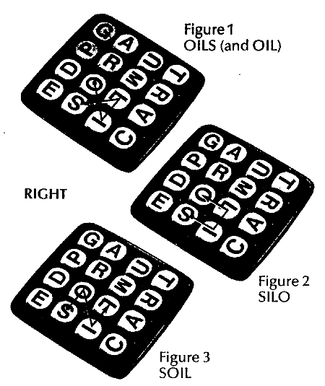
Another example: Boggle
recall the game
  random letters are placed in a 4x4 grid
  want to find words by connecting adjacent letters (cannot reuse the same letter)
  for each word found, the player earns points = length of the word
  the player who earns the most points after 3 minutes wins
how do we automate the search for words?

Slide 13
Boggle (cont.)
G | A | U | T
P | R | M | R
D | O | L | A
E | S | I | C
can use recursive backtracking to search for a word
  when the first letter is found:
    remove first letter & recursively search for remaining letters
again, we must not double count any letters
  must "erase" a used letter, but then restore for later searches
private boolean findWord(String word, int row, int col) {
if (WORD IS EMPTY) {
return true;
}
else if (OFF_THE_GRID || GRID LETTER != FIRST LETTER OF WORD) {
return false;
}
else {
ERASE LETTER;
String rest = word.substring(1, word.length());
boolean result = this.findWord(rest, row-1, col-1) ||
this.findWord(rest, row-1, col) ||
this.findWord(rest, row-1, col+1) ||
this.findWord(rest, row, col-1) ||
this.findWord(rest, row, col+1) ||
this.findWord(rest, row+1, col-1) ||
this.findWord(rest, row+1, col) ||
this.findWord(rest, row+1, col+1);
RESTORE LETTER;
return result;
}
}
pseducode:

Slide 14
BoggleBoard class
public class BoggleBoard {
private char[][] board;
. . .
public boolean findWord(String word) {
for (int row = 0; row < this.board.length; row++) {
for (int col = 0; col < this.board.length; col++) {
if (this.findWord(word, row, col)) {
return true;
}
}
}
return false;
}
private boolean findWord(String word, int row, int col) {
if (word.equals("")) {
return true;
}
else if (row < 0 || row >= this.board.length ||
col < 0 || col >= this.board.length ||
this.board[row][col] != word.charAt(0)) {
return false;
}
else {
char safe = this.board[row][col];
this.board[row][col] = '*';
String rest = word.substring(1, word.length());
boolean result = this.findWord(rest, row-1, col-1) ||
this.findWord(rest, row-1, col) ||
this.findWord(rest, row-1, col+1) ||
this.findWord(rest, row, col-1) ||
this.findWord(rest, row, col+1) ||
this.findWord(rest, row+1, col-1) ||
this.findWord(rest, row+1, col) ||
this.findWord(rest, row+1, col+1);
this.board[row][col] = safe;
return result;
}
}
. . .
}
can define a BoggleBoard class that represents a board
  has public method for finding a word
  it calls the private method that implements recursive backtracking
  also needs a constructor for initializing the board with random letters
  also needs a toString method for easily displaying the board

Slide 15
BoggleGame class
public class BoggleGame {
private final static String DICT_FILE = "dictionary.txt";
private BoggleBoard board;
private Set<String> guessedWords;
private Set<String> unguessedWords;
public BoggleGame() {
this.board = new BoggleBoard();
this.guessedWords = new TreeSet<String>();
this.unguessedWords = new TreeSet<String>();
try {
Scanner dictFile = new Scanner(new File(DICT_FILE));
while (dictFile.hasNext()) {
String nextWord = dictFile.next();
if (this.board.findWord(nextWord)) {
this.unguessedWords.add(nextWord);
}
}
}
catch (java.io.FileNotFoundException e) {
System.out.println("DICTIONARY FILE NOT FOUND");
}
}
public boolean makeGuess(String word) {
if (this.unguessedWords.contains(word)) {
this.unguessedWords.remove(word);
this.guessedWords.add(word);
return true;
}
return false;
}
. . .
}
a separate class can implement the game functionality
  constructor creates the board and fills unguessedWords with all found words
  makeGuess checks to see if the word is valid and has not been guessed, updates the sets accordingly
  also need methods for accessing the guessedWords, unguessedWords, and the board (for display)
see BoggleGUI

Slide 16
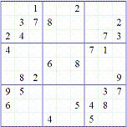
Sudoku
Sudoku is a popular puzzle where you fill in a 9x9 grid with numbers
  each row & col & subsquare contains the numbers 1-9 (with no duplicates)
  note: there are 16x16 and 25x25 extensions as well

Slide 17
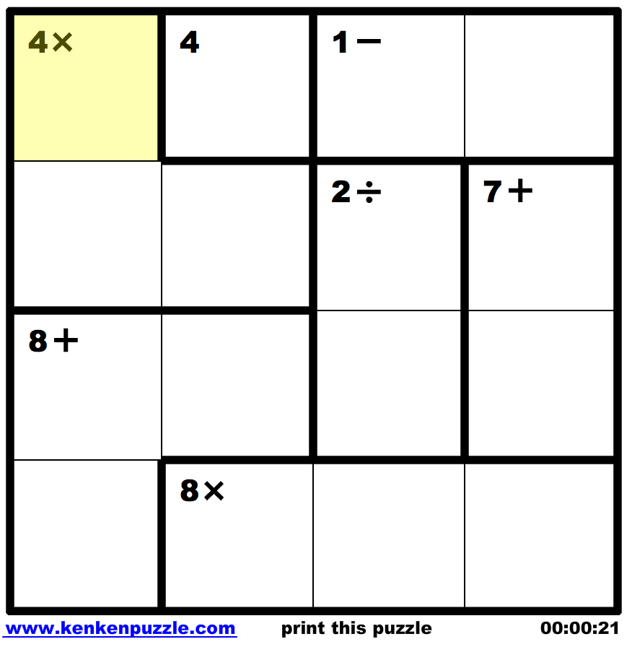
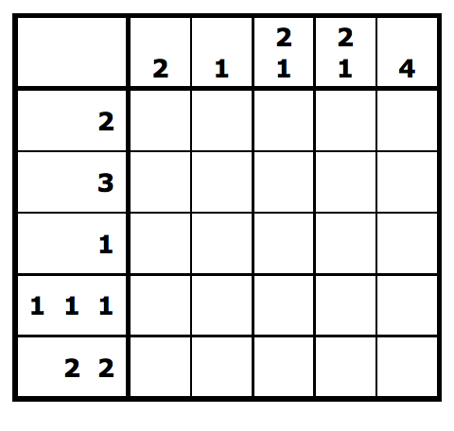
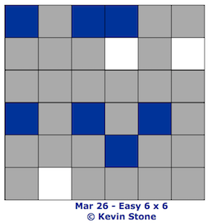
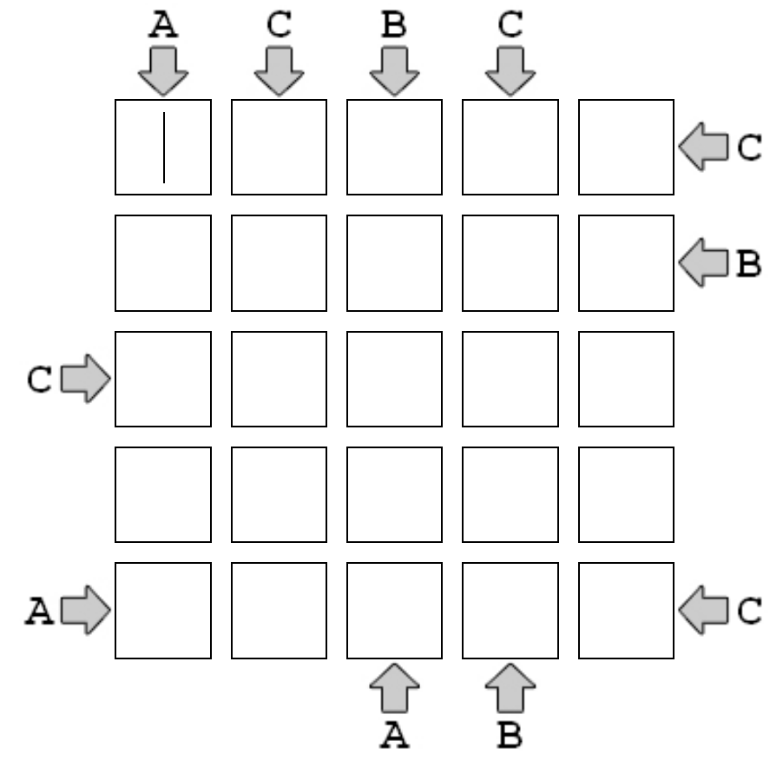
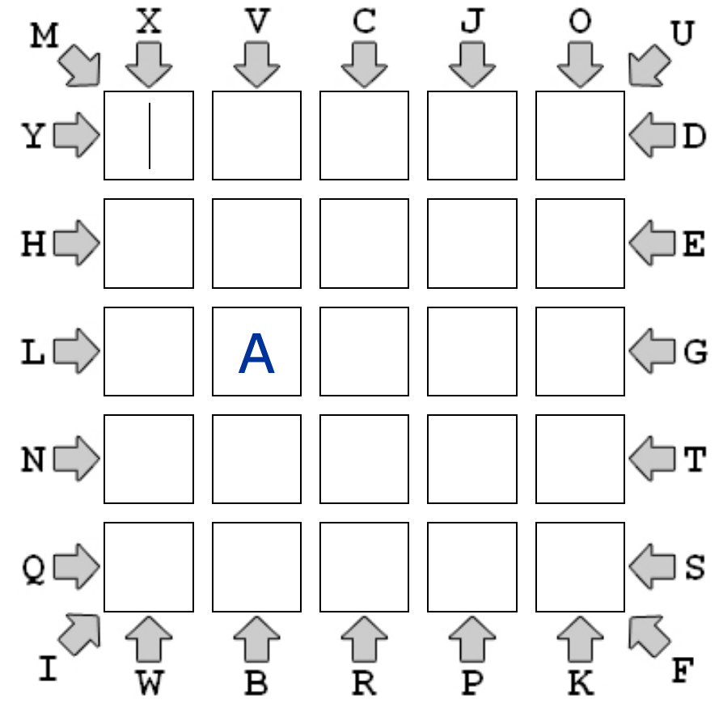
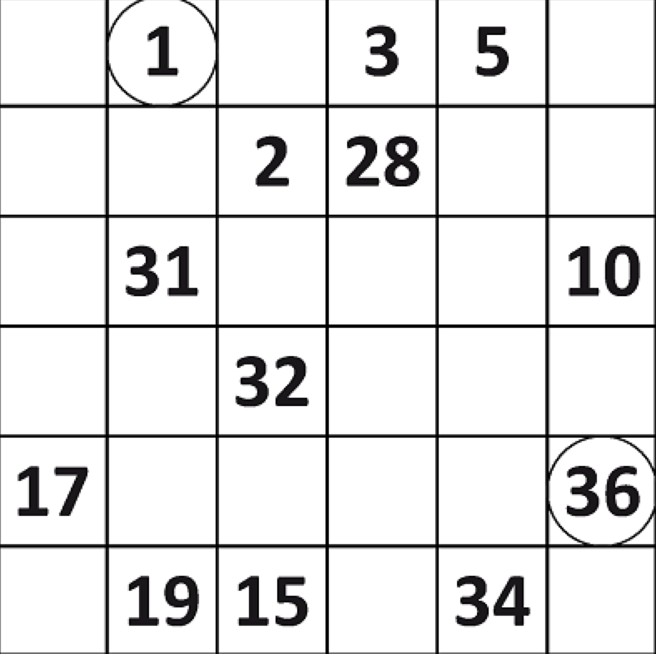
Grid-based puzzles
Sudoku is similar to many grid-based puzzles (see Brainbashers.com)
  KenKen, Nonogrids, 3-in-a-row, ABC Views, ABC Paths, Hidoku, …
  all are based on filling a grid with values (numbers, colors, letters, …) that meet some constraints

Slide 18
Generic backtracking approach
while the grid is not full
  find an empty cell
  for each possible value (number, color, letter, …)
    check to see if it meets the constraints
    if so, place the value in the grid,
    then try to fill the rest of the grid
    if can't fill the rest, then backtrack
      (i.e., erase the value and continue looping
      through the remaining values)

Slide 19
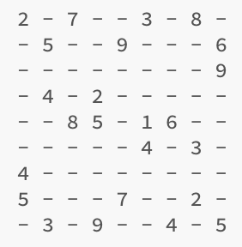
Sudoku solver
the Sudoku grid is read in from a file
  stored in a 2-D array of ints (why ints and not chars?)
public class SudokuGrid {
private static final int GRID_SIZE = 9;
private int[][] grid;
public SudokuGrid(String filename) throws java.io.FileNotFoundException {
Scanner infile = new Scanner(new File(filename));
this.grid = new int[GRID_SIZE][GRID_SIZE];
for (int r = 0; r < GRID_SIZE; r++) {
for (int c = 0; c < GRID_SIZE; c++) {
String str = infile.next();
if (str.contains("-")) {
this.grid[r][c] = 0;
}
else {
this.grid[r][c] = Integer.parseInt(str);
}
}
}
}
. . .
}

Slide 20
Sudoku fillGrid
fillGrid uses recursive backtracking to fill the grid row-by-row
  starts at row 0, col 0
public boolean fillGrid() {
return this.fillGrid(0, 0);
}
private boolean fillGrid(int row, int col) {
if (row == GRID_SIZE) { // HAVE FILLED ALL THE ROWS
return true;
}
else if (col == GRID_SIZE) { // HAVE FILLED THIS ROW, SO WRAP
return this.fillGrid(row+1, 0);
}
else if (this.grid[row][col] != 0) { // SPOT IS ALREADY FILLED
return this.fillGrid(row, col+1);
}
else { // NEED TO FILL SPOT
for (int i = 1; i <= GRID_SIZE ; i++) { // FOR EACH VALUE 1-9,
if (this.isLegalSpot(i, row, col)) { // CHECK IF LEGAL
this.grid[row][col] = i; // IF SO, PLACE IT AND
// TRY TO FILL REST
if (this.fillGrid(row, col+1)) { // IF SUCCESSFUL, THEN
return true; // RETURN TRUE
} // IF NOT, THEN
// REMOVE THE NUM
this.grid[row][col] = 0; // AND CONTINUE TO
} // TRY OTHER NUMS
} // IF NONE OF THE NUMS LED
return false; // TO A FILLED GRID,
} // RETURN FALSE
}

Slide 21
Sudoku helpers
private boolean isLegalSpot(int num, int row, int col) {
return this.isLegalRow(num, row) &&
this.isLegalCol(num, col) &&
this.isLegalSub(num, row, col);
}
private boolean isLegalRow(int num, int row) {
for (int c = 0; c < GRID_SIZE; c++) {
if (grid[row][c] == num) {
return false;
}
}
return true;
}
private boolean isLegalCol(int num, int col) {
for (int r = 0; r < GRID_SIZE; r++) {
if (grid[r][col] == num) {
return false;
}
}
return true;
}
private boolean isLegalSub(int num, int row, int col) {
int squareSide = (int)Math.sqrt(GRID_SIZE);
int baseRow = squareSide * (row/squareSide);
int baseCol = squareSide * (col/squareSide);
for (int r = baseRow; r < baseRow+squareSide; r++) {
for (int c = baseCol; c < baseCol+squareSide; c++) {
if (grid[r][c] == num) {
return false;
}
}
}
return true;
}
private helper methods check if a possible move is legal

Slide 22
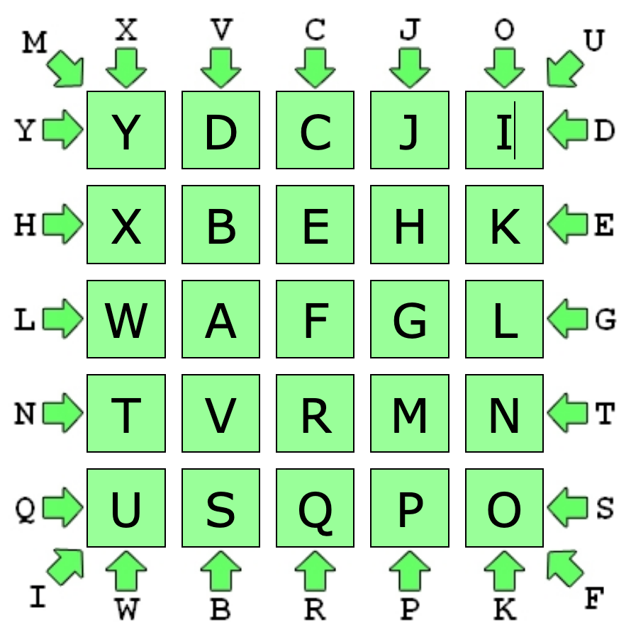
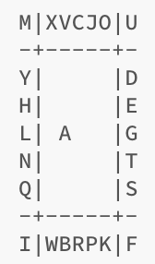
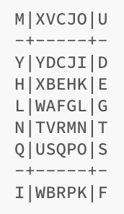
HW5: ABC Path
design & implement a class (or classes) for solving ABC Path puzzles
  each puzzle is a 5x5 grid in which you are to place the letters A-Y (A already placed)
  each successive letter is adjacent, either horizontally, vertically or diagonally
  edge constraints specify the row, column, or diagonal where each letter must appear
  your program must read the puzzle from a file, produce the solution (if any)

Slide 23
Branch & bound
the central idea of backtracking is cutting off a branch of the search as soon as we see that it can't lead to a solution
  then, backtrack and try a different branch
e.g., for the shortest path problem
  we cut off a branch if the vertex was a dead end
  we also cut it off if its length exceeded that of an already found path
what if we also had the ability to look ahead?
  i.e., if we could tell ahead of time (using some deduction) that a branch was not going to work, then we could preemptively cut
  this variant of backtracking is known as branch & bound

Slide 24
B & B example
suppose you have four jobs and 4 contractors (with bids), and want to assign the jobs to the contractors to minimize cost
  e.g., a → 1, b → 2, c → 3, d → 4 9 + 4 + 1 + 4 = $18K total
  e.g., a → 2, b → 3, c → 1, d → 4 2 + 3 + 5 + 4 = $14K total
generate & test?
 | job 1 | job 2 | job 3 | job 4
contractor a | $9K | $2K | $7K | $8K
contractor b | $6K | $4K | $3K | $7K
contractor c | $5K | $8K | $1K | $8K
contractor d | $7K | $6K | $9K | $4K

Slide 25
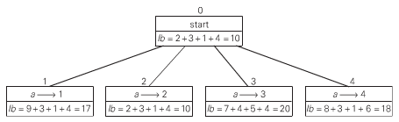
B & B example (cont.)
 | job 1 | job 2 | job 3 | job 4
contractor a | $9K | $2K | $7K | $8K
contractor b | $6K | $4K | $3K | $7K
contractor c | $5K | $8K | $1K | $8K
contractor d | $7K | $6K | $9K | $4K
note that there is a (possibly unobtainable) lower bound on the bid total
  you can't possibly do better than assigning every contractor their lowest bid
  here, 2 + 3 + 1 + 4 = $10K is a lower bound
  (it is not even achievable, since b & c are assigned the same job)
the lower bound gives us a basis for choosing one branch over another
  i.e., use a greedy approach to select the branch with smallest lower bound
    lb = cost of bids assigned so far + minimal bids possible for remaining contractors

Slide 26
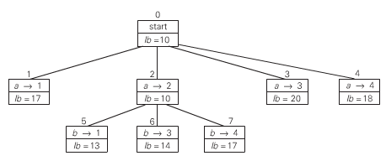
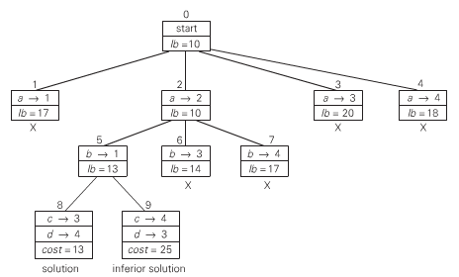
B & B example (cont.)
 | job 1 | job 2 | job 3 | job 4
contractor a | $9K | $2K | $7K | $8K
contractor b | $6K | $4K | $3K | $7K
contractor c | $5K | $8K | $1K | $8K
contractor d | $7K | $6K | $9K | $4K
at each step, choose the vertex/state with smallest lower bound, and extend
  can cut off a branch if its lb exceeds the cost of a found solution

Slide 27
Algorithmic approaches summary (so far)
brute force: sometimes the straightforward approach suffices
transform & conquer: sometimes the solution to a simpler variant suffices
divide/decrease & conquer: tackles a complex problem by breaking it into smaller piece(s), solving each piece (often w/ recursion), and combining into an overall solution
  applicable for any application that can be divided into smaller or independent parts
greedy: makes a sequence of choices/actions, choose whichever looks best at the moment
  applicable when a solution is a sequence of moves & perfect knowledge is available
backtracking: makes a sequence of choices/actions (similar to greedy), but stores alternatives so that they can be attempted if the current choices lead to failure
  more costly in terms of time and memory than greedy, but general-purpose
  branch & bound variant cuts off search at some level and backtracks

Slide 28
Interesting aside: B & B search in game playing
consider games involving:
  2 players
  perfect information
  zero-sum (player's gain is opponent's loss)
examples: tic-tac-toe, checkers, chess, othello, …
non-examples: poker, backgammon, prisoner's dilemma, …
von Neumann (the father of game theory) showed that for such games, there is always a "rational" strategy
  that is, can always determine a best move, assuming the opponent is equally rational

Slide 29
Game trees
idea: model the game as a search tree
  associate a value with each game state (possible since zero-sum)
    player 1 wants to maximize the state value (call him/her MAX)
    player 2 wants to minimize the state value (call him/her MIN)
  players alternate turns, so differentiate MAX and MIN levels in the tree
the leaves of the tree will be end-of-game states

Slide 30
Minimax search
minimax search:
  at a MAX level, take the maximum of all possible moves
  at a MIN level, take the minimum of all possible moves
can visualize the search bottom-up (start at leaves, work up to root)
likewise, can search top-down using recursion

Slide 31
Minimax example

Slide 32
In-class exercise

Slide 33
Minimax in practice
while Minimax Principle holds for all 2-party, perfect info, zero-sum games, an exhaustive search to find best move may be infeasible
  EXAMPLE: in an average chess game, ~100 moves with ~35 options/move
    → ~35¹⁰⁰ states in the search tree!
practical alternative: limit the search depth and use heuristics
  expand the search tree a limited number of levels (limited look-ahead)
  evaluate the "pseudo-leaves" using a heuristic
    high value → good for MAX low value → good for MIN
  back up the heuristic estimates to determine the best-looking move
    at MAX level, take maximum at MIN level, take minimum

Slide 34
Tic-tac-toe example
{
1000 if win for MAX (X)
heuristic(State) = -1000 if win for MIN (O)
(#rows/cols/diags open for MAX –
#rows/cols/diags open for MIN) otherwise
suppose look-ahead of 2 moves

Slide 35
α-β bounds
sometimes, it isn't necessary to search the entire tree
α-β technique: associate bonds with state in the search
  associate lower bound α with MAX: can increase
  associate upper bound β with MIN: can decrease

Slide 36
α-β pruning
discontinue search below a MIN node if β value <= α value of ancestor
discontinue search below a MAX node if α value >= β value of ancestor
<= 3 (
β
)
3
>= 5 (
α
)
no need to search
already searched

Slide 37
larger example

Slide 38
tic-tac-toe example
α-β vs. minimax:
  worst case: α-β examines as many states as minimax
  best case: assuming branching factor B and depth D, α-β examines ~2b^{d/2} states
  (i.e., as many as minimax on a tree with half the depth)

Slide 39
Iterative deepening
a common approach in game search is to set a lookahead range
  e.g., in chess, lookahead 4 moves (by each player) and rate boards at that stage
  this catches wins/losses within that range
  presumably, you can better judge the state of the game in the future
if decisions are timed,
  you can pick a conservative lookahead range to ensure a choice is made
  if time remains, extend the lookahead range and try again
  each iteration looks deeper and so makes a more informed choice
clearly, there is redundancy with iterative deepening
  lookead search of (n+1) levels must reproduce the search for n levels
  HOW COSTLY IS THIS?

