Slide 1
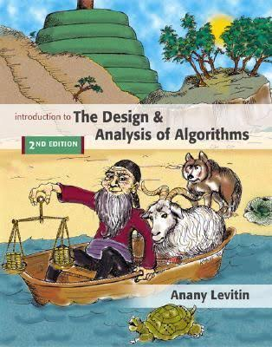
CSC 421: Algorithm Design and Analysis
Fall 2024
See online syllabus: http://dave-reed.com/csc421 (also on BlueLine)
Text: The Design & Analysis of Algorithms, 3rd ed.
Anany Levitin, Pearson, 2012.
note: free PDFs are readily available online

Slide 2
Course goals
To appreciate the role of algorithms in problem solving and software design, recognizing that a given problem might be solved with a variety of algorithms.
To be capable of selecting among competing algorithms and justifying their selection based on efficiency.
To be capable of selecting and utilizing appropriate data structures in implementing algorithms as computer programs.
To develop programs using different problem-solving approaches (divide-and-conquer, backtracking, dynamic programming), and be able to recognize when one approach is a better fit for a given problem.
To design and implement programs to model real-world systems, and subsequently analyze their behavior.

Slide 3
Your programming evolution…
221: programming in the small
focused on the design & implementation of small programs
introduced fundamental programming concepts
variables, assignments, expressions, I/O
control structures (if, if-else, while, for), strings, lists
functions, parameters, OO philosophy
you should be familiar with these concepts (we will do some review but you should review your own notes & text)
222: programming in the medium
focused on the design & analysis of more complex programs
introduced object-oriented approach
classes, objects, fields, methods, object composition, libraries
interfaces, inheritance, polymorphism, system modeling
searching & sorting, Big-Oh efficiency, recursion, GUIs
321: programming in the larger
focus on more complex problems where data structure choices matter
introduce standard data structures, design techniques, performance analysis
stacks, queues, sets, maps, linked structures, trees, graphs, hash tables
algorithm design, data structure selection/comparison/analysis
algorithm analysis, recurrence relations, counting & proof techniques

Slide 4
421: programming in the even larger
still not developing large-scale, multi-programmer systems
see CSC 548, CSC 599
we will tackle medium-sized (3-10 interacting classes) projects in which
there may be multiple approaches, with different performance characteristics
the choice of algorithm and accompanying data structure is important
the wrong choice can make a solution infeasible
we will consider multiple design paradigms and problem characteristics that suggest which paradigm to apply
brute force, decrease & conquer, divide & conquer, transform & conquer
greedy algorithms, backtracking, dynamic programming, space/time tradeoffs
we will also study the notions of computability and feasibilty
P vs. NP, NP-hard problems, approximation algorithms

Slide 5
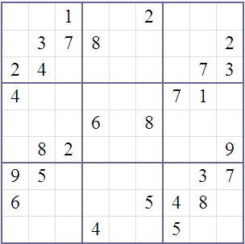
When problems start to get complex…
…choosing the right algorithm and data structures are important
e.g., phone book lookup, checkerboard puzzle
must develop problem-solving approaches (e.g., divide&conquer, backtracking)
be able to identify appropriate data structures (e.g., lists, trees, sets, maps)
EXAMPLE: solving a Sudoku puzzle
need to be able to represent the grid
devise an algorithm to fill in the blanks so that every row, column & subsquare contains 1-9
how do you solve Sudoku puzzles?
should the computer use the same approach?
how complicated/fast would it be?

Slide 6
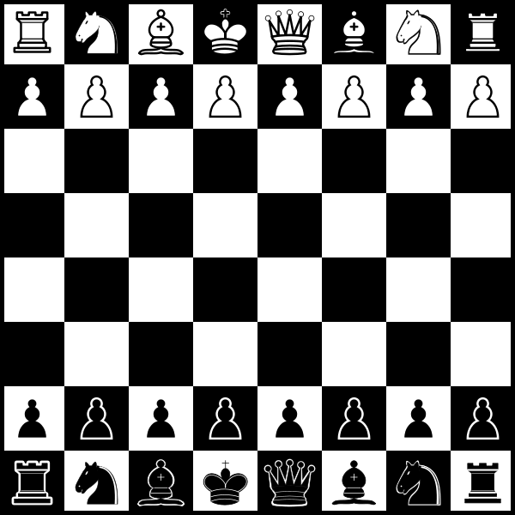
Another example
consider two-player, perfect-knowledge strategy games
e.g., tic-tac-toe, checkers, chess
need to be able to represent the board
identify winning/losing state
select the best move at any given state of the game
how do you play tic-tac-toe? chess?
should the computer use the same approach?
are the approaches to tic-tac-toe and chess similar?
what is white’s rational move?

Slide 7
Another example
suppose you are given a set of integers (positive and negative)
{ 4, -9, 3, 4, -1, -5, 8 }
is there a subset of integers that add up to 0?
this is known as the subset sum problem
it turns out that there is no known efficient algorithm to solve this
may have to exhaustively try every possible subset of numbers
how many subsets of N items can there be?

Slide 8
OOP and code reuse
when solving large problems, code reuse is important
designing, implementing, and testing large software projects is HARD
whenever possible, want to utilize existing, debugged code
reusable code is:
clear and readable (well documented, uses meaningful names, no tricks)
modular (general, independent routines – test & debug once, then reuse)
OOP is the standard approach to software engineering
philosophy: modularity and reuse apply to data as well as functions
when solving a problem, must identify the objects involved
e.g., banking system: customer, checking account, savings account, …
develop a software model of the objects in the form of abstract data types (ADTs)
a program is a collection of interacting software objects
can utilize inheritance to derive new classes from existing ones

