Slide 1
CSC 421: Algorithm Design and Analysis
Fall 2024
Dynamic programming
  top-down vs. bottom-up
  divide & conquer vs. dynamic programming
  examples: Fibonacci sequence, binomial coefficient
  examples: World Series puzzle, Floyd's algorithm
  top-down with caching
  example: making change
  problem-solving approaches summary

Slide 2
Divide and conquer
divide/decrease & conquer are top-down approaches to problem solving
  start with the problem to be solved (i.e., the top)
  break that problem down into smaller piece(s) and solve
  continue breaking down until reach base/trivial case (i.e., the bottom)
they work well when the pieces can be solved independently
  e.g., merge sort – sorting each half can be done independently, no overlap
what about Fibonacci numbers? 1, 1, 2, 3, 5, 8, 13, 21, …
  public static int fib(int n) {
  if (n <= 1) {
  return 1;
  }
  else {
  return fib(n-1) + fib(n-2);
  }
  }

Slide 3
Top-down vs. bottom-up
divide and conquer is a horrible way of finding Fibonacci numbers
  the recursive calls are NOT independent; redundencies build up
  public static int fib(int n) {
  if (n <= 1) {
  return 1;
  }
  else {
  return fib(n-1) + fib(n-2);
  }
  }
fib(5)
fib(4) + fib(3)
fib(3) + fib(2) fib(2) + fib(1)
. . . .
. . . .
. . . .
  public static int fib(int n) {
  int prev = 1, current = 1;
  for (int i = 1; i < n; i++) {
  int next = prev + current;
  prev = current;
  current = next;
  }
  return current;
  }
in this case, a bottom-up solution makes more sense
  start at the base cases (the bottom) and work up to the desired number
  requires remembering the previous two numbers in the sequence

Slide 4
Dynamic programming
dynamic programming is a bottom-up approach to solving problems
  start with smaller problems and build up to the goal, storing intermediate solutions as needed
  applicable to the same types of problems as divide/decrease & conquer, but bottom-up
  usually more effective than top-down if the parts are not completely independent (thus leading to redundancy)
example: binomial coefficient C(n, k) is relevant to many problems
  the number of ways can you select k lottery balls out of n
  the number of birth orders possible in a family of n children where k are sons
  the number of acyclic paths connecting 2 corners of an k(n-k) grid
  the coefficient of the x^{k}y^{n-k} term in the polynomial expansion of (x + y)^{n}

Slide 5
Example: binary coefficient
while easy to define, a binomial coefficient is difficult to compute
  e.g, 6 number lottery with 49 balls → 49!/(6!43!)
  49! = 608,281,864,034,267,560,872,252,163,321,295,376,887,552,831,379,210,240,000,000,000
could try to get fancy by canceling terms from numerator & denominator
  can still end up with individual terms that exceed integer limits
a computationally easier approach makes use of the following recursive relationship
e.g., to select 6 lottery balls out of 49, partition into:
selections that include 1
(must select 5 out of remaining 48)
+
selections that don't include 1
(must select 6 out of remaining 48)

Slide 6
Example: binomial coefficient
could use straight divide & conquer to compute based on this relation
public static int binomial(int n, int k) {
if (k == 0 || n == k) {
return 1;
}
else {
return binomial(n-1, k-1) + binomial(n-1, k);
}
}
however, this will take a long time or exceed memory due to redundant work

Slide 7
Dynamic programming solution
 | 0 | 1 | 2 | 3 | … | k
0 | 1
1 | 1 | 1
2 | 1 |  | 1
3 | 1 |  |  | 1
… | … |  |  |  | …
n | 1 |  |  |  |  | 1
could instead work bottom-up, filling a table starting with the base cases
  k = 0 OR n = k → 1
  otherewise, add upper-left and upper values
public static int binomial(int n, int k) {
if (n < 2) {
return 1;
}
else {
int bin[][] = new int[n+1][n+1]; // CONSTRUCT TABLE
for (int r = 0; r <= n; r++) {
for (int c = 0; c <= r && c <= k; c++) {
if (c == 0 || c == r) {
bin[r][c] = 1; // ENTER 1 IF BASE CASE
}
else { // OTHERWISE, USE FORMULA
bin[r][c] = bin[r-1][c-1] + bin[r-1][c];
}
}
}
return bin[n][k]; // ANSWER IS AT bin[n][k]
}
}

Slide 8
World Series puzzle
Consider the following puzzle:
  At the start of the world series (best-of-7), you must pick the team you want to win and then bet on games so that
    if your team wins the series, you win exactly $1,000
    if your team loses the series, you lose exactly $1,000
  You may bet different amounts on different games, and can even bet $0 if you wish.
  QUESTION: how much should you bet on the first game?
DIVIDE & CONQUER SOLUTION? DYNAMIC PROGRAMMING?

Slide 9
Divide and conquer approach
BASE CASES: winnings(4, ?) → $1,000
winnings(?, 4) → $-1,000
RECURSION: winnings(W, L) = (winnings(W+1,L)+winnings(W,L+1))/2
winnings(0,0)
winnings(0,1)
winnings(1,0)
winnings(0,2)
winnings(1,1)
winnings(1,1)
winnings(2,0)
.
.
.
.
.
.
.
.
.
.
.
.

Slide 10
Dynamic approach
fill in a table, where each entry is winnings(row, column)
  base cases are row 4 (win $1000) and column 4 (lose $1000)
  for other cells, average cell below and to right
L W | 0 | 1 | 2 | 3 | 4
0 |  |  |  |  | -1000
1 |  |  |  |  | -1000
2 |  |  |  |  | -1000
3 |  |  |  |  | -1000
4 | 1000 | 1000 | 1000 | 1000

Slide 11
World Series puzzle code
private static double winningsTopDown(int numWins, int numLosses) {
if (numWins == GAMES_TO_WIN) {
return FINAL_WORTH;
}
else if (numLosses == GAMES_TO_WIN) {
return -FINAL_WORTH;
}
else {
return (winningsTopDown(numWins+1, numLosses) +
winningsTopDown(numWins, numLosses+1))/2;
}
}
divide & conquer solution
private static double winningsBottomUp(int numWins, int numLosses) {
double winGrid[][] = new double[GAMES_TO_WIN+1][GAMES_TO_WIN+1];
for (int w = GAMES_TO_WIN; w >= numWins; w--) {
for (int l = GAMES_TO_WIN; l >= numLosses; l--) {
if (w == GAMES_TO_WIN) {
winGrid[w][l] = FINAL_WORTH;
}
else if (l == GAMES_TO_WIN) {
winGrid[w][l] = -FINAL_WORTH;
}
else {
winGrid[w][l] = (winGrid[w+1][l]+winGrid[w][l+1])/2;
}
}
}
return winGrid[numWins][numLosses];
}
dynamic programming solution

Slide 12
All-pairs shortest path
recall Dijkstra's algorithm for finding the shortest path between two vertices in a graph
  simple implementation is O(|V|²)
  trickier implementaion is O((|E| + |V|) log |V|)
suppose we wanted to find the shortest paths between all pairs of vertices
  e.g., oracleofbacon.org
brute force solution: run Dijkstra's algorithm for every pair
  O(|V|²) pairs x O(|V|²) → O(|V|⁴)
  O(|V|²) pairs x O((|E| + |V|) log |V|) → O((|E||V|² + |V|³) log |V|)
we can do much better

Slide 13
Floyd's algorithm
Floyd's algorithm uses a dynamic programming approach to find all shortest path in O(|V|³)
  computes a series of distance matrices D⁽⁰⁾, D⁽¹⁾, …, D^{(|V|)}
  D⁽⁰⁾ is is the weight matrix for the graph (D⁽⁰⁾[i][j] is weight of edge from v_{i} to v_{j})
    represents the minimum distances if no intermediate vertices are allowed
  D⁽¹⁾ allows paths with v₁ as intermediate vertex
  D⁽²⁾ allows paths with v_{1,} v₂ as intermediate vertices
  …
  D^{(|V|)} allows paths with v_{1,} v₂, …, v_{|V|} as intermediate vertices (i.e., all paths)
when calculating the entries in D^{(k)}
  shortest path connecting v_{i} and v_{j} either uses v_{k} or it doesn't
    D^{(k)}[i][j] = min(D^{(k-1)}[i][j], D^{(k-1)}[i][k] + D^{(k-1)}[k][j] )

Slide 14
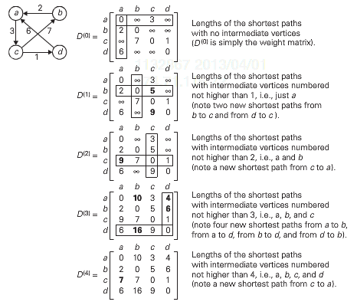
Floyd's example
    D⁽⁰⁾[i][j] = w_{ij}
    D^{(k)}[i][j] = min(D^{(k-1)}[i][j], D^{(k-1)}[i][k] + D^{(k-1)}[k][j] )

Slide 15
Another example
8
a
b
2
6
4
3
c

Slide 16
Another example
8
a
b
2
6
9
4
3
c
1
d
5

Slide 17
Floyd's algorithm
bottom-up algorithm statement:
  D = weight matrix
  for k from 1 to |V|:
  for i from 1 to |V|:
  for j from 1 to |V|:
  D[i][j] = min( D[i][j], D[i][k] + D[k][j] );
clearly, this is O(|V|³)
could be formulated top-down (requires 3 dimensions)
    solve(0, i, j) ← weight[i][j]
    solve(k, i, j) ← min( solve(k-1, i, j), solve(k-1, i, k) + solve(k-1, k, j) )

Slide 18
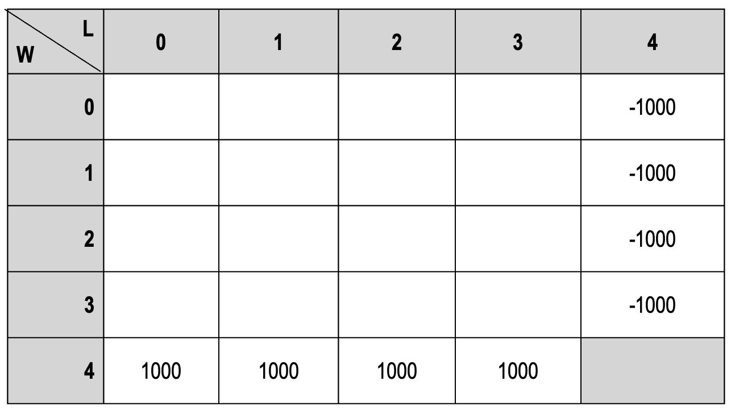
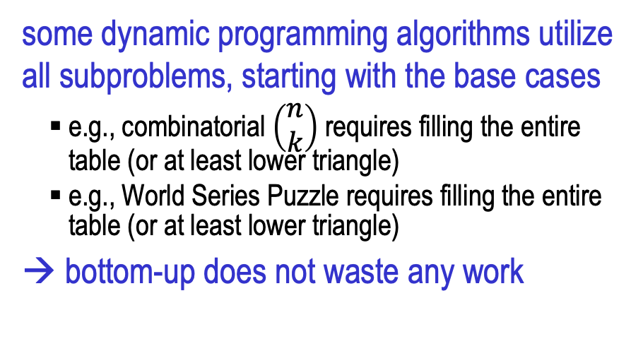
Exhaustive dynamic programming
 | 0 | 1 | 2 | 3 | … | k
0 | 1
1 | 1 | 1
2 | 1 |  | 1
3 | 1 |  |  | 1
… | … |  |  |  | …
n | 1 |  |  |  |  | 1
some dynamic programming algorithms utilize all subproblems, starting with the base cases
  e.g., combinatorial $\left(\begin{matrix}n \\ k\end{matrix}\right)$ requires filling the entire table (or at least lower triangle)
  e.g., World Series Puzzle requires filling the entire table (or at least lower triangle)
→ bottom-up does not waste any work
for many problems, this is not the case
  solving a problem may require only a subset of smaller problems to be solved
  constructing a table and exhaustively working up from the base cases could do lots of wasted work
  can dynamic programming still be applied?

Slide 19
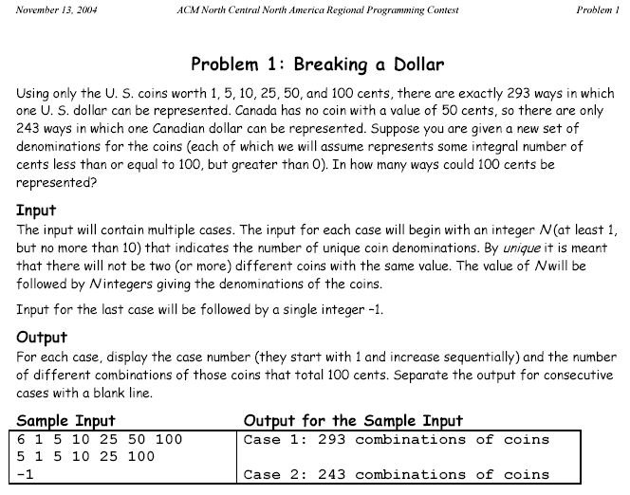
Example: programming contest problem

Slide 20
Divide & conquer approach
let getChange(amount, coinList) represent the number of ways to get an amount using the specified list of coins
getChange(amount, coinList) =
getChange(amount-biggestCoinValue, coinList) // # of ways that use at least
+ // one of the biggest coin
getChange(amount, coinList-biggestCoin); // # of ways that don't
// involve the biggest coin
e.g., suppose want to get 10¢ using only pennies and nickels
  getChange(10, [1¢, 5¢])
  getChange(5, [1¢, 5¢]) + getChange(10, [1¢])
getChange(0, [1¢, 5¢]) + getChange(5, [1¢]) 1
1 1

Slide 21
Divide & conquer solution
could implement as a ChangeMaker class
  when constructing, specify a sorted list of available coins (why sorted?)
  recursive helper method works with a possibly restricted coin list
public class ChangeMaker1 {
private ArrayList<Integer> coins;
public ChangeMaker1(ArrayList<Integer> coins) {
this.coins = coins;
}
public int getChange(int amount) {
return this.getChange(amount, this.coins.size()-1);
}
private int getChange(int amount, int maxIndex) {
if (amount < 0 || maxIndex < 0) {
return 0;
}
else if (amount == 0) {
return 1;
}
else {
return this.getChange(amount-this.coins.get(maxIndex), maxIndex) +
this.getChange(amount, maxIndex-1);
}
}
}
base case: if amount or max coin index becomes negative, then can't be done
base case: if amount is zero, then have made exact change
recursive case: count how many ways using a largest coin + how many ways not using a largest coin

Slide 22
Will this solution work?
certainly, it will produce the correct answer -- but, how quickly?
  at most 10 coins
  worst case: 1 2 3 4 5 6 7 8 9 10
  6,292,069 combinations → depending on your CPU, this can take a while
  # of combinations will explode if more than 10 coins allowed
the problem is duplication of effort
getChange(100, 9)
getChange(90, 9) + getChange(100, 8)
getChange(80, 9) + getChange(90, 8) getChange(91, 8) + getChange(100, 7)
. . . . . . . . . . . .
. . . . . . . . . . . .
. . . . . . . . . . . .
. . . .
. . . .
getChange(80, 6) getChange(80, 6) getChange(80, 6) getChange(80, 6)

Slide 23
Caching
we could use dynamic programming and solve the problem bottom up
  however, consider getChange(100, [1¢, 5¢, 10¢, 25¢])
  would we ever need to know getChange(99, [1¢, 5¢, 10¢, 25¢]) ?
  getChange(98, [1¢, 5¢, 10¢, 25¢]) ?
  getChange(73, [1¢, 5¢]) ?
when exhaustive bottom-up would yield too many wasted cases, dynamic programming can instead utilize top-down with caching
  create a table (as in the exhaustive bottom-up approach)
  however, fill the table in using a top-down approach
    that is, execute a top-down decrease and conquer solution, but store the solutions to subproblems in the table as they are computed
  before recursively solving a new subproblem, first check to see if its solution has already been cached
  avoids the duplication of pure top-down
  avoids the waste of exhaustive bottom-up (only solves relevant subproblems)

Slide 24
ChangeMaker with caching
as each subproblem is solved, its solution is stored in a map
each call to getChange checks the map first before recursing
public class ChangeMaker2 {
private ArrayList<Integer> coins;
private HashMap<String, Integer> cache;
public ChangeMaker2(ArrayList<Integer> coins) {
this.coins = coins;
this.cache = new HashMap<String, Integer>();
}
public int getChange(int amount) {
return this.getChange(amount, coins.size()-1);
}
private int getChange(int amount, int maxCoinIndex) {
if (maxCoinIndex < 0 || amount < 0) {
return 0;
}
else if (!this.cache.containsKey(amount+","+maxCoinIndex)) {
if (amount == 0) {
this.cache.put(amount+","+maxCoinIndex, 1);
}
else {
this.cache.put(amount+","+maxCoinIndex,
this.getChange(amount-this.coins.get(maxCoinIndex), maxCoinIndex) +
this.getChange(amount, maxCoinIndex-1));
}
}
return this.cache.get(amount+","+maxCoinIndex);
}
}
with caching, even the worst case is fast:
6,292,069 combinations

Slide 25
Algorithmic approaches summary
brute force: sometimes the straightforward approach suffices
transform & conquer: sometimes the solution to a simpler variant suffices
divide/decrease & conquer: tackles a complex problem by breaking it into smaller piece(s), solving each piece (often w/ recursion), and combining into an overall solution
  applicable for any application that can be divided into independent parts
dynamic: bottom-up implementation of divide/decrease & conquer – start with the base cases and build up to the desired solution, storing results to avoid redundancy
  usually more effective than top-down recursion if the parts are not completely independent
  can implement by adding caching to top-down recursion
greedy: makes a sequence of choices/actions, choose whichever looks best at the moment
  applicable when a solution is a sequence of moves & perfect knowledge is available
backtracking: makes a sequence of choices/actions (similar to greedy), but stores alternatives so that they can be attempted if the current choices lead to failure
  more costly in terms of time and memory than greedy, but general-purpose
  branch & bound variant cuts off search at some level and backtracks

