Slide 1
CSC 421: Algorithm Design and Analysis
Fall 2024
Decrease & conquer
decrease by constant
sequential search, insertion sort, topological sort
decrease by constant factor
binary search, fake coin problem
decrease by variable amount
BST search, selection problem

Slide 2
Decrease & Conquer
based on exploiting the relationship between a solution to a given instance of a problem and a solution to a smaller instance
once the relationship is established, it can be exploited either top-down or bottom-up
EXAMPLE: sequential search of N-item list
checks the first item, then searches the remaining sublist of N-1 items
EXAMPLE: binary search of sorted N-item list
checks the middle item, then searches the appropriate sublist of N/2 items
3 major variations of decrease & conquer
decrease by a constant (e.g., sequential search decreases list size by 1)
decrease by a constant factor (e.g., binary search decrease list size by factor of 2)
decrease by a variable amount

Slide 3
Decrease by a constant
decreasing the problem size by a constant (especially 1) is fairly common
many iterative algorithms can be viewed this way
e.g., sequential search, traversing a linked list
many recursive algorithms also fit the pattern
e.g., N! = (N-1)! * N a^{N} = a^{N-1} * a
EXAMPLE: insertion sort (decrease-by-constant description)
to sort a list of N comparable items:
sort the initial sublist of (N-1) items
take the Nth item and insert it into the correct position

Slide 4
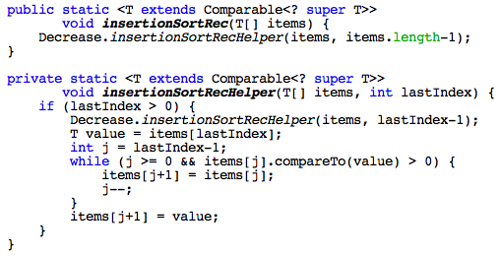
Top-down (recursive) definition
can use recursion to implement this algorithm
this a top-down approach, because it starts with the entire list & recursively works down to the base case

Slide 5
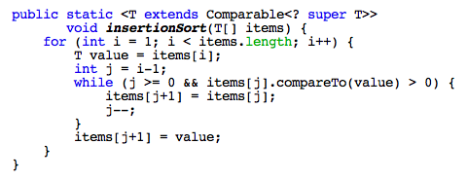
Bottom-up (iterative) definition
for most decrease-by-constant algorithms
top-down recursion is not necessary and in fact is less efficient
instead, could use a loop to perform the same tasks in a bottom-up fashion

Slide 6
Big-Oh of insertion sort
analyzing the recursive version
cost function?
worst case Big-Oh?
analyzing the iterative version
worst case Big-Oh?

Slide 7
Analysis of insertion sort
insertion sort has advantages over other O(N²) sorts
best case behavior of insertion sort?
what is the best case scenario for a sort?
does insertion sort take advantage of this scenario?
does selection sort?
what if a list is partially ordered? (a fairly common occurrence)
does insertion sort take advantage?

Slide 8
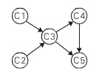
Another example
consider the problem of topological sorting
given a directed graph, find an ordering of the vertices such that if edge (v_{i}, v_{j}) is in the graph, then v_{i} comes before v_{j} in the ordering
as long as there are no cycles in the graph, at least one (and possibly many) topological sorts exists
C1, C2, C3, C4, C5 or C2, C1, C3, C4, C5
topological sorting is useful in many applications
constructing a job schedule among interrelated tasks
cell evaluation ordering in spreadsheet formulas
power rankings of sports teams (e.g., beat paths)
may sometimes generate a topological sort to verify that an ordering is possible, then invest resources into optimizing

Slide 9
DFS-based topological sort
one possible algorithm is based on depth first search
traverse the graph in a depth-first ordering (using a stack for reached vertices)
when you reach a dead-end (i.e., pop a vertex off the stack), add it to a list
finally, reverse the list
C5 C4
C3 C3 C3 C3 C3
C1 C1 C1 C1 C1 C1 C1 C2
C5 C4 C3 C1 C2
C2 C1 C3 C4 C5

Slide 10
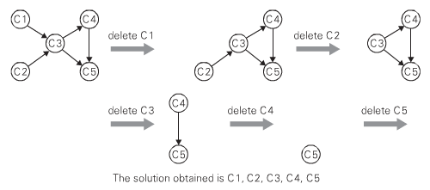
Decrease-by-1 topological sort
alternatively,
while the graph is nonempty
identify a vertex with no incoming edges
add the vertex to a list
remove that vertex and all outgoing edges from it

Slide 11
Decrease by a constant factor
a more efficient (but rare) variation of decrease & conquer occurs when you can decrease by an amount proportional to the problem size
e.g. binary search → divides a problem of size N into a problem of size N/2
Cost(N) = Cost(N/2) + C can unwind Cost(N/2)
= (Cost(N/4) + C) + C
= Cost(N/4) + 2C can unwind Cost(N/4)
= (Cost(N/8) + C) + 2C
= Cost(N/8) + 3C can continue unwinding
= … (a total of log₂ N times)
= Cost(1) + (log₂N)*C
= C log₂ N + C' where C' = Cost(1)
➔ O(log N)

Slide 12


Fake coin problem
Given a scale and N coins, one of which is lighter than all the others.
Identify the light coin using the minimal number of weighings.
solution? cost function? big-Oh?

Slide 13
What doesn't fit here?
decrease by a constant factor is efficient, but very rare
it is tempting to think of algorithms like merge sort & quick sort
each divides the problem into subproblems whose size is proportional to the original
key distinction: these algorithms require solving multiple subproblems, then somehow combining the results to solve the bigger problem
we have a different name for these types of problems: divide & conquer
NEXT WEEK

Slide 14
Decrease by a variable amount
sometimes things are not so consistent
the amount of the decrease may vary at each step, depending on the data
EXAMPLE: searching/inserting in a binary search tree
if the tree is full & balanced, then each check reduces the current tree into a subtree half the size
however, if not full & balanced, the sizes of the subtrees can vary
worst case: the larger subtree is selected at each check
for a linear tree, this leads to O(N) searches/insertions
in general, the worst case on each check is selecting the larger subtree
recall: randomly added values produce enough balance to yield O(log N)

Slide 15
Selection problem
suppose we want to determine the kth-order statistic of a list
i.e., find the kth smallest element in the list of N items
(special case, finding the median, is the N/2th order statistic)
obviously, could sort the list then access the kth item directly
O(N log N)
could do k passes of selection sort (find 1st, 2nd, …, kth smallest items)
O(k * N)
or, we could utilize an algorithm similar to quick sort called quick select
recall, quick sort works by:
partitioning the list around a particular element (i.e., moving all items ≤ the pivot element to its left, all items > the pivot element to its right)
recursively quick sorting each partition

Slide 16
Lomuto partition
we will assume that the first item is always chosen as pivot value
simple, but "better" strategies exist for choosing the pivot
mark the first index as the pivot index
traverse the list, for each item < the pivot value
increment the pivot index & swap the item into that index
finally, swap the pivot value into the pivot index
5 8 7 2 1 6 4
5 8 7 2 1 6 4
5 8 7 2 1 6 4
5 8 7 2 1 6 4
5 2 7 8 1 6 4
5 2 1 8 7 6 4
5 2 1 8 7 6 4
5 2 1 4 7 6 8
4 2 1 5 7 6 8

Slide 17
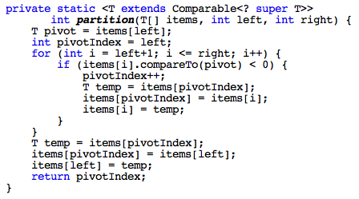
Lomuto partition implementation
for both quick sort & quick select, we need to be able to partition a section of the list
assume parameters left & right are the lower & upper indexes of the section to be partitioned

Slide 18
Quick select algorithm
to find the kth value in a list:
partition the list (using Lomuto's partitioning algorithm)
let pivotIndex denote the index that separates the two partitions
if k = pivotIndex+1, then
return the value at pivotIndex
if k < pivotIndex+1, then
recursively search for the kth value in the left partition
if k > pivotIndex+1, then
recursively search for the (k – (pivotIndex+1))th value in the right partition
4 2 1 5 7 6 8
here, pivotIndex = 3
if k = 4, then answer is in index 3 = 5
if k = 2, then find 2nd smallest value in
if k = 5, then find 1st smallest value in
4 2 1
7 6 8

Slide 19
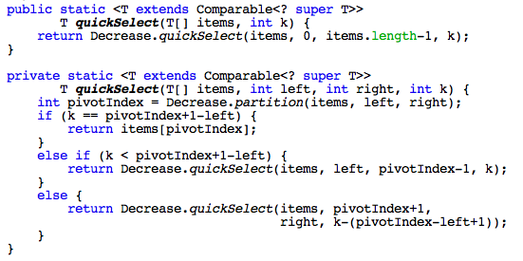
Quick select implementation
can be implemented recursively or iteratively
recursive solution requires a private helper method that utilizes the left & right boundaries of the list section
as with partition, the code must adjust for the changing boundaries

Slide 20
Efficiency of quick select
analysis is similar to quick sort (but only 1 recursive call)
if the partition is perfectly balanced:
Cost(N) = Cost(N/2) + C₁N + C₂ can unwind Cost(N/2)
= (Cost(N/4) + C₁N/2 + C₂) + C₁N + C₂
= Cost(N/4) + 3/2C₁N + 2C₂) can unwind Cost(N/4)
= (Cost(N/8) + C₁N/4 + C₂) + 3/2C₁N +2C₂
= Cost(N/8) + 7/4C₁N + 3C₂ can continue unwinding
= … (a total of log₂ N times)
≤ Cost(1) + 2C₁N + (log₂N)C₂ note: 1 + 1/2 + 1/4 + 1/8 … → 2
= 2C₁ N + C₂ log₂N + C' where C' = Cost(1)
➔ O(N)
in the worst case, the pivot chosen is the smallest or largest value
this reduces the algorithm to decrease-by-1 ➔ O(N²)
as long as the partitioning is reasonably balanced, get O(N) behavior in practice
there is a complex algorithm for choosing the pivot that guarantees linear performance

