Slide 1
CSC 421: Algorithm Design and Analysis
Fall 2024
Complexity & Computability
classifying problem complexity
tractability, decidability
P vs. NP, Turing machines
NP-complete, reductions
approximation algorithms, genetic algorithms

Slide 2
Classifying problem complexity
throughout this class, we have considered problems, designed algorithms, and classified their efficiency
e.g., sorting a list – could use O(N²) selection sort or O(N log N) quick sort
also considered the difficulty of problems
comparison-based searching of a sorted list has a lower bound of Ω(log N)
comparison-based sorting has a lower bound of Ω(N log N)
when is a problem too difficult?
EXTREMELY LOW BAR: we say that a problem is intractable if there does not exist a polynomial time O( N^{X} ) algorithm that solves it
Ω(2^{N}) is definitely intractable note: N = 20 → millions of steps
2⁶⁰ > # of seconds since Big Bang
2²⁷³ > # of atoms in the universe
but Ω(N²), Ω(N³), Ω(N⁴), … by definition, are tractable

Slide 3
Tractable vs. practical
recall Floyd's algorithm for finding all shortest paths in a graph
Ω(|V|³) where |V| is the number of vertices in the graph
how big of a graph can it handle in a reasonable time?
N | N³ | N⁴
10 | 1,000 | 10,000
100 | 1,000,000 | 100,000,000
1,000 | 1,000,000,000 | 1,000,000,000,000
10,000 | 1,000,000,000,000 | 10,000,000,000,000,000
100,000 | 1,000,000,000,000,000 | 100,000,000,000,000,000,000
1,000,000 | 1,000,000,000,000,000,000 | 1,000,000,000,000,000,000,000,000
anything worse than Ω(N³), while tractable, is not practical
beyond small problems, cannot be solved in reasonable time
note: the "small" boundary will increase slowly as computers get faster

Slide 4
Beyond intractable
Turing showed there are UNSOLVABLE problems (regardless of efficiency)
THE HALTING PROBLEM: Given a computer program and an input to it, determine whether the program will halt on the input.
Proof by contradiction:
Assume that there is a program that solves the Halting Problem.
def haltsOn(sourceFile, dataFile):
"""Returns true if the program in sourceFile halts when
executed on the data in dataFile; else false."""
CODE_NOT_SHOWN
e.g., haltsOn("prog.py", "data.txt") will return true if the program in prog.py halts on the input file data.txt; otherwise, false
We need to show that the existence of this program leads to a logical contradiction.

Slide 5
Halting problem proof (cont.)
Note: a program is stored in a text file, so can be input to another program.
haltsOn("prog1.py", "prog2.py") returns true if program in prog1.py halts on prog2.py
haltsOn("prog1.py", "prog1.py") returns true if program in prog1.py halts on itself (!)
Suppose the following function is stored in the file hp.py
def haltIfNoHalt(sourceFile):
if haltsOn(sourceFile, sourceFile):
while true:
print("infinite loop")
else:
return true
QUESTION: does the following call halt?
haltIfNoHalt("hp.py")
if haltIfNoHalt("hp.py") halts
then, according to the code, this means that
haltsOn("hp.py", "hp.py") returns false
which, by assumption, means that
the program in hp.py does not halt on hp.py
but the program in hp.py is haltIfNoHalt, so
haltIfNoHalt("hp.py") does not halt
CONTRADICTION → haltsOn can't exist

Slide 6
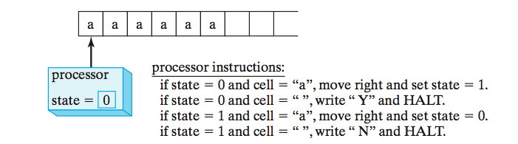
Impact of Turing's proof
Turing's proof of the Halting Problem in 1936 had profound impact
it proved that there are problems that are unsolvable
not only that, but easily understood (and potentially useful) unsolvable problems
for his proof, Turing introduced a simple, theoretical model of computation
a Turing Machine (TM) consists of:
a potentially infinite tape on which characters can be written
a processing unit that can read and write on the tape, move in either direction, and distinguish between a finite number of states
want to determine if even # of a's on tape

Slide 7
Example execution (even)
if in state 0 & read "a", then
write "a", move R, goto state 1
if in state 0 and read " ", then
write "Y", move right, goto HALT
if in state 1 & read "a", then
write "a", move R, goto state 0
if in state 1 and read " ", then
write "N", move right, goto HALT
a | a | a | a | _ | …
state 0
a | a | a | a | _ | …
state 1
a | a | a | a | _ | …
state 0
a | a | a | a | _ | …
state 1
a | a | a | a | _ | …
state 0
a | a | a | a | Y | …
HALT

Slide 8
Example execution (odd)
if in state 0 & read "a", then
write "a", move R, goto state 1
if in state 0 and read " ", then
write "Y", move right, goto HALT
if in state 1 & read "a", then
write "a", move R, goto state 0
if in state 1 and read " ", then
write "N", move right, goto HALT
a | a | a | _ | _ | …
state 0
a | a | a | _ | _ | …
state 1
a | a | a | _ | _ | …
state 0
a | a | a | _ | _ | …
state 1
a | a | a | N | _ | …
HALT

Slide 9
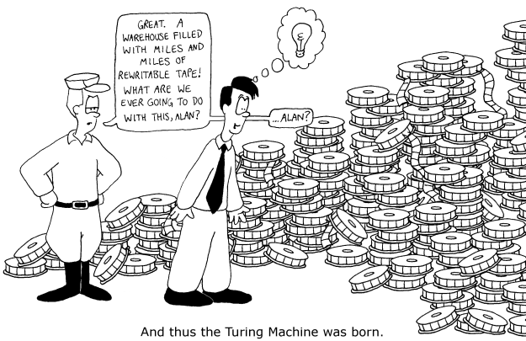

Slide 10
Church/Turing Thesis
Turing Machines provide a simple model of computation that is easier to reason with than code
Turing's proof of the undecidability of the Halting Problem used TMs
recall our proof relied on self reference: a program that can take another program (including itself) as input
similarly, a TM can take the program of any other TM as input and emulate that machine
Church/Turing Thesis: a TM is comparable to any other model of computation
→ proofs about the limitations of TMs apply to computation in general

Slide 11
Problem types: decision & optimization
the Halting Problem is an example of a decision problem
solving the problem requires answering a yes/no question
another common type of problem is an optimization problem
solving the problem requires finding the best/largest/shortest answer
e.g., shortest path, minimal spanning tree
many problems have decision and optimization versions
find the shortest path between vertices v₁ and v₂ in a graph
is there a path between v₁ and v₂ whose length is ≤ d
decision problems are more convenient for formal investigation of their complexity

Slide 12
Class P
P: the class of decision problems that are solvable in polynomial time O(N^{X})
i.e., the class of tractable decision problems
O(log N) binary search
add/remove/search a BST/AVL/red-black tree
add/remove/min a heap
O(N) sequential search
preorder/inorder/postorder of a binary tree
quick select (find kth largest value)
Boyer-Moore algorithm (search for pattern in string of N chars)
O(N log N) merge sort, quick sort, heap sort
Huffman coding (text compression)
closest pair on a plane
O(N²) insertion sort, selection sort
Prim’s algorithm (minimal spanning tree)
Dijkstra’s algorithm (shortest path)
O(N³) Floyd’s algorithm (all-pairs shortest path)

Slide 13
P or not?
interestingly, there are many important problems for which no polynomial-time algorithm has been devised
Knapsack Problem: Given a set of N items with integer weights and values, determine the most valuable subset that fits in a knapsack with limited capacity.
Traveling Salesman Problem: find the shortest Hamiltonian circuit in a complete graph)
Hamiltonian Circuit Problem: determine whether a graph has a path that starts and ends at the same vertex and passes through every other vertex once
Graph Coloring Problem: Determine the smallest number of colors needed so that adjacent vertices are different colors
Partition Problem: Given N positive integers, determine whether it is possible to partition them into two disjoint subsets with the same sum.
Bin-packing Problem: Given N items with varying sizes, determine the smallest number of uniform-capacity bins required to contain them.

Slide 14
Class NP
however, many of these problems fit into a (potentially) broader class
a nondeterministic polynomial algorithm is a two-stage procedure that:
generates a random string purported to solve the problem (guessing stage)
checks whether this solution is correct in polynomial time (verification stage)
NP: class of decision problems that can be solved by a nondeterministic polynomial algorithm
i.e., whose proposed solutions can be verified in polynomial time
example: Knapsack Decision Problem is in NP
given a subset of items, can verify their sum is ≥ X and weight is below limit in O(N)
example: Traveling Salesman Decision Problem is in NP
given a path of length N, can verify that it visits every city once, returns to the start city and sum of costs ≤ X in O(N)

Slide 15
P vs. NP
decision versions of Hamiltonian Cycle, Partition, Graph Coloring and many other optimization problems are also in NP
note that problems in P can also be solved using the 2-stage procedure
the guessing stage is unnecessary
the verification stage generates and verifies in polynomial time
so, P ⊆ NP
big question: does P = NP ?
considerable effort has gone into trying to find polynomial-time solutions to NP problems (without success)
most researchers believe they are not equal (i.e., P is a proper subset), but we don't know for sure
NP
? ?
?
P

Slide 16
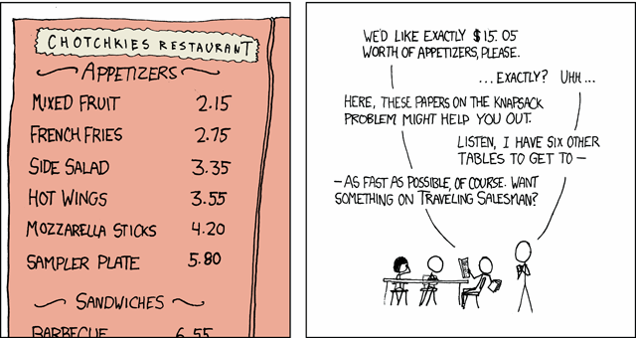

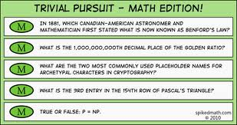
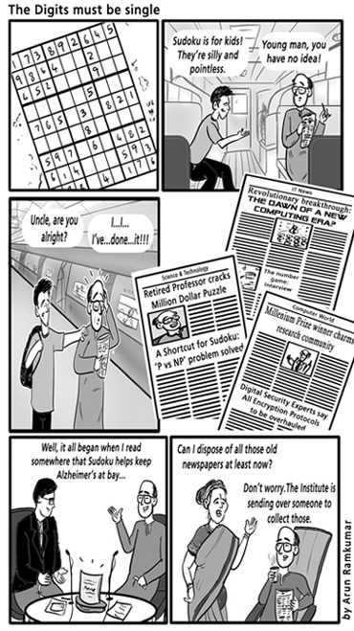
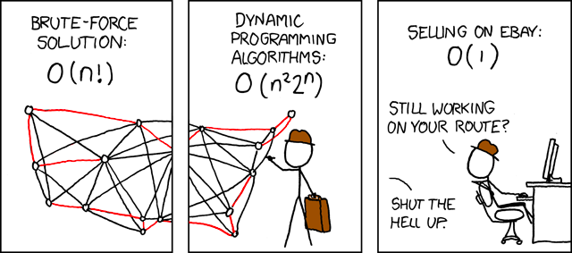
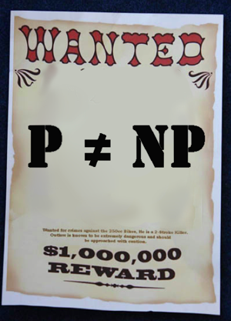
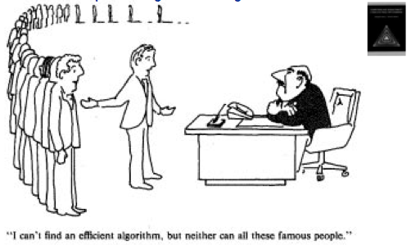


Slide 17
P, NP & Turing Machines
P and NP can alternatively be formulated in terms of Turing Machines
P is the class of decision problems that can be solved in polynomial time by a Turing Machine (TM)
NP is the class of decision problems that can be solved in polynomial time by a Non-deterministic Turing Machine (NTM)
an NTM allows for having multiple rules that can be applied in a state
e.g., if state = 4 and cell = ‘a’, can 1) move right and set state = 5 OR
2) move left and set state = 6
an NTM answers ‘yes’ if ANY sequence of transitions leads to the answer ‘yes’
in other words, it is greedy - can always guess the right one (equivalently, can think of it as trying all choices in parallel)
a → a, R
accept
if in s0 and read a, then
EITHER write a, move R, goto s0
OR write a, move R, goto accept
if in s0 and read anything else, then
write _, move R, goto reject
s0
a → a, R
? → _, R
reject

Slide 18
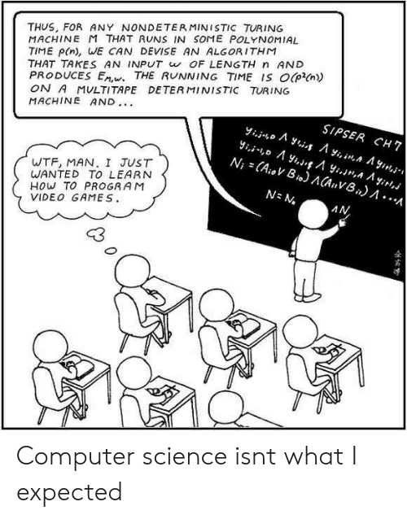
P, NP & Turing Machines
it has been shown that NTM’s and TM’s are equivalent in power
any problem that can be solved by a NTM can be solved by a TM
does this mean that P = NP?
NO!
not if the reduction can’t be done in polynomial time

Slide 19
NP-complete
while we don't know whether P = NP, we can identify extremes within NP
decision problem D₁ is polynomial-time reducible to D₂ if:
an instance of D₁ can be transformed into an instance of D₂ in polynomial time
this means D₂ is at least as hard as D₁
we say that decision problem D is NP-complete if:
D belongs to NP
every problem in NP is polynomial-time reducible to D
in short, an NP-complete problem is
as hard as any problem in NP

Slide 20
NP-complete example
the first problem proven to be NP-complete was BooleanSatisfiability (SAT)
given a Boolean expression, determine if it is satisfiable
e.g., (A ∨ B) ∧ (~B ∨ C) is true if A & C are true
SAT is clearly in NP
given true/false assignments to the terms, can evaluate the truth of the expression in polynomial time
to be NP-complete, every other NP problem must be polynomial-time reducible to it
proof idea (Cook, 1971):
for any problem in NP, can construct a non-deterministic (Turing) machine to solve it
for each input to that machine, can construct a Boolean expression that evaluates to true if the machine halts and answers "yes" on input
thus, original problem is reduced to determining whether the corresponding Boolean expression is satisfiable

Slide 21
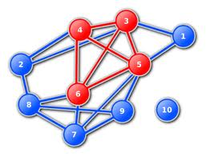
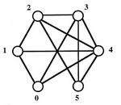
NP-complete reductions
if we can reduce SAT to another NP problem, then it is also NP-complete
SAT reduced to NewProb → NewProb at least as hard as SAT
→ but SAT is the hardest possible in NP
→ so NewProb is also hardest possible
→ NewProb is also NP-complete
Clique problem: given a graph with N vertices, is there a fully connected subgraph of C vertices?

Slide 22
SAT → Clique
can reduce the SAT problem to the Clique problem
given an instance of SAT, can transform it into conjunctive normal form
e.g., (A ∨ B) ∧ (~B ∨ C) ∧ (B ∨ C)
note: such an expression is satisfiable if there is at least one term in each disjunction that can be simultaneously true
e.g., (A ∨ B) ∧ (~B ∨ C) ∧ (B ∨ C)
construct a graph with a vertex for every term in the expression
color the vertices so that terms from the same disjunction are the same color
add an edge between two vertices if
the vertices are different colors, AND
the terms are not negations of each other
A
~B
B
C
B
C

Slide 23
SAT → Clique
A
~B
B
C
(A ∨ B) ∧ (~B ∨ C) ∧ (B ∨ C)
now, determine if there is a clique of size C, where C is the number of color groups)
if so, then the clique connects terms from each color group
e.g., greenA–redC ; redC–blueC ; blueC–greenA
the clique connects a term from each OR group
since no edges connect negations, all these terms can be simultaneously true
thus, the expression is satisfiable (A ∨ B) ∧ (~B ∨ C) ∧ (B ∨ C)
if not, then there is no way to assign so that each disjunction is true, so unsatisfiable
so, Clique is also NP-complete
B
C

Slide 24
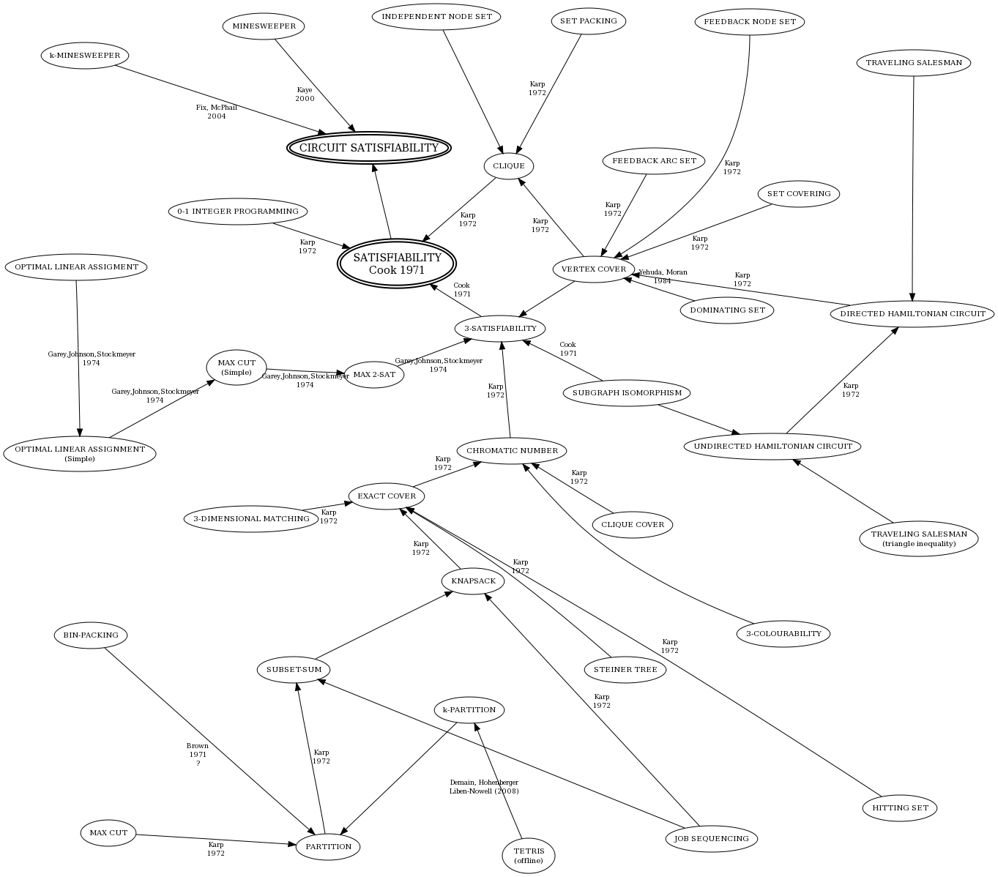

Slide 25
Implications of NP-completeness
an NP-complete problem is as hard as any problem in NP
i.e., all problems in NP reduce to it
discovering a polynomial solution to any NP-complete problem
would imply a polynomial solution to all problems in NP
would show P = NP
if P = NP, many problems currently thought to be intractable would be tractable
e.g., PrimeFactorization problem: decompose a number into its prime factors
the RSA encryption algorithm relies on the fact that factoring large numbers is intractable
if an efficient factorization algorithm were discovered, modern encryption could break
QUESTION: would it necessarily break?

Slide 26
Approximation algorithms
what if you need to solve a problem that is intractable?
in the case of optimization problems, approximation algorithms can be used
i.e., will find a solution, but it may not be optimal
Knapsack Problem (KP):
given N items (each with a value and weight) and a knapsack with weight capacity
want to find the subset of items that has optimal value without exceeding the knapsack weight capacity
example: given the following items and a knapsack with capacity 50 lbs.
tiara $5000 3 lbs
coins $2200 5 lbs
TV $2100 40 lbs
laptop $2000 8 lbs
silverware $1200 10 lbs
stereo $800 25 lbs
phone $600 1 lb
clock $300 4 lbs

Slide 27
Greedy approximations
tiara $5000 3 lbs
coins $2200 5 lbs
TV $2100 40 lbs
laptop $2000 8 lbs
silverware $1200 10 lbs
stereo $800 25 lbs
phone $600 1 lb
clock $300 4 lbs
1666
440
52.5
250
120
32
600
75
simple greedy approach:
repeatedly take the highest value item that fits, until capacity is reached
tiara + coins + TV + phone = $9,900 & 49 lbs
smarter greedy approach:
calculate the value/weight ratio, make greedy choices based on that
tiara + phone + coins + laptop + silverware + clock = $11,300 & 31 lbs
this happens to be the optimal choice, but this approach won’t always work
suppose there was also a vacuum worth $1400 and weighing 20 lbs.
its value/weight ratio is 70, which is less than the clock, but
tiara + phone + coin collection + laptop + silverware + vacuum = $12,400 & 47 lbs
it can be proven that the max from these two approaches > optimal/2

Slide 28
Genetic algorithms
many NP-hard problems have approximation algorithms
requires problem-specific techniques & analysis
generate & test is not tractable due to the size of the solution space
a genetic algorithm (GA) uses an evolutionary metaphor to perform a massive number of greedy searches in parallel
GAs were invented by psychologist/computer scientist John Holland in 1975
many real-world resource scheduling problems turn out to be NP-hard
e.g., Smart Airport Operations Center by Ascent Technology
uses GA for logistics: assign gates, direct baggage, direct service crews, …
considers diverse factors such as maintenance schedules, crew qualifications, shift changes, …
too many variables to juggle using a traditional algorithm (NP-hard)
GA is able to evolve sub-optimal schedules, improve performance
Ascent claims 30% increase in productivity (including SFO, Logan, Heathrow, …)

Slide 29
Genetic Algorithm (GA)
for a given problem, must define:
chromosome: bit string that represents a potential solution
fitness function: a measure of how good/fit a particular chromosome is
reproduction scheme: combining two parent chromosomes to yield offspring
mutation rate: likelihood of a random mutation in the chromosome
replacement scheme: replacing old (unfit) members with new offspring
termination condition: when is a solution good enough?
in general, the genetic algorithm:
start with an initial (usually random) population of chromosomes while the termination condition is not met
evaluate the fitness of each member of the population
select members of the population that are most fit
produce the offspring of these members via reproduction & mutation
replace the least fit member of the population with these offspring

Slide 30
GA example (cont.)
tiara $5000 3 lbs
coins $2200 5 lbs
TV $2100 40 lbs
laptop $2000 8 lbs
silverware $1200 10 lbs
stereo $800 25 lbs
phone $600 1 lb
clock $300 4 lbs
chromosome: a string of 8 bits with each bit corresponding to an item
1 implies that the corresponding item is included; 0 implies not included
e.g., 11100000 represents (tiara + coins + TV)
01101000 represents (coins + TV + silverware)
fitness function: favor collections with higher values
fit(chromosome) = sum of dollar amounts of items, or 0 if weight > 50
e.g., fit(11100000) = 9300
fit(01101000) = 0
reproduction scheme: utilize crossover (a common technique in GA's)
pick a random index, and swap left & right sides from parents
e.g., parents 11100000 and 01101000, pick index 4
1110|0000 and 0110|1000 yield offspring 11101000 and 01100000

Slide 31
GA example (cont.)
tiara $5000 3 lbs
coins $2200 5 lbs
TV $2100 40 lbs
laptop $2000 8 lbs
silverware $1200 10 lbs
stereo $800 25 lbs
phone $600 1 lb
clock $300 4 lbs
Generation 0 (randomly selected):
11100000 01101000 11001011 11010000
00010100 01001011 11110111 10011000
rank by fitness
11100000 (9300) 11001011 (9300) 11010000 (9200) 10011000 (8200)
01001011 (4300) 00010100 (2800) 01101000 (0) 11110111 (0)
select top half and perform crossover with possibility of mutation
111000|00 + 110010|11 → 11100011 11001001
110|10000 + 100|11000 → 11011000 10010000
replace least fit from Generation 0 with new
11100000 11001011 11010000 10011000
11100011 11001001 11011000 10010000

Slide 32
GA example (cont.)
tiara $5000 3 lbs
coins $2200 5 lbs
TV $2100 40 lbs
laptop $2000 8 lbs
silverware $1200 10 lbs
stereo $800 25 lbs
phone $600 1 lb
clock $300 4 lbs
Generation 1:
11100000 11001011 11010000 10011000
11100011 11001001 11011000 10010000
rank by fitness
11011000 (10400) 11100000 (9300) 11001011 (9300) 11010000 (9200)
11001001 (8700) 10011000 (8200) 10010000 (7000) 11100011 (0)
choose fittest 4, perform crossover with possibility of mutation
110|11000 + 111|00000 → 11000000 11111000
11001|011 + 11010|000 → 11001000 11010011
replace least fit from Generation 1 with new
11011000 11001011 11100000 11010000
11000000 11111000 11001000. 11010011

Slide 33
GA example (cont.)
tiara $5000 3 lbs
coins $2200 5 lbs
TV $2100 40 lbs
laptop $2000 8 lbs
silverware $1200 10 lbs
stereo $800 25 lbs
phone $600 1 lb
clock $300 4 lbs
Generation 2:
11011000 11001011 11100000 11010000
11000000 11111000 11001000 11010011
rank by fitness
11011000 (10400) 11010011 (10100) 11001011 (9300) 11100000 (9300)
11001000 (8400) 11010000 (9200) 11000000 (7200) 11111000 (0)
choose fittest 4, perform crossover with possibility of mutation
110110|00 + 110100|11 → 11011011 11010000
1100|1011 + 1110|0000 → 11000100 11101011
replace least fit from Generation 2 with new
11011000 11010011 11001011 11100000
11011011 11010000 11000100 11101011

Slide 34
GA example (cont.)
tiara $5000 3 lbs
coins $2200 5 lbs
TV $2100 40 lbs
laptop $2000 8 lbs
silverware $1200 10 lbs
stereo $800 25 lbs
phone $600 1 lb
clock $300 4 lbs
Generation 3:
11011000 11010011 11001011 11100000
11011011 11010000 11000100 11101011
rank by fitness
11011011 (11300) 11011000 (10400) 11010011 (10100) 11001011 (9300)
11100000 (9300) 11010000 (9200) 11000100 (8000) 11101011 (0)
.
.
.
when do you stop?
when the best solution is "good enough"
when the best solution hasn't changed after N consecutive generations
when you run out of time

