Slide 1
CSC 421: Algorithm Design and Analysis
Fall 2024
Brute force approach & efficiency
  brute force design
  KISS vs. generality
  exhaustive search: string matching
  generate & test: N-queens, TSP, Knapsack
  inheritance & efficiency
    ArrayList → SortedArrayList

Slide 2
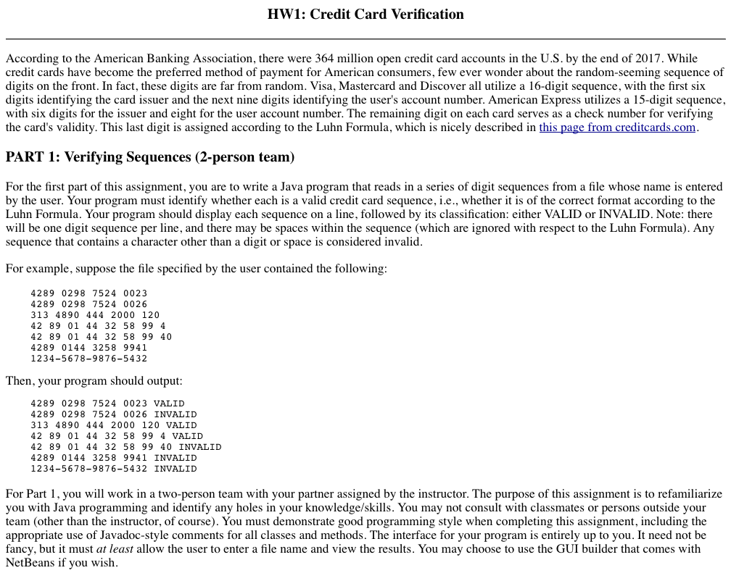
HW from past 222/321

Slide 3
public class CardDriver {
public static void main(String[] args) {
Scanner input = new Scanner(System.in);
System.out.print("Enter the file of credit card numbers: ");
try {
Scanner infile = new Scanner(new File(input.next()));
while (infile.hasNextLine()) {
String number = infile.nextLine().trim();
String cleanNum = number.replace(" ", "");
boolean validFormat = true;
for (int i = 0; i < cleanNum.length(); i++) {
if (!Character.isDigit(cleanNum.charAt(i))) {
validFormat = false;
}
}
int sum = 0;
for (int i = 0; i < cleanNum.length(); i++) {
if (cleanNum.length() % 2 == i % 2) {
int twiceValue = 2 * (cleanNum.charAt(i) - '0');
if (twiceValue > 9) {
twiceValue = 1 + (twiceValue % 10);
}
sum += twiceValue;
} else {
sum += (cleanNum.charAt(i) - '0');
}
}
boolean validSequence = (sum % 10 == 0);
if (validFormat && validSequence) {
System.out.println(number + " VALID");
} else {
System.out.println(number + " INVALID");
}
}
} catch (java.io.FileNotFoundException e) {
System.out.println("File not found.");
}
}
}
  Brute force design
  prompt for file name
  read in each card number from file
  remove spaces and check for non-digits
  check digits using Luhn Formula
  display status of each number

Slide 4
Adding modularity
this brute force approach works, but is difficult to read and modify
one simple step is to add modularity (via helper methods)
private static boolean isValidFormat(String num) {
for (int i = 0; i < num.length(); i++) {
if (!Character.isDigit(num.charAt(i))) {
return false;
}
}
return true;
}
private static boolean isValidSequence(String num) {
int sum = 0;
for (int i = 0; i < num.length(); i++) {
if (num.length() % 2 == i % 2) {
int twiceValue = 2 * (num.charAt(i) - '0');
if (twiceValue > 9) {
twiceValue = 1 + (twiceValue % 10);
}
sum += twiceValue;
}
else {
sum += (num.charAt(i) - '0');
}
}
return sum % 10 == 0;
}

Slide 5
Modular version
helper methods make the main method simpler, more readable
public class CardDriver {
public static void main(String[] args) {
Scanner input = new Scanner(System.in);
System.out.print("Enter the file of credit card numbers: ");
try {
Scanner infile = new Scanner(new File(input.next()));
while (infile.hasNextLine()) {
String number = infile.nextLine().trim();
String cleanNum = number.replace(" ", "");
if (CardDriver.isValidFormat(cleanNum) &&
CardDriver.isValidSequence(cleanNum)) {
System.out.println(number + " VALID");
}
else {
System.out.println(number + " INVALID");
}
}
}
catch (java.io.FileNotFoundException e) {
System.out.println("File not found.");
}
}
// HELPER METHODS HERE
}

Slide 6
Adding objects
object-oriented approach: identify objects that can be modeled with code
classes encapsulate the data and behaviors of objects
easier to develop, test, and reuse
public class CardNumber {
private String number;
private String cleanNum;
public CardNumber(String num) {
this.number = num.trim();
this.cleanNum = this.number.replace(" ", "");
}
public boolean isValidFormat() {
// SIMILAR TO PREVIOUSLY SHOWN METHOD
}
public boolean isValidSequence() {
// SIMILAR TO PREVIOUSLY SHOWN METHOD
}
public String toString() {
return number;
}
}

Slide 7
OO version
can then define a separate, simple driver class
public class CardDriver {
public static void main(String[] args) {
Scanner input = new Scanner(System.in);
System.out.print("Enter the file of credit card numbers: ");
try {
Scanner infile = new Scanner(new File(input.next()));
while (infile.hasNextLine()) {
CardNumber number = new CardNumber(infile.nextLine());
if (number.isValidFormat() && number.isValidSequence()) {
System.out.println(number + " VALID");
}
else {
System.out.println(number + " INVALID");
}
}
}
catch (java.io.FileNotFoundException e) {
System.out.println("File not found.");
}
}
}

Slide 8
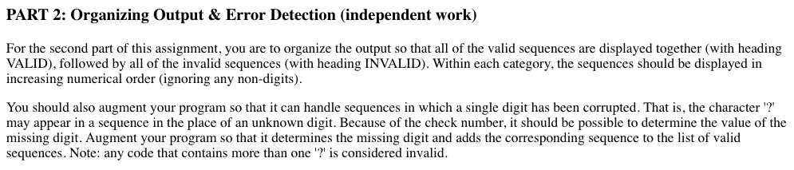
Brute force
if you have a one-time task of checking a file of credit card numbers,
  any of these three approaches is fine
  it could be argued that helper methods and/or classes will speed up testing & debugging, so worth it
in the real-world, problem-solving is rarely a one-time task
  you may need to go back and revise your solution as specifications change
  you may want to reuse parts of your solution

Slide 9
Extension
public class CardNumber implements Comparable<CardNumber> {
private String number;
private String cleanNum;
public CardNumber(String num) {
this.number = num.trim();
this.cleanNum = this.number.replace(" ", "");
int first = this.number.indexOf('?');
int last = this.number.lastIndexOf('?');
if (first != -1 && first == last) {
this.fixNumber();
}
}
public boolean isValidFormat() { /* AS BEFORE */ }
public boolean isValidSequence() { /* AS BEFORE */ }
public String toString() { return number; }
public int compareTo(CardNumber other) {
return this.cleanNum.compareTo(other.cleanNum);
}
//////////////////////////////////////////////////////////////
private void fixNumber() {
String safeNum = this.number;
for (int i = 0; i < 10; i++) {
this.number = safeNum.replace('?', (char)('0'+i));
this.cleanNum = this.number.replace(" ", "");
if (this.isValidFormat() && this.isValidSequence()) {
return;
}
}
this.number = safeNum;
this.cleanNum = this.number.replace(" ", "");
}
}
the OO version is easily extensible
to handle ordering, implement the Comparable interface
to handle error correction, add a method for fixing a corrupted digit

Slide 10
Extension
public class CardChecker {
private ArrayList<CardNumber> validNumbers;
private ArrayList<CardNumber> invalidNumbers;
public CardChecker() {
this.validNumbers = new ArrayList<CardNumber>();
this.invalidNumbers = new ArrayList<CardNumber>();
}
public void storeCC(CardNumber number) {
if (number.isValidFormat() && number.isValidSequence()) {
this.validNumbers.add(number);
}
else {
this.invalidNumbers.add(number);
}
}
public String toString() {
return "VALID\n" + this.stringify(this.validNumbers) +
"\nINVALID\n" + this.stringify(this.invalidNumbers);
}
//////////////////////////////////////////////////////////////
private String stringify(ArrayList<CardNumber> nums) {
Collections.sort(nums);
String message = "";
for (CardNumber num : nums) {
message += num + "\n";
}
return message;
}
}
add a CardChecker class that will separate valid & invalid numbers
since CardNumbers are Comparable, can use Collections.sort to order the two lists
note: neither class does I/O

Slide 11
Extension
the driver is solely responsible for I/O
all program logic is handled by objects
Model-View-Controller pattern
  model implements the logic of the solution (here, CardNumber & CardChecker)
  view is the interface the user uses (here, terminal window & keyboard)
  controller connects the two, performs I/O (here, CardDriver)
public class CardDriver {
public static void main(String[] args) {
Scanner input = new Scanner(System.in);
System.out.print("Enter the file of numbers: ");
try {
Scanner infile = new Scanner(new File(input.next()));
while (infile.hasNext()) {
String numStr = infile.nextLine();
checker.storeCC(new CardNumber(numStr));
}
System.out.println(checker);
}
catch (java.io.FileNotFoundException e) {
System.out.println("File not found.");
}
}
}

Slide 12
Brute force
many algorithms can be characterized as brute force as well
  utilize a straightforward approach, maybe not the most efficient or extensible
  consider the exponentiation application
    simple, iterative version: a^{b} = a * a * a * … * a (b times)
    recursive version: a^{b} = a^{b/2} * a^{b/2}
    while the recursive version is more efficient, O(log N) vs. O(N), is it really worth it?
brute force works fine when
  the problem size is small
  only a few instances of the problem need to be solved
  need to build a prototype to study the problem

Slide 13
Exhaustive search: string matching
  consider the task of the String indexOf method
  find the first occurrence of a desired substring in a string
  this problem occurs in many application areas, e.g., DNA sequencing
    CGGTAGCTTGCCTAGGAGGCTTCTCATAGAGCTCGATCGGTACG…
    TAGAG

Slide 14
Exhaustive string matching
the brute force/exhaustive approach is to sequentially search
    CGGTAGCTTGCCTAGGAGGCTTCTCATAGAGCTCGATCGGTACG…
    CGGTAGCTTGCCTAGGAGGCTTCTCATAGAGCTCGATCGGTACG…
    CGGTAGCTTGCCTAGGAGGCTTCTCATAGAGCTCGATCGGTACG…
    CGGTAGCTTGCCTAGGAGGCTTCTCATAGAGCTCGATCGGTACG…
    …
    CGGTAGCTTGCCTAGGAGGCTTCTCATAGAGCTCGATCGGTACG…
public static int indexOf(String seq, String desired) {
for (int start = 0; start <= seq.length() – desired.length(); start++) {
String sub = seq.substring(start, start+desired.length());
if (sub.equals(desired)) {
return start;
}
}
return -1;
}
efficiency of search?
we can do better (more later) – do we need to?

Slide 15
Generate & test
sometimes exhaustive algorithms are referred to as "generate & test"
  can express algorithm as generating each candidate solution systematically, testing each to see if the candidate is actually a solution
  string matching: try seq.substring(0, desired.length())
  if no match, try seq.substring(1, desired.length()+1)
  if no match, try seq.substring(2, desired.length()+2) …
extreme (and extremely bad) example – permu-sort
  to sort a list of items, generate every permutation and test to see if in order
  efficiency?

Slide 16
Generate & test: N-queens
given an NxN chess board, place a queen on each row so that no queen is in jeopardy
generate & test approach
  systematically generate every possible arrangement
  test each one to see if it is a valid solution
this will work (in theory), but the size of the search space may be prohibitive
  4x4 board →
  8x8 board →
= 1,820 arrangements
again, we can do better (more later)
4! = 24 arrangements
= 131,198,072 arrangements
8! = 40,320 arrangements

Slide 17
nP-hard problems: traveling salesman
there are some problems for which there is no known "efficient" algorithm (i.e., nothing polynomial) → known as nP-hard problems (more later)
generate & test may be the only option
Traveling Salesman Problem: A salesman must make a complete tour of a given set of cities (no city visited twice except start/end city) such that the total distance traveled is minimized.
example: find the shortest tour given this map
generate & test → try every possible route
efficiency?

Slide 18
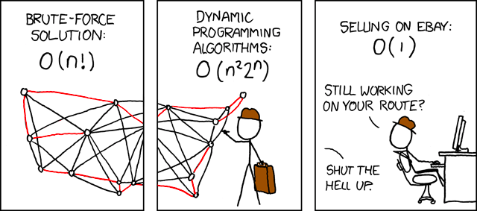
xkcd: Traveling Salesman Problem comic
a dynamic programming approach (more later) can improve performance slightly, but still intractable for reasonably large N

Slide 19
nP-hard problems: knapsack problem
another nP-hard problem:
Knapsack Problem: Given N items of known weights w₁,…,w_{N} and values v₁,…,v_{N} and a knapsack of capacity W, find the highest-value subset of items that fit in the knapsack.
example: suppose a knapsack with capacity of 50 lb. Which items do you take?
      tiara $5000 3 lbs
      coin collection $2200 5 lbs
      TV $2100 40 lbs
      laptop $2000 8 lbs
      silverware $1200 10 lbs
      stereo $800 25 lbs
      cell phone $600 1 lb
      clock $300 4 lbs
generate & test solution:
  try every subset & select the one with greatest value

Slide 20
Dictionary revisited
import java.util.List;
import java.util.ArrayList;
import java.util.Scanner;
import java.io.File;
public class Dictionary {
private List<String> words;
public Dictionary() {
this.words = new ArrayList<String>();
}
public Dictionary(String filename) {
this();
try {
Scanner infile = new Scanner(new File(filename));
while (infile.hasNext()) {
String nextWord = infile.next();
this.words.add(nextWord.toLowerCase());
}
}
catch (java.io.FileNotFoundException e) {
System.out.println("FILE NOT FOUND");
}
}
public void add(String newWord) {
this.words.add(newWord.toLowerCase());
}
public void remove(String oldWord) {
this.words.remove(oldWord.toLowerCase());
}
public boolean contains(String testWord) {
return this.words.contains(testWord.toLowerCase());
}
}
recall the Dictionary class earlier
  the ArrayList add method simply appends the item at the end → O(1)
  the ArrayList contains method performs sequential search → O(N)
this is OK if we are doing lots of adds and few searches

Slide 21
StopWatch
public class StopWatch {
private long lastStart;
private long lastElapsed;
private long totalElapsed;
public StopWatch() {
this.reset();
}
public void start() {
this.lastStart = System.currentTimeMillis();
}
public void stop() {
long stopTime = System.currentTimeMillis();
if (this.lastStart != -1) {
this.lastElapsed = stopTime - this.lastStart;
this.totalElapsed += this.lastElapsed;
this.lastStart = -1;
}
}
public long getElapsedTime() {
return this.lastElapsed;
}
public long getTotalElapsedTime() {
return this.totalElapsed;
}
public void reset() {
this.lastStart = -1;
this.lastElapsed = 0;
this.totalElapsed = 0;
}
}
big-Oh analysis is good for understanding long-term growth
sometimes, you want absolute timings to compare algorithm performance on real data

Slide 22
Timing dictionary searches
we can use our StopWatch class to verify the O(N) efficiency
  dict. size build time
  38,621 401 msec
  77,242 612 msec
  144,484 1123 msec
  dict. size search time
  38,621 1.10 msec
  77,242 2.61 msec
  144,484 5.01 msec
execution time roughly doubles as dictionary size doubles
import java.util.Scanner;
import java.io.File;
public class DictionaryTimer {
public static void main(String[] args) {
System.out.println("Enter name of dictionary:");
Scanner input = new Scanner(System.in);
String dictFile = input.next();
StopWatch timer = new StopWatch();
timer.start();
Dictionary dict = new Dictionary(dictFile);
timer.stop();
System.out.println(timer.getElapsedTime());
timer.start();
for (int i = 0; i < 100; i++) {
dict.contains("zzyzyba");
}
timer.stop();
System.out.println(timer.getElapsedTime()/100.0);
}
}

Slide 23
Sorting the list
if searches were common, then we might want to make use of binary search
  this requires sorting the words first, however
we could change the Dictionary class to do the sorting and searching
  a more general solution would be to extend the ArrayList class to SortedArrayList
  could then be used in any application that called for a sorted list
recall:
    public class java.util.ArrayList<E> implements List<E> {
    public ArrayList() { … }
    public boolean add(E item) { … }
    public void add(int index, E item) { … }
    public E get(int index) { … }
    public E set(int index, E item) { … }
    public int indexOf(Object item) { … }
    public boolean contains(Object item) { … }
    public boolean remove(Object item) { … }
    public E remove(int index) { … }
    . . .
    }

Slide 24
SortedArrayList (v.1)
using inheritance, we only need to redefine what is new
  add method sorts after adding; indexOf uses binary search
  no additional fields required
  big-Oh for add? big-Oh for indexOf?
import java.util.ArrayList;
import java.util.Collections;
public class SortedArrayList<E extends Comparable<? super E>> extends ArrayList<E> {
public SortedArrayList() {
super();
}
public boolean add(E item) {
super.add(item);
Collections.sort(this);
return true;
}
public int indexOf(Object item) {
return Collections.binarySearch(this, (E)item);
}
}

Slide 25
SortedArrayList (v.2)
is this version any better? when?
  big-Oh for add?
  big-Oh for indexOf?
import java.util.ArrayList;
import java.util.Collections;
public class SortedArrayList<E extends Comparable<? super E>> extends ArrayList<E> {
public SortedArrayList() {
super();
}
public boolean add(E item) { // NOTE: COULD REMOVE THIS METHOD AND
super.add(item); // JUST INHERIT THE ADD METHOD FROM
return true; // ARRAYLIST AS IS
}
public int indexOf(Object item) {
Collections.sort(this);
return Collections.binarySearch(this, (E)item);
}
}

Slide 26
SortedArrayList (v.3)
if insertions and searches are mixed, sorting for each insertion/search is extremely inefficient
  instead, could take the time to insert each item into its correct position
  big-Oh for add? big-Oh for indexOf?
import java.util.ArrayList;
import java.util.Collections;
public class SortedArrayList<E extends Comparable<? super E>> extends ArrayList<E> {
public SortedArrayList() {
super();
}
public boolean add(E item) {
int i;
for (i = 0; i < this.size(); i++) {
if (item.compareTo(this.get(i)) < 0) {
break;
}
}
super.add(i, item);
return true;
}
public int indexOf(Object item) {
return Collections.binarySearch(this, (E)item);
}
}
search from the start vs. from the end?

Slide 27
Dictionary using SortedArrayList
note that repeated calls to add serve as insertion sort
  dict. size build time
  38,621 29.2 sec
  77,242 127.9 sec
  144,484 526.2 sec
  dict. size search time
  38,621 0.0 msec
  77,242 0.0 msec
  144,484 0.1 msec
build time roughly quadruples as dictionary size doubles; search time is trivial
import java.util.Scanner;
import java.io.File;
import java.util.Date;
public class DictionaryTimer {
public static void main(String[] args) {
System.out.println("Enter name of dictionary:");
Scanner input = new Scanner(System.in);
String dictFile = input.next();
StopWatch timer = new StopWatch();
timer.start();
Dictionary dict = new Dictionary(dictFile);
timer.stop();
System.out.println(timer.getElapsedTime());
timer.start();
for (int i = 0; i < 100; i++) {
dict.contains("zzyzyba");
}
timer.stop();
System.out.println(timer.getElapsedTime()/100.0);
}
}

Slide 28
SortedArrayList (v.4)
if adds tend to be done in groups (as in loading the dictionary)
  it might pay to perform lazy insertions & keep track of whether sorted
  big-Oh for add? big-Oh for indexOf?
  if desired, could still provide addInOrder method (as before)
import java.util.ArrayList;
import java.util.Collections;
public class SortedArrayList<E extends Comparable<? super E>> extends ArrayList<E> {
private boolean isSorted;
public SortedArrayList() {
super();
this.isSorted = true;
}
public boolean add(E item) {
this.isSorted = false;
return super.add(item);
}
public int indexOf(Object item) {
if (!this.isSorted) {
Collections.sort(this);
this.isSorted = true;
}
return Collections.binarySearch(this, (E)item);
}
}

Slide 29
Timing the lazy dictionary on searches
modify the Dictionary class to use the lazy SortedArrayList
  dict. size build time
  38,621 340 msec
  77,242 661 msec
  144,484 1113 msec
  dict. size 1st search
  38,621 10 msec
  77,242 61 msec
  144,484 140 msec
  dict. size search time
  38,621 0.0 msec
  77,242 0.0 msec
  144,484 0.1 msec
import java.util.Scanner;
import java.io.File;
import java.util.Date;
public class DictionaryTimer {
public static void main(String[] args) {
System.out.println("Enter name of dictionary:");
Scanner input = new Scanner(System.in);
String dictFile = input.next();
StopWatch timer = new StopWatch()
timer.start();
Dictionary dict = new Dictionary(dictFile);
timer.stop();
System.out.println(timer.getElapsedTime());
timer.start();
dict.contains("zzyzyba");
timer.stop();
System.out.println(timer.getElapsedTime());
timer.start();
for (int i = 0; i < 100; i++) {
dict.contains("zzyzyba");
}
timer.stop();
System.out.println(timer.getElapsedTime()/100.0);
}
}

