Slide 1
CSC 421: Algorithm Design and Analysis
Fall 2024
Backtracking
  greedy vs. generate & test vs. backtracking (DFS)
  examples:
    N-queens, Sudoku, 2-D gels, Boggle
  problem characteristics
  branch & bound
  game trees

Slide 2
Greed is good?
IMPORTANT: the greedy approach is not applicable to all problems
  but when applicable, it is very effective (no planning or coordination necessary)
GREEDY approach for N-Queens: start with first row, find a valid position in current row, place a queen in that position then move on to the next row
since queen placements are not independent, local choices do not necessarily lead to a global solution
GREEDY does not work – need a more holistic approach

Slide 3

Generate & test?
recall the generate & test solution to N-queens
  systematically generate every possible arrangement
  test each one to see if it is a valid solution
= 1,820 arrangements
fortunately, we can do better if we recognize that choices can constrain future choices
  e.g., any board arrangement with a queen at (1,1) and (2,1) is invalid
  no point in looking at the other queens, so can eliminate 55 boards from consideration
  similarly, queen at (1,1) and (2,2) is invalid, so eliminate another 45 boards

Slide 4
Backtracking
backtracking is a smart way of doing generate & test
  view a solution as a sequence of choices/actions (similar to GREEDY)
  when presented with a choice, pick one (similar to GREEDY)
  however, reserve the right to change your mind and backtrack to a previous choice (unlike GREEDY)
  you must remember alternatives:
    if a choice does not lead to a solution, back up and try an alternative
  eventually, backtracking will find a solution or exhaust all alternatives
backtracking is essentially depth first search
  add ability to prune a path as soon as we know it can't succeed
  when that happens, back up and try another path

Slide 5
N-Queens psuedocode
/**
* Fills the board with queens starting at specified row
* (Assumes queens have already been placed in rows 0 to row-1.)
*/
private boolean placeQueens(int row) {
if (ROW EXTENDS BEYOND BOARD) {
return true;
}
else {
for (EACH COL IN ROW) {
ADD QUEEN AT [ROW][COL]
if (NO CONFLICT && this.placeQueens(row+1)) {
return true;
}
REMOVE QUEEN FROM [ROW][COL]
}
return false;
}
}
BASE CASE: if all queens have been placed, return true
place a queen in available column
RECURSIVE CASE: try to place remaining queens; if successful, then return true
otherwise, remove the queen and continue looping to try other columns
return false if unable to place queens

Slide 6
Why does backtracking work?
backtracking burns no bridges – all choices are reversible
it provides a systematic way of trying all paths (sequences of choices) until a solution is found
  assuming the search tree is finite, will eventually find a solution or exhaust the entire search space
it is different from generate & test in that choices are made sequentially
  earlier choices constrain later ones
  can avoid searching entire branches




 | 

 |  | 
X
X

 |  | 


 |  | 
 | 

 |  | 
 |  | 

 |  | 
 |  |  | 
X
X
X
X

Slide 7
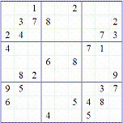
Sudoku
Sudoku is a popular puzzle where you fill in a 9x9 grid with numbers
  each row & col & subsquare contains the numbers 1-9 (with no duplicates)
  note: there are 16x16 and 25x25 extensions as well

Slide 8
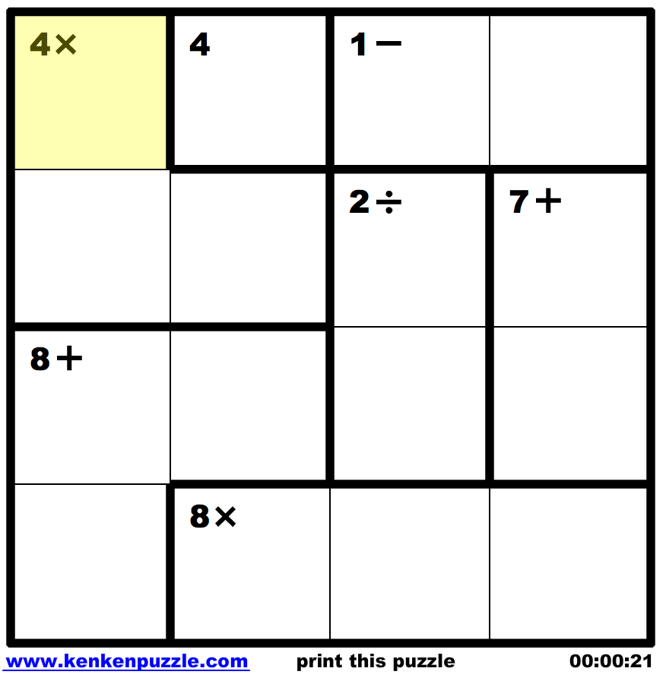
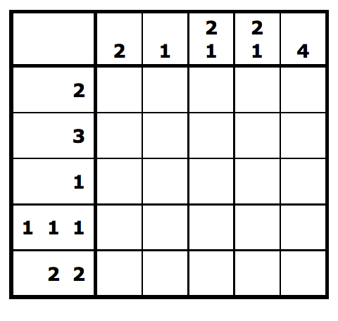
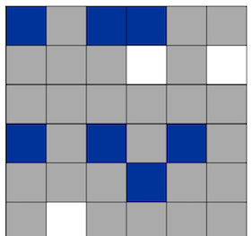
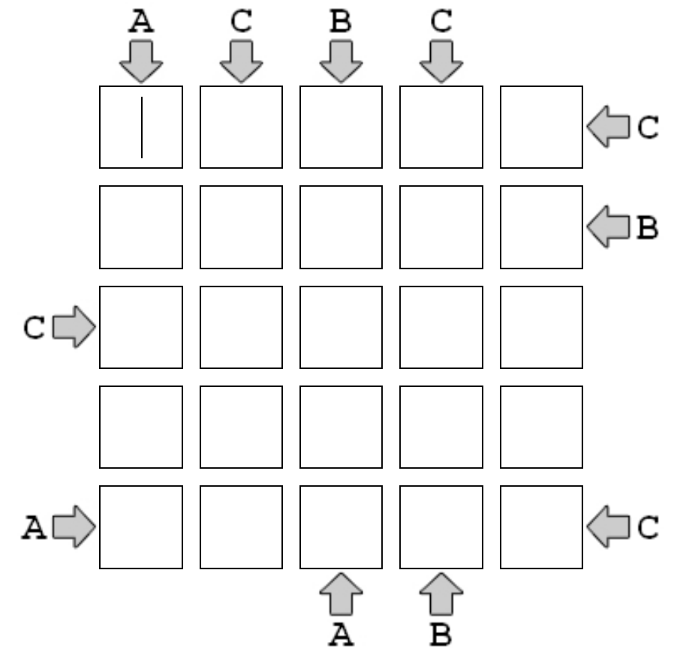
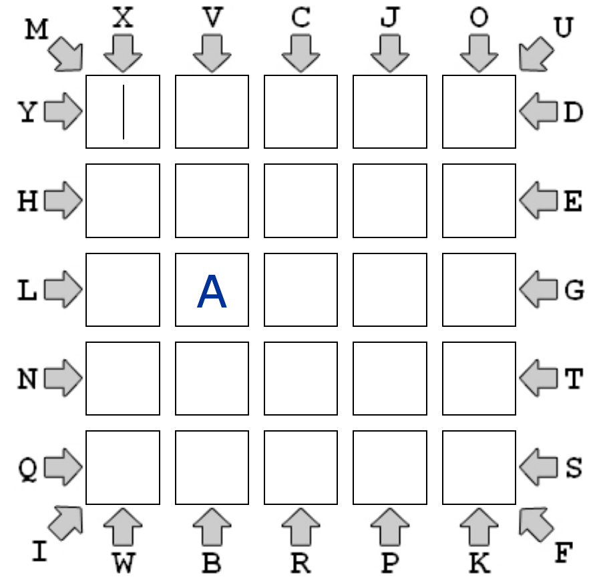
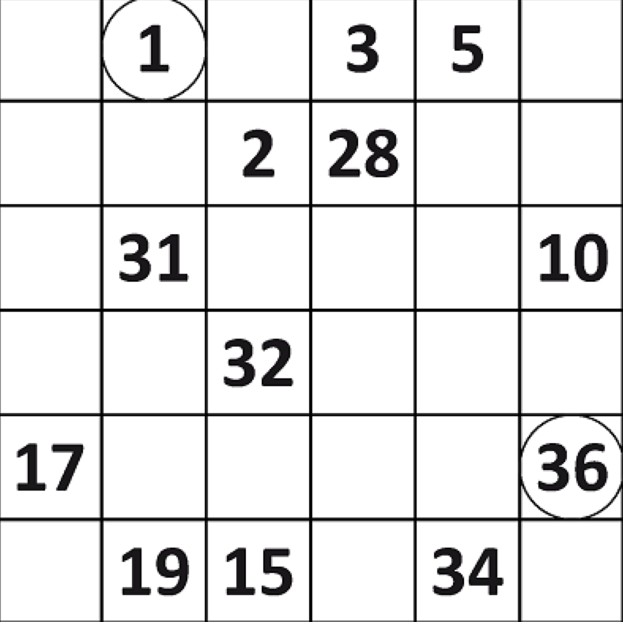
Grid-based puzzles
Sudoku is similar to many grid-based puzzles (see Brainbashers.com)
  KenKen, Nonogrids, 3-in-a-row, ABC Views, ABC Paths, Hidoku, …
  all are based on filling a grid with values (numbers, colors, letters, …) that meet some constraints

Slide 9
Generic puzzle-solving approach
while the grid is not full
  find an empty cell
  for each possible value (number, color, letter, …)
    place the value in the cell
    if no conflict occurs,
    recursively try to fill in the rest
    if successful, then done
    remove the value and continue looping

Slide 10
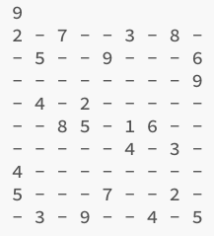
Sudoku solver
public class Sudoku {
private String[][] grid;
public Sudoku(String filename) throws java.io.FileNotFoundException {
Scanner infile = new Scanner(new File(filename));
int gridSize = infile.nextInt();
this.grid = new String[gridSize][gridSize];
for (int r = 0; r < gridSize; r++) {
for (int c = 0; c < gridSize; c++) {
this.grid[r][c] = infile.next();
}
}
}
public int size() {
return this.grid.length;
}
public String toString() {
// RETURNS STRING REPRESENTATION OF THE GRID
}

Slide 11
Solving via recursive backtracking
public boolean solve() {
return this.solve(0, 0);
}
private boolean solve(int row, int col) {
if (row == this.size()) {
return true;
}
else if (col == this.size()) {
return this.solve(row+1, 0);
}
else if (!this.grid[row][col].equals("-")) {
return this.solve(row, col+1);
}
else {
for (int i = 1; i <= this.size(); i++ ) {
this.grid[row][col] = ""+i;
if (!this.hasConflict(row, col) && this.solve(row, col+1)) {
return true;
}
this.grid[row][col] = "-";
}
}
return false;
}
if past last row, DONE
if past last col, wrap
if already filled, skip

Slide 12
Helper method to check for conflicts
private boolean hasConflict(int row, int col) {
String piece = this.grid[row][col];
for (int n = 0; n < this.size(); n++) {
if ((col != n && this.grid[row][n].equals(piece)) ||
(row != n && this.grid[n][col].equals(piece))) {
return true;
}
}
int squareSide = (int)Math.sqrt(this.grid.length);
int baseRow = squareSide * (row/squareSide);
int baseCol = squareSide * (col/squareSide);
for (int r = baseRow; r < baseRow+squareSide; r++) {
for (int c = baseCol; c < baseCol+squareSide; c++) {
if ((row != r || col != c) && this.grid[r][c].equals(piece)) {
return true;
}
}
}
return false;
}
}
check if in same row or column
check if in subsquare

Slide 13
HW5
you will generalize the Sudoku class to work for various puzzles
Puzzle class is an abstract class that contains
  the board (2D array of Strings)
  has size and toString methods
  has solve method that uses recursive backtracking
Sudoku class will have Sudoku-specific details
  read in initial board from a file
  specify the possible values that go into the grid
  define the hasConflict helper
can easily be applied to other puzzles

Slide 14
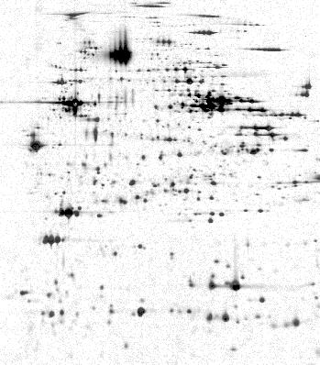
Another example: blob count
application: 2-D gel electrophoresis
  biologists use electrophoresis to produce a gel image of cellular material
  each "blob" (contiguous collection of dark pixels) represents a protein
  identify proteins by matching the blobs up with another known gel image
we would like to identify each blob, its location and size
  location is highest & leftmost pixel in the blob
  size is the number of contiguous pixels in the blob
  in this small image: Blob at [0][1]: size 5
    Blob at [2][7]: size 1
    Blob at [6][0]: size 4
    Blob at [6][6]: size 4
  can use backtracking to locate & measure blobs

Slide 15
Blob count (cont.)
can use recursive backtracking to get a blob's size
  when find a spot:
    1 (for the spot) +
    size of all connected subblobs (adjacent to spot)
note: we must not double count any spots
  when a spot has been counted, must "erase" it
  keep it erased until all blobs have been counted
private int blobSize(int row, int col) {
if (OFF THE GRID || NOT A SPOT) {
return 0;
}
else {
ERASE SPOT;
return 1 + this.blobSize(row-1, col-1)
+ this.blobSize(row-1, col)
+ this.blobSize(row-1, col+1)
+ this.blobSize( row, col-1)
+ this.blobSize( row, col+1)
+ this.blobSize(row+1, col-1)
+ this.blobSize(row+1, col)
+ this.blobSize(row+1, col+1);
}
}
pseudocode:

Slide 16
Blob count (cont.)
public class Gel{
private char[][] grid;
. . .
public void findBlobs() {
for (int row = 0; row < this.grid.length; row++) {
for (int col = 0; col < this.grid.length; col++) {
if (this.grid[row][col] == '*') {
System.out.println("Blob at [" + row + "][" +
col + "] : size " +
this.blobSize(row, col));
}
}
}
for (int row = 0; row < this.grid.length; row++) {
for (int col = 0; col < this.grid.length; col++) {
if (this.grid[row][col] == 'O') {
this.grid[row][col] = '*';
}
}
}
}
private int blobSize(int row, int col) {
if (row < 0 || row >= this.grid.length ||
col < 0 || col >= this.grid.length ||
this.grid[row][col] != '*') {
return 0;
}
else {
this.grid[row][col] = 'O';
return 1 + this.blobSize(row-1, col-1)
+ this.blobSize(row-1, col)
+ this.blobSize(row-1, col+1)
+ this.blobSize( row, col-1)
+ this.blobSize( row, col+1)
+ this.blobSize(row+1, col-1)
+ this.blobSize(row+1, col)
+ this.blobSize(row+1, col+1);
}
}
}
findBlobs traverses the image, checks each grid pixel for a blob
blobSize uses backtracking to expand in all directions once a blob is found
each pixel is "erased" after it is processed in blobSize to avoid double-counting (& infinite recursion)
the image is restored at the end of findBlobs

Slide 17
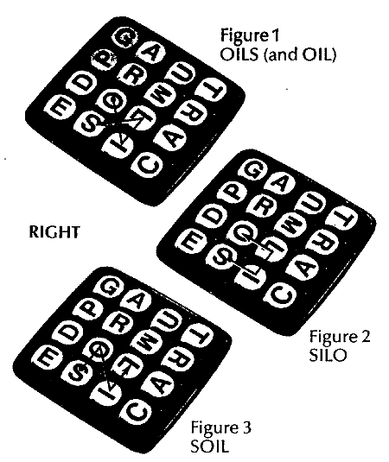
Another example: Boggle
recall the game
  random letters are placed in a 4x4 grid
  want to find words by connecting adjacent letters (cannot reuse the same letter)
  for each word found, the player earns points = length of the word
  the player who earns the most points after 3 minutes wins
how do we automate the search for words?

Slide 18
Boggle (cont.)
G | A | U | T
P | R | M | R
D | O | L | A
E | S | I | C
can use recursive backtracking to search for a word
  when the first letter is found:
    remove first letter & recursively search for remaining letters
again, we must not double count any letters
  must "erase" a used letter, but then restore for later searches
private boolean findWord(String word, int row, int col) {
if (WORD IS EMPTY) {
return true;
}
else if (OFF_THE_GRID || GRID LETTER != FIRST LETTER OF WORD) {
return false;
}
else {
ERASE LETTER;
String rest = word.substring(1, word.length());
boolean result = this.findWord(rest, row-1, col-1) ||
this.findWord(rest, row-1, col) ||
this.findWord(rest, row-1, col+1) ||
this.findWord(rest, row, col-1) ||
this.findWord(rest, row, col+1) ||
this.findWord(rest, row+1, col-1) ||
this.findWord(rest, row+1, col) ||
this.findWord(rest, row+1, col+1);
RESTORE LETTER;
return result;
}
}
pseducode:

Slide 19
BoggleBoard class
public class BoggleBoard {
private char[][] board;
. . .
public boolean findWord(String word) {
for (int row = 0; row < this.board.length; row++) {
for (int col = 0; col < this.board.length; col++) {
if (this.findWord(word, row, col)) {
return true;
}
}
}
return false;
}
private boolean findWord(String word, int row, int col) {
if (word.equals("")) {
return true;
}
else if (row < 0 || row >= this.board.length ||
col < 0 || col >= this.board.length ||
this.board[row][col] != word.charAt(0)) {
return false;
}
else {
char safe = this.board[row][col];
this.board[row][col] = '*';
String rest = word.substring(1, word.length());
boolean result = this.findWord(rest, row-1, col-1) ||
this.findWord(rest, row-1, col) ||
this.findWord(rest, row-1, col+1) ||
this.findWord(rest, row, col-1) ||
this.findWord(rest, row, col+1) ||
this.findWord(rest, row+1, col-1) ||
this.findWord(rest, row+1, col) ||
this.findWord(rest, row+1, col+1);
this.board[row][col] = safe;
return result;
}
}
. . .
}
can define a class that represents a board
  has public method for finding a word
  it calls the private method that implements recursive backtracking
  also needs a constructor for initializing the board with random letters
  also needs a toString method for easily displaying the board

Slide 20
public class BoggleGame {
private final static String DICT_FILE = "dictionary.txt";
private BoggleBoard board;
private Set<String> guessedWords;
private Set<String> unguessedWords;
public BoggleGame() {
this.board = new BoggleBoard();
this.guessedWords = new TreeSet<String>();
this.unguessedWords = new TreeSet<String>();
try {
Scanner dictFile = new Scanner(new File(DICT_FILE));
while (dictFile.hasNext()) {
String nextWord = dictFile.next();
if (this.board.findWord(nextWord)) {
this.unguessedWords.add(nextWord);
}
}
}
catch (java.io.FileNotFoundException e) {
System.out.println("DICTIONARY FILE NOT FOUND");
}
}
public boolean makeGuess(String word) {
if (this.unguessedWords.contains(word)) {
this.unguessedWords.remove(word);
this.guessedWords.add(word);
return true;
}
return false;
}
. . .
}
a separate class can implement the game functionality
  constructor creates the board and fills unguessedWords with all found words
  makeGuess checks to see if the word is valid and has not been guessed, updates the sets accordingly
  also need methods for accessing the guessedWords, unguessedWords, and the board (for display)
see BoggleGUI

Slide 21
Branch & bound
the central idea of backtracking is cutting off a branch of the search as soon as we see that it can't lead to a solution
  then, backtrack and try a different branch
e.g., for the shortest path problem
  we cut off a branch if the vertex was a dead end
  we also cut it off if its length exceeded that of an already found path
what if we also had the ability to look ahead?
  i.e., if we could tell ahead of time (using some deduction) that a branch was not going to work, then we could preemptively cut
  this variant of backtracking is known as branch & bound

Slide 22
B & B example
suppose you have four jobs and 4 contractors (with bids), and want to assign the jobs to the contractors to minimize cost
  e.g., a → 1, b → 2, c → 3, d → 4 9 + 4 + 1 + 4 = $18K total
  e.g., a → 2, b → 3, c → 1, d → 4 2 + 3 + 5 + 4 = $14K total
generate & test?
 | job 1 | job 2 | job 3 | job 4
contractor a | $9K | $2K | $7K | $8K
contractor b | $6K | $4K | $3K | $7K
contractor c | $5K | $8K | $1K | $8K
contractor d | $7K | $6K | $9K | $4K

Slide 23
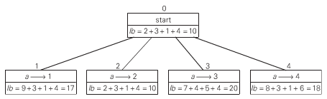
B & B example (cont.)
 | job 1 | job 2 | job 3 | job 4
contractor a | $9K | $2K | $7K | $8K
contractor b | $6K | $4K | $3K | $7K
contractor c | $5K | $8K | $1K | $8K
contractor d | $7K | $6K | $9K | $4K
note that there is a (possibly unobtainable) lower bound on the bid total
  you can't possibly do better than assigning every contractor their lowest bid
  here, 2 + 3 + 1 + 4 = $10K is a lower bound
  (it is not even achievable, since b & c are assigned the same job)
the lower bound gives us a basis for choosing one branch over another
  i.e., use a greedy approach to select the branch with smallest lower bound
    lb = cost of bids assigned so far + minimal bids possible for remaining contractors

Slide 24
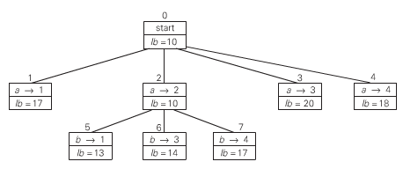
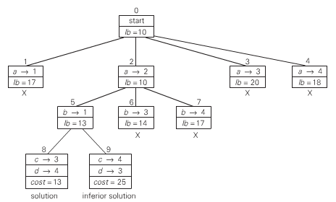
B & B example (cont.)
 | job 1 | job 2 | job 3 | job 4
contractor a | $9K | $2K | $7K | $8K
contractor b | $6K | $4K | $3K | $7K
contractor c | $5K | $8K | $1K | $8K
contractor d | $7K | $6K | $9K | $4K
at each step, choose the vertex/state with smallest lower bound, and extend
  can cut off a branch if its lb exceeds the cost of a found solution

Slide 25
Interesting aside: B & B search in game playing
consider games involving:
  2 players
  perfect information
  zero-sum (player's gain is opponent's loss)
examples: tic-tac-toe, checkers, chess, othello, …
non-examples: poker, backgammon, prisoner's dilemma, …
von Neumann (the father of game theory) showed that for such games, there is always a "rational" strategy
  that is, can always determine a best move, assuming the opponent is equally rational

Slide 26
Game trees
idea: model the game as a search tree
  associate a value with each game state (possible since zero-sum)
    player 1 wants to maximize the state value (call him/her MAX)
    player 2 wants to minimize the state value (call him/her MIN)
  players alternate turns, so differentiate MAX and MIN levels in the tree
the leaves of the tree will be end-of-game states

Slide 27
Minimax search
minimax search:
  at a MAX level, take the maximum of all possible moves
  at a MIN level, take the minimum of all possible moves
can visualize the search bottom-up (start at leaves, work up to root)
likewise, can search top-down using recursion

Slide 28
Minimax example

Slide 29
In-class exercise

Slide 30
Minimax in practice
while Minimax Principle holds for all 2-party, perfect info, zero-sum games, an exhaustive search to find best move may be infeasible
  EXAMPLE: in an average chess game, ~100 moves with ~35 options/move
    → ~35¹⁰⁰ states in the search tree! (more than # atoms in universe)
practical alternative: limit the search depth and use heuristics
  expand the search tree a limited number of levels (limited look-ahead)
  evaluate the "pseudo-leaves" using a heuristic
    high value → good for MAX low value → good for MIN
  back up the heuristic estimates to determine the best-looking move
    at MAX level, take maximum at MIN level, take minimum

Slide 31
Tic-tac-toe example
{
1000 if win for MAX (X)
heuristic(State) = -1000 if win for MIN (O)
(#rows/cols/diags open for MAX –
#rows/cols/diags open for MIN) otherwise
suppose look-ahead of 2 moves

Slide 32
α-β bounds
sometimes, it isn't necessary to search the entire tree
α-β technique: associate bonds with state in the search
  associate lower bound α with MAX: can increase
  associate upper bound β with MIN: can decrease

Slide 33
α-β pruning
discontinue search below a MIN node if β value <= α value of ancestor
discontinue search below a MAX node if α value >= β value of ancestor
<= 3 (
β
)
3
>= 5 (
α
)
no need to search
already searched

Slide 34
larger example

Slide 35
tic-tac-toe example
α-β vs. minimax:
  worst case: α-β examines as many states as minimax
  best case: assuming branching factor B and depth D, α-β examines ~2b^{d/2} states
  (i.e., as many as minimax on a tree with half the depth)

Slide 36
Iterative deepening
a common approach in game search is to set a lookahead range
  e.g., in chess, lookahead 4 moves (by each player) and rate boards at that stage
  this catches wins/losses within that range
  presumably, you can better judge the state of the game in the future
if decisions are timed,
  you can pick a conservative lookahead range to ensure a choice is made
  if time remains, extend the lookahead range and try again
  each iteration looks deeper and so makes a more informed choice
clearly, there is redundancy with iterative deepening
  lookead search of (n+1) levels must reproduce the search for n levels
  HOW COSTLY IS THIS?

Slide 37
Algorithmic approaches summary (so far)
brute force: sometimes the straightforward approach suffices
transform & conquer: sometimes the solution to a simpler variant suffices
divide/decrease & conquer: tackles a complex problem by breaking it into smaller piece(s), solving each piece (often w/ recursion), and combining into an overall solution
  applicable for any application that can be divided into smaller or independent parts
greedy: makes a sequence of choices/actions, choose whichever looks best at the moment
  applicable when a solution is a sequence of moves & perfect knowledge is available
backtracking: makes a sequence of choices/actions (similar to greedy), but stores alternatives so that they can be attempted if the current choices lead to failure
  more costly in terms of time and memory than greedy, but general-purpose
  branch & bound variant cuts off search at some level and backtracks

