Slide 1
CSC 321: Data Structures
Spring 2024
Trees & recursion
  trees, tree recursion
  BinaryTree class
  BST property
  BinarySearchTree class: override add, contains
  search efficiency

Slide 2
Trees
a tree is a nonlinear data structure consisting of nodes (structures containing data) and edges (connections between nodes), such that:
  one node, the root, has no parent (node connected from above)
  every other node has exactly one parent node
  there is a unique path from the root to each node (i.e., the tree is connected and there are no cycles)
nodes that have no children (nodes connected below them) are known as leaves

Slide 3
Recursive definition of a tree
trees are naturally recursive data structures:
  the empty tree (with no nodes) is a tree
  a node with subtrees connected below is a tree
tree with 1 node (empty subtrees)
empty tree
tree with 7 nodes
a tree where each node has at most 2 subtrees (children) is a binary tree

Slide 4
Trees in CS
trees are fundamental data structures in computer science
example: file structure
  an OS will maintain a directory/file hierarchy as a tree structure
  files are stored as leaves; directories are stored as internal (non-leaf) nodes
descending down the hierarchy to a subdirectory

traversing an edge down to a child node
DISCLAIMER: directories contain links back to their parent directories, so not strictly a tree

Slide 5
Recursively listing files
to traverse an arbitrary directory structure, need recursion
to list a file system object (either a directory or file):
  print the name of the current object
  if the object is a directory, then
    recursively list each file system object in the directory
in pseudocode:
  public static void ListAll(FileSystemObject current) {
  System.out.println(current.getName());
  if (current.isDirectory()) {
  for (FileSystemObject obj : current.getContents()) {
  ListAll(obj);
  }
  }
  }

Slide 6
Recursively listing files
  public static void ListAll(FileSystemObject current) {
  System.out.println(current.getName());
  if (current.isDirectory()) {
  for (FileSystemObject obj : current.getContents()) {
  ListAll(obj);
  }
  }
  }
this method performs a pre-order traversal: prints the root first, then the subtrees

Slide 7
UNIX du command
in UNIX, the du command lists the size of all files and directories
from the ~davereed directory:
  unix> du –a
  2 ./public_html/index.html
  3 ./public_html/Images/reed.jpg
  3 ./public_html/Images/logo.gif
  7 ./public_html/Images
  10 ./public_html
  1 ./mail/dead.letter
  2 ./mail
  13 .
this method performs a post-order traversal: prints the subtrees first, then the root
  public static int du(FileSystemObject current) {
  int size = current.blockSize();
  if (current.isDirectory()) {
  for (FileSystemObject obj : current.getContents()) {
  size += du(obj);
  }
  }
  System.out.println(size + " " + current.getName());
  return size;
  }

Slide 8
Tree terms
A
Properties of trees
root
leaves
height
branching factor
Properties of nodes
children
parent
siblings
ancestors
descendants
subtree
depth
degree
Tree T
B
C
D
E
F
G
H
I
J
K
L
M
N
Notes:
Height = Max length from root to node
Depth = dist from root

Slide 9
Kinds of trees
binary tree
  each node has at most 2 children (branching factor 2)
n-ary tree:
  each node has at most n children (branching factor n)
perfect tree:
  each row completely full
complete tree:
  each row completely full except maybe the bottom row, which is filled from left to right

Slide 10
Trees as recursive structures
a tree is a recursive data structure
  an empty tree is a tree (BASE CASE)
  a non-empty tree consists of a root and subtrees (RECURSIVE CASE)
  i.e., a non-empty binary tree consists of a root, left subtree & right subtree
  when reasoning about trees, inductive proofs follow this recursive structure
left
subtree
right
subtree

Slide 11
How deep is a balanced tree?
CLAIM: A binary tree with height H can store up to 2^{H}-1 nodes.
Proof (by induction):
  BASE CASES: when H = 0, 2⁰ - 1 = 0 nodes ✓
  when H = 1, 2¹ - 1 = 1 node ✓
  HYPOTHESIS: Assume property holds for all H < X.
  e.g., a tree with height X-1 can store up to 2^{X-1} -1 nodes.
  INDUCTIVE STEP: Must show property holds for X.
    Assume a tree of height X. For max # of nodes, each subtree will have height X-1.
  By our hypothesis, left and right subtree can each store up to 2^{X-1} -1 nodes.
  Thus, entire tree can store: 1 + (2^{X-1} -1) + (2^{X-1} -1) =
    2^{X-1} + 2^{X-1} -1 =
    2^{X} - 1 nodes ✓
height X
left
subtree
right
subtree
height X-1
equivalently: N nodes can be stored in a binary tree of height ⎡log₂(N+1)⎤

Slide 12
Trees & recursion
since trees are recursive structures, most tree traversal and manipulation operations are also recursive
  can divide a tree into root + left subtree + right subtree
  most tree operations handle the root as a special case, then recursively process the subtrees
  e.g., to display all the values in a (nonempty) binary tree, divide into
    displaying the root
    (recursively) displaying all the values in the left subtree
    (recursively) displaying all the values in the right subtree
  e.g., to count number of nodes in a (nonempty) binary tree, divide into
    (recursively) counting the nodes in the left subtree
    (recursively) counting the nodes in the right subtree
    adding the two counts + 1 for the root

Slide 13
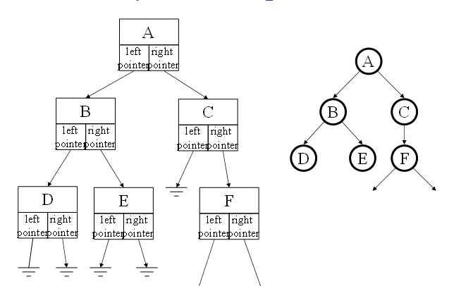
Tree representation
will need to define a TreeNode structure, that stores
  root value
  pointer to left subtree
  pointer to right subtree

Slide 14
BinaryTree class
public class BinaryTree<E> {
protected TreeNode<E> root;
public BinaryTree() {
this.root = null;
}
public void add(E value) { … }
public boolean remove(E value) { … }
public boolean contains(E value) { … }
public int size() { … }
public String toString() { … }
//////////////////////////////////////
protected class TreeNode<E> {
…
}
}
to implement a binary tree, need to link together tree nodes
  the root of the tree is maintained in a field (initially null for empty tree)
  the root field is "protected" instead of "private" to allow for inheritance
  recall: a protected field is accessible to derived classes, otherwise private
  similar to Node in MyLinkedList, TreeNode is an inner class

Slide 15
TreeNode class
protected class TreeNode<E> {
private E data;
private TreeNode<E> left;
private TreeNode<E> right;
public TreeNode(E d, TreeNode<E> l, TreeNode<E> r) {
this.data = d;
this.left = l;
this.right = r;
}
public E getData() { return this.data; }
public TreeNode<E> getLeft() { return this.left; }
public TreeNode<E> getRight() { return this.right; }
public void setData(E newData) { this.data = newData; }
public void setLeft(TreeNode<E> newLeft) {
this.left = newLeft;
}
public void setRight(TreeNode<E> newRight) {
this.right = newRight;
}
}
virtually same as DNode class
  change the field & method names to reflect the orientation of nodes
  uses left/right instead of previous/next

Slide 16
size method
recursive approach:
  BASE CASE: if the tree is empty, number of nodes is 0
  RECURSIVE: otherwise, number of nodes is
    (# nodes in left subtree) + (# nodes in right subtree) + 1 for the root
note: a recursive implementation requires passing the root as parameter
  will have a public "front" method, which calls the recursive "worker" method
public int size() {
return this.size(this.root);
}
private int size(TreeNode<E> current) {
if (current == null) {
return 0;
}
else {
return this.size(current.getLeft()) +
this.size(current.getRight()) + 1;
}
}

Slide 17
contains method
recursive approach:
  BASE CASE: if the tree is empty, the item is not found
  BASE CASE: otherwise, if the item is at the root, then found
  RECURSIVE: otherwise, search the left and then right subtrees
public boolean contains(E value) {
return this.contains(this.root, value);
}
private boolean contains(TreeNode<E> current, E value) {
if (current == null) {
return false;
}
else {
return value.equals(current.getData()) ||
this.contains(current.getLeft(), value) ||
this.contains(current.getRight(), value);
}
}

Slide 18
toString method
must traverse the entire tree and build a string of the items
  there are numerous patterns that can be used, e.g., in-order traversal
  BASE CASE: if the tree is empty, then nothing to traverse
  RECURSIVE: recursively traverse the left subtree, then access the root,
  then recursively traverse the right subtree
public String toString() {
String recStr = this.toString(this.root);
return "[" + recStr.substring(0,recStr.length()-1) + "]";
}
private String toString(TreeNode<E> current) {
if (current == null) {
return ",";
}
return this.toString(current.getLeft()) +
current.getData().toString() + "," +
this.toString(current.getRight());
}

Slide 19
Alternative traversal algorithms
pre-order traversal:
  BASE CASE: if the tree is empty, then nothing to traverse
  RECURSIVE: access root, recursively traverse left subtree, then right subtree
private String toString(TreeNode<E> current) {
if (current == null) {
return "";
}
return current.getData().toString() + "," +
this.toString(current.getLeft()) +
this.toString(current.getRight());
}
post-order traversal:
  BASE CASE: if the tree is empty, then nothing to traverse
  RECURSIVE: recursively traverse left subtree, then right subtree, then root
private String toString(TreeNode<E> current) {
if (current == null) {
return "";
}
return this.toString(current.getLeft()) +
this.toString(current.getRight()) +
current.getData().toString() + ",";
}

Slide 20
Exercises
/** @return the number of times value occurs in the tree with specified root */
public int numOccur(TreeNode<E> root, E value) {
}
/** @return the sum of all the values stored in the tree with specified root */
public int sum(TreeNode<Integer> root) {
}
/** @return the maximum value in the tree with specified root */
public int max(TreeNode<Integer> root) {
}

Slide 21
add method
how do you add to a binary tree?
  ideally would like to maintain balance, so (recursively) add to smaller subtree
  big Oh?
  we will consider more efficient approaches for maintaining balance later
public void add(E value) {
this.root = this.add(this.root, value);
}
private TreeNode<E> add(TreeNode<E> current, E value) {
if (current == null) {
current = new TreeNode<E>(value, null, null);
}
else if (this.size(current.getLeft()) <= this.size(current.getRight())) {
current.setLeft(this.add(current.getLeft(), value));
}
else {
current.setRight(this.add(current.getRight(), value));
}
return current;
}

Slide 22
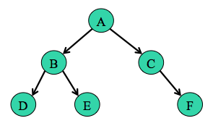
remove method
how do you remove from a binary tree?
  tricky, since removing an internal node means rerouting pointers
  must maintain binary tree structure
simpler solution
  find node (as in search)
  if a leaf, simply remove it
  if no left subtree, reroute parent pointer to right subtree
  otherwise, replace current value with a leaf value from the left subtree (and remove the leaf node)
  DOES THIS MAINTAIN BALANCE?
  (you can see the implementation in BinaryTree.java)

Slide 23
Induction and trees
which of the following are true? prove/disprove
  in a full binary tree, there are more nodes on the bottom (deepest) level than all other levels combined
  in any (non-empty) binary tree, there will always be more leaves than non-leaves
  in any (non-empty) binary tree, there will always be more empty children (i.e., null left or right fields within nodes) than children (i.e., non-null fields)

Slide 24
Searching linked lists
recall: a (linear) linked list only provides sequential access → O(N) searches
it is possible to obtain O(log N) searches using a tree structure
in order to perform binary search efficiently, must be able to
  access the middle element of the list in O(1)
  divide the list into halves in O(1) and recurse
  HOW CAN WE GET THIS FUNCTIONALITY FROM A TREE?

Slide 25
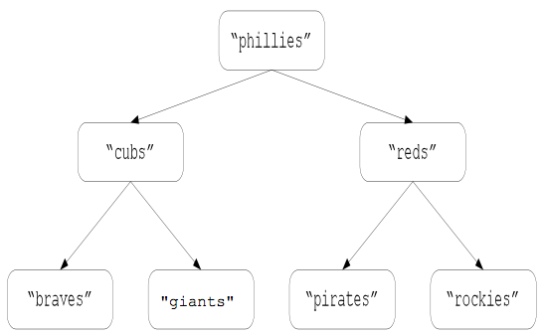
Binary search trees
a binary search tree is a binary tree in which, for every node:
  the item stored at the node is > all items stored in its left subtree
  the item stored at the node is ≤ all items stored in its right subtree
in a (balanced) binary search tree:
  middle element = root
  1st half of list = left subtree
  2nd half of list = right subtree
furthermore, these properties hold for each subtree

Slide 26
BinarySearchTree class
can use inheritance to derive BinarySearchTree from BinaryTree
public class BinarySearchTree<E extends Comparable<? super E>>
extends BinaryTree<E> {
public BinarySearchTree() {
super();
}
public void add(E value) {
// OVERRIDE TO MAINTAIN BINARY SEARCH TREE PROPERTY
}
public void contains(E value) {
// OVERRIDE TO TAKE ADVANTAGE OF BINARY SEARCH TREE PROPERTY
}
public void remove(E value) {
// DOES THIS NEED TO BE OVERRIDDEN?
}
}

Slide 27
Binary search in BSTs
to search a binary search tree:
  if the tree is empty, NOT FOUND
  if desired item is at root, FOUND
  if desired item < item at root, then recursively search the left subtree
  if desired item > item at root, then recursively search the right subtree
public boolean contains(E value) {
return this.contains(this.root, value);
}
private boolean contains(TreeNode<E> current, E value) {
if (current == null) {
return false;
}
else if (value.equals(current.getData())) {
return true;
}
else if (value.compareTo(current.getData()) < 0) {
return this.contains(current.getLeft(), value);
}
else {
return this.contains(current.getRight(), value);
}
}

Slide 28
Search efficiency
how efficient is search on a BST?
  in the best case?
    O(1) if desired item is at the root
  in the worst case?
    O(height of the tree) if item is leaf on the longest path from the root
in order to optimize worst-case behavior, want a (relatively) balanced tree
  otherwise, don't get binary reduction
  e.g., consider two trees, each with 7 nodes

Slide 29
Search efficiency (cont.)
we showed that N nodes can be stored in a binary tree of height ⎡log₂(N+1)⎤
so, in a balanced binary search tree, searching is O(log N)
  N nodes → height of ⎡log2(N+1)⎤ → in worst case, have to traverse ⎡log2(N+1)⎤ nodes
what about the average-case efficiency of searching a binary search tree?
  assume that a search for each item in the tree is equally likely
  take the cost of searching for each item and average those costs
costs of search
1
2 + 2
3 + 3 + 3 + 3
17/7 ➔ 2.42
  define the weight of a tree to be the sum of all node depths (root = 1, …)
  average cost of searching a BST = weight of tree / number of nodes in tree

Slide 30

Search efficiency (cont.)
17/7 ➔ 2.42
~log N
costs of search
1
2 + 2
3 + 3 + 3 + 3
costs of search
1
+ 2
+ 3
+ 4
+ 5
+ 6
+ 7
28/7 ➔ 4.00
~N/2

Slide 31
Inserting an item
inserting into a BST
  traverse edges as in a search
  when you reach a leaf, add the new node below it
public void add(E value) {
this.root = this.add(this.root, value);
}
private TreeNode<E> add(TreeNode<E> current, E value) {
if (current == null) {
return new TreeNode<E>(value, null, null);
}
if (value.compareTo(current.getData()) <= 0) {
current.setLeft(this.add(current.getLeft(), value));
}
else {
current.setRight(this.add(current.getRight(), value));
}
return current;
}

Slide 32
Removing an item
recall BinaryTree remove
  find node (as in search)
  if a leaf, simply remove it
  if no left subtree, reroute parent pointer to right subtree
  otherwise, replace current value with a leaf value from the left subtree (and remove the leaf node)
  CLAIM: as long as you select the rightmost (i.e., maximum) value in the left subtree, this remove algorithm maintains the BST property
    WHY?
  since the BinaryTree remove does this, no need to override

Slide 33
Maintaining balance
PROBLEM: random insertions (and removals) do not guarantee balance
  e.g., suppose you started with an empty tree & added words in alphabetical order
    braves, cubs, giants, phillies, pirates, reds, rockies, …
braves
cubs
giants
phillies
with repeated insertions/removals, can degenerate so that height is O(N)
  specialized algorithms exist to maintain balance & ensure O(log N) height
  or take your chances

