Slide 1
CSC 321: Data Structures
Spring 2024
Hash tables
  HashSet & HashMap
  hash table, hash function
  collisions
    linear probing, lazy deletion, clustering, rehashing
    chaining
  Java hashCode method

Slide 2
HashSet & HashMap
recall: TreeSet & TreeMap use an underlying binary search tree (actually, a red-black tree) to store values
  as a result, add/put, contains/get, and remove are O(log N) operations
  iteration over the Set/Map can be done in O(N)
the other implementations of the Set & Map interfaces, HashSet & HashMap, use a "magic" data structure to provide O(1) operations*
  *legal disclaimer: performance can degrade to O(N) under bad/unlikely conditions
  however, careful setup and maintenance can deliver O(1) in practice
the underlying data structure is known as a Hash Table

Slide 3
Hash tables
a hash table is a data structure that supports constant time insertion, deletion, and search on average
  degenerative performance is possible, but unlikely
  it may waste some storage
  iteration order is not defined (and may even change over time)
idea: data items are stored in a table, based on a key
  the key is mapped to an index in the table, where the data is stored/accessed
example: letter frequency
  want to count the number of occurrences of each letter in a file
  have an array of 26 counters, map each letter to an index
  to count a letter, map to its index and increment
"A" → 0
1
0
3
. . .
0
"B" → 1
"C" → 2
"Z" → 25

Slide 4
Mapping examples
extension: word frequency
  must map entire words to indices, e.g.,
  "A" → 0 "AA" → 26 "BA" → 52 . . .
  "B" → 1 "AB" → 27 "BB" → 53 . . .
  . . . . . . . . .
  "Z" → 25 "AZ" → 51 "BZ" → 77 . . .
  PROBLEM?
mapping each potential item to a unique index is generally not practical
  # of 1 letter words = 26
  # of 2 letter words = 26² = 676
  # of 3 letter words = 26³ = 17,576
  . . .
  even if you limit words to at most 8 characters, need a table of size 217,180,147,158
  for any given file, the table will be mostly empty!

Slide 5
Table size < data range
since the actual number of items stored is generally MUCH smaller than the number of potential values/keys:
  can have a smaller, more manageable table
  e.g., table size = 26
  possible mapping: map word based on first letter
  "A*" → 0 "B*" → 1 . . . "Z*" → 25
  e.g., table size = 1000
  possible mapping: add ASCII values of letters, mod by 1000
  "AB" → 65 + 66 = 131
  "BANANA" → 66 + 65 + 78 + 65 + 78 + 65 = 417
  "BANANABANANABANANA" → 417 + 417 + 417 = 1251 % 1000 = 251
  POTENTIAL PROBLEMS?

Slide 6
Collisions
the mapping from a key to an index is called a hash function
  the hash function can be written independent of the table size
  if it maps to an index > table size, simply wrap-around (i.e., index % tableSize)
since |range(hash function)| < |domain(hash function)| , Pigeonhole Principle ensures collisions are possible (v₁ & v₂ → same index)
  "ACT" → 67 + 65 + 84 = 216 "CAT" → 67 + 65 + 84 = 216
techniques exist for handling collisions, but they are costly (LATER)
it's best to avoid collisions as much as possible – HOW?
  want to be sure that the hash function distributes the key evenly
  e.g., "sum of ASCII codes" hash function
    OK if table size is 1000
    BAD if table size is 10,000
    most words are ≤ 10 letters, so max sum of ASCII codes = 1,270
    so most entries are mapped to first 13% of table

Slide 7
Better hash function
a good hash function for words should
  produce an even spread, regardless of table size
  take order of letters into account (to handle anagrams)
  the hash function used by java.util.String multiplies the ASCII code for each character by a power of 31
    hashCode() = char₀*31^{(len-1)} +char₁*31^{(len-2)} + char₂*31^{(len-3)} + … + char_{(len-1)}
  where len = this.length(), char_{i} = this.charAt(i):
/**
* Hash code for java.util.String class
* @return an int used as the hash index for this string
*/
private int hashCode() {
int hashIndex = 0;
for (int i = 0; i < this.length(); i++) {
hashIndex = (hashIndex*31 + this.charAt(i));
}
return hashIndex;
}

Slide 8
Equal Objects Must Hash the Same
the Java library makes a crucial assumption that users must satisfy
  if a.equals(b) then a.hashCode() == b.hashCode()
to ensure your class will work in hash tables
  if you define .equals, be sure to implement .hashCode too
public class MyDate {
private int month;
private int year;
private int day;
. . .
public boolean equals(Object otherObject) {
if(this==otherObject) return true;
if(otherObject==null) return false;
if(this.getClass()!=other.getClass()) return false;
return this.month = otherObject.month &&
this.year = otherObject.year &&
this.day = otherObject.day;
}
}

Slide 9
One possible hashCode
public class MyDate {
private int month;
private int year;
private int day;
. . .
public boolean equals(Object otherObject) {
if(this==otherObject) return true;
if(otherObject==null) return false;
if(this.getClass()!=other.getClass()) return false;
return this.month = otherObject.month &&
this.year = otherObject.year &&
this.day = otherObject.day;
}
public int hashCode() {
return (year*365 + month)*12 + day;
}
}

Slide 10
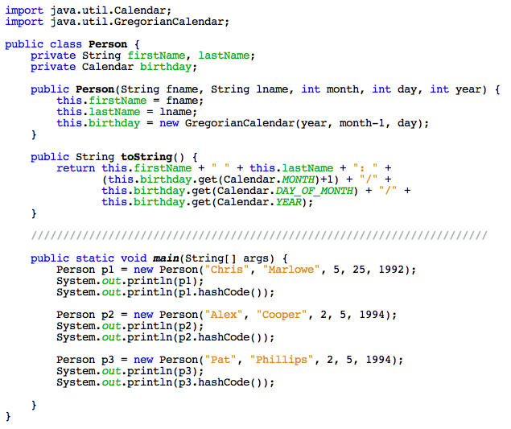
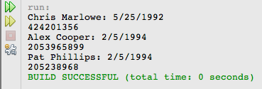
Another example
a default hashCode function is defined for every Object
  uses native code to access and return the address of the object

Slide 11
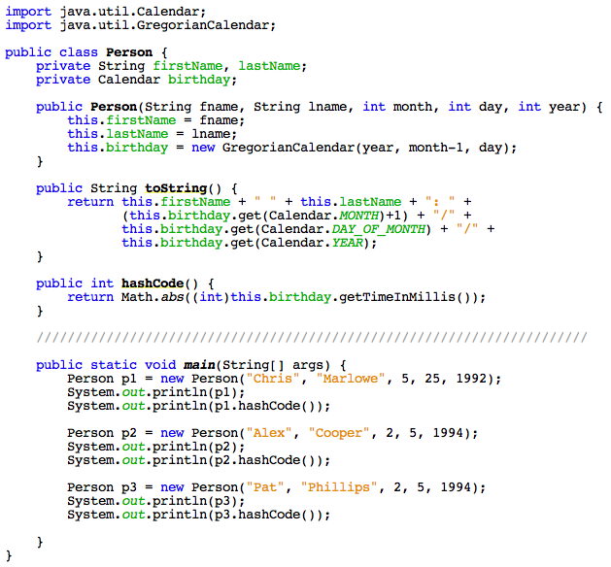
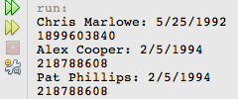
hashCode example
can override using class-specific knowledge
  but must map equal objects to the same index

Slide 12
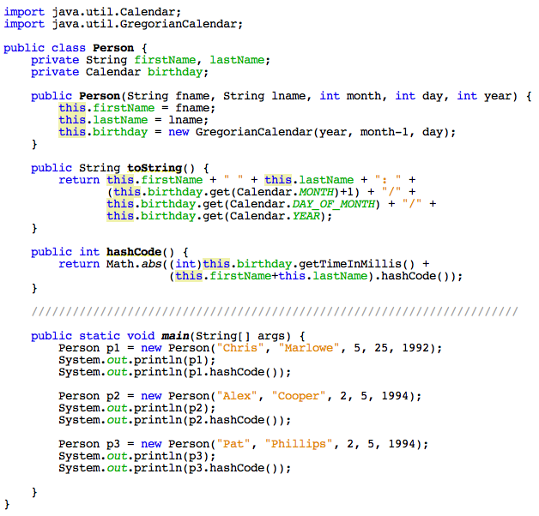
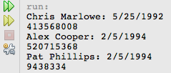
hashCode example
to avoid birthday collisions, can incorporate names

Slide 13
Word frequency example
returning to the word frequency problem
  pick a hash function
  pick a table size
  store word & associated count in the table
  as you read in words,
    map to an index using the hash function
    if an entry already exists, increment
    otherwise, create entry with count = 1
0
. . .
"FOO"
1
1
2
"BAR"
3
999
WHAT ABOUT COLLISIONS?

Slide 14
Linear probing
linear probing is a simple strategy for handling collisions
  if a collision occurs, try next index & keep looking until an empty one is found (wrap around to the beginning if necessary)
  example: assume "first letter" hash function
  insert "BOO", "BAR", "COO", "BOW, …
linear probing requires "lazy deletion"
  when you delete an item, you can't just empty
  the location, since it would leave a hole
  subsequent searches would reach that whole
  and stop probing
  instead, leave a marker (a.k.a a tombstone)
  in that spot 0 can be overwritten but not
  skipped when probing
  example: given above insertions
  delete "BAR", search for "COO"
0
. . .
1
2
3
4
25

Slide 15
Clustering and load factor
0
1
2
3
4
5
6
7
"BOO"
"BIZ"
"COO"
"DOG"
in practice, probes are not independent
  as the table fills, clusters appear that degrade performance
    maps to 0, 5-7 require 1 check
    map to 4 requires 2 checks
    map to 3 requires 3 checks
    map to 2 requires 4 checks
    map to 1 requires 5 checks
    average = 18/8 = 2.25 checks
the load factor λ is the fraction of the table that is full
  empty table λ = 0 half full table λ = 0.5 full table λ = 1
THEOREM: assuming a reasonably large table, the average number of locations examined per insertion is roughly (1 + 1/(1-λ)²)/2
    empty table (1 + 1/(1 - 0)²)/2 = 1
    half full (1 + 1/(1 – .5)²)/2 = 2.5
    3/4 full (1 + 1/(1 - .75)²)/2 = 8.5
    9/10 full (1 + 1/(1 - .9)²)/2 = 50.5

Slide 16
Rehashing
as long as you keep the load factor low (e.g., < 0.75), inserting, deleting and searching a hash table are all O(1) operations
if the table becomes too full, then must resize
  create new table at least twice as big
  just copy over table entries to same locations???
  NO! when you resize, you have to rehash existing entries
    new table size → new hash function (+ different wraparound)
LET hashCode = word.length()
ADD "UP"
ADD "OUT"
ADD "YELLOW"
0
1
2
3
4
5
6
7
NOW RESIZE AND REHASH
0
1
2
3

Slide 17
Chaining
linear probing (or variants) were initially used when memory was expensive
  clustering, lazy deletion, and rehashing are all issues
modern languages like Java utilize a different approach
chaining:
  each entry in the hash table is a bucket (list)
  when you add an entry, hash to correct index then add to bucket
  when you search for an entry, hash to correct index then search sequentially
0
1
2
3
25
. . .
"AND"
"APPLE"
"CAT"
"COO"
"COWS"
"DOG"

Slide 18
Analysis of chaining
in practice, chaining is generally faster than probing
  cost of insertion is O(1) – simply map to index and add to list
  cost of search is proportional to number of items already mapped to same index
    e.g., using naïve "first letter" hash function, searching for "APPLE" might requires traversing a list of all words beginning with 'A'
    if hash function is fair, then average size of each bucket is λ (load factor)
    → average cost of a successful search is roughly λ/2
chaining is sensitive to the load factor, but not as much as probing – WHY?
chaining uses more memory – WHY?

Slide 19

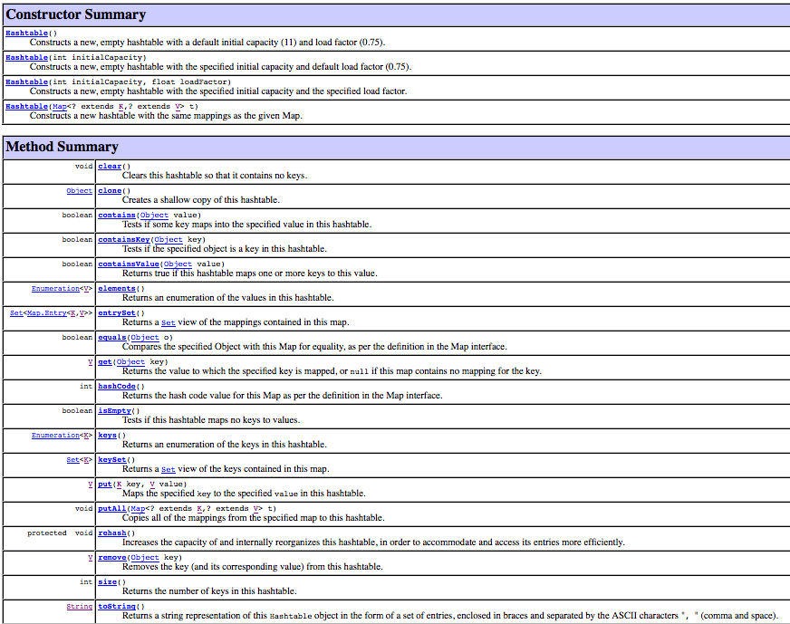
Hashtable class
Java provides a basic hash table implementation
  utilizes chaining
  can specify the initial table size & threshold for load factor
  can even force a rehashing
not commonly used, instead provides underlying structure for HashSet & HashMap

Slide 20
HashSet & HashMap
java.util.HashSet and java.util.HashMap use hash table w/ chaining
  e.g., HashSet<String> HashMap<String, Integer>
0
1
2
3
25
"AND"
"APPLE"
0
1
2
3
25
"AND"
4
"APPLE"
1
"CAT"
"COO"
"COWS"
"CAT"
2
"COO"
1
"COWS"
3
"DOG"
"DOG"
2
.
.
.
.
.
.
  defaults: table size = 16, max capacity before rehash = 75%
    can override these defaults in the HashSet/HashMap constructor call
note: iterating over a HashSet or HashMap is: O(num stored + table size) WHY?

Slide 21
Word frequencies (again)
import java.util.Map;
import java.util.HashMap;
import java.util.Scanner;
import java.io.File;
public class WordFreq {
private Map<String, Integer> words;
public WordFreq() {
words = new HashMap<String, Integer>();
}
public WordFreq(String filename) {
this();
try {
Scanner infile = new Scanner(new File(filename));
while (infile.hasNext()) {
String nextWord = infile.next();
this.add(nextWord);
}
}
catch (java.io.FileNotFoundException e) {
System.out.println("FILE NOT FOUND");
}
}
public void add(String newWord) {
String cleanWord = newWord.toLowerCase();
if (words.containsKey(cleanWord)) {
words.put(cleanWord, words.get(cleanWord)+1);
}
else {
words.put(cleanWord, 1);
}
}
public void showAll() {
for (String str : words.keySet()) {
System.out.println(str + ": " + words.get(str));
}
}
}
using HashMap instead of TreeMap
  containsKey, get & put operations are all O(1)*
  however, iterating over the keySet (and their values) does not guarantee any order
  if you really care about speed → use HashSet/HashMap
  if the data/keys are comparable & order matters → use TreeSet/TreeMap

Slide 22
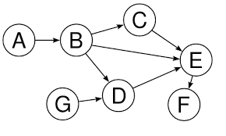
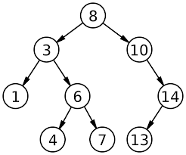
Graphs (sneak peek)
trees are special instances of the more general data structure: graphs
informally, a graph is a collection of nodes/data elements with connections
a tree is a graph in which one node has no edges coming into it (the root) and no cycles

Slide 23

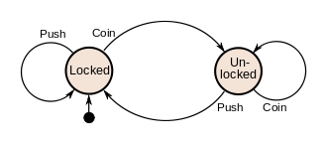
Finite State Machines (FSMs)
many useful problems can be defined using simple graphs
  a Finite State Machine (a.k.a. Finite Automaton) defines a finite set of states (i.e., nodes) along with transitions between those states (i.e., edges)
  e.g., the logic controlling a coin-operated turnstile
can be in one of two states: locked or unlocked
  if locked, pushing → it does not allow passage & stays locked
    inserting coin → unlocks it
  if unlocked, pushing → allows passage & then relocks
    inserting coin → keeps it unlocked

Slide 24
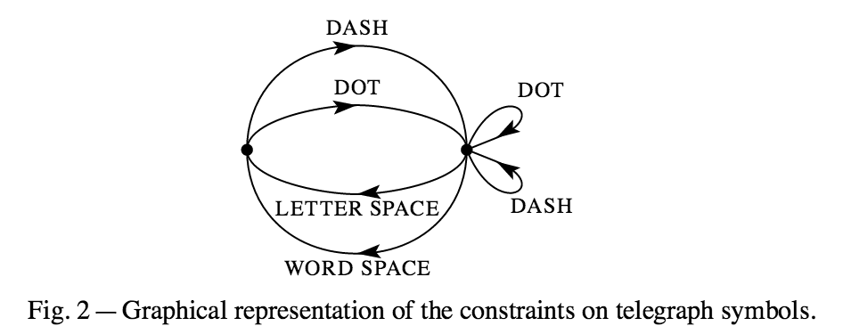
Other examples
Claude Shannon used a FSM to show constraints on Morse code
25¢
Q
D
D
can use a FSM to specify the behavior of a vending machine
adding a coin (Q, D, N) changes the state
N
35¢
0¢
N
D
5¢
15¢
Q
N
N
N
N
D
Q
30¢
10¢
N
D
20¢
D

Slide 25
HW7: Simulate a FSM
locked push locked
locked coin unlocked
unlocked push locked
unlocked coin unlocked
model a FSM by storing the edges and providing lookup methods
  private HashMap<StateLabel, HashMap<EdgeLabel, StateLabel>> table;
locked
unlocked
  the key to the table is the start state of an edge
  the value is another map, which maps edge labels to the end states
  table.get("locked") →
  a map containing edges from "locked"
    table.get("locked").get("coin") →
    "unlocked"
coin | unlocked
push | locked
coin | unlocked
push | locked

Slide 26
HW7: Other examples
inLetter . inLetter
inLetter – inLetter
inLetter _ betweenLetters
inLetter __ betweenLetters
betweenLetters . inLetter
betweenLetters - inLetter
0cents N 5cents
0cents D 10cents
0cents Q 25cents
5cents N 10cents
5cents D 15cents
5cents Q 30cents
10cents N 15cents
10cents D 20cents
10cents Q 35cents
15cents N 20cents
15cents D 25cents
20cents N 25cents
20cents D 30cents
25cents N 30cents
25cents D 35cents
30cents N 35cents
25¢
Q
D
D
35¢
0¢
N
N
5¢
D
15¢
Q
N
N
N
N
D
Q
30¢
10¢
N
D
20¢
D

Slide 27
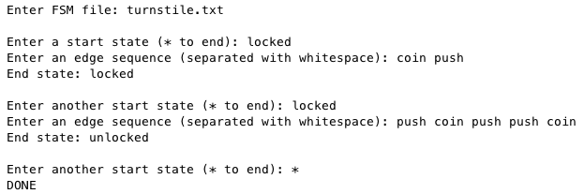
HW7: PathTracer
locked push locked
locked coin unlocked
unlocked push locked
unlocked coin unlocked
given a start state and sequence of edges, determine the end state

Slide 28
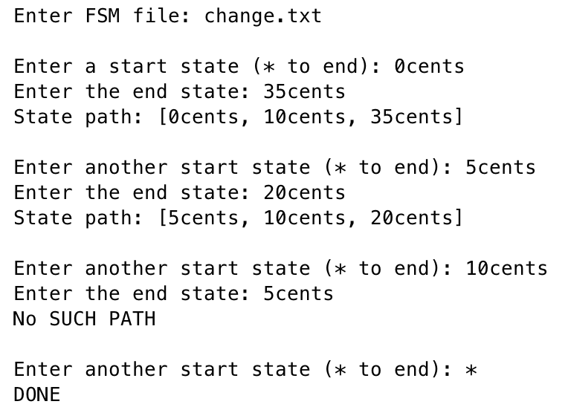
HW7: PathFinder
you are given a method that finds a shortest path between to states
  fsm.findPath("0cents","35cents") → ["0cents","10cents","35cents"]
  you will write a driver class that repeatedly finds and prints paths
25¢
Q
D
D
35¢
0¢
N
D
N
5¢
15¢
Q
N
D
N
N
N
10¢
Q
N
30¢
D
20¢
D

