Slide 1
CSC 321: Data Structures
Spring 2024
Elegant code
what is elegance?
why is it important?
examples

Slide 2
What is elegance?
Elegance: the quality of being gracefully refined and dignified, as in tastes, habits, or literary style
dictionary.com
"Elegant code is code that is readable, maintainable, efficient, and does what it sets out to do and nothing more. And pretty much in that order - you don't want to obfuscate your code in the name of micro-optimizations that make things less readable unless you have documented the need for such efficiencies... "
— anonymous Senior Developer
Elegant Code What Does It All Mean? by Stephen Owens

Slide 3
Why is elegant code important?
readable code is easier to
debug
develop in teams
maintain
it is estimated that 60-80% of software development is focused on maintaining code after it is written
maintenance is often done by people other than the originator
code that is clear, understandable, and avoids duplication is easier to maintain
efficiency comes down to knowing your data structure & algorithm options, choosing wisely
in general: readability/maintainability > efficiency (within reason)

Slide 4
Readable code
follow language conventions, e.g., in Java:
variables/fields/methods start with lowercase letter, classes start with uppercase
variables/fields/classes are typically nouns, methods are verbs
BankAccount balance getBalance
make identifiers long enough to be meaningful, use camelBack notation
numberOfExams is better than num
indent consistently
while (num > 0) {
if (num % 2 == 0) {
num /=2;
} else {
num = 3*num+1;
}
}
while (num > 0) {
if (num % 2 == 0) {
num /=2;
}
else {
num = 3*num+1;
}
}

Slide 5
Readable code (cont.)
don't be clever for cleverness' sake
int x = (byte) + (char) - (int) + (long) - 1;
System.out.println(x);
int p = 5;
int q = 3 + p++;
int r = 8 + ++p;
System.out.println(p + " " + q + " " + r);
num = (num % 2 == 0) ? num/2 : (3*num+1);

Slide 6
Maintainable code
first off, readable code is more maintainable
follow language conventions, meaningful names, consistent indentation, …
code segments should be of "reasonable" size
my rule-of-thumb: a method should fit on the screen
if more complex, break into multiple methods
if some methods are just helpers, make them private
code should be clearly documented
Javadoc comments provide for a universal convention
each class should have comment with description, @author & @version
each method should have comment with description, @param & @return
assuming "reasonably" sized methods, this should be sufficient

Slide 7
Maintainable code (cont.)
using an object-oriented language, follow good OO design principles
highly cohesive:
each class maps to a single, well-defined entity
each method of the class maps to a single, well-defined behavior
loosely coupled:
each class is largely independent, manipulated via methods
methods should be callable in any order
if a class is meant to be a blueprint for creating objects,
should have private methods, a constructor, public methods
if a class is meant to act as a "driver", then should contain main and possibly other static methods (but no fields)
make use of standard libraries
e.g., don't define your own list type if ArrayList or LinkedList work fine

Slide 8
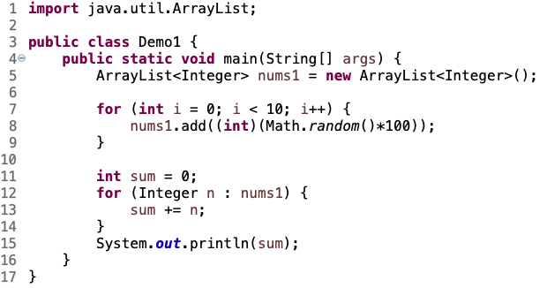
Maintainable code (cont.)
AVOID UNNECESSARY DUPLICATION IN CODE!
duplication not only adds complexity and hurts readability, it is difficult to maintain
if you make a change in one place, must make same change in others
suppose we wanted to do the same with a LinkedList

Slide 9
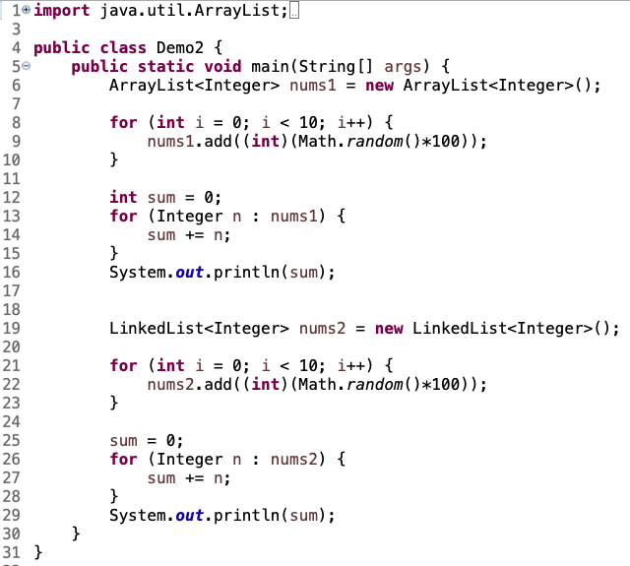
Copy-paste solution
copy-paste lines 5-15
rename ArrayList → LinkedList
rename num1 → num2
remove sum decl.
doubles the length of the code
exact same operations
suppose we wanted 20 numbers, in range 0-200?
fortunately, polymorphism provides a better way

Slide 10
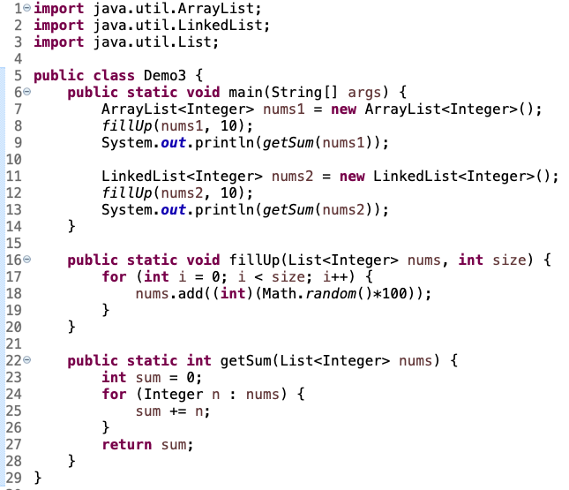
Polymorphism
the List interface provides a single name that encompasses both ArrayList and LinkedList
can define a method that takes a List as input and pass either one
the method can only use methods common to all Lists
shortens the code
if want to change the range of numbers, there is only one place to change

Slide 11
HW2
I am seeing programs with massive duplication of code
if (USER SPECIFIED ARRAY) {
ArrayQueue<Integer> q = new ArrayQueue<Integer>();
// CODE FOR FILLING THE QUEUE, TIMING OPERATIONS
// USES add, remove, peek (same as below)
}
else {
LinkedList<Integer> q = new LinkedList<Integer>();
// CODE FOR FILLING THE QUEUE, TIMING OPERATIONS
// USES add, remove, peek (same as above)
}
when you see duplication like this
identify the common parts and factor them out
here, the code for filling & timing is the same so separate it from the data structure initialization

Slide 12
HW2: better version
separate the code into
initializing a Queue variable to whichever type specified
executing the common code on that Queue
Queue<Integer> q;
if (USER SPECIFIED ARRAY) {
q = new ArrayQueue<Integer>();
}
else {
q = new LinkedList<Integer>();
}
// CODE FOR FILLING THE QUEUE, TIMING OPERATIONS
// USES add, remove, peek (same as above)

