Slide 1
CSC 321: Data Structures
Spring 2024
Counting and proofs
  mappings, bijection rule
  sequences, product rule, sum rule
  generalized product rule, permutations
  division rule, inclusion/exclusion
  pigeonhole principle
  proof techniques: direct, by-contradiction, by-induction

Slide 2
Bijections
it is often easier to count one thing by counting another
  e.g., to count sheep, count legs and divide by 4
recall:
  a function (f : D → R) is a mapping from elements of a domain D to elements of a range R
    e.g., sqrt: R → R abs: R → R+
  a bijective function or bijection is a one-to-one mapping between two sets
    e.g., current Creighton students & staff, active netIDs
    each student/staff has a unique netID; each netID has a unique student/staff
    e.g., f : R → R where f(x) = 2x+1
    each x maps to a unique f(x); each f(x) has a unique x
Bijection Rule: If there is a bijection f : A → B, then |A| = |B|.

Slide 3
Application: bijection rule
A = # of ways to assign letter grades (A/B/C/D/F) to 10 students
B = # of 14 bit patterns with exactly four 1's
consider grades from A: 2 A's, 4 B's, 1 C, 2 D's, 1 F
map to a bit pattern from B: 00100001010010
this is a 1-to-1 mapping, so |A| = |B|
  if we can determine the size of either set, then we know the size of the other
  |B| = = 14!/10!4! = 14*13*12*11/4*3*2*1 = 7*13*11 = 1,001

Slide 4
Sequences
general strategy:
  focus on techniques for counting sequences, then
  for each counting problem to be solved, try to map it into sequences
recall:
  if P₁, P₂, …, P_{n} are sets, then P₁ × P₂ × … × P_{n} is the set of all sequences where
  the 1st term is from P₁, 2nd term is from P₂, …, n^{th} term is from P_{n}
    e.g., C = {red, blue}, N = {1, 2, 3},
      C × N = {red-1, red-2, red-3, blue-1, blue-2, blue-3}
Product Rule: if P₁, P₂, …, P_{n} are sets, then
|P₁ × P₂ × … × P_{n}| = |P₁| * |P₂| * … * |P_{n}|

Slide 5
Application: product rule
suppose we are trying to build a computer out of components
  P = { i5, i7 }
  R = { 2GB, 4GB, 8GB }
  C = { 1MB, 2MB, 4MB }
how many combinations of processor, RAM & cache are there to choose from?
  |P × R × C| = |P| * |R| * |C| = 2 * 3 * 3 = 18
  { i5-2GB-1MB, i5-2GB-2MB, i5-2GB-4MB,
  i5-4GB-1MB, i5-4GB-2MB, i5-4GB-4MB,
  i5-8GB-1MB, i5-8GB-2MB, i5-8GB-4MB,
  i7-2GB-1MB, i7-2GB-2MB, i7-2GB-4MB,
  i7-4GB-1MB, i7-4GB-2MB, i7-4GB-4MB,
  i7-8GB-1MB, i7-8GB-2MB, i7-8GB-4MB }

Slide 6
Application: product rule
how many possible subsets of a set of N elements?
  S = { x₁, x₂, …, x_{N} }
can map each subset into a sequence of N bits: b_{i} = 1 → x_{i} in subset
{ x₁, x₄, x₅ } ←→ 10011000…0
  for an N-element set, count number of N-bit sequences
  | {0,1} × {0,1} × {0,1} × … × {0, 1} | = | {0,1} |^{N} = 2^{N}
  e.g., S = {a, b, c}
  subsets of S = { { }, {a}, {b}, {c}, {a,b}, {a,c}, {b,c}, {a,b,c} }
  |subsets of S| = 2^{|S|} = 2³ = 8

Slide 7
Combining rules
many problems involve a combination of counting methods
  Sum Rule: if S₁, ..., S_{n} are disjoint sets, then |S₁ U … U S_{n}| = |S₁|+…+|S_{n}|
  Division Rule: if f : A → B is k-to-1, then |A| = k * |B|.
EXERCISE:
  suppose a computer system requires 6-8 character passwords, consisting of letters & digits that must start with a letter
  how many passwords are possible

Slide 8
Exercise solution
  suppose a computer system requires 6-8 character passwords, consisting of letters & digits that must start with a letter
  how many passwords are possible
  alpha = { a, b, …, z, A, B, …, Z }
  anum = alpha U { 0, 1, 2, …, 9 }
  passwords = (6-char passwords) U (7-char passwords) U (8-char passwords)
  = (alpha × anum⁵) U (alpha × anum⁶) U (alpha × anum⁷)
  | passwords | = | (alpha × anum⁵) U (alpha × anum⁶) U (alpha × anum⁷) |
  = | alpha × anum⁵ | + | alpha × anum⁶ | + | alpha × anum⁷ | [Sum Rule]
  = |alpha|*|anum|⁵ + |alpha|*|anum|⁶ + |alpha|*|anum|⁷ [Product Rule]
  = 52*62⁵ + 52*62⁶ + 52*62⁷
  = 186,125,210,680,448

Slide 9
Generalized product rule
the product rule assumes that the choices are independent
  pick-4 lotto: 4 bins of balls numbered 0-9.
    | {0..9} × {0..9} × {0..9} × {0..9} | = |{0..9}|⁴ = 10⁴ = 10,000
what about a lottery where balls numbered 1-42 are in a bin & draw 4?
Generalized Product Rule: Let S be a set of length-k sequences. If there are:
  n₁ possible first entries,
  n₂ possible second entries for each first entry,
  n₃ possible third entries for each combination of first and second entries, etc.
then:
| S | = n₁ * n₂ * n₃ * … * n_{k}
  | 4-ball draws | = 42 * 41 * 40 * 39 = 2,686,320

Slide 10
Counting subsets
the lottery problem is an example of a more generic problem
  how many k-element subsets of an n-element set are there?
  e.g., how many 4-ball lottery numbers are there (assuming 42 balls)?
  e.g., how many 5-card poker hands are there (assuming 52 cards)?
  e.g., how many 3-topping pizzas are there (assuming 10 toppings)?
"n choose k" is such a common expression that it has its own notation:
  can map any permutation of n items into a k-element subset by simply taking the first k elements in the permutation
  this is not a 1-1 mapping though, since any arrangement of the k-element prefix and (n-k)-element suffix yields the same subset
  Division rule → |perms| = |perms of prefix| * |perms of suffix| *
  →

Slide 11
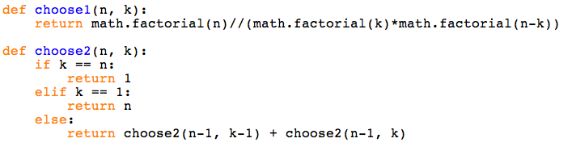
Pascal's identity
"n choose k" can also be defined using recursion
  select a "special" element of the list (e.g., lottery ball #1)
  |subsets| = |subsets that include special element| + |subsets that don't|
  e.g., choose 4 out of 42 lottery balls =
    choose 3 out of 41 balls (includes 1) +
    choose 4 out of 41 balls (doesn't include 1)

Slide 12
Application: card counting
a standard deck of cards has 52 cards divided into 4 suits
    2S 3S 4S 5S 6S 7S 8S 9S TS JS QS KS AS
    2H 3H 4H 5H 6H 7H 8H 9H TH JH QH KH AH
    2D 3D 4D 5D 6D 7D 8D 9D TD JD QD KD AD
    2C 3C 4C 5C 6C 7C 8C 9C TC JC QC KC AC
how many different 4-of-a-kind hands are there?
  can define a bijection with the sequence:
  rank of matching cards, rank of 5th card, suit of 5th card
  e.g., 5S-5C-5H-5D-AS → '5AS'
  Generalized Product Rule:
    |sequences| = |rank of matching|*|rank of 5th|*|suit of 5th|
    = 13 * 12 * 4
    = 624
  there are "52 choose 5" possible hands = 52!/(47!5!) = 2,598,960
  odds of drawing 4-of-a-kind are 624/2598960 ≈ 1/4165

Slide 13
Application: card counting
how many different full house hands are there?
  can define a mapping with the sequence:
  rank of 3, suits of 3, rank of 2, suits of 2
  e.g., QH-QD-QS-4C-4S → 'QHDS4CS'
  Generalized Product Rule:
    |sequences| = |rank of 3|*|suits of 3|*|rank of 2|*|suits of 2|
    = 13 * (4*3*2) * 12 * (4*3)
    = 13 * 24 * 12 * 12
    = 13 * 24/6 * 12 * 24/4
    = 44,928
  odds of drawing a full house are 44928/2598960 ≈ 1/58
WRONG: the mapping is not a bijection
QHDS4CS and QDSH4CS map to the same hand

Slide 14
Application: card counting
there are many sequences that map to the same hand
  'QHDS4CS' 'QHSD4CS' 'QDHS4CS' 'QDSH4CS' 'QSDH4CS' 'QSHD4CS'
  'QHDS4SC' 'QHSD4SC' 'QDHS4SC' 'QDSH4SC' 'QSDH4SC' 'QSHD4SC'
  note: 3! = 6 permutations of 3 suits, 2! = 2 permutations of 2 suits
  this is a 12-1 mapping, so 44928/12 = 3,744 unique hands
  odds of drawing a full house are 3744/2598960 ≈ 1/694
or, could utilize 'choose' to account for the permutations
    |sequences| = |rank of 3|*|suits of 3|*|rank of 2|*|suits of 2|
    = 13 * (4 choose 3) * 12 * (4 choose 2)
    = 13 * 4!/(3!1!) * 12 * 4!/(2!2!)
    = 13 * 24/6 * 12 * 24/4
    = 3,744

Slide 15
Application: card counting
how many different 2-pair hands are there?
  can define a mapping with the sequence:
  rank 1st pair, suits 1st pair, rank 2nd pair, suits 2nd pair, rank of extra, suit of extra
  e.g., 4S-4C-3H-3C-9D → '4SC3HC9D'
    again, not a bijection:
    '4SC3HC9D' '4SC3CH9D' '4CS3HC9D' '4CS3CH9D'
  '3HC4SC9D' '3HC4CS9D' '3CH4SC9D' '3CH4CS9D'
  Generalized Product Rule:
    |sequences| = 13 * (4*3) * 12 * (4*3) * 11 * 4
    = 13 * 12 * 12 * 12 * 11 * 4
    = 988,416
  since 8-1 mapping, 988416/8 = 123,552 unique hands
  odds of drawing 2-pairs are 123552/2598960 ≈ 1/23

Slide 16
Set overlap
recall the Sum Rule: if S₁, ..., S_{n} are disjoint sets, then |S₁ U … U S_{n}| = |S₁|+…+|S_{n}|
  but what if the sets are not disjoint?
suppose CSDJ has 60 CSC majors, 30 GDE majors and 30 JRM majors
  that doesn't necessarily mean 120 distinct majors
    total majors = (single majors) – (dual majors) + (triple majors)
Inclusion/Exclusion Rule:
|S₁ U S₂ U … U S_{n}| = the sum of the sizes of the individual sets –
the sizes of all two-way intersections +
the sizes of all three-way intersections –
the sizes of all four-way intersections +
. . .

Slide 17
Pigeonhole principle
suppose your sock drawer contains black, brown, and white socks
  if you grab socks at random, how many must you grab to ensure a match?
Pigeonhole Principle: if |X| > |Y|, then for every total function f : X → Y, there exist two different elements of X that are mapped to the same element of Y
  need to grab 4 socks to make |socks| > |colors|
  how many people must be in a room to ensure at least one shared birthday?
  (only requires 23 for 50% probability; 57 for a 99% probability)

Slide 18
Direct proofs
the simplest kind of proof is a logical explanation or demonstration
CLAIM: The best case for sequential search is O(1)
PROOF: Suppose the item to be found is in the first index. Then sequential search will find it on the first check. You can't find something in fewer than one check.
CLAIM: you can add to either end of a doubly-linked list in O(1) time.
PROOF:
    add at front front = new DNode(3, null, front); → O(1)
              if (front.getNext() == null) { → O(1)
              back = front; → O(1)
              }
              else {
              front.getNext().setPrevious(front); → O(1)
              }
    add at back back = new DNode(3, back, null); → O(1)
    if (back.getPrevious() == null) { → O(1)
              front = back → O(1)
              }
              else {
              back.getPrevious().setNext(back); → O(1)
              }

Slide 19
Proof by contradiction
to disprove something, all you need to do is find a counter-example
CLAIM: every set has an even number of elements.
DISPROOF: { 4 }
however, you can't prove a general claim just by showing examples
CLAIM: there is no largest integer
to prove a claim by contradiction
  assume the opposite and find a logical contradiction
  CLAIM: there is no largest integer
  PROOF: Assume there exists a largest integer. Call that largest integer N.
  But N+1 is also an integer (since the sum of two integers is an integer), and N+1 > N.
  This contradicts our assumption, so the original claim must be true.

Slide 20
Proof by induction
inductive proofs are closely related to recursion
  prove a parameterized claim by building up from a base case
To prove some property is true for all N:
  BASE CASE: Show that the property is true for smallest possible value of N.
  HYPOTHESIS: Assume the property is true for all N < X (for some X)
  INDUCTIVE STEP: Show that that the property is true for X.
CLAIM: 1+2+…+N = N(N+1)/2
  BASE CASE: N=1. 1 = 1(1+1)/2 ✓
  HYPOTHESIS: Assume the relation holds for all N < X, e.g., 1+2+…+(X-1) = (X-1)X/2.
  INDUCTIVE STEP: Then 1+2+…+X = [1+2+…+(X-1)]+X regrouping
  = (X-1)X/2 + X by hypothesis
  = (X² – X)/2 + 2X/2 simplification
  = (X² + X)/2 simplification
  = X(X+1)/2 ✓

Slide 21
Proof by induction
N ≤ 2(N-1) for all N > 1
  BASE CASE: N=2. 2 ≤ 2(1) = 2(2-1) ✓
  HYPOTHESIS: Assume true for all N < X (for some X).
  INDUCTIVE STEP?
N ≤ 2^{N} for all N > 0
  BASE CASE: N=1. 1 ≤ 2 = 2¹ ✓
  HYPOTHESIS: Assume true for all N < X (for some X).
  INDUCTIVE STEP?

Slide 22
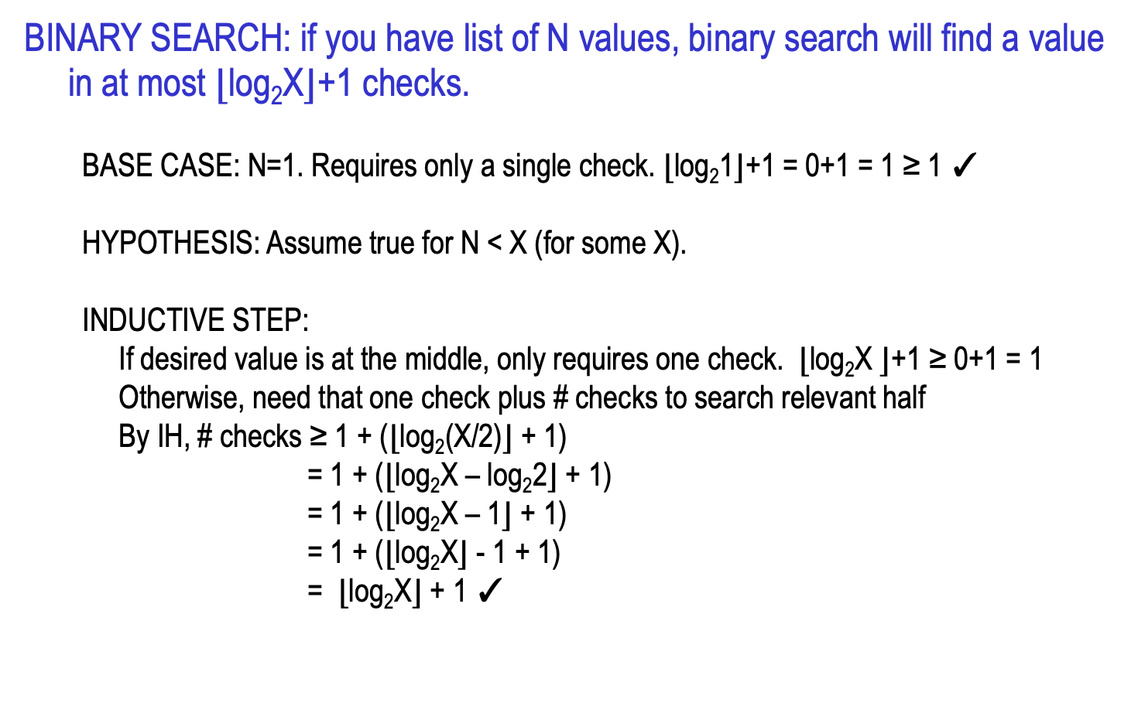
Proof by induction
BINARY SEARCH: if you have list of N values, binary search will find a value in at most ⌊log₂X⌋+1 checks.
  BASE CASE: N=1. Requires only a single check. ⌊log₂1⌋+1 = 0+1 = 1 ≥ 1 ✓
  HYPOTHESIS: Assume true for N < X (for some X).
  INDUCTIVE STEP:
  If desired value is at the middle, only requires one check. ⌊log₂X ⌋+1 $\text{≥}$ 0+1 = 1
  Otherwise, need that one check plus # checks to search relevant half
  By IH, # checks ≥ 1 + (⌊log₂(X/2)⌋ + 1)
  = 1 + (⌊log₂X – log₂2⌋ + 1)
  = 1 + (⌊log₂X – 1⌋ + 1)
  = 1 + (⌊log₂X⌋ - 1 + 1)
  = ⌊log₂X⌋ + 1 ✓

Slide 23
Proof by induction
FUNDAMENTAL THEOREM OF ARITHMETIC: every integer N > 1 is either prime or the product of primes
  BASE CASE: N=2. 2 is prime. ✓
  HYPOTHESIS: Assume true for N < X (for some X).
  INDUCTIVE STEP?
  Either X is a prime number or not.
  If X is prime, the assertion is proven.
  If not, then X = x₁*x₂*…*x_{k}, where each x_{i} < X (by the definition of non-prime).
  By the induction hypothesis,
  each x_{i} is either prime or a product of primes x_{i}= p_{i1}*…*p_{ij}
  Thus, X = x₁*x₂*…*x_{k =} p₁₁*…*p_{1j} * . . . * p_{k1}*…*p_{kj} is a product of primes. ✓

Slide 24
Exercise: prove by induction
  A pyramid of blocks with height H consists of H(H+1)/2 blocks.
  BASE CASE:
  HYPOTHESIS:
  INDUCTIVE STEP:

