Slide 1
CSC 321: Data Structures
Fall 2018
See online syllabus (also available through BlueLine):
http://dave-reed.com/csc321
Course goals:
To understand fundamental data structures (lists, stacks, queues, sets, maps, and linked structures) and be able to implement software solutions to problems using these data structures.
To achieve a working knowledge of various mathematical structures essential for the field of computer science, including graphs, trees, and networks.
To develop analytical techniques for evaluating the efficiency of data structures and programs, including counting, asymptotics, and recurrence relations.
To be able to design and implement a program to model a real-world system, selecting and implementing appropriate data structures.

Slide 2
221 vs. 222 vs. 321
221: intro to programming via scripting
focused on the design & analysis of small scripts (in Python)
introduced fundamental programming concepts
variables, assignments, expressions, I/O
control structures (if, if-else, while, for), lists
functions, parameters, intro to OO
you should be familiar with these concepts (we will do some review next week, but you should review your own notes & text)
222: object-oriented programming
focused on the design & analysis of more complex programs (in Java)
utilized OO approach & techniques for code reuse
classes, fields, methods, objects
interfaces, inheritance, polymorphism, object composition
searching & sorting, Big-Oh efficiency, recursion
321: data-driven programming & analysis
focus on problems that involve storing & manipulating large amounts of data
focus on understanding/analyzing/selecting appropriate structures for problems
standard collections (lists, stacks, queues, trees, sets, maps)
mathematical structures (trees, graphs, networks)
analysis techniques (counting, asymptotics, recurrence relations)

Slide 3
When problems start to get complex…
…choosing the right algorithm and data structures are important
e.g., phone book lookup, Sudoku solver, path finder
must develop problem-solving approaches (e.g., brute force, backtracking)
be able to identify appropriate data structures (e.g., lists, trees, sets, maps)
example: dictionary lookup
you are given a large dictionary of 100K+ words
want to be able to store and lookup words
store in an unsorted ArrayList, perform sequential search
insert into a sorted ArrayList, perform binary search
store in an unsorted ArrayList, sort before each sequence of binary searches
store in a LinkedList or TreeSet (?) or HashSet (?)
the efficiency of each approach depends not only on the size of the dictionary, but the pattern of operations
sequence of adds followed by sequence of searches?
mixture of adds and searches?

Slide 4
Another example: anagram finder
you are given a large dictionary of 100K+ words
repeatedly given a word, must find all anagrams of that word
pale → leap pale peal plea
steal→ least setal slate stale steal stela taels tales teals tesla
banana → banana
there are many choices to be made & many "reasonable" decisions
how do you determine if two words are anagrams?
should you store the dictionary words internally? if so, how?
should you preprocess the words? if so, how?
is a simplistic approach going to be efficient enough to handle 100K+ words?
how do you test your solution?

Slide 5
Possible implementations
generate every permutation of the letters, check to see if a word
how many permutations are there?
will this scale?
compare against each word in the dictionary and test if an anagram
how costly to determine if two words are anagrams?
how many comparisons will be needed?
will this scale?
preprocess all words in the dictionary and index by their sorted form
e.g., store "least" and "steal" together, indexed by "aelst"
how much work is required to preprocess the entire dictionary?
how much easier is the task now?

Slide 6
HW1: credit card numbers
HW1 is posted
part1 is to be completed in 2-person teams, due in 1.5 weeks
we will meet to go over the code, go over holes in your knowledge/skills
part2 is to be completed individually, builds on part1 code
both parts involve verifying credit card numbers
Visa, Mastercard & Discover use 16-digits (6 for issuer, 9 for user account, 1 check)
American Express uses 15-digits (6 for issuer, 8 for user account, 1 check)
as a security measure, the numbers must conform to the Luhn Formula
4289 0298 1524 0026
4 2 8 9 0 2 9 8 1 5 2 4 0 0 2 6
8 16 0 18 2 4 0 4
8+2+7+9+0+2+9+8+2+5+4+4+0+0+4+6 = 70

Slide 7
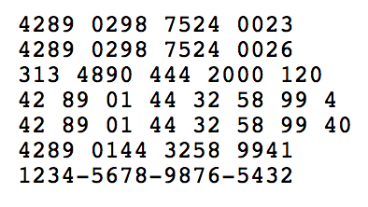
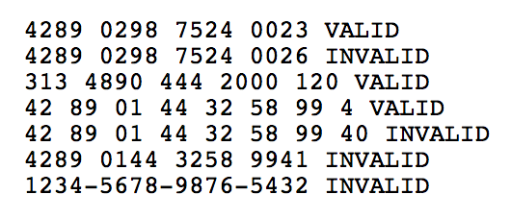
HW1 part 1: working in pairs
read in digit sequences from a file
file name should be specified by user
one sequence per line (varying lengths), ignore spaces
for each, determine and display if valid or invalid
ADVICE: work with your partner – you both should understand everything in your program
be introspective – identify holes, help each other, come see me!

Slide 8
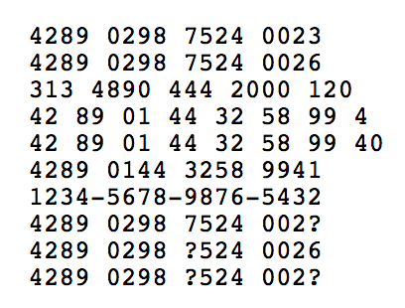
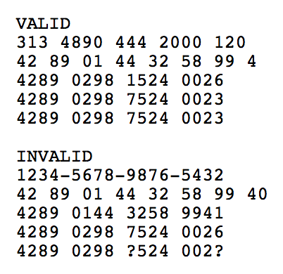
HW1 part 2: working individually
display valid/invalid sequences in groups
within each group, display in numerical order (ignoring spaces)
in the case of a corrupted digit, determine the missing digit
a corrupted digit specified as '?'
NOTE: this part must be completed individually, building upon your team's code
come see me A LOT!

