Slide 1
CSC 321: Data Structures
Fall 2018
Lists, stacks & queues
Collection classes:
List (ArrayList, LinkedList), Set (TreeSet, HashSet), Map (TreeMap, HashMap)
ArrayList performance and implementation
LinkedList performance
Stacks
Queues

Slide 2
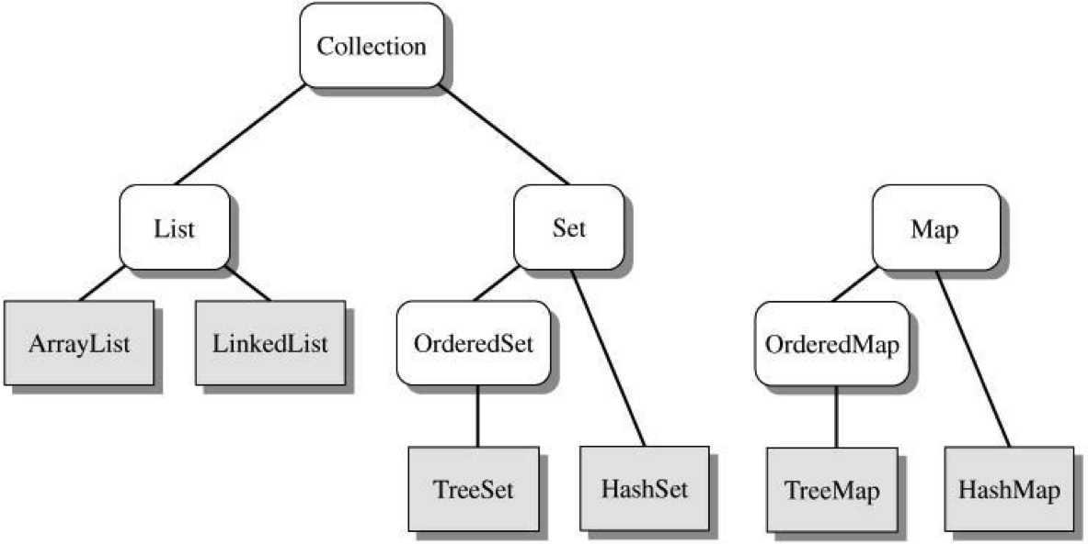
Java Collection classes
a collection is an object (i.e., data structure) that holds other objects
the Java Collection Framework is a group of generic collections
defined using interfaces abstract classes, and inheritance
more on Sets & Maps later

Slide 3
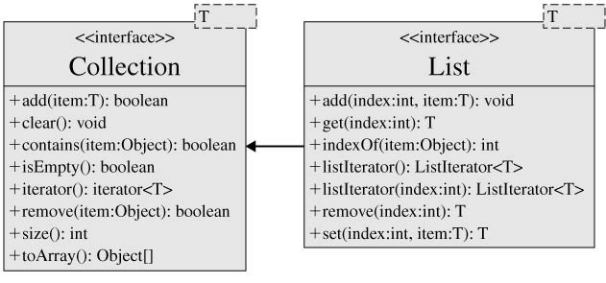
ArrayList performance
recall: ArrayList implements the List interface
which is itself an extension of the Collection interface
underlying list structure is an array
get(index), add(item), set(index, item) → O(1)
add(index, item), indexOf(item), contains(item),
remove(index), remove(item) → O(N)

Slide 4
ArrayList implementation
public class MyArrayList<E> implements Iterable<E>{
private static final int INIT_SIZE = 10;
private E[] items;
private int numStored;
public MyArrayList() {
this.clear();
}
public void clear() {
this.numStored = 0;
this.ensureCapacity(INIT_SIZE);
}
public void ensureCapacity(int newCapacity) {
if (newCapacity > this.size()) {
E[] old = this.items;
this.items = (E[]) new Object[newCapacity];
for (int i = 0; i < this.size(); i++) {
this.items[i] = old[i];
}
}
}
.
.
.
the ArrayList class has as fields
the underlying array
number of items stored
the default initial capacity is defined by a constant
capacity != size
interestingly: you can't create a generic array
this.items = new E[capacity]; // ILLEGAL
can work around this by creating an array of Objects, then casting to the generic array type

Slide 5
ArrayList: add
the add method
throws an exception if the index is out of bounds
calls ensureCapacity to resize the array if full
shifts elements to the right of the desired index
finally, inserts the new value and increments the count
the add-at-end method calls this one
public void add(int index, E newItem) {
this.rangeCheck(index, "ArrayList add()", this.size());
if (this.items.length == this.size()) {
this.ensureCapacity(2*this.size() + 1);
}
for (int i = this.size(); i > index; i--) {
this.items[i] = this.items[i-1];
}
this.items[index] = newItem;
this.numStored++;
}
private void rangeCheck(int index, String msg, int upper) {
if (index < 0 || index > upper)
throw new IndexOutOfBoundsException("\n" + msg +
": index " + index + " out of bounds. " +
"Should be in the range 0 to " + upper);
}
public boolean add(E newItem) {
this.add(this.size(), newItem);
return true;
}

Slide 6
ArrayList: size, get, set, indexOf, contains
size method
returns the item count
get method
checks the index bounds, then simply accesses the array
set method
checks the index bounds, then assigns the value
indexOf method
performs a sequential search
contains method
uses indexOf
public int size() {
return this.numStored;
}
public E get(int index) {
this.rangeCheck(index, "ArrayList get()", this.size()-1);
return items[index];
}
public E set(int index, E newItem) {
this.rangeCheck(index, "ArrayList set()", this.size()-1);
E oldItem = this.items[index];
this.items[index] = newItem;
return oldItem;
}
public int indexOf(E oldItem) {
for (int i = 0; i < this.size(); i++) {
if (oldItem.equals(this.items[i])) {
return i;
}
}
return -1;
}
public boolean contains(E oldItem) {
return (this.indexOf(oldItem) >= 0);
}

Slide 7
ArrayList: remove
the remove method
checks the index bounds
then shifts items to the left and decrements the count
note: could shrink size if becomes ½ empty
the other remove
calls indexOf to find the item, then calls remove(index)
public void remove(int index) {
this.rangeCheck(index, "ArrayList remove()", this.size()-1);
for (int i = index; i < this.size()-1; i++) {
this.items[i] = this.items[i+1];
}
this.numStored--;
}
public boolean remove(E oldItem) {
int index = this.indexOf(oldItem);
if (index >= 0) {
this.remove(index);
return true;
}
return false;
}

Slide 8
ArrayLists vs. LinkedLists
LinkedList is an alternative List structure
stores elements in a sequence but allows for more efficient interior insertion/deletion
elements contain links that reference previous and successor elements in the list
can access/add/remove from either end in O(1)
if given a reference to an interior element, can reroute the links to add/remove an element in O(1) [more later when we consider iterators]
getFirst(), getLast(),
add(item), addFirst(), addLast()
removeFirst(), removeLast() → O(1)
get(index), set(index, item),
add(index, item), indexOf(item), contains(item),
remove(index), remove(item) → O(N)
front
null
4
5
6
null
back

Slide 9
Lists & stacks
stack
a stack is a special kind of (simplified) list
can only add/delete/look at one end (commonly referred to as the top)
DATA: sequence of items
OPERATIONS: push on top, peek at top, pop off top, check if empty, get size
these are the ONLY operations allowed on a stack
— stacks are useful because they are simple, easy to understand
— each operation is O(1)
PEZ dispenser
deck of cards
cars in a driveway
method activation records (later)
a stack is also known as
push-down list
last-in-first-out (LIFO) list

Slide 10
Stack examples
top
3
peek() → 3
top
3
2
2
1
1
push(4)
pop() → 3
top
4
3
2
top
2
1
1

Slide 11
Stack exercise
start with empty stack
PUSH 1
PUSH 2
PUSH 3
PEEK
PUSH 4
POP
POP
PEEK
PUSH 5

Slide 12
Stack<T> class
since a stack is a common data structure, a predefined Java class exists
import java.util.Stack;
Stack<T> is generic to allow any type of object to be stored
Stack<String> wordStack = new Stack<String>();
Stack<Integer> numStack = new Stack<Integer>();
standard Stack<T> methods
public T push(T item); // adds item to top of stack
public T pop(); // removes item at top of stack
public T peek(); // returns item at top of stack
public boolean empty(); // returns true if empty
public int size(); // returns size of stack

Slide 13
Stack application
consider mathematical expressions such as the following
a compiler must verify such expressions are of the correct form
(A * (B + C)) ([A * (B + C)] + [D * E])
attempt 1: count number of left and right delimeters; if equal, then OK
what about: (A * B) + )C(
attempt 2: start a counter at 0, +1 for each left delimiter and -1 for each right
if it never becomes negative and ends at 0, then OK
what about: ([A + B) + C]
stack-based solution:
start with an empty stack of characters
traverse the expression from left to right
if next character is a left delimiter, push onto the stack
if next character is a right delimiter, must match the top of the stack

Slide 14
Delimiter matching
import java.util.Stack;
public class DelimiterChecker {
private static final String DELIMITERS = "()[]{}<>";
public static boolean check(String expr) {
Stack<Character> delimStack = new Stack<Character>();
for (int i = 0; i < expr.length(); i++) {
char ch = expr.charAt(i);
if (DelimiterChecker.isLeftDelimiter(ch)) {
delimStack.push(ch);
}
else if (DelimiterChecker.isRightDelimiter(ch)) {
if (!delimStack.empty() &&
DelimiterChecker.match(delimStack.peek(), ch)) {
delimStack.pop();
}
else {
return false;
}
}
}
return delimStack.empty();
}
}
how would you implement the helpers? isLeftDelimiter
isRightDelimiter
match

Slide 15
Run-time stack
when a method is called in Java (or any language):
suspend the current execution sequence
allocate space for parameters, locals, return value, …
transfer control to the new method
when the method terminates:
deallocate parameters, locals, …
transfer control back to the calling point (& possibly return a value)
note: method invocations are LIFO entities
main is called first, terminates last
if main calls foo and foo calls bar, then
bar terminates before foo which terminates before main
➔ a stack is a natural data structure for storing information about method calls and the state of the execution

Slide 16
Run-time stack (cont.)
an activation record stores info (parameters, locals, …) for each invocation of a method
when the method is called, an activation record is pushed onto the stack
when the method terminates, its activation record is popped
note that the currently executing method is always at the top of the stack
public class Demo {
public static void main(String[] args) {
int x = 12;
Demo.foo(x);
System.out.println("main " + x);
}
public static void foo(int a) {
a++;
System.out.println("foo " + a);
}
}
Foo(a=12):
a ⬅ 13
...
main(?):
x ⬅ 12
...
main(?):
x ⬅ 12
...
main(?):
x ⬅ 12
...
automatically start with main
when foo called, push
when foo done, pop
when main done, pop & end

Slide 17
Lists & queues
queues
a queue is another kind of simplified list
add at one end (the back), delete/inspect at other end (the front)
DATA: sequence of items
OPERATIONS: add(enqueue/offer at back), remove(dequeue off front),
peek at front, check if empty, get size
these are the ONLY operations allowed on a queue
— queues are useful because they are simple, easy to understand
— each operation is O(1)
line at bank, bus stop, grocery store, …
printer jobs
CPU processes
voice mail
a queue is also known as
first-in-first-out (FIFO) list

Slide 18
Queue examples
peek() → 1
3
2
1
3
2
1
back
front
back
front
remove() → 1
add(4)
4
3
2
1
3
2
back
front
back
front

Slide 19
Queue exercise
start with empty queue
ADD 1
ADD 2
ADD 3
PEEK
ADD 4
REMOVE
REMOVE
PEEK
ADD 5

Slide 20
Queue interface
Queue<Integer> numQ = new LinkedList<Integer>();
for (int i = 1; i <= 10; i++) {
numQ.add(i);
}
while ( !numQ.empty() ) {
System.out.println(numQ.peek());
numQ.remove();
}
a queue is a common data structure, with many variations
Java provides a Queue interface
also provides several classes that implement the interface (with different underlying implementations/tradeoffs)
java.util.Queue<T> interface
public boolean add(T newItem);
public T remove();
public T peek();
public boolean empty();
public int size();
java.util.LinkedList<T> implements the Queue interface
Queue<Integer> q1 = new LinkedList<Integer>();
Queue<Integer> q2 = new LinkedList<Integer>();
for (int i = 1; i <= 10; i++) {
q1.add(i);
}
while ( !q1.empty() ) {
q2.add(q1.remove());
}
while ( !q2.empty() ) {
System.out.println(q2.remove());
}

Slide 21
Queues and simulation
queues are especially useful for simulating events
e.g., consider simulating a 1-teller bank
customers enter a queue and are served FCFS (or FIFO)
can treat the arrival of a customer and their transaction length as random events
What is the time duration (in minutes) to be simulated? 10
What percentage of the time (0-100) does a customer arrive? 30
2: Adding customer 1 (job length = 4)
2: Serving customer 1 (finish at 6)
4: Adding customer 2 (job length = 3)
6: Finished customer 1
6: Serving customer 2 (finish at 9)
9: Finished customer 2
if multiple tellers are available,
could have a separate queue for each teller (FAIRNESS ISSUES?)
or, could still have one queue, whenever a teller becomes free he/she serves the customer at the front

