Slide 1
CSC 321: Data Structures
Fall 2018
Hash tables
HashSet & HashMap
hash table, hash function
collisions
linear probing, lazy deletion, clustering, rehashing
chaining
Java hashCode method

Slide 2
HashSet & HashMap
recall: TreeSet & TreeMap use an underlying binary search tree (actually, a red-black tree) to store values
as a result, add/put, contains/get, and remove are O(log N) operations
iteration over the Set/Map can be done in O(N)
the other implementations of the Set & Map interfaces, HashSet & HashMap, use a "magic" data structure to provide O(1) operations*
*legal disclaimer: performance can degrade to O(N) under bad/unlikely conditions
however, careful setup and maintenance can deliver O(1) in practice
the underlying data structure is known as a Hash Table

Slide 3
Hash tables
a hash table is a data structure that supports constant time insertion, deletion, and search on average
degenerative performance is possible, but unlikely
it may waste some storage
iteration order is not defined (and may even change over time)
idea: data items are stored in a table, based on a key
the key is mapped to an index in the table, where the data is stored/accessed
example: letter frequency
want to count the number of occurrences of each letter in a file
have an array of 26 counters, map each letter to an index
to count a letter, map to its index and increment
"A" → 0
1
0
3
. . .
0
"B" → 1
"C" → 2
"Z" → 25

Slide 4
Mapping examples
extension: word frequency
must map entire words to indices, e.g.,
"A" → 0 "AA" → 26 "BA" → 52 . . .
"B" → 1 "AB" → 27 "BB" → 53 . . .
. . . . . . . . .
"Z" → 25 "AZ" → 51 "BZ" → 77 . . .
PROBLEM?
mapping each potential item to a unique index is generally not practical
# of 1 letter words = 26
# of 2 letter words = 26² = 676
# of 3 letter words = 26³ = 17,576
. . .
even if you limit words to at most 8 characters, need a table of size 217,180,147,158
for any given file, the table will be mostly empty!

Slide 5
Table size < data range
since the actual number of items stored is generally MUCH smaller than the number of potential values/keys:
can have a smaller, more manageable table
e.g., table size = 26
possible mapping: map word based on first letter
"A*" → 0 "B*" → 1 . . . "Z*" → 25
e.g., table size = 1000
possible mapping: add ASCII values of letters, mod by 1000
"AB" → 65 + 66 = 131
"BANANA" → 66 + 65 + 78 + 65 + 78 + 65 = 417
"BANANABANANABANANA" → 417 + 417 + 417 = 1251 % 1000 = 251
POTENTIAL PROBLEMS?

Slide 6
Collisions
the mapping from a key to an index is called a hash function
the hash function can be written independent of the table size
if it maps to an index > table size, simply wrap-around (i.e., index % tableSize)
since |range(hash function)| < |domain(hash function)| , Pigeonhole Principle ensures collisions are possible (v₁ & v₂ → same index)
"ACT" → 67 + 65 + 84 = 216 "CAT" → 67 + 65 + 84 = 216
techniques exist for handling collisions, but they are costly (LATER)
it's best to avoid collisions as much as possible – HOW?
want to be sure that the hash function distributes the key evenly
e.g., "sum of ASCII codes" hash function
OK if table size is 1000
BAD if table size is 10,000
most words are ≤ 10 letters, so max sum of ASCII codes = 1,270
so most entries are mapped to first 13% of table

Slide 7
Better hash function
a good hash function for words should
produce an even spread, regardless of table size
take order of letters into account (to handle anagrams)
the hash function used by java.util.String multiplies the ASCII code for each character by a power of 31
hashCode() = char₀*31^{(len-1)} +char₁*31^{(len-2)} + char₂*31^{(len-3)} + … + char_{(len-1)}
where len = this.length(), char_{i} = this.charAt(i):
/**
* Hash code for java.util.String class
* @return an int used as the hash index for this string
*/
private int hashCode() {
int hashIndex = 0;
for (int i = 0; i < this.length(); i++) {
hashIndex = (hashIndex*31 + this.charAt(i));
}
return hashIndex;
}

Slide 8
Word frequency example
returning to the word frequency problem
pick a hash function
pick a table size
store word & associated count in the table
as you read in words,
map to an index using the hash function
if an entry already exists, increment
otherwise, create entry with count = 1
0
. . .
"FOO"
1
1
2
"BAR"
3
999
WHAT ABOUT COLLISIONS?

Slide 9
Linear probing
linear probing is a simple strategy for handling collisions
if a collision occurs, try next index & keep looking until an empty one is found (wrap around to the beginning if necessary)
example: assume "first letter" hash function
insert "BOO", "BAR", "COO", "BOW, …
linear probing requires "lazy deletion"
when you delete an item, you can't just empty
the location, since it would leave a hole
subsequent searches would reach that whole
and stop probing
instead, leave a marker (a.k.a a tombstone)
in that spot 0 can be overwritten but not
skipped when probing
example: given above insertions
delete "BAR", search for "COO"
0
. . .
1
2
3
4
25

Slide 10
Clustering and load factor
0
1
2
3
4
5
6
7
"BOO"
"BIZ"
"COO"
"DOG"
in practice, probes are not independent
as the table fills, clusters appear that degrade performance
maps to 0, 5-7 require 1 check
map to 4 requires 2 checks
map to 3 requires 3 checks
map to 2 requires 4 checks
map to 1 requires 5 checks
average = 18/8 = 2.25 checks
the load factor λ is the fraction of the table that is full
empty table λ = 0 half full table λ = 0.5 full table λ = 1
THEOREM: assuming a reasonably large table, the average number of locations examined per insertion is roughly (1 + 1/(1-λ)²)/2
empty table (1 + 1/(1 - 0)²)/2 = 1
half full (1 + 1/(1 – .5)²)/2 = 2.5
3/4 full (1 + 1/(1 - .75)²)/2 = 8.5
9/10 full (1 + 1/(1 - .9)²)/2 = 50.5

Slide 11
Rehashing
as long as you keep the load factor low (e.g., < 0.75), inserting, deleting and searching a hash table are all O(1) operations
if the table becomes too full, then must resize
create new table at least twice as big
just copy over table entries to same locations???
NO! when you resize, you have to rehash existing entries
new table size → new hash function (+ different wraparound)
LET hashCode = word.length()
ADD "UP"
ADD "OUT"
ADD "YELLOW"
0
1
2
3
4
5
6
7
NOW RESIZE AND REHASH
0
1
2
3

Slide 12
Chaining
linear probing (or variants) were initially used when memory was expensive
clustering, lazy deletion, and rehashing are all issues
modern languages like Java utilize a different approach
chaining:
each entry in the hash table is a bucket (list)
when you add an entry, hash to correct index then add to bucket
when you search for an entry, hash to correct index then search sequentially
0
1
2
3
25
. . .
"AND"
"APPLE"
"CAT"
"COO"
"COWS"
"DOG"

Slide 13
Analysis of chaining
in practice, chaining is generally faster than probing
cost of insertion is O(1) – simply map to index and add to list
cost of search is proportional to number of items already mapped to same index
e.g., using naïve "first letter" hash function, searching for "APPLE" might requires traversing a list of all words beginning with 'A'
if hash function is fair, then average size of each bucket is λ (load factor)
→ average cost of a successful search is roughly λ/2
chaining is sensitive to the load factor, but not as much as probing – WHY?
chaining uses more memory – WHY?

Slide 14
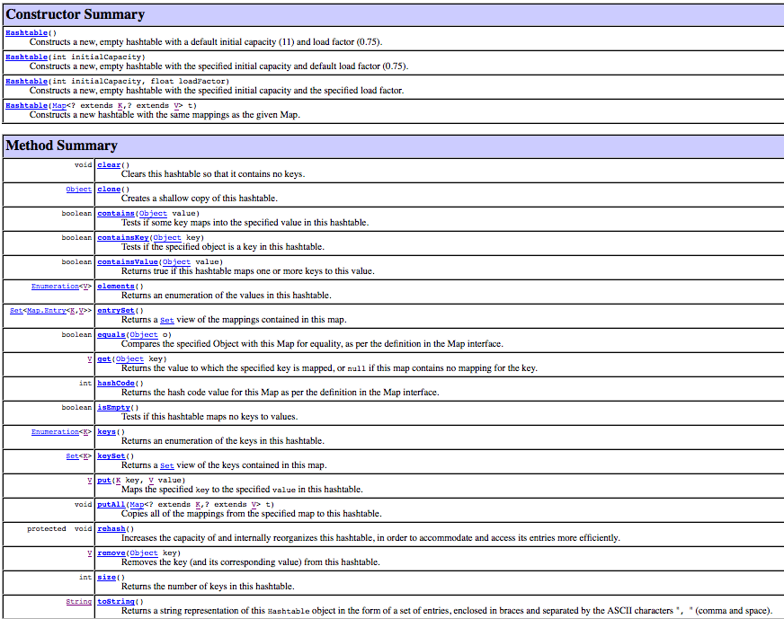
Hashtable class
Java provides a basic hash table implementation
utilizes chaining
can specify the initial table size & threshold for load factor
can even force a rehashing
not commonly used, instead provides underlying structure for HashSet & HashMap

Slide 15
HashSet & HashMap
java.util.HashSet and java.util.HashMap use hash table w/ chaining
e.g., HashSet<String> HashMap<String, Integer>
0
1
2
3
25
"AND"
"APPLE"
0
1
2
3
25
"AND"
4
"APPLE"
1
"CAT"
"COO"
"COWS"
"CAT"
2
"COO"
1
"COWS"
3
"DOG"
"DOG"
2
.
.
.
.
.
.
defaults: table size = 16, max capacity before rehash = 75%
can override these defaults in the HashSet/HashMap constructor call
note: iterating over a HashSet or HashMap is: O(num stored + table size) WHY?

Slide 16
Word frequencies (again)
import java.util.Map;
import java.util.HashMap;
import java.util.Scanner;
import java.io.File;
public class WordFreq {
private Map<String, Integer> words;
public WordFreq() {
words = new HashMap<String, Integer>();
}
public WordFreq(String filename) {
this();
try {
Scanner infile = new Scanner(new File(filename));
while (infile.hasNext()) {
String nextWord = infile.next();
this.add(nextWord);
}
}
catch (java.io.FileNotFoundException e) {
System.out.println("FILE NOT FOUND");
}
}
public void add(String newWord) {
String cleanWord = newWord.toLowerCase();
if (words.containsKey(cleanWord)) {
words.put(cleanWord, words.get(cleanWord)+1);
}
else {
words.put(cleanWord, 1);
}
}
public void showAll() {
for (String str : words.keySet()) {
System.out.println(str + ": " + words.get(str));
}
}
}
using HashMap instead of TreeMap
containsKey, get & put operations are all O(1)*
however, iterating over the keySet (and their values) does not guarantee any order
if you really care about speed → use HashSet/HashMap
if the data/keys are comparable & order matters → use TreeSet/TreeMap

Slide 17
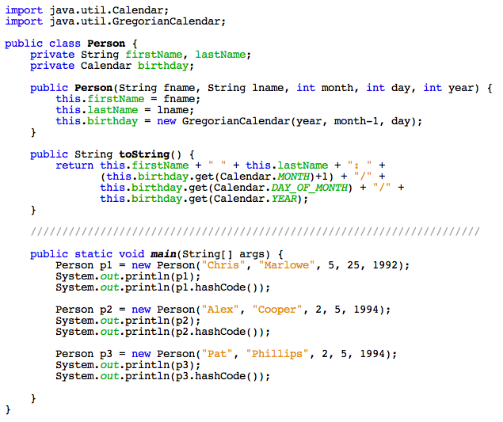
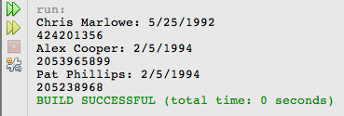
hashCode function
a default hash function is defined for every Object
uses native code to access & return the address of the object

Slide 18
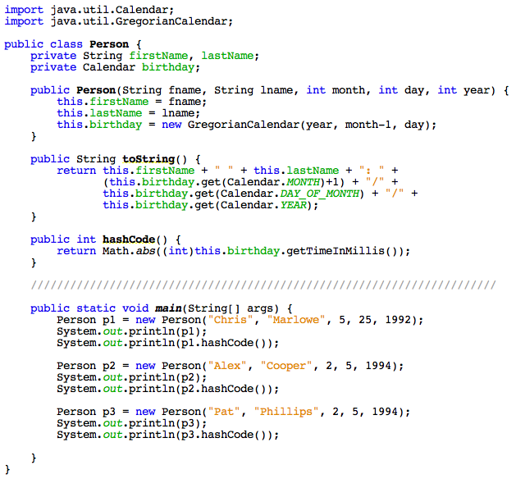
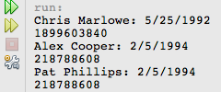
overriding hashCode v.1
can override hashCode if more class-specific knowledge helps
must consistently map the same object to the same index
must map equal objects to the same index

Slide 19
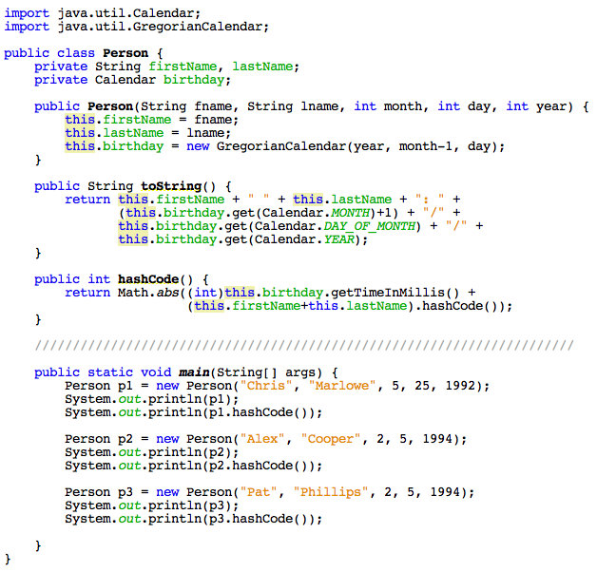
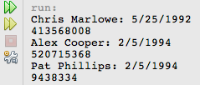
overriding hashCode v.2
to avoid birthday collisions, can also incorporate the names
utilize the String hashCode method

Slide 20
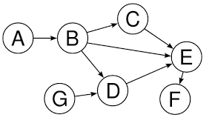
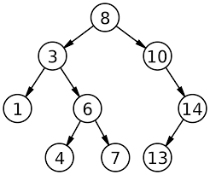
Graphs (sneak peek)
trees are special instances of the more general data structure: graphs
informally, a graph is a collection of nodes/data elements with connections
a tree is a graph in which one node has no edges coming into it (the root) and no cycles

Slide 21
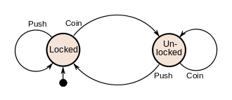
Finite State Machines (FSMs)
many useful problems can be defined using simple graphs
a Finite State Machine (a.k.a. Finite Automaton) defines a finite set of states (i.e., nodes) along with transitions between those states (i.e., edges)
e.g., the logic controlling a coin-operated turnstile
can be in one of two states: locked or unlocked
if locked, pushing → it does not allow passage & stays locked
inserting coin → unlocks it
if unlocked, pushing → allows passage & then relocks
inserting coin → keeps it unlocked

Slide 22
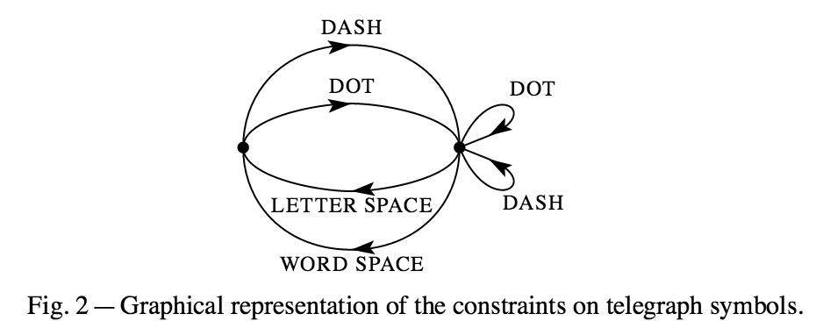
Other examples
Claude Shannon used a FSM to show constraints on Morse code
25¢
Q
D
D
can use a FSM to specify the behavior of a vending machine
adding a coin (Q, D, N) changes the state
N
35¢
0¢
N
D
5¢
15¢
Q
N
N
N
N
D
Q
30¢
10¢
N
D
20¢
D

Slide 23
HW6: Simulate a FSM
locked push locked
locked coin unlocked
unlocked push locked
unlocked coin unlocked
model a FSM by storing the edges and providing lookup methods
private HashMap<StateLabel, HashMap<EdgeLabel, StateLabel>> table;
locked
unlocked
the key to the table is the start state of an edge
the value is another map, which maps edge labels to the end states
table.get("locked") →
a map containing edges from "locked"
table.get("locked").get("coin") →
"unlocked"
coin | unlocked
push | locked
coin | unlocked
push | locked

Slide 24
HW6: Other examples
inLetter . inLetter
inLetter – inLetter
inLetter _ betweenLetters
inLetter __ betweenLetters
betweenLetters . inLetter
betweenLetters - inLetter
0cents N 5cents
0cents D 10cents
0cents Q 25cents
5cents N 10cents
5cents D 15cents
5cents Q 30cents
10cents N 15cents
10cents D 20cents
10cents Q 35cents
15cents N 20cents
15cents D 25cents
20cents N 25cents
20cents D 30cents
25cents N 30cents
25cents D 35cents
30cents N 35cents
25¢
Q
D
D
35¢
0¢
N
N
5¢
D
15¢
Q
N
N
N
N
D
Q
30¢
10¢
N
D
20¢
D

Slide 25
HW6: PathTracer
locked push locked
locked coin unlocked
unlocked push locked
unlocked coin unlocked
given a start state and sequence of edges, determine the end state

Slide 26
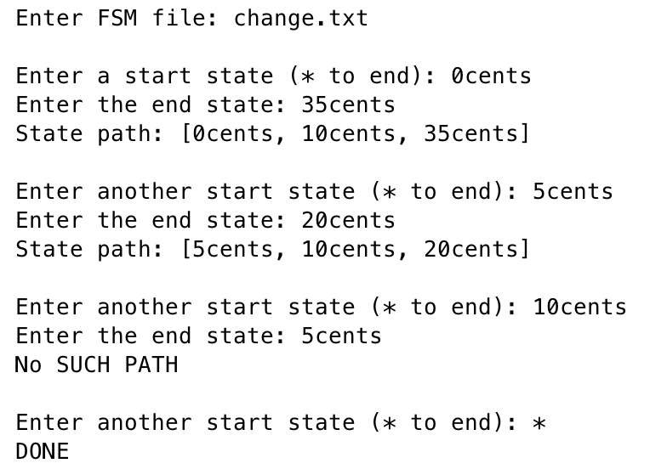
HW6: PathFinder
you are given a method that finds a shortest path between to states
fsm.findPath("0cents","35cents") → ["0cents","10cents","35cents"]
you will write a driver class that repeatedly finds and prints paths
25¢
Q
D
D
35¢
0¢
N
D
N
5¢
15¢
Q
N
D
N
N
N
10¢
Q
N
30¢
D
20¢
D

