Slide 1
CSC 321: Data Structures
Fall 2018
Graphs & search
graphs, isomorphism
simple vs. directed vs. weighted
adjacency matrix vs. adjacency lists
graph traversals
depth-first search, breadth-first search
finite automata

Slide 2
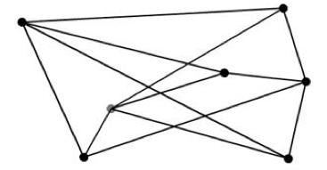
Graphs
trees are special instances of the more general data structure: graphs
informally, a graph is a collection of nodes/data elements with connections
many real-world and CS-related applications rely on graphs
the connectivity of computers in a network
cities on a map, connected by roads
cities on a airline schedule, connected by flights
Facebook friends
finite automata

Slide 3
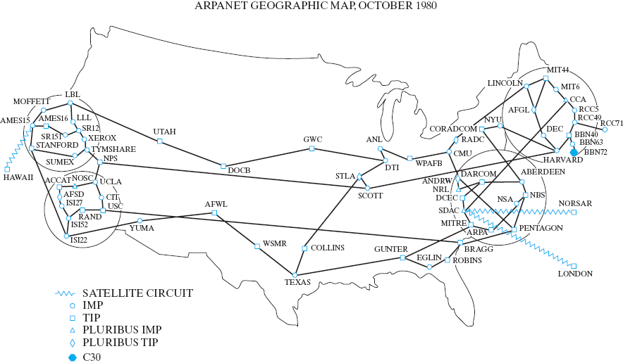
Interesting graphs

Slide 4
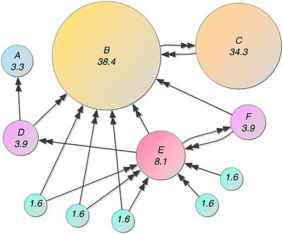
Interesting graphs
Google pagerank algorithm
the pagerank of a page is based on the number of pages that link to it and their pageranks
https://en.wikipedia.org/wiki/PageRank

Slide 5
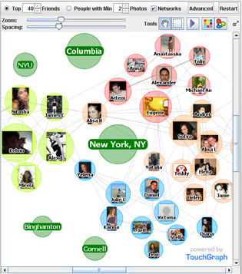
Interesting graphs
TouchGraph Facebook Browser
allows you to view all of your friends and groups as a graph
http://www.touchgraph.com/facebook

Slide 6
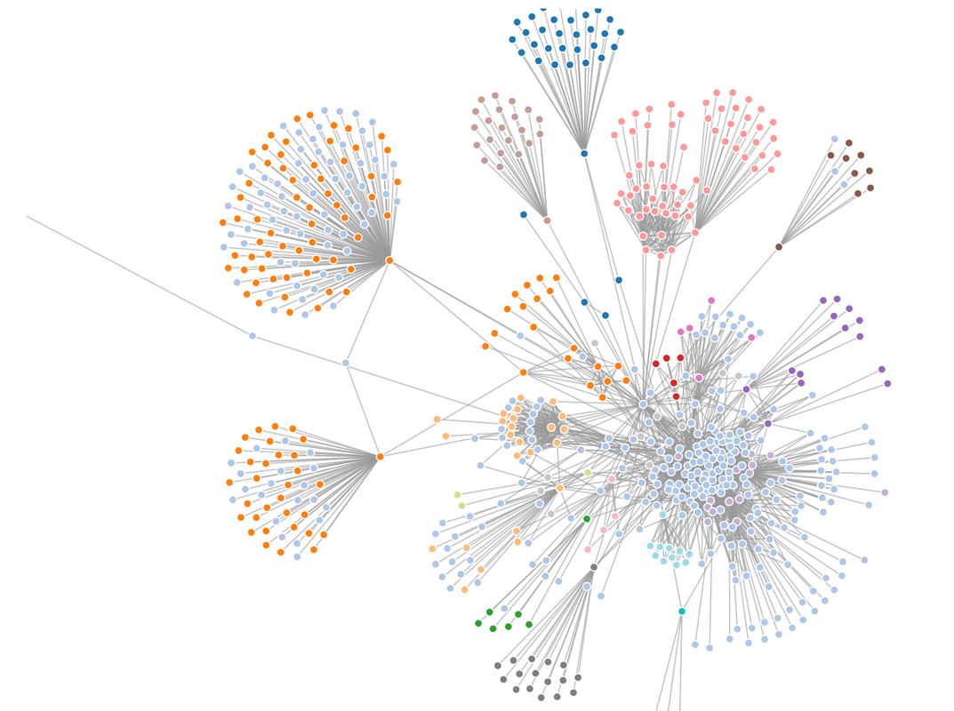
Interesting graphs
Enron email graph
was used during prosecution to identify conspirators
http://www.contextsmith.com/blog/enron-emails-help-improve-project-communication/

Slide 7
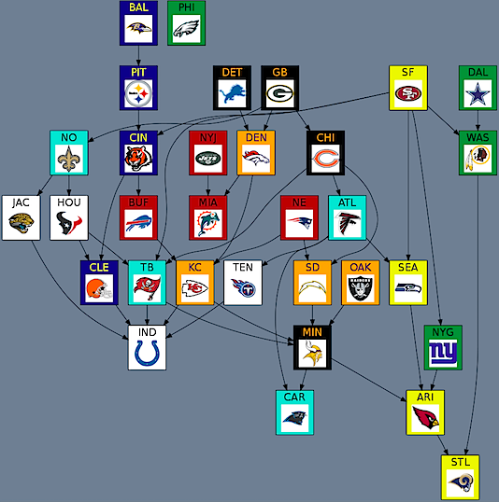
Interesting graphs
NFL 2011 @ week 11
edges from one team to another show a clear beat path
e.g., Chicago > Tampa > Indy
http://beatpaths.com/

Slide 8
Formal definition
a simple graph G consists of a nonempty set V of vertices, and a set E of edges (unordered vertex pairs)
can write simply as G = (V, E)
e.g., consider G = (V, E) where V = {a, b, c, d} and E = {{a,b}, {a, c}, {b,c}, {c,d}}
➔ DRAW IT!
graph terminology for G = (V, E)
vertices u and v are adjacent if {u, v} ∈ E (i.e., connected by an edge)
edge {u,v} is incident to vertices u and v
the degree of v is the # of edges incident with it (or # of vertices adjacent to it)
|V| = # of vertices |E| = # of edges
a path between v₁ and v_{n} is a sequence of edges from E:
[ {v₁, v₂}, {v₂, v₃}, …, {v_{n-2}, v_{n-1}}, {v_{n-1}, v_{n}} ]

Slide 9
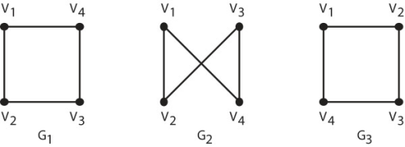
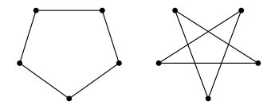
Depicting graphs
you can draw the same set of vertices & edges many different ways
are these different graphs?

Slide 10
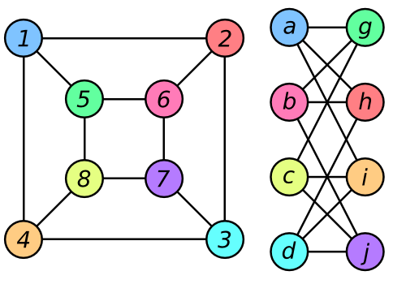
Isomorphism
how can we tell if two graphs are the same?
G₁ = (V₁, E₁) and G₂ = (V₂, E₂) are isomorphic if there is mapping f:V₁→V₂ such that
{u,v} ∈ E₁ iff {f(u), f(v)} ∈ E₂
i.e., G₁ and G2 are isomorphic if they are identical modulo a renaming of vertices

Slide 11
Simple vs. directed?
in a simple graph, edges are presumed to be bidirectional
{u,v} ∈ E is equivalent to saying {v,u} ∈ E
for many real-world applications, this is appropriate
if computer c₁ is connected to computer c₂, then c₂ is connected to c₁
if person p₁ is Facebook friends with person p₂, then p₂ is friends with p₁
however, in other applications the connection may be 1-way
a flight from city c₁ to city c₂ does not imply a return flight from c₂ to c₁
roads connecting buildings in a town can be 1-way (with no direct return route)
NFL beat paths are clearly directional

Slide 12
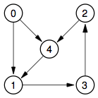
Directed graphs
a directed graph or digraph G consists of a nonempty set V of vertices, and a set E of edges (ordered vertex pairs)
draw edge (u,v) as an arrow pointing from vertex u to vertex v
e.g., consider G = (V, E) where V = {a, b, c, d} and E = {(a,b), (a, c), (b,c), (c,d)}
DRAW IT!

Slide 13
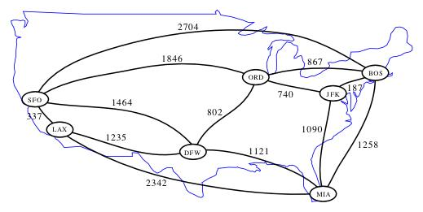
Weighted graphs
a weighted graph G = (V, E) is a graph/digraph with an additional weight function ω:E→ℜ
draw edge (u,v) labeled with its weight
shortest path from BOS to SFO?
does the fewest legs automatically imply the shortest path in terms of miles?
from Algorithm Design by Goodrich & Tamassia

Slide 14
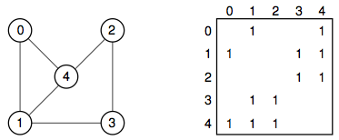
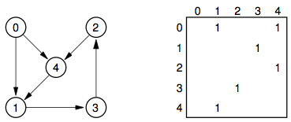
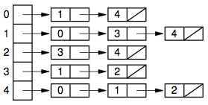
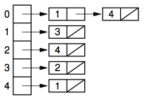
Graph data structures
an adjacency matrix is a 2-D array, indexed by the vertices
for graph G, adjMatrix[u][v] = 1 iff {u,v} ∈ E (or weights in place of 1s)
an adjacency list is an array of linked lists
for graph G, adjList[u] contains v iff {u,v} ∈ E (or weights in addition to vertex)
note: our HashMap of HashMaps was a smart implementation of an adjacency list

Slide 15
Matrix vs. list
space tradeoff
adjacency matrix requires O(|V|²) space
adjacency list requires O(|V| + |E|) space
which is better?
it depends
if the graph is sparse (few edges), then |V|+|E| < |V|² → adjacency list
if the graph is dense, i.e., |E| is O(|V|²), then |V|² < |V|+|E| → adjacency matrix
many graph algorithms involve visiting every adjacent neighbor of a node
adjacency list makes this efficient, so tends to be used more in practice

Slide 16
Java implementations
to allow for alternative implementations, we will define a Graph interface
import java.util.Set;
public interface Graph<E> {
public boolean isAdjacentTo(E v1, E v2);
public Set<E> getAllAdjacent(E v);
}
many other methods are possible, but these suffice for now
from this, we can implement simple graphs or directed graphs
can utilize an adjacency matrix or an adjacency list

Slide 17
Class hierarchy
in addition to the Graph interface, can utilize inheritance to simplify the development of the graph variants
Graph interface
(isAdjacentTo, getAllAdjacent)
DiGraphList class
implements a directed graph using adjacency list
DiGraphMatrix class
implements a directed graph using adjacency matrix
GraphList class
implements an undirected graph using adjacency list
GraphMatrix class
implements an undirected graph using adjacency matrix

Slide 18
DiGraphList
public class DiGraphList<E> implements Graph<E>{
private Map<E, Set<E>> adjLists;
public DiGraphList(List<Pair<E, E>> edges) {
this.adjLists = new HashMap<E, Set<E>>();
for (Pair<E, E> edgePair : edges) {
this.addEdge(edgePair.getKey(), edgePair.getValue());
}
}
protected void addEdge(E v1, E v2) {
if (!this.adjLists.containsKey(v1)) {
this.adjLists.put(v1, new HashSet<E>());
}
this.adjLists.get(v1).add(v2);
}
public boolean isAdjacentTo(E v1, E v2) {
return this.adjLists.containsKey(v1) &&
this.getAllAdjacent(v1).contains(v2);
}
public Set<E> getAllAdjacent(E v) {
if (!this.adjLists.containsKey(v)) {
return new HashSet<E>();
}
return this.adjLists.get(v);
}
}
we could implement the adjacency list using a standard array of LinkedLists
conceptually equivalent but simpler approach: use a HashMap to map each vertex to a Set of adjacent vertices
(but it does waste memory)
constructor takes a list of edges (stored as Pairs)
helper method addEdge handles storing an edge in the map

Slide 19
DiGraphMatrix
public class DiGraphMatrix<E> implements Graph<E>{
private E[] vertices;
private Map<E, Integer> lookup;
private boolean[][] adjMatrix;
public DiGraphMatrix(List<Pair<E, E>> edges) {
Set<E> vertexSet = new HashSet<E>();
for (Pair<E, E> edgePair : edges) {
vertexSet.add(edgePair.getKey());
vertexSet.add(edgePair.getValue());
}
this.vertices = (E[])(new Object[vertexSet.size()]);
this.lookup = new HashMap<E, Integer>();
int index = 0;
for (E nextVertex : vertexSet) {
this.vertices[index] = nextVertex;
lookup.put(nextVertex, index);
index++;
}
this.adjMatrix = new boolean[index][index];
for (Pair<E, E> edgePair : edges) {
this.addEdge(edgePair.getKey(), edgePair.getValue());
}
}
...
adjacency matrix implementation is tricky in Java
have to first determine the set of vertices in order to create the table
since Java arrays are only accessible via indices, have to map to/from labels
vertices array converts index → label
lookup map converts label → index

Slide 20
DiGraphMatrix
...
protected void addEdge(E v1, E v2) {
Integer index1 = this.lookup.get(v1);
Integer index2 = this.lookup.get(v2);
if (index1 != null && index2 != null) {
this.adjMatrix[index1][index2] = true;
}
}
public boolean isAdjacentTo(E v1, E v2) {
Integer index1 = this.lookup.get(v1);
Integer index2 = this.lookup.get(v2);
return index1 != null && index2 != null &&
this.adjMatrix[index1][index2];
}
public Set<E> getAllAdjacent(E v) {
Integer row = this.lookup.get(v);
Set<E> neighbors = new HashSet<E>();
if (row != null) {
for (int c = 0; c < this.adjMatrix.length; c++) {
if (this.adjMatrix[row][c]) {
neighbors.add(this.vertices[c]);
}
}
}
return neighbors;
}
}
addEdge is easy
lookup indices of vertices
then store true in matrix at row/column
isAdjacentTo also easy
lookup indices of vertices
then access row/column
getAllAdjacent is more work
lookup index of vertex
traverse row
collect all adjacent vertices in a set

Slide 21
GraphMatrix & GraphList
can utilize inheritance to implement simple graph variants
can utilize the same internal structures, just add edges in both directions
public class GraphList<E> extends DiGraphList<E> {
public GraphList(List<Pair<E, E>> edges) {
super(edges);
}
protected void addEdge(E v1, E v2) {
super.addEdge(v1, v2);
super.addEdge(v2, v1);
}
}
constructors simply call the superclass constructors
override the addEdge methods so that they add edges in both directions (using the superclass addEdge)
public class GraphMatrix<E> extends DiGraphMatrix<E> {
public GraphMatrix(List<Pair<E, E>> edges) {
super(edges);
}
protected void addEdge(E v1, E v2) {
super.addEdge(v1, v2);
super.addEdge(v2, v1);
}
}

Slide 22
Graph traversal
many applications involve systematically searching through a graph
starting at some vertex, want to traverse the graph and inspect/process vertices along paths
e.g., list all the computers on the network
e.g., find a sequence of flights that get the customer from BOS to SFO (perhaps with some property?)
similar to tree traversals, we can follow various patterns
recall for trees: inorder, preorder, postorder
for arbitrary graphs, two main alternatives
depth-first search (DFS): boldly follow a single path as long as possible
breadth-first search (BFS): tentatively try all paths level-by-level

Slide 23
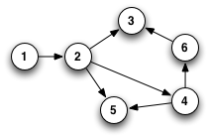
DFS vs. BFS
consider the following digraph
suppose we wanted to find a path from 1 to 5
depth-first search would:
start with the starting vertex 1
select an adjacent vertex from there 1 → 2
select an adjacent vertex from there 1 → 2 → 3
dead-end, so back up 1 → 2
select a different adjacent vertex 1 → 2 → 4
select an adjacent vertex from there 1 → 2 → 4 → 5
breadth-first search would:
start with the starting vertex 1
expand to length-1 paths 1 → 2
expand to length-2 paths 1 → 2 → 3
1 → 2 → 4
1 → 2 → 5

Slide 24
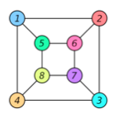
Bigger examples
DFS? BFS?

Slide 25
DFS implementation
DFS can be implemented recursive backtracking (more in CSC421)
public static <E> List<E> DFSrec(Graph<E> g, E start, E goal) {
List<E> path = new ArrayList<E>();
path.add(start);
if (GraphSearch.DFSrec(g, path, goal)) {
return path;
}
return null;
}
private static <E> boolean DFSrec(Graph<E> g,
List<E> pathSoFar, E goal) {
E lastVertex = pathSoFar.get(pathSoFar.size()-1);
if (lastVertex.equals(goal)) {
return true;
}
else {
for (E adj : g.getAllAdjacent(lastVertex)) {
if (!pathSoFar.contains(adj)) {
pathSoFar.add(adj);
if (GraphSearch.DFSrec(g, pathSoFar, goal)) {
return true;
}
pathSoFar.remove(pathSoFar.size()-1);
}
}
return false;
}
}
recursive method is passed path so far and goal state
BASE CASE: when path so far ends in goal state
RECURSIVE: extend the path for each adjacent vertex and recurse
to avoid cycles, don't extend if the adjacent vertex is already in the path

Slide 26
Stacks & Queues
DFS can alternatively be implemented using a stack of paths
initially contains a single path (w/ start)
at each step, pop the path at the top of the stack
extend that path for each adjacent vertex, and push that extended path on the stack
BFS is most naturally implemented using a queue of paths
initially contains a single path (w/ start)
at each step, remove the path at the front of the queue
extend that path for each adjacent vertex, and add that extended path to the back of the queue
[ 1 ]
[ 1 → 2 ]
[ 1→ 2 → 5, 1 → 2 → 4, 1 → 2 → 3 ]
1 → 2 → 3
1 → 2 → 4
1 → 2 → 5
1
1 → 2
1 → 2 → 4 → 5
1 → 2 → 4 → 6
1 → 2 → 5
1 → 2 → 4
1 → 2 → 5

Slide 27
Implementations
public static <E> List<E> DFS(Graph<E> g, E start, E goal) {
List<E> startPath = new ArrayList<E>();
startPath.add(start);
Stack<List<E>> paths = new Stack<List<E>>();
paths.push(startPath);
while (!paths.isEmpty()) {
List<E> pathToExtend = paths.pop();
E current = pathToExtend.get(pathToExtend.size()-1);
if (current.equals(goal)) {
return pathToExtend;
}
else {
for (E adj : g.getAllAdjacent(current)) {
if (!pathToExtend.contains(adj)) {
List<E> copy = new ArrayList<E>(pathToExtend);
copy.add(adj);
paths.push(copy);
}
}
}
}
return null;
}

Slide 28
Implementations
public static <E> List<E> BFS(Graph<E> g, E start, E goal) {
List<E> startPath = new ArrayList<E>();
startPath.add(start);
Queue<List<E>> paths = new LinkedList<List<E>>();
paths.add(startPath);
while (!paths.isEmpty()) {
List<E> pathToExtend = paths.remove();
E current = pathToExtend.get(pathToExtend.size()-1);
if (current.equals(goal)) {
return pathToExtend;
}
else {
for (E adj : g.getAllAdjacent(current)) {
if (!pathToExtend.contains(adj)) {
List<E> copy = new ArrayList<E>(pathToExtend);
copy.add(adj);
paths.add(copy);
}
}
}
}
return null;
}

Slide 29
DFSrec vs. DFS vs. BFS
public static void main(String[] args) throws java.io.FileNotFoundException {
List<Pair<Integer, Integer>> edges = new ArrayList<Pair<Integer, Integer>>();
edges.add(new Pair<Integer, Integer>(1, 2));
edges.add(new Pair<Integer, Integer>(2, 3));
edges.add(new Pair<Integer, Integer>(2, 4));
edges.add(new Pair<Integer, Integer>(2, 5));
edges.add(new Pair<Integer, Integer>(4, 5));
edges.add(new Pair<Integer, Integer>(4, 6));
edges.add(new Pair<Integer, Integer>(6, 3));
Graph<Integer> g = new DiGraphList<Integer>(edges);
System.out.println("DFSrec " + GraphSearch.DFSrec(g, 1, 3));
System.out.println("DFSrec " + GraphSearch.DFSrec(g, 1, 5));
System.out.println();
System.out.println("DFS " + GraphSearch.DFS(g, 1, 3));
System.out.println("DFS " + GraphSearch.DFS(g, 1, 5));
System.out.println();
System.out.println("BFS " + GraphSearch.BFS(g, 1, 3));
System.out.println("BFS " + GraphSearch.BFS(g, 1, 5));
}
DFSrec [1, 2, 3]
DFSrec [1, 2, 4, 5]
DFS [1, 2, 4, 6, 3]
DFS [1, 2, 5]
BFS [1, 2, 3]
BFS [1, 2, 5]

Slide 30
HW6: PathFinder
public List<StateLabel> findPath(StateLabel startState, StateLabel endState) {
List<StateLabel> startPath = new ArrayList<StateLabel>();
startPath.add(startState);
Queue<List<StateLabel>> paths = new LinkedList<List<StateLabel>>();
paths.add(startPath);
while (!paths.isEmpty()) {
List<StateLabel> shortestPath = paths.remove();
StateLabel current = shortestPath.get(shortestPath.size()-1);
if (current.equals(endState)) {
return shortestPath;
}
else {
for (StateLabel s : this.getAllAdjacentStates(current)) {
if (!shortestPath.contains(s)) {
List<StateLabel> copy = new ArrayList<StateLabel>(shortestPath);
copy.add(s);
paths.add(copy);
}
}
}
}
return null;
}
HW6 utilizes a modified BFS to find shortest paths in a FSM

Slide 31
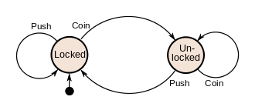
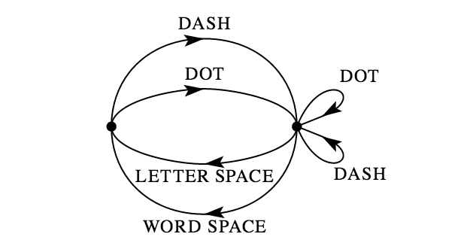
Finite State Machines (revisited)
recall: a Finite State Machine (a.k.a. Finite Automaton) defines a finite set of states (i.e., vertices) along with transitions between those states (i.e., edges)
25¢
Q
D
D
35¢
0¢
N
N
5¢
D
15¢
Q
N
N
N
N
D
Q
30¢
10¢
N
D
20¢
D

Slide 32
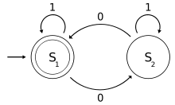
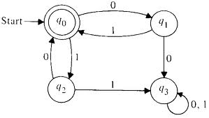
Recognition/acceptance
we say that a FSM recognizes a pattern if all sequences that meet that pattern terminate in an accepting state (drawn with double circle)
Start
accepts
1
00
0101
0001110
in general?
accepts
10
01
1010
100110
in general?

Slide 33
Regular expressions
alternatively, we say that a FSM defines a language made up of the sequences accepted by the FSM
a language is known as a regular language if there exists a FSM that accepts it
a regular expression denotes a regular language using * for arbitrary repetition and + for OR
L₁ = 1*(01*0)*1* L₂ = (01 + 10)*
Start

Slide 34
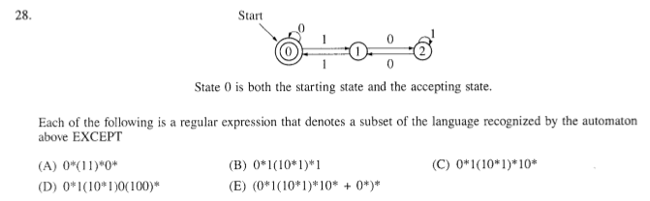
Old GRE CS exam – sample question

Slide 35
Regular language examples
if locked is initial state and unlocked is goal state:
Coin (Push Push* Coin)* Coin*
if betweenLetters is initial and goal state:
((Dot + Dash) (Dot + Dash)* (Lspace + Wspace))*

Slide 36
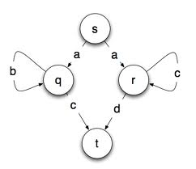
Deterministic vs. nondeterministic
the examples so far are deterministic, i.e., each transition is unambiguous
a FSM can also be nondeterministic, if there are multiple transitions from a state with different labels/weights
a nondeterministic FSM accepts a sequence if there exists a path that accepts
nondeterministic FSMs are especially useful for defining complex regular languages

Slide 37
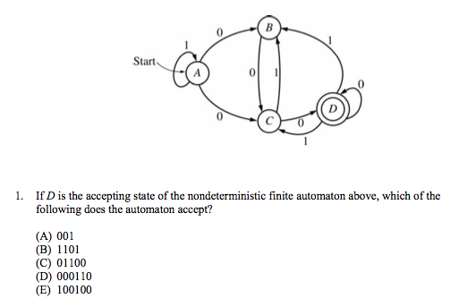
MFT CS exam – sample question

Slide 38
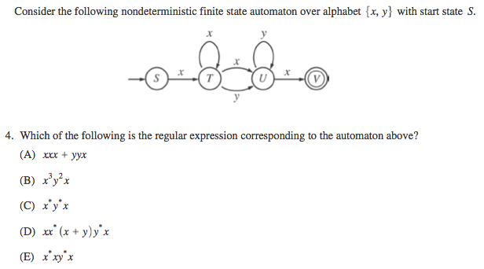
GRE CS exam – sample question

Slide 39

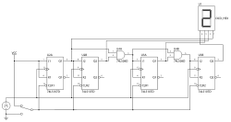
Uses of FSM
FSM machines are useful in many areas of CS
designing software for controlling devices (e.g., vending machine, elevator, …)
first identify states, constructing a table of state transitions, then implement in code
parsing symbols for programming languages or text processing
may define the language using rules or via a regular expression, then build a FSM to parse the characters into tokens & symbols
designing circuitry
commonly used to model complex circuitry, design components

