Slide 1
CSC 222: Object-Oriented Programming
Fall 2017
Simulations & library classes
  HW3: RouletteWheel, RouletteGame, RouletteTester
  javadoc
  java.lang classes: String, Character, Integer
  java.util.Random
  for vs. while loops
  scope and static fields/methods

Slide 2
Simulations
programs are often used to model real-world systems
  often simpler/cheaper to study a model
  easier to experiment, by varying parameters and observing the results
  Pig game simulation allowed us to compare strategies across a statistically significant number of games
HW3: you will use & develop classes that simulate different betting strategies for roulette
  if you start with 100 credits and play 100 spins of the wheel, what is your best strategy for winning?
  how do we define winning? ending the rounds with a profit? ending the rounds with the most credits?

Slide 3
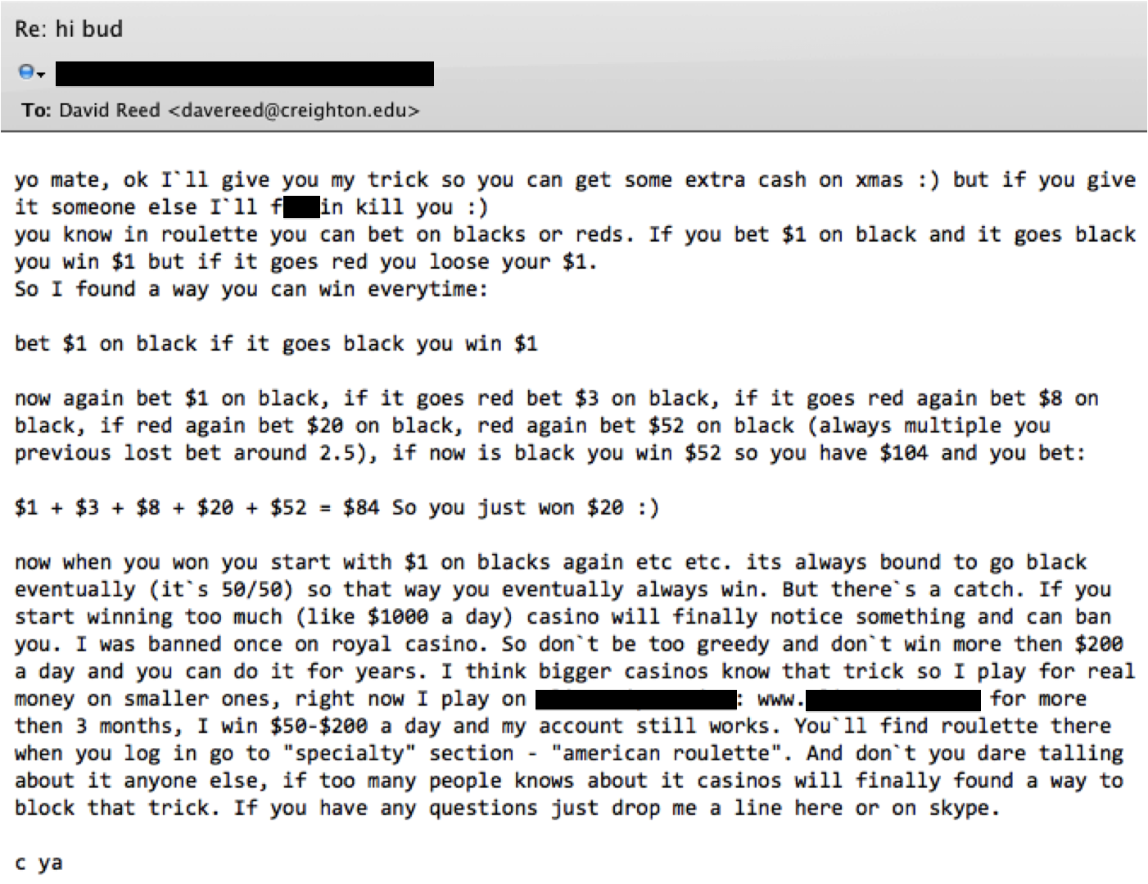
Spam alert

Slide 4
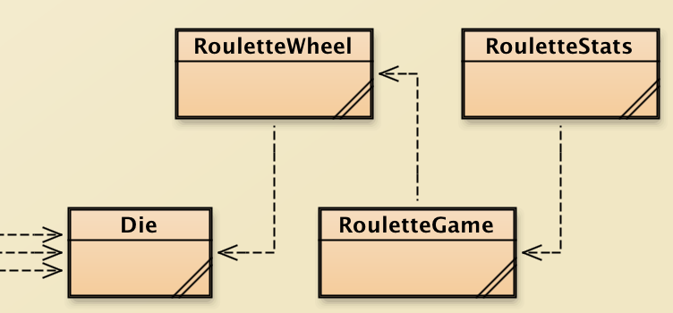
HW3 classes
you will write parts of a project that includes several interacting classes
  RouletteWheel: models a roulette wheel that can be spun, access the number, color or parity of the spin
  RouletteGame: uses RouletteWheel to simulate a game with betting, keeping track of winnings/losses
  RouletteStats: uses RouletteGame to perform repeated simulations and display stats (can be used to compare betting strategies)
recall: Die is used by lots of other classes

Slide 5
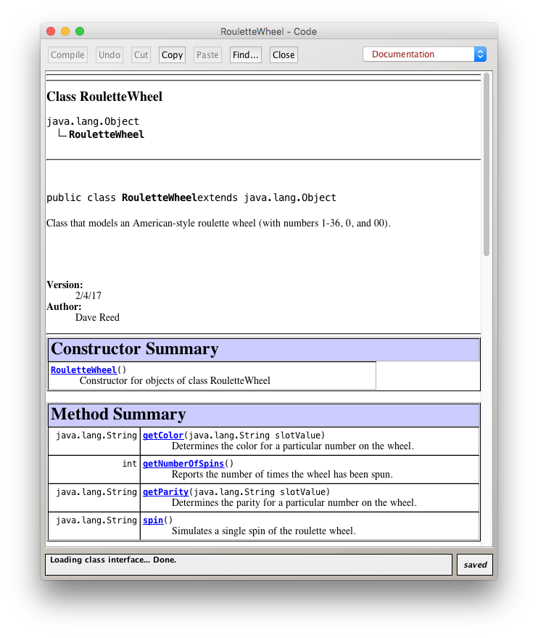
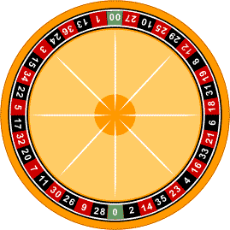
Abstraction & classes
note that RouletteGame will depend upon RouletteWheel
  but you don't have to know the details of how that class works
  can abstract away the details and focus on its behavior
  recall that javadoc comments can be used to document the behavior of a class
  always include javadoc comments for each class (incl. @author & @version) and for every method (incl. @param & @return)

Slide 6
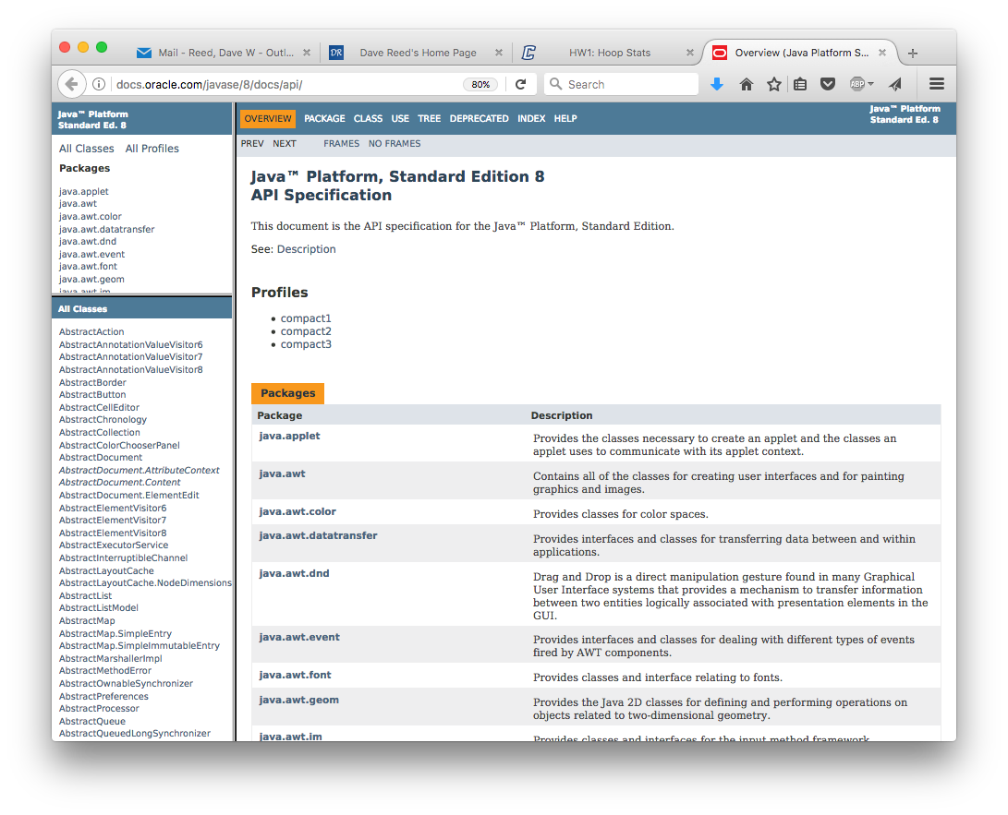
Java Standard Library
the Java language provides an extensive library of nearly 4,000 classes
  documentation for the entire library is accessible in javadoc form
  to view in BlueJ, select Java Class Libraries under the Help menu

Slide 7
String class
one of the most useful library classes is String
  technically, its full name is java.lang.String, but the java.lang prefix can be omitted
  a String object encapsulates a sequence of characters and many useful methods
  since Strings are so common, Java provides shortcuts to make them easier to use (and look like primitives)
    String str = "foo"; ➔ String str = new String("foo");
  we have already seen a few basic operations on Strings
    you can display Strings using System.out.print and System.out.println
    System.out.println(firstName);
  the '+' operator concatenates two strings (or string and number) together
    String str = "foo" + "lish" + 1;

Slide 8
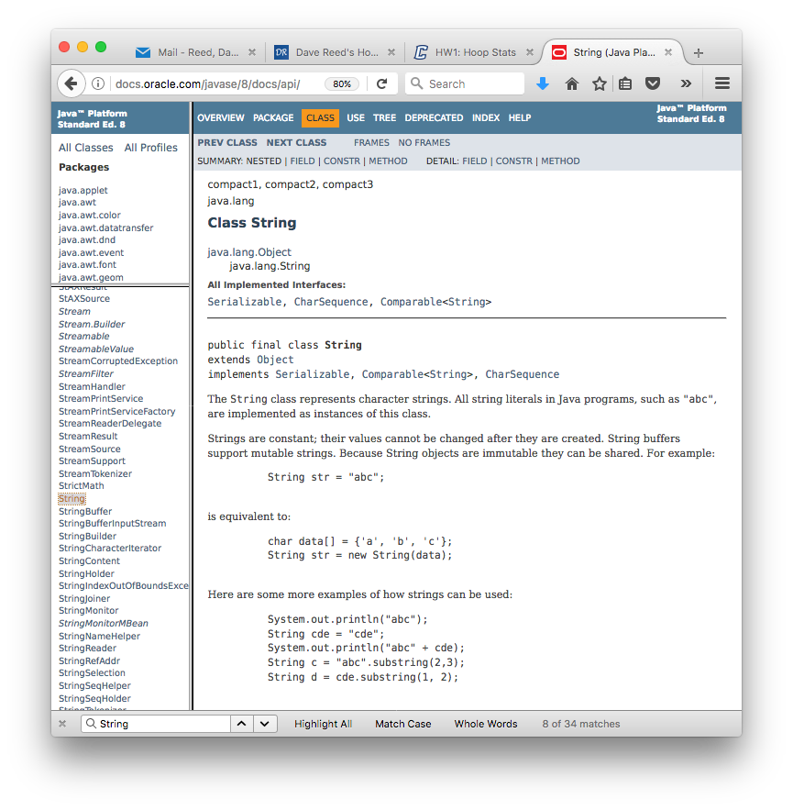
String javadoc
many of the javadoc details will be revealed later
  for now, important feature is that we can scan the constructors & methods of a class
  String has MANY of each
  can click on a constructor/method link to see more details

Slide 9
Common String methods
int length() returns number of chars in String
char charAt(int index) returns the character at the specified index
(indices range from 0 to str.length()-1)
boolean contains(String str) returns true if str occurs in the String, else false
int indexOf(char ch) returns index where ch/str first occurs in the
int indexOf(String str) String (-1 if not found)
String substring(int start, int end)
returns the substring from indices start to (end-1)
String toUpperCase() returns copy of String with all letters uppercase
String toLowerCase() returns copy of String with all letters lowercase
boolean equals(String other) returns true if other String has same value
int compareTo(String other) returns -1 if less than other String,
0 if equal to other String,
1 if greater than other String

Slide 10
Character class
recall: in Java, strings and characters are different types
  String is a class, char is a primitive type
the (java.lang.)Character class has numerous static methods for manipulating characters
char toLowerCase(char ch) returns lowercase copy of ch
char toUpperCase(char ch) returns uppercase copy of ch
boolean isLetter(char ch) returns true if ch is a letter
boolean isLowerCase(char ch) returns true if lowercase letter
boolean isUpperCase(char ch) returns true if uppercase letter

Slide 11
String/Character examples
public boolean isVowel(char ch) {
String vowels = "aeiouAEIOU";
return vowels.contains(""+ch);
}
public char randomChar(String str) {
Die d = new Die(str.length());
return str.charAt(d.roll()-1);
}
public String capitalize(String str) {
if (str.length() == 0) {
return str;
}
else {
return Character.toUpperCase(str.charAt(0)) +
str.substring(1, str.length());
}
}

Slide 12
Comparing strings
comparison operators (< <= > >=) are defined for primitives but not objects
  String str1 = "foo", str2 = "bar";
  if (str1 < str2) … // ILLEGAL
== and != are defined for objects, but don't do what you think
  if (str1 == str2) … // TESTS WHETHER THEY ARE THE
  // SAME OBJECT, NOT WHETHER THEY
  // HAVE THE SAME VALUE!
Strings are comparable using the equals and compareTo methods
  if (str1.equals(str2)) … // true IF THEY REPRESENT THE
  // SAME STRING VALUE
  if (str1.compareTo(str2) < 0) … // RETURNS neg # if str1 < str2
  // RETURNS 0 if str1 == str2
  // RETURNS pos # if str1 > str2

Slide 13
Comparison example
suppose we wanted to compare two names to see which comes first alphabetically
  Kelly Jones < Kelly Miller < Chris Smith < Pat Smith
public void compareNames(String myFirst, String myLast,
String yourFirst, String yourLast) {
int lastCompare = myLast.compareTo(yourLast);
int firstCompare = myFirst.compareTo(yourFirst);
if (lastCompare < 0 || (lastCompare == 0 && firstCompare < 0)) {
System.out.println("My name comes before yours alphabetically!");
}
else if (lastCompare > 0 || (lastCompare == 0 && firstCompare > 0)) {
System.out.println("Your name comes before mine alphabetically!");
}
else {
System.out.println("We have the same name!");
}
}
note: we have been using == to compare Strings up to this point
  dangerous – sometimes it works, sometimes it doesn't!
  from now on, always use .equals for Strings

Slide 14
RouletteWheel implementation
public class RouletteWheel {
private Die roller;
public RouletteWheel() {
this.roller = new Die(38);
}
public String spin() {
int number = this.roller.roll();
if (number == 38) {
return "00";
}
else if (number == 37) {
return "0";
}
else {
return ""+number;
}
}
public int getNumberOfSpins() {
return this.roller.getNumRolls();
}
public String getColor(String slotValue) {
// NEXT SLIDE
}
public String getParity(String slotValue) {
// SLIDE AFTER THAT
}
}
  we can use a Die object to choose between 38 values
  the spin method must return a String, since we may want to differentiate between 0 and 00
  38 → "00", 37 → "0"
  1-36 are converted to a string by concatenating with the empty string
  e.g., ""+36 → ""+"36" → "36"
  the Die field already keeps track of the number of rolls/spins

Slide 15
RouletteWheel implementation (cont.)
  getting the color associated with a number is not obvious
    we could have a large cascading if else to map each number to a color
  instead can use the String method contains
    redNums & blackNums contain all the numbers of each color, with spaces
    to see if "3" is red/black, see if redNums/blackNums contains " 3 "
public class RouletteWheel {
. . .
public String getColor(String slotValue) {
String redNums = " 1 3 5 7 9 12 14 16 18 19 21 23 25 27 30 32 34 36 ";
String blackNums = " 2 4 6 8 10 11 13 15 17 20 22 24 26 28 29 31 33 35 ";
if (redNums.contains(" "+slotValue+" ")) {
return "red";
}
else if (blackNums.contains(" "+slotValue+" ")) {
return "black";
}
else {
return "green";
}
}
}

Slide 16
RouletteWheel implementation (cont.)
  similarly, could have a large cascading if else to map each number to odd/even
  or, could use charAt to access the last digit, see if it is "0", "2", "4", "6", or "8"
  instead, the (java.lang.)Integer class contains a static method for converting a string of digits into an int: parseInt
    e.g., Integer.parseInt("14") → 14
public class RouletteWheel {
. . .
public String getParity(String slotValue) {
int numVal = Integer.parseInt(slotValue);
if (numVal == 0) {
return "zero";
}
else if (numVal % 2 == 0) {
return "even";
}
else {
return "odd";
}
}
}

Slide 17

Random class
instead of the Die class, we could have used the
java.util.Random
class
  the nextInt method returns a random int from 0..(parameter-1)
  other methods can be used to generate different random numbers

Slide 18
RouletteWheel w/ Random
import java.util.Random;
public class RouletteWheel {
private Random randGen;
public RouletteWheel() {
this.randGen = new Random();
}
public String spin() {
int number = this.randGen.nextInt(38);
if (number == 37) {
return "00";
}
else {
return ""+number;
}
}
public int getNumberOfSpins() {
// SAME AS BEFORE
}
public String getColor(String slotValue) {
// SAME AS BEFORE
}
public String getParity(String slotValue) {
// SAME AS BEFORE
}
}
  classes defined within the java.lang library are automatically available
    java.lang.Math
    java.lang.System
    java.lang.String
    java.lang.Character
    java.lang.Integer
  we won't list the unnecessary prefix (but Javadoc will)
  for other libraries, must explicitly import the class

Slide 19
Variable scope
scope: the section of code in which a variable exists
  for a field, the scope is the entire class definition
  for a parameter, the scope is the entire method
  for a local variable, the scope begins with its declaration & ends at the end of the enclosing block (i.e., right curly brace)
since each method defines its own scope, can reuse the same parameter/local variable name in multiple methods
public class DiceStuff {
private Die d6;
. . .
public void showSevens(int numReps) {
int count = 0;
for (int numRolls = 0; numRolls < numReps; numRolls++) {
if (d6.roll() + d6.roll() == 7) {
count++;
}
}
System.out.println(count);
}
. . .
}
within a method, can have a parameter/local variable with same name as a field (although confusing)
use this. to differentiate

Slide 20
Static fields & constants
static fields
  a field declared to be static is shared by all objects of that class
  useful when there is data that needs to be accessed/updated by all objects
  also useful for constants – values that will not change during execution (so there is no reason for object to have its own copy)
    public class RouletteStats {
private final static int START_CREDITS = 100;
private final static int BET_AMOUNT = 1;
    // METHODS CAN ACCESS THESE CONSTANTS
    }
  note: constants are initialized when declared (not in a constructor)
  convention is to use all caps for constants
  any attempt to reassign a final value will cause a compiler error

Slide 21
Static methods
sometimes a class doesn't require fields (other than constants)
  without fields, every object of the class would look/behave exactly the same
  essentially, it is a collection of independent functions/methods
  so, why even create objects at all?
  the alternative is to declare the methods to be static
    that way, they belong to the class
    you can call them directly on the class, without creating an object
    public class RouletteStats {
private final static int START_CREDITS = 100;
private final static int BET_AMOUNT = 1;
public static int playSession(String betType, int numBets) {
…
}
public static void playManySessions(String betType, int numBets,
int numSessions) {
…
}
    }

Slide 22
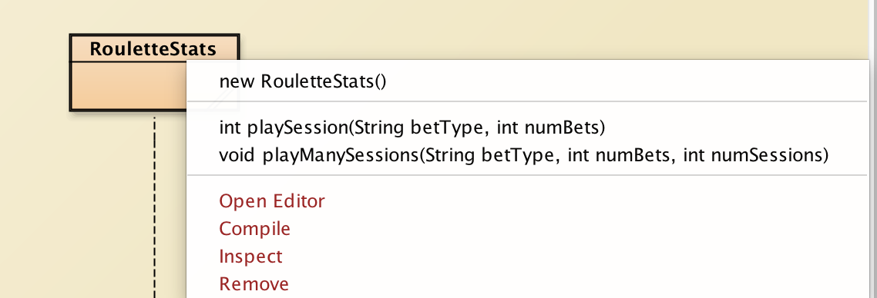
Static methods in BlueJ
when you have a class with only static methods,
  BlueJ will still list a default constructor (which creates a default object)
  will also see a list of static methods
  you don't need to create an object, just call the methods directly

