Slide 1
CSC 222: Object-Oriented Programming
Fall 2017
  Searching and sorting
    sequential search vs. binary search
    algorithm analysis: big-Oh, rate-of-growth
    O(N²) sorts: insertion sort, selection sort

Slide 2
Searching a list
suppose you have a list, and want to find a particular item, e.g.,
  lookup a word in a dictionary
  find a number in the phone book
  locate a student's exam from a pile
searching is a common task in computing
  searching a database
  checking a login password
  lookup the value assigned to a variable in memory
if the items in the list are unordered (e.g., added at random)
  desired item is equally likely to be at any point in the list
  need to systematically search through the list, check each entry until found
    ➔ sequential search

Slide 3
Sequential search
sequential search traverses the list from beginning to end
  check each entry in the list
  if matches the desired entry, then FOUND (return its index)
  if traverse entire list and no match, then NOT FOUND (return -1)
recall: the ArrayList class has an indexOf method
  /**
  * Performs sequential search on the array field named items
  * @param desired item to be searched for
  * @returns index where desired first occurs, -1 if not found
  */
  public int indexOf(T desired) {
  for(int k=0; k < this.items.length; k++) {
  if (desired.equals(this.items[k])) {
  return k;
  }
  }
  return -1;
  }

Slide 4
How efficient is sequential search?
for this algorithm, the dominant factor in execution time is checking an item
  the number of checks will determine efficiency
in the worst case:
  the item you are looking for is in the last position of the list (or not found)
  requires traversing and checking every item in the list
  if 100 or 1,000 entries → NO BIG DEAL
  if 10,000 or 100,000 entries → NOTICEABLE
in the average case?
in the best case?

Slide 5
Big-Oh notation
to represent an algorithm’s performance in relation to the size of the problem, computer scientists use Big-Oh notation
  an algorithm is O(N) if the number of operations required to solve a problem is proportional to the size of the problem
  sequential search on a list of N items requires roughly N checks (+ other constants)
    ➔ O(N)
for an O(N) algorithm, doubling the size of the problem requires double the amount of work (in the worst case)
  if it takes 1 second to search a list of 1,000 items, then
  it takes 2 seconds to search a list of 2,000 items
  it takes 4 seconds to search a list of 4,000 items
  it takes 8 seconds to search a list of 8,000 items
  . . .

Slide 6
Searching an ordered list
when the list is unordered, can't do any better than sequential search
  but, if the list is ordered, a better alternative exists
e.g., when looking up a word in the dictionary or name in the phone book
  can take ordering knowledge into account
  pick a spot – if too far in the list, then go backward; if not far enough, go forward
binary search algorithm
  check midpoint of the list
  if desired item is found there, then DONE
  if the item at midpoint comes after the desired item in the ordering scheme, then repeat the process on the left half
  if the item at midpoint comes before the desired item in the ordering scheme, then repeat the process on the right half

Slide 7
Binary search
the Collections utility class contains a binarySearch method
  takes a List of Comparable items and the desired item
    List is an interface that specifies basic list operations (ArrayList implements)
    Comparable is an interface that requires compareTo method (String implements)
    MORE ON INTERFACES LATER
this ugly code simply ensures that the list contains Comparable objects
/**
* Performs binary search on a sorted list.
* @param items sorted list of Comparable items
* @param desired item to be searched for
* @returns index where desired first occurs, -(insertion point)-1 if not found
*/
public static <T extends Comparable<? super T>> int
binarySearch(List<T> items, Comparable desired) {
int left = 0; // initialize range where desired could be
int right = items.length-1;
while (left <= right) {
int mid = (left+right)/2; // get midpoint value and compare
int comparison = desired.compareTo(items[mid]);
if (comparison == 0) { // if desired at midpoint, then DONE
return mid;
}
else if (comparison < 0) { // if less than midpoint, focus on left half
right = mid-1;
}
else { // otherwise, focus on right half
left = mid + 1;
}
}
return /* CLASS EXERCISE */ ; // if reduce to empty range, NOT FOUND
}

Slide 8
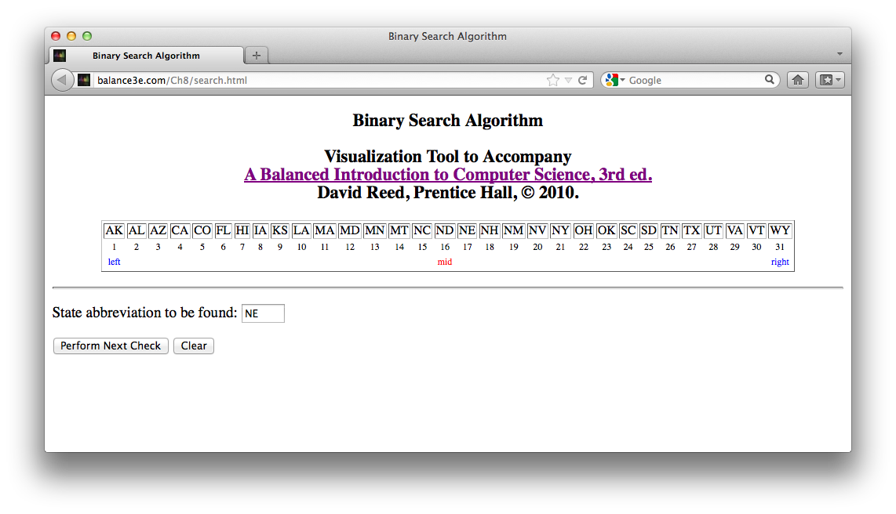
Visualizing binary search
note: each check reduces the range in which the item can be found by half
  see http://balance3e.com/Ch8/search.html for demo

Slide 9
How efficient is binary search?
again, the dominant factor in execution time is checking an item
  the number of checks will determine efficiency
in the worst case:
  the item you are looking for is in the first or last position of the list (or not found)
  start with N items in list
    after 1st check, reduced to N/2 items to search
    after 2nd check, reduced to N/4 items to search
    after 3rd check, reduced to N/8 items to search
    . . .
    after log₂ N checks, reduced to 1 item to search
in the average case?
in the best case?

Slide 10
Big-Oh notation
an algorithm is O(log N) if the number of operations required to solve a problem is proportional to the logarithm of the size of the problem
  binary search on a list of N items requires roughly log₂ N checks (+ other constants)
  ➔ O(log N)
for an O(log N) algorithm, doubling the size of the problem adds only a constant amount of work
  if it takes 1 second to search a list of 1,000 items, then
  searching a list of 2,000 items will take time to check midpoint + 1 second
  searching a list of 4,000 items will take time for 2 checks + 1 second
  searching a list of 8,000 items will take time for 3 checks + 1 second
  . . .

Slide 11
Comparison: searching a phone book
Number of entries in phone book | Number of checks performed by sequential search | Number of checks performed by binary search
100 | 100 | 7
200 | 200 | 8
400 | 400 | 9
800 | 800 | 10
1,600 | 1,600 | 11
… | … | …
10,000 | 10,000 | 14
20,000 | 20,000 | 15
40,000 | 40,000 | 16
… | … | …
1,000,000 | 1,000,000 | 20
to search a phone book of the United States (~310 million) using binary search?
to search a phone book of the world (7 billion) using binary search?

Slide 12
Dictionary revisited
binary search works as long as the list of words is sorted
  dictionary.txt is sorted, so can load the dictionary and do searches
  to ensure correct behavior, must also make sure that add methods maintain sorting
public class Dictionary {
private ArrayList<String> words;
. . .
public boolean addWord(String newWord) {
int index = Collections.binarySearch(this.words, newWord.toLowerCase())
this.words.add(Math.abs(index)-1, newWord.toLowerCase());
return true;
}
public boolean addWordNoDupes(String newWord) {
int index = Collections.binarySearch(this.words, newWord.toLowerCase());
if (index < 0) {
this.words.add(Math.abs(index)-1, newWord.toLowerCase());
return true;
}
return false;
}
public boolean findWord(String desiredWord) {
return (Collections.binarySearch(this.words, desiredWord.toLowerCase()) >= 0);
}
}

Slide 13
In the worst case…
suppose words are added in reverse order: "zoo", "moo", "foo", "boo"
zoo
to add "moo", must first shift "zoo" one spot to the right
moo
zoo
to add "foo", must first shift "moo" and "zoo" each one spot to the right
foo
moo
zoo
to add "boo", must first shift "foo", "moo" and "zoo" each one spot to the right
boo
foo
moo
zoo

Slide 14
Worst case (in general)
if inserting N items in reverse order
  1st item inserted directly
  2nd item requires 1 shift, 1 insertion
  3rd item requires 2 shifts, 1 insertion
  . . .
  N^{th} item requires N-1 shifts, 1 insertion
  ---------------------------------------------------------
  (1 + 2 + 3 + … + N-1) = N(N-1)/2 = (N² – N)/2 shifts + N insertions
this approach is called "insertion sort"
  insertion sort builds a sorted list by repeatedly inserting items in correct order
since an insertion sort of N items can take roughly N² steps,
it is an O(N²) algorithm

Slide 15
Timing the worst case
System.currentTimeMillis method accesses the system clock and returns the time (in milliseconds)
  we can use it to time repeated adds to a dictionary
# items (N) time in msec
5,000 15
10,000 49
20,000 162
40,000 651
80,000 2270
160,000 9168
320,000 36463
public class TimeDictionary {
public static int timeAdds(int numValues) {
Dictionary dict = new Dictionary();
int startTime = (int)System.currentTimeMillis();
for (int i = numValues; i > 0; i--) {
String word = "0000000000" + i;
dict.addWord(word.substring(word.length()-10));
}
int endTime = (int)System.currentTimeMillis();
return endTime - startTime;
}
}

Slide 16
O(N²) performance
as the problem size doubles, the time can quadruple
makes sense for an O(N²) algorithm
  if X items, then X² steps required
  if 2X items, then (2X)² = 4X² steps
QUESTION: why is the factor of 4 not realized immediately?
# items (N) time in msec
5,000 15
10,000 49
20,000 162
40,000 651
80,000 2270
160,000 9168
320,000 36463
Big-Oh captures rate-of-growth behavior in the long run
  when determining Big-Oh, only the dominant factor is significant (in the long run)
  cost = N(N-1)/2 shifts (+ N inserts + additional operations) → O(N²)
  N=1,000: 499,500 shifts + 1,000 inserts + … overhead cost is significant
  N=100,000: 4,999,950,000 shifts + 100,000 inserts + … only N² factor is significant

Slide 17
Best case for insertion sort
while insertion sort can require ~N² steps in worst case, it can do much better sometimes
  BEST CASE: if items are added in order, then no shifting is required
  only requires N insertion steps, so O(N)
  → if double size, roughly double time
list size (N) time in msec
40,000 32
80,000 79
160,000 194
320,000 400
on average, might expect to shift only half the time
  (1 + 2 + … + N-1)/2 = N(N-1)/4 = (N² – N)/4 shifts, so still O(N²)
  → would expect faster timings than worst case, but still quadratic growth

Slide 18
Timing insertion sort (average case)
can use a Random object to pick random numbers and add to a String
import java.util.Random;
public class TimeDictionary {
public static int timeAdds(int numValues) {
Dictionary1 dict = new Dictionary1();
Random randomizer = new Random();
int startTime = (int)System.currentTimeMillis();
for (int i = 0; i < numValues; i++) {
String word = "0000000000" +
randomizer.nextInt();
dict.addWord(word.substring(word.length()-10));
}
int endTime = (int)System.currentTimeMillis();
return endTime - startTime;
}
}
list size (N) time in msec
10,000 87
20,000 119
40,000 397
80,000 1420
160,000 5306
320,000 20442

Slide 19
A more generic insertion sort
we can code insertion sort independent of the Dictionary class
  could use a temporary list for storing the sorted numbers, but not needed
  don't stress about <T extends Comparable<? super T>>
  specifies that the parameter must be an ArrayList of items that either implements or extends a class that implements the Comparable interface (???)
  more later, for now, it ensures the class has a compareTo method
public static <T extends Comparable<? super T>> void insertionSort(ArrayList<T> items) {
for (int i = 1; i < items.size(); i++) { // for each index i,
T itemToPlace = items.get(i); // save the value at index i
int j = i; // starting at index i,
while (j > 0 && itemToPlace.compareTo(items.get(j-1)) < 0) {
items.set(j, items.get(j-1)); // shift values to the right
j--; // until find spot for the value
}
items.set(j, itemToPlace); // store the value in its spot
}
}

Slide 20
Other O(N²) sorts
alternative algorithms exist for sorting a list of items
e.g., selection sort:
  find smallest item, swap into the 1st index
  find next smallest item, swap into the 2nd index
  find next smallest item, swap into the 3rd index
  . . .
public static <T extends Comparable<? super T>> void selectionSort(ArrayList<T> items) {
for (int i = 0; i < items.size()-1; i++) { // for each index i,
int indexOfMin = i; // find the ith smallest item
for (int j = i+1; j < items.size(); j++) {
if (items.get(j).compareTo(items.get(indexOfMin)) < 0) {
indexOfMin = j;
}
}
T temp = items.get(i); // swap the ith smallest
items.set(i, items.get(indexOfMin)); // item into position i
items.set(indexOfMin, temp);
}
}

