Slide 1
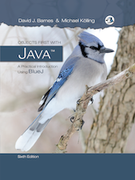
CSC 222: Object-Oriented Programming
Fall 2017
See online syllabus at: dave-reed.com/csc222
Course goals:
To know and use basic Java programming constructs for object-oriented problem solving (e.g., classes, polymorphism, inheritance, interfaces).
To appreciate the role of algorithms and data structures in problem solving and software design (e.g., objected-oriented design, lists, files, searching and sorting).
To be able to design and implement a Java program to model a real-world system, and subsequently analyze its behavior.
To develop programming skills that can serve as a foundation for further study in computer science.

Slide 2
Assumed background
technically, CSC 221 is a prerequisite for this course
what is really needed is basic programming & problem-solving experience
variables: data types, assignments, expressions
control structures: if, if-else, while, for
functions: parameters, return, libraries
data structures: strings, lists, files
early on, I will map Java constructs back to their corresponding Python
if you learned a different language, will need to make your own connection
as an intro, 221 focused on programming-in-the-small
simple problems; could be solved in 1-3 functions; few design choices
this class extends to programming-in-the-medium
and lays the groundwork for programming-in-the-large by emphasizing the object-oriented approach to software design

Slide 3
When problems start to get complex…
…choosing the right algorithm and data structures are important
e.g., phone book lookup, checkerboard puzzle, word ladders
must develop problem-solving approaches (e.g., iteration, recursion)
be able to identify appropriate data structures (e.g., array, ArrayList, stack, queue)
…code reuse is important
designing, implementing, and testing large software projects is HARD
whenever possible, want to utilize existing, debugged code
reusable code is:
clear and readable (well documented, uses meaningful names, no tricks)
modular (general, independent routines – test & debug once, then reuse)

Slide 4
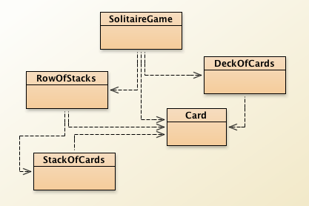
Object-oriented programming
OOP is the standard approach to software engineering
philosophy: modularity and reuse apply to data as well as functions
when solving a problem, must identify the objects involved
e.g., banking system: customer, checking account, savings account, …
develop a software model of the objects in the form of abstract data types (ADTs)
an ADT is a collection of data items and the associated operations on that data
in Java, ADTs are known as classes
focus on software objects:
hides unnecessary details (programmer doesn't have to know the details of the class in order to use it)
ensures the integrity of data (programmer can only access public operations)
allows for reuse and easy modification (can plug classes into different applications)

Slide 5
Getting started
recall: you got a sneak peek at OO at the end of 221
we will start next week with basic Java programming constructs
variables, expressions, conditionals, loops, functions, …
will map from Python to Java, get lots of hands-on practice (using codingbat.com)
then will learn how to package these constructs into classes and objects
eventually, will think and design in an object-oriented way
we will eventually be using the BlueJ development environment
contained on the CD that comes with the book
can also be downloaded for free from the Web
BlueJ (4.1) from www.bluej.org
BlueJ is a simple, visual environment; designed for beginners to OO approach

