Slide 1
CSC 222: Object-Oriented Programming
Fall 2017
Objects and classes: a first pass
software objects, classes, object-oriented design
BlueJ IDE, compilation & execution, figures example
method calls, parameters
data types, object state
other examples: Die, SequenceGenerator

Slide 2
Object-oriented programming
the object-oriented approach to programming:
solve problems by modeling real-world objects
e.g., if designing a banking system, model clients, accounts, deposits, …
a program is a collection of interacting objects
in software, objects are created from classes
the class describes the kind of object (its properties and behaviors)
the objects represent individual instantiations of the class
REAL WORLD CLASS: automobiles
REAL WORLD OBJECTS: my 2011 Subaru Outback, the batmobile, …
the class encompasses all automobiles
they all have common properties: color, seats, wheels, engine, brakes, …
they all have common behaviors: can sit in them, start them, accelerate, steer, …
each car object has its own specific characteristics and ways of producing behaviors
my car is white & seats 5; the batmobile is black & seats 2
accelerating with V-4 is different than accelerating with jet engine

Slide 3
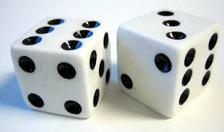
Die example
Dice
what properties do all dice share?
how can these be different for different dice objects?
what behaviors do all dice share
how can these be different for different dice objects?

Slide 4
Shape classes and objects
a slightly more abstract example involves shapes
class: circles
what properties do all circles share?
what behaviors do all circles exhibit?
objects:
similarly, could define classes and object instances for other shapes
squares:
triangles:

Slide 5
BlueJ and software shapes
the BlueJ interactive development environment (IDE) is a tool for developing, visualizing, and debugging Java programs
BlueJ was developed by researchers at Deakin University (Australia), Maersk Institute (Denmark), and University of Kent (UK)
supported by Oracle (previously Sun Microsystems), the developers of Java
BlueJ includes an editor, debugger, visualizer, documentation viewer, …
we will start with a visual example in BlueJ: drawing shapes

Slide 6
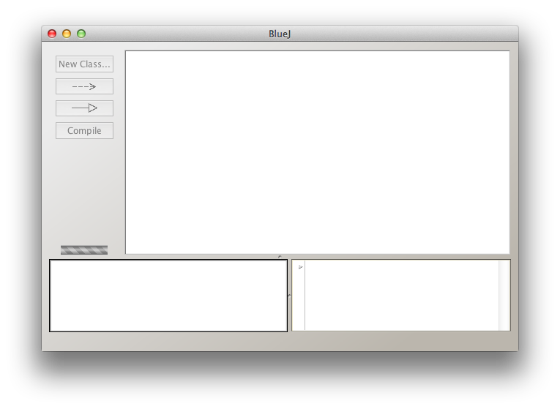
Starting up BlueJ
to start up the BlueJ IDE, double-click on the BlueJ desktop icon
this opens the BlueJ main window
in order to create and execute a program, must first create or load a project
a project groups together all the files needed to produce a working program
e.g., could create a project for the entire semester, or HW by HW
to create a new BlueJ project
click on the Project heading at the top left & select New Project
enter the project name and location
to open an existing BlueJ project
click on the Project heading at the top left & select Open Project
browse to locate and select the project

Slide 7
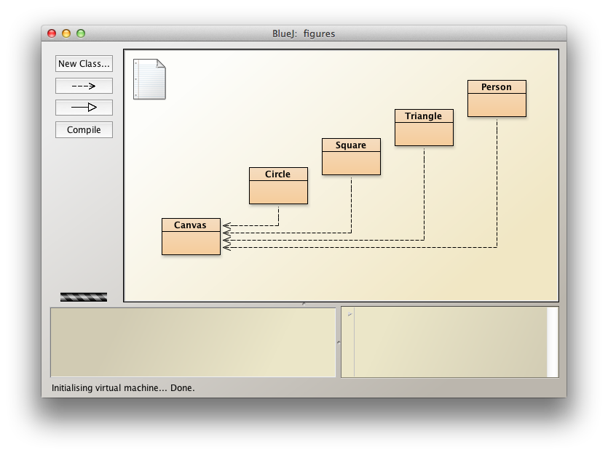
Loading the figures project
download figures.zip from the class Code directory
save it on the Desktop and double-click to unzip
in BlueJ, select Open Project
browse to select figures
when a project loads, its classes are shown in a diagram
here, there are 5 classes
Canvas represents a painting area
Circle, Square, Triangle, and Person represent shapes
the arrows show that the shapes depend upon the Canvas class

Slide 8
Editing and compiling classes
you can view/edit a class definition by double-clicking on its box
this opens the associated file in the BlueJ editor
before anything can be executed, the classes must be compiled
recall, the Java compiler translates Java source code into Java byte code
to compile all classes in a project, click on the Compile button
(note: non-compiled classes are shaded, compiled classes are not)
IMPORTANT: classes don't act, objects do!
you can't drive the class of all automobiles
but you can drive a particular instance of an automobile
in order to draw a circle, must create a circle object
then, can specify properties of that instance (radius, color, position, …)

Slide 9
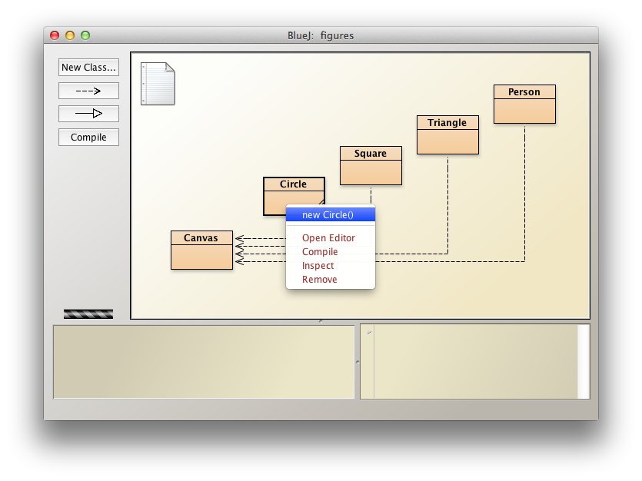
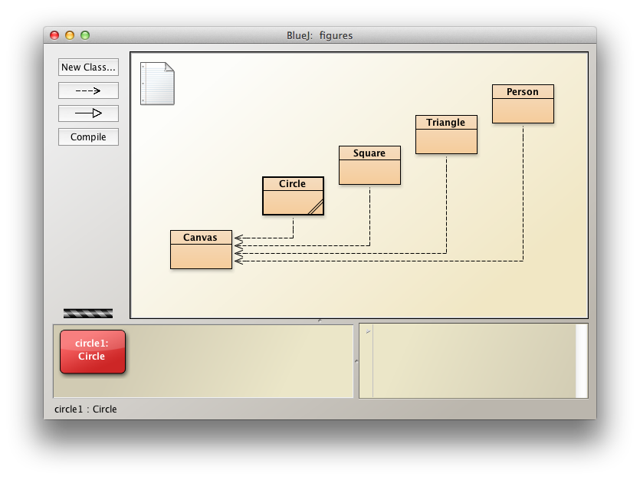
Example: creating a circle
right-click on a class to see all the actions that can be applied
select new Circle() to create a new object
you will be prompted to specify a name for that object (circle1 by default)
the new Circle object appears as a box at the bottom of the screen
note: classes and objects look different
EXERCISE: create 2 circles, a square, and a
triangle

Slide 10
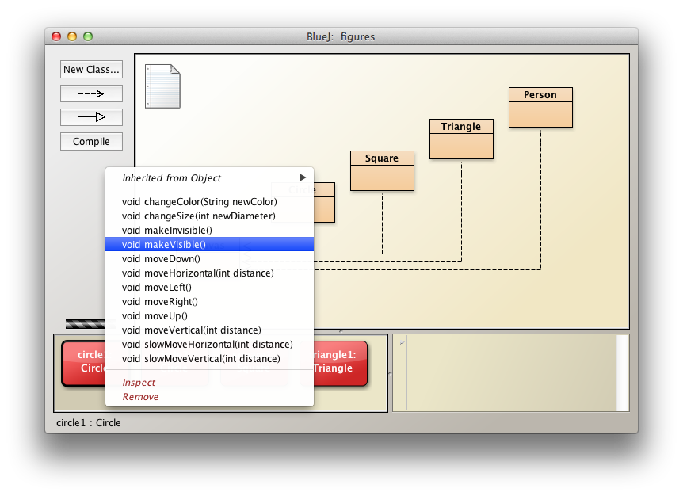
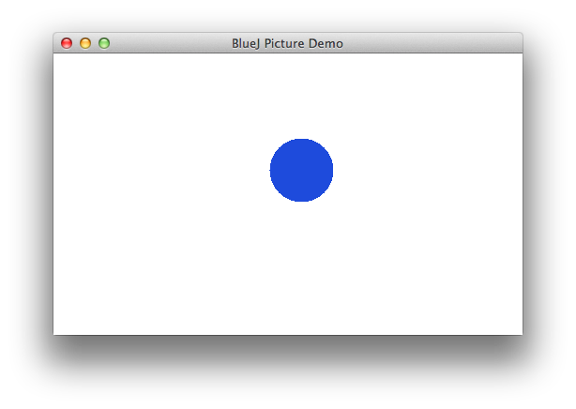
Applying object methods
can cause objects to act by right-clicking on the object box, then selecting the action
the actions that objects can perform are called methods
(same as in Python: a method is a function that belongs to an object.)
here, void makeVisible() opens a Canvas in which the shape is displayed
EXERCISE: make the other shapes visible
EXERCISE: select other methods to change the color and size of objects
EXERCISE: play

Slide 11
Methods and parameters
sometimes an action (i.e., method) requires information to do its job
the changeColor method requires a color ("red", "green", "black", …)
the moveHorizontal method requires a number (# of pixels to move)
data values provided to a method are called parameters
Java provides for different types of values
String is a sequence of characters, enclosed in double-quotes (e.g., "red")
int is an integer value (e.g., 40)
double is a real value (e.g., 3.14159)
char is a character value (e.g., 'A')
the parameter to changeColor is a String representing the new color
the parameter to moveHorizontal is an int representing the # of pixels to move

Slide 12
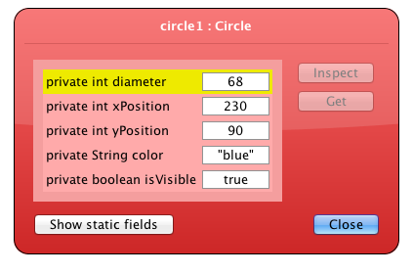
Objects and state
recall that each object has properties and methods associated with it
when you create a Circle, it has an initial size, color, position, …
those values are stored internally as part of the object
as methods are called, the values may change
at any given point, the property values of an object define its state
BlueJ enables you to inspect state of an object
right-click on the object
select Inspect to see the values of
object properties
note: objects of the same class have
the same properties, but may have
different values

Slide 13
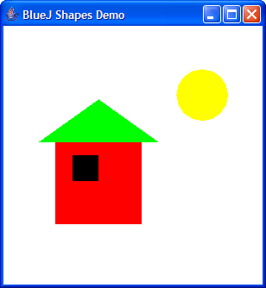
IN-CLASS EXERCISE
create objects and call the appropriate methods to produce a picture like this

Slide 14
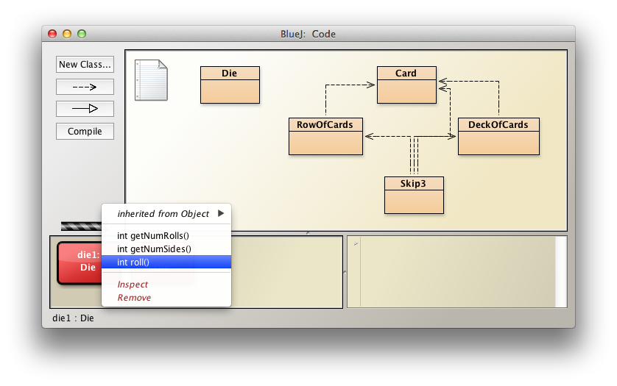
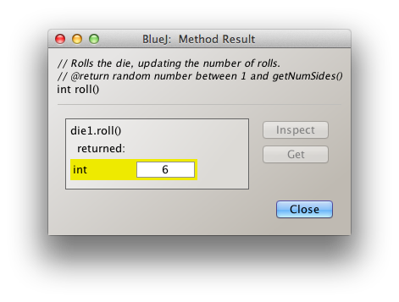
Another example: Die class
can define a Die class to model different (numeric) dice
properties shared by all dice: number of sides, number of times rolled
behaviors/methods shared by all dice: roll it, get # of sides, get # of rolls
the roll method generates a random roll and returns it
the return value is displayed by BlueJ in a Method Result window

Slide 15
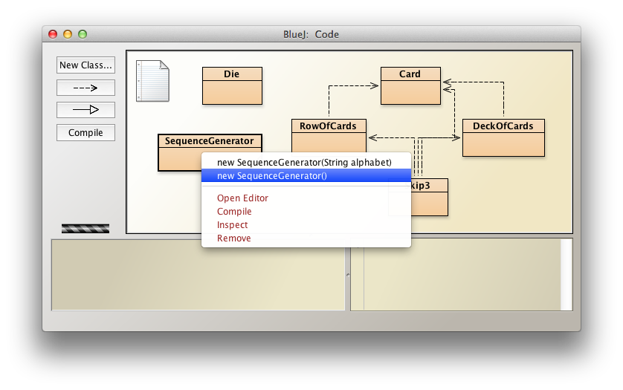
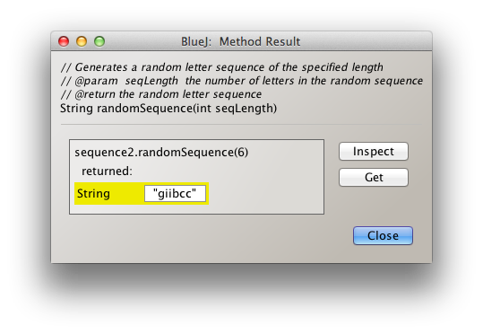
Another example: SequenceGenerator
there are two options for creating a SequenceGenerator object
can specify an alphabet to choose from (e.g., "etaoinshrd")
if nothing specified, will assume "abcdefghijklmnopqrstuvwxyz"

