Slide 1
CSC 222: Object-Oriented Programming
Fall 2017
Understanding class definitions
  class structure
  fields, constructors, methods
  parameters
  shorthand assignments
  local variables
  final-static fields, static methods

Slide 2
Looking inside classes
recall that classes define the properties and behaviors of its objects
a class definition must:
  specify those properties and their types FIELDS
  define how to create an object of the class CONSTRUCTOR
  define the behaviors of objects METHODS
public class CLASSNAME {
FIELDS
CONSTRUCTOR
METHODS
}
public is a visibility modifier – declaring the class to be public ensures that the user (and other classes) can use of this class
fields are optional – only needed if an object needs to maintain some state

Slide 3
Fields
fields store values for an object (a.k.a. instance variables)
  the collection of all fields for an object define its state
  when declaring a field, must specify its visibility, type, and name
    private FIELD_TYPE FIELD_NAME;
  for our purposes, all fields will be private (accessible to methods, but not to the user)
/**
* A circle that can be manipulated and that draws itself on a canvas.
*
* @author Michael Kolling and David J. Barnes
* @version 2011.07.31
*/
public class Circle {
private int diameter;
private int xPosition;
private int yPosition;
private String color;
private boolean isVisible;
. . .
}
text enclosed in /** */ is a comment – visible to the user, but ignored by the compiler. Good for documenting code.
note that the fields are those values you see when you Inspect an object in BlueJ

Slide 4
Constructor
a constructor is a special method that specifies how to create an object
  it has the same name as the class, public visibility (since called by the user)
    public CLASS_NAME() {
    STATEMENTS FOR INITIALIZING OBJECT STATE
    }
public class Circle {
private int diameter;
private int xPosition;
private int yPosition;
private String color;
private boolean isVisible;
/**
* Create a new circle at default position with default color.
*/
public Circle() {
this.diameter = 30;
this.xPosition = 20;
this.yPosition = 60;
this.color = "blue";
this.isVisible = false;
}
. . .
}
in general, the constructor should contain an assignment for every field
provides initial values for all of the properties
when referring to a field, the this. prefix is optional
  makes it clear that the variable is a field & belongs to this particular object
  I will use consistently in my code & strongly recommend you do so too

Slide 5
Methods
methods implement the behavior of objects
  public RETURN_TYPE METHOD_NAME() {
  STATEMENTS FOR IMPLEMENTING THE DESIRED BEHAVIOR
  }
public class Circle {
. . .
/**
* Make this circle visible. If it was already visible, do nothing.
*/
public void makeVisible() {
this.isVisible = true;
this.draw();
}
/**
* Make this circle invisible. If it was already invisible, do nothing.
*/
public void makeInvisible() {
this.erase();
this.isVisible = false;
}
. . .
}
void return type specifies no value is returned by the method – here, the result is drawn on the Canvas
note that one method can "call" another one
  this.draw() calls draw method (on this object) to show it
  this.erase() calls erase method (on this object) to hide it

Slide 6
Simpler example: Die class
note: comments in gray
/**
* This class models a simple die object, which can have any number of sides.
* @author Dave Reed
* @version 1/20/2017
*/
public class Die {
private int numSides;
/**
* Constructs an arbitrary die object.
* @param sides the number of sides on the die
*/
public Die(int sides) {
this.numSides = sides;
}
/**
* Gets the number of sides on the die object.
* @return the number of sides (an N-sided die can roll 1 through N)
*/
public int getNumberOfSides() {
return this.numSides;
}
/**
* Simulates a random roll of the die.
* @return the value of the roll (for an N-sided die,
* the roll is between 1 and N)
*/
public int roll() {
return (int)(Math.random()*this.numSides + 1);
}
}
a Die object needs to keep track of its number of sides
the constructor takes the # of sides as a parameter
getNumberOfSides is an accessor method – enables look at private field
roll is a mutator method – changes the state of the object

Slide 7
Java class vs. Python class
public class Die {
private int numSides;
public Die(int sides) {
this.numSides = sides;
}
public int getNumberOfSides() {
return this.numSides;
}
public int roll() {
return (int)(Math.random()*this.numSides) + 1;
}
}
class Die:
def __init__(self, sides):
self.numSides = sides
def getNumberOfSides(self):
return self.numSides
def roll(self):
return randint(1, self.numSides)
Java provides accessibility options (all public in Python), so must specify
Java variables (fields & parameters) are committed to one type of value, so must declare name & type
methods that return values must specify the type
constructor is similar to __init__
this. in Java is similar to self. (but don't specify as method parameter)

Slide 8
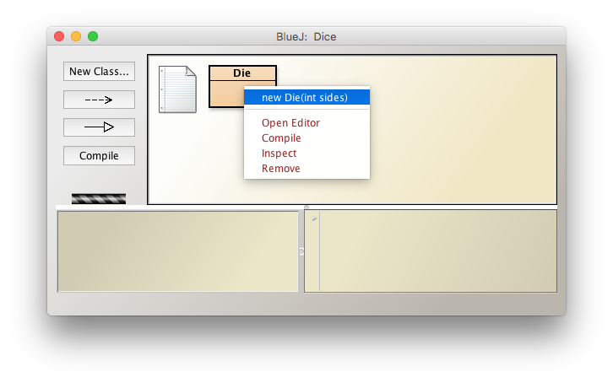
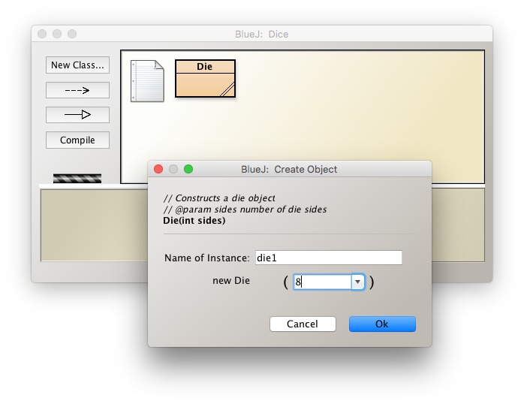
In BlueJ
create an object from a class by:
right-clicking on the class icon
selecting the constructor
you will be prompted for:
the name of the object
values for any parameters

Slide 9
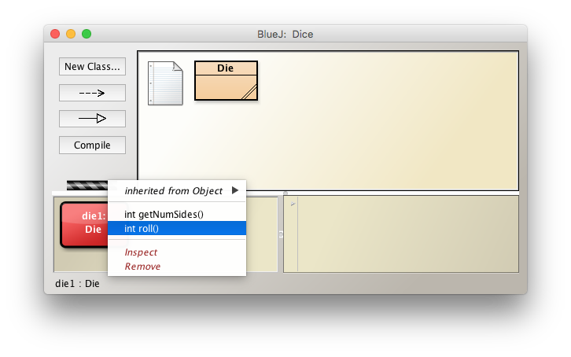
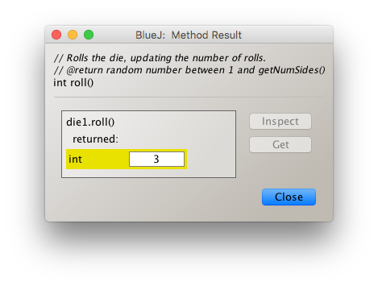
In BlueJ
the created object will appear as a red icon in the lower left
right-clicking on the object icon to select and call methods
if the method returns a value, it will appear in a pop-up window

Slide 10
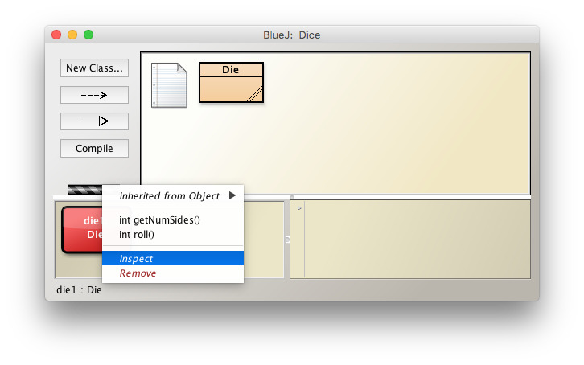
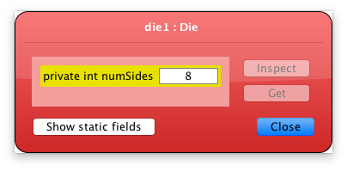
In BlueJ
BlueJ has a nice feature that allows you to see the internal state of an object
right-click and select Inspect
a pop-up window will show the values of all fields

Slide 11
Variation: adding more state
public class Die {
private int numSides;
private int numRolls;
public Die(int sides) {
this.numSides = sides;
this.numRolls = 0;
}
public int getNumberOfSides() {
return this.numSides;
}
public in getNumberOfRolls() {
return this.numRolls;
}
public int roll() {
this.numRolls = this.numRolls + 1;
return (int)(Math.random()*this.numSides) + 1;
}
}
we might want to have another field to keep track of the number of times the die has been rolled
add a private field (numRolls)
initialize it in the constructor
provide an accessor method
update it in roll method

Slide 12
Variation: adding another constructor
public class Die {
private int numSides;
private int numRolls;
public Die() {
this.numSides = 6;
this.numRolls = 0;
}
public Die(int sides) {
this.numSides = sides;
this.numRolls = 0;
}
public int getNumberOfSides() {
return this.numSides;
}
public in getNumberOfRolls() {
return this.numRolls;
}
public int roll() {
this.numRolls = this.numRolls + 1;
return (int)(Math.random()*this.numSides) + 1;
}
}
since 6-sided dice are most common, we might want a simpler way of creating them
a class can have more than one constructor – useful if there are different ways to create/initialize an object
add a default constructor (with no parameters) for 6-sided dice
if a class has multiple constructors, they must differ in their parameters

Slide 13
Variation: linking constructors
public class Die {
private int numSides;
private int numRolls;
public Die() {
this(6);
}
public Die(int sides) {
this.numSides = sides;
this.numRolls = 0;
}
public int getNumberOfSides() {
return this.numSides;
}
public in getNumberOfRolls() {
return this.numRolls;
}
public int roll() {
this.numRolls = this.numRolls + 1;
return (int)(Math.random()*this.numSides) + 1;
}
}
within a class a method can call another method
likewise, a constructor can call another constructor
here, the default constructor can just call the other constructor with 6 as parameter

Slide 14
Building complexity
/**
* Class that models a fair coin.
* @author Dave Reed
* @version 8/30/17
*/
public class Coin {
private Die d2;
public Coin() {
this.d2 = new Die(2);
}
public String flip() {
if (this.d2.roll() == 1) {
return "HEADS";
}
else {
return "TAILS";
}
}
public int getNumberOfFlips() {
return this.d2.getNumberOfRolls();
}
}
recall: can have an object as a field
here, can model a coin using a 2-sided die
flip method converts 1 or 2 roll into HEADS or TAILS
getNumberOfFlips method makes use of getNumberOfRolls

Slide 15
Example from text: Ticket Machine
75¢
Enter:
Refund
Dispense Ticket
consider a simple ticket machine
  machine supplies tickets at a fixed price
  customer enters cash, possibly more than one coin in succession
  once the required amount entered, customer hits a button to dispense ticket
  machine keeps track of total sales for the day
  properties/fields:
    ticket price, balance entered, total amount for day
  behaviors/methods:
    insert money, print ticket, get balance, get ticket price, get total sales

Slide 16
TicketMachine class
/**
* This class simulates a simple ticket vending machine.
* @author Barnes & Kolling (modified by Dave Reed)
* @version 9/2/17
*/
public class TicketMachine {
private int price; // price of a ticket
private int balance; // amount entered by user
private int total; // total intake for the day
/**
* Constructs a ticket machine.
* @param ticketCost the fixed price of a ticket
*/
public TicketMachine(int ticketCost) {
this.price = ticketCost;
this.balance = 0;
this.total = 0;
}
/**
* Mutator method for inserting money to the machine.
* @param amount the amount of cash (in cents)
* inserted by the customer
*/
public void insertMoney(int amount)
{
if (amount > 0) {
this.balance = this.balance + amount;
}
else {
System.out.println("Must be a positive amount!");
}
}
. . .
}
fields: will need to store
  price of the ticket
  amount entered so far by the customer
  total intake for the day
constructor: will take the fixed price of a ticket as parameter
  must initialize the fields
insertMoney:
  mutator method that adds to the customer's balance (or displays warning if not a positive amount)

Slide 17
TicketMachine methods
/**
* Accessor method for the ticket price.
* @return the fixed price (in cents) for a ticket
*/
public int getPrice() {
return this.price;
}
/**
* Accessor method for the amount inserted.
* @return the amount inserted so far
*/
public int getBalance() {
return this.balance;
}
/**
* Accessor method for the total amount.
* @return the total amount inserted so far
*/
public int getTotal() {
return this.total;
}
/**
* Simulates the printing of a ticket.
* Note: this naive method assumes that the user
* has entered the correct amount.
*/
public void printTicket() {
if (this.balance >= this.price) {
System.out.println("##################");
System.out.println("# The BlueJ Line");
System.out.println("# Ticket");
System.out.println("# " + this.price + " cents.");
System.out.println("##################");
System.out.println();
this.total = this.total + this.price;
this.balance = this.balance - this.price;
}
else {
System.out.println("You must enter at least: " +
(this.price – this.balance) + " cents.");
}
}
}
getPrice:
  accessor method that returns the ticket price
getBalance:
  accessor method that returns the balance
getTotal:
  accessor method that returns the total
printTicket:
  simulates the printing of a ticket (or displays warning if not enough entered)

Slide 18
Shorthand assignments
recall: the right-hand side of an assignment can be
  a value (String, int, double, …) this.balance = 0;
  a variable (parameter or field name) this.price = cost;
  an expression using (+, -, *, /) this.balance = this.balance + amount;
updating an existing value is a fairly common task, so arithmetic assignments exist as shorthand notations:
  x += y; is equivalent to x = x + y;
  x -= y; is equivalent to x = x – y;
  x *= y; is equivalent to x = x * y;
  x /= y; is equivalent to x = x / y;
  x++; is equivalent to x = x + 1; is equivalent to x += 1;
  x--; is equivalent to x = x - 1; is equivalent to x -= 1;
+= works for Strings as well
  str += "!"; is equivalent to str = str + "!";

Slide 19
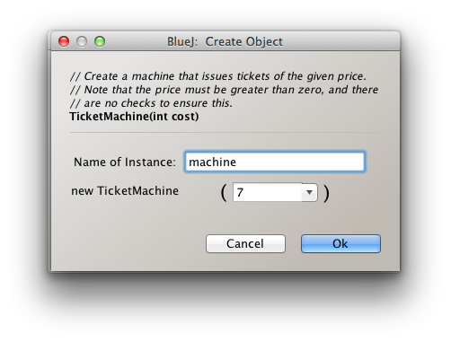
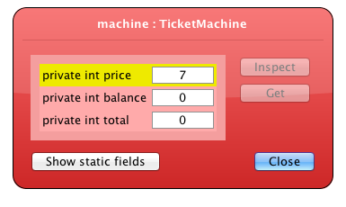
More on parameters
recall that a parameter is a value that is passed in to a method
  a parameter is a variable (it refers to a piece of memory where the value is stored)
  a parameter "belongs to" its method – only exists while that method executes
  using BlueJ, a parameter value can be entered by the user – that value is assigned to the parameter variable and subsequently used within the method

Slide 20
Local variables
fields are variables that
  are initialized by the constructor
  exist throughout the life of the object
  are accessible throughout the class
parameters are variables that
  are initialized when the method is called
  exist only while the method executes
  are accessible only within that method
in addition, methods can include short-lived local variables
  are declared and initialized when needed in the method
  exist only as long as the method is being executed
  are accessible only within that method
  local variables are useful whenever you need to store some temporary value (e.g., in a complex calculation)

Slide 21
New method: refundBalance
suppose we want a method to refund the ticket balance
  need to return the balance amount and reset balance to 0
/**
* Refunds the customer's current balance and resets their balance to 0.
* @return the balance refund amount
*/
public int refundBalance() {
return this.balance;
this.balance = 0;
}
is this OK?
when a return statement is reached, the method terminates
  the Java compiler won't even allow a statement after a return!
  here, need a local variable
/**
* Refunds the customer's current balance and resets their balance to 0.
* @return the balance refund amount
*/
public int refundBalance() {
int amountLeft = balance;
this.balance = 0;
return amountLeft;
}

Slide 22

example: Pig
Pig is a simple, children's dice game
  2 players take turns rolling a die
  on each turn, a player can make as many rolls as they want
    but, if they roll 1, the turn is over and the player earns 0 points
    if they choose to stop before rolling 1, they earn the total of rolls in that turn
  first player to 100 points wins
  e.g., possible turns
      4 6 1
    2 3 bust
    6 1 earns 0 points
    stop 4
    earns 12 points 5
    1
    bust
    earns 0 points

Slide 23
Pig analysis?
what is the best strategy for playing Pig?
when do you stop? when do you risk rolling again?
does it depend on the score or is it consistent?
once we have a strategy in mind, how do we test its effectiveness?
  the Law of Large numbers states that as the number of experiments approaches infinity, the results will converge on the expected outcome
  in plain English, the more experiments you conduct, the better (closer to the expected probability) your results
how many games would you have to play to be confident in your results?
computer are perfect for carrying out tedious, repetitive simulations
  we can build a model of a game & perform thousands or millions of simulations in seconds
  we can get results as accurate as we need them to be

Slide 24
Designing a PigGame class
we want to build a class that can simulate Pig games & maintain statistics
  for now, let's assume consistent (score-independent) strategies only
    e.g., stop rolling if your turn total exceeds 15
  fields/properties?
  constructor?
  methods/behaviors?
recall: end goal is to be able to determine the average number of turns it takes to reach 100, given a specific strategy
  can then compare different strategies to determine the best one

Slide 25
PigGame
public class PigGame {
private Die roller = new Die();
private int threshold;
public PigGame(int cutoff) {
this.threshold = cutoff;
this.roller = new Die();
}
public int playTurn() {
int turnPoints = 0;
while (turnPoints < this.threshold) {
int roll = this.roller.roll();
//System.out.println(roll);
if (roll == 1) {
return 0;
}
else {
turnPoints += roll;
}
}
return turnPoints;
}
public int playGame() {
int totalPoints = 0;
int turn = 0;
while (totalPoints < 100) {
totalPoints += this.playTurn();
//System.out.println(totalPoints);
turn++;
}
return turn;
}
}
many options for fields:
Die for rolling
threshold for when to stop
points total?
number of turns?
ideally, keep fields to a minimum
  assume each PigGame has its own cutoff (specified in constructor)
  don't need points or turns, methods can return these
  for testing purposes, can print each roll/round
  then comment out so not inundated with output

Slide 26
PigGame
it is bad practice to have "magic numbers" in code
in 6 months, will you remember what the 100 in playGame represents?
how easy would it be to change the game length?
better solution – define a constant at the top of the class
  a constant is a field that is declared to be "final static"
public class PigGame {
private final static int GOAL_POINTS = 100;
private Die roller = new Die();
private int threshold;
. . .
public int playGame() {
int totalPoints = 0;
int turn = 0;
while (totalPoints < PigGame.GOAL_POINTS) {
totalPoints += this.playTurn();
//System.out.println(totalPoints);
turn++;
}
return turn;
}
}
final → once assigned, it cannot be changed (so SAFE)
static → shared by all objects of the class (so EFFICIENT)
since the field belongs to the class, specify the class name to the left of the dot

Slide 27
PigGame (cont.)
how do we collect statistics?
could call playGame repeatedly, keep track ourselves
or, could add a method for simulating repeated games
  keeps a running total of all rounds, then calculates average per game
/**
* Simulates repeated games of 1-player Pig.
* @param numGames the number of games to simulate (numGames > 0)
* @param cutoff the point total at which the player holds (cutoff > 0)
* @return the average number of rounds required to win
*/
public double averageLengthOfGame(int numGames) {
int totalRounds = 0;
for (int i = 0; i < numGames; i++) {
totalRounds += this.playGame();
}
return (double)totalRounds/numGames;
}

Slide 28
PigStats driver class
while adding the stats generation method to PigGame works, it is not ideal
generating stats about repeated games is not the job of the game itself
better to create another class whose job is to simulate repeated games and report stats
  can use a constant to specify the number of games for each simulation
public class PigStats {
private final static int NUM_GAMES = 1000000;
public double averageLengthOfGame(int cutoff) {
PigGame game = new PigGame(cutoff);
int totalRounds = 0;
for (int i = 0; i < PigStats.NUM_GAMES; i++) {
totalRounds += game.playGame();
}
return (double)totalRounds/PigStats.NUM_GAMES;
}
public void showGameStats(int lowCutoff, int highCutoff) {
for (int i = lowCutoff; i <= highCutoff; i++) {
PigGame game = new PigGame(i);
double avg = game.averageLengthOfGame(PigStats.NUM_GAMES);
System.out.println(i + ": " + avg + " turns");
}
}
}
note: no fields & no constructor
WHY?

Slide 29
Static methods
if a class has no fields, all objects of that class would be identical
  ➔ that means you never need to create more than one object of that class
if that is the case, make the methods static
since static methods class belong to the class, can call directly from the con in BlueJ
  (saves the extra step of creating an object and then calling the method on that object)
public class PigStats {
private final static int NUM_GAMES = 1000000;
public static double averageLengthOfGame(int cutoff) {
PigGame game = new PigGame(cutoff);
int totalRounds = 0;
for (int i = 0; i < PigStats.NUM_GAMES; i++) {
totalRounds += game.playGame();
}
return (double)totalRounds/PigStats.NUM_GAMES;
}
public static void showGameStats(int lowCutoff, int highCutoff) {
for (int i = lowCutoff; i <= highCutoff; i++) {
PigGame game = new PigGame(i);
double avg = game.averageLengthOfGame(PigStats.NUM_GAMES);
System.out.println(i + ": " + avg + " turns");
}
}
}

