Slide 1
CSC 222: Object-Oriented Programming Fall 2017
Object-oriented design, revisited
highly cohesive, loosely coupled
HW6: Hunt the Wumpus
enumerated types
MVC pattern

Slide 2
OO design principles
recall from earlier:
the object-oriented approach focuses on identifying the entities/objects that make up a problem solution, then build software models
want code to be modular, so that it can be developed & tested independently
also, want to be able to reuse useful code
in a highly cohesive system:
each class maps to a single, well-defined entity – encapsulating all of its internal state and external behaviors
each method of the class maps to a single, well-defined behavior
highly cohesive code is easier to read and reuse
in a loosely coupled system:
each class is largely independent and communicates with other classes via a small, well-defined interface
loosely coupled code is easier to develop and modify

Slide 3
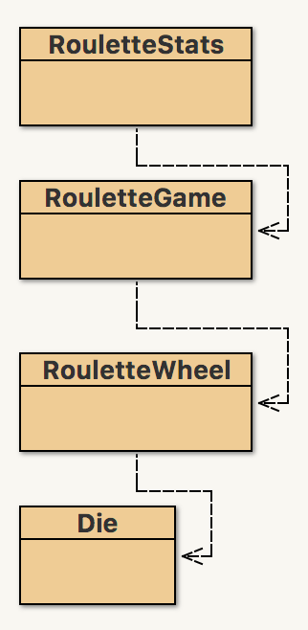
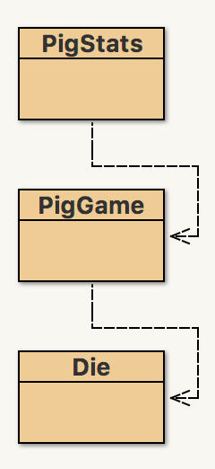
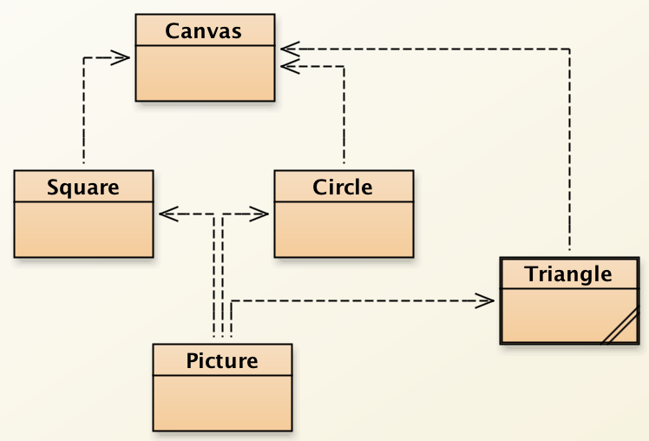
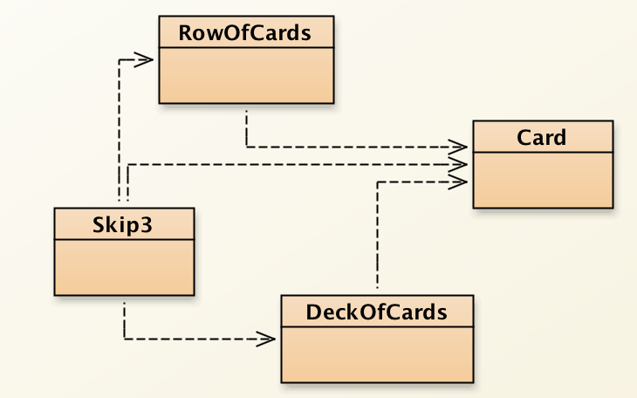
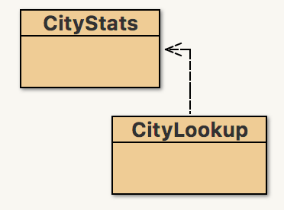
Previous examples

Slide 4

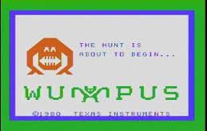
HW6: Hunt the Wumpus
you will implement a variant of one of the first text-based video games
written in BASIC by Gregory Yob in 1972
later ported to various PC's, (e.g., Commodore, TI) and UNIX
named by Time Magazine as one of the All-Time 100 Video Games

Slide 5
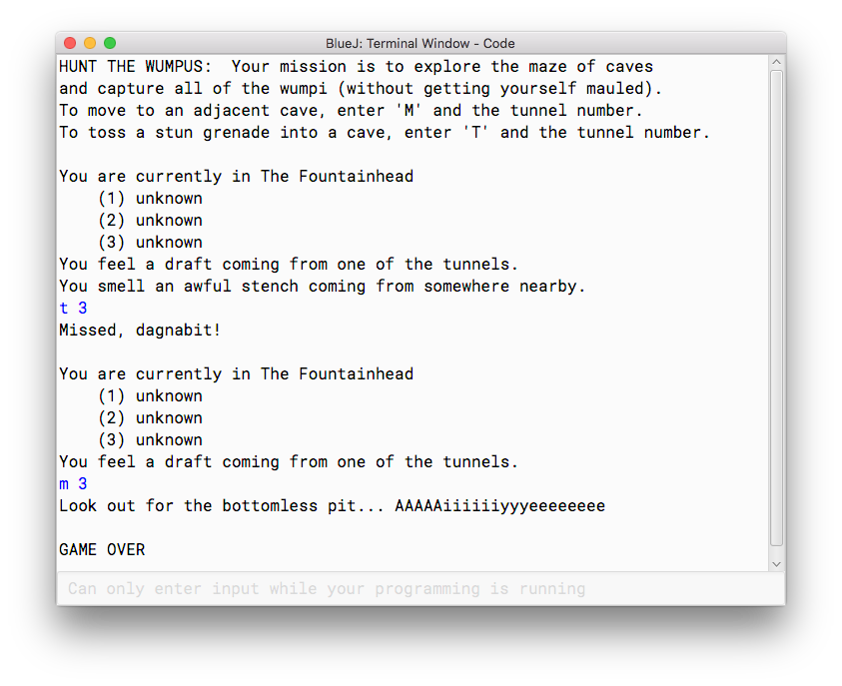
Game rules
player explores a maze of caves, with each cave connected to 1-4 others
randomly placed wumpi (1-3), bottomless pit (1) and bat swarm (1)
player can sense when an obstacle is adjacent
player can move or throw a stun grenade through a tunnel, wumpi move when hear an explosion
goal: avoid obstacles and capture all of the wumpi before they maul you!
5

Slide 6
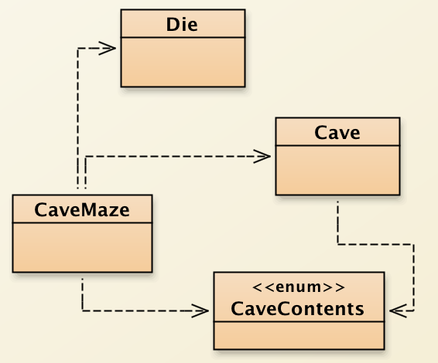
Hunt the Wumpus design
Cave:
contains all of the information about a given cave, including its contents
CaveContents:
special type of class for specifying the possible contents of a cave
CaveMaze:
models the maze of caves
the caves stored in an ArrayList, linked together
utilizes the Die class in order to select random locations in the maze

Slide 7
Cave class
you must implement a class that models a single cave
each cave has a name & number, and is connected to 1-5 other caves via tunnels
by default, caves are empty & unvisited (although these can be updated)
how do we represent the cave contents?
we could store the contents as a string: "EMPTY", "WUMPUS", "BATS", "PIT"
Cave c = new Cave("Cavern of Doom", 0, adjList);
c.setContents("WUMPUS");
potential problems?
there are only 4 possible values for cave contents
the trouble with using a String to represent these is the lack of error checking
c.setContents("WUMPIS"); // perfectly legal, but ???

Slide 8
Enumerated types
there is a better alternative for when there is a small, fixed number of values
an enumerated type is a new type (class) whose value are explicitly enumerated
public enum CaveContents {
EMPTY, WUMPUS, PIT, BATS
}
note that these values are NOT Strings – they do not have quotes
you specify a enumerated type value by ENUMTYPE.VALUE
c.setContents(CaveContents.WUMPUS);
since an enumerated type has a fixed number of values, any invalid input would be caught by the compiler

Slide 9
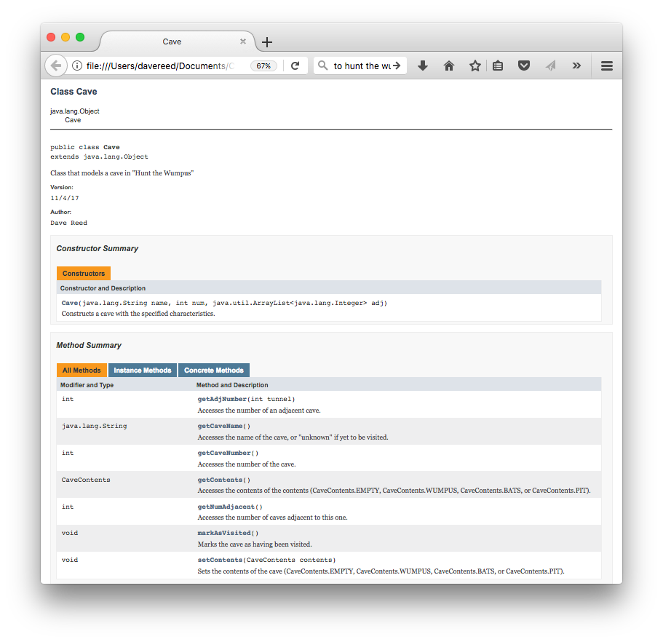
Cave javadoc
be sure your class follows the javadoc specifications
will need to decide what fields are needed (and only those fields!)
cave contents are define by CaveContents enumerated type
getCaveName will return "unknown" if that cave is unvisited, otherwise return the cave's name

Slide 10
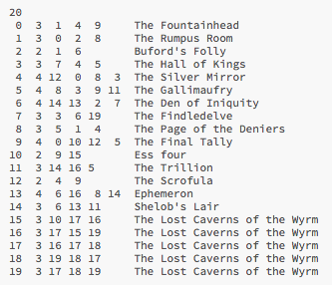
CaveMaze
the CaveMaze class reads in & stores a maze of caves
provided version uses an ArrayList (but could have used an array)
the caves and their connections are defined in a file: caves.txt
cave 0 is assumed to be the start cave
public class CaveMaze {
private Cave currentCave;
private ArrayList<Cave> caves;
public CaveMaze(String filename) throws java.io.FileNotFoundException {
Scanner infile = new Scanner(new File(filename));
int numCaves = infile.nextInt();
this.caves = new ArrayList<Cave>();
for (int i = 0; i < numCaves; i++) {
this.caves.add(null);
}
for (int i = 0; i < numCaves; i++) {
int num = infile.nextInt();
int numAdj = infile.nextInt();
ArrayList<Integer> adj = new ArrayList<Integer>();
for (int a = 0; a < numAdj; a++) {
adj.add(infile.nextInt());
}
String name = infile.nextLine().trim();
this.caves.set(num, new Cave(name, num, adj));
}
this.currentCave = this.caves.get(0);
this.currentCave.markAsVisited();
}
. . .

Slide 11
CaveMaze (cont.)
currently,
can move between caves
only see the names of caves you have already visited
you must add the full functionality of the game (incl. adding & reacting to dangers, winning/losing)
. . .
public String move(int tunnel) {
if (tunnel < 1 || tunnel > this.currentCave.getNumAdjacent()) {
return "There is no tunnel number " + tunnel;
}
int caveNum = this.currentCave.getAdjNumber(tunnel);
this.currentCave = this.caves.get(caveNum);
this.currentCave.markAsVisited();
return "Moving down tunnel " + tunnel + "...";
}
public String showLocation() {
String message = "You are currently in " +
this.currentCave.getCaveName();
for (int i = 1; i <= this.currentCave.getNumAdjacent(); i++) {
int caveNum = this.currentCave.getAdjNumber(i);
Cave adjCave = this.caves.get(caveNum);
message += "\n (" + i + ") " + adjCave.getCaveName();
}
return message;
}
. . .
}

Slide 12
User Interface
using BlueJ, we have been able to manipulate objects directly
create an object by right-clicking on the class icon (& providing inputs if necessary)
call a method by right-clicking on the object icon (& providing inputs if necessary)
for an interactive application like a game, you want a class to automate the top-level control
convention is to have a "driver" class with a static "main" method
(main is automatically called using other development environments)
in this case, the main method
creates the CaveMaze
loops to get each player action (e.g., move or toss)
calls the CaveMaze method associated with that action
displays the result of the action

Slide 13
Terminal driver
public class WumpusTerminal {
public static void main(String[] args) throws java.io.FileNotFoundException {
CaveMaze maze = new CaveMaze("caves.txt");
System.out.println("HUNT THE WUMPUS: Your mission is to explore the maze of caves");
System.out.println("and capture all of the wumpi (without getting yourself mauled).");
System.out.println("To move to an adjacent cave, enter 'M' and the tunnel number.");
System.out.println("To toss a stun grenade into a cave, enter 'T' and the tunnel number.");
Scanner input = new Scanner(System.in);
while (maze.stillAble() && maze.stillWumpi()) {
System.out.println("\n"+maze.showLocation());
try {
String action = input.next();
if (action.toLowerCase().charAt(0) == 'q') {
System.out.println("Nobody likes a quitter.");
break;
}
if (action.toLowerCase().charAt(0) == 't') {
System.out.println(maze.toss(input.nextInt()));
} else if (action.toLowerCase().charAt(0) == 'm') {
System.out.println(maze.move(input.nextInt()));
} else {
System.out.println("Unrecognized command -- please try again.");
}
}
catch (java.util.InputMismatchException e) {
System.out.println("Unrecognized command -- please try again.");
}
}
System.out.println("\nGAME OVER");
}
}

Slide 14
MVC pattern
model-view-controller is a software pattern used to develop reusable, modular software
goal: isolate the application-specific logic from the user interface
allows for independent testing & development, easy updates
for this example:
the model consists of the logic of the application – Die, CaveContents, Cave, CaveMaze
the view is the Java terminal window
the controller is the WumpusTerminal class with its text-based input/output
by separating the logic from the interface, it makes it possible to plug in a different interface, e.g., a Graphical User Interface (GUI)

Slide 15
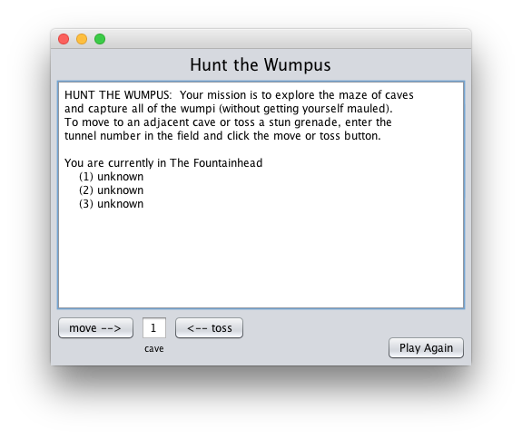
GUI version
for Hunt the Wumpus
none of the Model classes did any input/output (other than the caves data file)
the Controller (WumpusTerminal) connects the Model with the View
if want to use a different View, must replace the Controller
your HW6 classes should work with either WumpusTerminal or WumpusGUI

