Slide 1
CSC 221: Introduction to Programming
Fall 2023
Sequences and strings
    indexing
    slicing
    string operations
      capitalize, upper, lower
      center, ljust, rjust, strip
      count, find, replace

Slide 2
Sequence summary
range, string, and list are all instances of sequences
  a range is a sequence of numbers
  a string is a sequence of characters
  a list is a sequence of arbitrary items
all sequences support:
  iteration using for
  len function
  search using in
  assignment
words = ["foo", "banana", "billy", "bluejay"]
for w in words:
numLong = 0
if len(w) > 5:
numLong = numLong + 1
phrase = "I love programming."
vowelCount = 0
for ch in phrase:
if ch in "aeiouAEIOU":
vowelCount = vowelCount + 1
there are additional operations on sequences
  indexing
  slicing
  . . .
coordinate = [3, 4]
[x, y] = coordinate

Slide 3
Sequence indexing
can access an item in a sequence using indexing
  individual items are assumed to be numbered starting at 0
  word = "foobar"
  nums = [3, 6, 1, 4]
can access an item in a sequence: seq[index]
  word[0] → 'f' nums[0] -> 3
  word[1] → 'o' nums[1] -> 6
  word[2] → 'o' nums[2] -> 1
  word[3] → 'b' nums[3] -> 4
  word[4] → 'a'
  word[5] → 'r'
'f' | 'o' | 'o' | 'b' | 'a' | 'r'
0 | 1 | 2 | 3 | 4 | 5
3 | 6 | 1 | 4
0 | 1 | 2 | 3

Slide 4
Indexing example
suppose we wanted to generate acronyms of phrases
  for now, we will start from a list of words
    def acronym(wordlist:str) -> str:
    acro = ""
    for word in wordlist:
    acro = acro + word[0]
    return acro
    -----------------------------------------
    acronym(["laughed", "out", "loud"])
    acronym(["in", "case", "you're", "interested"])
    acronym(["International", "Business", "Machines"])
    acronym(["fouled", "up", "beyond", "all", "recognition"])
    "lol"
    "icyi"
    "IBM"
    "fubar"

Slide 5
Indexing vs. for
note that indexing provides a variant of for loop iteration
    word = "foobar" word = "foobar"
    copy = "" copy = ""
    for ch in word: for index in range(len(word)):
    copy = copy + ch copy = copy + word[index]
    nums = [3, 7, 6, 2] nums = [3, 7, 6, 2]
    sum = 0 sum = 0
    for n in nums: for index in range(len(nums)):
    sum = sum + n sum = sum + nums[index]
    if you need to traverse the entre list, a plain for loop (on left) is simpler
    if you need to selectively access items, or access multiple items at a time, an index loop can be better
    word = "foobar"
    copy = ""
    for index in range(0, len(word), 2):
    copy = copy + word[index]

Slide 6
Better example
suppose we have a list of numbers, and want to determine if sorted in non-decreasing order
    def nondecreasing(nums:[float]) -> bool:
    for index in range(len(nums)):
    if nums[index] > nums[index+1]:
    return False
    return True
    -----------------------------------------
    nondecreasing([2.8, 4,5, 10, 17.7, 25])
    nondecreasing([3, 6, 5, 8])
    nondecreasing([5])
    nondecreasing([ ])
    True
    False
    True
    True

Slide 7
Yet another example
suppose we want to check if a word is a palindrome
  i.e., the same forwards and backwards
    def palindrome(word:str) -> bool:
    for index in range(len(word)//2):
    if word[index] != word[len(word)-index-1]:
    return False
    return True
    -----------------------------------------
    palindrome("madam")
    palindrome("atlanta")
    palindrome("x")
    palindrome("")
    palindrome([1, 2, 2, 1])
    True
    False
    True
    True
    True

Slide 8
Negative indexing
can use negative index to work from the end of the string
  last item: seq[-1]
  next-to-last item: seq[-2]
  next-to-next-to-last seq[-3]
  . . .
  this allows us to simplify palindrome a little bit
    def palindrome(word:str) -> bool:
    for index in range(len(word)//2):
    if word[index] != word[-index-1]:
    return False
    return True
'f' | 'o' | 'o' | 'b' | 'a' | 'r'
0 (-6) | 1 (-5) | 2 (-4) | 3 (-3) | 4 (-2) | 5 (-1)
BE CAREFUL: an index beyond the end of the string is an error!
must be in the range -len(seq) ≤ index < len(seq)
any index outside will result in an out-of-range error

Slide 9
Exercise
write a function that returns the reverse of a string
  def reverse(word:str) -> str:
  """Returns a reversed copy of word."""
once you have tested your function, rewrite palindrome using it
  def palindrome(word:str) -> bool:
  """Returns whether word is same as reversed word."""

Slide 10
Slicing
indexing allows you to access a single item in a sequence
slicing allows you to access a subsequence
  specify the subsequence by seq[lowIndex:highIndex]
  where lowIndex is inclusive and highIndex is exclusive
    w = "foobarbiz"
    w[0:3]
    w[1:3]
    w[3:len(w)]
    w[-3:len(w)]
  w[-3:-2]
    if first index is omitted or too small, is assumed to be 0
    w[:3] == w[0:3]
    w[-100:3] == w[0:3]
    if 2nd index is omitted or too big, is assumed to be len()
    w[3:] == w[3:len(w)]
    w[3:100] == w[-3:len(w)]
    → "foo"
    → "oo"
    → "barbiz"
    "biz"
    "b"

Slide 11
Slicing examples
    def rotateLeft(word:str) -> str:
    return word[1:] + word[0]
    def rotateRight(word:str) -> str:
    return word[-1] + word[:-1]
    def insert(newStr:str, oldStr:str, index:int) -> str:
    return oldStr[:index] + newStr + oldStr[index:]
rotateLeft("abcd") → "bcda"
rotateLeft("12345") → "23451"
rotateRight("abcd") → "dabc"
rotateRight("12345") → "51234"
insert("x", "abcd", 2) → "abxcd"
insert("99", "12345", -1) → "1234995"
QUESTION: are any of these functions crashable?

Slide 12
More robust versions
    def rotateLeft(word:str) -> str:
    if word == "":
    return word
    else:
    return word[1:] + word[0]
    def rotateRight(word:str) -> str:
    if word == "":
    return word
    else:
    return word[-1] + word[:-1]
    def insert(newStr:str, oldStr:str, index:int) -> str:
    return oldStr[:index] + newStr + oldStr[index:]

Slide 13
Python objects
normally, when we call a function we specify the function name and inputs in parentheses
round(3.8)
however, when we used the turtle module things looked different
donatelo.forward(100) raphael.right(60)
donatelo.right(90) raphael.forward(50)
a turtle is a special kind of value in Python known as an object
  an object has its own state (here, a location, orientation, color, pen position)
  a method is a function that can be applied to an object to change its state
  you call a method differently than a standard function: OBJECT.METHOD(PARAMS)
    e.g., donatelo.forward(100) changes the position of donatelo, but no other
    e.g., raphael.right(60) changes the orientation of raphael, but no other

Slide 14
Strings as objects
Python strings are also objects
  each string has a state (sequence of characters, counter to keep track of length)
  there are many methods provided for manipulating strings
>>> word = "foobar"
>>> word.capitalize()
'Foobar'
>>> word.upper()
'FOOBAR'
>>> word.lower()
'foobar'
>>> word.find("oo")
1
>>> word.find("z")
-1
>>> word.replace("oo", "u")
'fubar'
note: each of these methods returns a value based on the string's state – the string is NOT altered

Slide 15
Common string methods
capitalize( ) Return a copy of the string with only its first character capitalized
lower( ) Return a copy of the string converted to lowercase.
upper( ) Return a copy of the string converted to uppercase.
center(width) Return centered in a string of length width.
ljust(width) Return the string left justified in a string of length width.
rjust(width) Return the string right justified in a string of length width.
strip( ) Return a copy of the string with the leading and trailing whitespace characters removed.
count(sub) Return the number of occurrences of substring sub in string. Can provide two additional inputs, low & high, to limit to [low:high] slice.
find(sub) Return the lowest index in the string where substring sub is found; -1 if not found. Can similarly provide low & high inputs to limit the range.
replace(old, new) Return a copy of the string with all occurrences of substring old replaced by new. Can similarly provide low & high inputs to limit the range.

Slide 16
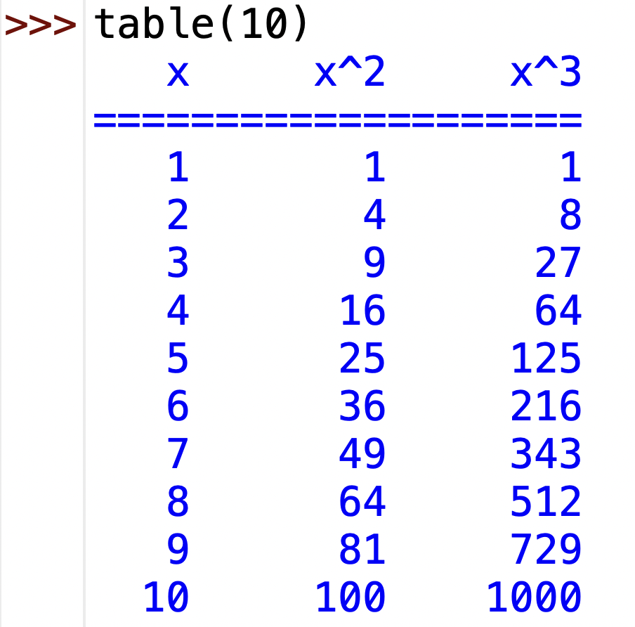
Formatting output
recall in HW3 we wanted to displays numbers in columns
  one way to do that is to use center, ljust or rjust
def table(num:int) -> None:
print(" x x^2 x^3")
print("====================")
for x in range(1, num+1):
print(str(x).rjust(4) + str(x**2).rjust(8) + str(x**3).rjust(8))
how would the table have looked using center?
using ljust?

Slide 17
Example: censoring words
what does the following function do?
def censor(word:str) -> str:
word = word.replace("a", "*")
word = word.replace("e", "*")
word = word.replace("i", "*")
word = word.replace("o", "*")
word = word.replace("u", "*")
return word
what if we wanted to censor capital vowels as well?
def censor(word:str) -> str:
word = word.replace("a", "*")
word = word.replace("e", "*")
word = word.replace("i", "*")
word = word.replace("o", "*")
word = word.replace("u", "*")
word = word.replace("A", "*")
word = word.replace("E", "*")
word = word.replace("I", "*")
word = word.replace("O", "*")
word = word.replace("U", "*")
return word
this is getting tedious!

Slide 18
Example: censor revisited
using a for loop, can greatly simplify our censor function
def censor(word:str) -> str:
for ch in "aeiouAEIOU":
word = word.replace(ch, "*")
return word
EXERCISE: generalize the censor function so that the letters to be censored are provided as inputs
  note: lowercase and uppercase occurrences of the letters should be censored
  >>> censor("foobar", "aeiou")
  'f**b*r'
  >>> censor("Oof dah Abba goo", "aeiou")
  '**f d*h *bb* g**'
  >>> censor("Funk", "unto")
  'F**k'

Slide 19
Palindrome revisited
suppose we want to generalize our palindrome function two work with phrases (ignoring non-letters)
  "bob"
  "madam"
  "Madam, I'm Adam."
  "Able was I ere I saw Elba."
  "A man, a plan, a canal: Panama."
to strip non-letters from a string, could try to
  call remove to remove every possible non-letter character
    way too many possibilities, most of which won't appear in the string
  traverse the string, character by character
  for each non-letter encountered, call remove to remove that letter
    could work, but inefficient (remove has to search for the char all over again)

Slide 20
Building up a string
better solution
  recall code for copying a string
    copy = ""
    for ch in phrase:
    copy = copy + ch
  we just want to be selective, only add ch to the copy if it is a letter
    def stripNonLetters(phrase:str) -> str:
    copy = ""
    for ch in phrase:
    if ch.isalpha():
    copy = copy + ch
    return copy
    ----------------------------------------
    >>> stripNonLetters("Madam, I'm Adam.")
    'MadamImAdam'
ch.islaph() returns True if ch is an alphabetic character (i.e., a letter)

Slide 21
Palindrome (new versions)
def palindrome(word:str) -> bool:
stripped = stripNonLetters(word)
capped = stripped.upper()
for index in range(len(capped)//2):
if capped[index] != capped[-index-1]:
return False
return True
-------------------------------------------------
def reverse(word:str) -> str:
rev = ""
for ch in word:
rev = ch + rev
return rev
def palindrome(word:str) -> bool:
stripped = stripNonLetters(word)
capped = stripped.upper()
return capped == reverse(capped)
ICYI, this also works!
def reverse(word:str) -> str:
return word[::-1]

Slide 22
Searching a string
suppose we want to determine if a character or substring appears somewhere in a string
  call count or find and test the result
  could also use in and not in to test this directly
>>> s = "banana"
>>> s,count("a") > 0
True
>>> s.count("z") > 0
False
>>> s,find("a") != -1
True
>>> s.find("z") != -1
False
>>> "a" in str
True
>>> "z" in str
False
>>> "a" not in str
False
>>> "z" nt in str
True
>>> "ana" in str
True
>>> "baba" not in str
True

Slide 23
Exercise: generalize the stripping
recall that we generalized the censor function so that you could specify the characters to censor
similarly, generalize the stripNonLetters function so that it has an additional input specifying the characters to strip
def censor(word:str) -> str:
for ch in "aeiuoAEIOU:
word = word.replace(ch, "*")
return word
def censor(word:str, badChars:str) -> str:
for ch in badChars:
word = word.replace(ch, "*")
return word
def stripNonLetters(word:str) -> str:
copy = ""
for ch in word:
if ch.isalpha():
copy = copy + ch
return copy

Slide 24
Example: Caesar cipher
one of the earliest examples of encryption (secret codes for protecting messages) was the Caesar cipher
  used by Julius Caesar in 50-60 B.C. to encrypt military messages
  worked by shifting each letter three spots in the alphabet
    e.g., ET TU BRUTE → HW WX EUXWH
for each letter in the message:
  need to be able to find its position in the alphabet
  then find the character three spots later (wrapping around to the front for "XYZ")
  there are numerous ways of doing this
  simplest: construct a string made up of all the letters in the alphabet,
    use the find method to find the index of a char in that string,
    use indexing to find the char at (index+3)

Slide 25
Example: Caesar cipher
for simplicity, we'll assume the message is made of uppercase letters only
ALPHABET = "ABCDEFGHIJKLMNOPQRSTUVWXYZ"
def caesar(word:str) -> str:
copy = ""
for ch in word:
index = ALPHABET.find(ch)
newIndex = (index + 3) % 26
copy = copy + ALPHABET[newIndex]
return copy
ALPHABET is constant, a variable that is assigned once and accessible to all
the convention is to write constant in all-caps
wrap-around is handled using the remainder operator
  for the letter "Z", index = 25
  newIndex = (25+3)%26 = 28%26 = 2
  so, "Z" → "C"

Slide 26
Exercise: Caesar update
enter the definition of the caesar function and try it out on different strings
ALPHABET = "ABCDEFGHIJKLMNOPQRSTUVWXYZ"
def caesar(word:str) -> str:
copy = ""
for ch in word:
index = ALPHABET.find(ch)
newIndex = (index + 3) % 26
copy = copy + ALPHABET[newIndex]
return copy
what would happen if we changed the alphabet?
  e.g., the the Classical Roman alphabet did not have the letters 'J', 'U', or 'W'
  if we removed those letters from the ALPHABET string, would the function still work?

Slide 27
Avoiding dependencies in code
the problem here is that calculation of newIndex is dependent on the ALPHABET length (using the % operator)
  if we change the ALPHABET string, we also have to change this number
as a general rule in programming, we want to avoid these kinds of dependencies
  when possible, write code so that a single change is propagated everywhere
ALPHABET = "ABCDEFGHIJKLMNOPQRSTUVWXYZ"
def caesar(word:str) -> str:
copy = ""
for ch in word:
index = ALPHABET.find(ch)
newIndex = (index + 3) % len(ALPHABET)
copy = copy + ALPHABET[newIndex]
return copy

Slide 28
Exercise: generalized rotation cipher
generalize the Caesar cipher so that it can be used to perform any rotation
  including negative rotations, which could be used to decode messages
  rotateCode(word, 3) → encode using Caesar cipher
  rotateCode(word, -3) → decode using Caesar cipher
  rotateCode(word, 13) → encode/decode using rot13
ALPHABET = "ABCDEFGHIJKLMNOPQRSTUVWXYZ"
def caesar(word:str) -> str:
copy = ""
for ch in word:
index = ALPHABET.find(ch)
newIndex = (index + 3) % len(ALPHABET)
copy = copy + ALPHABET[newIndex]
return copy

Slide 29
Caesar revisited
once we have the generalized rotation cipher function
  we could use it to perform a Caesar cipher encodings/decodings
ALPHABET = "ABCDEFGHIJKLMNOPQRSTUVWXYZ"
def rotateCode(word:str, numChars:int) -> str:
copy = ""
for ch in word:
index = ALPHABET.find(ch)
newIndex = (index + numChars) % len(ALPHABET)
copy = copy + ALPHABET[newIndex]
return copy
def caesarEncode(word:str) -> str:
return rotateCode(word, 3)
def caesarDecode(word:str) -> str:
return rotateCode(word, -3)

