Slide 1
CSC 221: Introduction to Programming Fall 2023
Problem solving
coding problems from Test 2
International Collegiate Programming Contest
Anti-Palindrome, Cuckoo! Cuckoo!, Cyclical Periods
description, analysis, solution

Slide 2
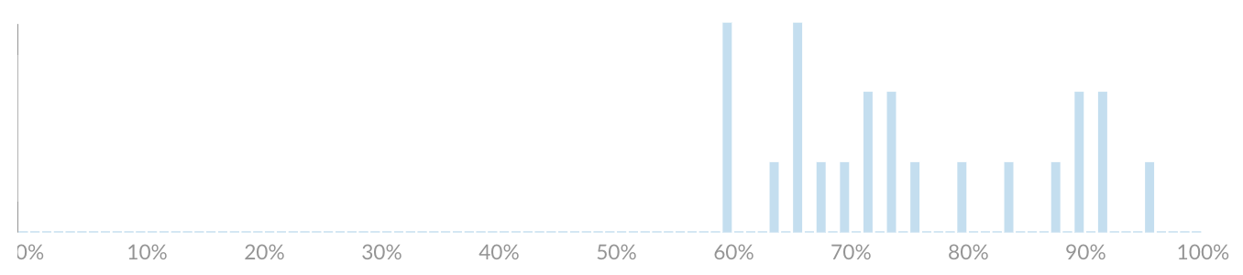
TEST 2 stats
TEST 2 performance not as strong as TEST 1
average = 76.6
median = 74
fewer in the 80-90% and 90-100% ranges
but there was a 51
many more in the 60-70% & 70-80% ranges
but at least no score < 60%
0 | 8 | 6 | 3 | 6
breakdown by problem type:
True/False + MultChoice + FillinBlanks = 77.0%
coding problems = 69.1%
BONUS = 100%

Slide 3
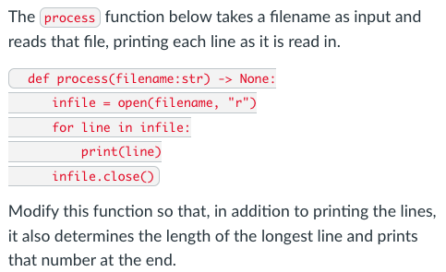
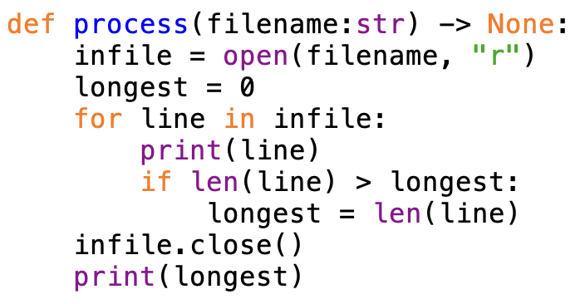
Accumulator pattern (find longest)
average = 3.1/4 = 78%
median = 4

Slide 4
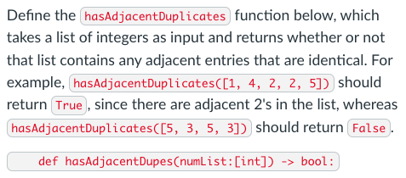
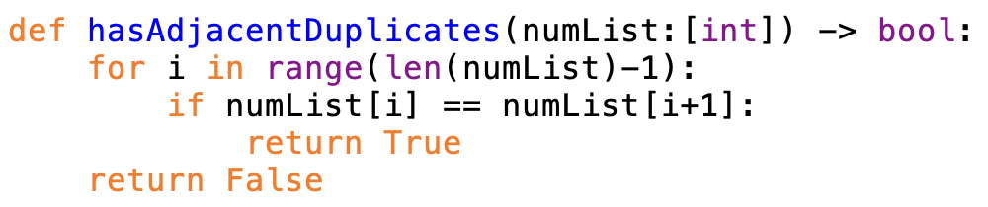
List traversal via indexing
average = 3.9/6 = 65%
median = 4

Slide 5
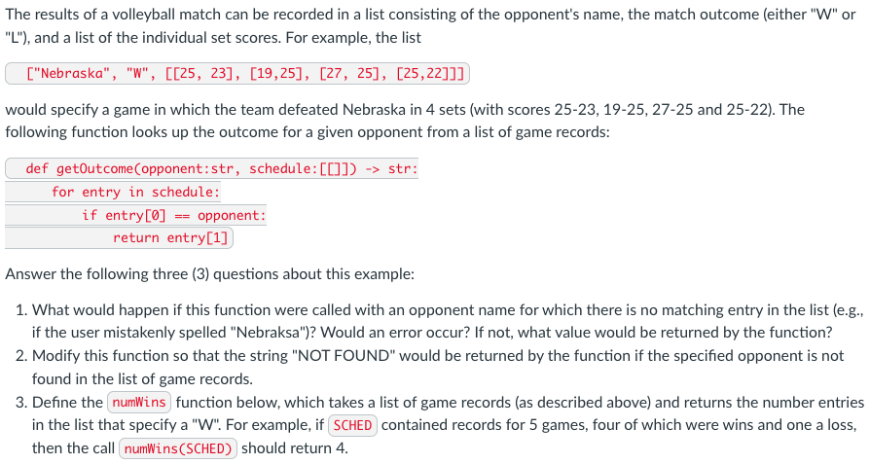
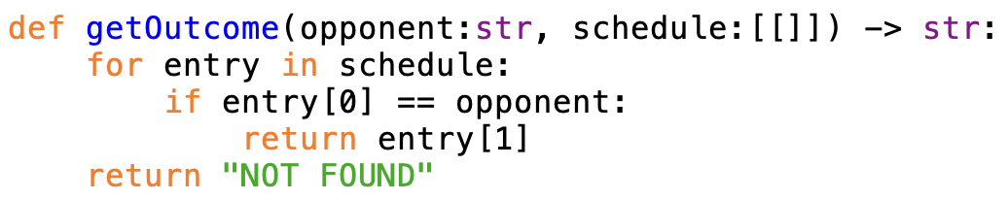
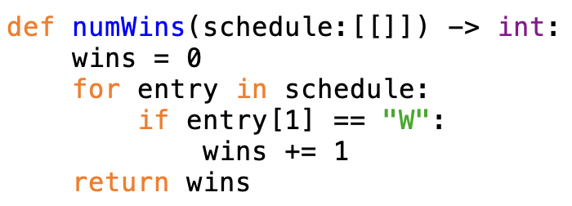
Nested lists, accumulator pattern (counter)
average = 7.0/10= 70%
median = 7

Slide 6
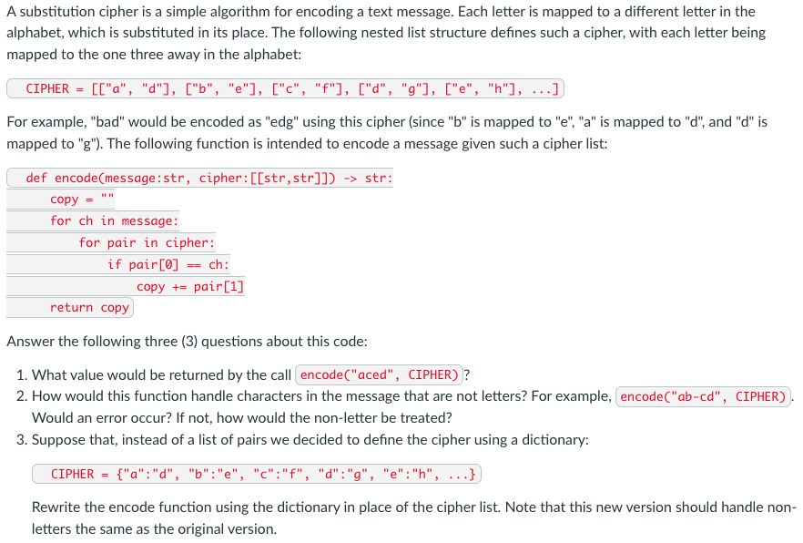
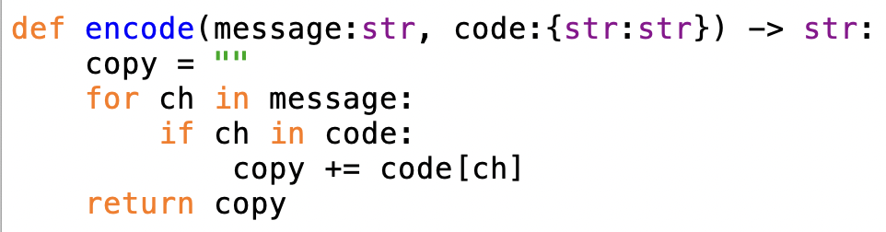
Lists, dictionary, accumulator (string copy)
average = 5.4/8= 67%
median = 5

Slide 7
International Collegiate Programming Contest (ICPC)
each year, the ICPC is held across multiple sets, multiple rounds
50,000+ students from 3,000+ universities across the world
2023 World Finals in Sharm El Sheikh, Egypt
North America North Central Region contest was last Saturday
129 teams competed, 3 from Creighton
student compete in teams of 3 with only one computer
given 12 problems, 5 hours to solve as many as possible
can program solutions in Python, Java, C/C++, Kotlin
some problems are doable to a 221-level programmer
but, must be able to read the problem, define the actual task, code & test
let's look at three problems from the contest

Slide 8
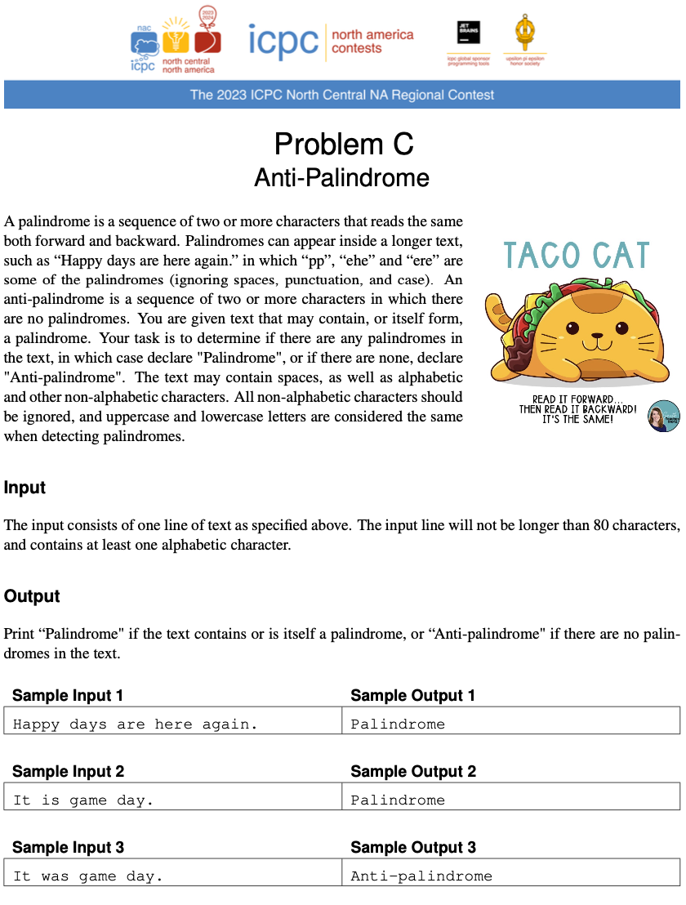
Problem C
easiest problem
solved by 101 teams
average of 2.65 tries to get correct
first correct solution was submitted in 6 min!
what is this question asking for?
what is the "trick"
what "busy work" is there to do?

Slide 9
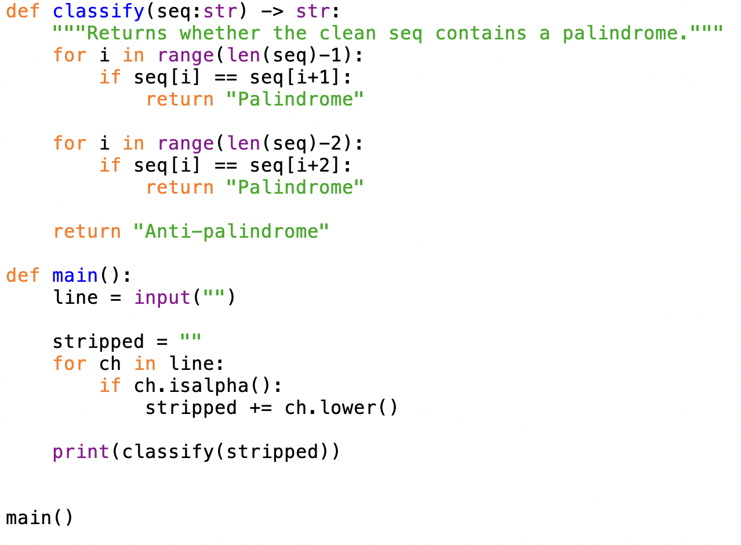
Solution

Slide 10
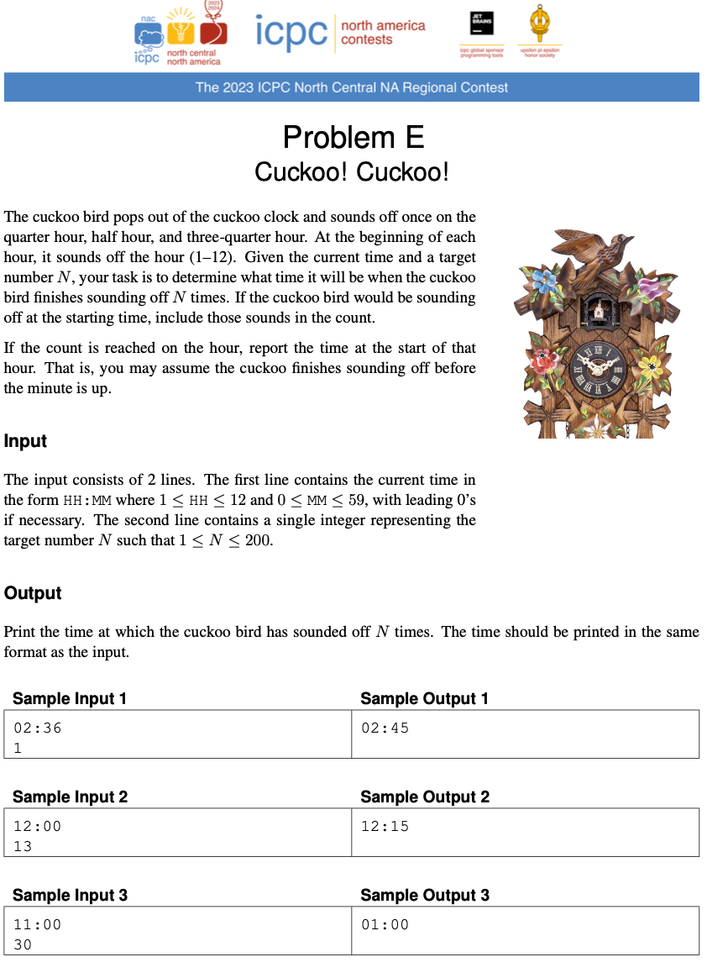
Problem E
2nd easiest question
solved by 81 teams
average of 2.83 tries to get correct
first solution in 11 min
what is this question asking for?
what is the "trick"
what "busy work" is there to do?

Slide 11
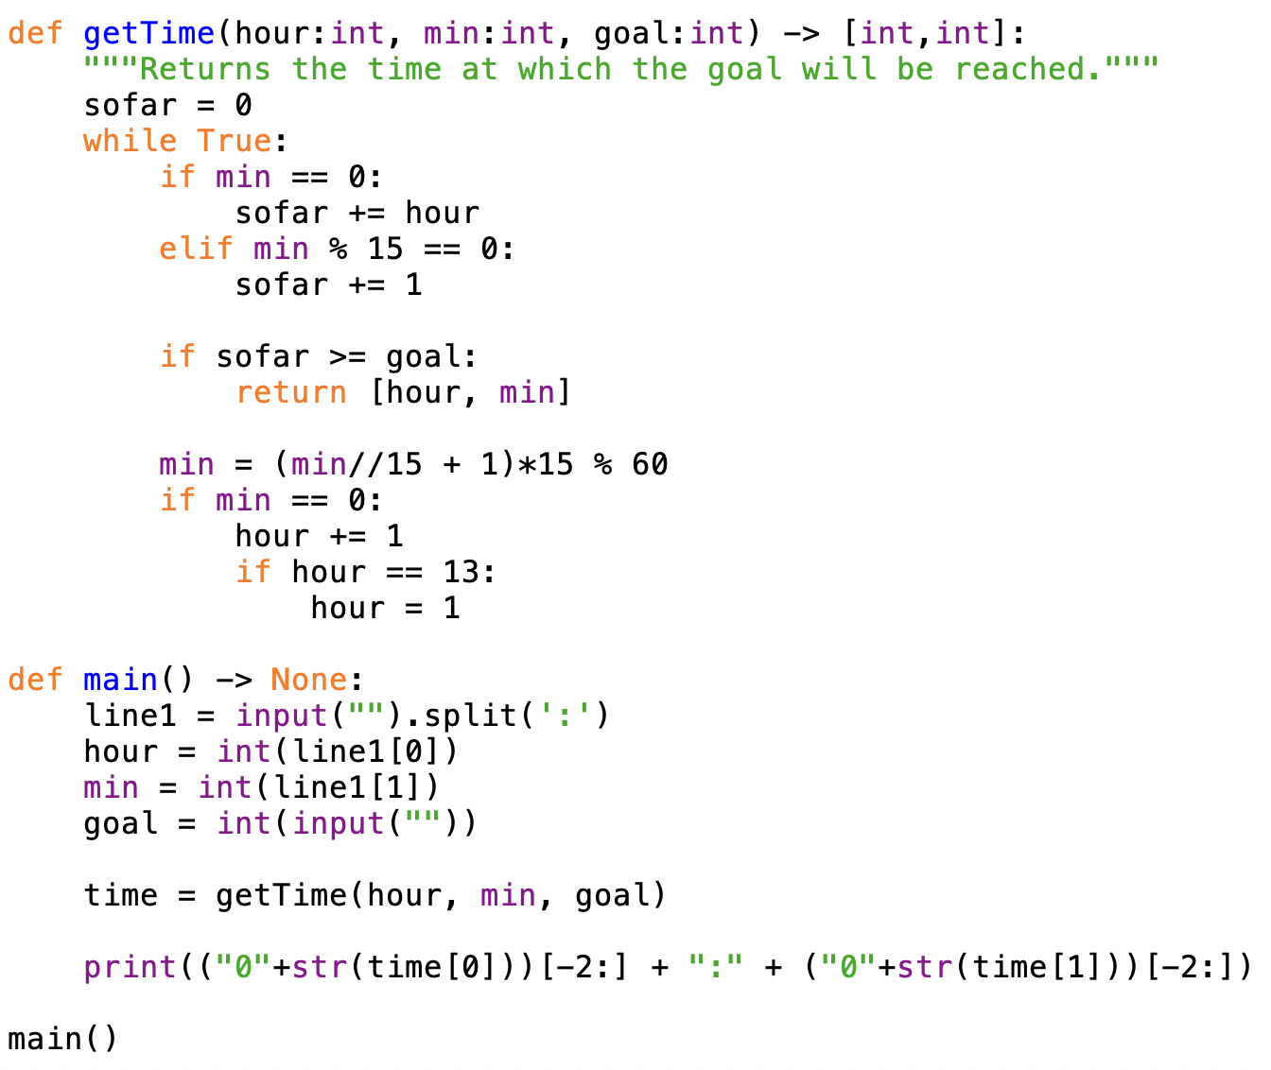
Solution

Slide 12
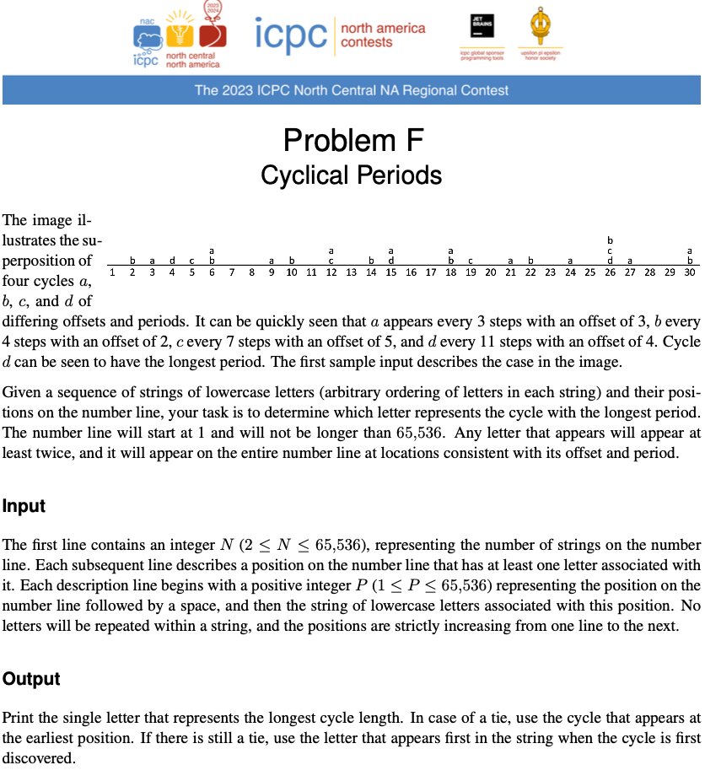
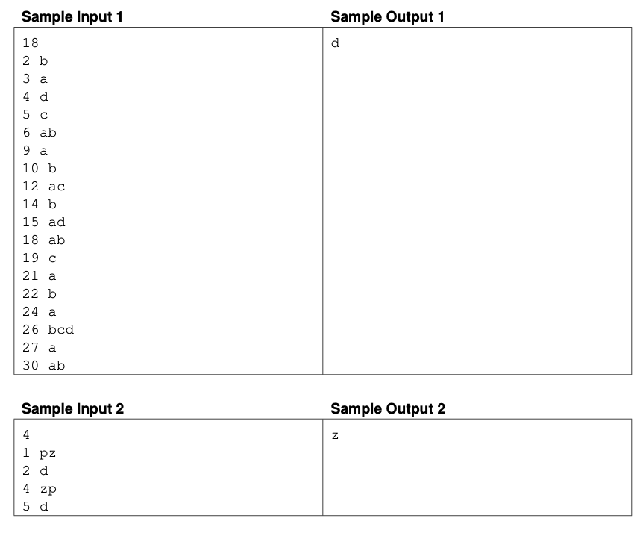
Problem F
looks tricky but not bad
solved by 67 teams
average of 1.39 tries to get correct
first solution in 18 min
what is this question asking for?
what is the "trick"
what "busy work" is there to do?

Slide 13
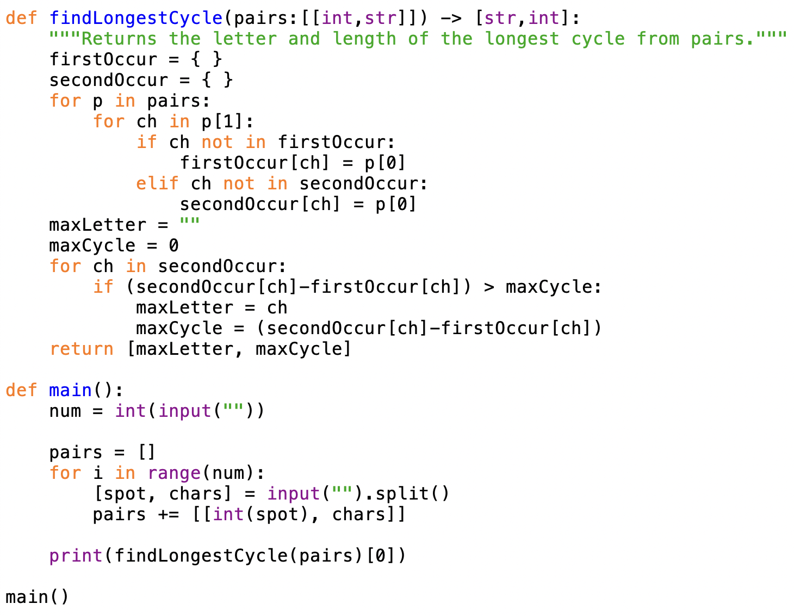
Solution

