Slide 1
CSC 221: Introduction to Programming
Fall 2023
see online syllabus (also accessible via BlueLine): http://dave-reed.com/csc221
free, online, interactive text: Foundations of Python Programming: Functions First
course goals:
  To develop problem solving and programming skills to enable the student to design solutions to non-trivial problems and implement those solutions in Python.
  To master the fundamental programming constructs of Python, including variables, expressions, functions, control structures, and arrays.
  To build a foundation for more advanced programming techniques, including object-oriented design and the use of standard data structures (as taught in CSC 222).

Slide 2
What is programming?
programming is applied problem-solving
  understand a problem
  identify relevant characteristics
  design an algorithm (step-by-step sequence of instructions to carry out a task)
  implement the algorithm as a computer program
  test the program by repeated (and carefully planned) executions
  GO BACK AND REPEAT/REVISE AS NECESSARY
in short: programming is the process of designing, writing, testing and debugging algorithms that can be carried out by a computer
we encounter algorithms everyday: directions to dorm, instruction manual, recipe
  people are smart, so spoken languages can be vague
  computers are not smart, so programming languages are extremely picky

Slide 3
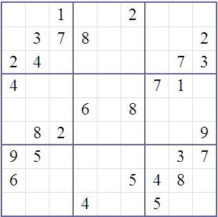
Problem-solving example
Sudoku is a popular puzzle
  given a partially-filled 9x9 grid, place numbers in the grid so that
    each row contains 1..9
    each column contains 1..9
    each 3x3 sub-square contains 1..9
how do people solve Sudoku puzzles?
if we wanted to write a program to solve Sudoku puzzles, must/should it use the same strategies?

Slide 4
Programming is a means to an end
important point: programming is a tool for solving problems
  computers allow people in many disciplines to solve problems they couldn’t solve without them
    — natural sciences, mathematics, medicine, business, …
  to model this, many exercises will involve writing a program, then using it to collect data & analyze results
DISEASE VECTOR MODELING: suppose you started with a single infected individual in a population – given a constant infection rate, how long until some percentage of the population is infected?
  what information do you need (e.g., infection rate)?
  what data values do you need to store and update?
  what is the basic algorithm?
  what real-life factors are we ignoring?

Slide 5
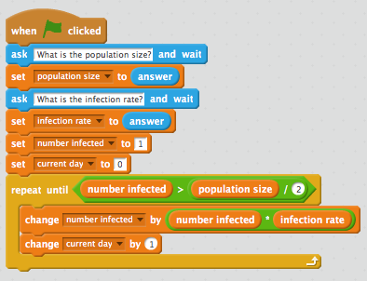
Disease vector model in Scratch (block language)

Slide 6
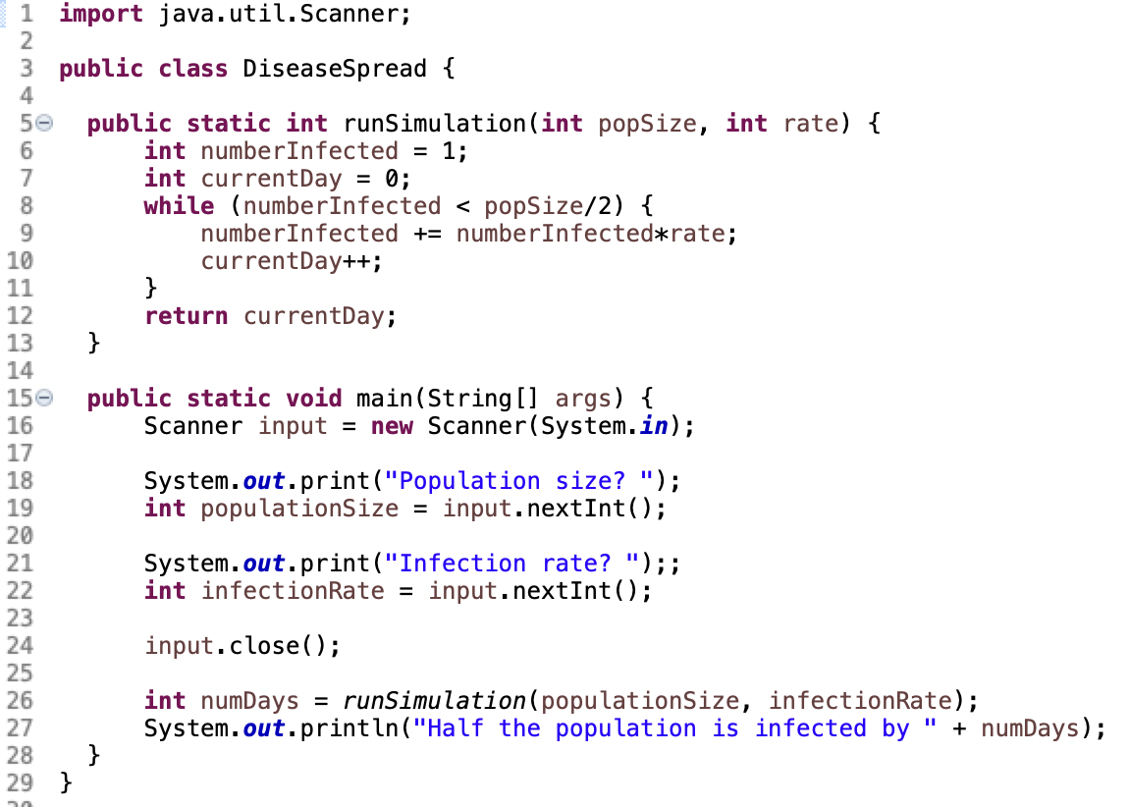
Disease vector model in Java (industry OO language)

Slide 7
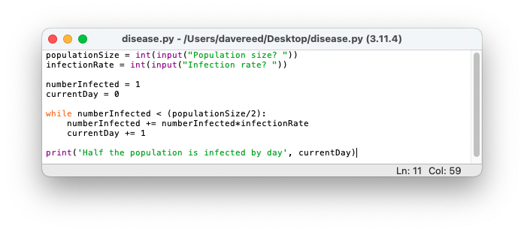
Disease vector model in Python

Slide 8
Another interesting problem
HAILSTONE SEQUENCE: Start with any positive integer. If even, divide by two. If odd, multiply by three and add 1. Continue until you get stuck in a loop. For example:
    5 → 16 → 8 → 4 → 2 → 1 → 4 → 2 → 1 → …
    26 → 13 → 40 → 20 → 10 → 5 → …
QUESTION: Does every starting number end up in 4-2-1 loop?
mathematical analysis has failed to answer this question (so far)
but we can write a program to generate the sequence for any number
  what information do we need?
  what data values do we need to store and update?
  what is the basic algorithm?

Slide 9


Why Python?
Python is a simple but powerful language
  invented in 1991 by Guido von Rossum
  intuitive, elegant language
  widely used in industry, lots of community support
  freely downloadable for all platforms from python.org
free, online, interactive textbook
  did I mention it's FREE?!?!?!
  a programming environment is embedded in the chapters
    can read about a concept then try it out (e.g., see Chapter 1.4)
    can even trace code execution

Slide 10



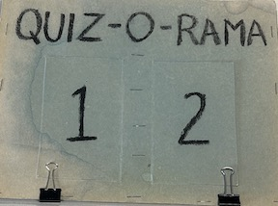

Flipped classroom
we will be working in a "flipped" modality
  you will read the chapter BEFORE class,
    can try out exercises & auto-graded review questions
  DURING class, I will review key concepts and go over examples
  THROUGHOUT class, hands-on exercises will reinforce the concepts
a quiz will be posted every day in Blueline on material from previous day
  only a 50/50 chance that the quiz will be administered
  if administered, should only take 5-10 minutes
  if not, it remains in Blueline for your review
you will demonstrate competency via
  6-8 programming assignments
  2 tests & cumulative final exam

