Slide 1
CSC 221: Introduction to Programming Fall 2023
Image processing
digital images
bitmaps, pixels, resolution, RGB, image formats
Python Image Library (PIL)
open, new, save, show, width, height, getpixel, putpixel
image processing functions
negative, tint, grayscale, black&white, random fill, art effects, reflection, striping
images & steganography
splitting into random image files
split, join
embedding text in an image
chars←→ bits, embed, extract

Slide 2
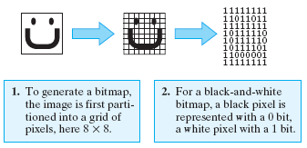
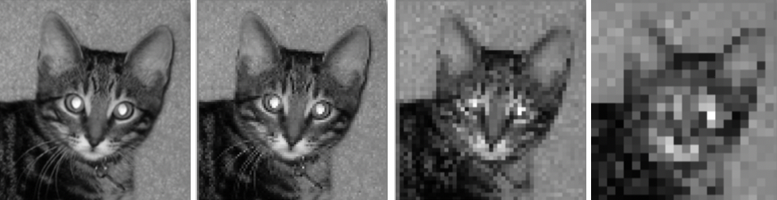
Image processing
representing images
images are stored using a variety of formats and compression techniques
the simplest representation is a bitmap
bitmaps partition an image into a grid of picture elements, called pixels, and then convert each pixel into a bit pattern
resolution refers to the sharpness or clarity of an image
images divided into smaller pixels will yield higher resolution (but require more memory)
the left image is stored using 72 pixels per square inch, then 36ppsi, 18ppsi, 9ppsi

Slide 3
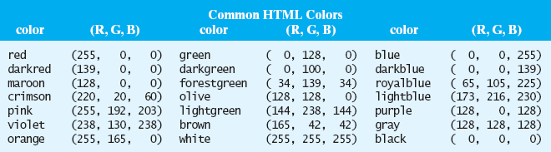
Color formats
when creating a bitmap of a color image, more than one bit is required to represent each pixel
the most common system is to translate each pixel into a 24 bit code, known as its RGB value: 8 bits to represent the intensity of each red/green/blue component
common image formats implement various compression techniques to reduce storage size
GIF (Graphics Interchange Format) – pronounced JIF
a lossless format, meaning no information is lost in the compression
outdated but still widely used on the Web
PNG(Portable Network Graphics)
more modern alternative to GIF - more colors, 10-50% more compact
JPEG (Joint Photographic Experts Group)
a lossy format, so the compression is not fully reversible (but more efficient)
commonly used for photographs (90-95% more compact than bitmap)

Slide 4
Python Image Library (PIL)
the Python Image Library contains classes for storing and manipulating images
to install under MacOS:
open Applications → Utilities → Terminal
ensure pip is installed
type: python3 –m ensurepip
install PILLOW (latest PIL distribution)
type: pip install pillow
to install under Windows:
open Windows command line
ensure pip is installed
type: pip --version
install PILLOW (latest PIL distribution)
type: pip install pillow

Slide 5
Image class
img = Image.open(filename)
Loads an image from the file named filename and returns an Image object that represents this image. The file must exist in the current working directory.
img = Image.new("RGB", (width, height))
Returns an Image object of the specified width and height with a single color (black by default).
img.save(filename)
Saves the image in a file named filename (in the current working directory).
img.show() Shows the image in a separate window.
img.width The width of the image (# of pixels).
img.height The height of the image (# of pixels).
img.getpixel((x,y))
Returns the pixel at the specified coordinates. A pixel is of the form (r, g, b), where the letters are integers representing the red, green, and blue values of a color. Note: there may be a fourth component: a mask (e.g., with PNG files).
img.putpixel((x,y), (r,g,b))
Resets the pixel at position (x, y) to the color value represented by (r, g, b).

Slide 6
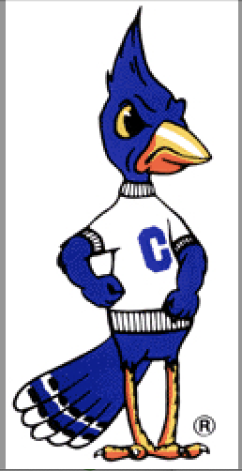
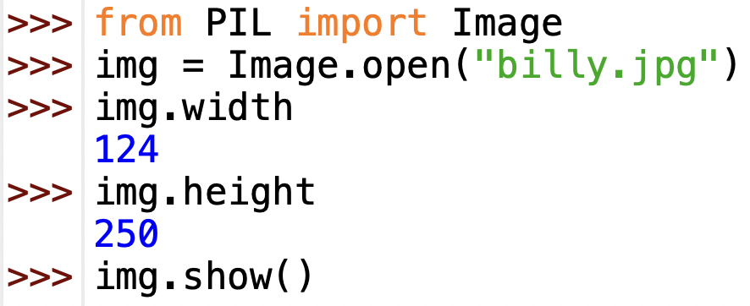
Image example
to use, must import the PIL module
to avoid having to type PIL.Image all the time, use
from PIL import Image

Slide 7
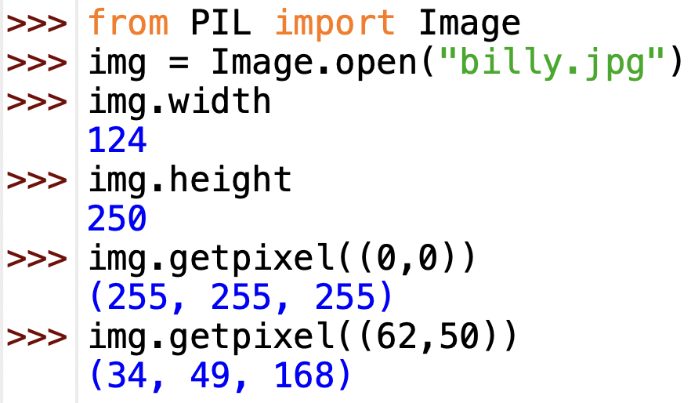
Image = grid of pixels
recall that an image is made up of a 2-dimensional grid of pixels
top-left corner is (0, 0)
top-right corner is (img.width-1, 0)
bottom-left corner is (0, img.height-1)
bottom-right corner is (img.width-1, img.height-1)
(0,0)
(123,0)
(0,249)
(123,249)

Slide 8
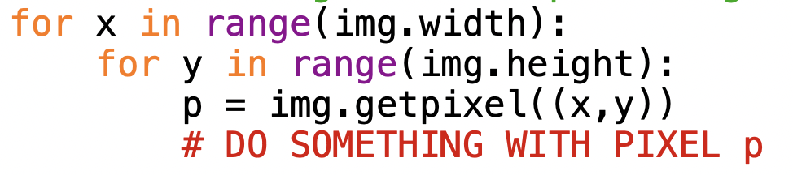
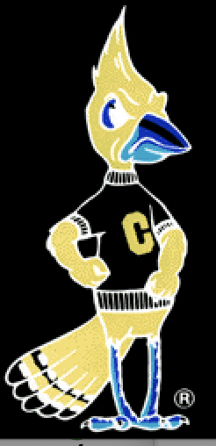
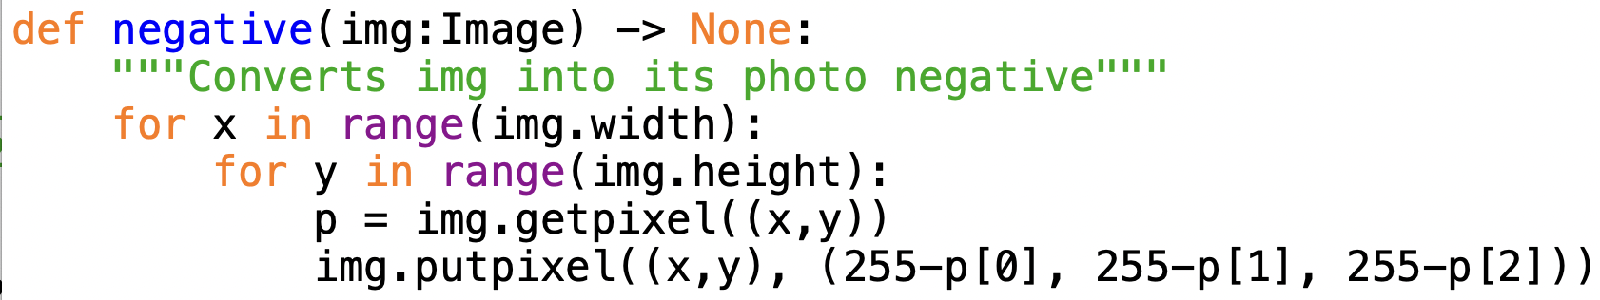
Traversing the pixels
can go through each pixel in an image using nested loops:
e.g., can obtain a photo negative by inverting each RGB number

Slide 9
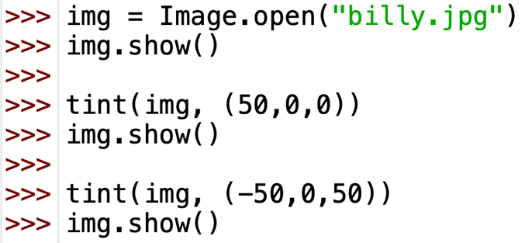
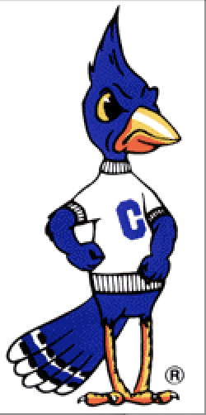
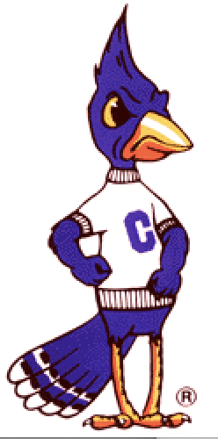
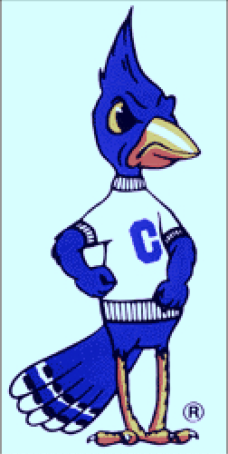
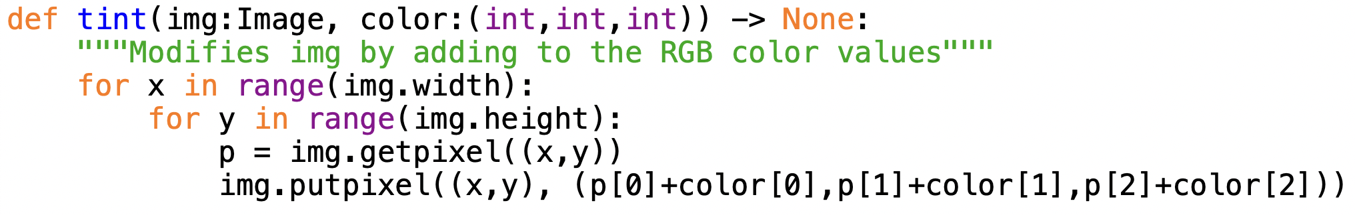
Image tinting
similar task, adjust the tint of the image
want to be able to change the RGB values uniformly for every pixel
note: color addition maxes out at 255

Slide 10
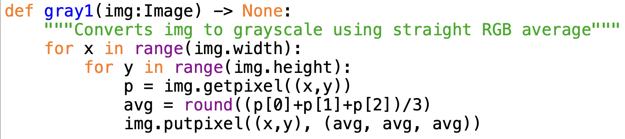
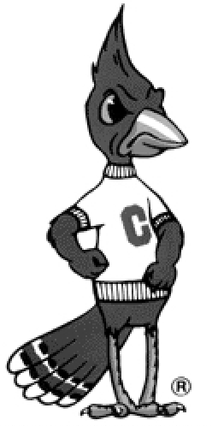
Converting to grayscale (v. 1)
to store a grayscale image, really only need one value per pixel
0 is black … 64 is dark gray … 128 is gray … 192 is light gray … 255 is white
can simulate this in a color image by having equal RGB values
(0,0,0) … (64,64,64) … (128,128,128) … (192,192,192) … (255,255,255)
to convert a color image to grayscale, simple approach:
for each pixel, replace RGB value with the average of the color RGB values

Slide 11
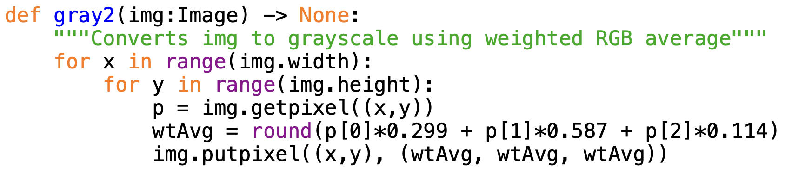
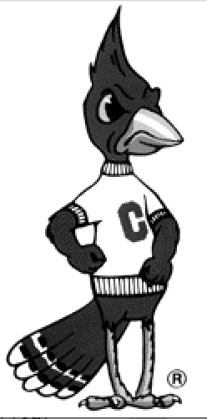
Converting to grayscale (v. 2)
it turns out that the human eye is more sensitive to green, then red, then blue
the relative sensitivities have been determined experimentally
a better grayscale conversion uses a weighted average based on these

Slide 12
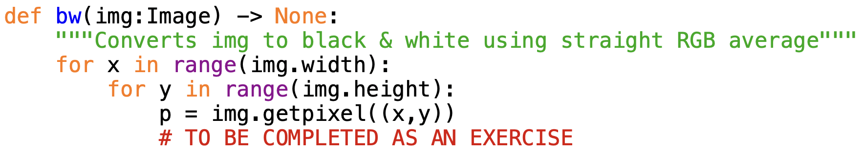
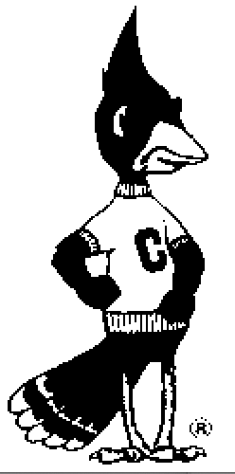
Exercise: converting to B&W
to convert from color to black & white, for each pixel:
if the average RGB value < 128, then replace with black pixel: (0,0,0)
if the average RGB value ≥ 128, then replace with white pixel: (255,255,255)

Slide 13
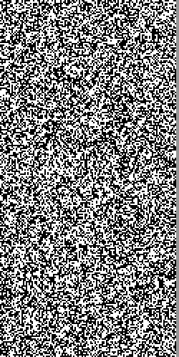
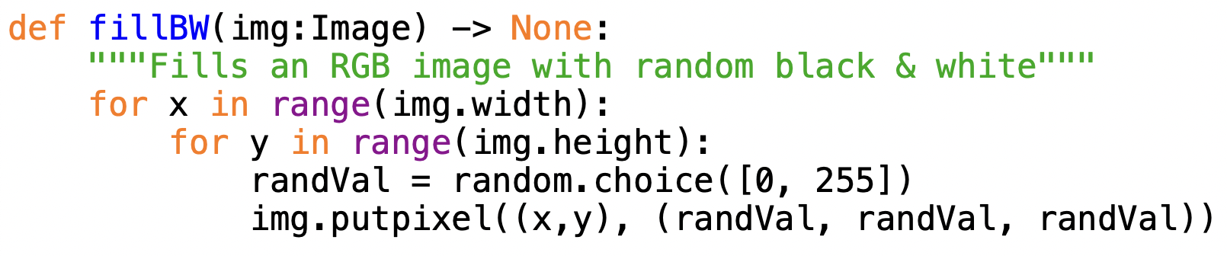
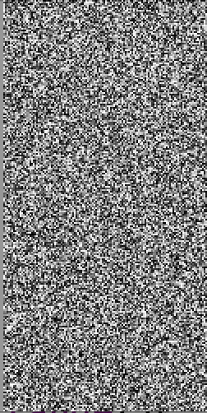
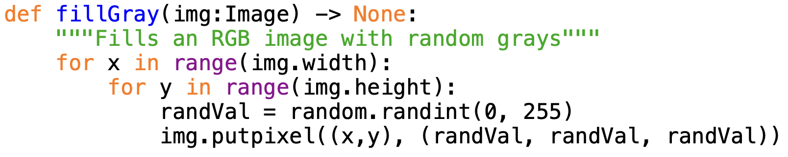
Making static
the following functions replace each pixel with a random B&W/Gray value
EXERCISE: implement a color version fillColor

Slide 14
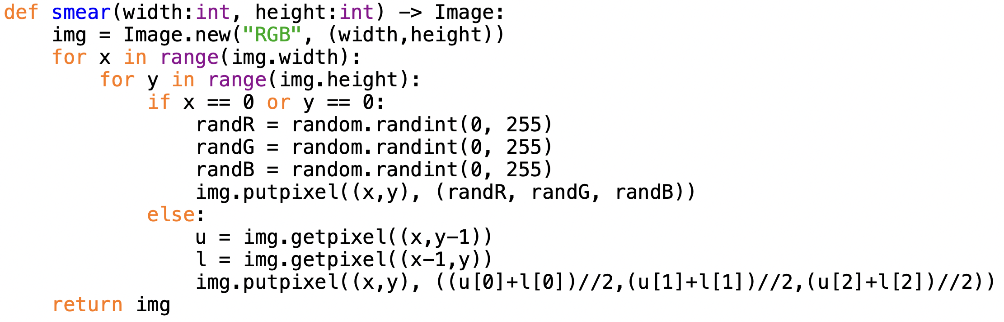
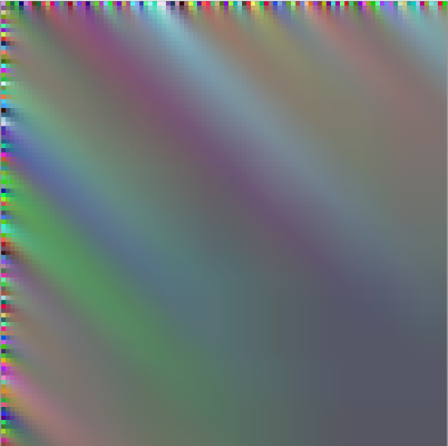
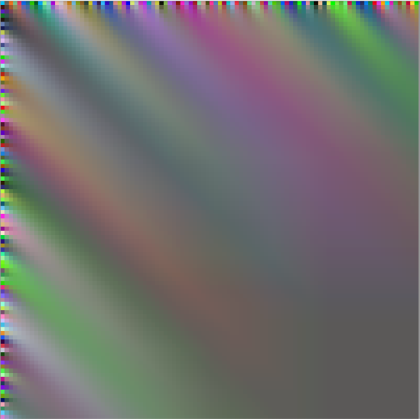
Art effects

Slide 15
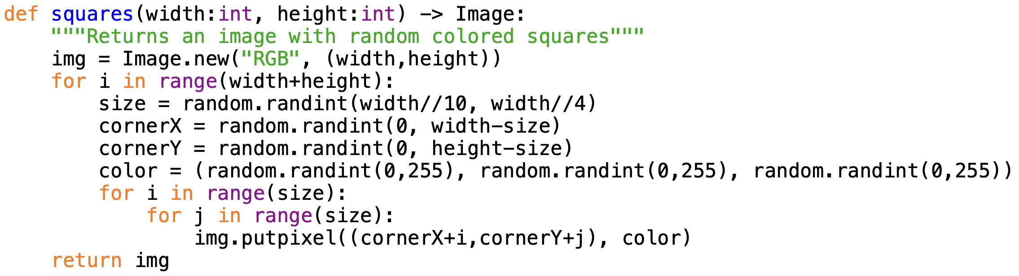
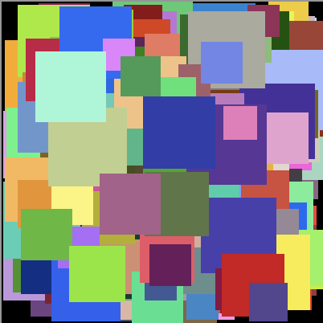
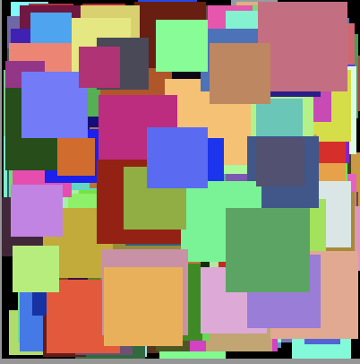
Random shapes

Slide 16
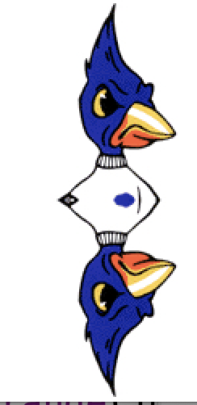
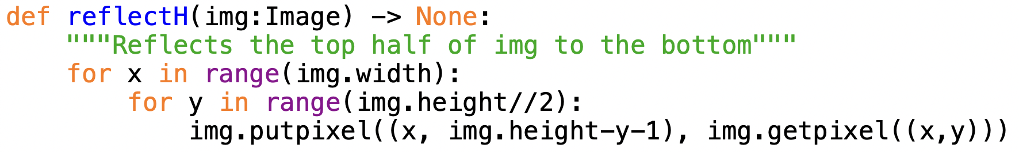
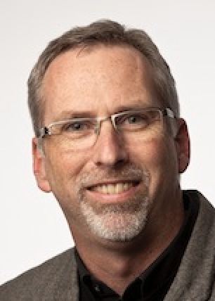
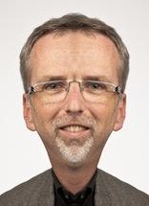
Horizontal reflection
suppose we want to add a mirror effect to the image
take the top half of the image, reflect it below
for each pixel (x,y) in the top half:
copy its value to the corresponding (x, img.height-y-1) pixel in the bottom half
EXERCISE: implement reflectV

Slide 17
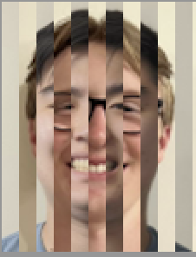
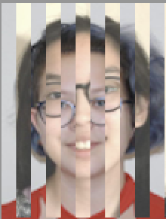
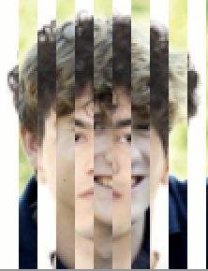
Striping images together
suppose we wanted to combine two images, with alternating stripes coming from the two
function will have 2 images and width (int) as inputs
construct a new image (be careful if input images are not same size)
traverse the new image row by row:
first N pixels in a row are copied from img1, 2nd N pixels copied from img2, …

Slide 18
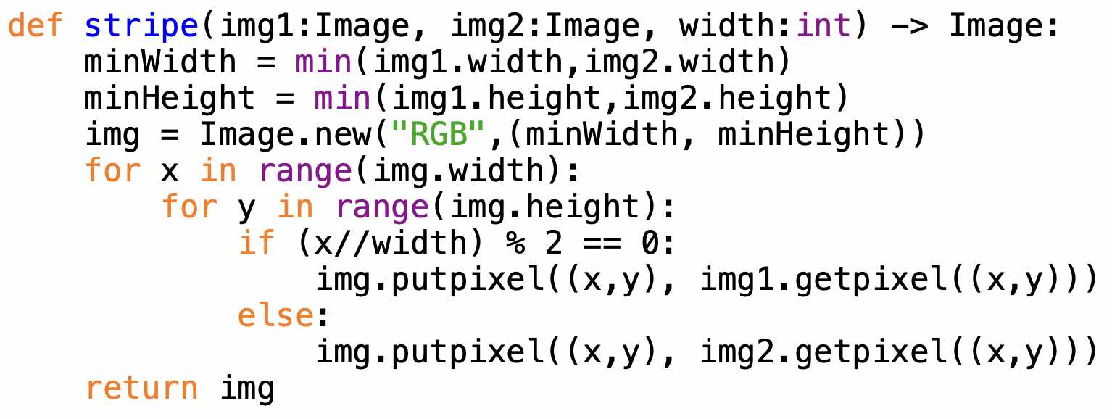
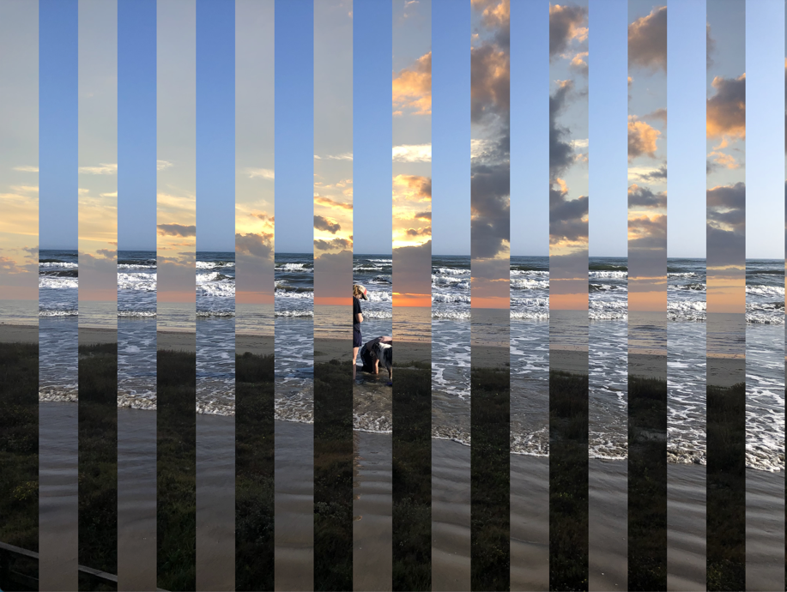
Stripe function

Slide 19
Images & steganography
steganography is the art & science of hiding messages in plain sight
messages written in invisible ink or lemon juice
microdots hidden in the period on a page (WWII)
tattooing a message on a scalp, then growing hair to cover (ancient Greece)
SECRET MESSAGE:
Caleb and Natalie yanked our underwear rather egregiously.
Arnie didn't think his intelligence sufficed.
steganography can be applied to digital images as well as text
we can hide the contents of an image by splitting it into two (seemingly) random files of static
we can hide text (or even other images) inside the pixels of an image

Slide 20


Static files
consider the following PNG images (why PNG and not JPEG?)
both are random static
if you found one on a hard drive or attached to an email – no information!

Slide 21


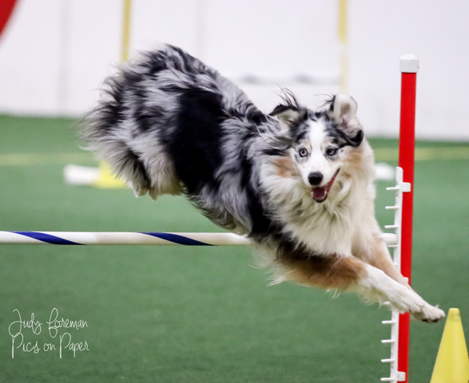
Joining images
while these files are random, they are not independent
if you add the pixels, you get a real image
image(x,y) = (mystery1(x,y) + mystery2(x,y)) % 256
note the use of modulo arithmetic (using %)
if the sum of any RGB values exceeds 255, wrap around to 0
e.g., (128, 128, 128) + (200, 200, 200) → (72, 72, 72)
+
→

Slide 22
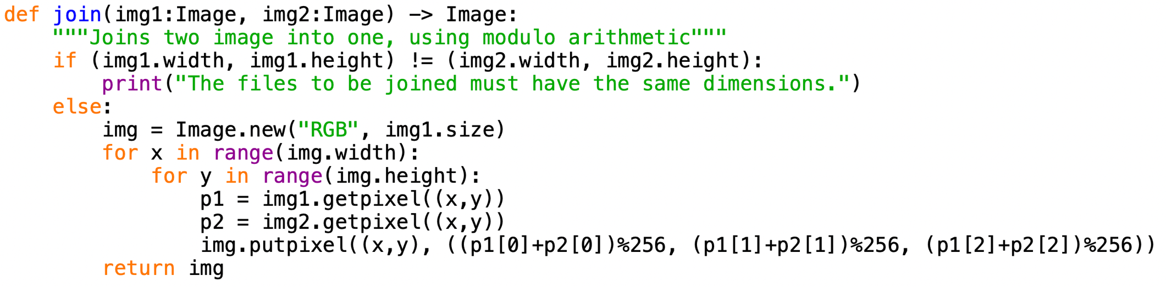
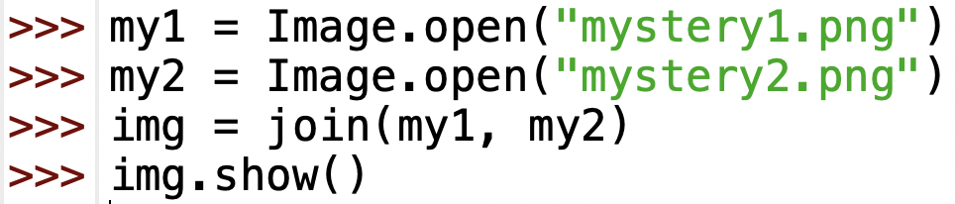
Join code
note: the images should have the same dimensions
could we handle different sized images? how?

Slide 23
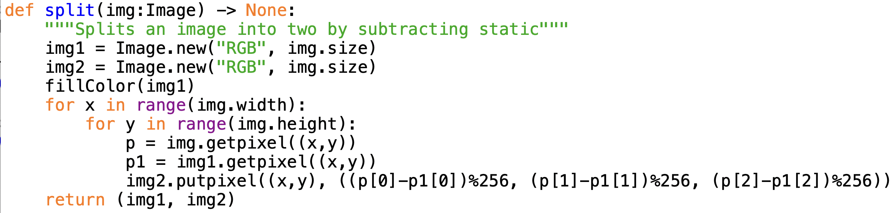
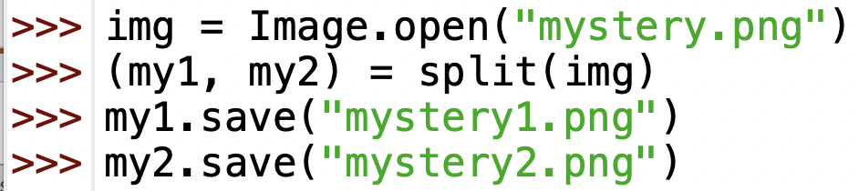
Split code
splitting an image into two static files involves two steps
generating a completely random file of grayscale pixels
subtracting each of those random pixels from the image pixels (using %)

Slide 24
Exercise
take your favorite PNG file
split it into two static images using split
join them back together using split
note: when you split an image
the first split is completely chosen at random
when you subtract a random amount from a pixel, also get a random amount
both files are completely random when taken in isolation – they only have meaning when taken together
now, discover the secret to acing the final exam for this course
download secret1.png & secret2.png, join them together to obtain the secret file

Slide 25

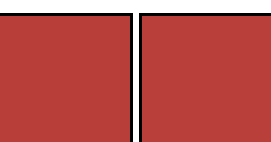
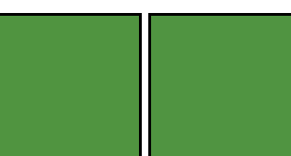
Embedding text in an image
are these pairs of blocks the same color?
no:
each differs by 1 in blue component
bottom left is (50, 150, 50)
bottom right is (r0, 150, 51)
a 1-digit difference in the blue component is not very significant
the human eye cannot distinguish the difference
can use that digit to hide a message

Slide 26
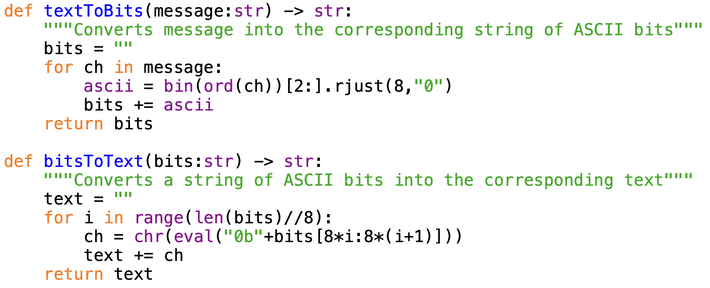
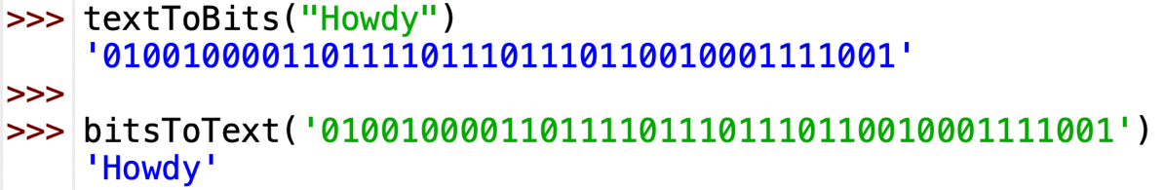
Repurposing bits
suppose we wanted to hide the message "Howdy" in an image
we can convert the message into bits using the ASCII code for each character
ord("H") → 72 → 01001000
ord("o") → 111 → 01101111
...
"Howdy" → 0100100001101111011101110110010001111001

Slide 27
Repurposing bits
idea: take the first 40 pixels in the image
replace the least significant bit in the pixel color with the corresponding bit in the message
"Howdy" → 0100100001101111011101110110010001111001
replace the least significant bit in the pixel color with the corresponding bit in the message
img(0,0) = (128, 128, 128)
= 100000001000000010000000 → 100000001000000010000000 = (128, 128, 128)
img(0,1) = (128, 128, 128)
= 100000001000000010000000 → 100000001000000010000001 = (128, 128, 129)
img(0,3) = (127, 255, 127)
= 011111111111111101111111 → 011111111111111101111110 = (127, 255, 126)
img(0,3) = (255, 255, 255)
= 111111111111111111111111 → 111111111111111111111110 = (255, 255, 254)
img(0,4) = (253, 253, 253)
= 111111011111110111111101 → 111111011111110111111101 = (253, 253, 253)
. . .

Slide 28
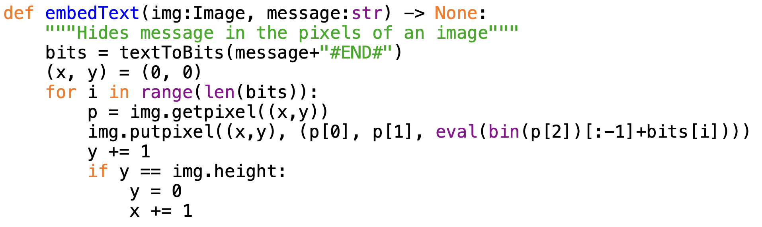
Embedding code
before embedding the message,
must add a marker at end (#END#) so the extraction process knows when to stop
suppose p[2] = 128, bits[i] = '1'
bin(p[2]) → '0b10000000'
bin(p[2])[:1] → '0b1000000'
bin(p[2])[:1]+bits[i] → '0b10000001''
eval(bin(p[2])[:1]+bits[i]) → 129

Slide 29
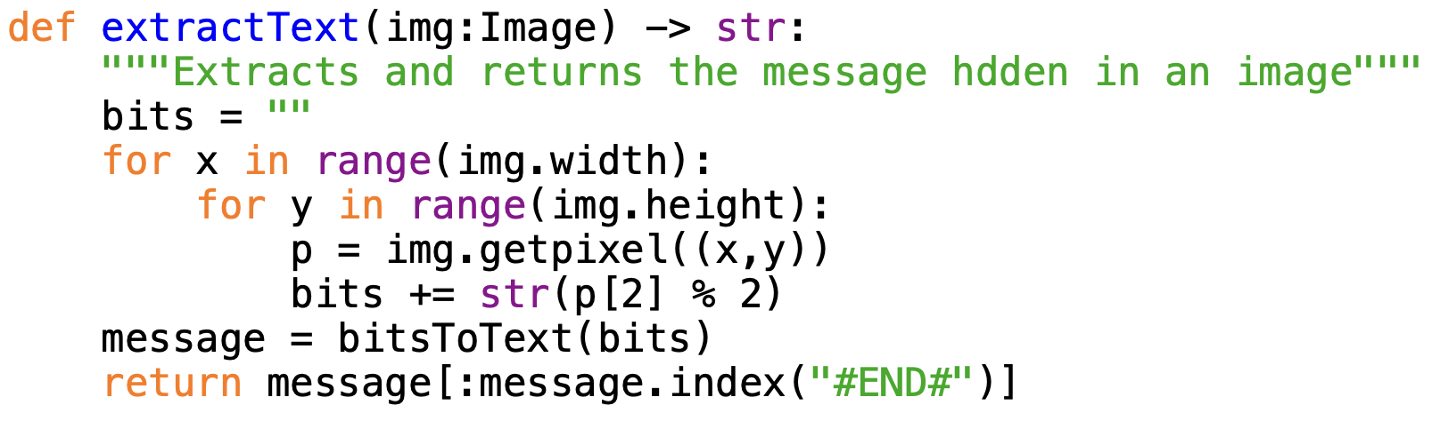
Extracting code
when extracting the message
convert the bits to text, then strip off the letters up to the marker (#END#)
now, find the doubly secret message hidden in (secret1.png & secret2.png)

